Slide 1
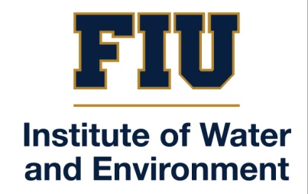

Water and Environment Security Conference
September 17-18 2018
The Challenge of Water Security in Small Island States:
The case of Haiti.
Evens Emmanuel
Université Quisqueya
Port-au-Prince, Haiti
E-mail: evens.emmanuel@uniq.edu

Slide 2
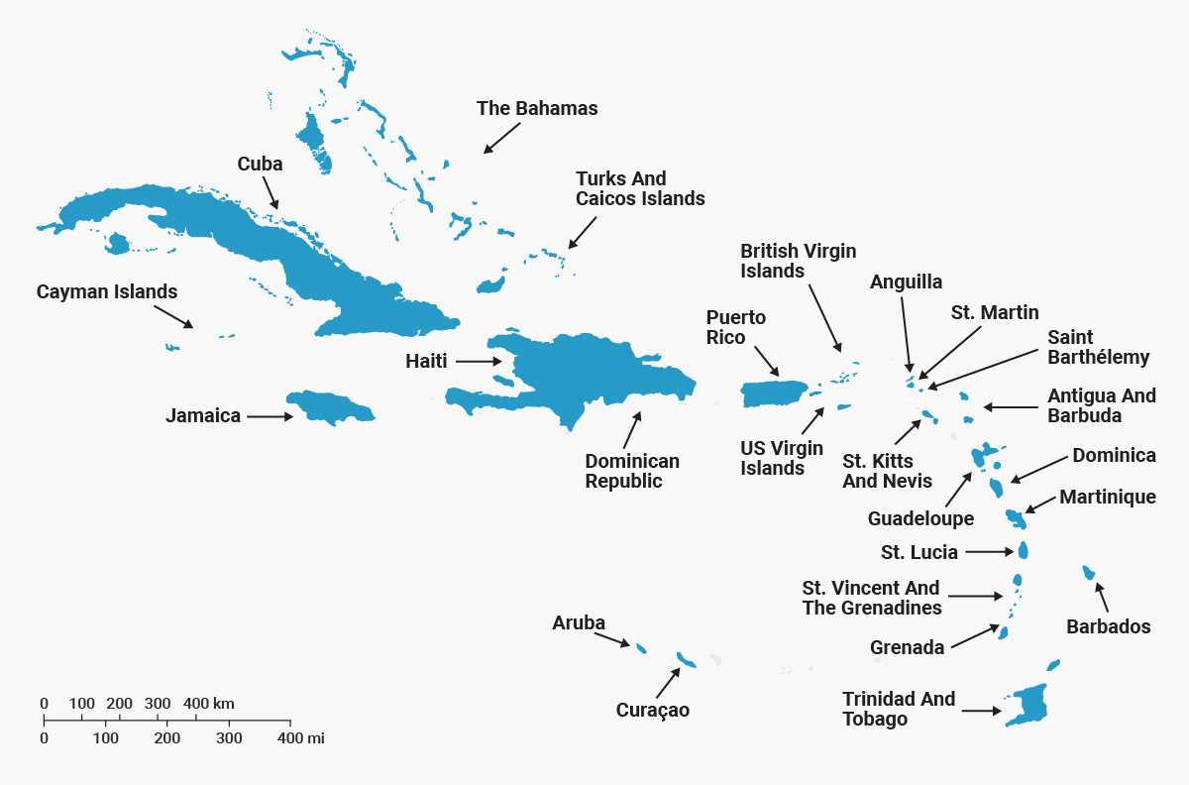
Caribbean islands map
4 islands constitute the great Antilles:
Cuba, Hispaniola or the island of Haiti, Jamaica and Puerto Rico.
The island of Hispaniola is divided into 2 countries: Haiti and the Dominican Republic.
The other islands are known under the name of small Antilles.

Slide 3
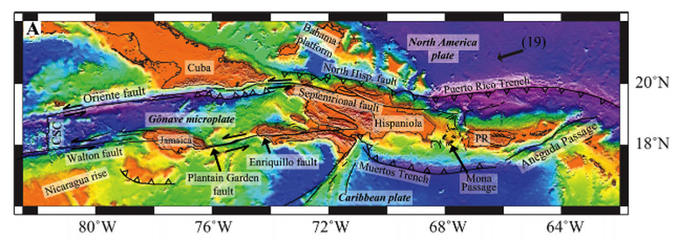
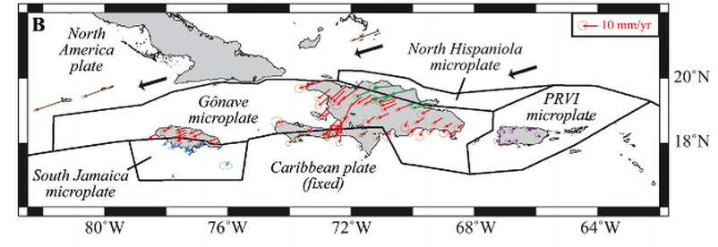
Environmental imperfections of the Caribbean
The Caribbean islands are exposed to earthquakes and tropical hurricanes.
Caribbean tectonic environment.
(Benford et al., 2012).

Slide 4
Environmental imperfections of the Caribbean
Impacts of hurricanes on the economy of the islands of the Caribbean
Annual % of GDP growth (World Bank,2012)

Slide 5
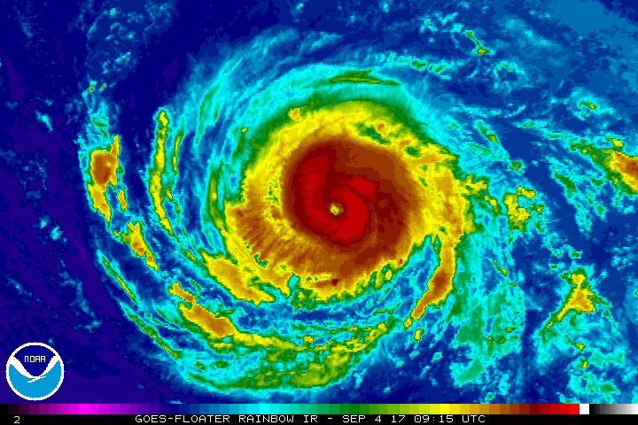
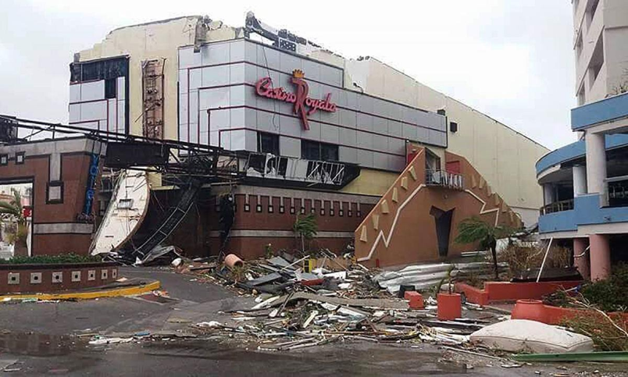
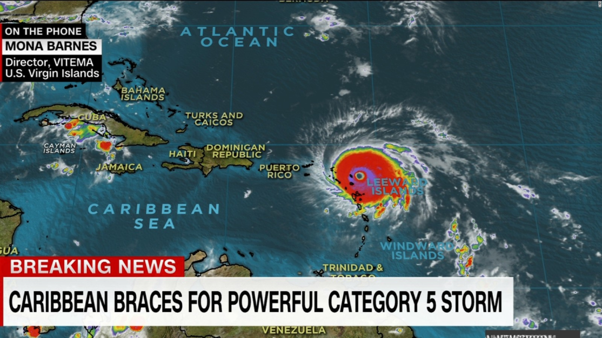
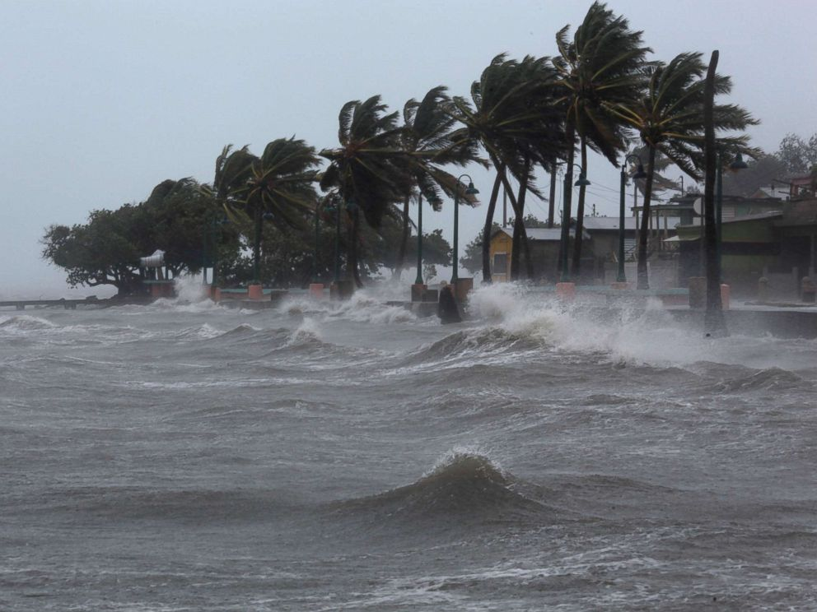
Environmental imperfections of the Caribbean
Hurricanes in the Caribbean: annual appointments

Slide 6
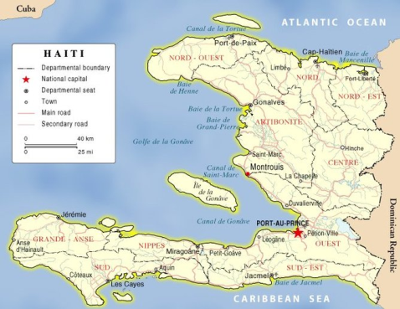
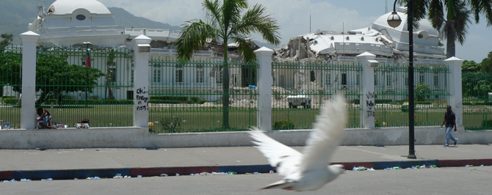
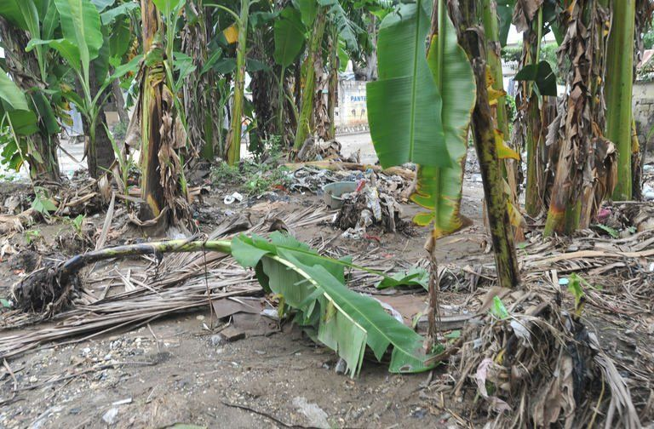
Environmental imperfections of Haiti
Between 2004 and 2016, Haiti experienced 18 natural disasters.
The major events that hit the Haitian territory :
hurricane Jeanne in Gonaïves (2004),
4 hurricanes in autumn 2008,
The earthquake of January 12, 2010,
Hurricane Matthew (2016).

Slide 7
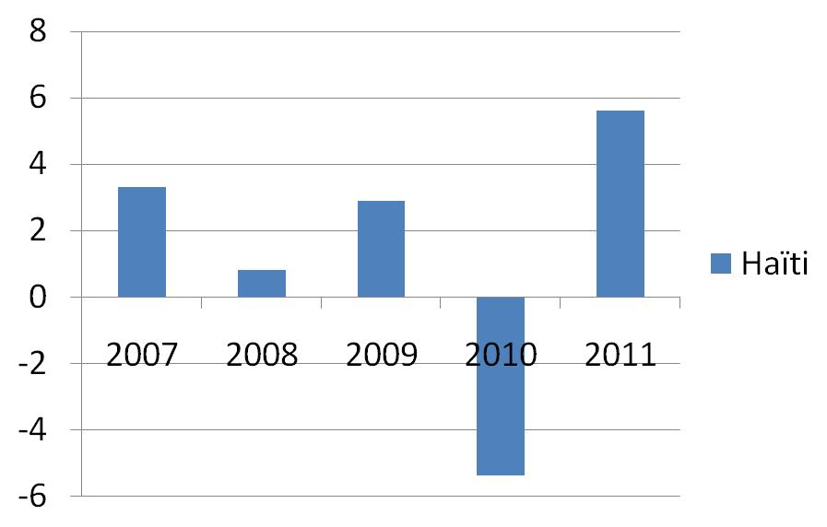
Environmental imperfections of Haiti
In addition to the impact of natural disasters on the population’s life, their socio-economic impacts have been significant.
Haiti annual % of GDP growth (World Bank,2012)

Slide 8
Challenge of Water Security : the case of Haiti
The development of Haiti’s natural resources is to a large extent linked to maximizing the rational utilization of its water resources. Failing these factors, the country’s agricultural and industrial development, as well as the life of its inhabitants, will be confronted by severe limitations.
OAS (1972)

Slide 9

Challenge of Water Security : the case of Haiti
The Pluviometry
The country’s relief.
The influence of geological factors.
The management of water resources
Water quality
Population growth and urbanization
Lack of WWTP
Impacts of wastewater on aquatic ecosystems

Slide 10
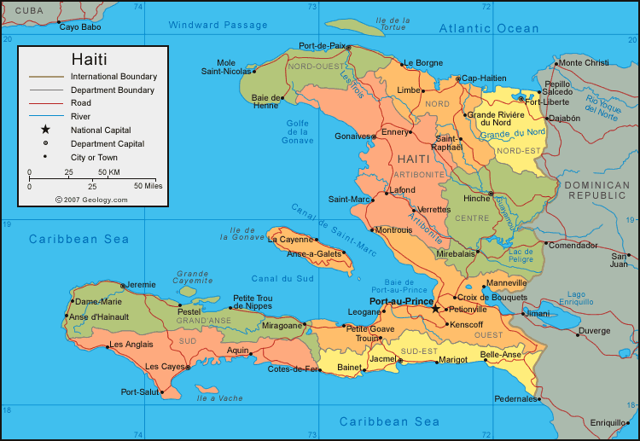
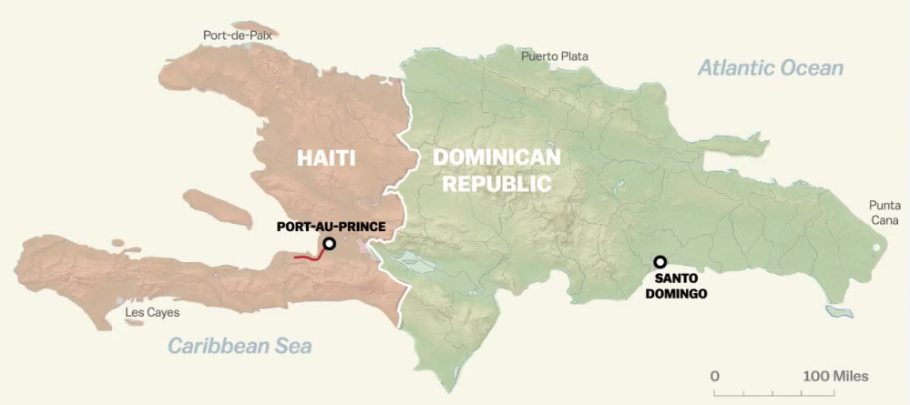
Challenge of Water Security : the case of Haiti
Massacre Aquifer
Studies from the transboundary aquifer of Massacre, Northeast of Haiti.

Slide 11
Transboundary aquifer
of Massacre
Description | Surface area ( ha) | Surface area (%)
Semi-confined aquifers | 5907.199 | 5.44
Unconfined aquifers | 58421.1 | 53.82
Fissured and carbonated aquifers | 5432.349 | 5.00
Karstics Aquifers | 29.711 | 0.03
Crystalline formations | 38759.29 | 35.71
Others | 0.882 | 0.00
Total | 108550.5 | 100
Hydrogeological characteristics

Slide 12
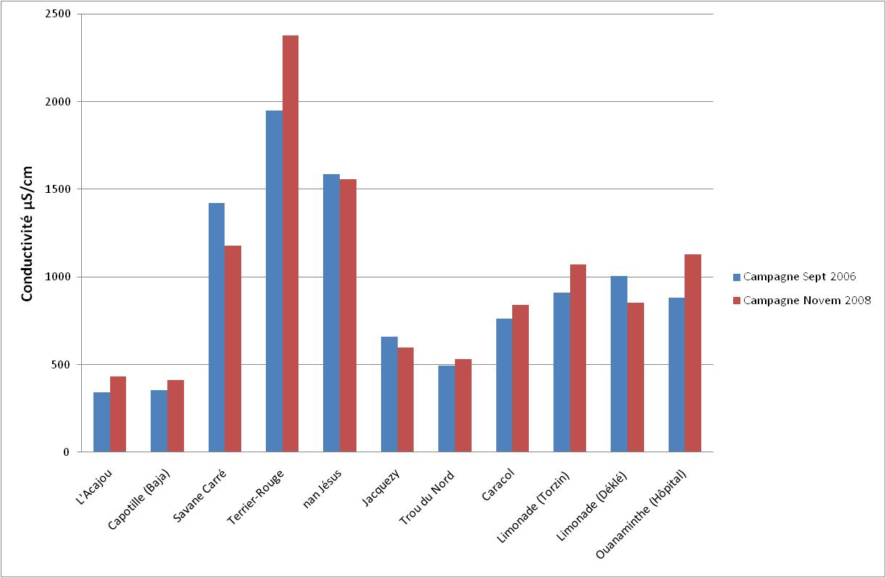
Transboundary aquifer of Massacre
Salinity results from samples points by 2006 vs 2008

Slide 13
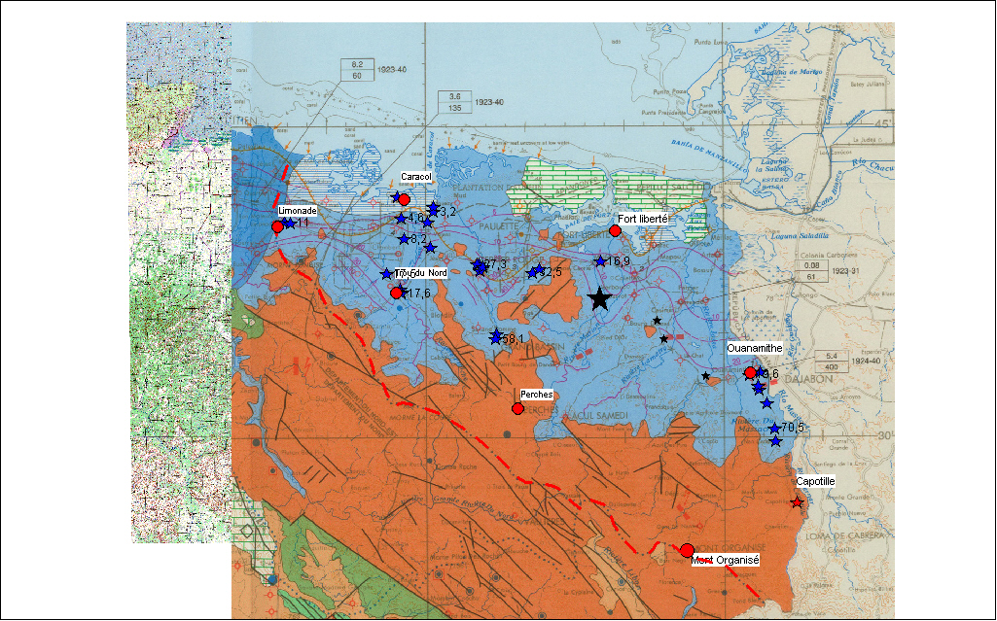
Challenge of Water Security : the case of Haiti
Transboundary aquifer of Massacre

Slide 14
Opportunities of Water Security in Haiti
Resolución No. PHI-LAC IX-7
Los Comités Nacionales y Puntos Focales del PHI-LAC presentes en la reunión apoyan la propuesta presentada por el Comité Nacional del PHI Haití de declarar la cuenca de Masacre (departamento Noroeste de Haití) como “cuenca piloto” para la implementación de los programas del PHI; y recomiendan a la oficina del PHI-LAC la constitución de un grupo de trabajo ad-hoc para la preparación de un proyecto y defina las acciones y resultados.

Slide 15
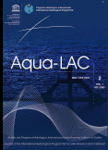




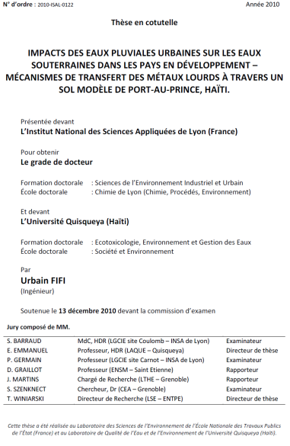
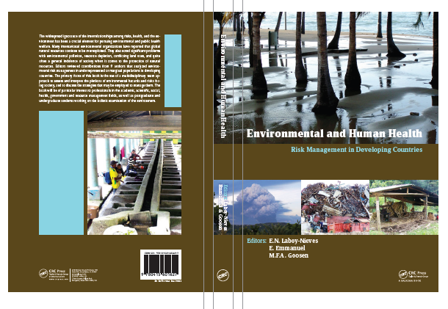
Opportunities of Water Security in Haiti

Slide 16
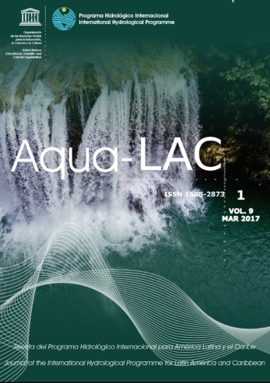
Opportunities of Water Security in Haiti
This special issue addresses the urgent need for the Haitian authorities to establish a national water policy. By relying on the basic principles of integrated water resource management, I strongly believe that this reform will lead the country in the short, medium and long terms to: (i) reduce the environmental risks linked to water, (ii) better satisfy the population’s needs for water, and (iii) solve conflicts between the different actors in this sector.
Jovenel Moïse
President of the Republic of Haiti
Guest Editor:
Maria Donoso.

Slide 17
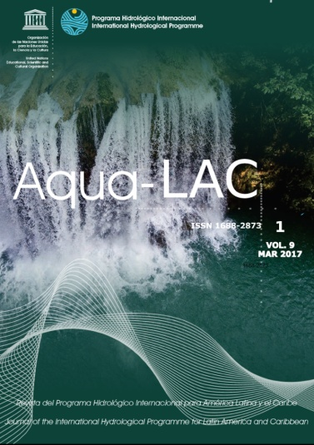
Opportunities of Water Security in Haiti
My administration is committed to this process by proposing legislative and administrative changes, and by making new choices for investment in the water sector by waging on stronger scientific and technical cooperation between and IHP-LAC. This is the context in which I have made the management and control of surface water a major goal of my governmental program.
Jovenel Moïse
President of the Republic of Haiti
Guest Editor:
Maria Donoso.

Slide 18
Merci
Thank you
Gracias

