Slide 1
Decision Support for Risk Management of Integrated Physical, Social/Behavioral and Economic Systems
Sept 8, 2020
Robert Lempert
RAND Corp
CoPe Workshop

Slide 2

Decision Support Tools
Help People Make Better Decisions
People often make better decisions with the help of decision support tools
The term decision support tool refers to a wide range of (often computer based) information products designed to:
  Help counter biases in human decision making
  Lower to effort needed to gather and process the information needed to make reasoned decisions
Notes:
A vast body of experience and scientific literature make clear that people often make better decisions when assisted by well crafted decision support tools. Daniel Kahneman is one of the most famous researchers who have charted the biases and imperfections in un-assisted human reasoning. Not that people are bad decision makers. Far from it. But life is complicated and full of decisions. To get through even the simplest day people most chose by the use of heuristics – simple set of rules or processes that, while not perfect, generally results in a reasonable outcome.
”Generally” is the key word here. Sometimes heuristics don’t work. Kahneman and his collaborator Amos Tversky made their names showing in detail the heuristics people generally use and how they can go wrong. In addition to these decision processes by individuals, scientists have also documented the ways in which groups of people come to decisions and how these decision processes can go right or wrong.
Kahneman calls heuristics ”thinking fast.” When heuristics don’t work, we should “think slow.” Thinking slow is a lot harder, but sometimes worth it.
The term decision support tool refers to a wide range of often computer based information products designed to support decision making and participatory processes. Decision support tools are designed to help individuals and groups do a better job of thinking slow by: 1) helping them recognize when their heuristics may go wrong and 2) providing useful and sometimes complicated information in easier to understand form.

Slide 3
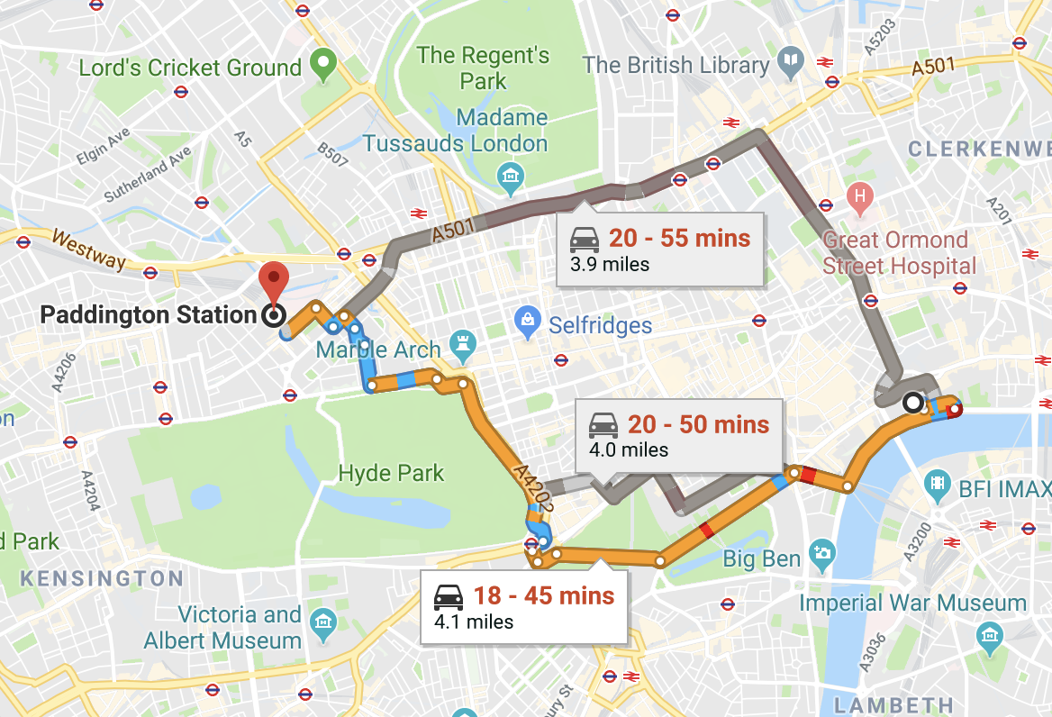
Some Tools Support Straight Forward Decisions
For instance, way finding apps on your smart phone are decision support tools that help you:
  Figure out where you are
  Decide how to get where you want to go
  Find the fastest route to your destination
Notes:
The information provided by some decision support tools is relatively straight forward, even if the data and analytics required to produce is not. For instance, way finding apps for your smart phone, such as Google Maps, help you know where you are, how to get where you want to go, and the fastest way to get there.

Slide 4
What is a Good Decision?
For map app, criteria is easy – did you get to your appointment on time?
But answer is less obvious for more complex decisions,
  Many attributes to consider
  Counterfactuals are ambiguous
  Consequences of decision may take a long time to unfold
IPCC AR5 WGII Chap 2
Notes:
Decision support tools aim to help you make better decisions. That begs the question – what is a good decision?
For a map app, the answer is easy – did it help you find the fastest route to where you wanted to go and avoid getting lost along the way?
But sometimes it’s a lot harder to determine what is a good decision.
Let’s say you are as interested in the journey as in getting to the destination?
Let’s say you are trying to make your society safer, healthier, more prosperous, more just and equitable, or more free?
Good decisions aimed at these goals are harder to evaluate.

Slide 5
What is a Good Decision?
Seemingly reasonable decisions can turn out badly, bad decisions can turn out well
Good outcome ≠ Good decision
IPCC AR5 WGII Chap 2
Notes:
Among the many complications, seemingly reasonable decisions can turn out badly, bad decisions can turn out well, and it can often take many years to know which is which– if you ever know at all.
For instance, anyone who has ever raised, or been, a teenager knows from experience that this is true.
So if we can’t reliably evaluate good decisions solely on the basis of good outcomes, what can we do?

Slide 6
What is a Good Decision?
No universal criterion exists, but good decisions tend to emerge from processes in which people are:
Explicit about their goals
Contemplate the decision from a wide range of views and vantages
Consider a range of alternative options
Use best available science to understand the potential consequences of their actions
Consider tradeoffs
Follow agreed-upon rules and norms that enhance the legitimacy of the process and its outcomes
IPCC AR5 WGII Chap 2
6
Notes:
There is no universal criteria, but good decisions often result from a process with these characteristics.
This list of characteristics emerges from a large body of experience and literature that falls under the name of “decision support”

Slide 7
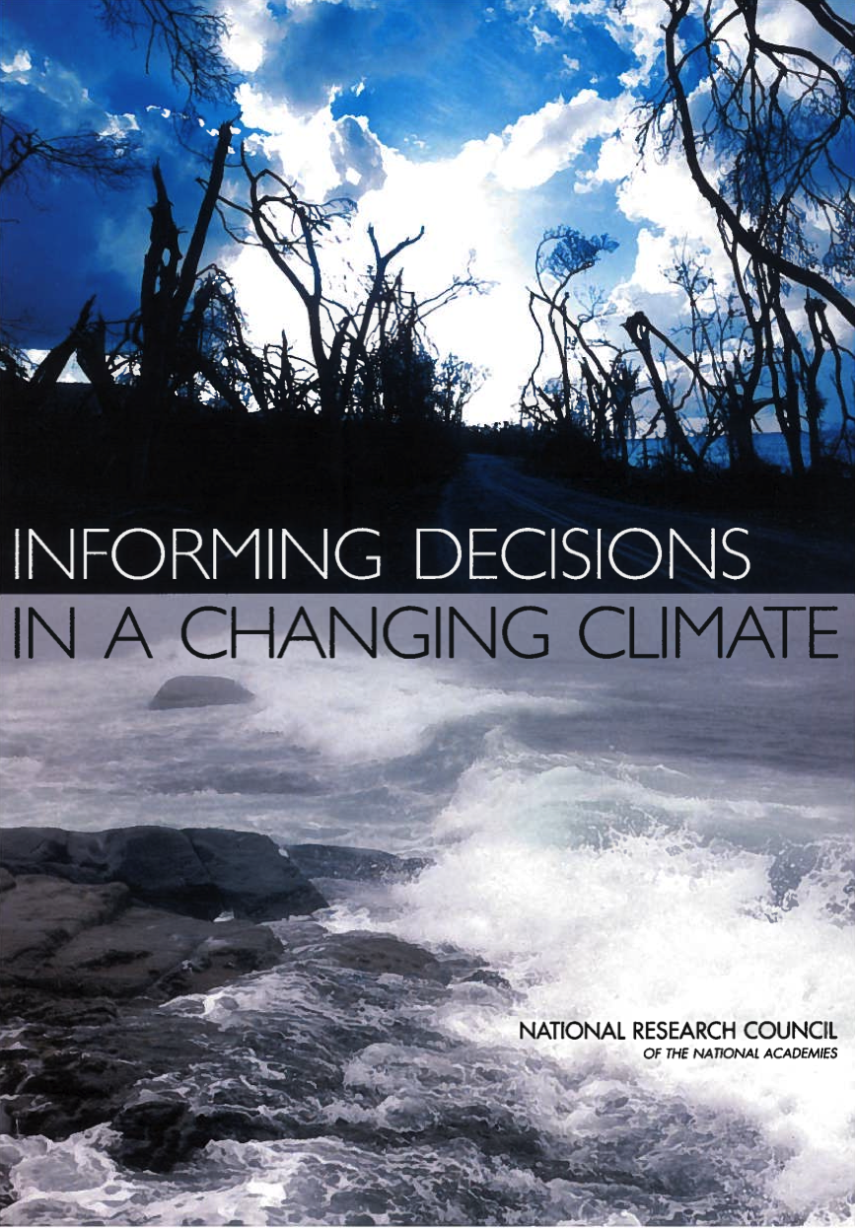
‘Decision Support’ Concept Helps Organize Insights from Cognitive and Organizational Literatures
Decision support represents organized efforts to produce, disseminate, and facilitate the use of data and information to improve decisions
Effective decision support improves:
Usefulness of information:
  Intended users regard the information as credible, legitimate, actionable, and salient
Relationships between knowledge producers and users:
  Producers and users engage in mutual learning and ‘coproduction of knowledge’ and increase mutual understanding, respect, and trust
Decisions:
  Decisions have qualities of a good decision and parties to the decision view it as having been improved by the support received
NRC (2009)
7
Notes:
Decision support represents organized efforts to produce, disseminate, and facilitate the use of data and information to improve decisions.
Our knowledge of decision support emerges from a synthesis of experience and evaluation of the provision of information to aid decision making in many policy areas, including from: public health, hazards management, natural resource management, environmental management and policy making, land use planning, environmental risk communication, sustainability science, local air quality, stratospheric ozone and greenhouse gas mitigation, and climate change adaptation.
Many useful summaries of decision support exist, for instance this report from the US National Academy of Sciences, upon which much RDM work is based.
What are the outcomes of good decision support? These include:
Usefulness of information, that is the intended users regard the information as credible, legitimate, actionable, and salient
Relationships between knowledge producers and users, that is, producers and users engage in mutual learning and ‘coproduction of knowledge’ and increase mutual understanding, respect, and trust
Decisions, that is the resulting choices have qualities of a good decision and parties to the decision view it as having been improved by the support received
7

Slide 8
Effective Decision Support Rests on Three Elements
Products:
  Includes tangible deliverables such as data, maps, projections, images, tools, models, documents, brochures, web pages, etc.
Services:
  Activities, consultations, and other forms of interactions that enable decision makers to make better use of decision-relevant information
Systems:
  Individuals, organizations, communications networks, and supporting institutional structures that provide and use decision support services and produces
NRC (2009) p. 36-37

Slide 9
What Principles Lead to Good Decision Support?
Build from users' needs/co-produce knowledge
  Identify needs collaboratively in two-way communication between information providers and users
Emphasize decision processes over information products
  Design information systems and products to support decision support processes
Design decision support for learning
NRC (2009) p. 40-41
9
Notes:
While decision support includes information products, such as those generated by decision support tools, these are not it’s only important elements. The literature identifies several principles of effective decision support, as listed on this slide.
Note that effective decision support generally includes the co-production of knowledge among information producers and users, emphasizes decision processes as much as decision processes, and is designed for learning.
RDM’s iterative process, which can include stakeholders in most of its steps, is designed to address these principles
9

Slide 10
Decision Support for Complex Coastal Systems May Support ”Deliberation with Analysis”
With “deliberation with analysis”
  Stakeholder deliberate over problem framing
  Analysts produce decision relevant information products
Parties to a decision define objectives, options, and other parameters
Deliberation
Analysis
Participants work with experts to generate and interpret decision-relevant information
“Deliberation with analysis most appropriate when the values of pluralistic participants may evolve in response to interactions with each other and the analytic products
NRC (2009)
10
Notes:
The decision support literature identifies different types of learning, including unplanned learning, program evaluation, and adaptive management.
The type of learning often most appropriate for decisions relevant to RDM is called deliberation with analysis. Deliberation with analysis is an iterative process that begins with the many participants to a decision working together to define its objectives and other parameters, working with experts to generate and interpret decision-relevant information, and then revisiting the objectives and choices based on that information. The process proceeds iteratively as shown on this chart.
Of all the methods for stakeholder engagement learning, deliberation with analysis is perhaps the most involved. But is the most appropriate form of learning in situations when participants’ preferences and understanding may be expected to evolve during interactions with other people and the analytics.

Slide 11
Your Checklist for Effective Decision Support
Tools connected to:
a clear decision process
Trusting and ongoing relationship with tool developers
Adapted from: Wong-Parodi, G., K. J. Mach, K. Jagannathan and K. D. Sjostrom (2020). "Insights for developing effective decision support tools for environmental sustainability." Current Opinion in Environmental Sustainability 42: 52-59
11
Notes:
The decision support literature identifies different types of learning, including unplanned learning, program evaluation, and adaptive management.
The type of learning often most appropriate for decisions relevant to RDM is called deliberation with analysis. Deliberation with analysis is an iterative process that begins with the many participants to a decision working together to define its objectives and other parameters, working with experts to generate and interpret decision-relevant information, and then revisiting the objectives and choices based on that information. The process proceeds iteratively as shown on this chart.
Of all the methods for stakeholder engagement learning, deliberation with analysis is perhaps the most involved. But is the most appropriate form of learning in situations when participants’ preferences and understanding may be expected to evolve during interactions with other people and the analytics.

Slide 12
END

