Slide 1
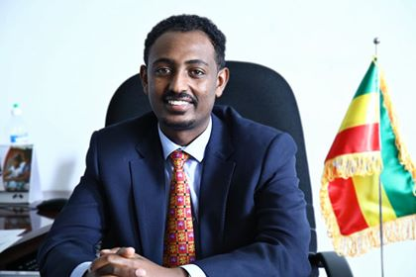




BLUE NILE/ABBAY AND GRAND ETHIOPIAN RENAISSANCE DAM
PRESENTATION 1
2020 International Conference on the Nile and GERD
ZERIHUN ABEBE YIGZAW*
Ministry of Foreign Affairs, Ethiopia
PRESENTATION TITLE:
The Politics of the GERD: Decision Making in the Negotiations between Securitization and De-securitization
*The views expressed here are only of the author`s and does not necessarily reflect the views of the Ministry.

Slide 2
Transboundary Water Resources
276 transboundary River Basins
TBRB do not recognize artificial boundaries of sovereign states
Subject to both the domestic and foreign policy of states
The Debate: TBRB a source of conflict or a means for cooperation?
States choices

Slide 3
Securitization
Security from National Security to … ?-The Word that has become to mean everything since the cold war.
Securitization and the sense of threat…
The goals
  Prevention?
  legitimization of previous appropriations?
  more control?

Slide 4
Abbay/The Nile:
Two major tributaries-White Nile and Blue Nile
11 Sovereign and independent riparian states
3 Million km2 -10% of the African Continent
530Million (> 250Million Directly lives in the Basin)
Imbalance between water contribution and utilization: the largest contributor is the least user, and a country which contributes nothing is the largest user
economic, socio-cultural as well as political differences
The burden of the past- war, mutual suspicion, mistrust, lack of cooperation

Slide 5
Common Challenges and Solutions
The Nile Basin countries face common challenges of
  Climate change
  Rapid population growth
  Environmental degradation
  Increasing water stress
The Solution
  Cooperation
  The Nile Basin Initiative experience
  But the Nile is the most politicized river in the world: why?

Slide 6
How the Nile is securitized : Historical Anecdote: The Ottomans- From Mohammed Ali to Khedive Ismail
An era of imperial/colonial aspiration and its demise
  Warner Muzinger`s Advice: “Ethiopia with a disciplined administration and army, and a friend of the European powers, is a danger for Egypt. Egypt must either take over Ethiopia and Islamize it, or retain it in anarchy and misery.”
  To put the whole Nile Valley under the Green flag of Egypt
  The colonial and imperial aspirations and the expedition to the South, 1821 to 1876

Slide 7
How the Nile is securitized : Historical Anecdote : The British era
Mixing science and politics till 1952
  the Guardian of the Nile
  control the Nile by any means
  Nile Valley Plan of Harold Edwin Hurst, Britsh Hydrologist
  The Nile as one geographic unit
    Build Dams in the upstream-Ethiopia and Sudan

Slide 8
How the Nile is securitized : Historical Anecdote :
The Free Officers and After
  an era of proxy wars and increasing securitization
  The climax of Securitization and a new era in the Nile Basin
  Create the Nile in Egypt: the Nile an Egyptian river from Aswan for political reasons… Greek-Egyptian engineer Adrian Daninos `s plan accepted within two months they assumed power
  No room for negotiation
  Control the Nile by any means
  “War in Ethiopia is peace in Egypt and Peace in Ethiopia is war in Egypt”
A rare civilian regime and a chance for cooperation lost following the 2011 change of government in Egypt

Slide 9
Cooperation Attempts and the challenge of securitization
From Hydromet through Undugu to TECCONILE
The Nile Basin Initiative
    The first basin wide multilateral forum
The shared vision: “To achieve sustainable socio-economic development through equitable utilization of, and benefit from, the common Nile Basin Water resources”.
The CFA Process: what happened in the negotiations and after?
  Water Security: Article 14(b)

Slide 10
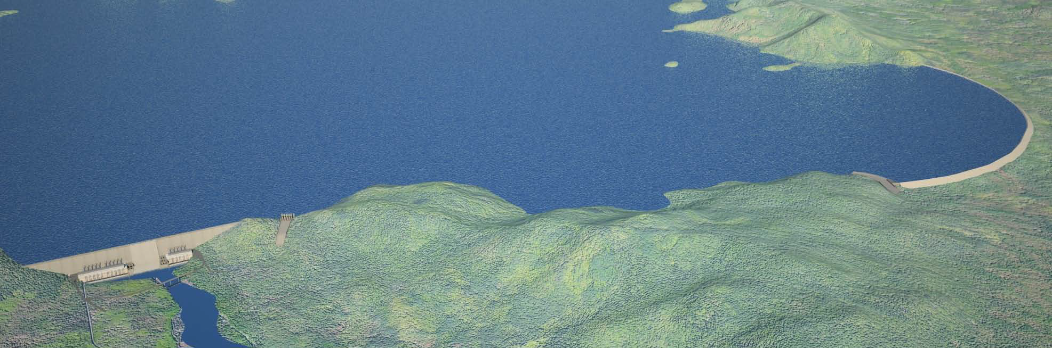
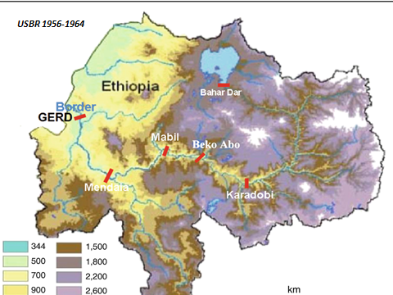
The GERD

Slide 11
Enter the Grand Ethiopian Renaissance Dam-GERD: 2010
The Project
Ethiopia`s initiative of soliciting understanding and build confidence-the IPoE
The Issues
  First filling and annual operation
The Agreement on the Declaration of Principles of 2015: The Tripartite National Committee-TNC Process

Slide 12
The GERD, Ethiopia, the Sudan and Egypt : The Positions
  Ethiopia- Owner of the Dam.
  Sudan- From Hydropolitical Dilemma to“As the High Aswan Dam is for Egypt, the Grand Ethiopian Renaissance Dam is for Sudan”.
  Egypt`s evolving position: From “No Dam on the Blue Nile” to “My Dam on the Blue Nile”.

Slide 13
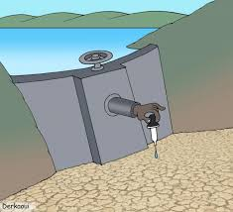
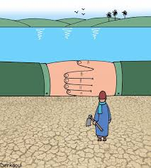
Securitizing the GERD: Securitization as social construction and sanctioned discourses of fear and threat

Slide 14
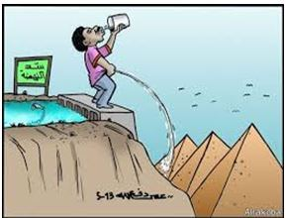
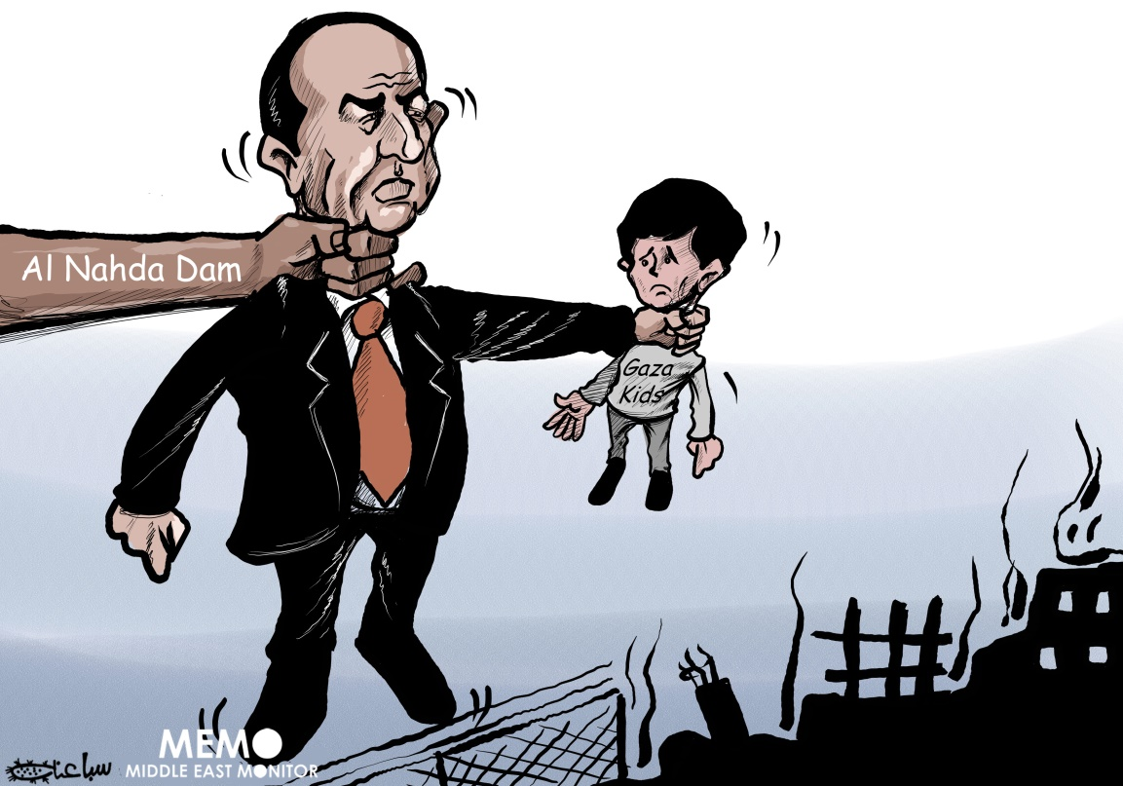
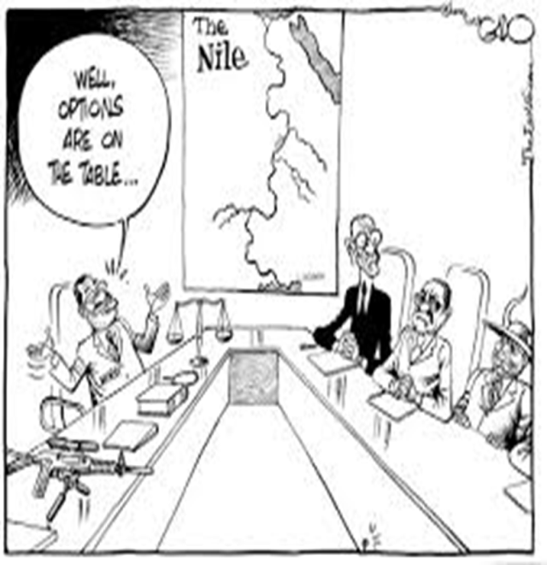
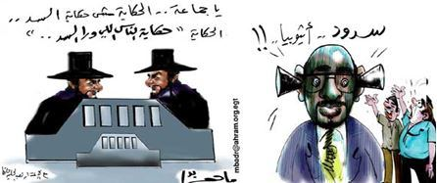
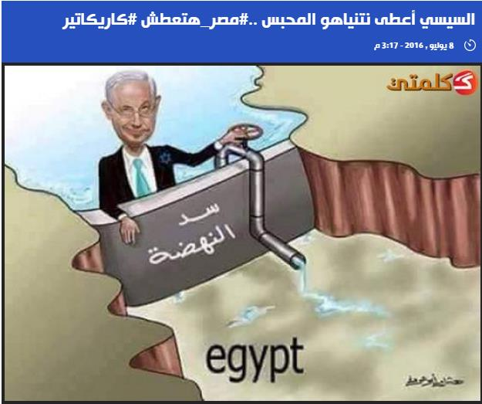

Slide 15
The Nile: Actors and Interests in Ethiopia, the Sudan and Egypt
Ethiopia: A matter of life but a n issue of water resource management
Sudan: dilemma between interest & Pressure
Ministry of Water
Ministry of Foreign Affairs
Cooperation is a positive sum
technical
Egypt: The Nile is a Securitized River
Ministry of Water
Cooperation is a positive sum but…
Technical
Higher Committee on the GERD: a new path
  Justice
  Water
  MoFA
  Intelligence
The Supreme Committee for the Nile Water (SCNW)
    The Prime Minister
    Water Resources
    Defense-Army
    MoFA
    The President
    The constitution-Article 44
    Political-Security
    Cooperation is a zero-sum-game

Slide 16
Securitization of the GERD: the evolution 2011-2020
Security
Political
Ministers of Water Affairs
IPoE
TNC
NISRG
The Ministers of Foreign Affairs
Ministers of Water Affairs and Ministers of Foreign Affairs
Tripartite Summits
Nine Party
The intelligence
Third Party
US
WB
UNSC
Technical
Missed Opportunities
TNC
NISRG

Slide 17
African solution to Africa`s Problem: the New Approach
The Hope at the end of the tunnel?
The need for a political will and commitment: declare the Nile is a shared river not a sole property of one or a few riparian countries

Slide 18
The Differences on the GERD Negotiations
The Differences
  Future Development
  Prolonged Dry Years
  Dispute Resolution
  Annual Rule Curve
  Review and Termination
All related with maintaining historic wrongs on the Nile and Securitization

Slide 19
The Way Forward
For the GERD: focus on the first filling and annual operation of the GERD
The issue of the Nile is an issue of management and utilization of a shared water resource
Sustainable solution: Only an acceptance of the equitable and reasonable utilization of the Nile –CFA still the opportunity to move forward

Slide 20
THANK YOU!
We hope you enjoyed the conference.
If you have any follow-up questions/requests, please email: environment@fiu.edu
2020 International Conference on the Nile and GERD

