Slide 1
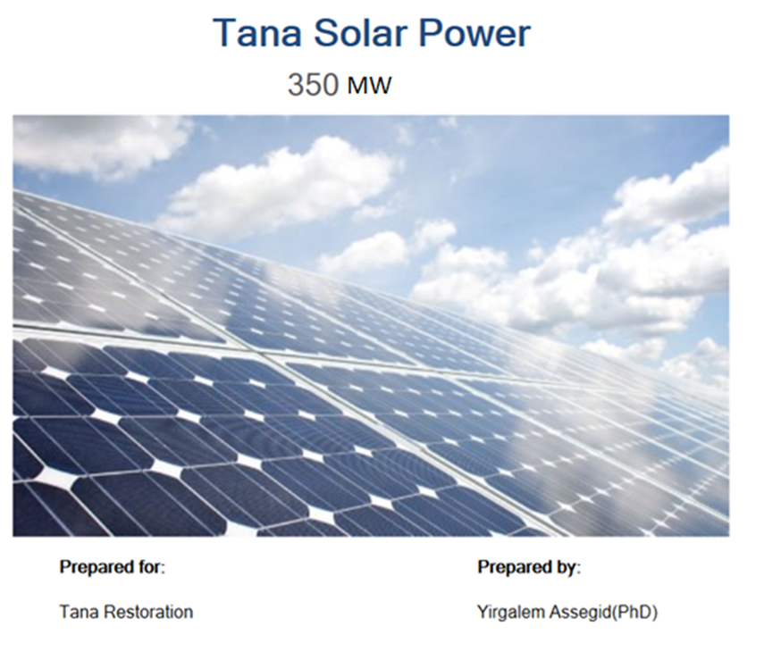
Restoring Lake Tana Through Reduction of Outflow and Compensation of the Power Gap with An Alternative Energy Source
Yirgalem Assegid¹, Assefa M. Melesse²
¹South Florida Water Management District, West Palm Beach, FL, USA
²Department of Earth and Environment, Florida International University, FL, USA

Slide 2
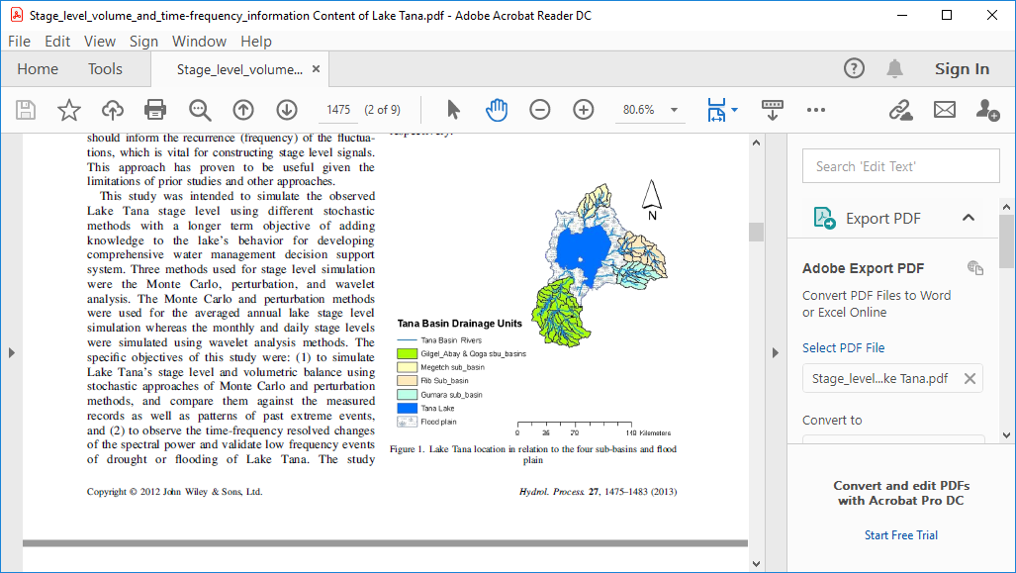
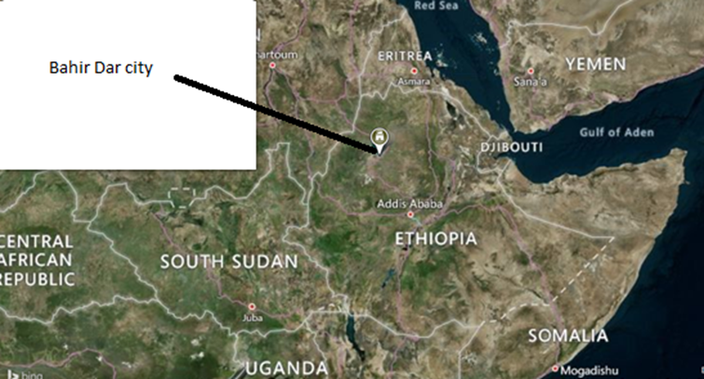
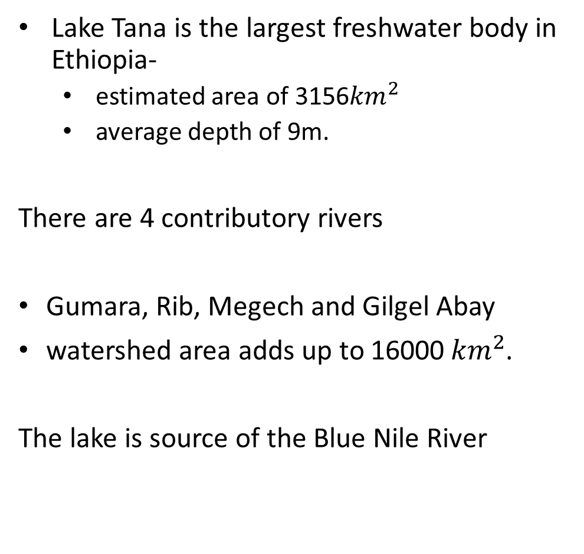
Context of Lake Tana
Lake Tana is the largest freshwater body in Ethiopia-
  estimated area of 3156${km}^{2}$
  average depth of 9m.
There are 4 contributory rivers
Gumara, Rib, Megech and Gilgel Abay
watershed area adds up to 16000${ km}^{2}$.
The lake is source of the Blue Nile River
Lake Tana

Slide 3

Economic and Ecohydrological Services of Lake Tana
Sector | Contribution of Lake Tana (million)
Energy | $ 200 | 460 MW+11MW+73MW
Tourism | $ 5.1 | Bahir Dar City Only (Woldu, 2018);
Fishery | $ 15 | 13-18 tomes (Amare et al,2018)
Irrigation | $20 | 100,000 ha (Worqlul et. al., 2015)
Maintains micro climatic conditions of the surrounding forcing convective rainfall system (Haile et. al., 2008).
Supports a wetland system surrounding the lake which in turn serves as a genetic pool of indigenous flora and fauna (Alemayehu et. al., 2013).

Slide 4
Water demands from Lake Tana Basin for hydropower and Irrigation
Irrigation demand table
Four storage dams are under planning and implementation with a combined active storage volume of 1.2BCM.
Withdrawal from the lake with pump irrigation in 3 localities accounts 0.1 BCM
Comparing against the total inflow of 5.1 BCM (Chebud et. al., 2009) the irrigation demand cuts 25% of the inflow
Hydropower demand
Beles I hydropower, and Abay I & II hydropower demand an outflow of 2.9 BCM/yr and 2.4BCM respectively with a constant flow (supply).
The ecological requirement demands a constant flow of 17m3/s (Gebre, Getachew and Mcarthy,2008) totaling 0.52BCM.

Slide 5
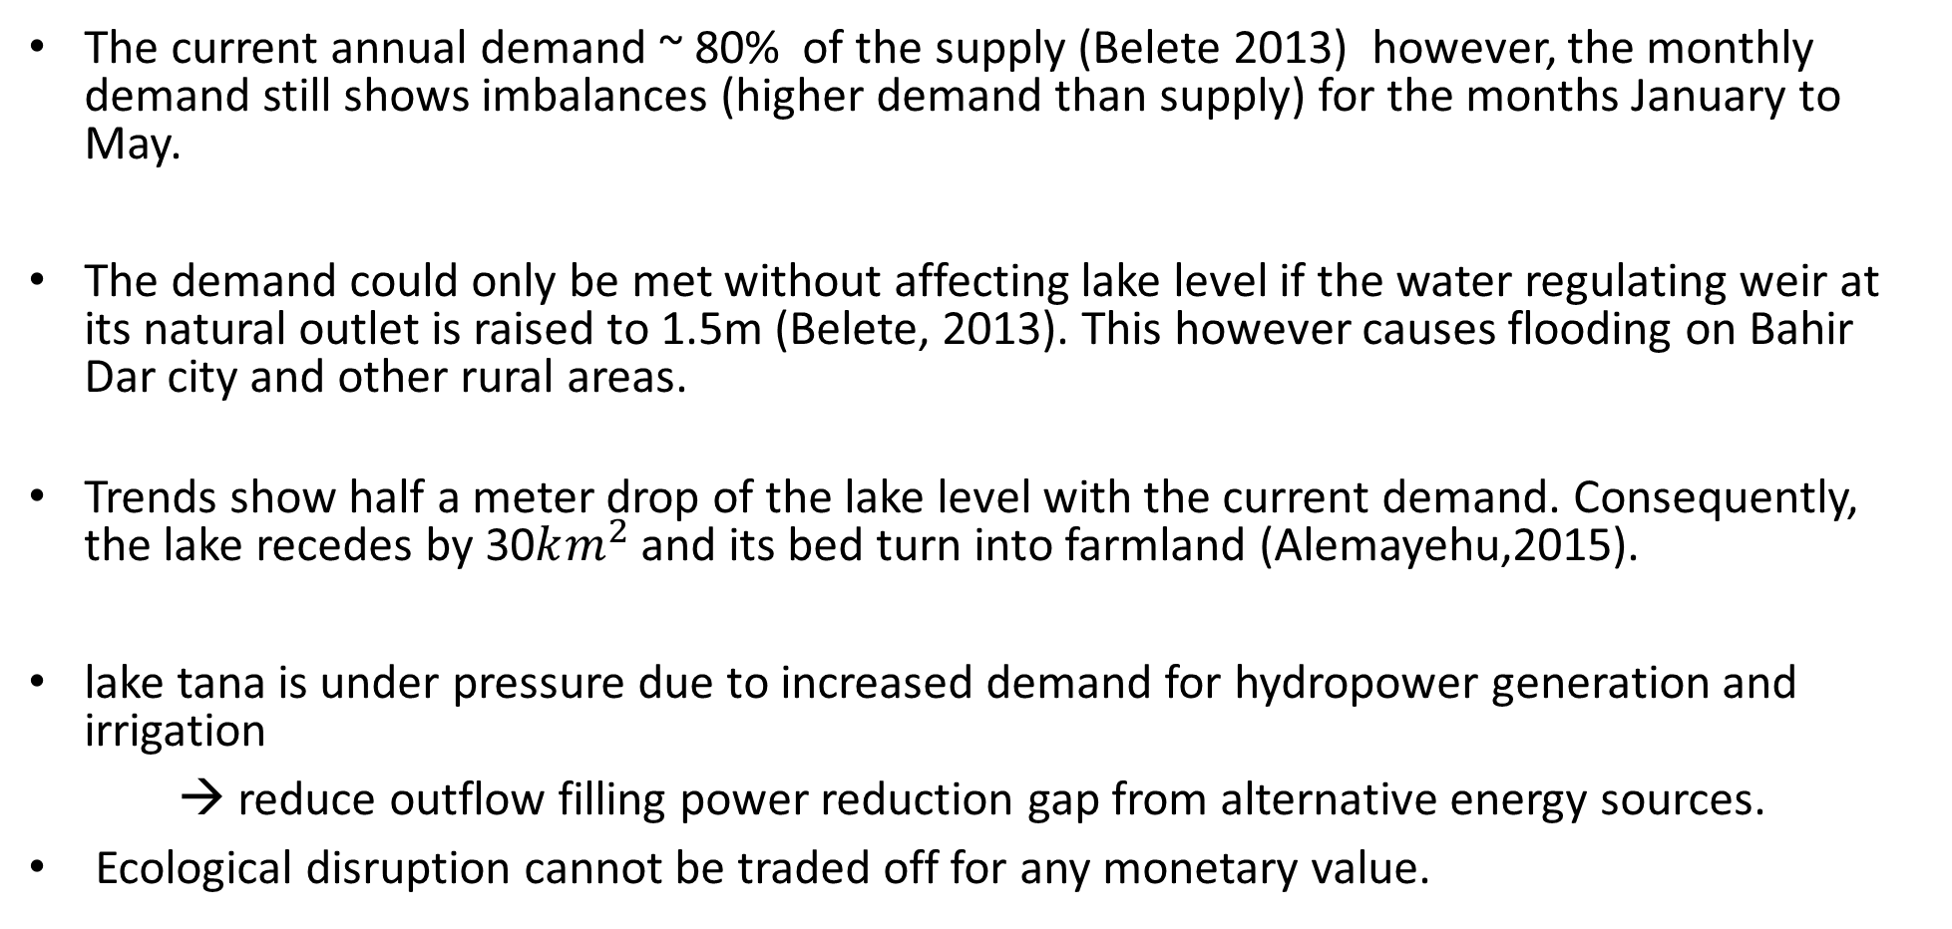
Demand patterns
The current annual demand ~ 80% of the supply (Belete 2013) however, the monthly demand still shows imbalances (higher demand than supply) for the months January to May.
The demand could only be met without affecting lake level if the water regulating weir at its natural outlet is raised to 1.5m (Belete, 2013). This however causes flooding on Bahir Dar city and other rural areas.
Trends show half a meter drop of the lake level with the current demand. Consequently, the lake recedes by 30$km^{2}$ and its bed turn into farmland (Alemayehu,2015).
lake tana is under pressure due to increased demand for hydropower generation and irrigation
→ reduce outflow filling power reduction gap from alternative energy sources.
Ecological disruption cannot be traded off for any monetary value.

Slide 6
Alternative source of energy and availability for Ethiopia
Globally about 9000 PV stations are built to produce 40GW.
In African continent Libya has built 600MW PV station to preserve oil and fossil fuel (Rehman et. al. 2006).
Saudi Arabia shared the same intentions of preserving its natural resources and conducted pilot level grid-based solar power production and performance test (Rehman et. al., 2006).
The contribution of solar energy in Ethiopia is off grid and limited to 1% (EEPCO).
Tapping solar power to reduce the pressure on Lake Tana is in line with the policy to grow the contribution at least to 15%.

Slide 7
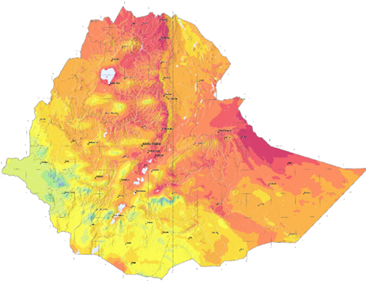
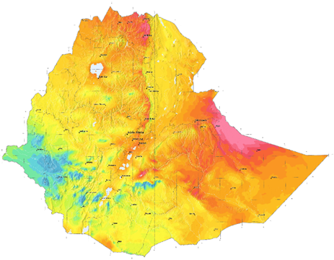
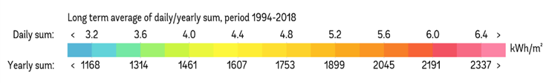

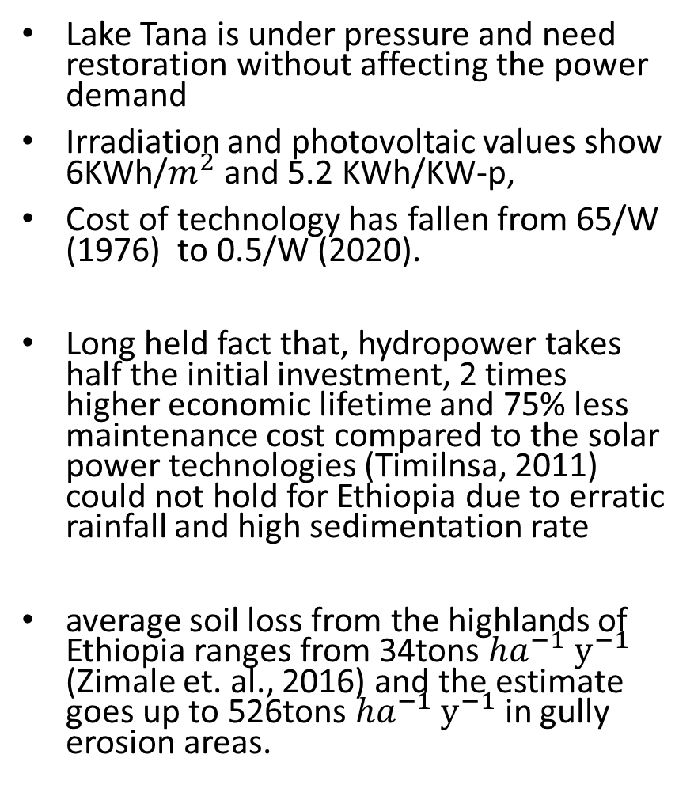
Rationale for Alternative source of energy
Lake Tana is under pressure and need restoration without affecting the power demand
Irradiation and photovoltaic values show 6KWh/$m^{2}$ and 5.2 KWh/KW-p,
Cost of technology has fallen from 65/W (1976) to 0.5/W (2020).
Long held fact that, hydropower takes half the initial investment, 2 times higher economic lifetime and 75% less maintenance cost compared to the solar power technologies (Timilnsa, 2011) could not hold for Ethiopia due to erratic rainfall and high sedimentation rate
average soil loss from the highlands of Ethiopia ranges from 34tons ${ha}^{−1}$ $y^{−1}$ (Zimale et. al., 2016) and the estimate goes up to 526tons ${ha}^{−1}$ $y^{−1}$ in gully erosion areas.

Slide 8
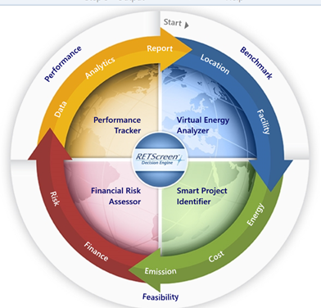
Cost Benefit Analysis
RETScreen is used to analyze:
  solar energy production and operational costs,
  the type of product used to minimize cost,
  cash flows, financial viability, and risks
It has 4 modules as indicated
.

Slide 9
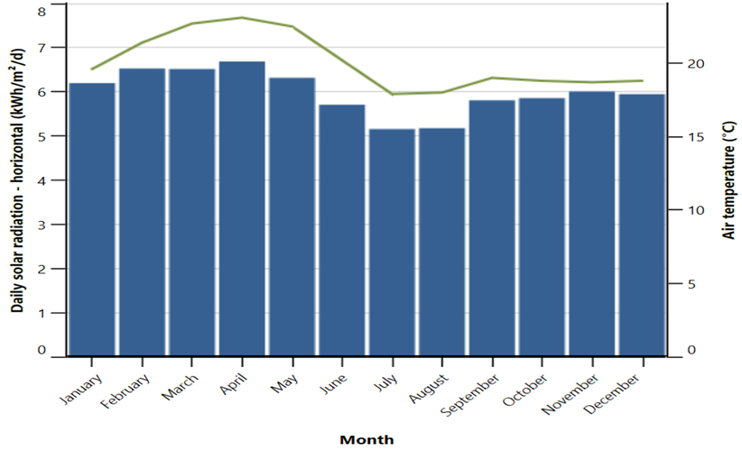
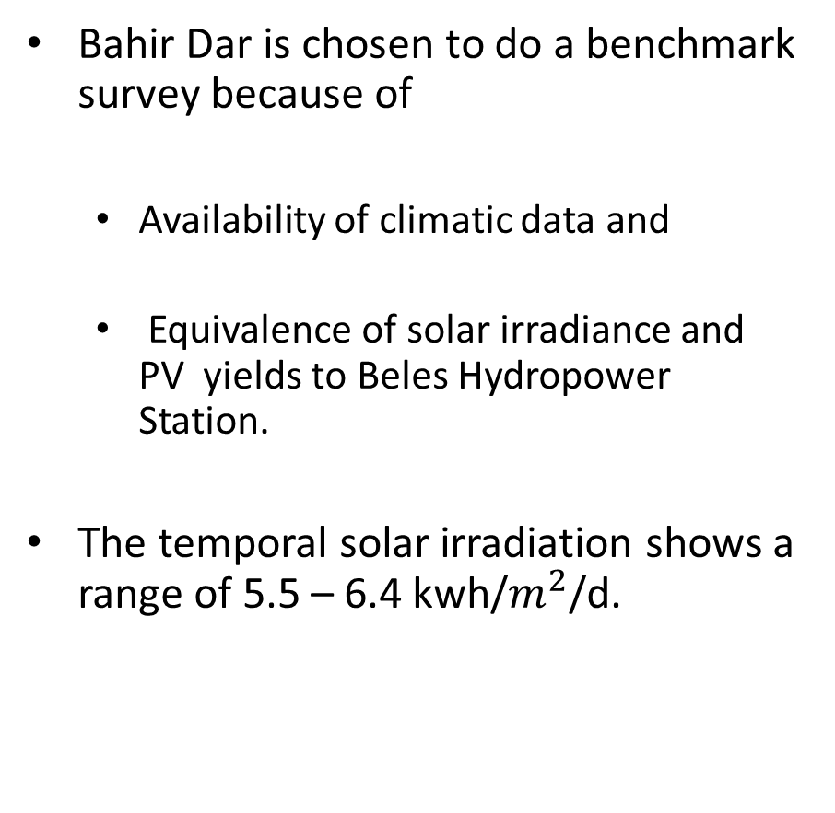
Benchmark analysis
Bahir Dar is chosen to do a benchmark survey because of
  Availability of climatic data and
  Equivalence of solar irradiance and PV yields to Beles Hydropower Station.
The temporal solar irradiation shows a range of 5.5 – 6.4 kwh/$m^{2}$/d.

Slide 10
Resource Allocations and Assumptions
Abay I & II power plants are assumed to restart the production getting extra 84 MW from the current plan of production as it has a dual advantage of satisfying the ecological requirement flows and sustain tourism.
Beles I power plant is suggested to be reduced to 110MW whereas the remaining 350 MW could be the gap that should be compensated based on the current plan.
The selection of specific PV products was made based on the cost, availability, maintenance costs, capacity of power per unit, and technical easiness. Accordingly, “mono-Si - LR6-60PH – 310W” manufactured by LONGi-Solar is selected.
it is the cheapest silicon-based material (~161/unit) and the cost gets 10% reduction at decadal scale
To produce 350MW with 18.96% efficiency (vertical to horizontal irradiation conversion) it requires 1,129,033 units of panels requires 200ha (184ha for panels and 16ha for access and other accessories).

Slide 11
Costs and Revenue

Slide 12
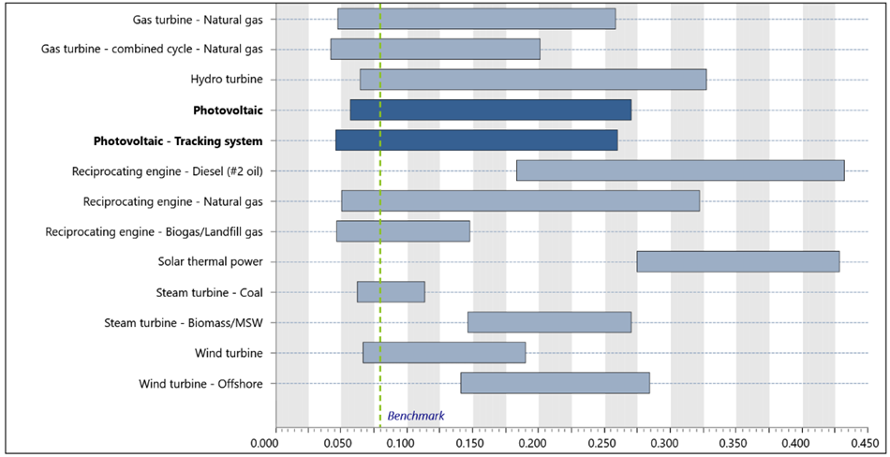
The current cost of production of PV power is competitive gives an increased margin for financial viability.
For this project analysis was made at a cost $0.1kw/h (4 times the minimum).
In this project and a debt period of 10 years
The rate of escalation of the power is set at 2% compared to the 4%.
The project lifetime is set 25 years

Slide 13
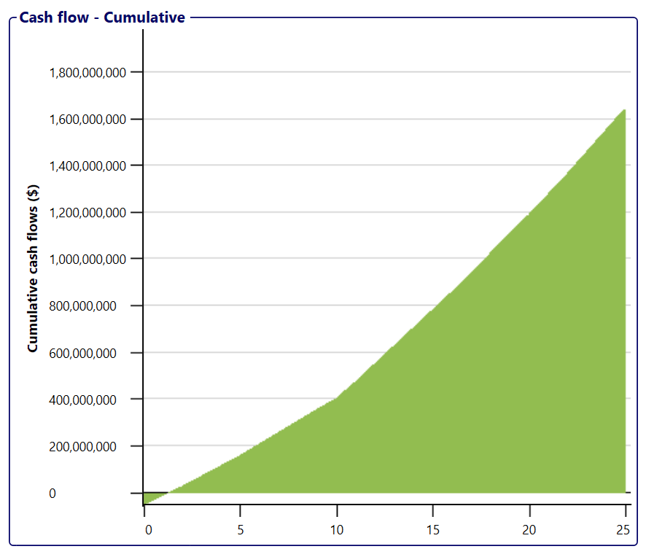
Results
Parameter | Value
Simply pay back | 3.2 yr
Equity payback | 1.2 yr
Inflation rate | 2% NPV $1.8 Billion
Inflation rate | 5% NPV $3 Billion
Inflation rate | 10% NPV $6 Billion
Benefit-Cost ratio | 10.1
The results show that the internal rate of return (IRR) 0.75 is greater than the reduced rate of return (0.09).
The simple payback 3.2 years and equity pay back of 1.2 years show a positive cash flow could be gained in a very short period.
the average inflation rate of 2% is used and it turns a net present value (NPV) cumulative cash flow of 1.8Billion USD.
If the inflation rate is 5% the NPV cumulative cash flow would be 3 Billion USD.
For a 10% inflation rate (Ethiopian context) the NPV cumulative cash flow reaches 6billion USD.
Finally, the benefit-const ratio of 10.1 seals the feasibility of the PV project.

Slide 14
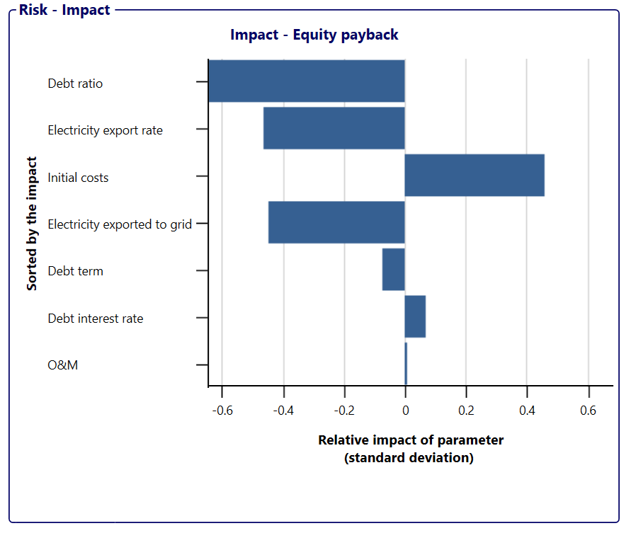
Risks
The risk is analyzed with sensitivity analysis of 25%
in all input values of
  interest rate,
  reduced rate of return
  inflation rates.
In all the cases the maximum risk is observed from PV technological costs which practically is declining since 1976.

Slide 15
Conclusion
A full-scale implementation of 350MW from solar energy may seem unrealistic for a country that has not tested PV in grid power at pilot level.
A flexibility would be vital and decision makers can execute at pilot level with the vision to expand till the lake regains its water balance.
  This strategy, first, helps to test performance of the PV and secondly it minimizes the investment cost benefiting from the existing trend.
  Second, PV being considered newer (relative to hydropower), there would be lack of interest from financial institutions at such a bigger scale.
  Third, setting institutional arrangement and skilled labor needs time and hence a pilot scale could serve as experimentation time to develop the institutional framework.
Comparing internal rate of return or the discount rate against any projects is not a level field given the importance of lake while the PV shows viability in all economic parameters.

Slide 16
THANK YOU

