Slide 1
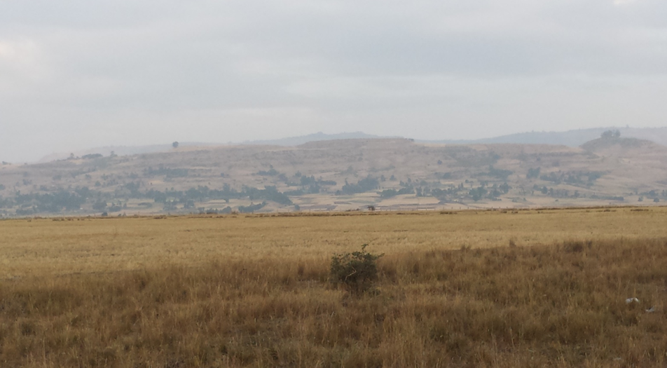
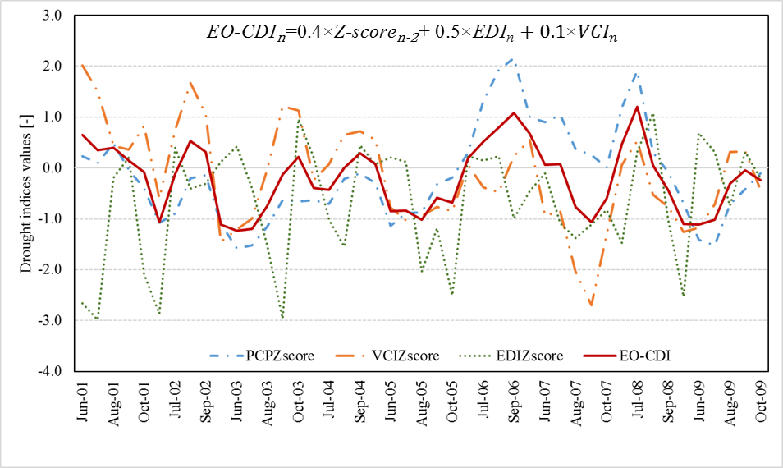
Multi-dimensional nature of drought in Abbay/Upper Blue Nile Basin and the importance of regional coordination efforts for mitigation
DEVELOPING AN IMPACT-BASED COMBINED DROUGHT INDEX FOR MONITORING CROP YIELD ANOMALIES IN THE UPPER BLUE NILE BASIN, ETHIOPIA
International Conference on the Nile and Grand Ethiopian Renaissance Dam: Science, Conflict Resolution and Cooperation
August 20-21, 2020
By:
Yared A. Bayissa, Semu A. Moges, Assefa M. Melesse,
Tsegaye Tadesse, Anteneh Z. Abiy

Slide 2
Outline
Background
Drought history of the UBN basin
Material and methods
Spatial and temporal features of different types of droughts
Drought impact on socio-economic
Summary and recommendation

Slide 3
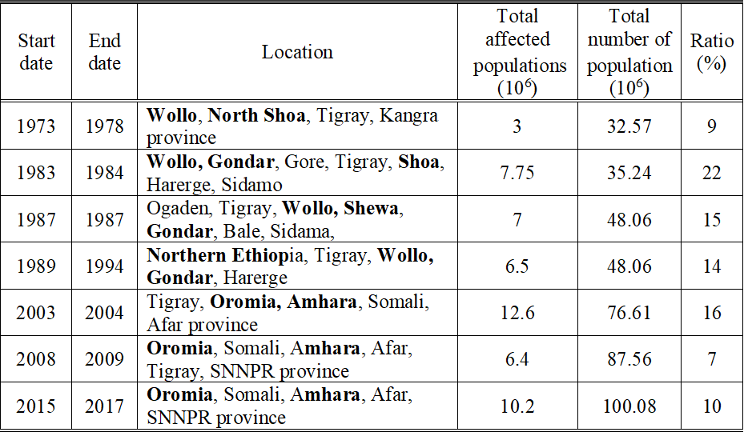
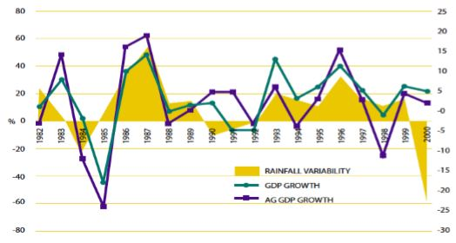
Background
Historic droughts in Ethiopia
  1983/84 was one of the worst drought events
  Covered large area and affected many populations
  Drought has become more frequent
  Now it occurs every 2 to 3 years
(Data source: EM-DAT: The International Disaster Database. Centre for Research on the Epidemiology of Disasters-CRED)
Drought impacts on Ethiopia economy
  The economy is less resilient to drought
  The economy is highly linked to annual rainfall variability
(Source: Economics of resilience to drought: Ethiopia analysis (USAID report, 2018))

Slide 4
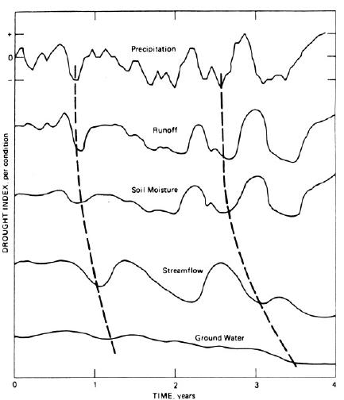
Cont’d …
Natural Climate Variability
Precipitation deficiency
(amount, intensity, timing)
High temp, high winds, low relative humidity
(amount, intensity, timing)
Duration
Reduced infiltration, runoff, deep percolation, and GW
Increased evaporation and transpiration
Soil Water Deficiency
Hydrological Agricultural Meteorological
drought drought drought
Plant water stress, reduced biomass and yield
Reduced streamflow, inflow to reservoirs, lakes, and ponds; reduced wetlands, wildlife habitat
Economic impact
Social Impact
Environmental impact
Proceeding of precipitation deficit throughout the
Hydrological cycle (Rasmusson, 1993)
Influence of precipitation deficiency and other factors on drought development
(National Drought Mitigation Center)

Slide 5
Cont’d …
Demonstrate the different forms of droughts that occurred in the Abbay/ Upper Blue Nile River basin and its national and regional implication

Slide 6
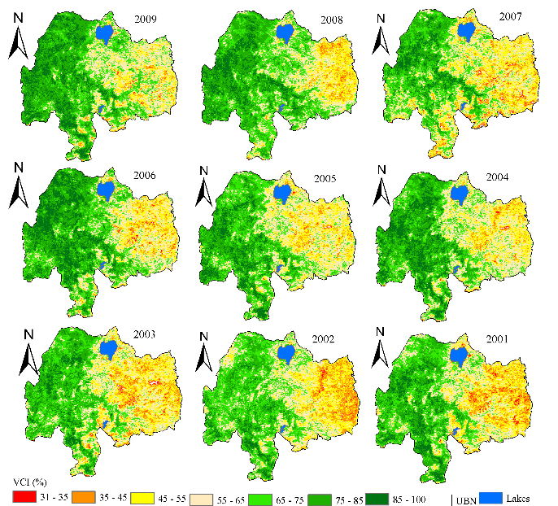
Drought history of the UBN basin
UBN basin is vulnerable to drought
1984, 2002, 2009 and 2015 drought years
The eastern part more drought susceptible
Regional cooperation is vital to mitigating its impact

Slide 7
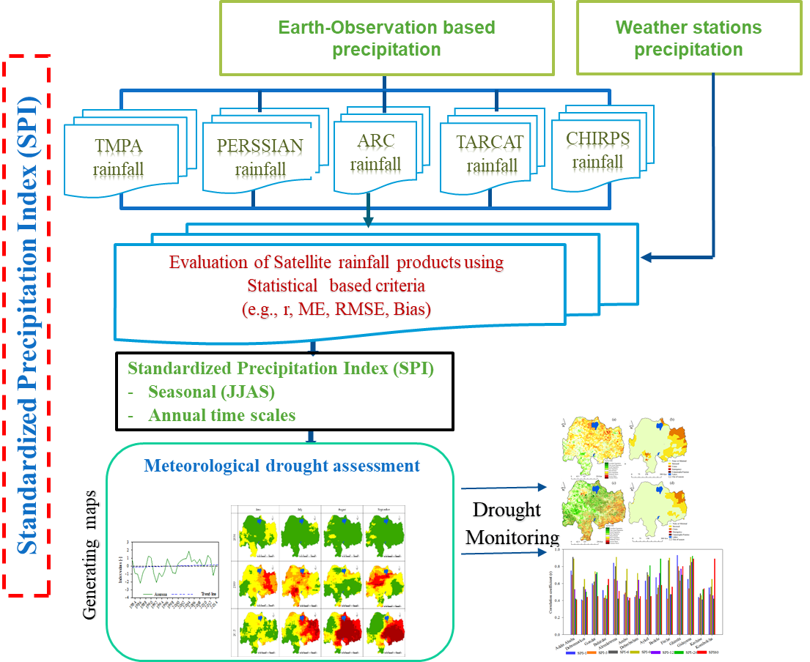
Material and methods
Drought indices
  Standardized Precipitation Index
  Soil Moisture Deficit Index
  Surface Runoff Index

Slide 8
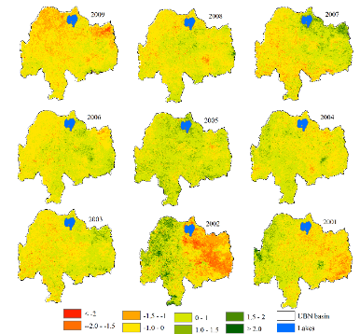

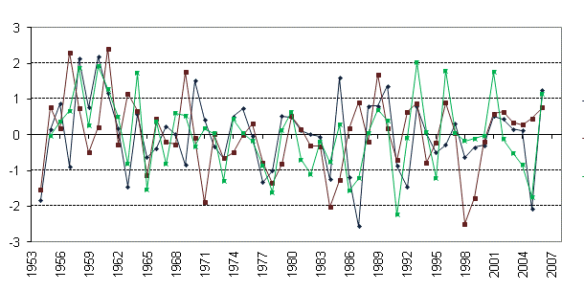



Land Data Assimilation System (FLDAS)
(Monthly soil moisture time series)
Long-term Stream flow
Cont’d …
Soil Moisture Deficit Index (SMDI)
Seasonal
Annual time scales
Surface Runoff Index (SRI)
Seasonal
Annual
$$SD_{i,j}=\frac{SW_{i,j}−MSW_{j}}{MSW_{j}−\min{S}W_{j}}×100, if SW_{i,j}< MSW_{j}$$
Standardized Runoff Index (SRI)
Soil Moisture Deficit Index (SMDI)
$$SD_{i,j}=\frac{SW_{i,j}−MSW_{j}}{\max{S}W_{j}−MSW_{j}}×100,if SW_{i,j}> MSW_{j}$$
$$SMDI_{i,j}=0.5SMDI_{j−1}+\frac{SD_{j}}{100}$$
Hydrological drought assessment
Agricultural drought assessment
Generating maps

Slide 9
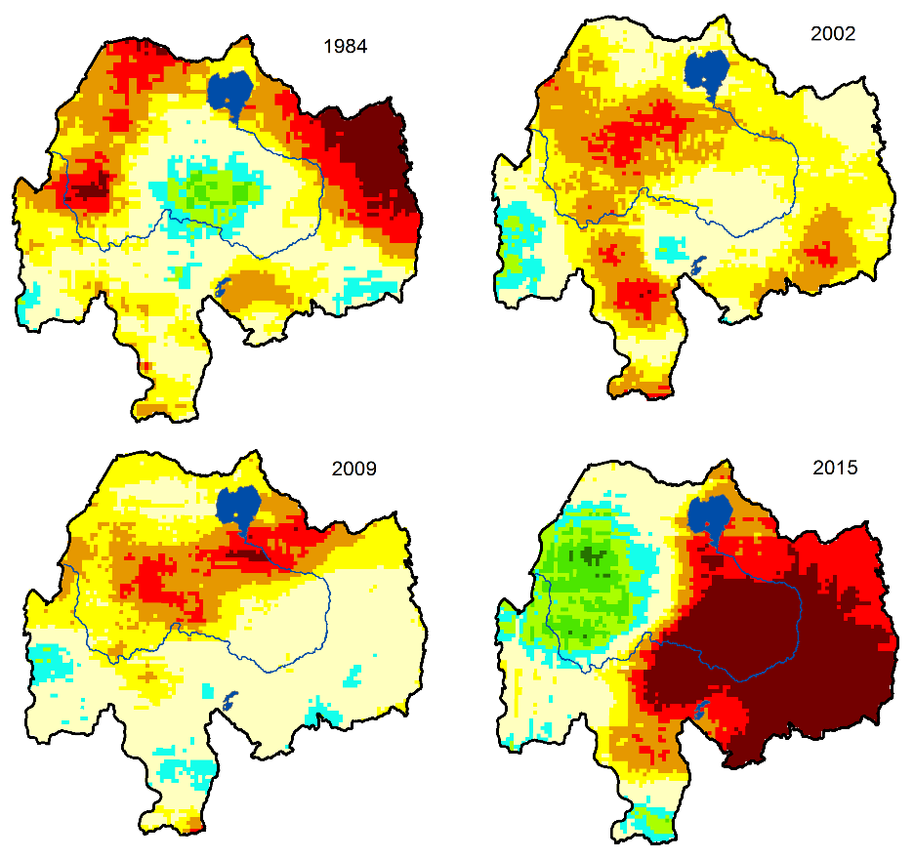
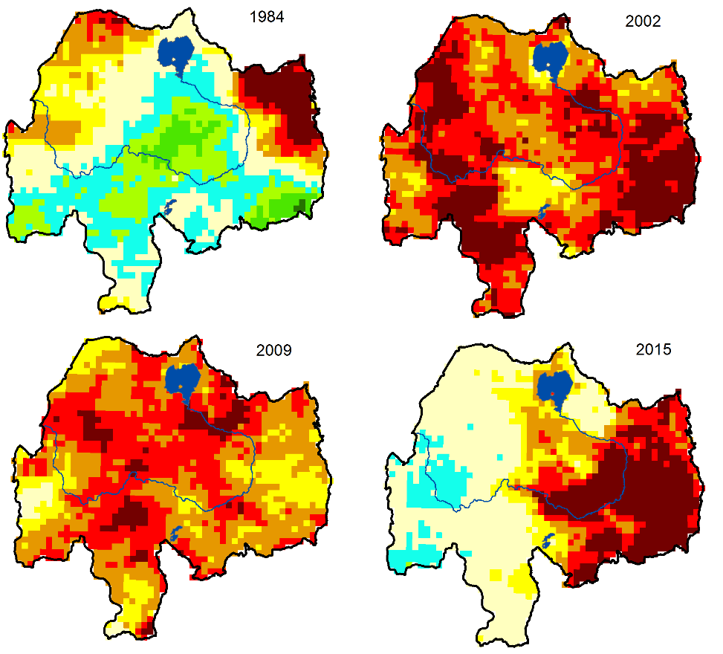
Seasonal SPI (JJAS) Seasonal stdSMDI (JJAS)
Spatial features of meteorological and agricultural droughts
- Similar drought pattern b/n SPI and stdSMDI in 1984 and 2015
- Wide spread and severe drought is shown by stdSMDI as compared to SPI in 2002 and 2009

Slide 10
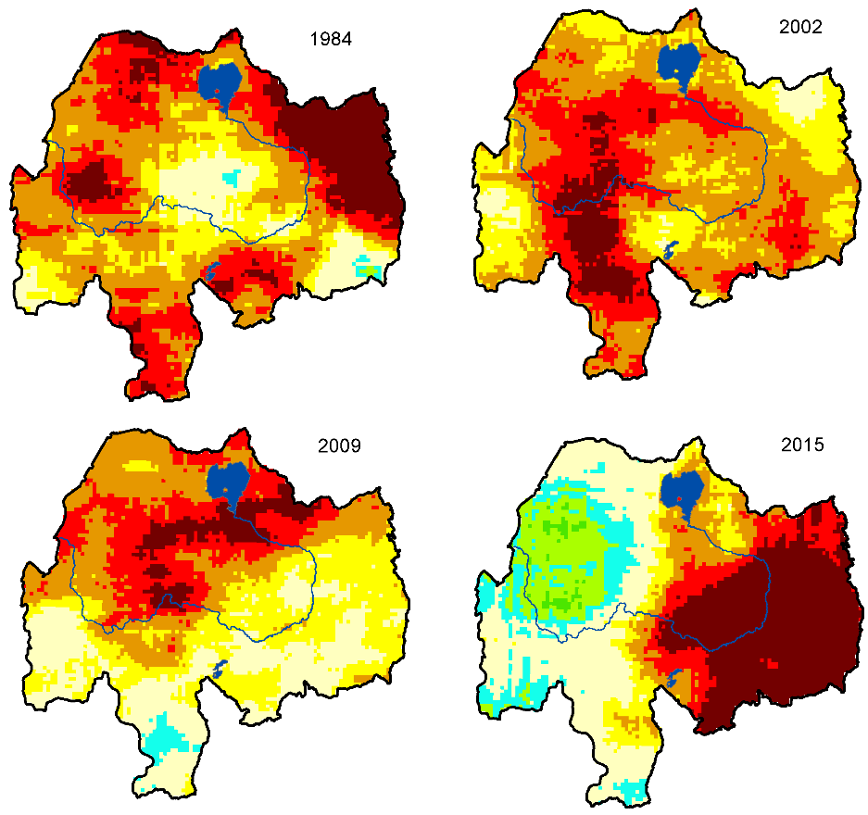
Annual SPI Annual stdSMDI
Cont’d …
- Similar drought patterns as compared to seasonal for the selected years
- Relatively widespread and intensified drought condition in 1984, 2002 and 2009

Slide 11

Seasonal Annual
Temporal pattern of meteorological, agricultural and hydrological droughts
There is a high nexus between each drought type and all indices consistently indicated the historic drought events in the basin.

Slide 12
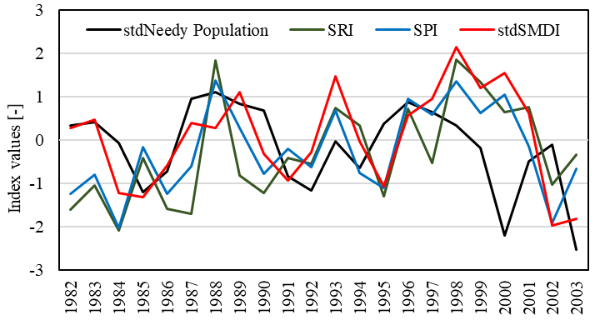
Drought impact on socio-economic
(Source: Abate, 2003)

Slide 13
Summary and recommendation
The nature of drought in Abbay/UBN basin is multi-dimensional and occurring concurrently
It has both complementary as well as supplementary socio-economic impacts (agriculture, GDP)
We recommend constructing upstream storage facilities to delink drought induced socio-economic losses and to mitigate the multi-dimensional drought related disaster
Understanding multidimensional aspects of drought provides perspectives for regional cooperation and the need for shared drought management

Slide 14
Thank you!!!
Multi-dimensional nature of drought in Abbay/Upper Blue Nile Basin and the importance of regional coordination efforts for mitigation
DEVELOPING AN IMPACT-BASED COMBINED DROUGHT INDEX FOR MONITORING CROP YIELD ANOMALIES IN THE UPPER BLUE NILE BASIN, ETHIOPIA
International Conference on the Nile and Grand Ethiopian Renaissance Dam: Science, Conflict Resolution and Cooperation

