Slide 1
GERD and Abay basin: a review using text mining and natural language processing techniques
Wuletawu Abera, Lulseged Tamene, Melkamu Beyene, Bryce Gallant, Nigussie Haregeweyn, Yihun Dile, Ayele A. Fenta, Hailemariam Meaza, Kifle Woldearegay, Biadgilgn Demissie
21 August 2020
Wuletawu.abera@cgiar.org
Notes:
God afternoon. My name is WA. I am part of ASL team – based in Ethiopia. I am hydrologist by profession but also working in geospatial science in general. Today I will present brief overview of some selected project activities that ASL team we are working in Ethiopia – and look forward to discuss with you in of these topics and related topics for collaboration – for paper – proposal development etc.

Slide 2
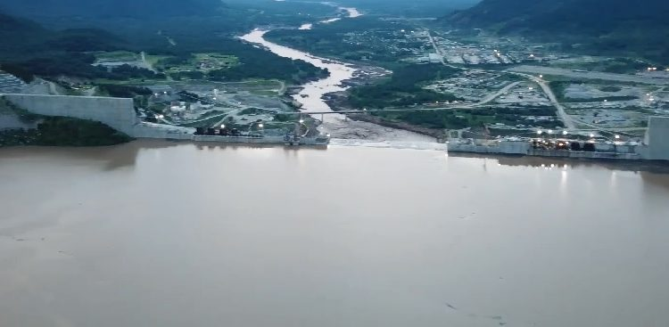
Introduction
Once completed, the GERD will be one of the largest hydroelectric power dams in the world, with a generation capacity of 6,450 megawatts per year.
Attract attention from both the political and scientific communities thus many studies are conducted considering its different aspects in the last 9 years.
250 per-reviewed papers and more than 150 gray literature (thesis and reports) are published

Slide 3
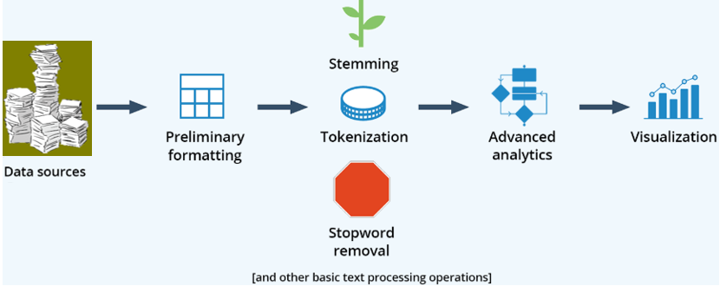
Stock take and assess the knowledge and information generated by scientific community
250 peer review paper
convert to text; indexing etc
Word frequency; correlation; topic modelling; sentiment etc

Slide 4
Extraction of the most informative word …
most commonly used words (>5000)

Slide 5
Extraction of the most informative word pairs…
A group of words can be more informative

Slide 6
Sentiment analysis
Emotional intent of words to infer whether a document is positive or negative, or neutral
About 20% of the papers have overall negative sentiments
Small/large negative – implication for dialogues

Slide 7
sentiment analysis
Erosion, conflict, hegemony, waste, degradation etc – are the cause of negative intent
Sustainable, right, improved, recommendation etc are positive emotion

Slide 8
Word correlation
Correlation between “GERD”, “Ethiopia”, “Sudan”, “Egypt” to see how those appear or not together.
Not that in all papers, the term GERD is there as binding node
The highest correlation is between Egypt and sudan, followed by “GERD and sudan”, “GERD and Egypt”
The correlation between “GERD” and “Ethiopia” is the lowest

Slide 9
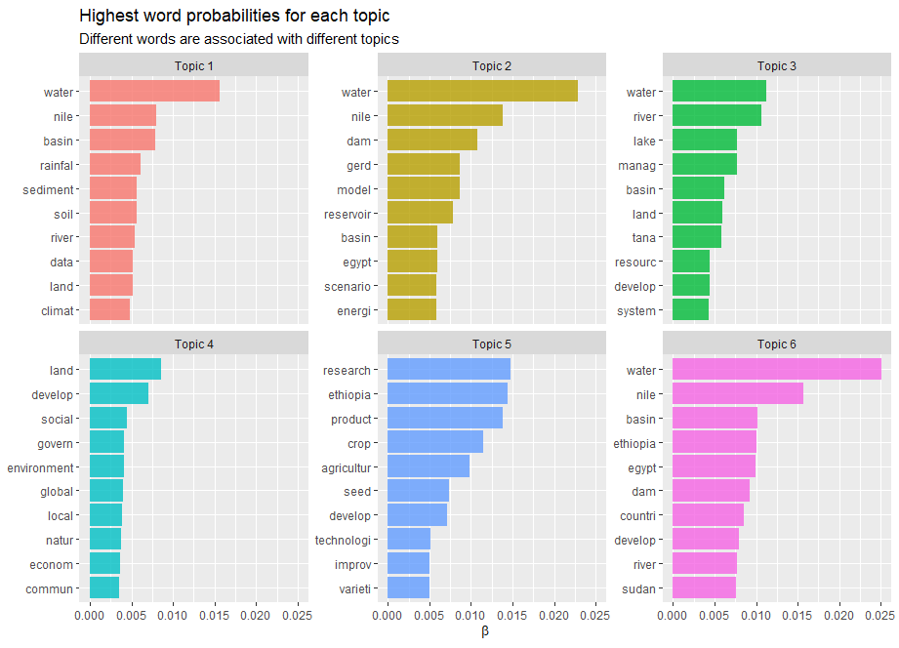
Topic modelling…
unsupervised classification of all article into topics

Slide 10
The Way Forward
More bibliometric analysis including author(s), countries, institutions, cooperation among authors…..
Identify research gaps in each topic and suggestion research topic for collaboration
Identify and suggest researchers for future collaborations
Connecting with social media such as sentiment analysis on Twitter to see if there is any correlation with the scientific results

Slide 11
Thank you!

