Slide 1
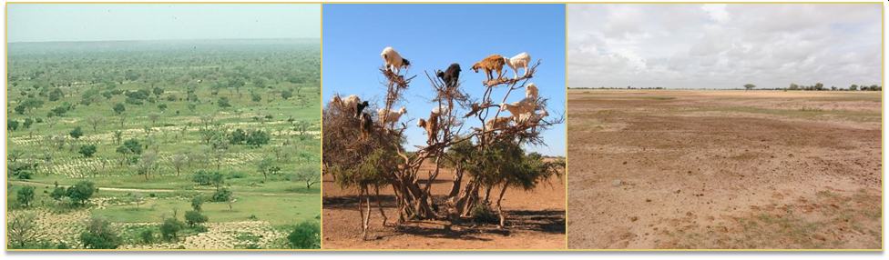
Wossenu Abtew, Ph.D., P.E., D.WRE
Principal Civil Engineer
Water and Environment Consulting LLC, Affiliate, FIU
Assefa M. Melesse, Ph. D., P.E., D.WRE
Professor & Graduate Program Director, FIU
Land Surface Dynamics and Hydrologic Connectivity
The Sahel
The Sahel
Photos from futurechallenges.org, Lusile17.centerblog.net, & vega.isara.fr
2020 International Conference on the Nile and
Grand Ethiopian Renaissance Dam: Science,
Conflict Resolution and Cooperation
August 20-21, 2020

Slide 2
Topics
Landscape degradation and desertification
What is the link between landscape dynamics, energy and mass, the hydrologic cycle
The importance of wetlands, lakes, riverine, forests, green spaces and landscape management and restoration

Slide 3
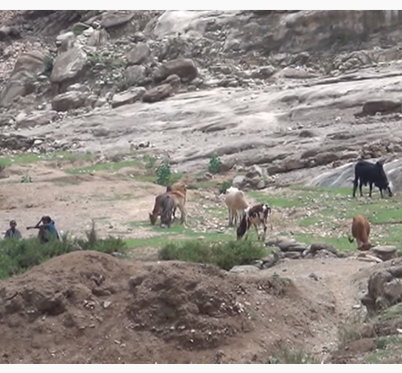
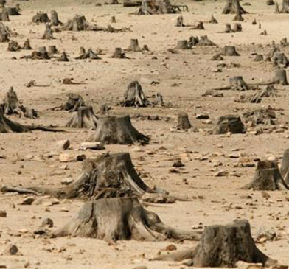
Overgrazing and Deforestation in Ethiopia
(Lake Tana Watershed Regreening Ethiopia’s
highlands: A new hope for Africa)
Ethiopia: Source: Insidene.com

Slide 4
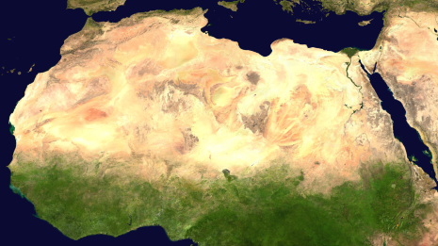
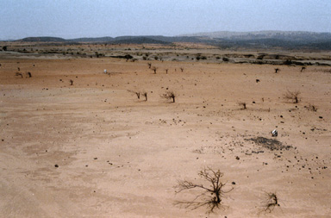
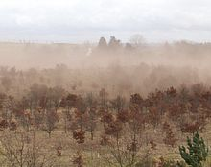
Desertification and Landscape Change
The Sahara has Expanded by 10% since 1920 https://earthsky.org/earth/sahara-desert-is-expanding
Source: FAO; desertification in Africa
Wind Erosion

Slide 5
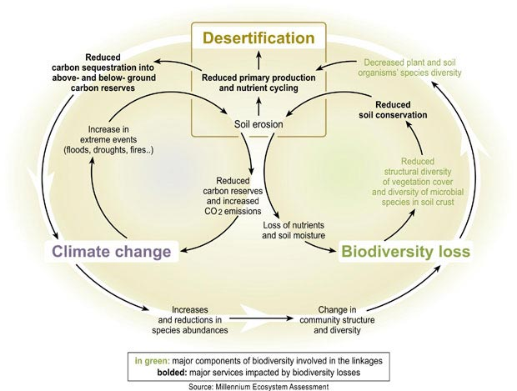
Desertification
Overgrazing
Deforestation
Wetland loss
Soil loss by wind and water erosion

Slide 6
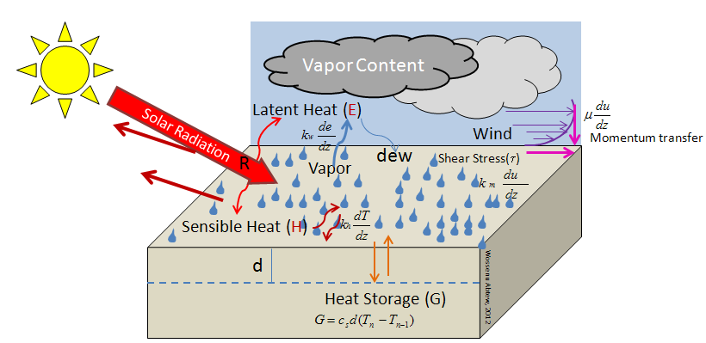
The Evaporation Process
Water must be available
Energy to detach water molecules
Wind to carry out water molecules
Atmosphere must have space to hold water molecule or release
Energy Balance
H + E = R - G
Abtew, W and A. Melesse. 2015. Chapter 3: Landscape Impact on Regional Hydrology and Climate. In: Melesse A. and W. Abtew (eds.). Landscape Dynamics, Soil and Hydrological Processes in Varied Climates, Springer.

Slide 7


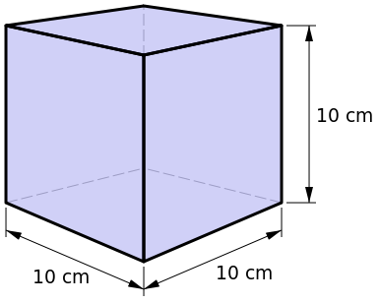
Energy and Mass of Water
Evaporation
2.45 MJ of energy
Condensation
2.45 MJ of energy
One liter of water
One kg of water

Slide 8
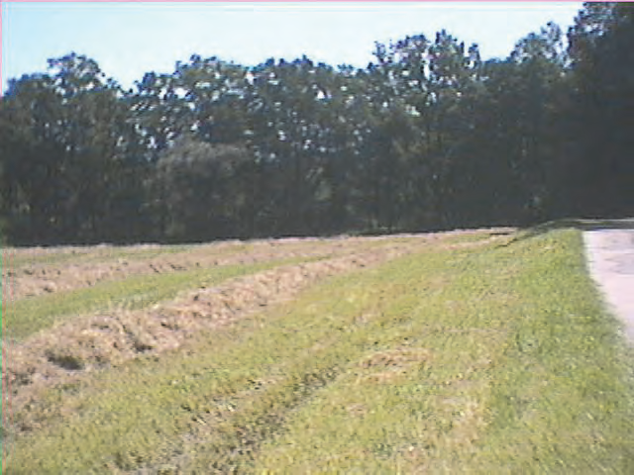
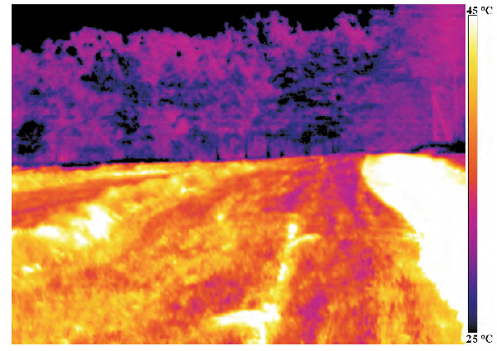
Surface Temperature of Forest and Drained Meadow with Road as seen by Thermovision Camera
Energy Balance
H + E = R - G
Sensible Heat + Latent Heat = R - G
Modified from: Eiseltova, M., J. Pokorny, P. Hesslerova and W. Ripl. 2012. Chapter 14: Evapotranspiration - A driving force in landscape sustainability. Irmak A (ed.) Evapotranspiration Remote Sensing and Modeling. InTech (open access book)

Slide 9

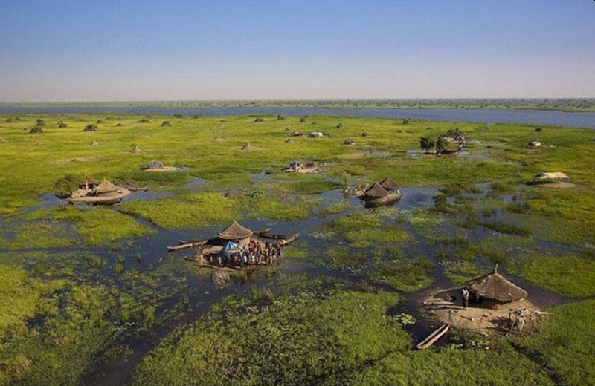
Energy Partitioning and Landscape Changes (Latent and Sensible Heat)
Energy Balance
R ≈ H + E + G
E > H
H > E
The Sudd (http://www.southsudan.
net/the-sudd-swamp-in-south-sudan/)
Africa (FAO)
Sahel (USGS)

Slide 10
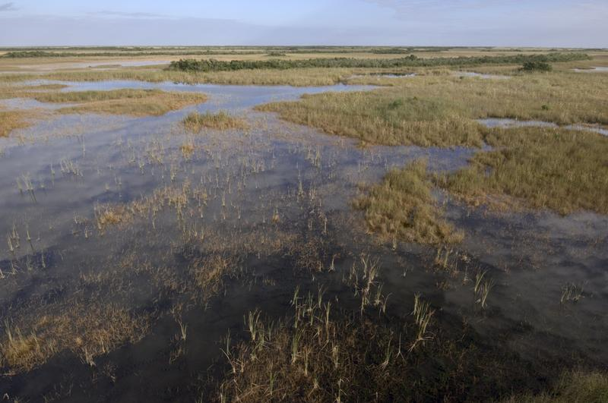
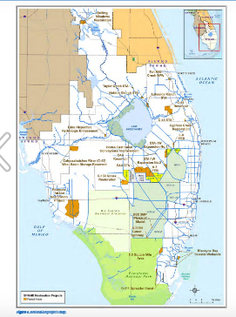
Importance of Wetlands in Regional Hydrology and Wetland Restoration – The Everglades, Florida, USA
E > H

Slide 11
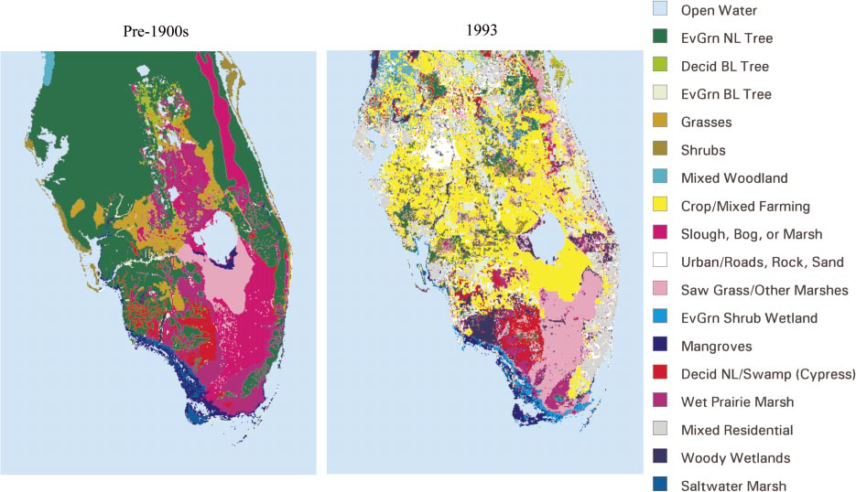
Land-Cover Changes, Energy Fractionation and Regional Hydrology

Slide 12
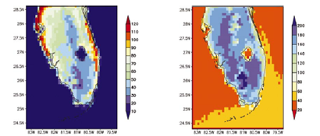
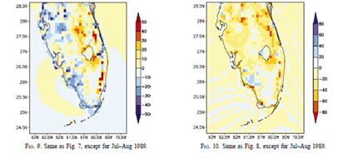
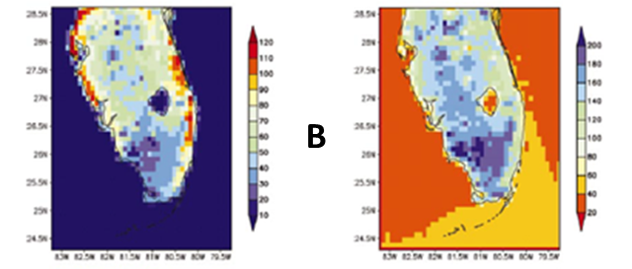
Average Sensible Heat, H (left) and Latent Heat, E (right) Flux (w m⁻²) for July – August
Pre 1900 land cover
Energy Balance
H + E = R - G
H (Sensible)
E (Latent)
A
B-A
H increased
E decreased
1993 land cover
B
Source: Marshall, C.H, Pielke, R.A., Steyaert, L., Willard, D.A. 2004. The impact of anthropogenic land-cover change on the Florida Peninsula sea breezes and warm season sensible weather. Monthly Weather Review. 132:28-52

Slide 13
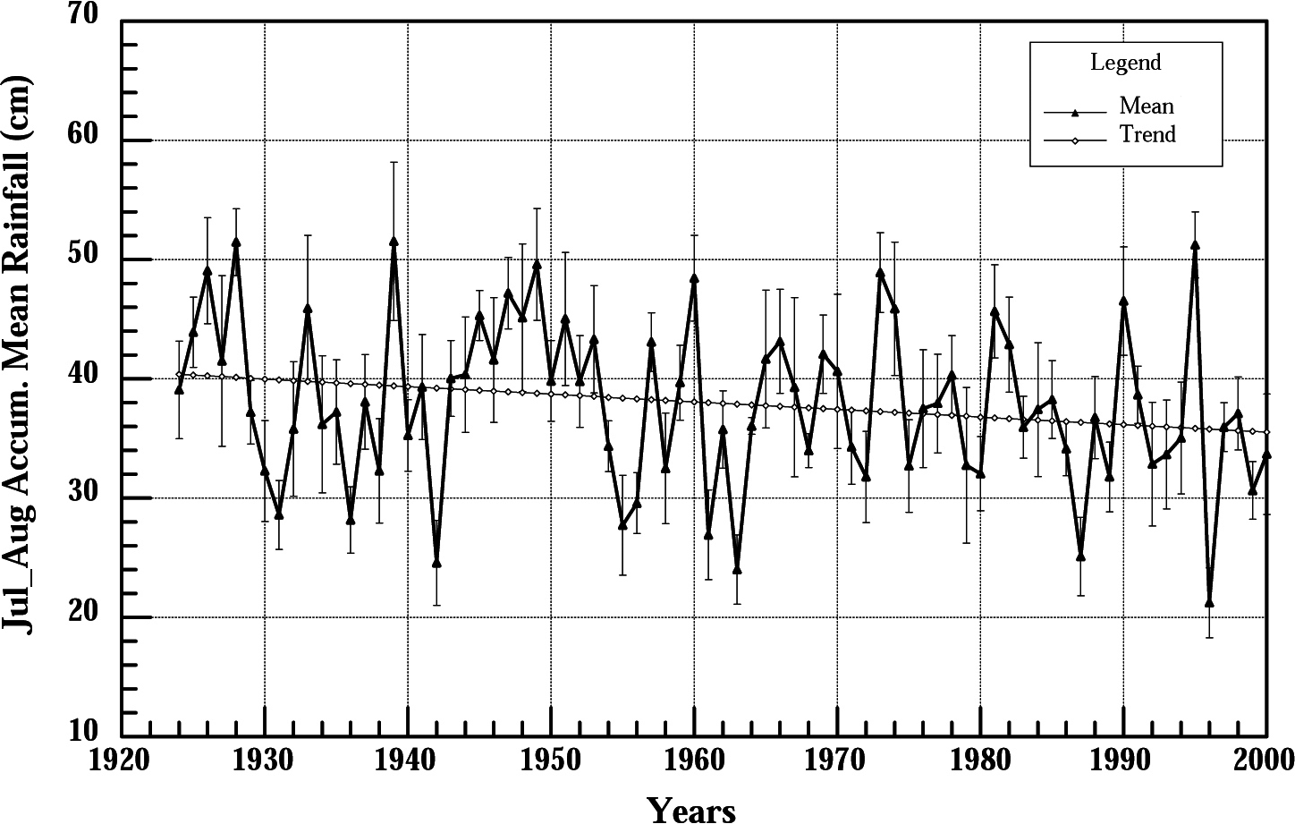
July-August Convective Rainfall Declining Trend in Florida
Source: Marshall, C.H, Pielke, R.A., Steyaert, L., Willard, D.A. 2004. The impact of anthropogenic land-cover change on the Florida Peninsula sea breezes and warm season sensible weather. Monthly Weather Review. 132:28-52

Slide 14
Summary Results of the Study
which Applied Regional Atmospheric Modeling
to the South Florida Region
When pre-1900 natural cover was replaced with 1993 land-use
Spatial patterns of sensible and latent heat flux were altered significantly
Drained and urbanized areas showed higher sensible and lower latent heat fluxes
Land-cover change resulted in change in rainfall
Source: Marshall, C.H, Pielke, R.A., Steyaert, L., Willard, D.A. 2004. The impact of anthropogenic land-cover change on the Florida Peninsula sea breezes and warm season sensible weather. Monthly Weather Review. 132:28-52

Slide 15
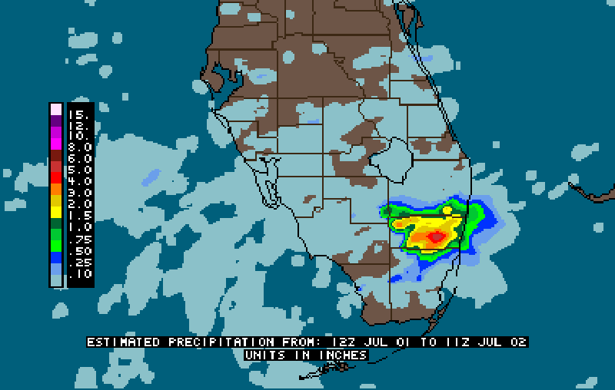
Convective Rainfall over South Florida (July 1-2, 1998)

Slide 16
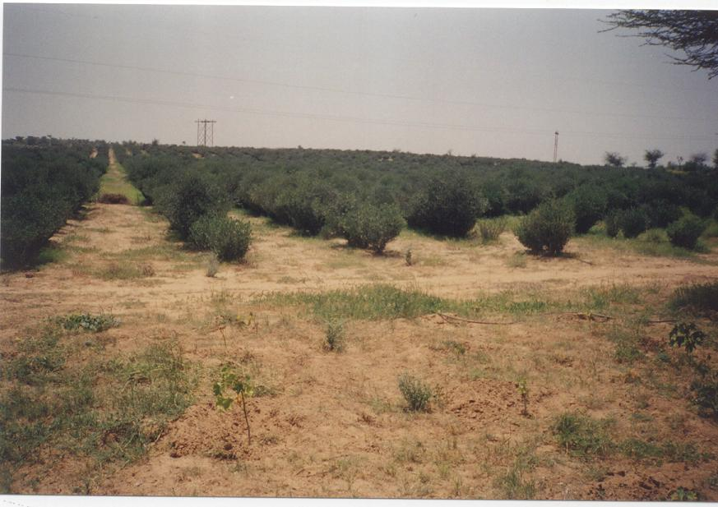
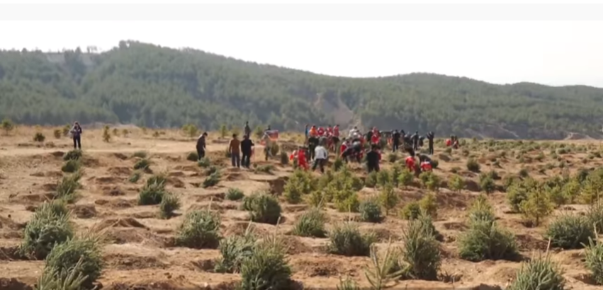
Combating Desertification
Jojoba plantation to combat desertification
Thar Desert, India
Inner Mongolia, China; Source: Xinhua
photograph by Terrence Moore

Slide 17
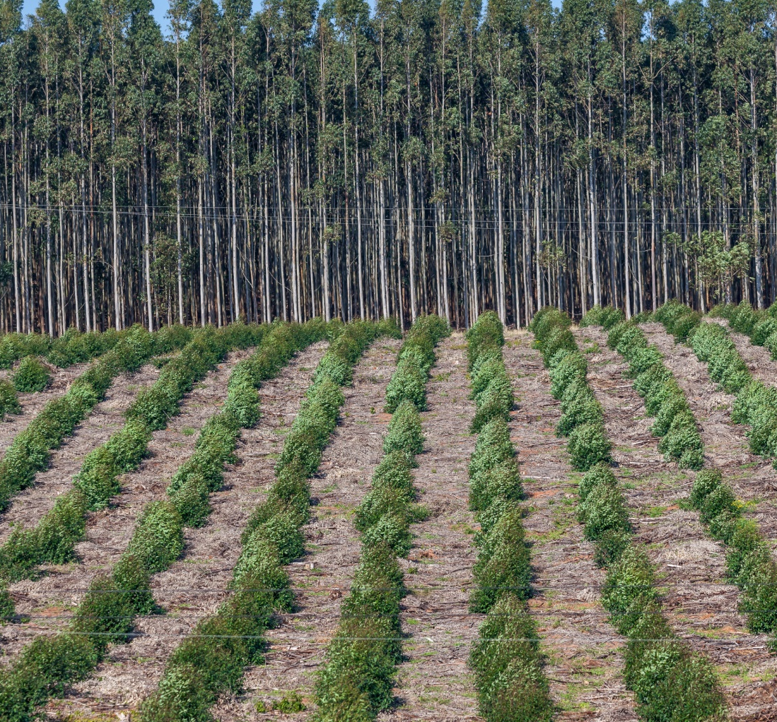
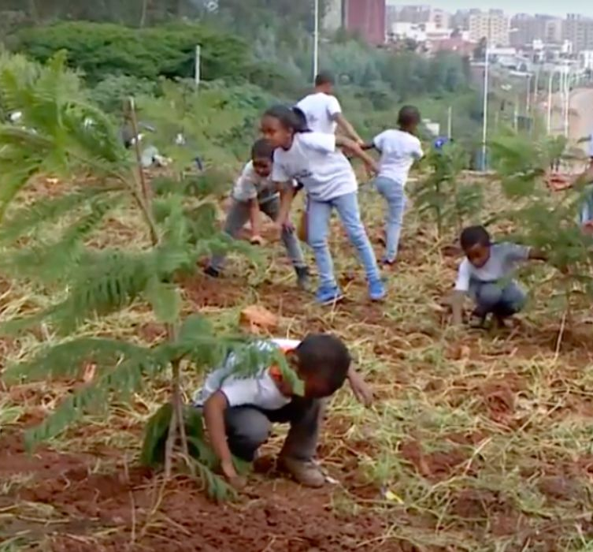
EcoWatch
Ethiopia Tree Planting Program
(KTLACreator: ChrisVanLennepPhoto | Credit: Getty Images/iStockphoto)
Tree Planting Program in Ethiopia

Slide 18
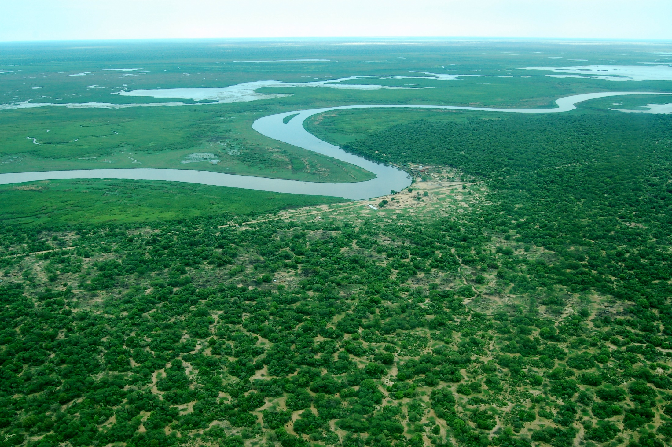
Importance of Wetlands in Regional Hydrology: The Sudd in the Nile Basin
E > H

Slide 19
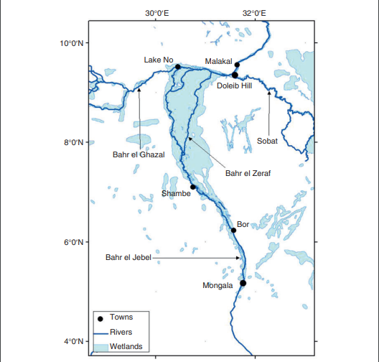
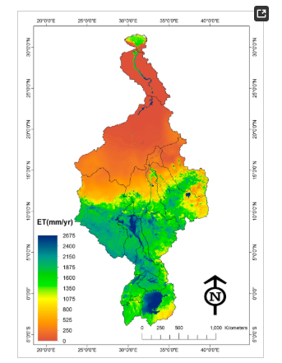
Wetlands in the Nile Basin – The Sudd
Robelo and El-Mogharaby. 2016. The Sudd. Springer Science+Business Media Dordrecht 2016 C.M. Finlayson et al. (eds.), The Wetland Book, DOI 10.1007/978-94-007-6173-5_23-5
Earth Observation Based Assessment of the Water Production and Water Consumption of Nile Basin Agro-Ecosystems
by Wim G.M. Bastiaanssen ^{1,2,3,*},Poolad Karimi ^{1,2,3},Lisa-Maria Rebelo ¹,Zheng Duan ³,Gabriel Senay ⁴,Lal Muthuwatte ¹ andVladimir Smakhtin ¹ , Remote Sensing MDPI

Slide 20

NBI launches wetlands project and forum to protect wetlands in the Nile Basin
The Nile Basin Initiative (NBI) Secretariat on 15th July 2016 launched the Nile Basin Trans-boundary Wetlands Project and the inaugural Nile Basin Wetlands Forum.
The goal of the Euro 6 million project is to strengthen the technical and institutional capacities of the NBI and its 10 Member States for sustainable management of wetlands and wetlands of trans-boundary significance in the Nile Basin.
The launch ceremony held in Entebbe, Uganda

Slide 21

Summary
Water, wetlands and forests modulate climate change and desertification
Restore and preserve wetlands, water bodies and forests
Photograph: Wossenu Abtew

