Slide 1
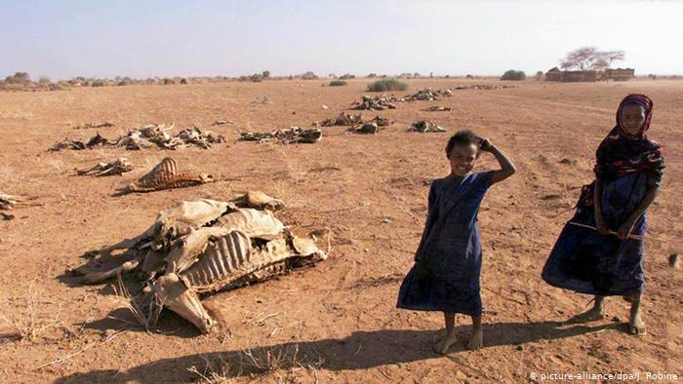
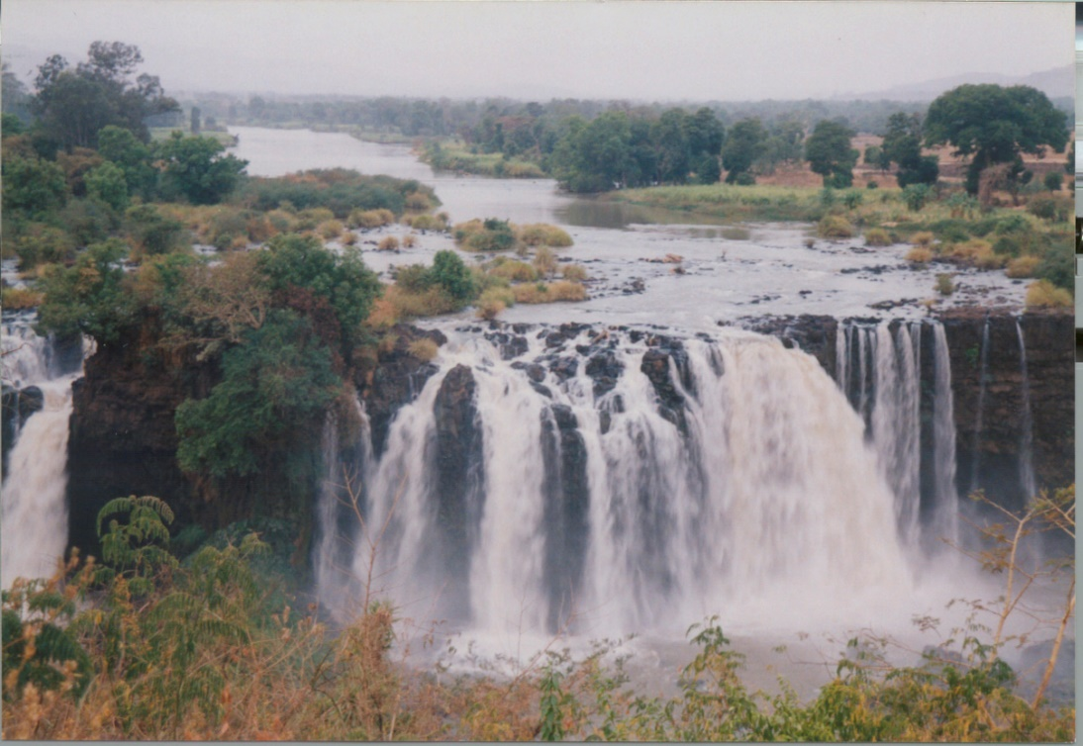
Global Water Condition
and Transboundary Rivers
The Nile River Basin
Wossenu Abtew, Ph.D., P.E., D.WRE
Principal Civil Engineer
Water and Environment Consulting LLC
Affiliate Faculty, Florida International University
2020 International Conference on the Nile and Grand Ethiopian Renaissance Dam: Science, Conflict Resolution and Cooperation
Keynote speech
August 20-21, 2020

Slide 2
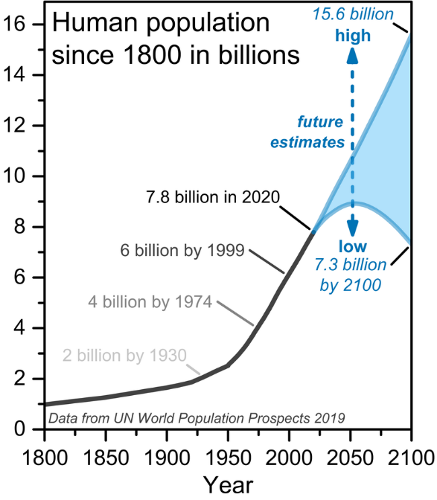
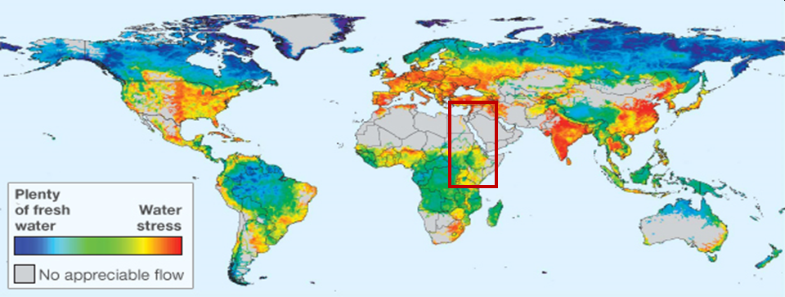
Population, Water Demand, Water Value Keeps on Increasing
“By 2030 water shortfall will reach 40%.”
World Economic Forum. 2017. https://www.weforum.org/our-impact/closing-the-water-gap
The scramble for fresh water has started – Africa may be late to realize
Wikipedia
1.2 billion people face physical water scarcity
0.5 billion approaching scarcity
1.6 billion face economic water shortage
Pinterest.com

Slide 3
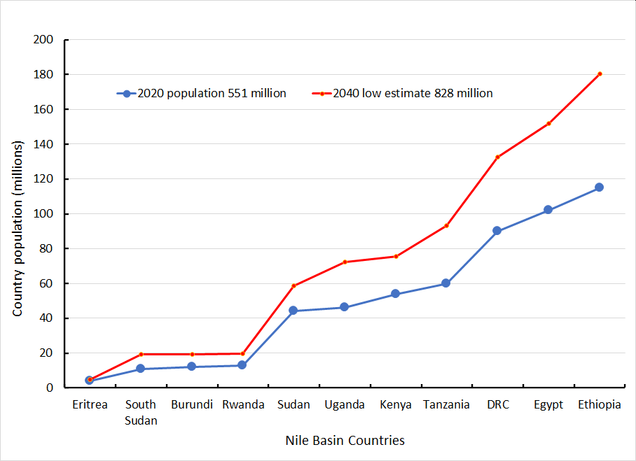
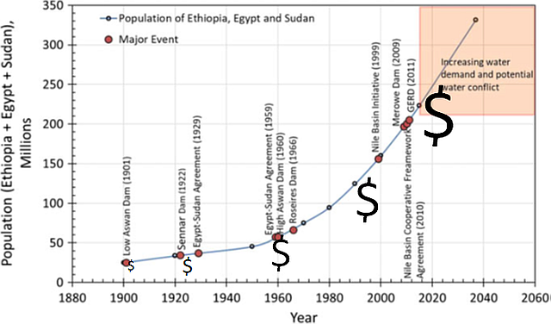
Eastern Nile Population Growth, Water Value and Water Conflict
The Price of Nile water has increased inviting
Out of basin water transfer/sale (direct or indirect); Egypt is feeding the Gulf
Political and economic bartering of water and internationalizing Nile water conflict
It is drawing speculators attention
Domestic political value of water keeps on increasing
The Nile flow will likely decrease
Nile Countries
Eastern Nile Countries
Abtew, W, Dessu S. 2018. The Grand Ethiopian Renaissance Dam on the Blue Nile River. Springer (https://www.springer.com/la/book/9783319970936)

Slide 4
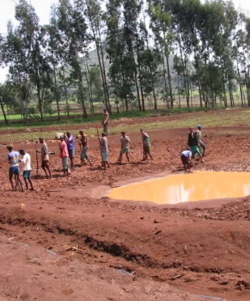

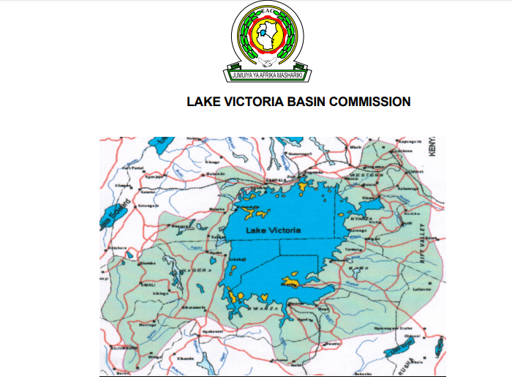
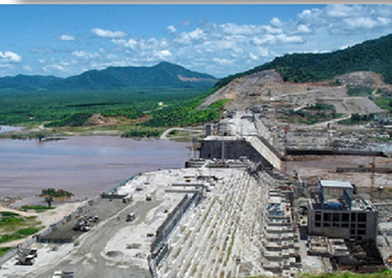
Upstream Water Right Affirmation - Institutional and Structural
Cooperative Framework Agreement

Slide 5
Downstream Upstream or Upstream Downstream Relationship Models for Transboundary Basins
UN Resolution of 1997 “Affirming the importance of international cooperation and good neighbourliness in this field”
Hostility
Cooperation
Undermine upstream security
Restrict sea access
Undermine upstream development by blocking fund etc.
Threaten militarily
Propaganda war
Diplomatic war
No water sharing
Race for water use expansion
Undermine upstream water needs
Stick to colonial treaties
Internationalize water use and water conflict
Fair water sharing agreement
Watershed management
Economic cooperation
Support economic development and access to diverse resources
Trust and data sharing
Peace among neighbors

Slide 6
GERD Negotiations
Are not about GERD Filling and Operation Plans?
The two Agendas – Water Share and Dam Filling/Operation
Egypt
Ethiopia
Secure current water share including water for potential beneficiaries out of the Nile Basin
Insert water share guarantee into GERD negotiations in an ingenious way
Make GERD a water supply reservoir
Achieve legally binding agreement that hinders
upstream water use
Fill GERD in a reasonably short period
Operate GERD to generate design power
Don’t want to loose right of water share for consumptive use by signing legally binding agreement
Will not sign until its water use right is respected

Slide 7
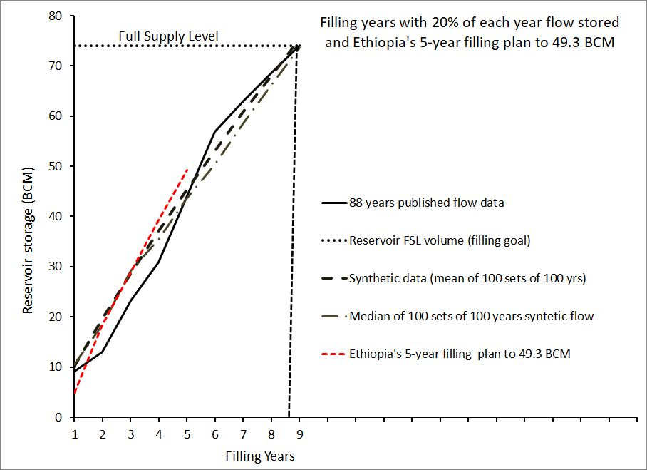
GERD Filling Plans and implication to Ethiopia’s Water Share (Does Ethiopia has 20% Water Share from its River?)
Abtew, W, Dessu S. 2018. The Grand Ethiopian Renaissance Dam on the Blue Nile River: Springer (https://www.springer.com/la/book/9783319970936)

Slide 8

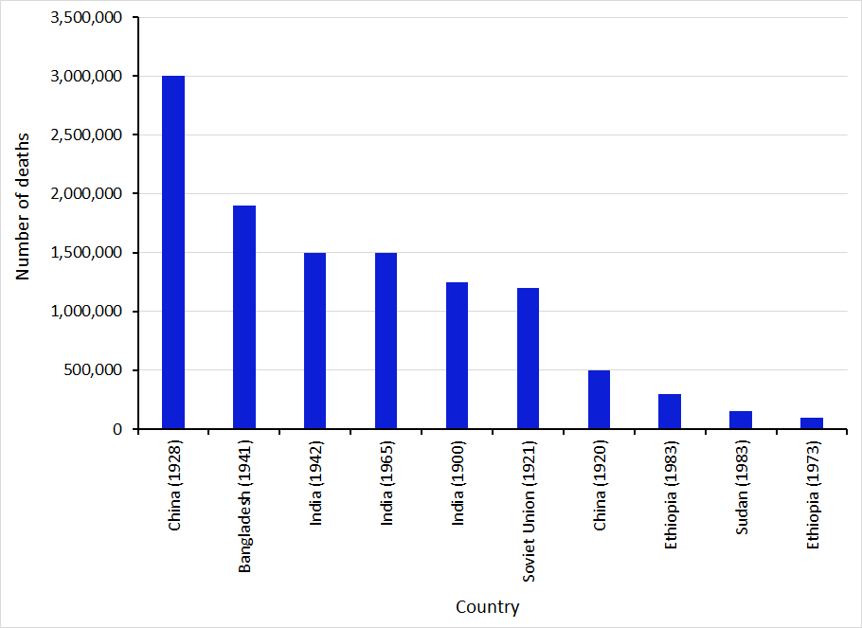
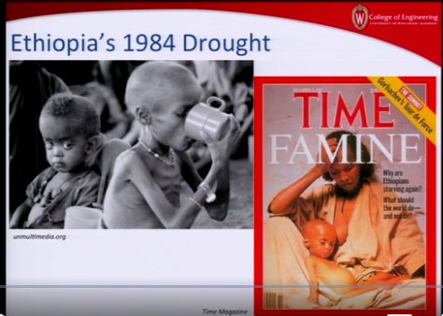
USA and Mexico Colorado Water Agreement During Drought
GERD Negotiations and the Question of Drought and Downstream Dams
Food insecurity in Ethiopia
70% of its water is in the Nile Basin
(Source: World Economic Forum)

Slide 9
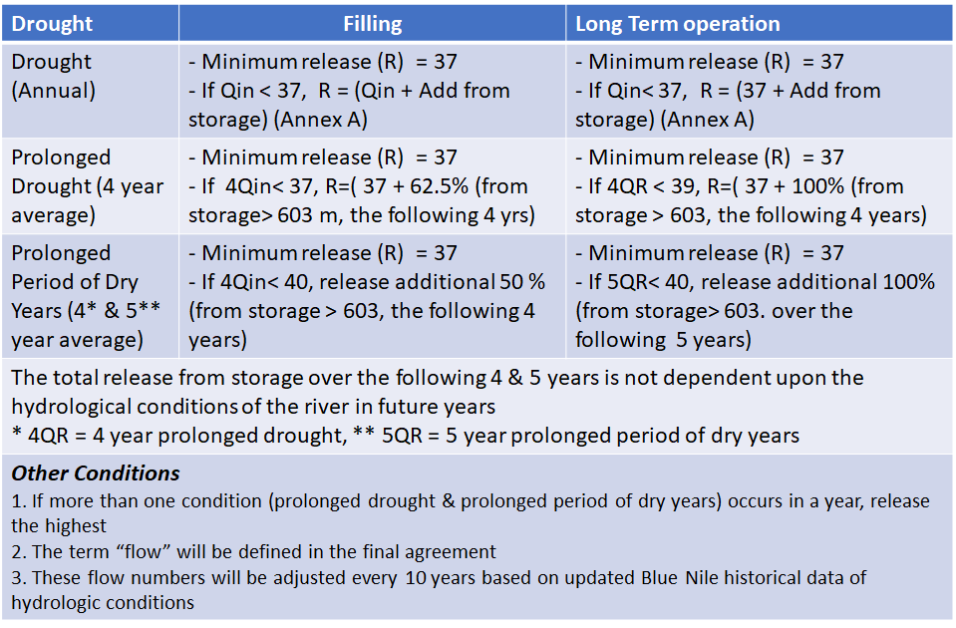
GERD Negotiations – Washington DC, The Numbers Game, How much is left for Ethiopia
Egypt
Ethiopia
Fill GERD in a reasonably short period
Operate GERD to generate design power
Don’t want to loose future right of water share for consumptive use and hydropower
No legally binding agreement
Secure current water share
Inserts water share into GERD negotiations
Achieve legally binding agreement swiftly

Slide 10
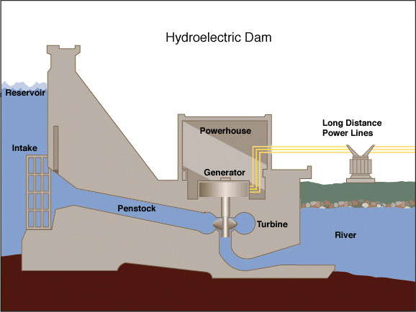
Dam Operation for Hydropower Generation with Downstream Constraint (Drought, Prolonged Drought, Prolonged Period of Dry Years) without Cooperation
US Energy Information Administration
Abtew, W, Dessu S. 2018. The Grand Ethiopian Renaissance Dam on the Blue Nile River:
Springer (https://www.springer.com/la/book/9783319970936)
Optimal power generation will be affected, refilling will create conflict

Slide 11
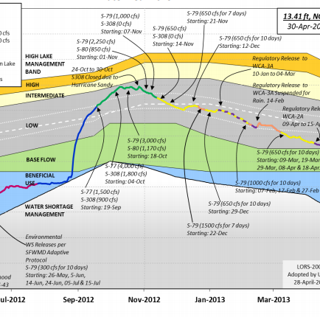
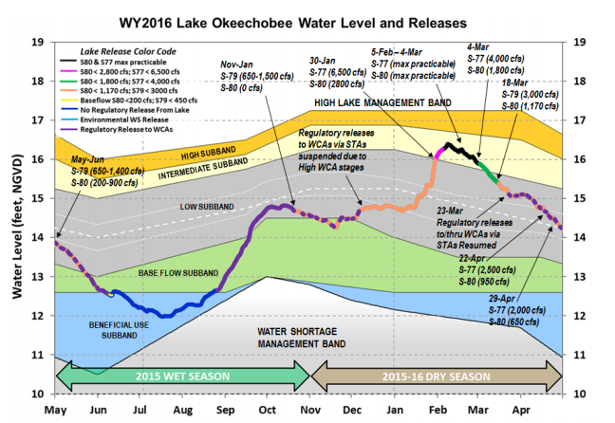
Treaty on Dam Operation?
What is the Rush?
Lake Okeechobee – An Earth Dam
Operation Schedule
Dam operation pan takes time to develop
Dam operation plan has to be flexible
Use short and long-term climate prediction
Incorporate dam safety
Be flexible for maintenance work
Deviations from regular operation have to be part of the plan
Needs periodic update
Wossenu Abtew and Violeta Ciuca. 2014, 2017 https://apps.sfwmd.gov/sfwmd/SFER/

Slide 12

GERD Negotiations – African Union Mediation
(COMMUNIQUE OF THE 2nd EXTRAORDINARY AFRICAN UNION (AU) BUREAU OF THE ASSEMBLY OF HEADS OF STATE AND GOVERNMENT
VIDEOTELECONFERENCE MEETING ON THE GRAND ETHIOPIAN RENAISSANCE DAM
(GERD) HELD ON 21 JULY 2020)
…. a binding Agreement on the Filling and Operation of the GERD, which should include a
Comprehensive Agreement on future developments on the Blue Nile River.
I can’t summarize Sudan’s position. Sudan is upstream and downstream of Nile water interests
Egypt
Ethiopia
Secure current water share
Inserts water guarantee into GERD negotiations
Achieve legally binding agreement swiftly
Fill GERD in a reasonably short period
Operate GERD to generate design power
Don’t want to loose future right of water share for consumptive use and hydropower
No legally binding agreement on dam operation

Slide 13


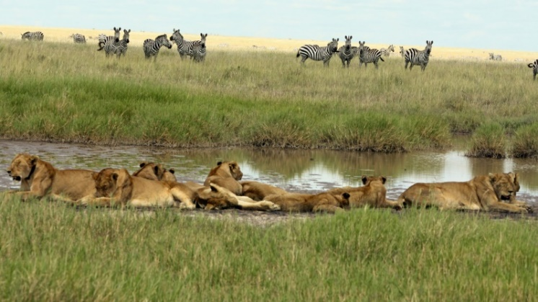
What is the Solution? Cooperation and Agreement or Join the Scramble for Water before it is too Late
Any draft agreement will benefit from independent review
Replace hostility with cooperation and separate GERD from water sharing
First, reach consensus on GERD filling plan
Then reach consensus on GERD operation plan subject to changes as dam operation, the climate, and other factors bring new challenges
Take sufficient time to reach basin water management and water sharing agreement based on percentage of prevailing flow and periodically reviewable agreements
Cooperation between riparian countries in all areas including access to the sea, economic, water sale, power sale, and climate change adaptation
Uniform water transfer right (Inter-basin, inter-country, inter-continental transfer of water share)
Collective ecological protection, watershed restoration/protection
Efficient water use and water management
https://www.africadreamsafaris.com/lemuta-hill-and-waterhole

