Slide 1
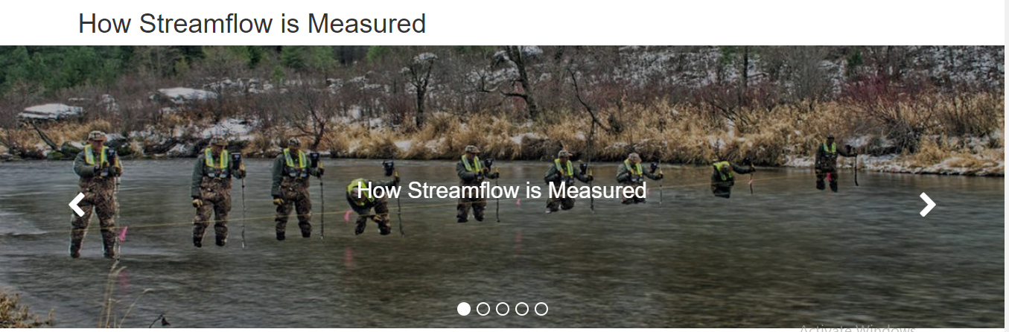
Wossenu Abtew, Ph.D., P.E., D.WRE
Principal Civil Engineer
Water and Environment Consulting LLC, Affiliate faculty, FIU
River Flow Monitoring and Data Quality for Equitable Nile Water Sharing
Wossenu Abtew, Semu Moges, Menberu Meles, and Muluneh Imru
Stream Gauging
USGS – Water Science School
2020 International Conference on the Nile and
Grand Ethiopian Renaissance Dam: Science,
Conflict Resolution and Cooperation
August 20-21, 2020

Slide 2
Importance of Flow Measurement and Quality of Data
Quality of flow data is not important when water is surplus
As water scarcity increases accurate flow measurement becomes more important
In water agreements clarity is needed on
  What set of flow data is used for reference or baseline
  Location of flow measurements
  Who does the measurement (staff training and staff integrity)
  How is flow measured?
A 5% error on Blue Nile flow is ±2.5 billion cubic meter
A 10% error is ±5 billion cubic meter
Flow monitoring and flow data could be a source of conflict

Slide 3
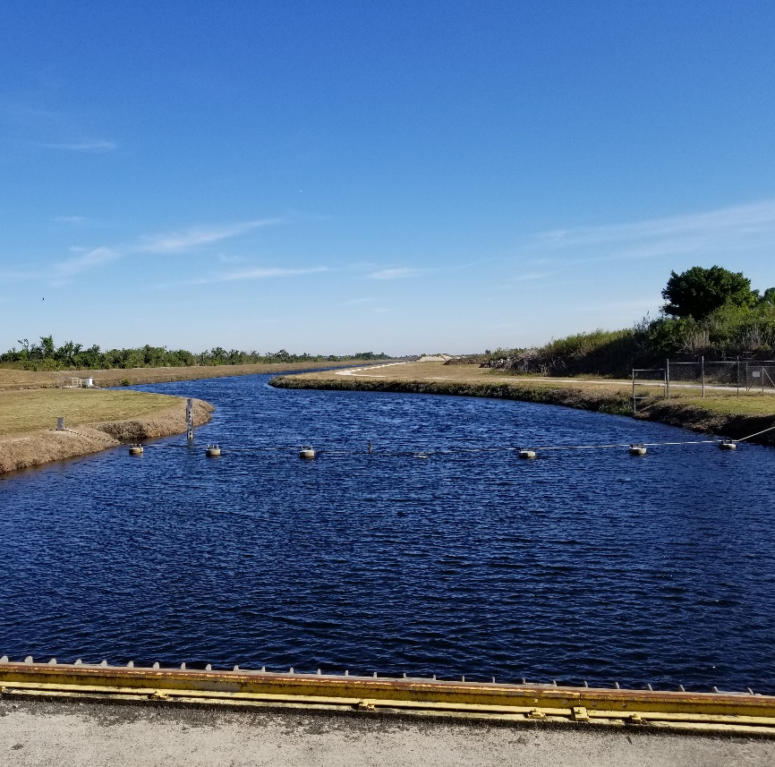
How Much is the River Flow?
Stream Gauging Process and Data Quality
Who does the stream gauging
Location of stream gauging
Method of stream gauging
Data acquisition
Data transmission
Data storage
Intentional Bias in data reporting
Photo: W. Abtew

Slide 4
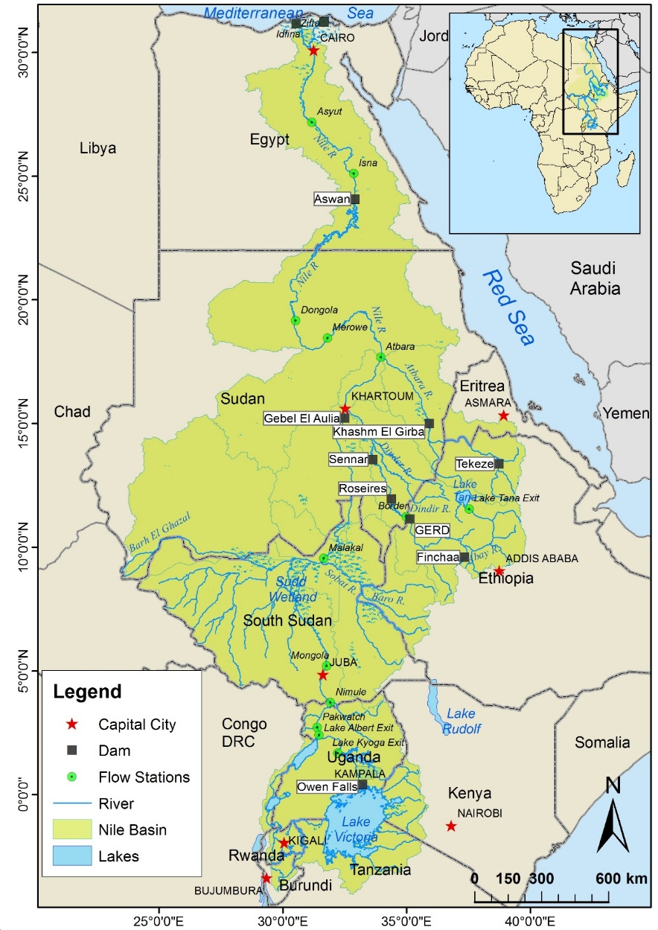
Nationalgeographic.com, August 3, 2020, Jon Heggie
Stream Flow Change with Time
The Colorado River flow has decreased by 19% since the 20th century average
Model predictions show 55% drop by 2100

Slide 5
Stream Flow Change with Time – The Need for Baseline Flow for Water Agreements
Blue Nile at El Diem
Period | Annual mean flow (BCM)
1965-1987 | 43.22
1990-1996 | 47.05
2002-2009 | 50.85
1999 - 2003 | 51.92
Nile at Dongola
Period | Annual mean flow (BCM)
1933-1972 | 85.4
1973-2012 | 70.01

Slide 6
Stream Flow Measurement Methods
Slope-Area Method
Stage-Discharge Method
Acoustic Doppler Current Profiler (ADCP)
Ultra Velocity Meter (UVM)
Radar Method

Slide 7
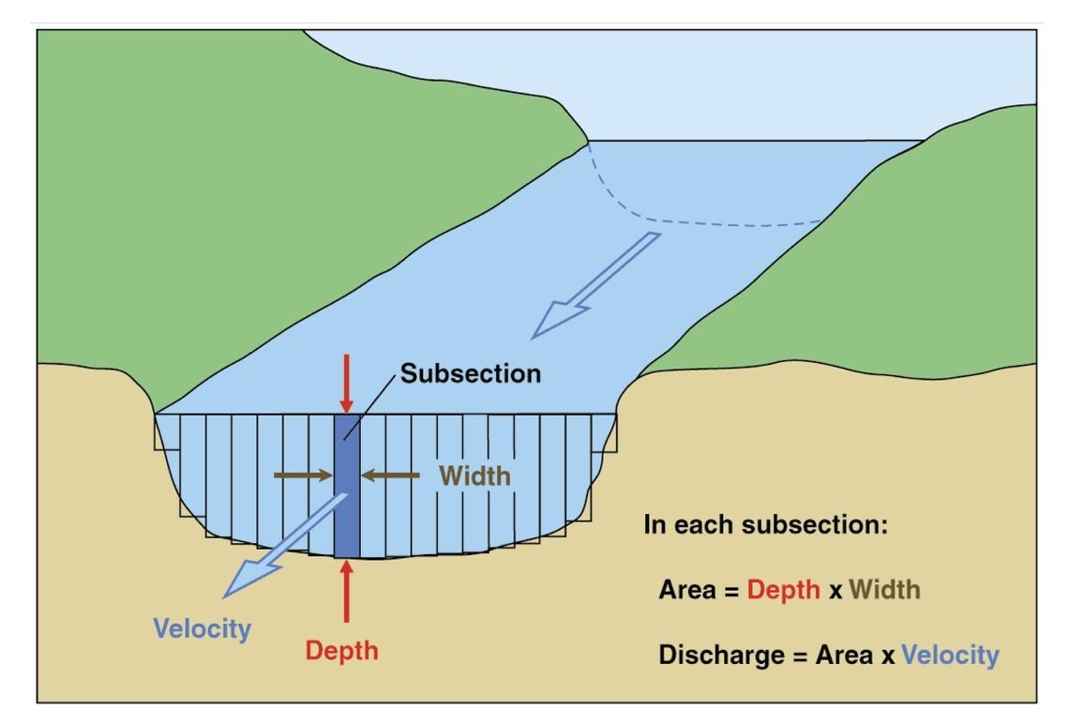
Stream Flow Measurement Methods

Slide 8
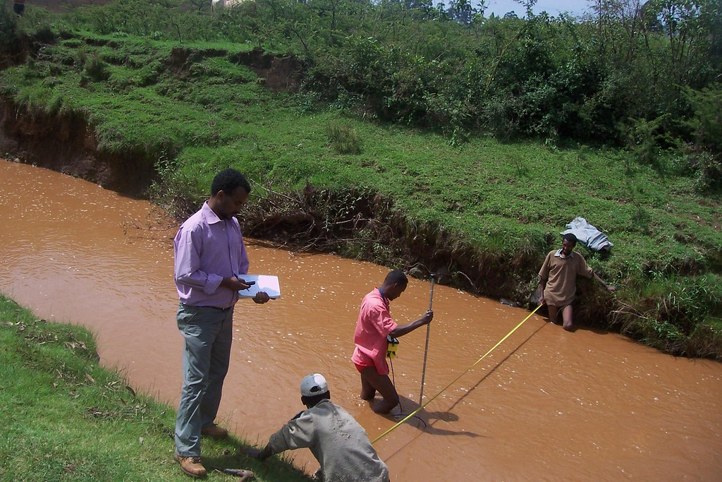
How much is the Flow? Stream Gauging in the Blue Nile Basin
This Photo by Unknown Author is licensed under CC BY-SA-NC

Slide 9
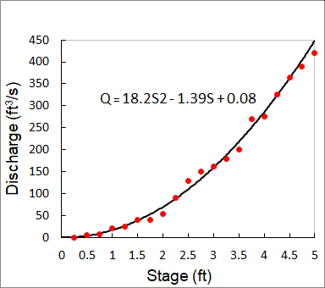
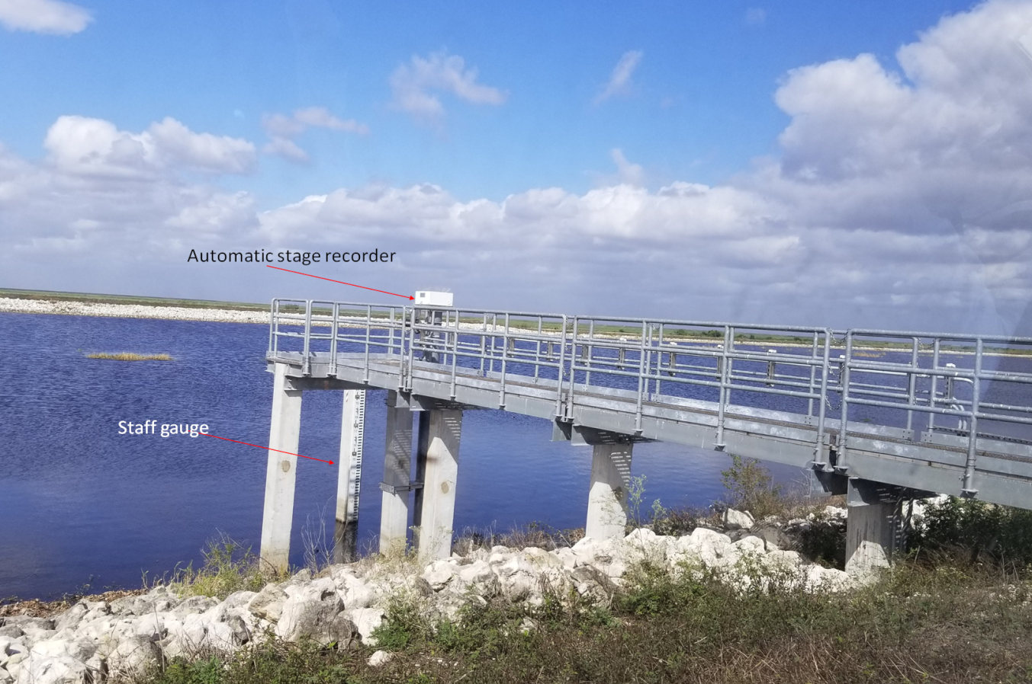

Flow Equation
Stream Flow Monitoring
$Q=A x Vmean$

Slide 10
Sources of Errors
Stream Flow Measurement and Sources of Errors
Stream gauging errors (depth, width, velocity measurement errors)
Stage-Discharge equation error
Stage observation, recording error
Change in stream cross-section error
Unaccounted inflows and outflows

Slide 11
Errors in Stage Measurement
Stream Stage Measurement and Sources of Errors
Staff Gauge observation, recording, transmission
Automated stage recorder malfunction

Slide 12
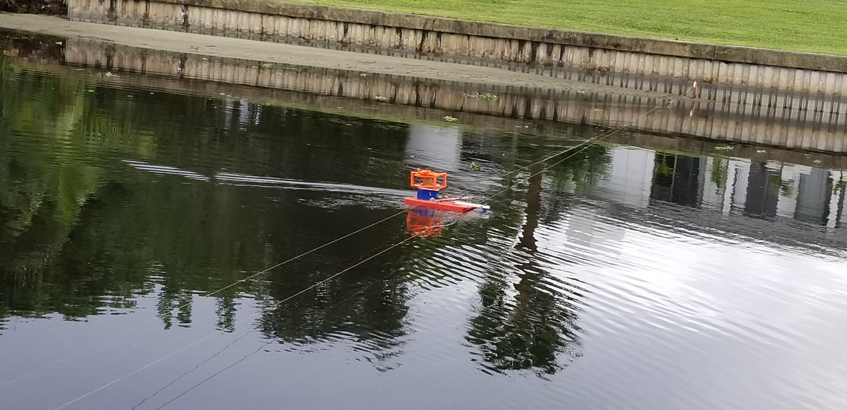
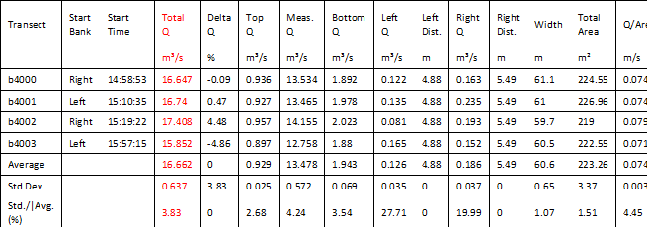
Acoustic Doppler Current Profiler (ADCP)

Slide 13
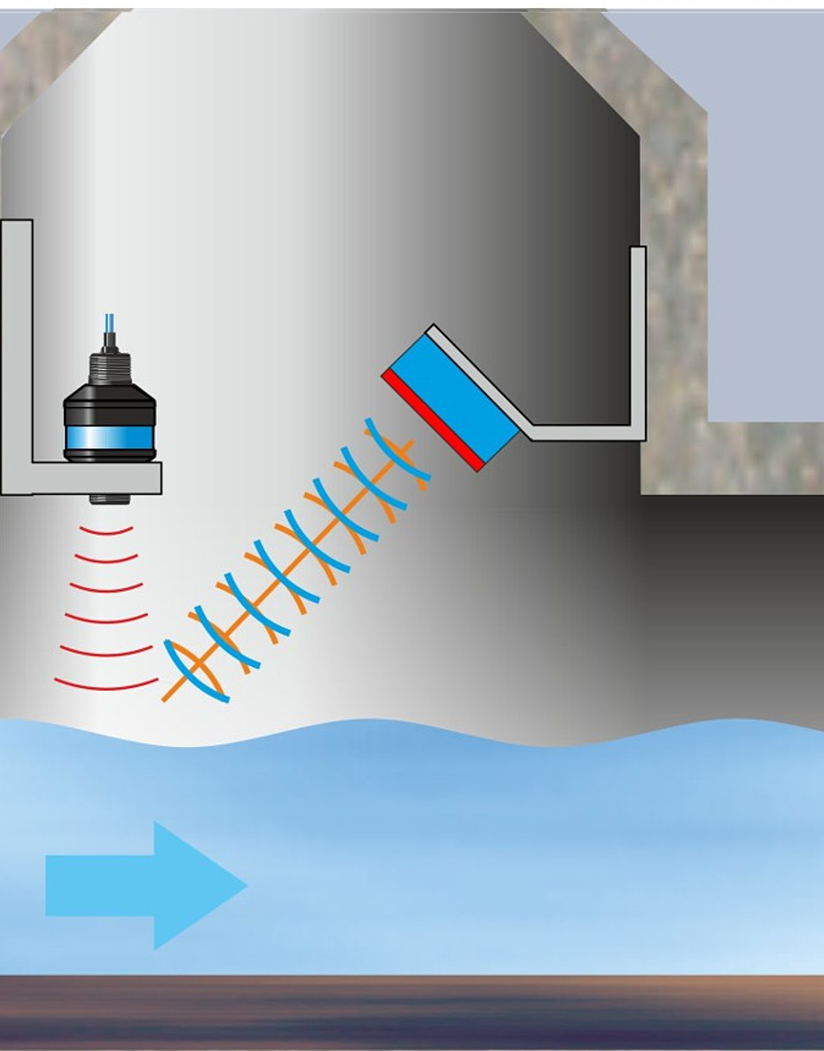
Radar – Noncontact Stream Flow Measurement
house instrumentation and provide power and telemetry
were located next to the field site, the stream gauge was
located between Portland, OR, and Seattle, Washington,
where field personnel were located, and the flow history of
the river indicated a high probability of floods during the
time of the experiment. The Cowlitz River at Castle Rock
drains about 5,800 km
Washington. The river is about 92 m wide and between 2 –
7 m deep at the measurement site.
surement of streamflow participated in the Cowlitz River
stream gauging station experiment: the USGS, the Applied
[
37] Three organizations interested in noncontact mea-
in the Cascade Mountains in central
Physics Laboratory of the University of Washington (UW),
and CODAR Ocean Sensors, Ltd. Table 2 describes the
radar systems deployed by each organization. All systems
were installed and operational for the period 28 October
2003 to 4 March 2004.
[
38] The RiverRad system was deployed with two dish
antennas, one pointing up river and one pointing down
river, separated by an angle of about 23. A RiverScat array
of eight microwave antennas was mounted under the
highway bridge over the Cowlitz River at the stream
gauging station about 100 m downstream from the bank-
2
operated cableway (Figure 7) [Plant et al., 2005b].
Figure 7. View under Cowlitz River bridge with four of eight RiverScat antennas visible and pointing
Wave formation on the water surface is the precondition
The sensor measures the waves’ movement and therefore the surface velocity of the water.
A single velocity is measured on the water surface. Model is used to convert to average velocity
An extra level sensor, for depth and cross-section area measurement is needed
Nivus.com

Slide 14
Accuracy of Stream Flow Data
A study of errors in individual streamflow measurement
cross-section (channel width and depth)
mean velocity (instrument error, pulsation
error, vertical velocity distribution, oblique flow,
stream turbulence)
Rating | Deviation from “True" flow
Excellent | 2%
Good | 5%
Fair | 8%
Poor | Greater or less than 8%

Slide 15
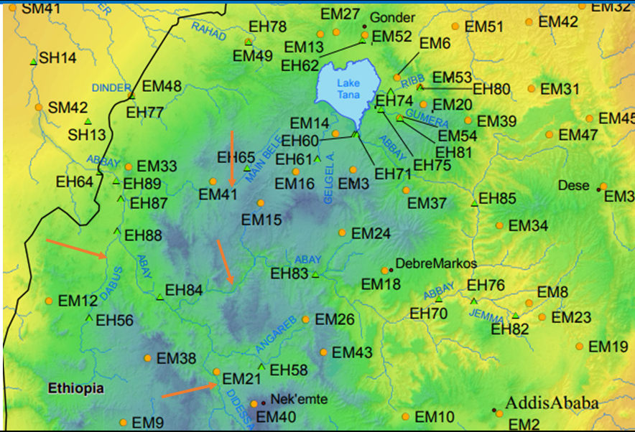
Blue Nile Basin and Surrounding Existing and Proposed Monitoring Network (green hydrometric and orange meteorological station) Riverside Technologies Inc 2010

Slide 16
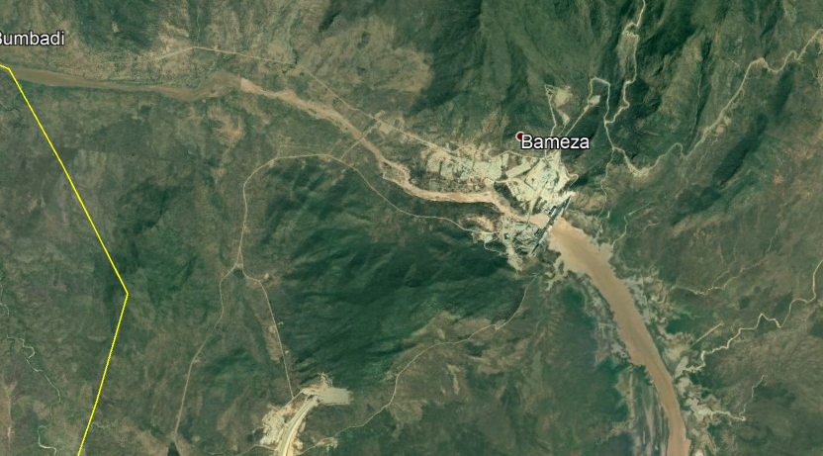
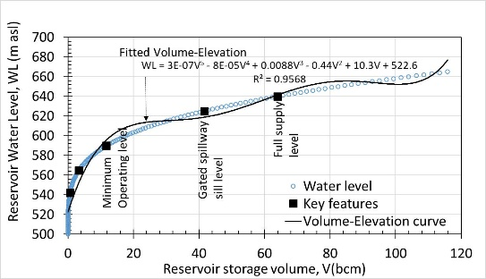
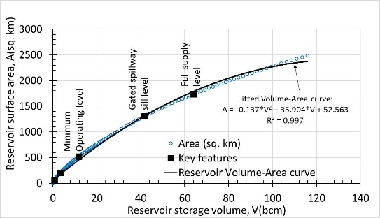
Outflow

Slide 17
Summary
Standardize flow measurement for good estimate of flow
Develop current baseline of flow at each reach of the Nile for water share agreement
Water share agreement should be based on percentage of current flow – agreement is for current and future generation (not the past)
Flow measurement integrity and data sharing is critical for water sharing
Flow data could be a source of conflict

