Slide 1


How UNESCO IHP, Regional and Local UNESCO Offices, Category 2 Centers and Chairs, Universities and Governments Work Together for Water Security
2018 Water and Environmental Security Conference
September 17-18, 2018
Florida International University, Miami, Florida
Will Logan
Director
International Center for Integrated Water Resources Management

Slide 2
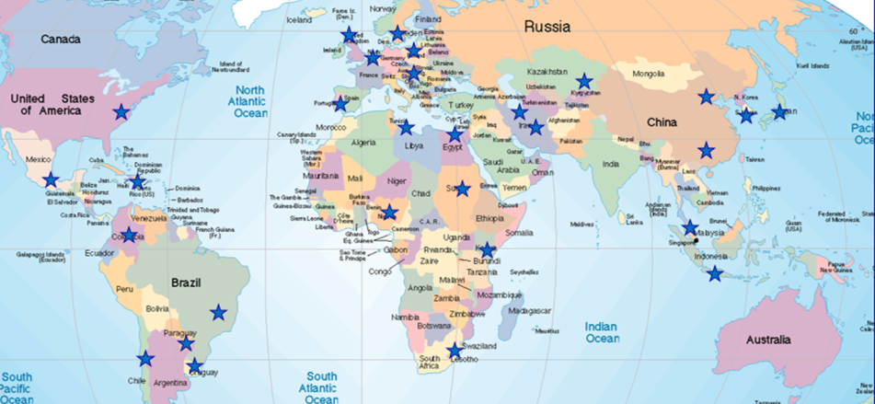
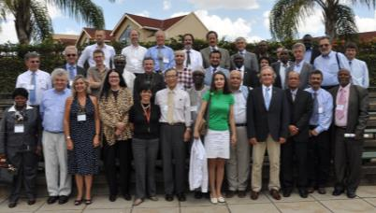
UNESCO-IHP’s
“Category 2 Center” Network
“Under the auspices of UNESCO”,
Provided and funded by Member States, and
Form a network to complement UNESCO’s programmes
Notes:
The centers are supposed to help UNESCO, not be a drain on its resources. The network provides openings to work with countries such as Iran and China.

Slide 3
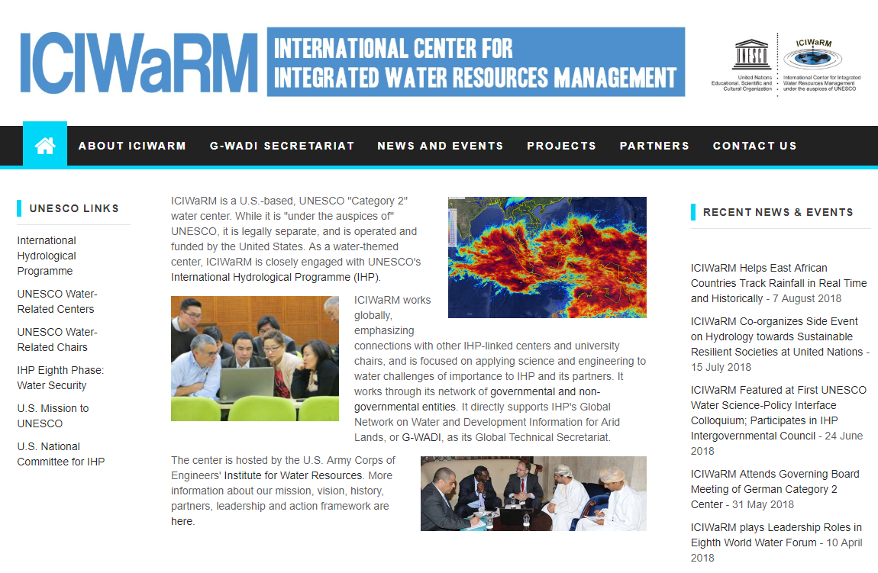
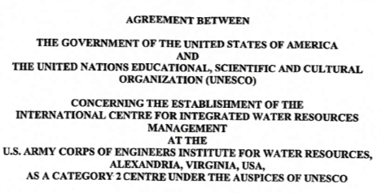

Slide 4
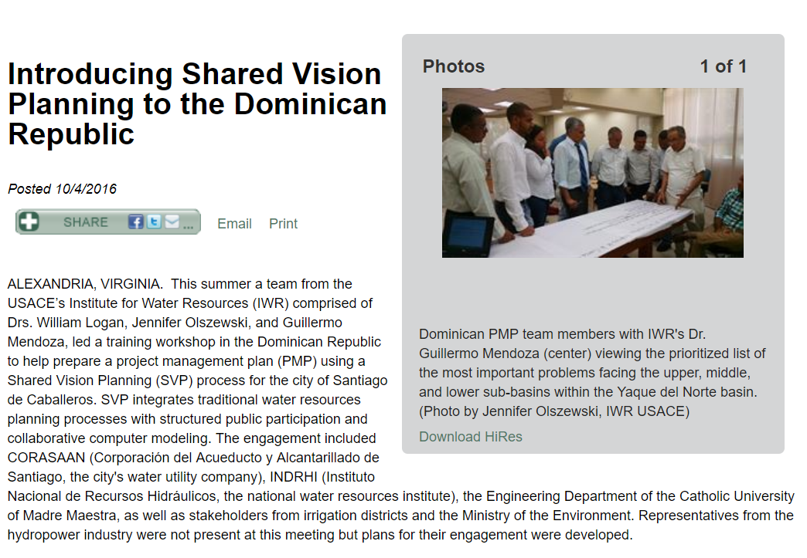
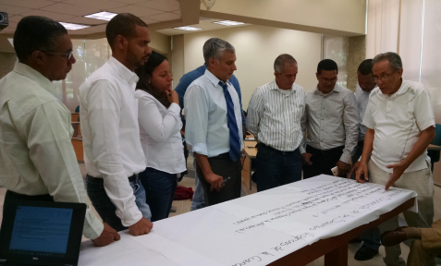

Slide 5

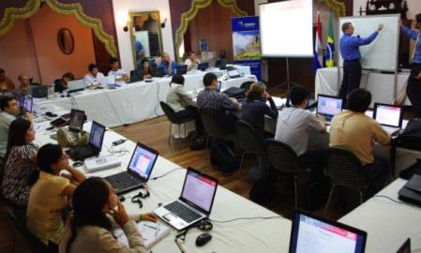
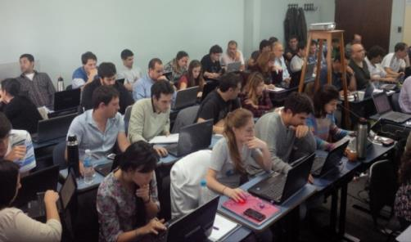
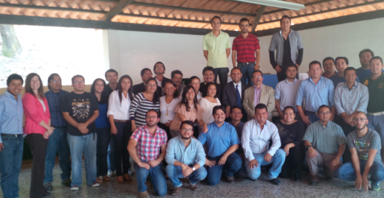
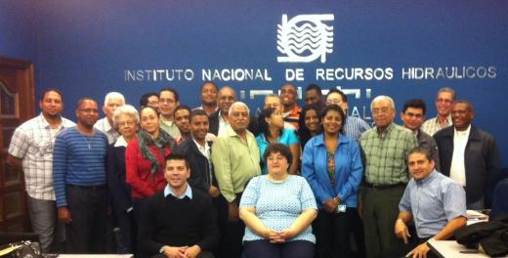
  Modeling courses: Hydrologic, hydraulic, reservoir simulation, ecohydrologic…

Slide 6

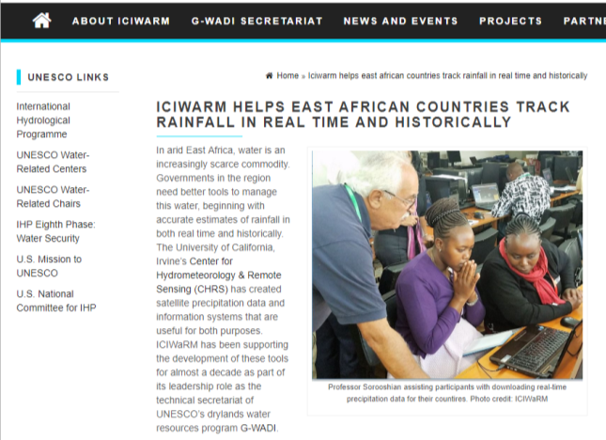
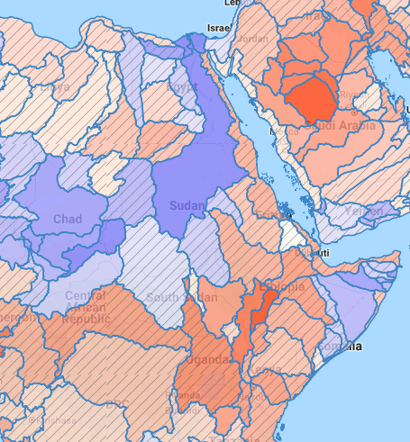
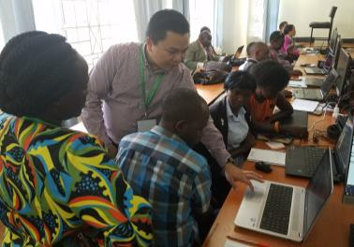


Slide 7
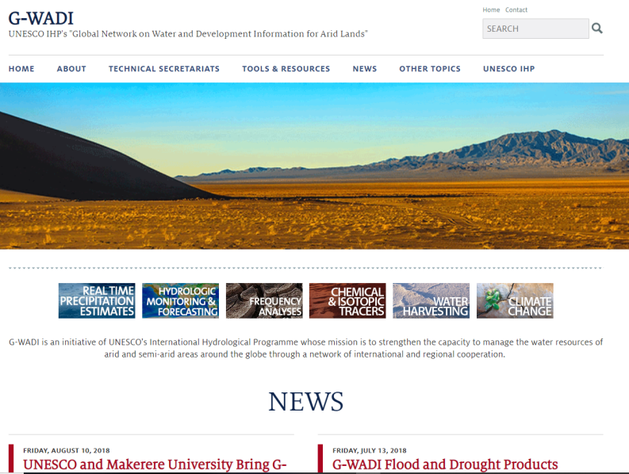
ICIWaRM is the Global Technical Secretariat of IHP’s Drylands Water Resources Program, G-WADI (www.gwadi.org)

Slide 8
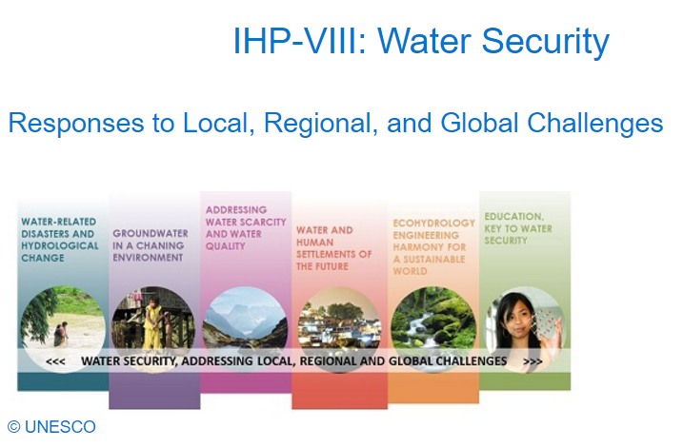
G-WADI

Slide 9
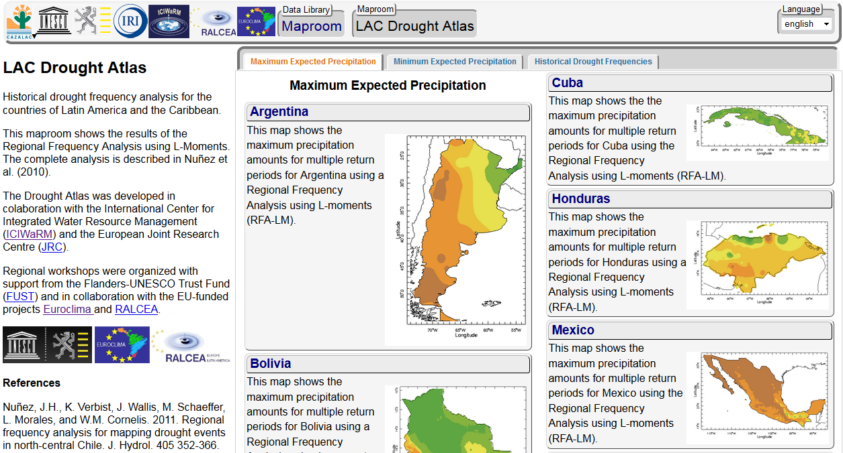
G-WADI LAC originally focused on Regional Frequency Analysis, and now Drought Monitoring and Forecasting
http://www.climatedatalibrary.cl/CAZALAC/maproom

Slide 10
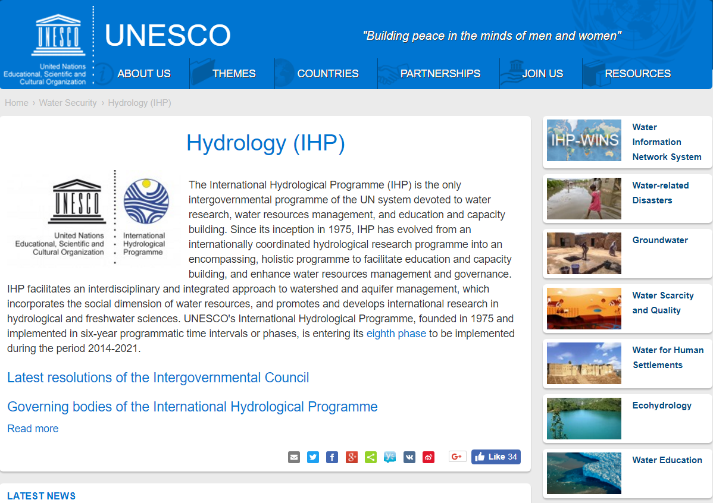
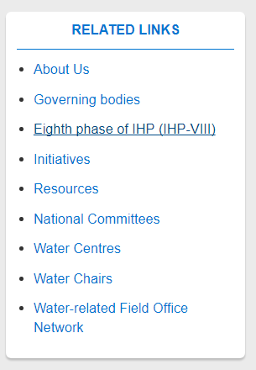
G-WADI Networks Derive from, and then Expand on, Existing UNESCO IHP Networks

Slide 11

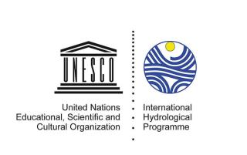
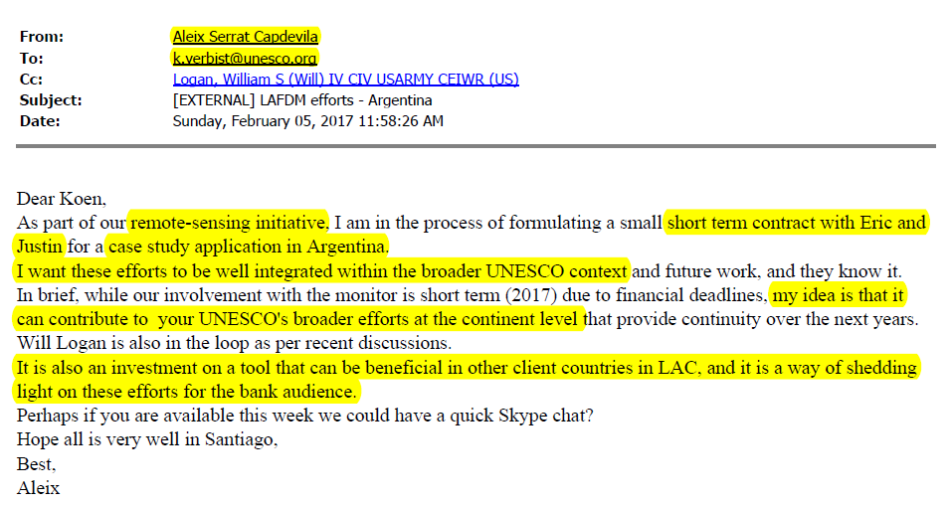

Slide 12
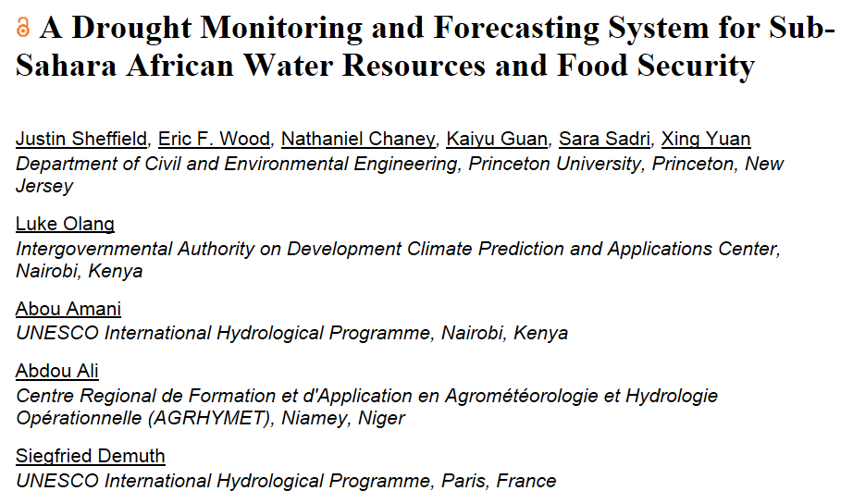
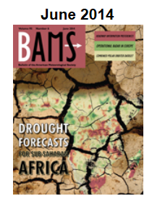
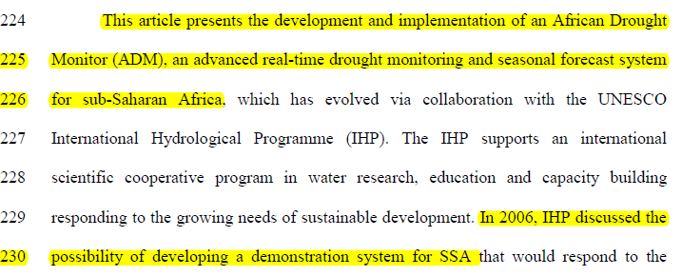
Stream. princeton. edu

Slide 13
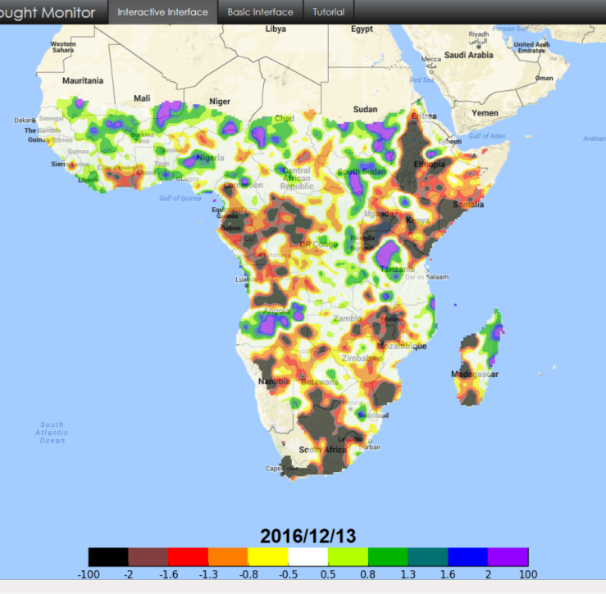
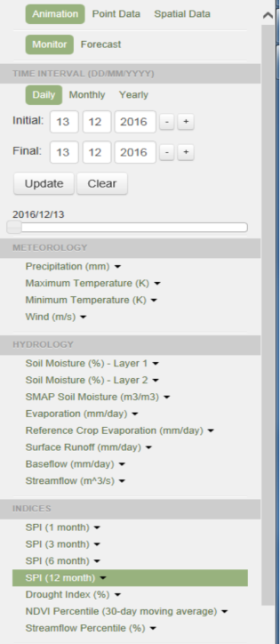
Workshops held in Niamey, Nairobi, Windhoek and Harare with collaboration and support from UNESCO regional and field offices, AGRHYMET, ICPAC, SADC, Govt of Namibia…

Slide 14
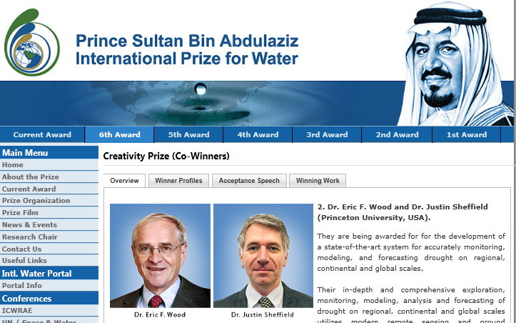
“We would also like to thank our collaborators…in particular…UNESCO International Hydrology Program [and] he International Center for Integrated Water Resources Management (ICIWaRM), with whom we have collaborated successfully …”

Slide 15
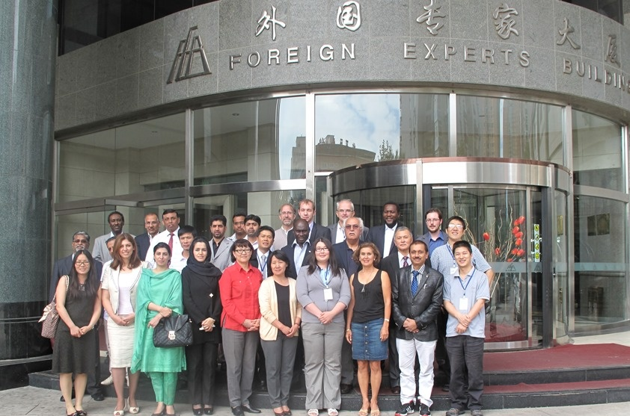
Connecting the G-WADI regional networks

Slide 16
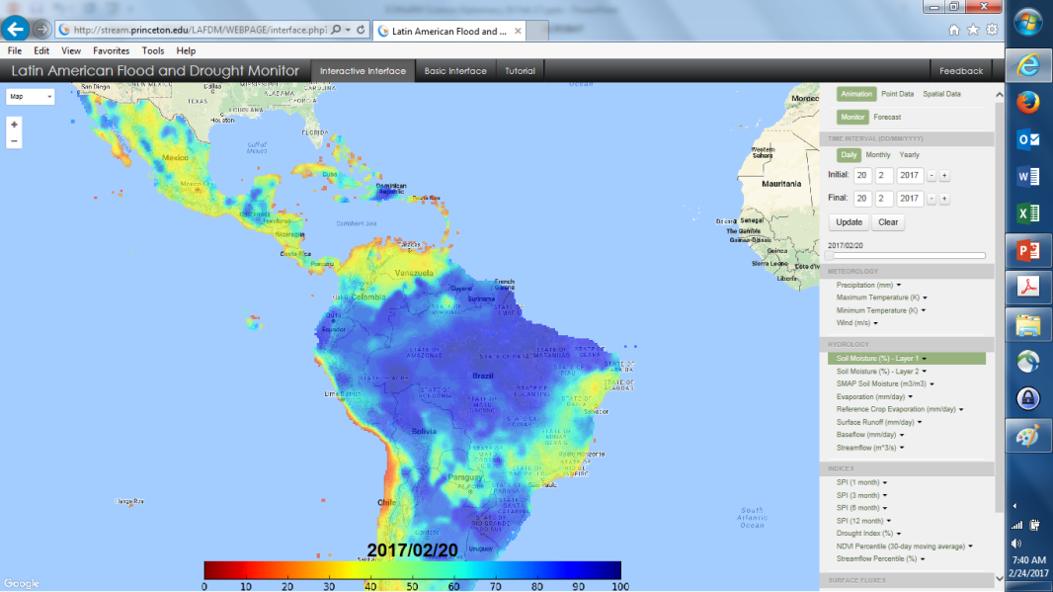
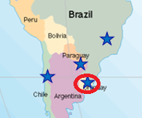

Slide 17
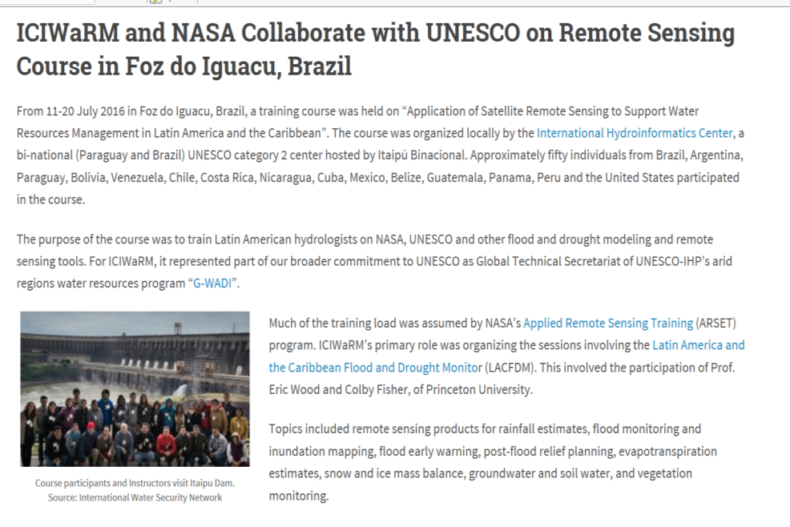
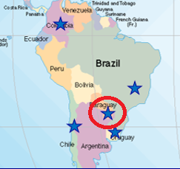

Slide 18
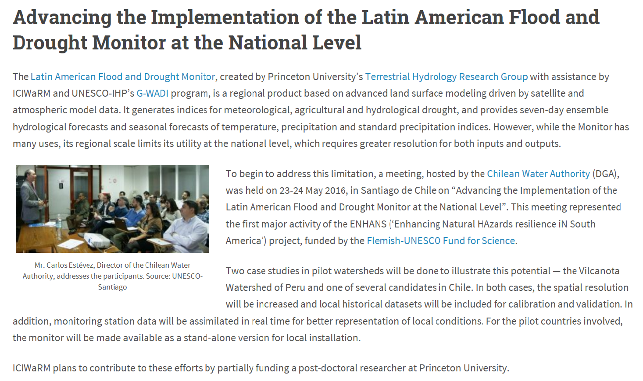
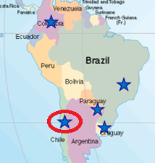

Slide 19
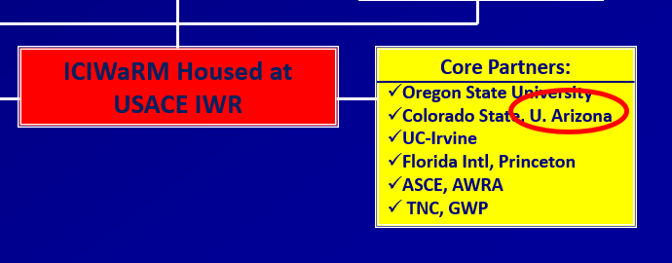
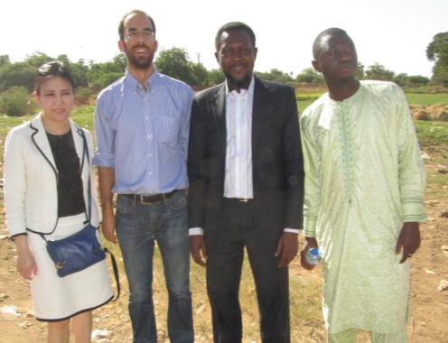
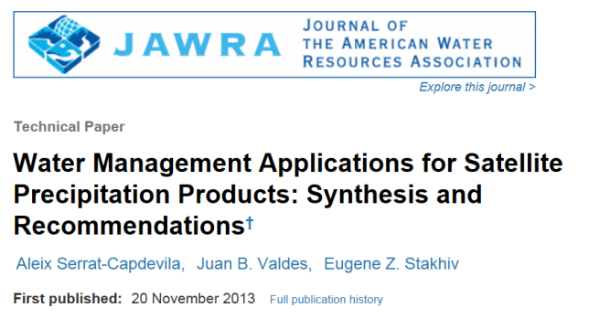

Slide 21
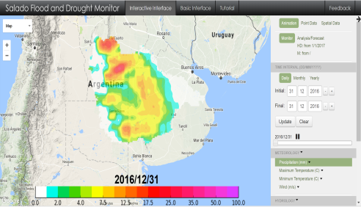
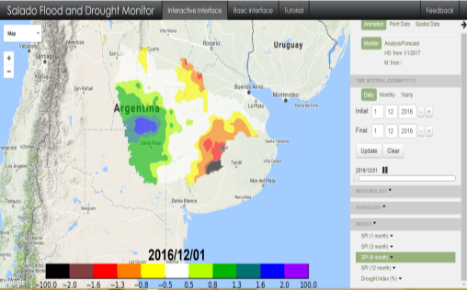

Regional 5km FDM for the Rio Salado, Argentina
Precipitation from MSWEP
SPI-based Drought Index

Slide 22
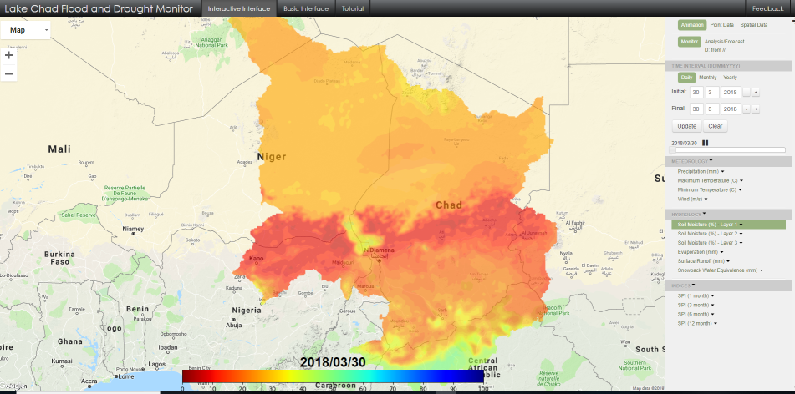
Regional 5km FDM for the Lake Chad basin, in collaboration with UNESCO

Slide 23

End of Story(?) It involved…
UNESCO IHP Paris;
at least 7 UNESCO regional and country offices in Africa, Asia and LAC,
at least 3 category 2 centers and the four G-WADI secretariats (global, Asia, LAC, Africa),
a collection of universities in the US, Chile, China...,
Engagement of the Flemish, the Swedes, the US, Argentina & the World Bank.
→ One can’t do this alone…

Slide 24
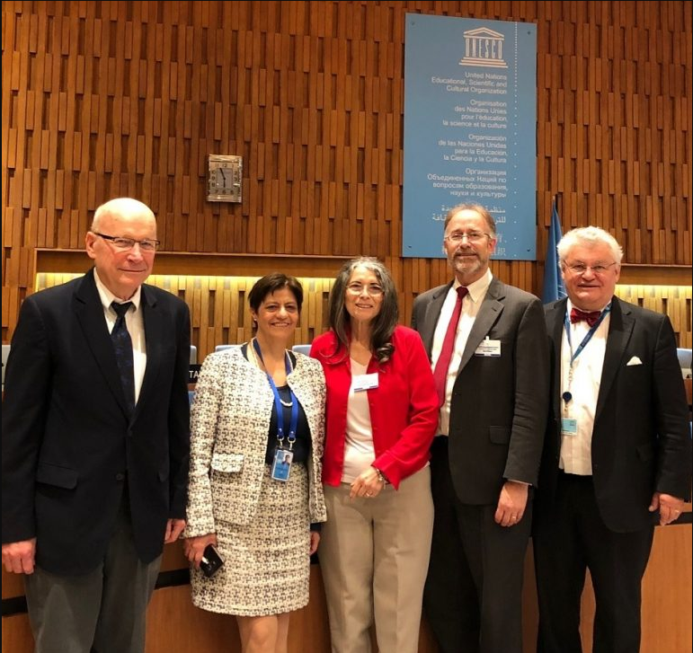
We need FIU

