Slide 1


  Impact of Water Education Programs in Water Security in the Dominicnan Repubic.
Silvio Carrasco
Director
Water Education Unit PUCMM

Slide 2
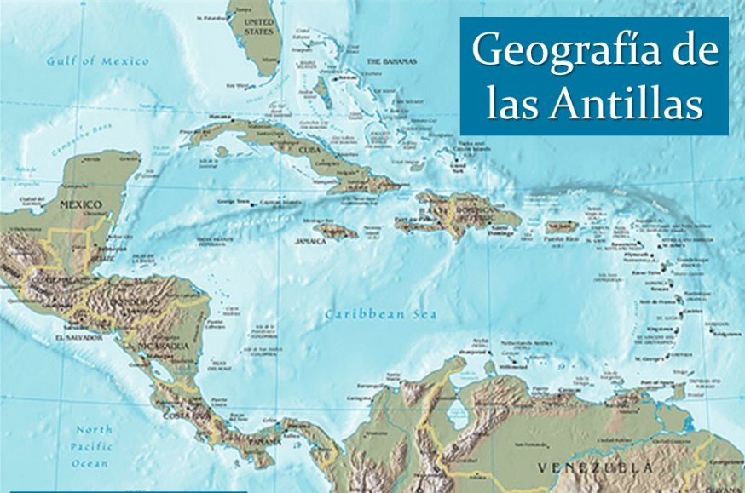

CARIBEAN ISLANDS RAINFALL GLOBAL SOURCES
TRADE WINDS
TROPICAL STORMS

Slide 3
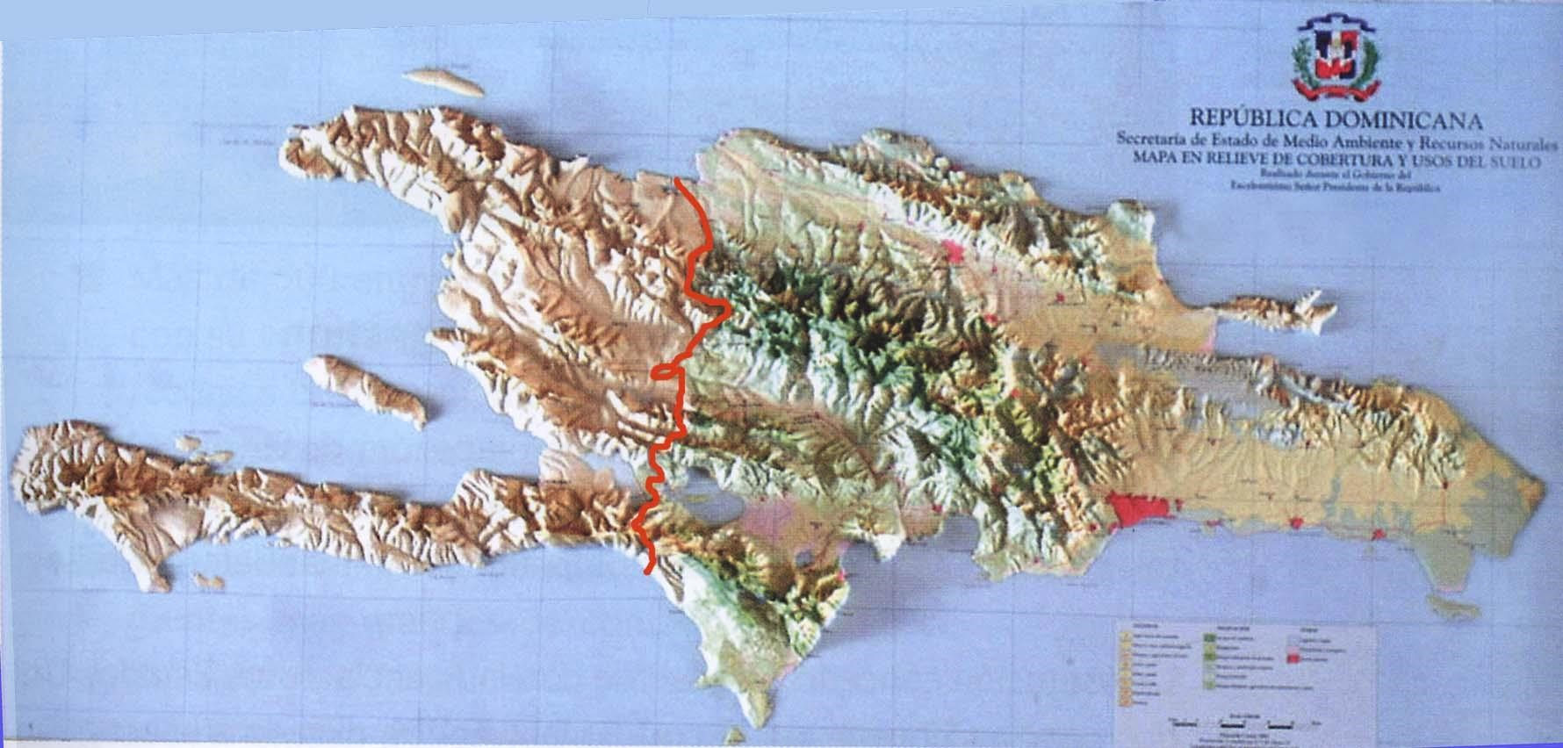
OROGRAPHIC MAP OF THE HISPANIOLA ISLAND

Slide 4
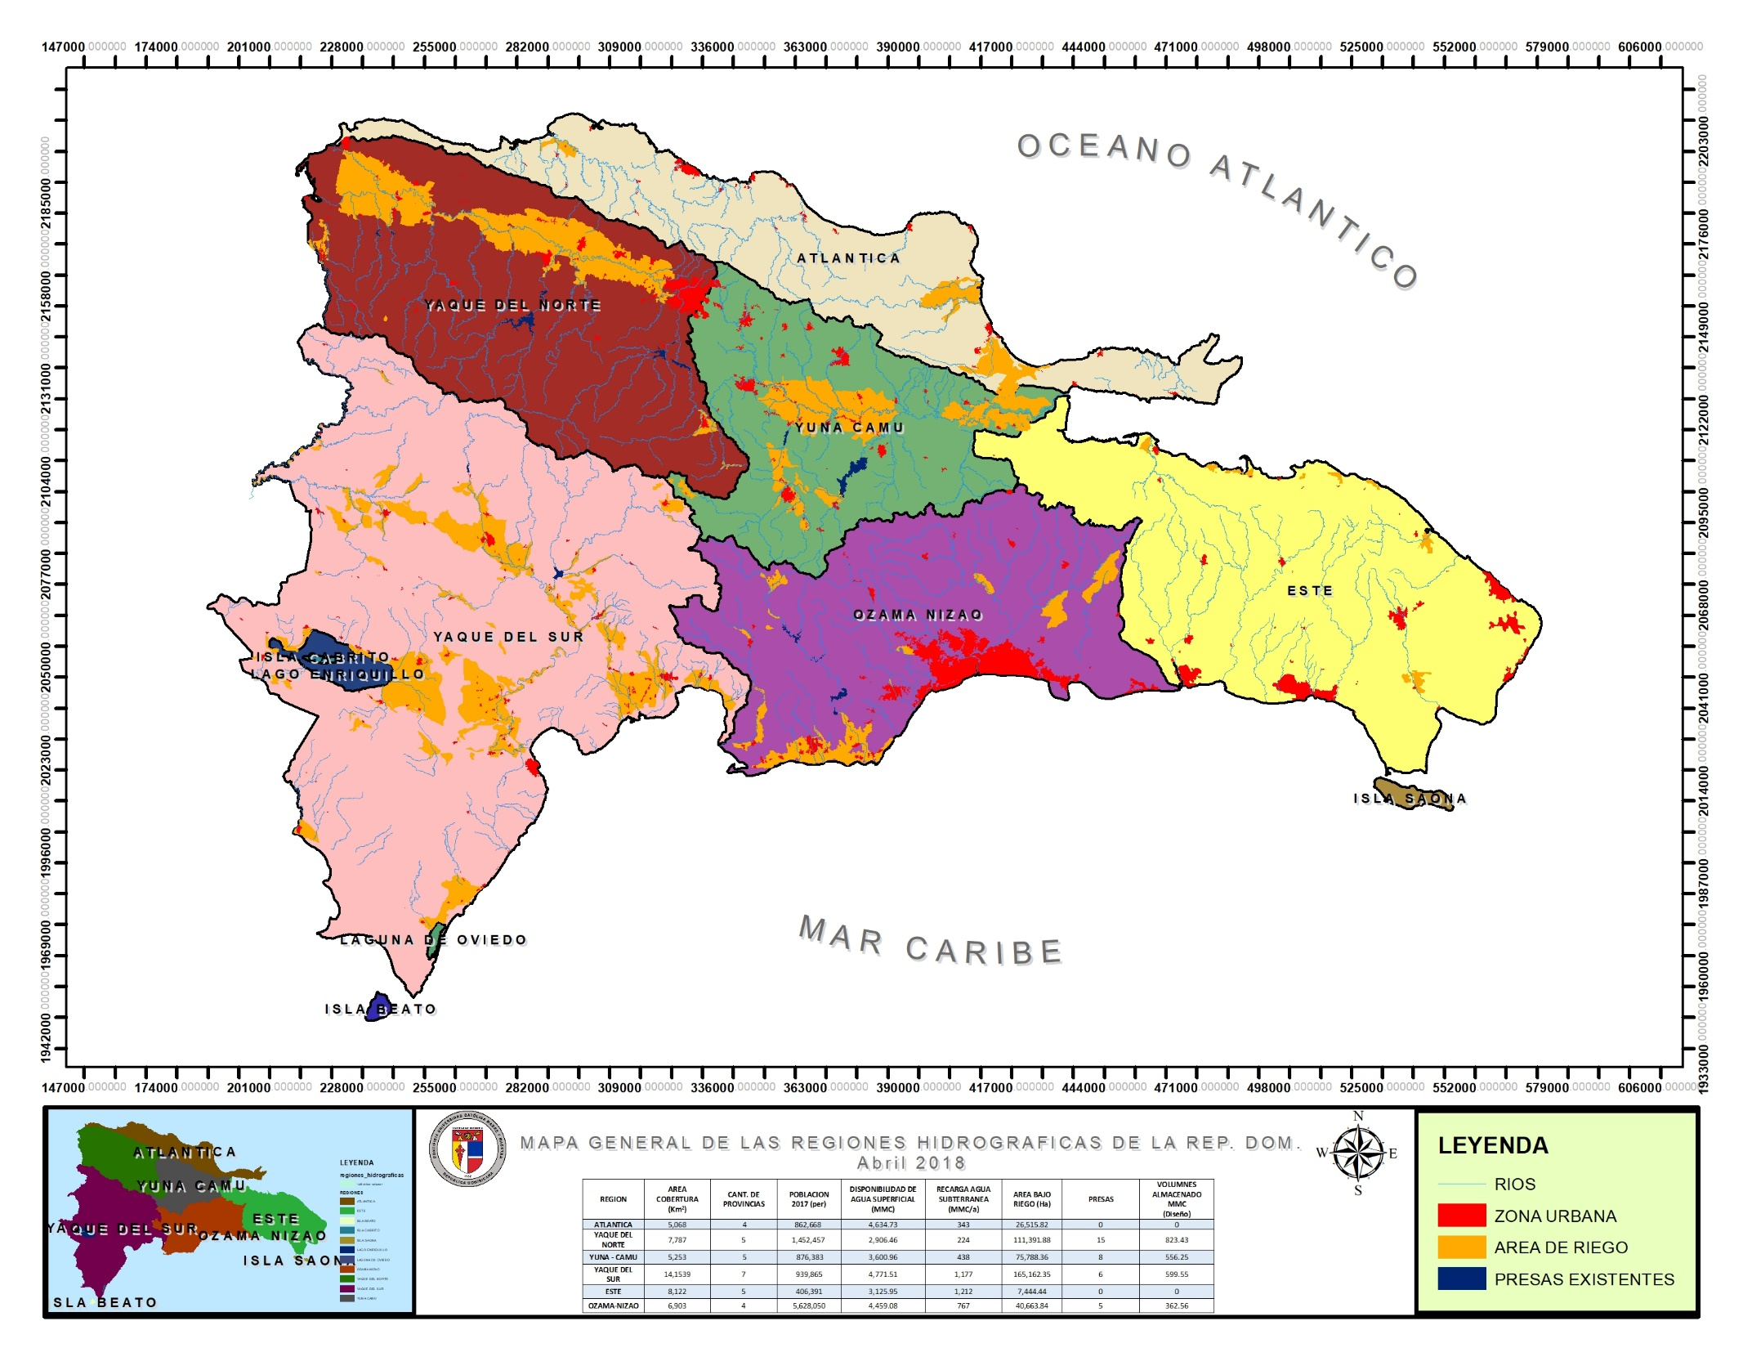
HYDROLOGICAL REGIONAL DIVISION OF THE REPÚBLICA DOMINICANA

Slide 5
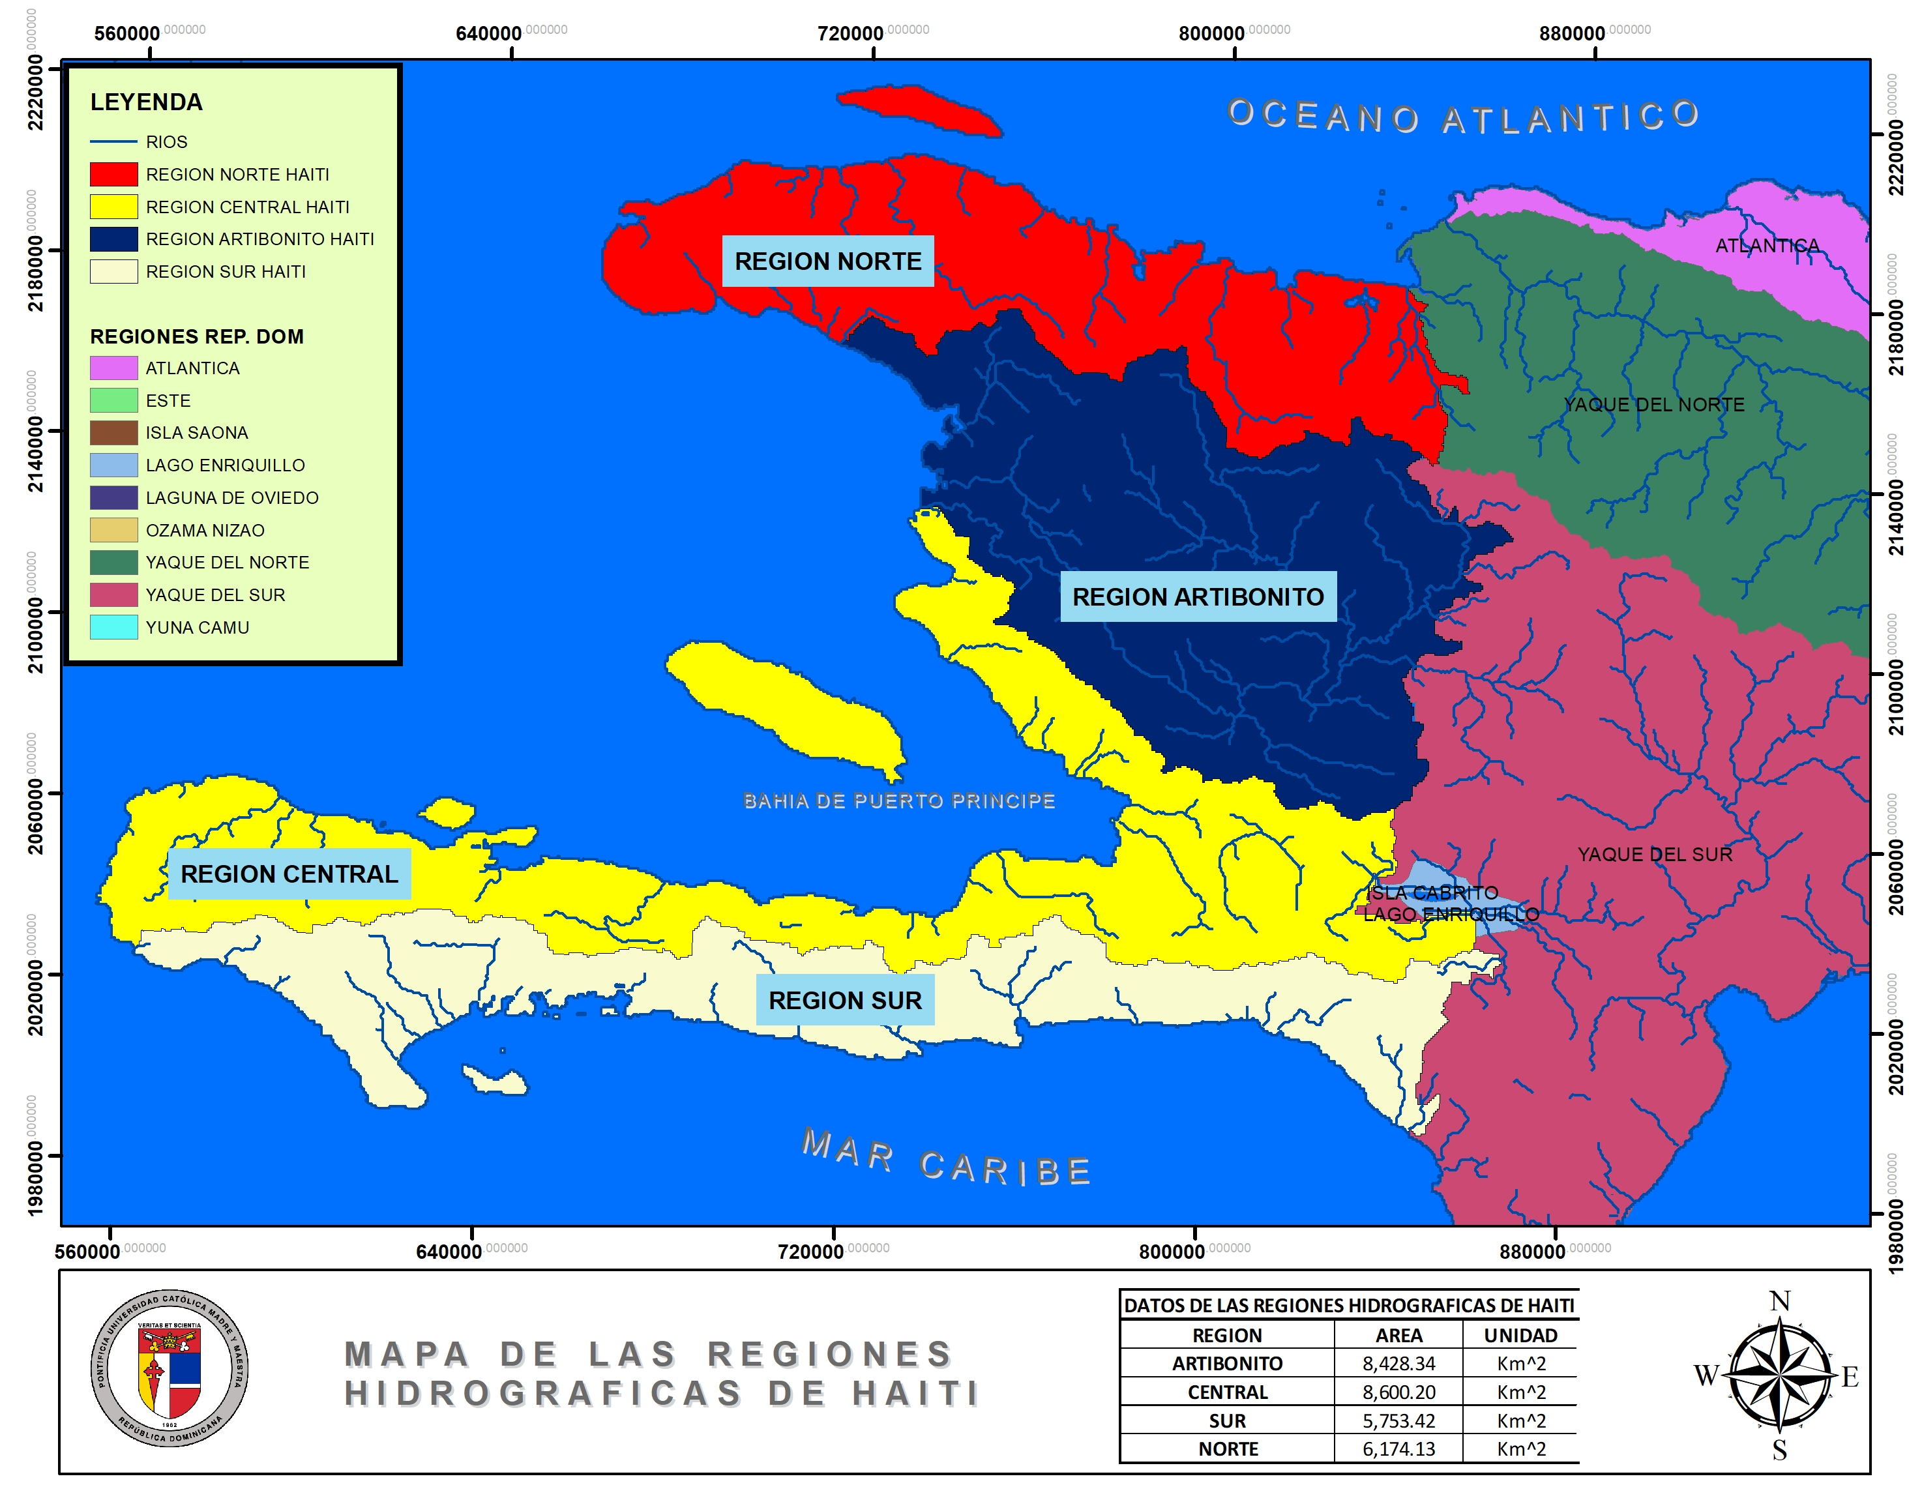
MAIN HIDROLOGICAL DIVISION OF HAITI

Slide 6
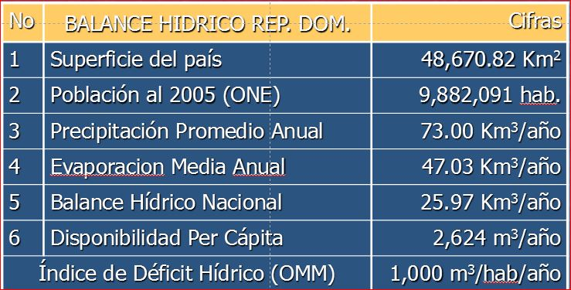
ESTIMATED WATER STRESS IN THE DOMINICAN REPUPLIC

Slide 7
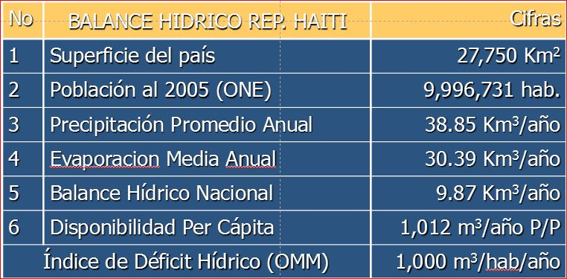
ESTIMATED WATER STRESS IN HAITI

Slide 8
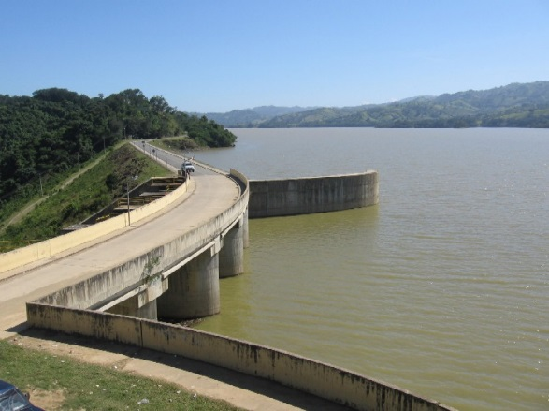
TAVERA DAM: FIST BIG DAM BUILT IN THE D. R.- 1973

Slide 9
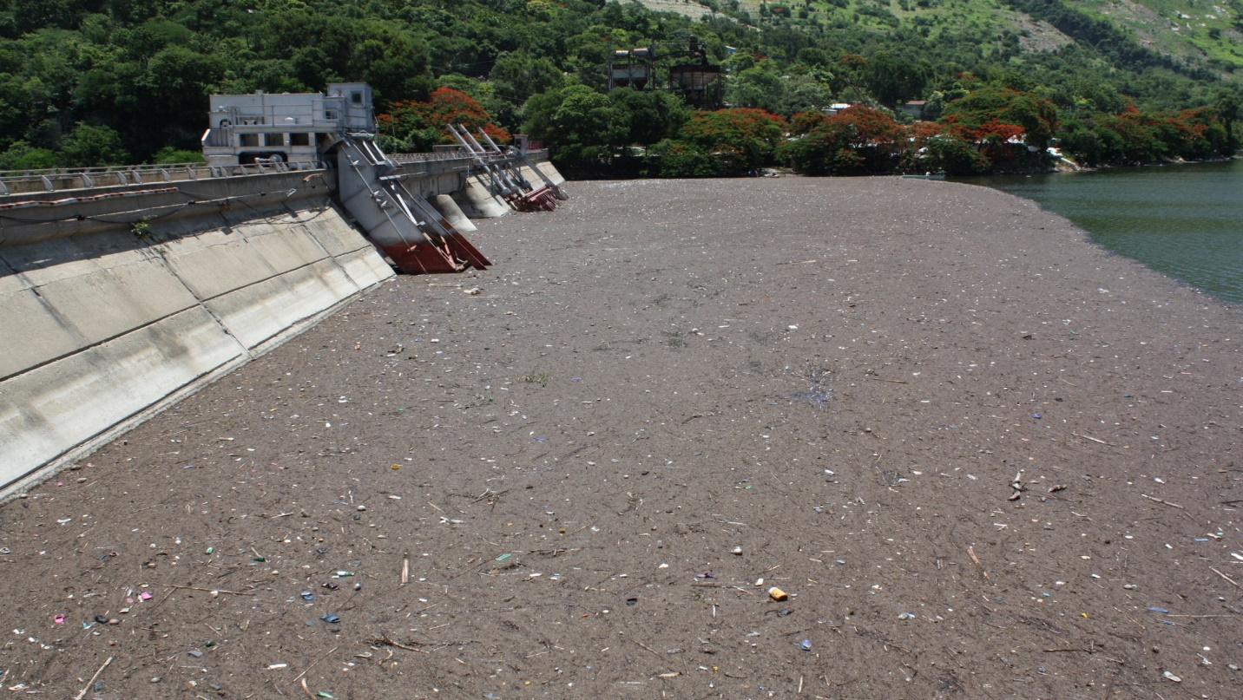
PELIGRE DAM FIRST AN OLY BIG DAM BUILT IN HAITI- 1957

Slide 10
TROPICAL STORM AND HURACAINES: NEDED O HAITED IN THE HISPANIOLA ISLAND?
;

Slide 11
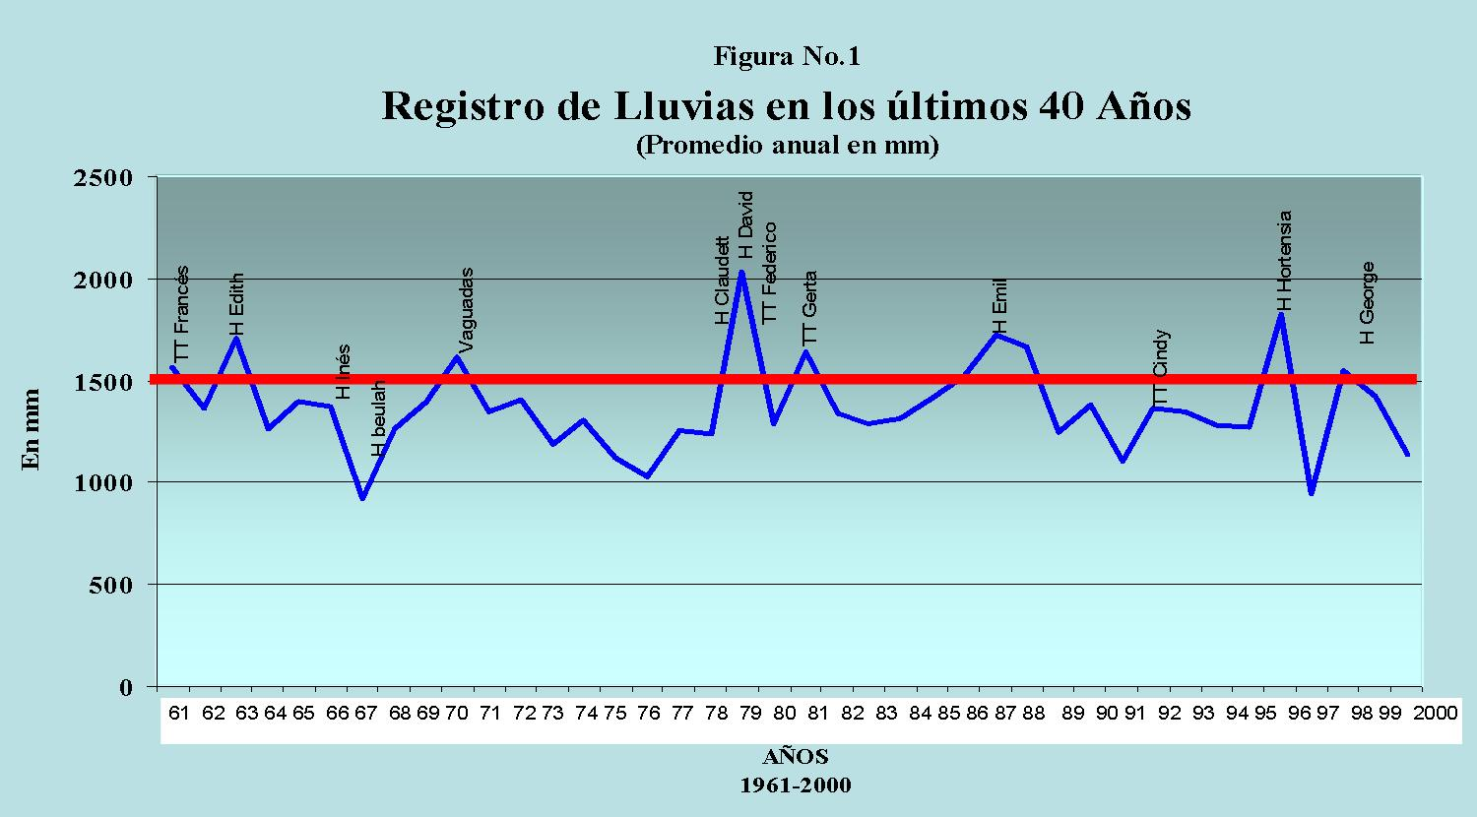
FRECUENCY OF BIG HURACAINES AND DRAWS IN THE DOMINICAN REPUBLIC 1960-2000

Slide 12
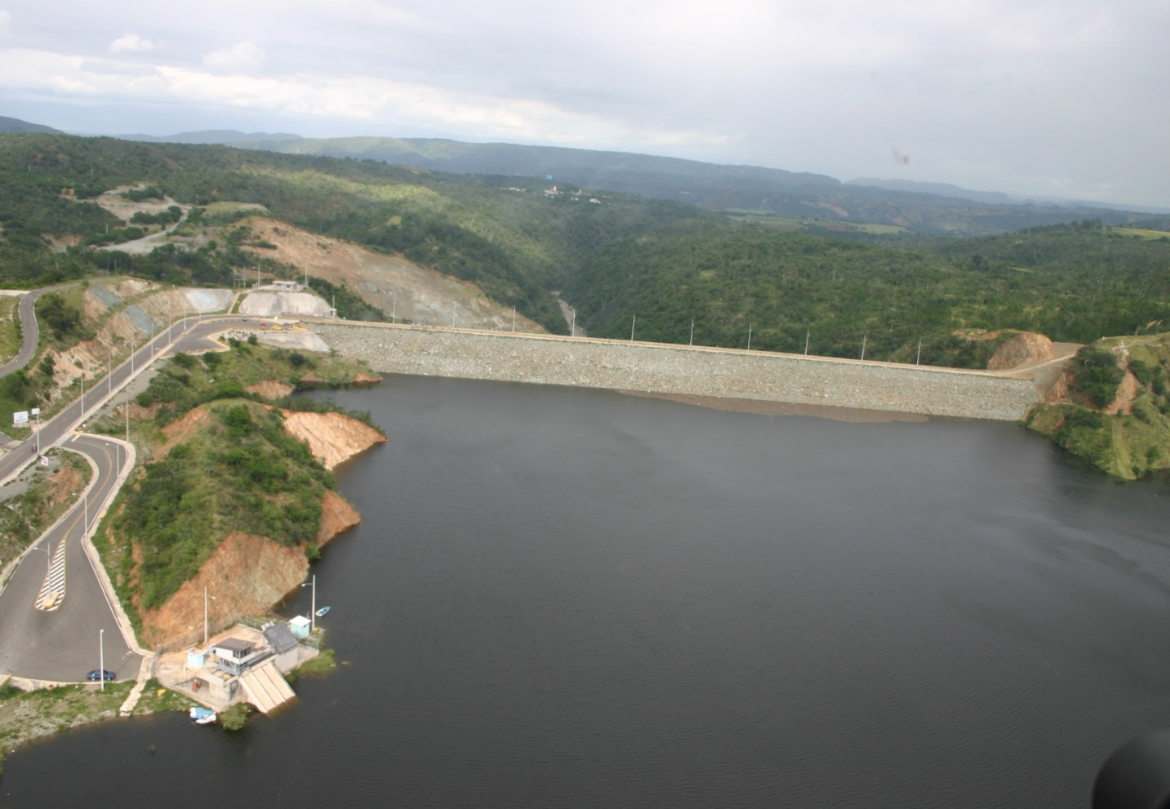
LAST BIG DAM BUILT IN THE D.R.: MONCION DAM- 2001

Slide 13
A HUGE FLUSH FLOOD AT TAVERA’S DAM AFTER A TROPICAL STORM- 2007

Slide 14
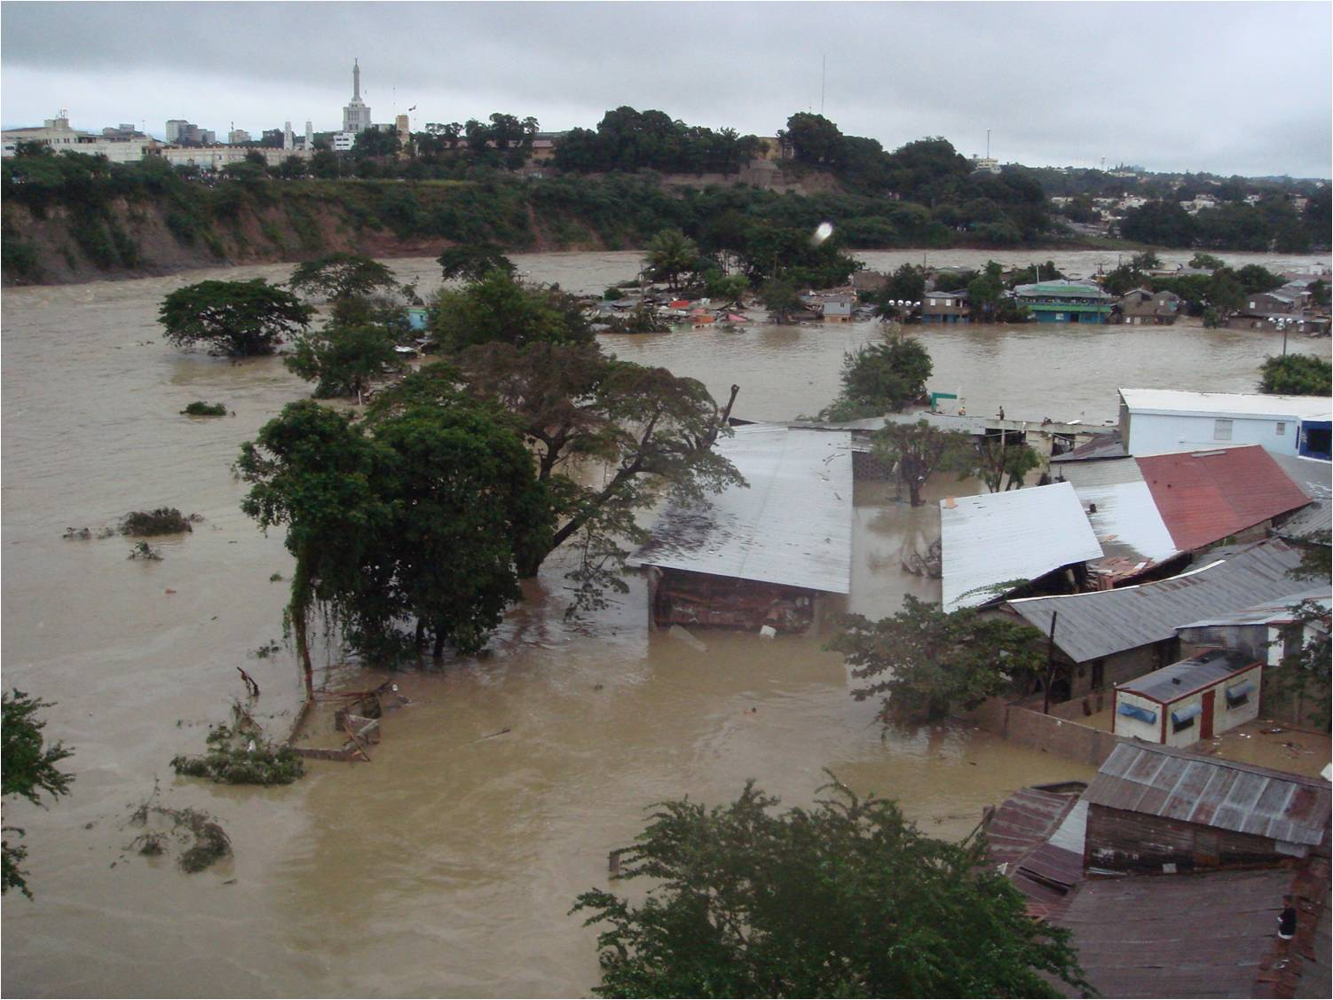
IMPACT OF A FLOOD ON POOR COMUNITIES
IN THE DOMINICAN REPUBLIC

Slide 15
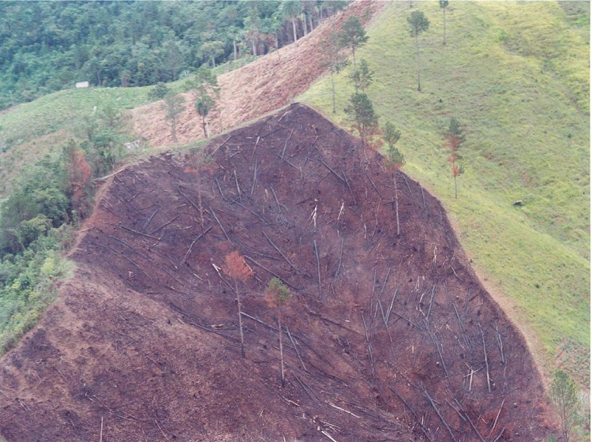
HILL FARMING INPACT ON WATERSHED DEGRADATION

Slide 16
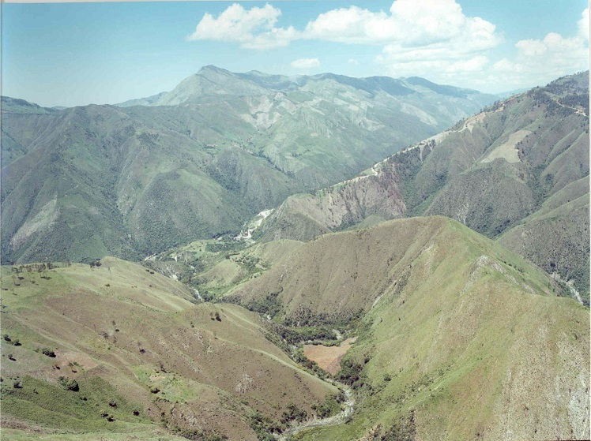
AN EXAMPLE OF DEGRADATION OF A WATERSHEDS IN THE DOMINCIAN REPUBLIC

Slide 17
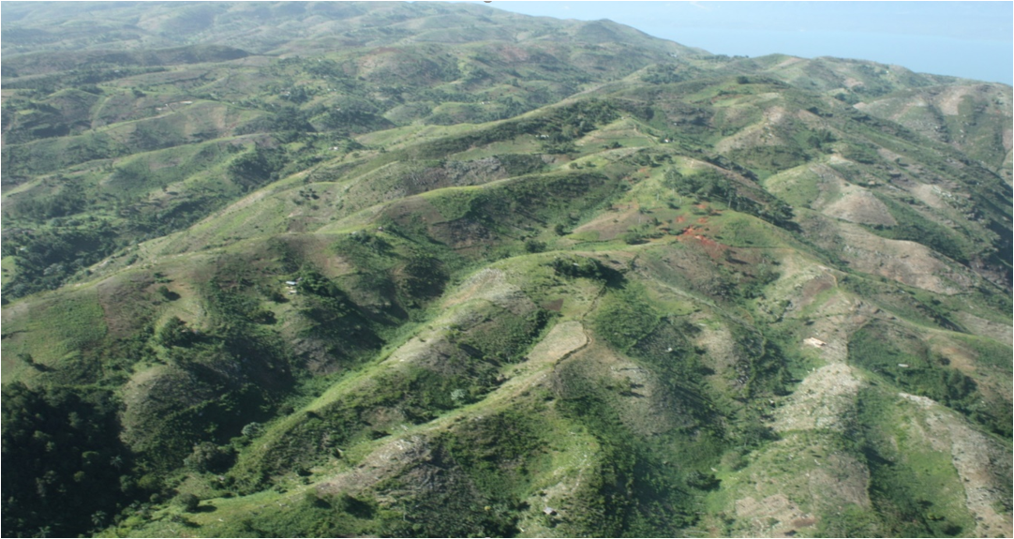
AN EXAMPLE OF DEGRADATION OF A WATERSHED IN HAITI

Slide 18
IMPACT A DEGRADATED WATERSHED IN THE PELIGRE DAM OF HAITI

Slide 19
AN EXAMPLE OF A WATER BI-NATIONAL PROJECT: HAITI AND DOMINICAN REPUBLIC

Slide 20
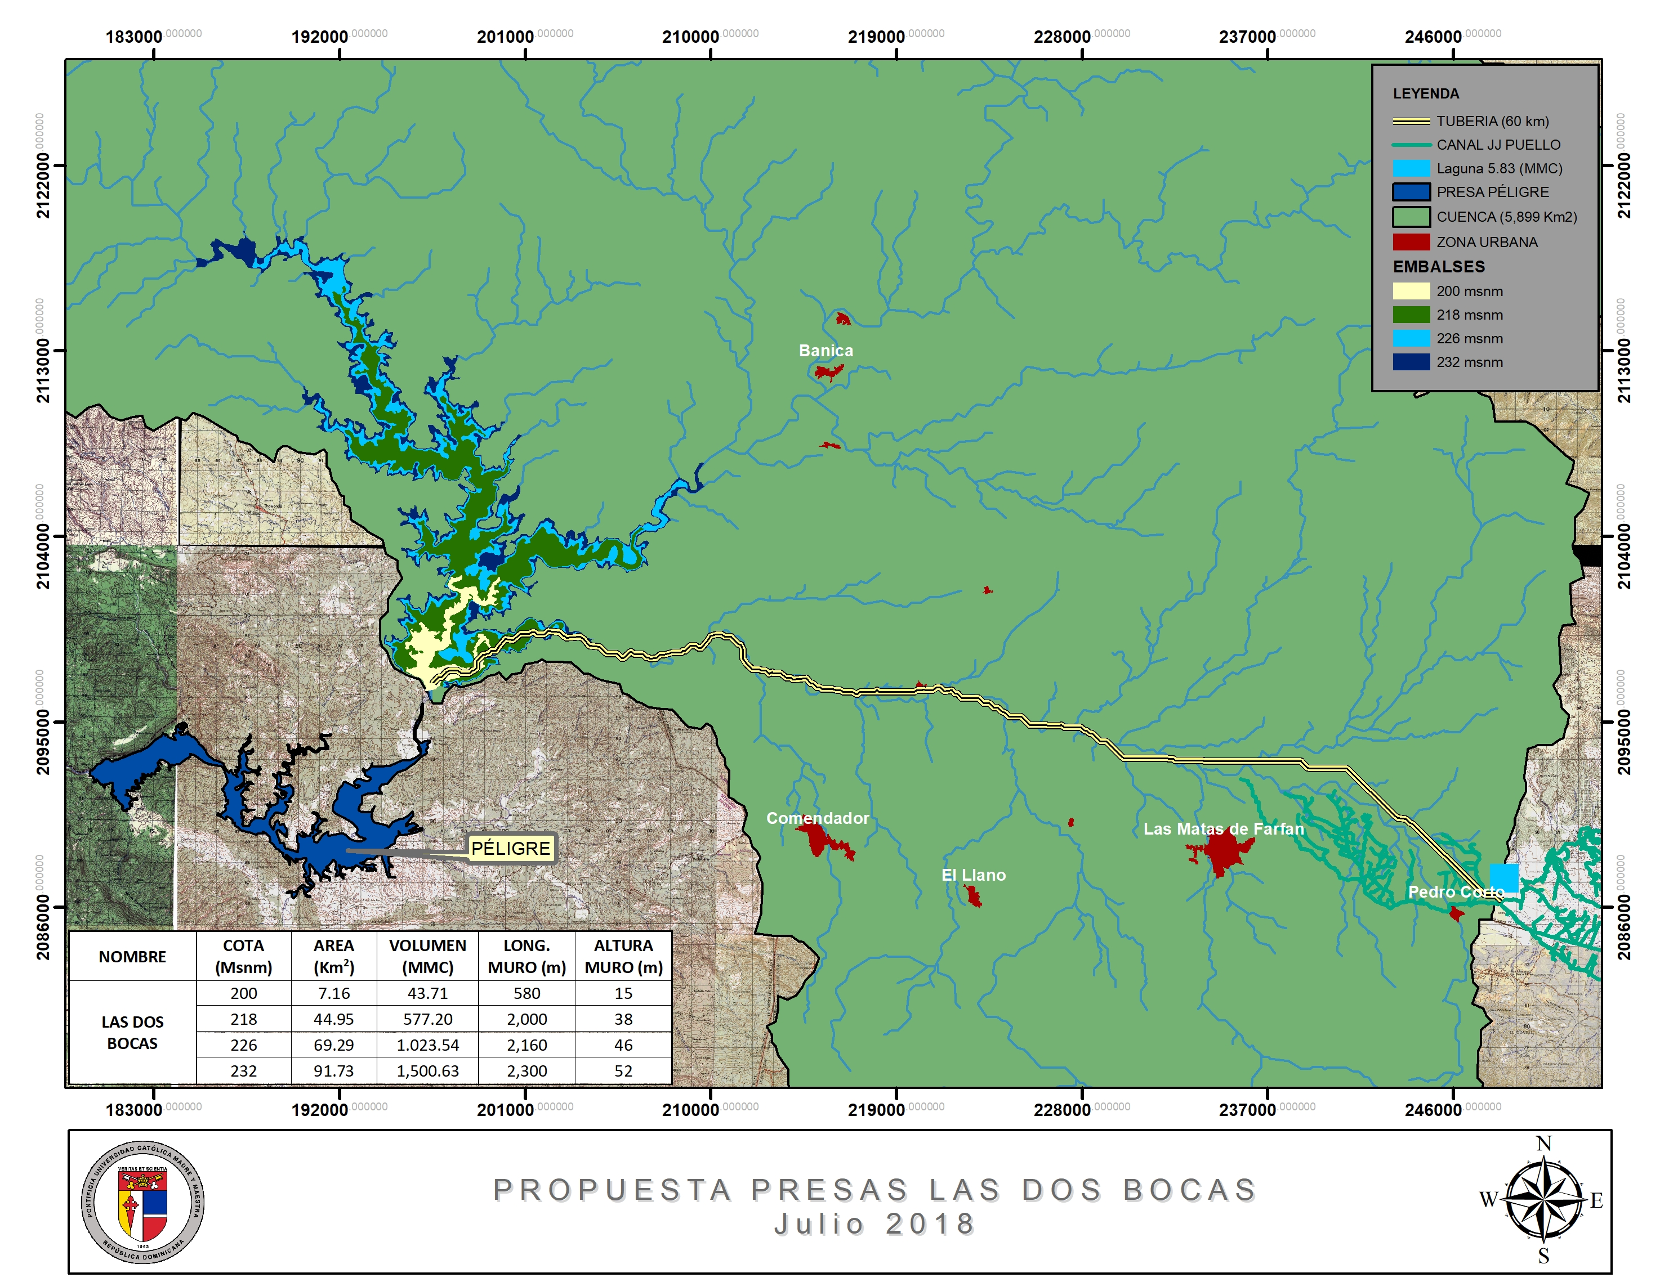
AN EXAMPLE OF A WATER BI-NATIONAL PROJECT: HAITI AND DOMINICAN REPUBLIC

Slide 21
CHALLENGES IN MEETING WATER SECURITY
IN THE DOMINICAN REPUBLIC
NATIONAL WATER EDUCATION
GOVERNANCE AND WATER POLICY
PRIVATE-PUBLIC PARTNERSHIP ON WATER PROJECTS
MORE FOOD WITH LESS WATER
WATER PRICING TO ALL USERS

Slide 22
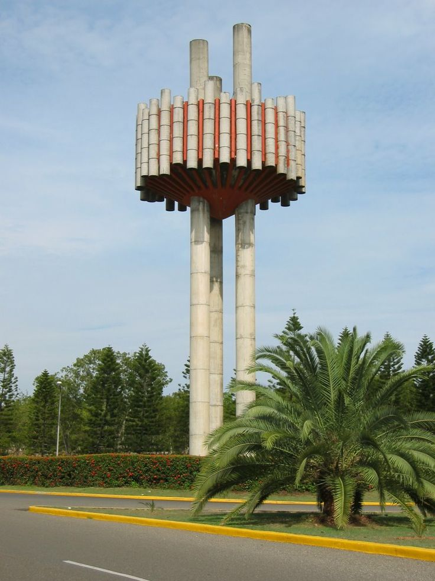
CX
  Impact of the Education Programs in the Water Secrity of the Dominicnan Repubic.
Silvio Carrasco
Director of
Unidad de Gestión de Agua PUCMM

Slide 23
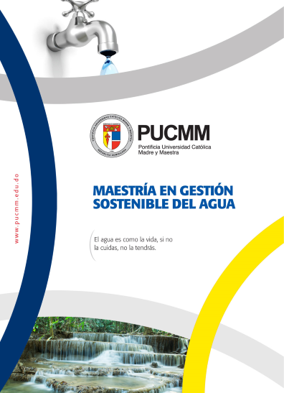


Slide 24
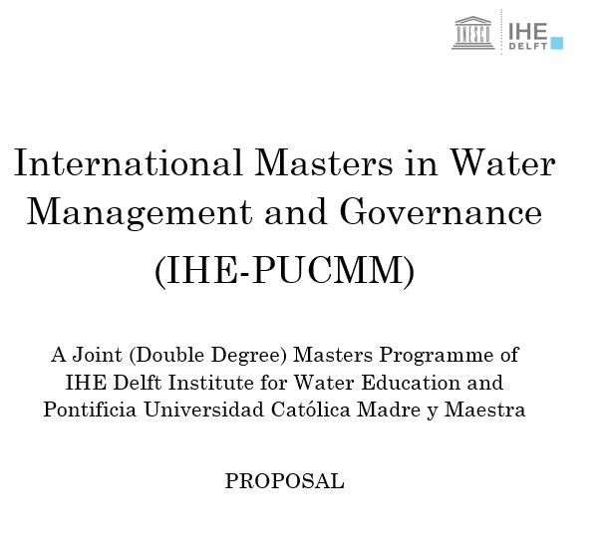

Slide 25
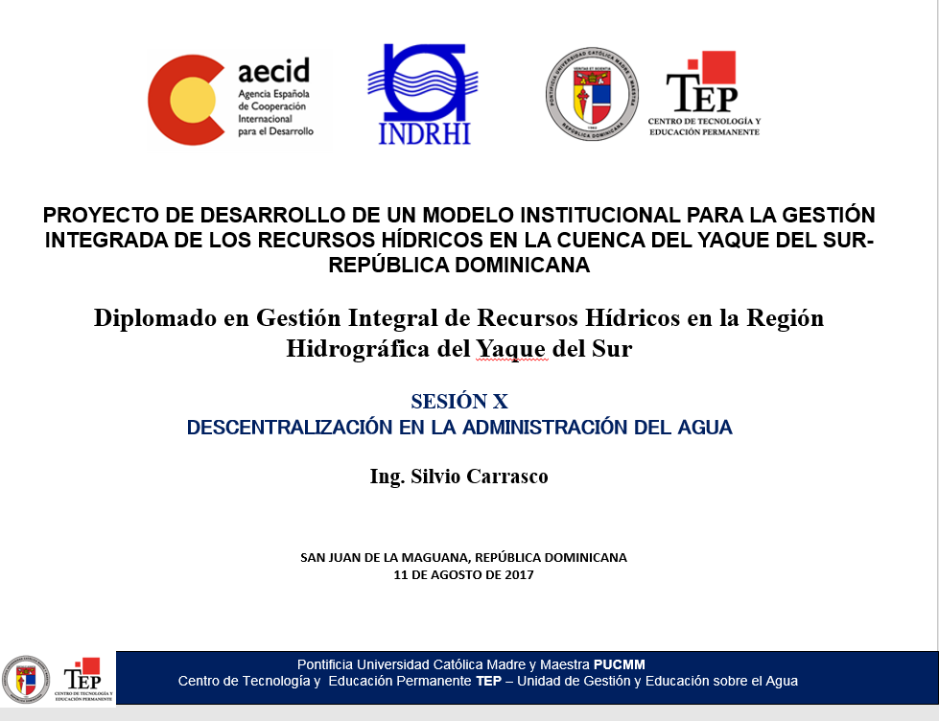

Slide 26
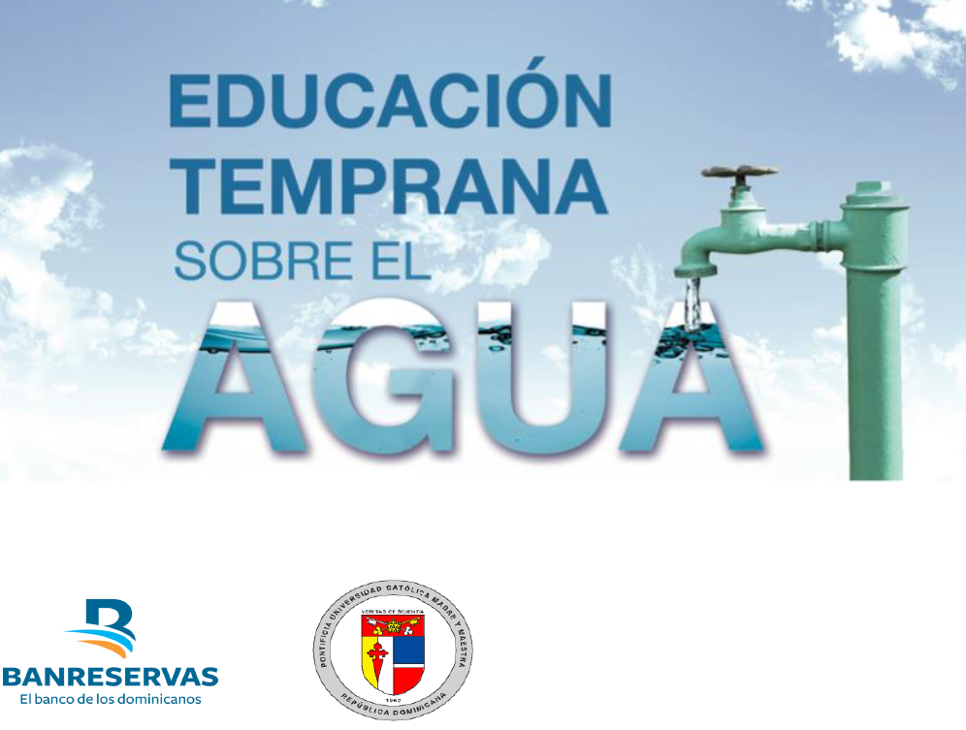

Slide 27

  IMPACT OF THE WATER EDUCATIONPROGRAMS OF PUCMM IN THE WATER SECURITY IN DOMINICAN REPUBLIC
Silvio Carrasco
Director of
Unidad de Gestión de Agua PUCMM

