Slide 1
Water and Sanitation at USAID
Notes:
For BFS I think we need to emphasize the following (in no particular order):
Strong bipartisan support for water and sanitation for its own sake--as its own IR akin to agricultural development; and that we program in support of many development objectives
GWS and Agency Plan/WDIP
Map of JMP data--highlighting urban and rural needs
Snapshot of where we sit relative to other WASH donors (just to show that we’re part of a broader ecosystem and often not the main show)
Map of our priority countries and their major focus areas

Slide 2
Today’s Presentation
Where we’ve been: consistent bipartisan and bicameral support for WASH over the last decade
Where we are now: required USG Strategy and Agency Plan in place
Where we’re going: Need to redouble pro-poor focus and institutionalize processes for strategy implementation

Slide 3
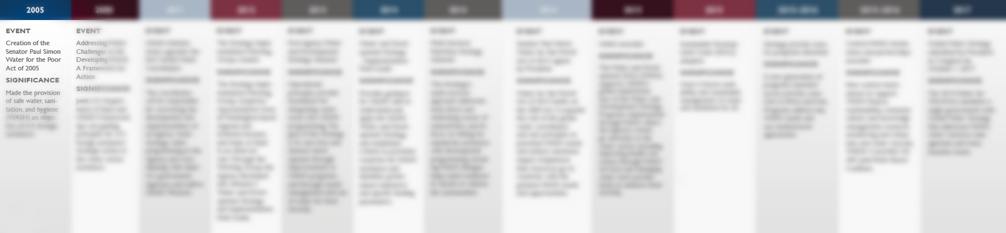
Notes:
While I won’t review the entire timeline of events over the past decade or so, I do want to highlight a few important moments that have shaped our current water program.
The Paul Simon Water for the Poor Act of 2005 put water and sanitation on the map by authorizing foreign assistance on water and sanitation. Budget followed suit with the first appropriation pursuant to the Water for the Poor Act in FY2008.

Slide 4
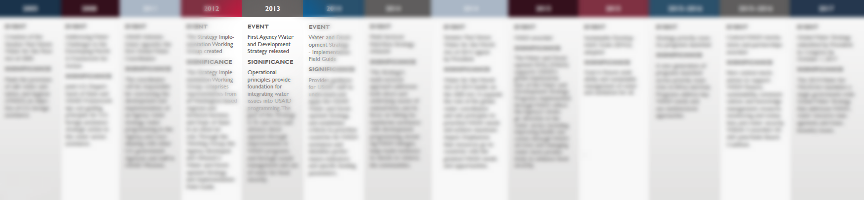

Slide 5
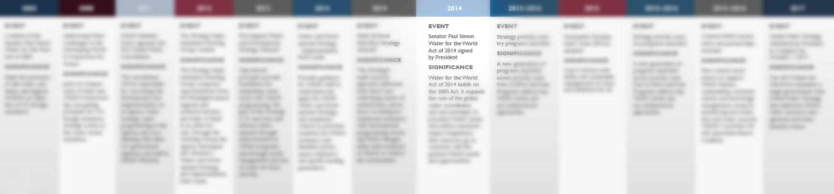

Slide 6
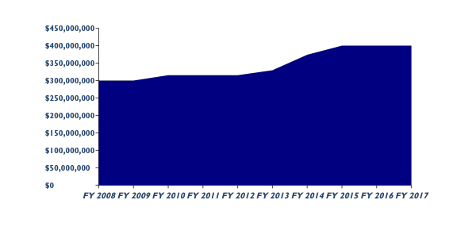
HISTORIC WASH FUNDING LEVELS
Congressional Directive for water and sanitation in the annual appropriation has increased steadily over the last decade to $400 million through FY17, with a $145 million sub-directive for Sub-Saharan Africa
Notes:
Discussion of what USAID asks for versus what we actually receive on annual basis…
Hill support appears to have remained in tact (ref. FY18)

Slide 7
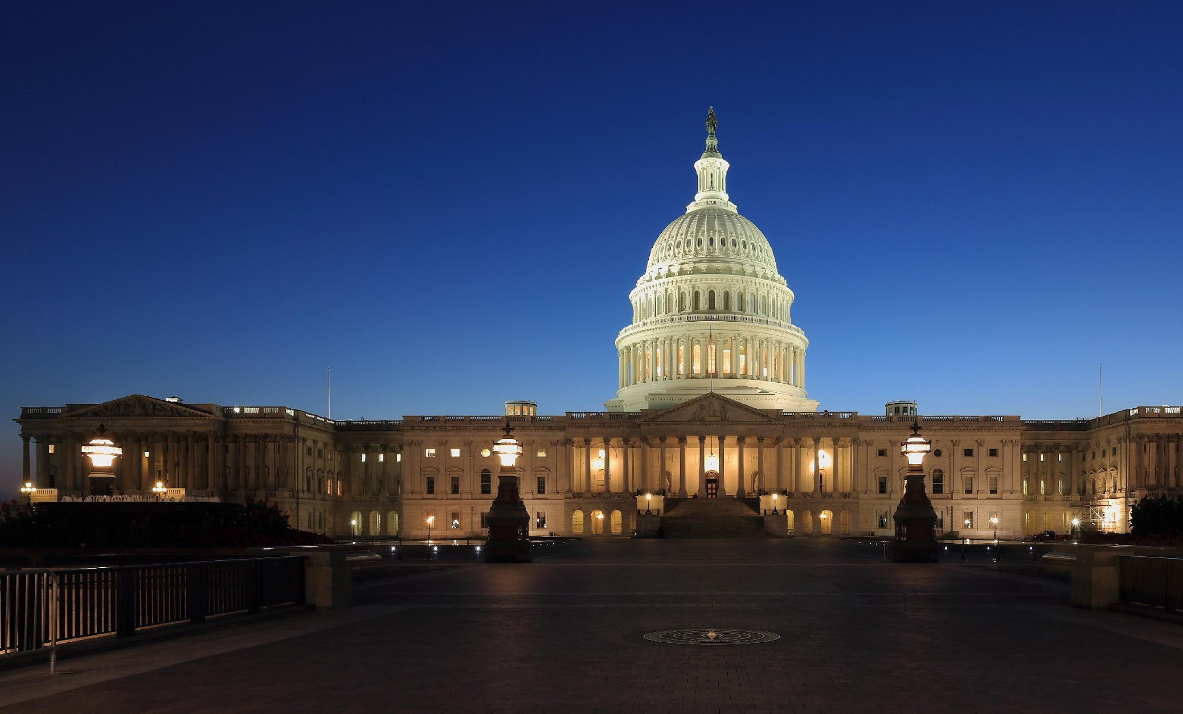
WATER FOR THE WORLD ACT of 2014
Amends the Senator Paul Simon Water for the Poor Act of 2005 by requiring:
Designation of a USAID Global Water Coordinator (DAA/SES) and State Special Advisor (DAS/SES)
USAID and DOS to develop a U.S. Global Water Strategy every 5 years (through 2027), including USAID and State Agency Plans, and USAID high priority country plans
Annual designation of high priority countries by USAID based on need and opportunity criteria
Notification of intent to obligate WASH resources in countries outside of a top 50 global ‘needs index’

Slide 8
Where We Are: USG Global Water Strategy
Government-wide U.S. Global Water Strategy released in November 2017, organized around four high-level strategic objectives:
  Increase sustainable access to safe drinking water, sanitation and hygiene.
  Improve management of water resources.
  Promote cooperation on shared waters.
  Strengthen sector governance, finance and institutions
The Strategy includes USAID and State Agency Specific Plans, as required by the WftW Act
Notes:
One of the primary stipulations in the Water for the World Act of 2014 was that, by October 1, 2017, USAID must:
Develop a Global Water Strategy, encompassing all Agencies overseas efforts related to water
Develop a corresponding Agency Plan (aka Agency Water Strategy)
Develop corresponding Country Plans for all priority countries
The resulting Global Water Strategy broadly covers four main objectives: sustainable access to water, sanitation and hygiene; improved water resources management; cooperation for transboundary waters; and sector governance, finance and institutions.
Includes contributions from agencies, but inter-agency cooperation has been weak. Will discuss further in opportunities section.

Slide 9
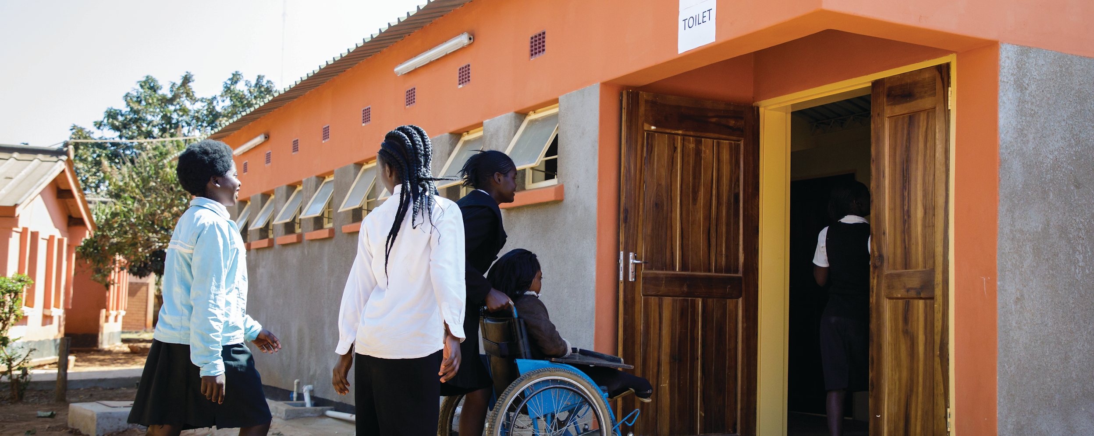
OVERVIEW
USAID WATER AND DEVELOPMENT PLAN
New Water and Development Plan articulates USAID’s contribution to the GWS
Goal: Increase the availability and sustainable management of safe water and sanitation for the underserved and most vulnerable, in alignment with U.S. national security and foreign policy objectives
New plan builds upon lessons learned, and replaces the 2013 USAID Water and Development Strategy

Slide 10
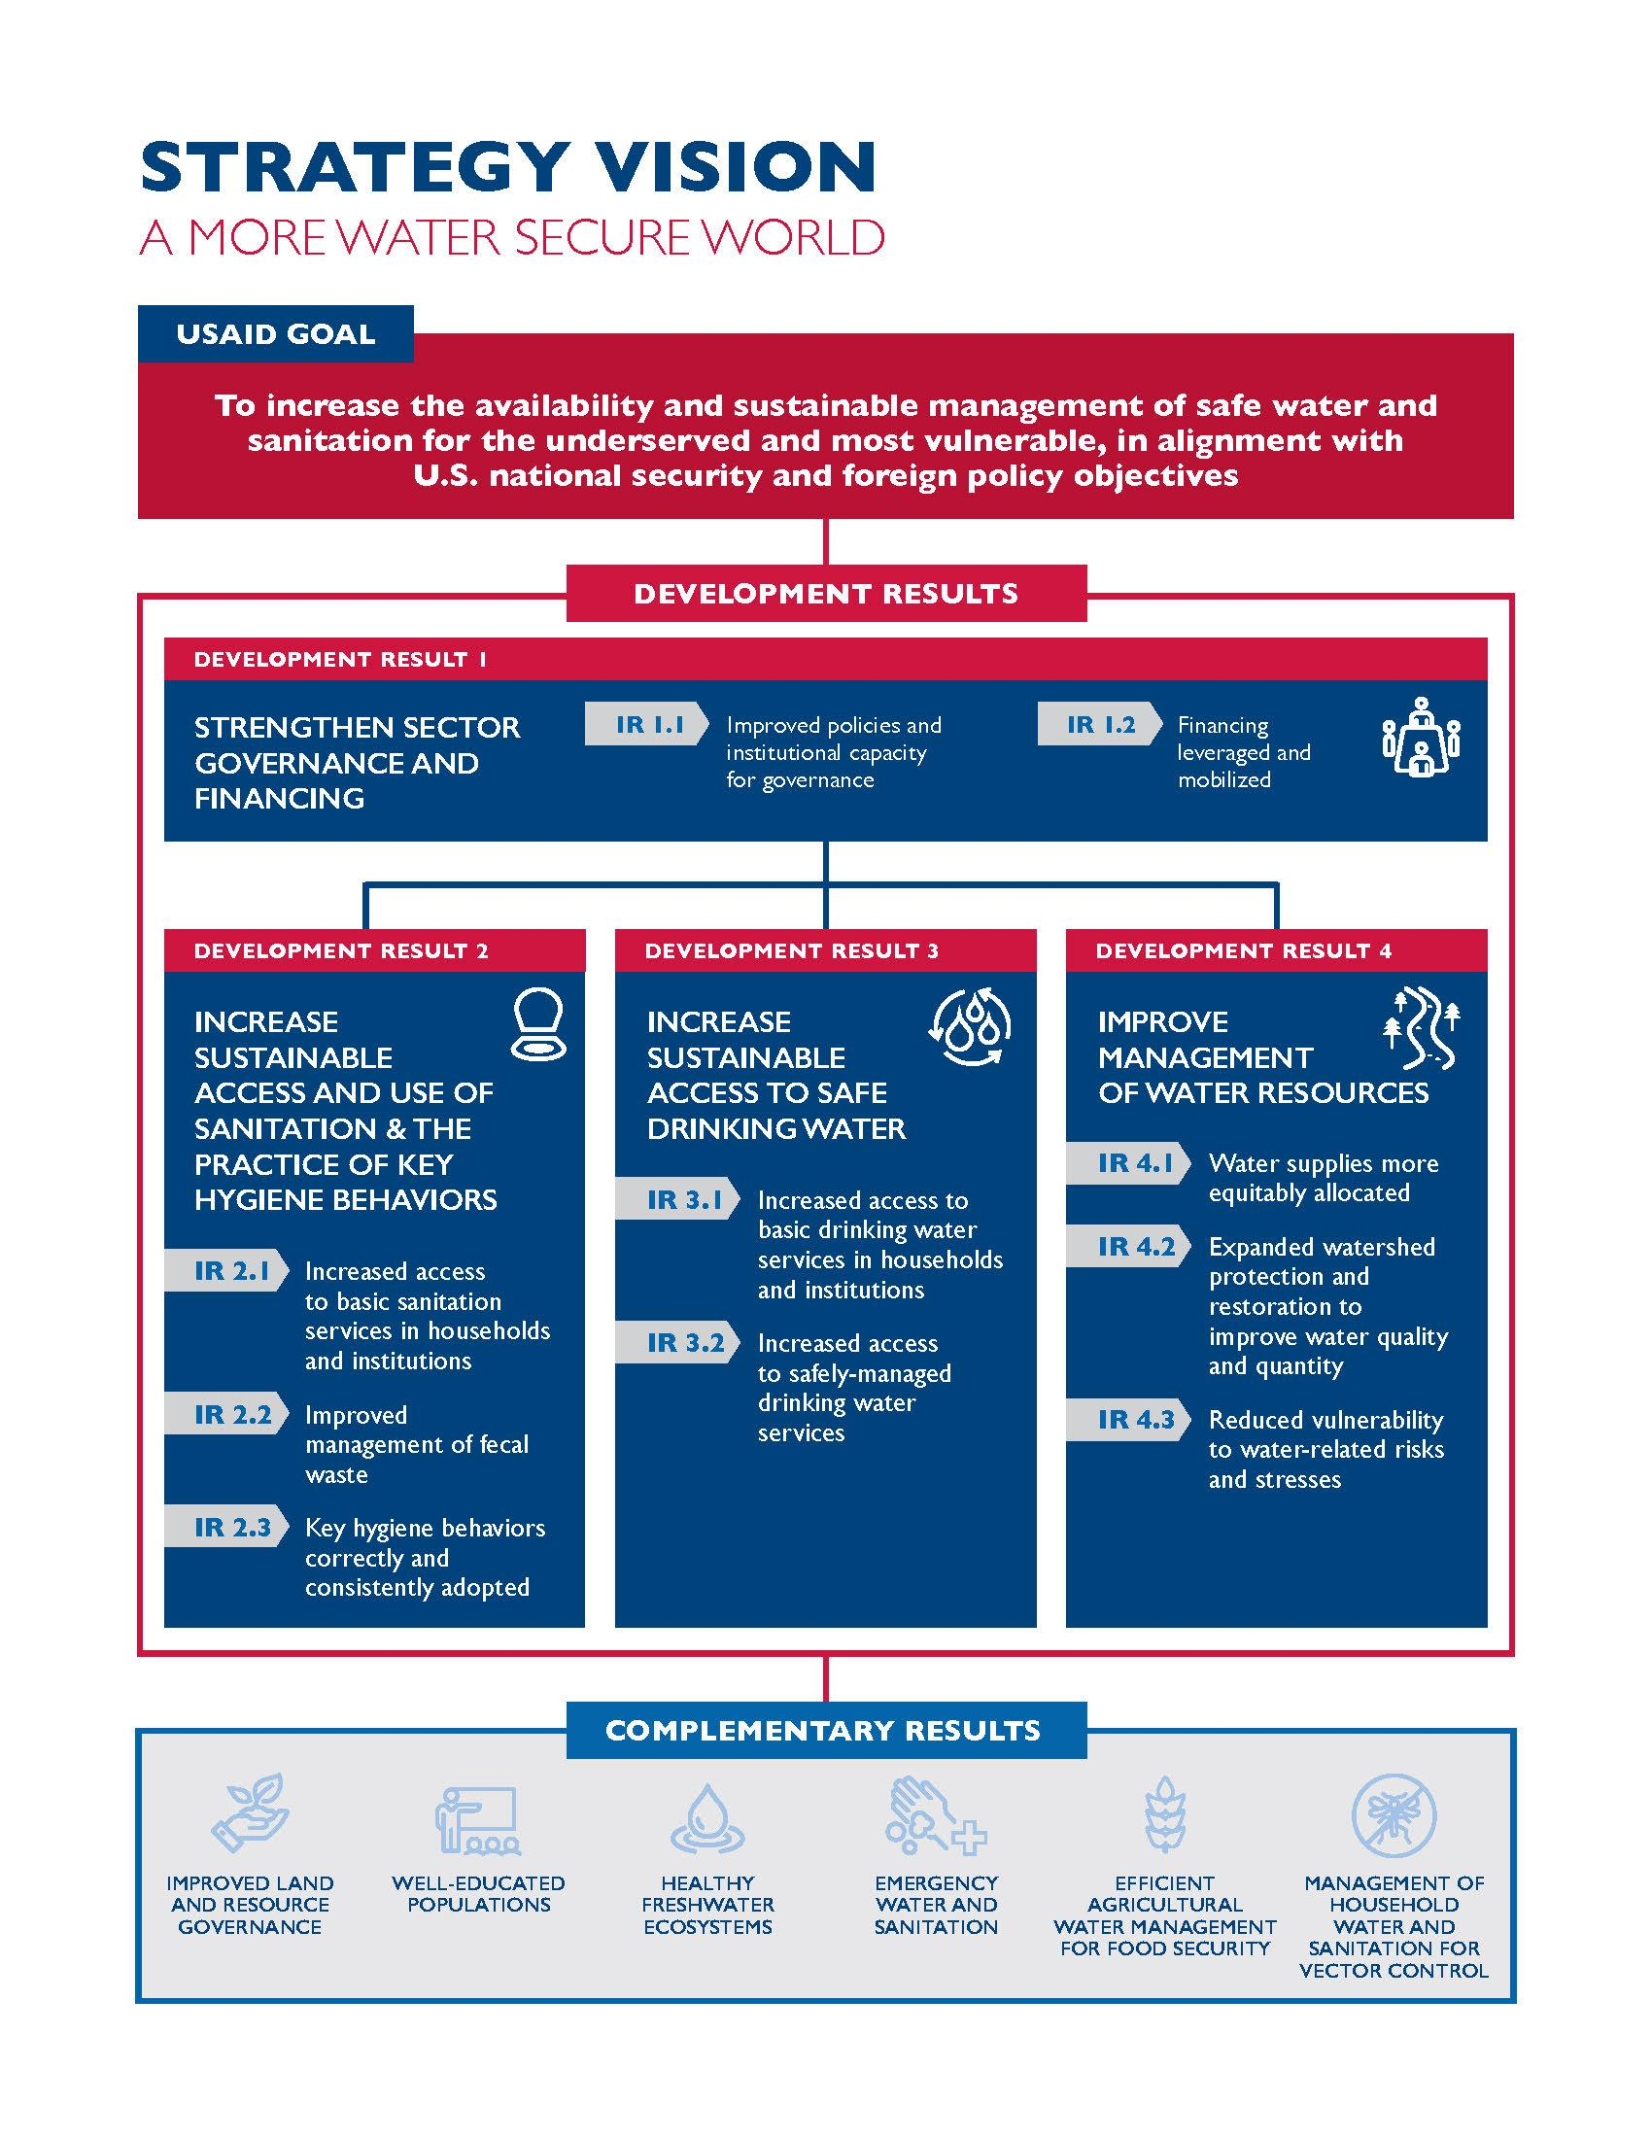
Agency Plan Results Framework – What’s New?
Aligns with international targets and benchmarks with an emphasis on the underserved and most vulnerable
Elevates water sector governance and financing and water resources management as stand alone development results
Disaggregates access to and use of sanitation and practice of key hygiene behaviors from access to safe drinking water
Highlights complementary results that water and sanitation reinforces and vice versa

Slide 11
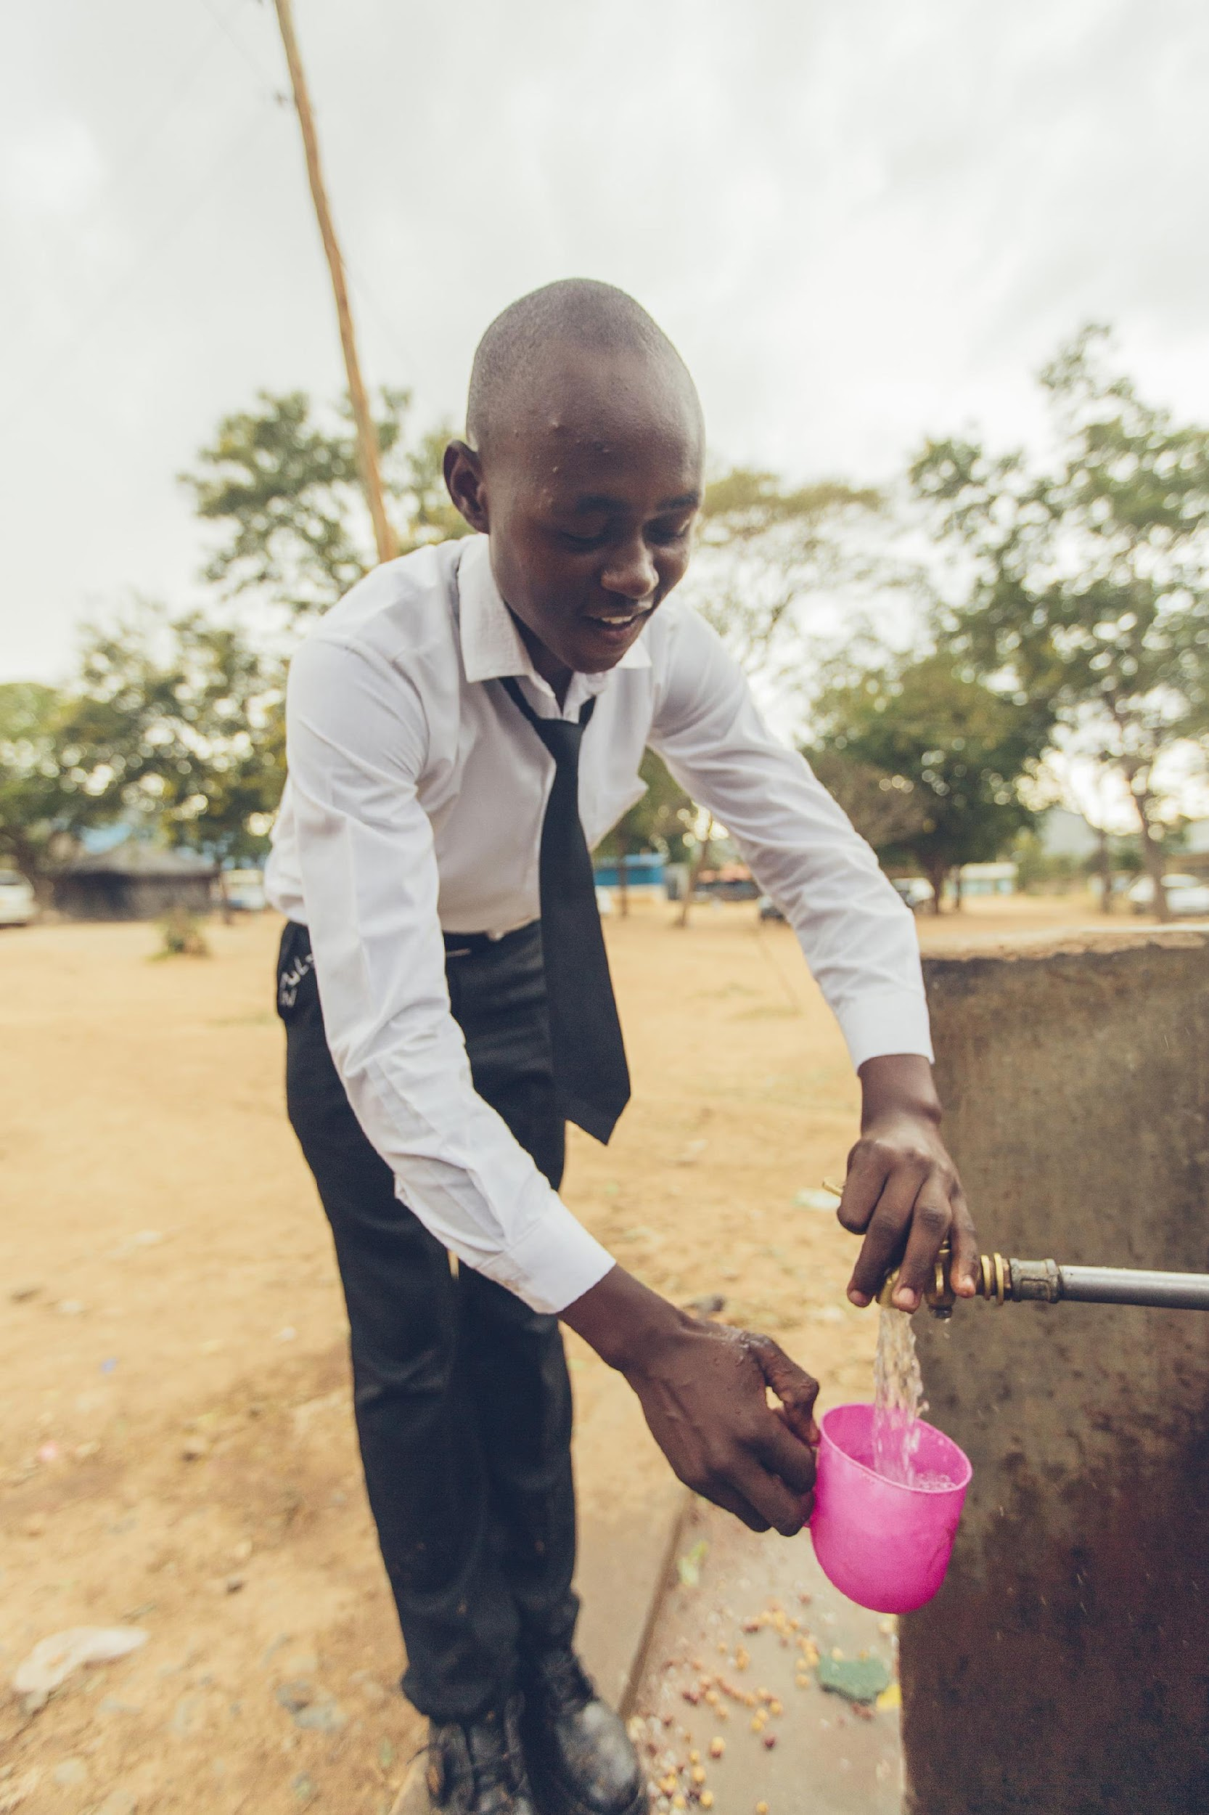
TARGETS
USAID WATER AND DEVELOPMENT PLAN
USAID/Madagascar
By 2022, USAID seeks to reach:
15 million people with sustainable access to safe drinking water services
8 million people with sustainable access to sanitation services
Also committed to reporting against new governance/finance and WRM DRs

Slide 12
U.S. GLOBAL WATER STRATEGY
Statutory Country Prioritization Criteria
 | Criteria | Definition
Needs | Country needs | Number of people and the percent of the population without access to improved sources of safe water and sanitation (JMP) The mortality rate and number of deaths of children under five years due to diarrhea (DHS)
Opportunities | Enabling environment | The extent of host government commitment to WASH
 | Leverage | The opportunities for leveraging existing donor and/or private sector investments in the water sector
 | Women | The likelihood of making significant improvements on a per capita basis on the health and educational opportunities available to women as a result of WASH

Slide 13
PRIORITY COUNTRIES & REGIONS
Pursuant to WftW Act needs and opportunity criteria, USAID designated 13 high priority countries and regions in FY18 and under the GWS:
Afghanistan D.R. Congo Ethiopia Haiti Indonesia Jordan Kenya | Lebanon Liberia Nigeria South Sudan Uganda West Bank/Gaza
Notes:
Priority countries for new strategy (FY17 – FY22)
President’s plan so countries should align with FY18 budget request…
Designation process is annual – represents opportunity to add countries – moving fwd, should discuss this relative to RFS process as intention of reorg is to leverage multi-sectoral investments toward resilience objectives.
Also a good time to talk about “aligned” countries and the difference between priority and aligned.

Slide 14
ALIGNED COUNTRIES AND REGIONS
In addition to high priority countries, USAID also programs in 15 aligned countries
Madagascar Mali Senegal Ghana Malawi Mozambique Tanzania Zambia | Cambodia Pakistan Bangladesh India Nepal Philippines Guatemala

Slide 15
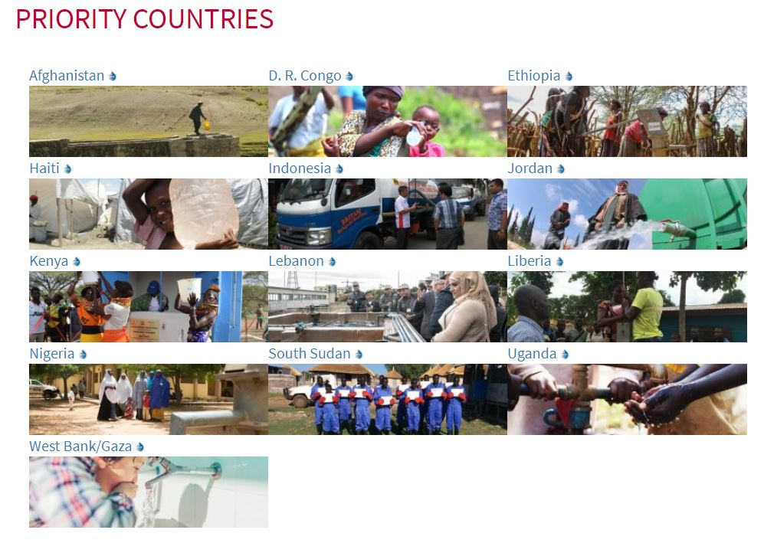
USAID HIGH-PRIORITY COUNTRIES/REGIONS
USAID WATER AND DEVELOPMENT PLAN
13 High-Priority Countries identified in the USAID Water and Development Plan
USAID High-Priority Countries are the primary recipients of U.S. Government assistance in water and sanitation
Each High-Priority Country developed a plan
Country plans can be accessed at: https://www.globalwaters.org/wherewework/priority-countries

Slide 16
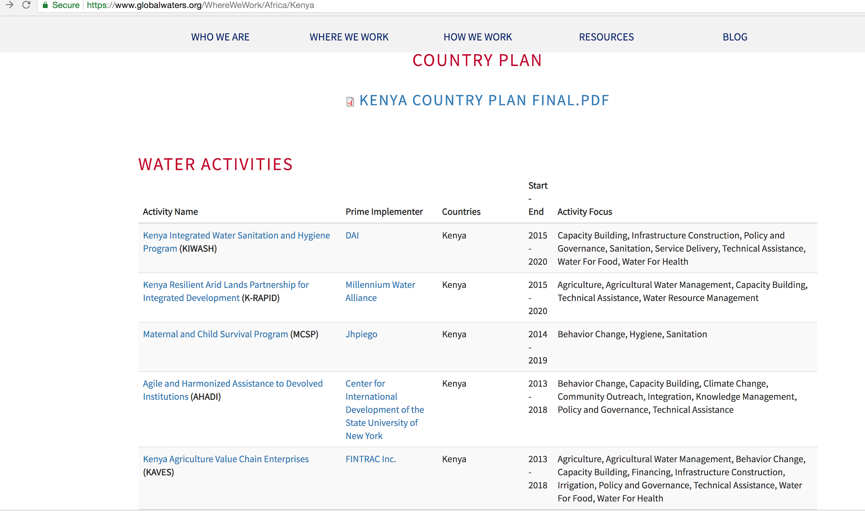
Country Specific Info on Globalwaters.org

Slide 17
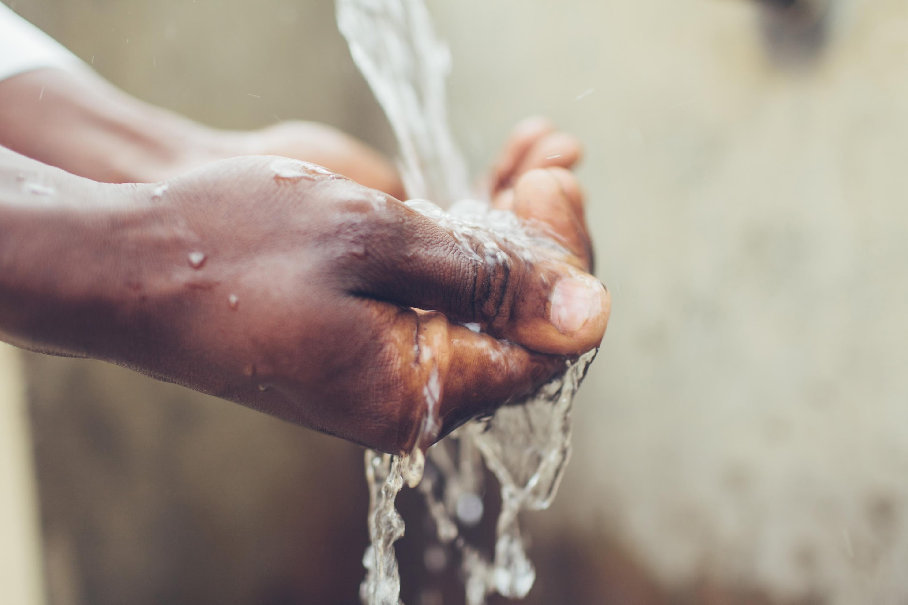

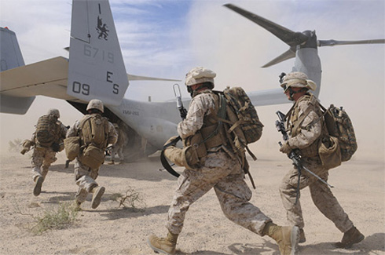
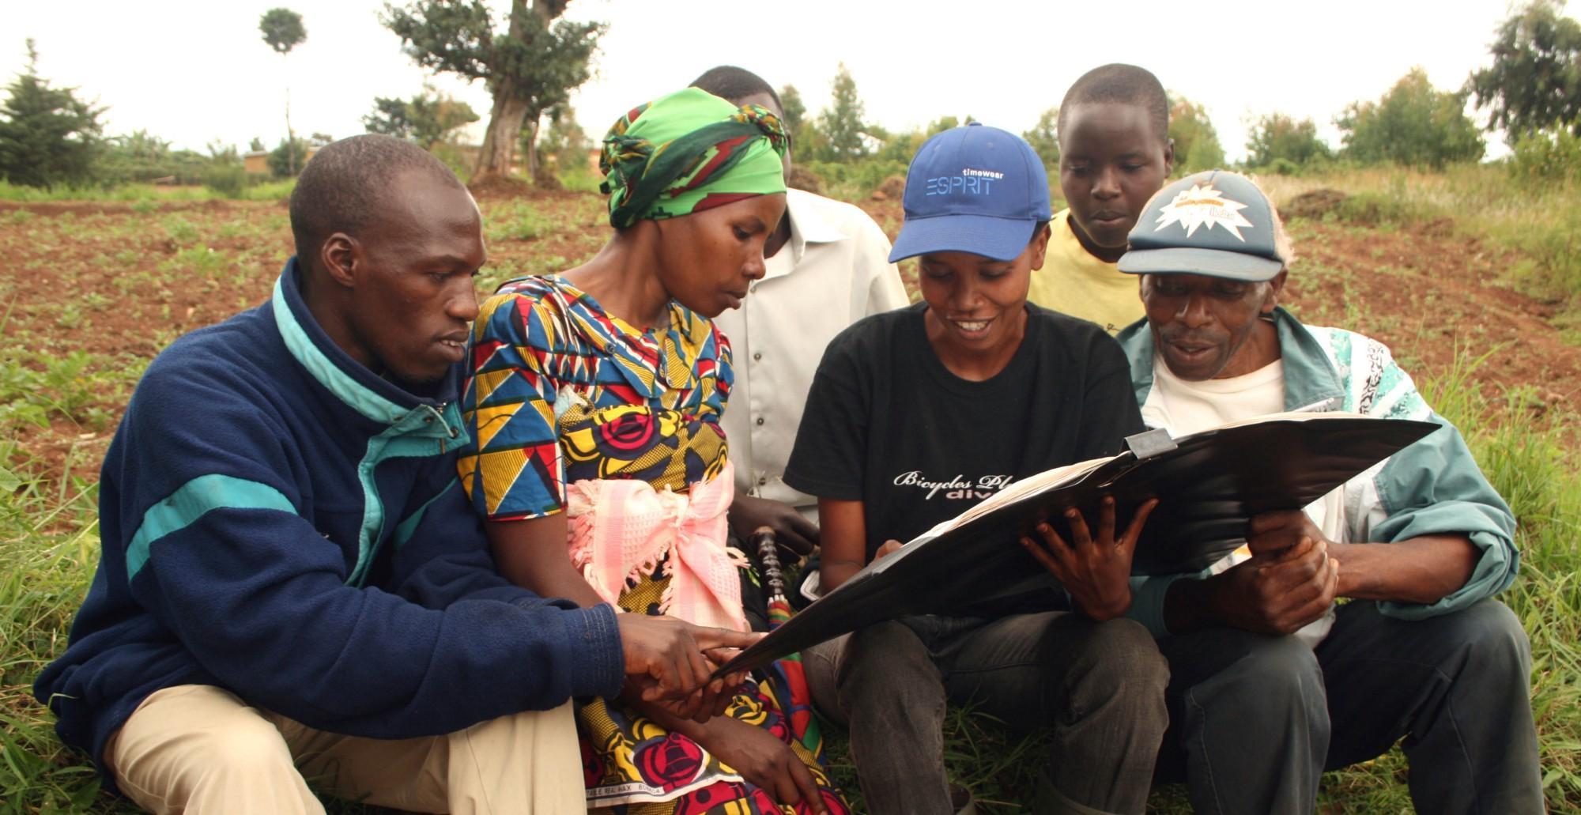
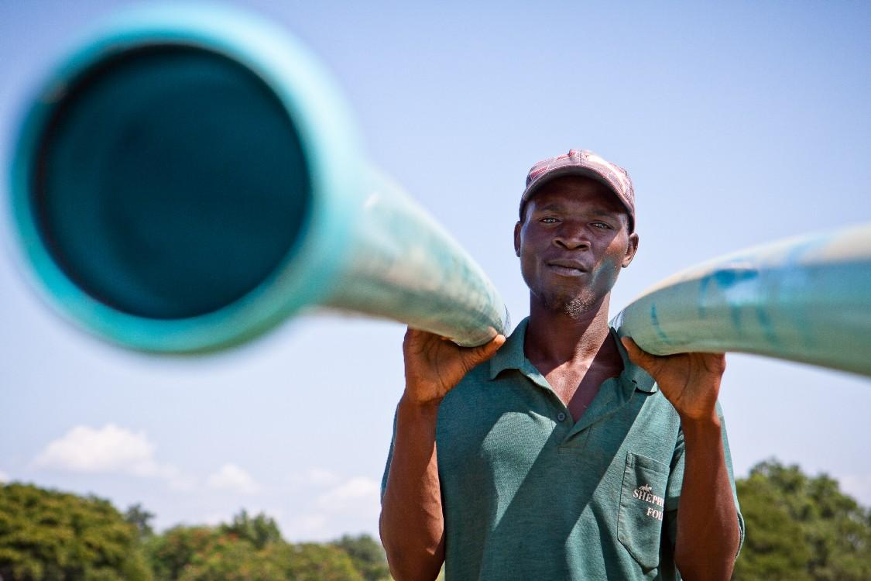

WHERE WE’RE GOING:
Water and sanitation in the journey to self reliance
Need to Address Cross-Cutting Impacts to Achieve GWS Objectives
Agriculture
Health
Governance
Economic Growth
Security
Education
Notes:
Water is cross-cutting and a way to make inroads in all of these development outcomes. Water is an essential element for human health, prosperity, and security. Reliable access to safe and affordable water, along with adequate sanitation and hygiene practices, underpins health and livelihoods, while nations’ economic prosperity and stability are profoundly shaped by the ability to effectively manage water resources and services.
Security:
In 2012, 1.2 billion people lived in areas of physical water scarcity, and the trend is expected to get worse over the next decade. Water scarcity is risk multiplier for conflict and instability.
Health:
Currently, 663 million people lack access to clean drinking water, and 2.4 billion people live without adequate sanitation. These access gaps have dire consequences for public health.
Economic Growth:
The world loses $260 billion per-year due to inadequate water supply and poor sanitation.
Weak Governance:
Weak governance and lack of effective service delivery undermines public trust of institutions.
Agriculture:
Globally, agriculture accounts for the majority of freshwater withdrawals, with some water sources being drawn down faster than they are being replenished.
Education:
Women and girls spend 200 million hours every day collecting water. This can hinder educational opportunities, and pose a safety risk.

Slide 18
Bottom Line
Where we’ve been: consistent bipartisan and bicameral support for WASH over the last decade
Where we are now: required USG and Agency strategies in place
Where we’re going: Need to redouble pro-poor focus and institutionalize processes for strategy implementation

