Slide 1
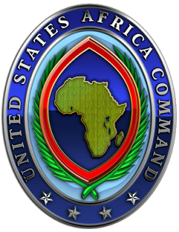
United States Africa Command
Environmental Security (EnSec):
A Short History
unclassified
Notes:
Jambo. I am pleased to be here to discuss AFRICOMs environmental Security program, but before that discussion I need to …

Slide 2
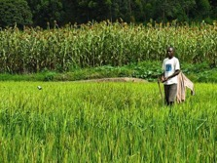
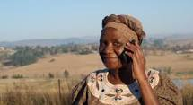
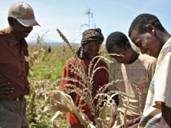
The Good
African continent is one of the world’s richest regions in oil, gas, and minerals
Africa has 6 of the world’s 13 fastest growing economies (Business Insider)
Africa is embracing technology: skipped land line telephones … went straight to cell phones
Africa possesses 99% of the world's chrome resources, 85% of its platinum, 70% of its tantalite, 68% of its cobalt, and 54% of its gold
There are the positive dynamics inherent in many of their economies, including a growing labor force, increased urbanization, and advances in technology
Notes:
Since 2000 the average life expectancy has increased by 9.4 years to 60 year (Source: http://www.who.int/mediacentre/news/releases/2016/health-inequalities-persist/en/)

Slide 3
The Bad
The nexus between rampant corruption, poor governance and a disenfranchised population is a powder keg for negative influencers
Boko Haram insurgency in Nigeria killed over 13,000 people in 2016
Al Shabaab; aligned to Al Qaida; has killed more people than Boko Haram
ISIS growing in Nigeria, Libya, Somalia, South Sudan, and Tunisia
Since 2008…16 irregular changes of government
South Sudan and Burundi potential for genocide
16 ongoing UN peacekeeping ops…9 in Africa (over 90% of UN forces)
“Why does DoD need AFRICOM? We’re in a counterterrorism pinch and that’s no joke. The evil of [Islamic State of Iraq and the Levant], narcotics, corruption, organized crime … are rife in Africa and ultimately they will come home to roost if we don’t combat it there, and that’s what you’re doing so ably.”
-Secretary of Defense Carter, June 2015

Slide 4
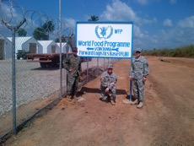
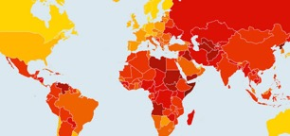
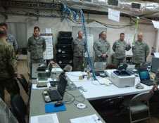




The Ugly
Four of the ten countries with the highest prevalence of modern slavery in the world are in Africa.
Africa has lost 64% of its elephants to poaching in only a decade
28,646 cases of Ebola resulting in 11,323 deaths
400,500 deaths from malaria in 2016 (70% were children under 5)
720,000 deaths from AIDS in 2016

Slide 5
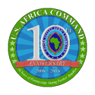
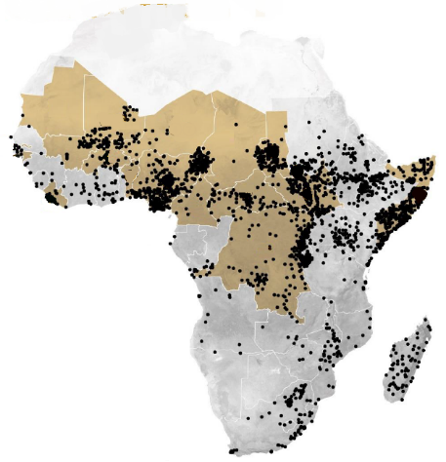
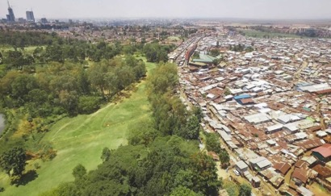
2025 Strategic Outlook
Social Conflict/Under governed Space
630 Armed Conflicts/75% of all global atrocities (1990 to 2015)
50% of population live in cities before 2050
Doubles by 2050
By 2030 Africans under age 24 will equal the population of the USA
GDP growth producing few jobs = population migration
Instability aggravated by urbanization
Uneven Development of Nairobi, Kenya
Ongoing UN or AU PKO
Rebel or Ethnic Militia
Caused Events
Est. City Populations in 2025
10 million
5 million
3 million
Notes:
(U) Accelerating Urbanization: 50% of population will live in cities before 2050; basic infrastructure already stressed or not available
(U) Population Growth: Population to more-than double by 2050; increased demands for natural resources, jobs, and government services
(U) Economic Outlook: GDP growth currently producing few jobs, may cause additional population migration to richer nations to include European allies
(U) Illicit Networks: Increasing connectivity supports legitimate and illegitimate activities; threats grow unless partners also improve institutions
(U) Peacekeeping Operations: Plateau likely achieved in 2016-perhaps highest ever number committed to PKO; unclear if donor support sustainable
(U) Trajectory: Instability will probably be aggravated by burgeoning urbanization, population growth, and prevalence of informal economies

Slide 6
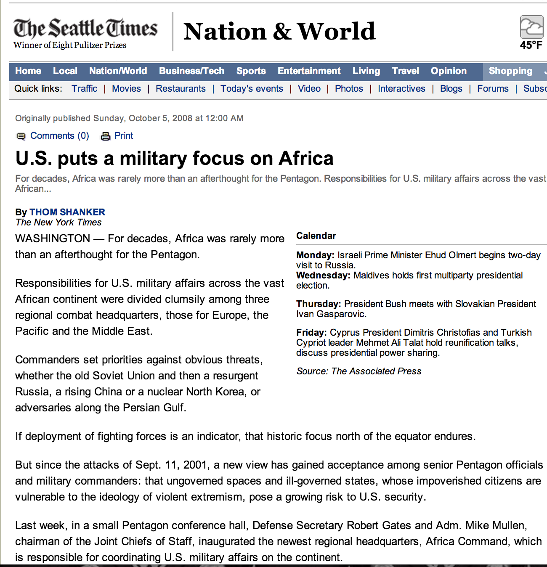
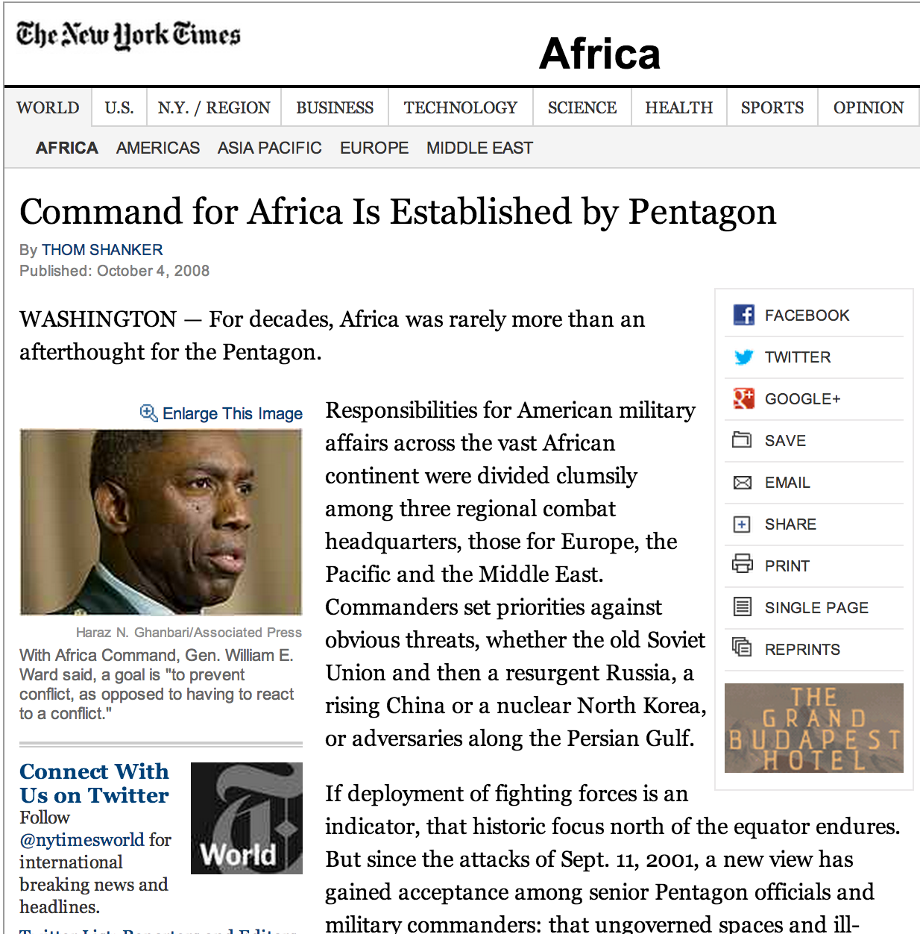
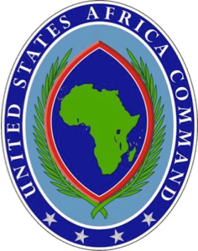
October 2008
unclassified

Slide 7
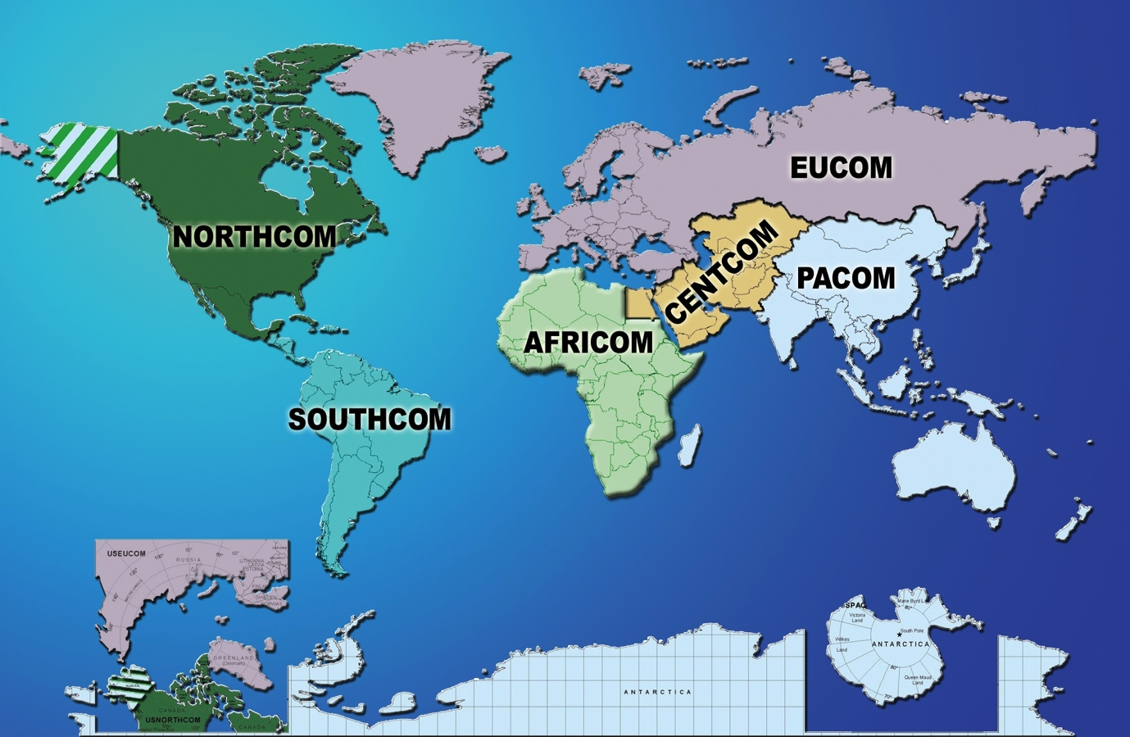

Slide 8
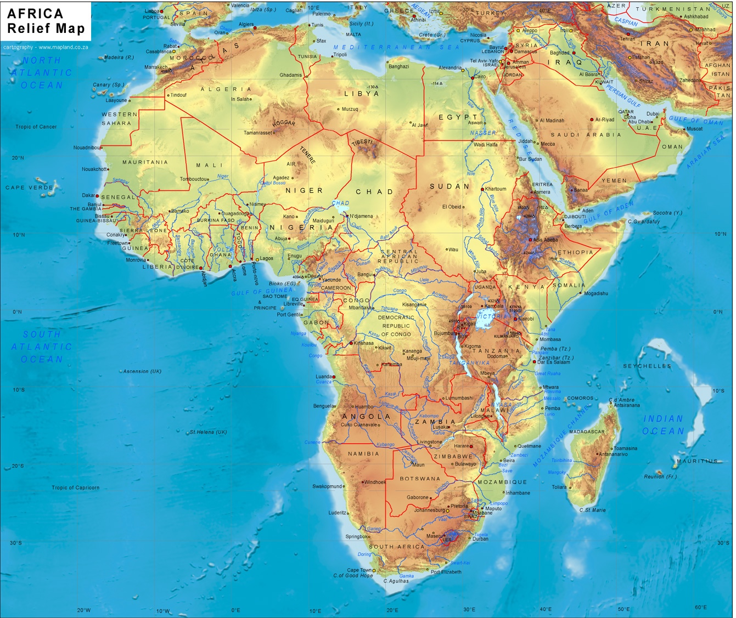
U.S. Basing Support
USAFRICOM’s Only “Base”
Camp Lemonnier, Djibouti
(CLDJ)

Slide 9
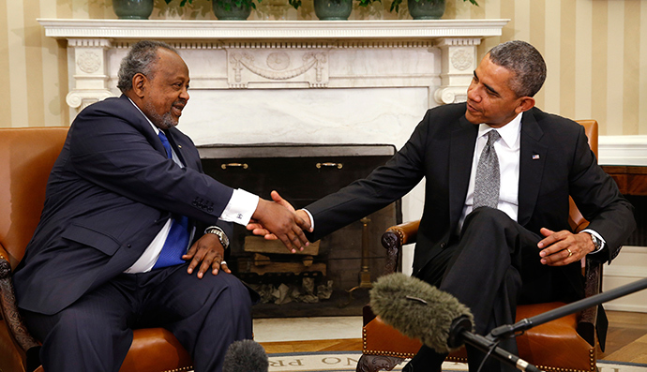
Camp Lemonnier, Djibouti
10 year lease with an option for 10 more
years on the same terms

Slide 10
Historical focus of United States security-related policy was on conflict resolution, not on conflict prevention.
Environmental issues have been identified as key
factors having major impact on local, regional
and global security.
As environment-related events intensify (e.g. floods and droughts, land, water and air degradation from pollution, soil erosion, and resource exploitation), they will create or contribute to conflicts in many parts of the world.

Slide 11
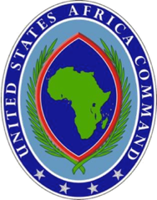
USAFRICOM Environmental Security
ENSEC
Operations and Readiness
OPERATIONS and READINESS
“environmental consideration protects the health and welfare of U.S. personnel…minimizes adverse environmental impact…”
unclassified

Slide 12
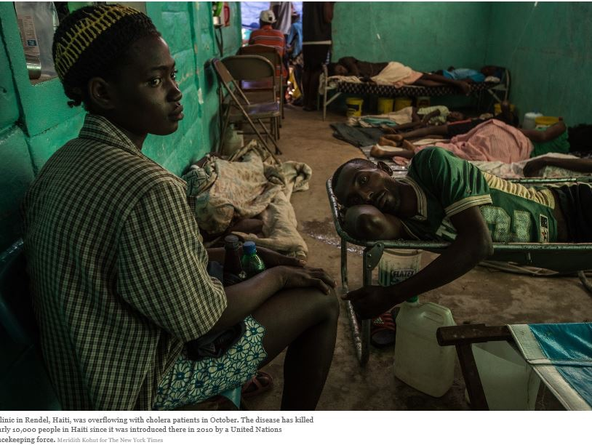
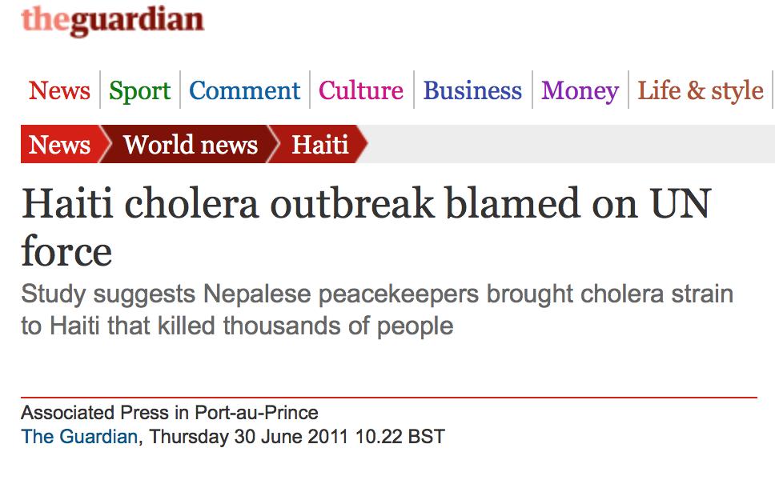
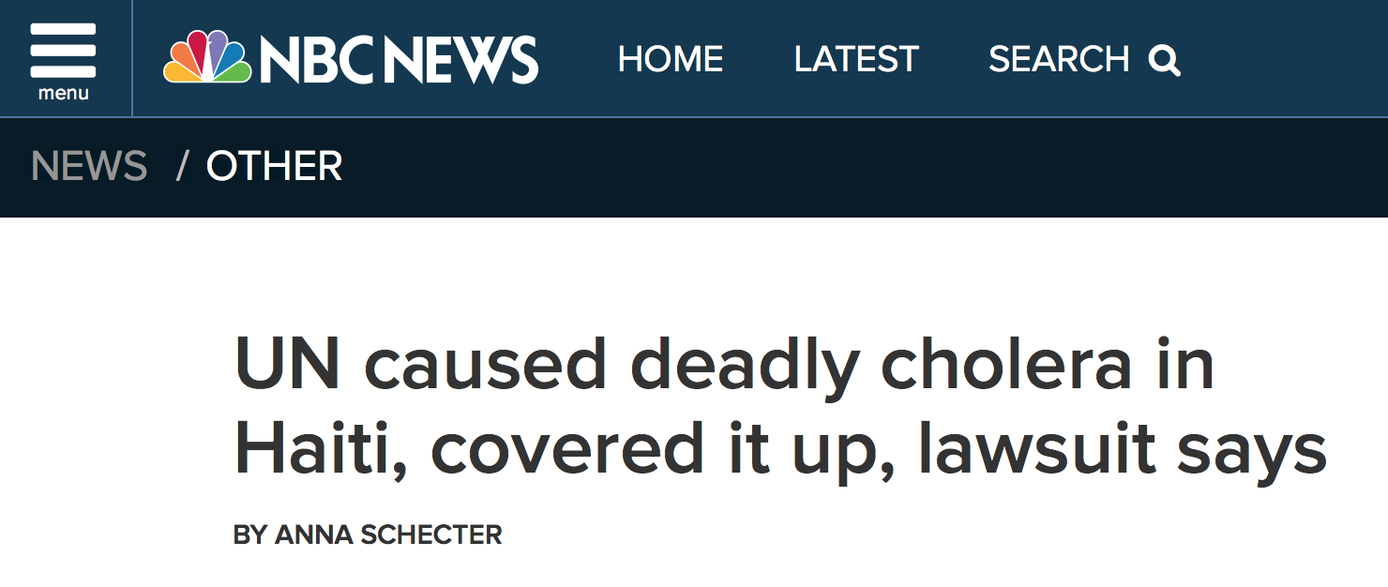
Environmental Considerations during Operations
8231
Over 8000 Haitians killed by cholera outbreak
6%
6% of Haitians have had the disease
4
Spreading to neighboring countries,
including Cuba, Dominican Republic,
and the United States

Slide 13

USAFRICOM Environmental Security
ENSEC
Theatre Security
Cooperation (TSC) Engagements
Capacity building for Partner African Nations Mil and Non-Mil Stakeholders.
THEATER SECURITY COOPERATION
“capacity building for partner African nations military and non-military stakeholders”, Information Exchange on environmental issues
unclassified

Slide 14
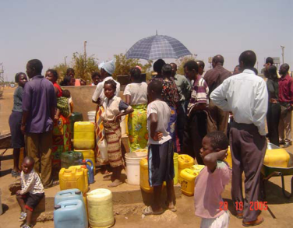
Water Security at US Africa Command
Why DOD Involvement?
Water and Environment are major
stressors and pose threats to
Stability and security – major
concerns for
AFRICOM and USG
Key water objectives:
  -Integrate DOD water programs in Africa w/DOS, USAID and other USG agencies
  -Reduce vulnerability of militaries and civilian equivalents to de-stabilizing natural events and trends
  -Create trans-national opportunities for cooperation and capacity building

Slide 15
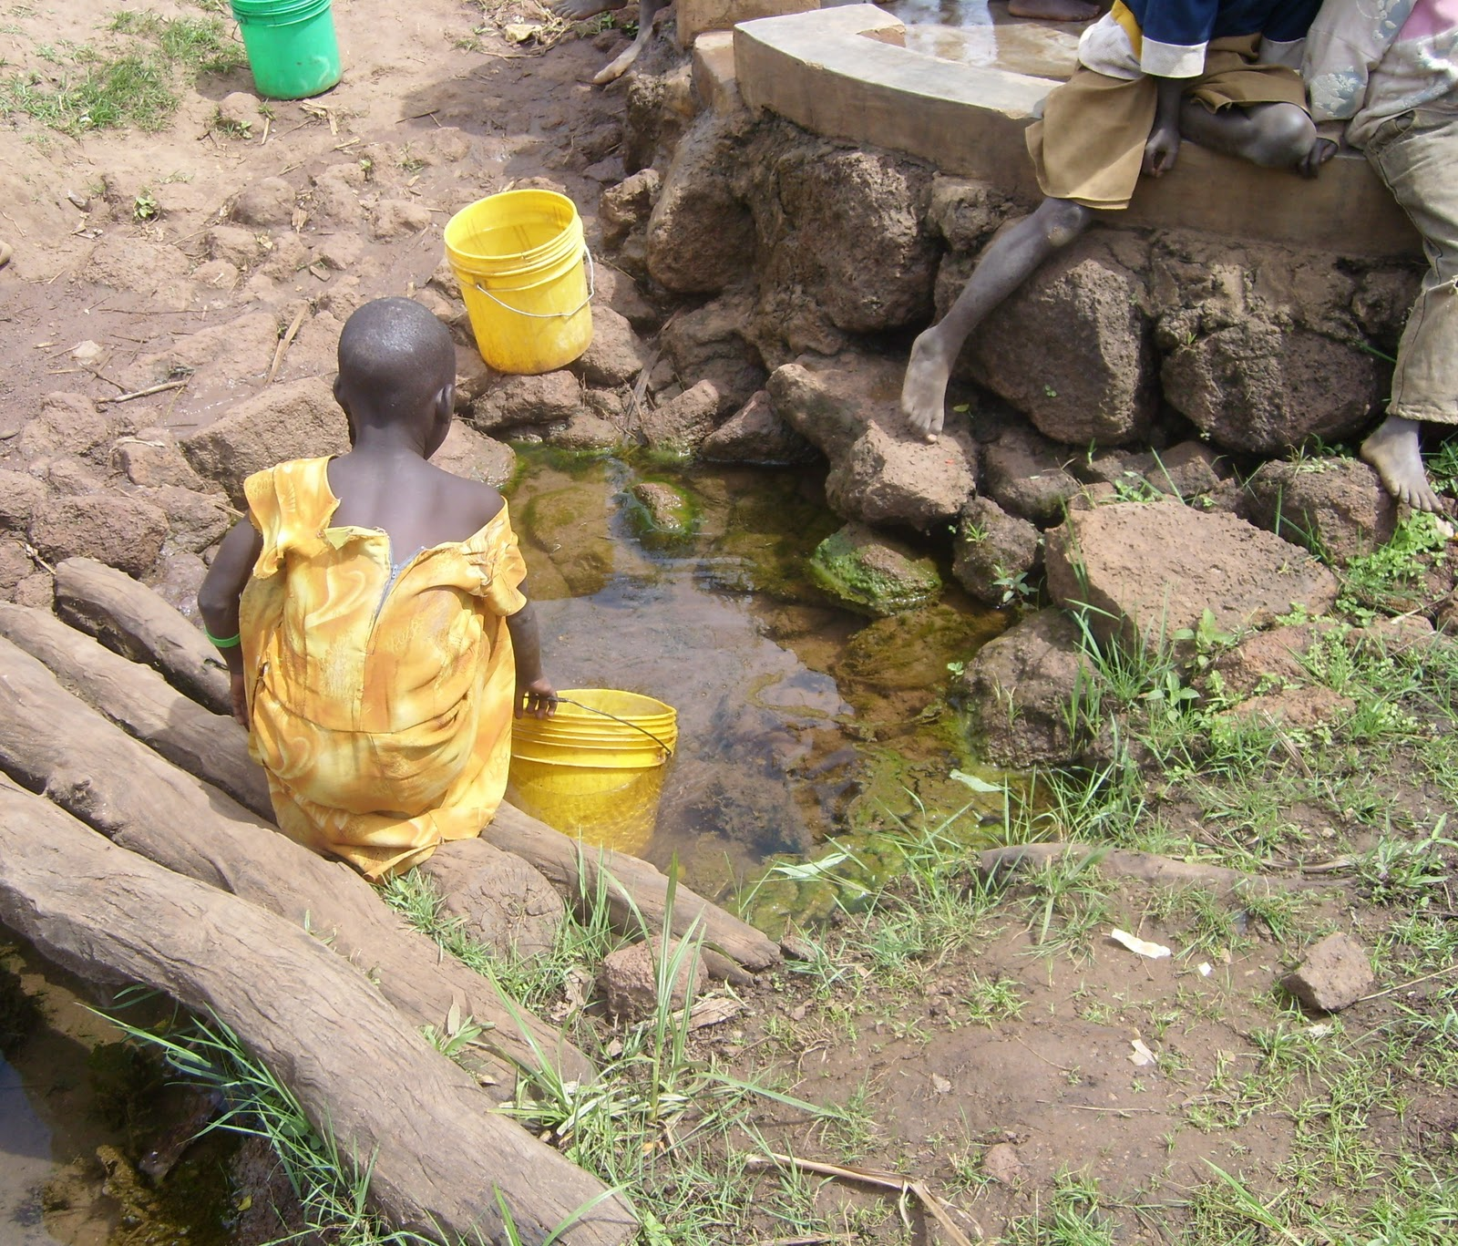
Access to Clean Water
42%
42% of population has access to
Clean water supply
1/3
1/3 of African population is
Living in drought prone areas
1%
One percent of cultivable area
Is under irrigation
Notes:
Rainfall in most of the countries in the Horn of Africa is low, unevenly distributed, highly variable and therefore unreliable. In the Horn of Africa, less than 1 per cent of the cultivable area is under irrigation; in other words, the farmers’ dependence on rainfall is huge. As the region has limited other water resources, the scale and duration of rainfall is the main climatic factor determining land productivity. According to FAO (2011) the climate in the Horn of Africa has become increasingly unstable and the weather events are more severe. Similar observations are made by Oxfam Novib claiming that Kenya had three successive seasons of poor rains, Ethiopia had four and Somalia had even five of these failed rainy seasons.

Slide 16


http://www.cna.org/sites/default/files/MAB_2014.pdf

Slide 17
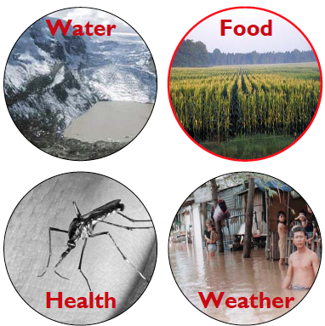
Findings - Africa
Climate change will facilitate:
  Weakened governance
  Economic collapse
  Human migrations
  Potential conflicts
  Stability operations
  and humanitarian
  missions could
  increase.

Slide 18
Water and Climate Change
Water resources are linked with climate so the prospect of global climate change has serious implications for water resources and regional development
The United Nations forecasts freshwater scarcity in almost half of 54 African countries
The population of Africa is projected to double to two billion persons by 2050, and the demand for water will drastically increase
unclassified
Notes:
Competing needs for water resources are well documented as a key factor contributing to conflict and instability worldwide
The U.N. had identified nine river basins in Africa that are at risk of the onset of tensions or conflict

Slide 19
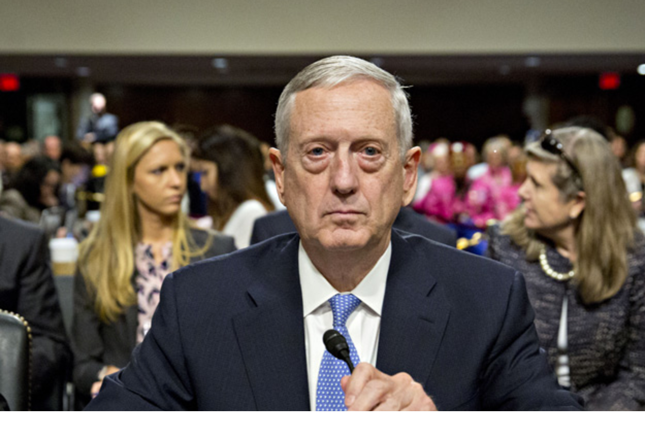
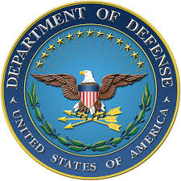
Secretary of Defense James Mattis
has asserted that climate change is real, and a threat to American interests abroad and the Pentagon’s assets everywhere, a position that appears at odds with the views of the President and many in the administration in which he serves. ”March 16, 2017”

Slide 20
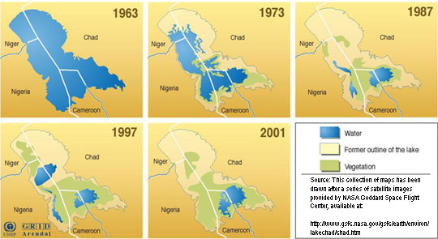
Water Security Challenge
Disappearance of Lake Chad
unclassified
Notes:
Lake Chad was once Africa’s largest water reservoir in the Sahel region, covering an area of about 26,000 square kilometres, about the size of the US state of Maryland and bigger than Israel or Kuwait. By 2001 the lake covered less than one-fifth of that area. “It may even be worse now,” says Abbas Mohammed, a climatologist at the University of Maiduguri, Nigeria.
Dams and irrigation
The UN Environment Programme (UNEP) and the Lake Chad Basin Commission (LCBC), a regional body that regulates the use of the basin’s water and other natural resources, maintain that inefficient damming and irrigation methods on the part of the countries bordering the lake are partly responsible for its shrinkage. Emmanuel Asuquo-Obot of the World Wildlife Fund (WWF), an organization devoted to wildlife conservation, points to the diversion of water from the Chari River to irrigation projects and dams along the Jama’are and Hadejia Rivers in northeastern Nigeria.
As parts of the lake dry up, most farmers and cattle herders have moved towards greener areas, where they compete for land resources with host communities. Others have gone to Kano, Abuja, Lagos and other big cities for menial jobs or to roam the streets as beggars.
Tensions rise
The impact of the drying lake is causing tensions among communities around Lake Chad. There are repeated conflicts among nationals of different countries over control of the remaining water. Cameroonians and Nigerians in Darak village, for example, constantly fight over the water. Nigerians claim to be the first settlers in the village, while Cameroonians invoke nationalistic sentiments, since the village is within Cameroonian territory. Fishermen also want farmers and herdsmen to cease diverting lake water to their farmlands and livestock.
The LCBC — established by the leaders of Chad, Nigeria, Cameroon and Niger in 1964 and later joined by the Central Africa Republic in 1994 — and its partners continue to make efforts to save the lake or at least mitigate the impact of its shrinkage on people’s lives. In his book An Inconvenient Truth, former US Vice-President Al Gore shows several images of the lake shrinking from 25,000 square kilometres in 1963 to just 1,500 square km in 2001. However, a 2007 satellite image shows improvements from previous years.
Recent drought may again have worsened the situation, says Professor Mohammed of the University of Maiduguri. He urges the LCBC and its partners to tackle the impact of climate change, as well as to control damming and irrigation by the LCBC countries.
20

Slide 21
Causes: Climate change, seasonal variability, and human uses (deforestation and irrigation)
The world’s sixth largest lake in 1960
1963-2001: Has shrunk about 95%
unclassified

Slide 22
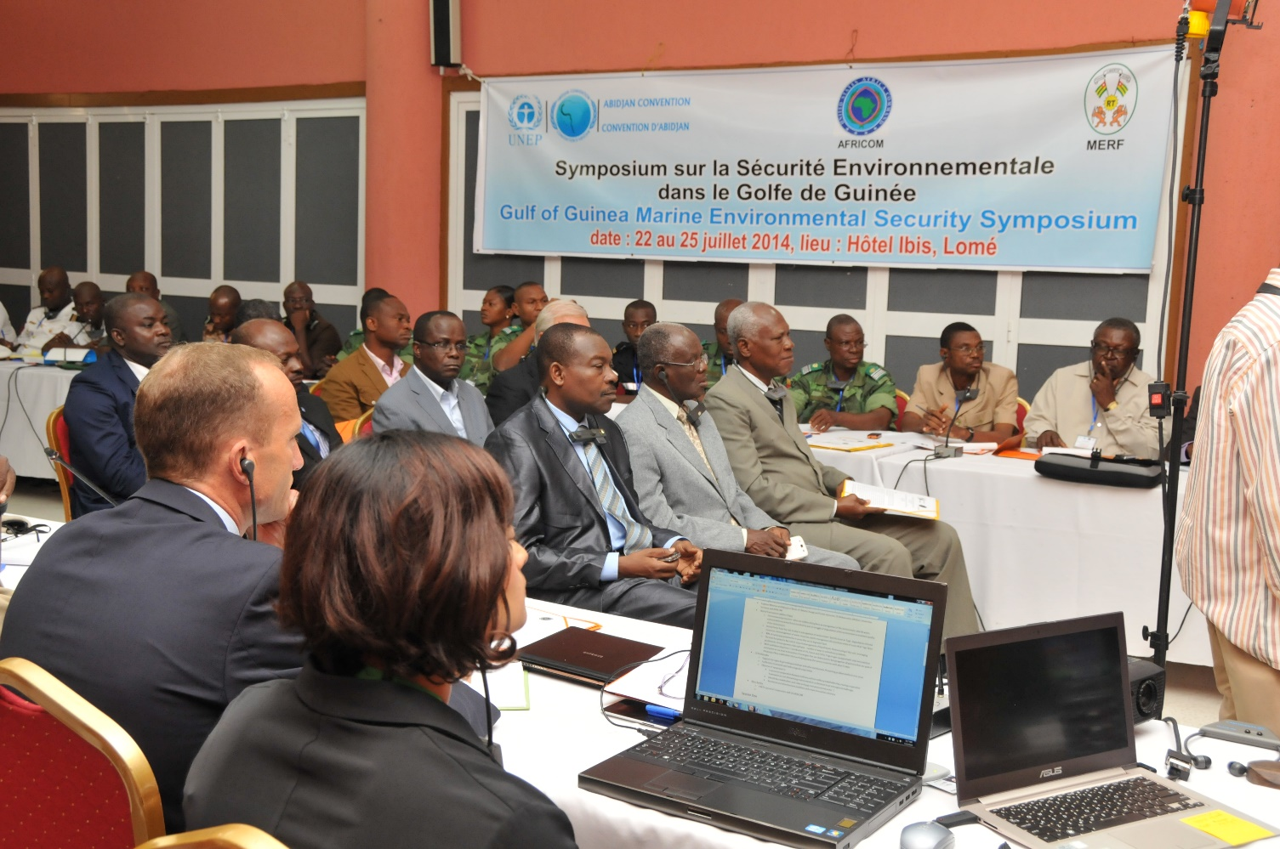
Outreach
Examples

Slide 23
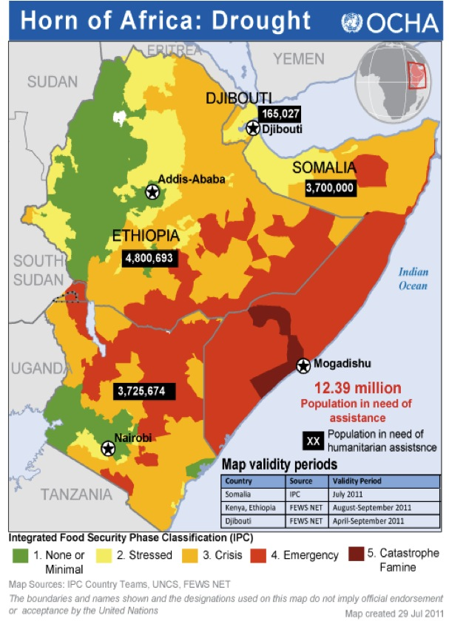

Slide 24

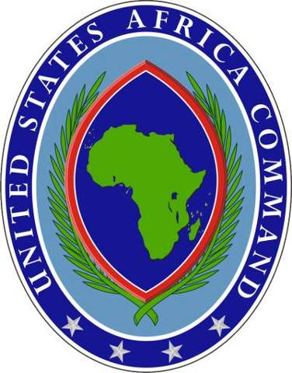

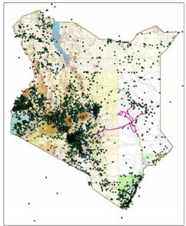
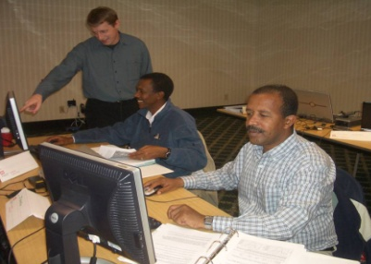
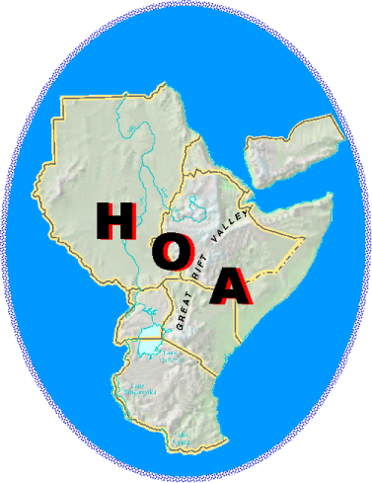
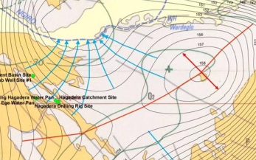
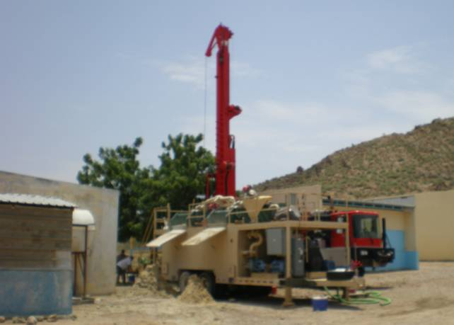
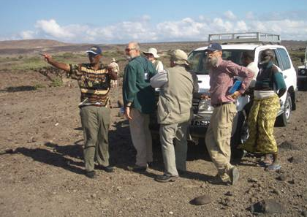
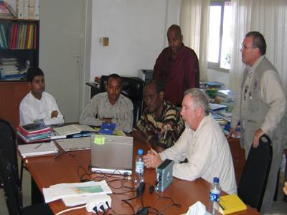
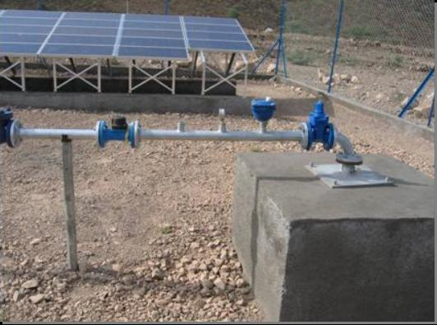
Capacity Building:
Past Collaboration
2010-17 Horn of Africa Water Resources Program Overview
Watershed Management Workshops in Collaboration with Partner Nations
Develop Water Well & Groundwater Inventory Database
Prepare Groundwater Maps
for Specific Areas
Provide Technical Support to CJTF-HOA Engineers and CA Teams
Conduct Field Surveys to Locate Water Sources
Capacity Building
Collect Existing Water Resources Information and Enter the Information into Databases
Identify Alternative Technologies to Improve Sustainability

Slide 25
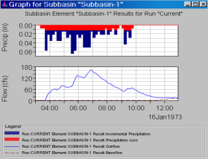
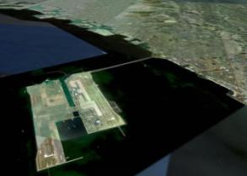
Mil-to-Mil and DEIC Water Security Opportunities
Train host country military or civilian equivalent
Provide technical and analytic support
Potential Topical Areas:
Water assessments: Where is it and how
much is available?
Water needs plans for forward deployed units?
Help resolve transboundary water issues.
Prevent and reduce vulnerability to extreme
natural events
Ensure navigability of ports and rivers
Notes:
25

Slide 26
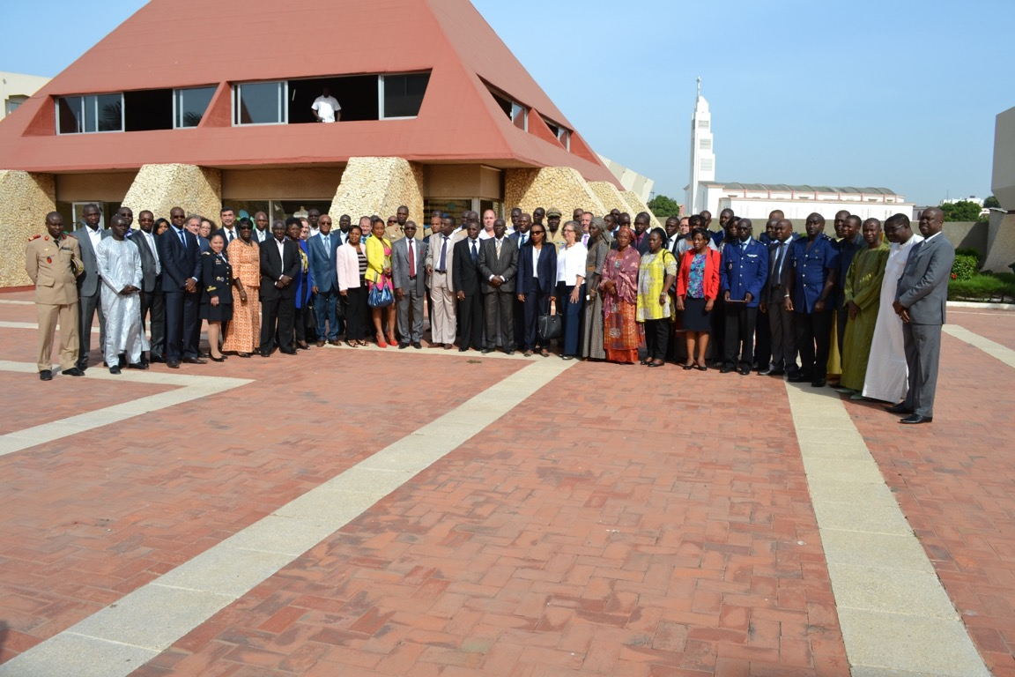
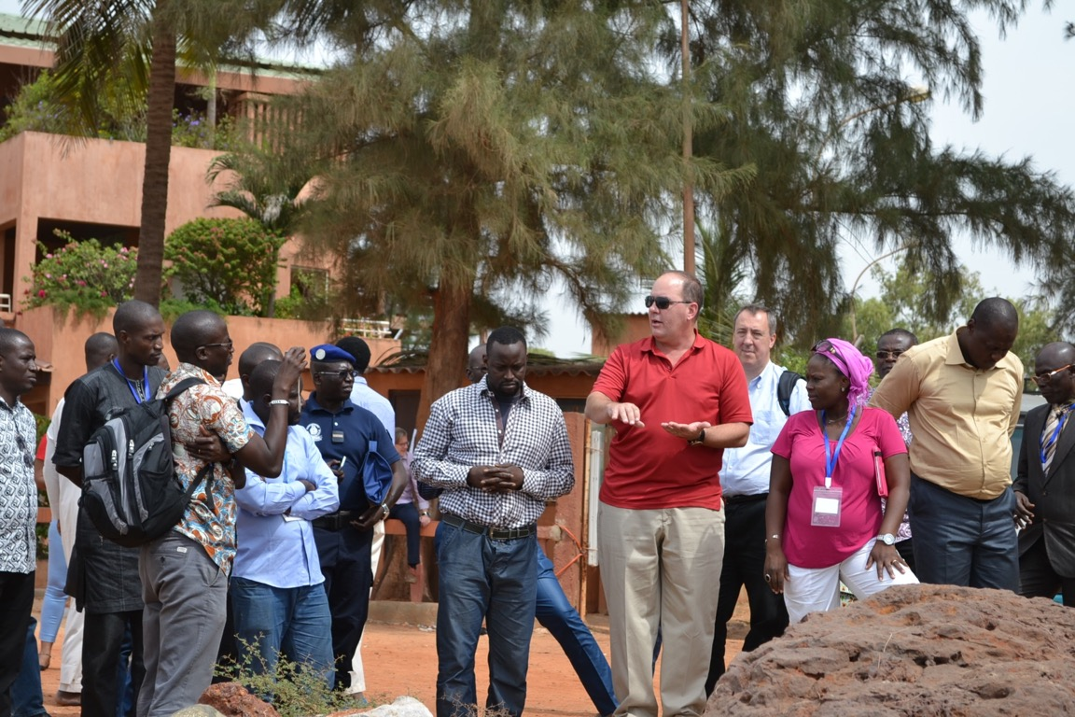

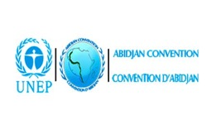

Climate change in Senegal is predicted to manifest as a decrease in the amount of rainfall--however, with increased intensity
Notes:
What is desertification: It is the term used to describe the changing of semi arid (dry) areas into desert. It is severe in Sudan, Chad, Senegal and Burkina Faso
What are the causes:
Overcultivation: the land is continually used for crops and does not have time to recover eventually al the nutrients are depleted (taken out) and the ground eventually turns to dust.
Overgrazing: In some areas animals have eaten all the vegetation leaving bare soil.
Deforestation: Cutting down trees leaves soil open to erosion by wind and rain.
Climate Change: Decrease in rainfall and rise in temperatures causes vegetation to die
What is being done to solve the problem?
Over the past twelve years Oxfam has worked with local villagers in Yatenga (Burkina Faso) training them in the process of BUNDING. This is building lines of stones across a slope to stop water and soil running away. This method preserves the topsoil and has improved farming and food production in the village.
Burkina Faso - desertification
This video shows the Sahel region south of the Sahara is at risk of becoming desert. Elders in a village in Burkina Faso describe how the area has changed from a fertile area to a drought-prone near-desert. The area experiences a dry season which can last up to eight or nine months. During this time rivers dry up and people, animals and crops are jeopardised.
- See more at: http://www.revisionworld.com/gcse-revision/geography/development/case-studies/case-study-sahel-desertification#sthash.a0dGPkre.dpuf
Read more at http://www.revisionworld.com/gcse-revision/geography/development/case-studies/case-study-sahel-desertification#CQfwrDDr8RVooweb.99

Slide 27
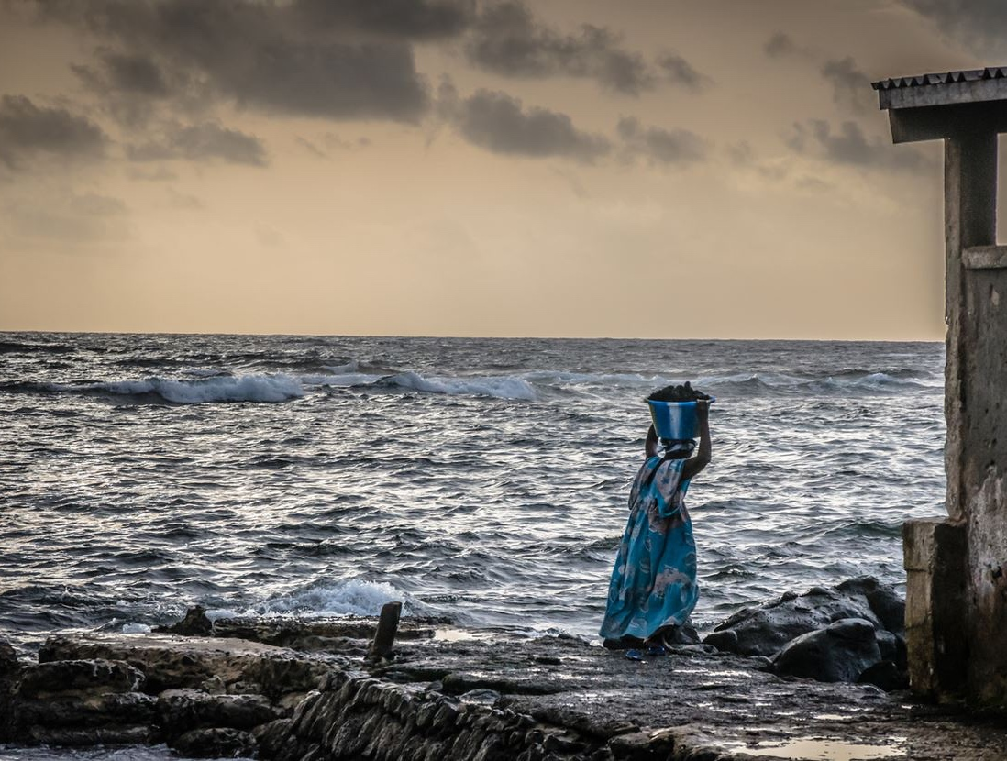
- Drought and saline intrusion threaten water supplies
- Coastal erosion, with sea-level rise, threatens infrastructure
- Temperatures increase and
sea-levels rise
- Urban-coastal migration and degraded natural resources are already aggravating development challenges

Slide 28
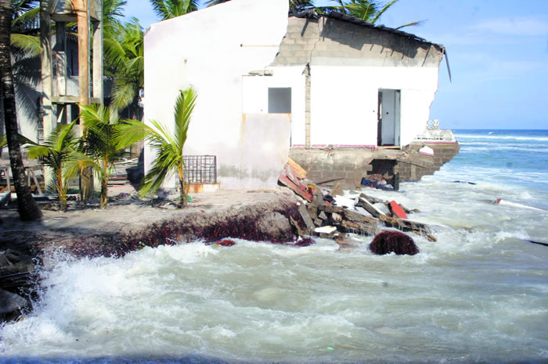


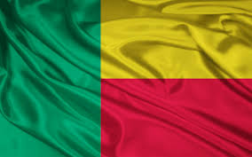
Symposium highlighted the need for long-term commitment and continued engagement with the Gulf of Guinea stakeholders in order to assist with capacity building within region.
Notes:
Togo beach called Ramatou which was destroyed by the sea.

Slide 29
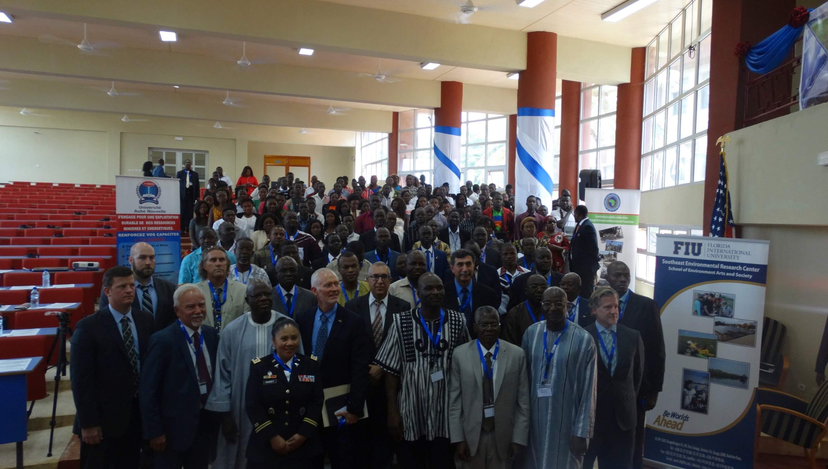
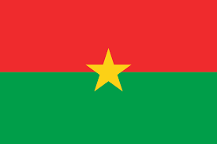




Slide 30
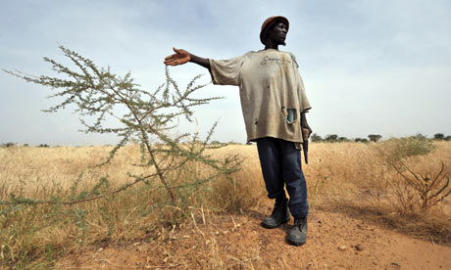
Burkina’s desert
areas have been
spreading, a process
known as
“desertification.”-
Overcultivation
Overgrazing
4-12% of agricultural GDP is lost due to deteriorating environmental conditions
Climate Change
Deforestation
Notes:
What is desertification: It is the term used to describe the changing of semi arid (dry) areas into desert. It is severe in Sudan, Chad, Senegal and Burkina Faso
What are the causes:
Overcultivation: the land is continually used for crops and does not have time to recover eventually al the nutrients are depleted (taken out) and the ground eventually turns to dust.
Overgrazing: In some areas animals have eaten all the vegetation leaving bare soil.
Deforestation: Cutting down trees leaves soil open to erosion by wind and rain.
Climate Change: Decrease in rainfall and rise in temperatures causes vegetation to die
What is being done to solve the problem?
Over the past twelve years Oxfam has worked with local villagers in Yatenga (Burkina Faso) training them in the process of BUNDING. This is building lines of stones across a slope to stop water and soil running away. This method preserves the topsoil and has improved farming and food production in the village.
Burkina Faso - desertification
This video shows the Sahel region south of the Sahara is at risk of becoming desert. Elders in a village in Burkina Faso describe how the area has changed from a fertile area to a drought-prone near-desert. The area experiences a dry season which can last up to eight or nine months. During this time rivers dry up and people, animals and crops are jeopardised.
- See more at: http://www.revisionworld.com/gcse-revision/geography/development/case-studies/case-study-sahel-desertification#sthash.a0dGPkre.dpuf
Read more at http://www.revisionworld.com/gcse-revision/geography/development/case-studies/case-study-sahel-desertification#CQfwrDDr8RVooweb.99

Slide 31
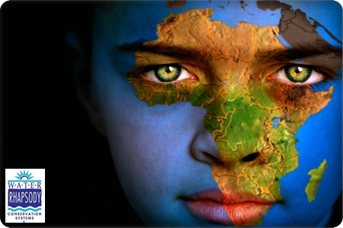
Access to Clean Water
3^{M}
3 million people in Burkina Faso lack
access to an improved water source
13.4^{M}
81% do not have access to improved
sanitation in Burkina Faso, over 13
million people
12,000
Over 12,000 children under five years old die annually
from poor water and sanitation in Burkina Faso

Slide 32
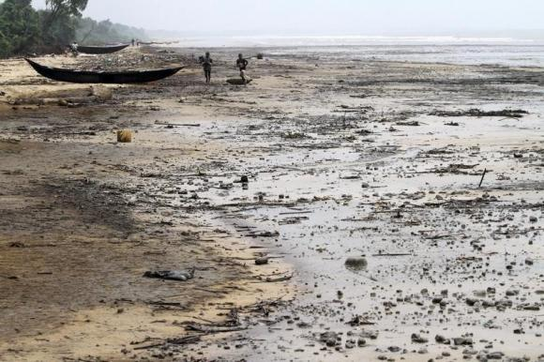





Engage key military, government authorities, and all other key stakeholders who are involved in maritime safety, oil pollution preparedness, and spill response.
Notes:
A view of the shore of the Atlantic ocean at Orobiri village days after Royal Dutch Shell’s Bonga off-shore oil spill, in Nigeria’s delta state December 31, 2011.
https://africajournalismtheworld.com/tag/nigeria-oil-spill/

Slide 33
Notes:
Opening
Bindu -Thank you for the opportunity. We’re really excited to be here! We are an interagency team here to pitch tech transfer to overcome energy poverty.
Slide 1: Title
Bindu - I’m Dr. Bindu Nair of the Department of Defense
Troy - I’m Troy Warshel also from DoD
Alexis - I’m Dr. Alexis Erwin from USAID
Molly - I’m Molly Ward the State Dept

Slide 34

Globally, over 1 billion people lack access to electricity.
Asia: 500m
Africa: 600m
Latin America: 20m
Notes:
Molly - This is a composite of the world at night. You can see that certain areas – notably the US and EU – are well lit, whereas other regions – particularly Africa and Asia – have very little light.
Bindu -- We propose to overcome energy poverty by testing microgrids in US military bases overseas and then transferring the technology to local communities.
Bindu - We can light up the world through low-emissions approaches wherever possible -- so we do not contribute to climate change.

Slide 35

Africa is the most electricity poor region in the world. 600m people (70% of population) are without power.
Notes:
Alexis - We chose Africa as a proof of concept because it is one of the most energy poor regions in the world and is an area of increasing US strategic interest. 600 million people are without power and half of those people live in areas too remote for connection to the national electric grid to be economically viable.

Slide 36

Access to electricity enables students to study at night, improving grades and graduation rates
Notes:
Alexis - Access to electricity drives development in multiple sectors.
Alexis - Access to electricity enables students to study at night which improves grades and graduation rates.

Slide 37

Access to electricity facilitates irrigation,
increasing production and food security.
Notes:
Alexis - Access to electricity facilitates irrigation, which increases production and food security.
Alexis - Access to electricity increases household income as much as 50% and drives economic growth and the creation of new markets.
Troy - We believe that by investing in energy and partnership today we will be able to reduce the security risks of tomorrow.

Slide 38


POWER AFRICA
Leveraging Partnerships to Increase
Access to Power in Sub-Saharan Africa
On June 30, 2013 in Cape Town, South Africa, President Obama announced Power Africa — an initiative to increase access to power in sub-Saharan Africa.
Focusing on six initial partner countries, Power Africa will add more than 10,000 megawatts (MW) of clean, efficient electricity generation capacity.

Slide 39

10 Years of Environmental Engagements
40 Countries
81 Environmental Engagements
unclassified

Slide 40
Finally ….
The main objective of the program is to conduct, in collaboration with other USG agencies and international partners, capacity building engagements with Host Nation military, civilian organizations, NGOs, UN, International Organizations (IOs), academia, and private sector participants, throughout the continent of Africa.

Slide 41
Thank you

