Slide 1

Drinking Water and Sanitation Services in a context of global uncertainty
Roberto Olivares
Director General, ANEAS
Sept/2018
cc: The PIX-JOCKEY (visual fantasist) - https://www.flickr.com/photos/18583731@N07

Slide 2
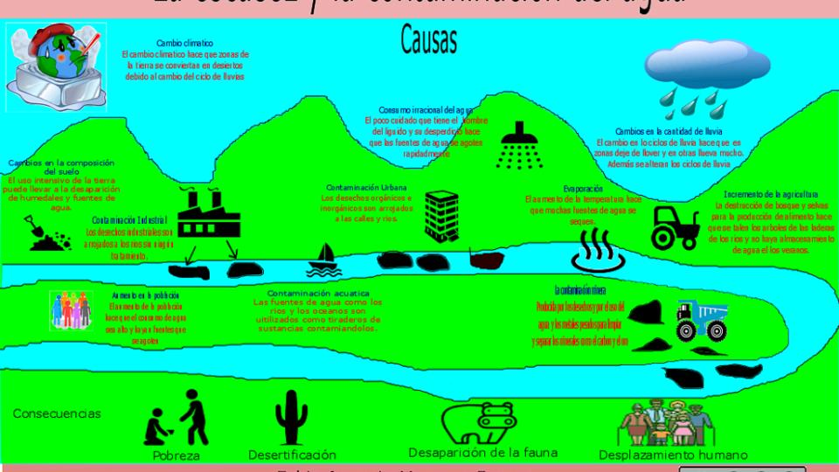
By 2030 the demand will be 40% higher than the water supply
cc: favanegasb - https://www.flickr.com/photos/26429742@N05

Slide 3
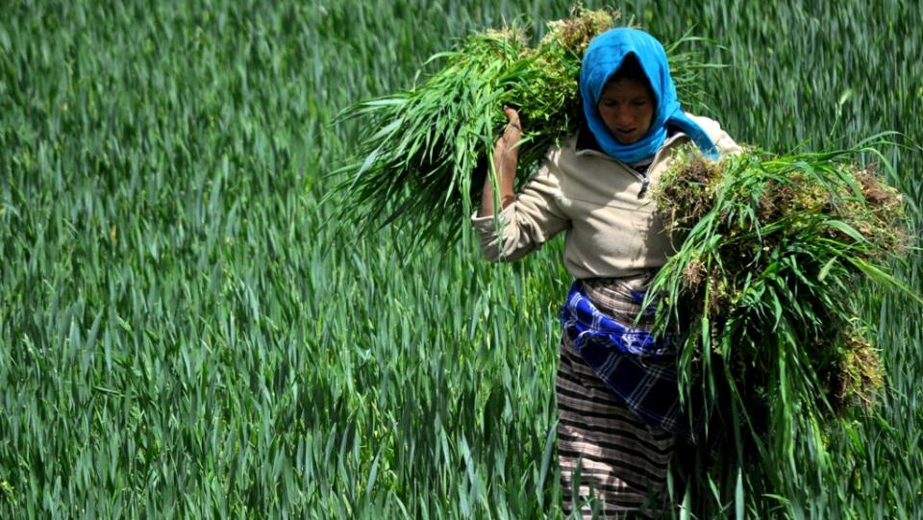
In the year 2050 more water will be needed to produce 60% of additional food to satisfy the requirements of the 9,000 million inhabitants the planet will host by the middle of the century
cc: Mário Tomé - https://www.flickr.com/photos/7498280@N08

Slide 4

Water management plays a key, strategic role
cc: Liter@to - https://www.flickr.com/photos/66591267@N00

Slide 5

What to do?
Certainly not what we have been doing!
cc: Leo Reynolds - https://www.flickr.com/photos/49968232@N00

Slide 6
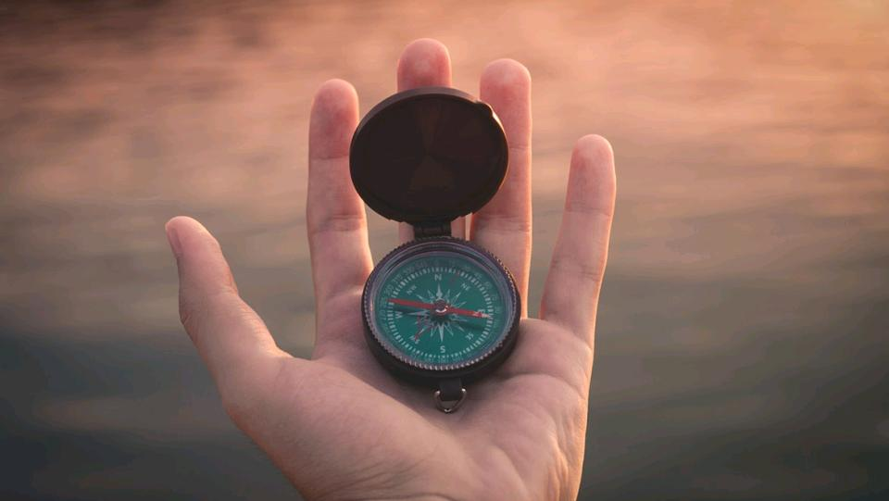
In the case of public water and sanitation services, building a new management paradigm is required
cc: Aron - https://unsplash.com/@aronunsplash?utm_source=haikudeck&utm_medium=referral&utm_campaign=api-credit

Slide 7
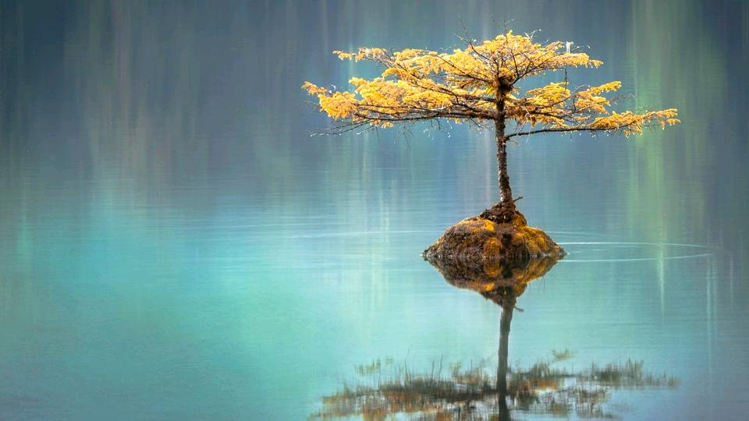
The concept of Water Security provides us with a sufficiently broad analytical framework to incorporate absent social and political variables
cc: Faye Cornish - https://unsplash.com/@fcornish?utm_source=haikudeck&utm_medium=referral&utm_campaign=api-credit

Slide 8
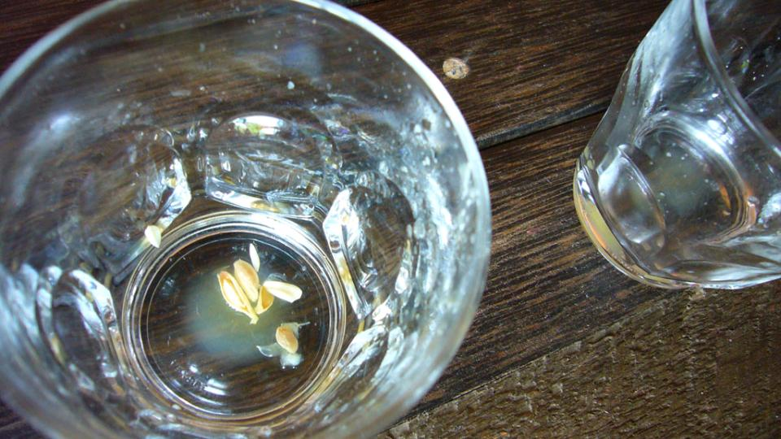
1) Actual water availability
cc: L'Angelo Custode - https://www.flickr.com/photos/39488699@N00

Slide 9
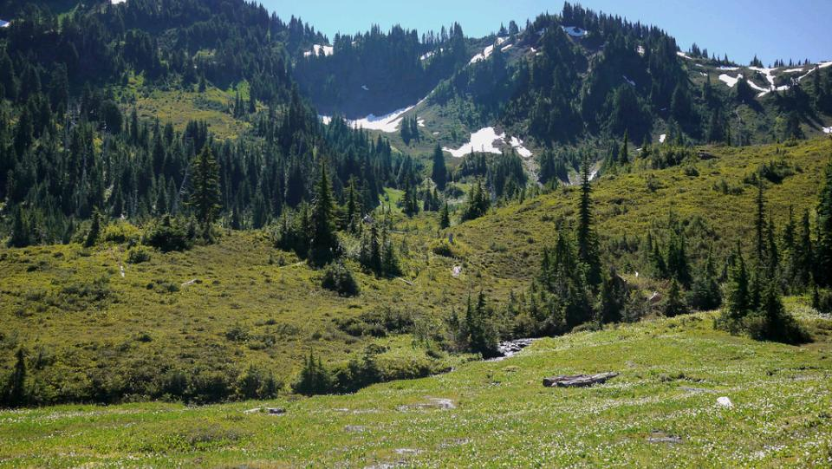
2) Manage water from a basin approach
cc: bensonk42 - https://www.flickr.com/photos/23276058@N04

Slide 10
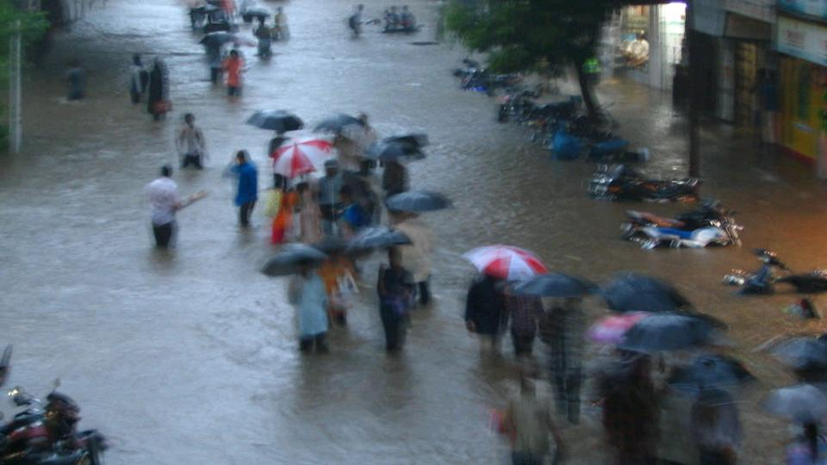
3) Risk management for extreme hydrometeorological events
cc: GreyArea - https://www.flickr.com/photos/34427465501@N01

Slide 11
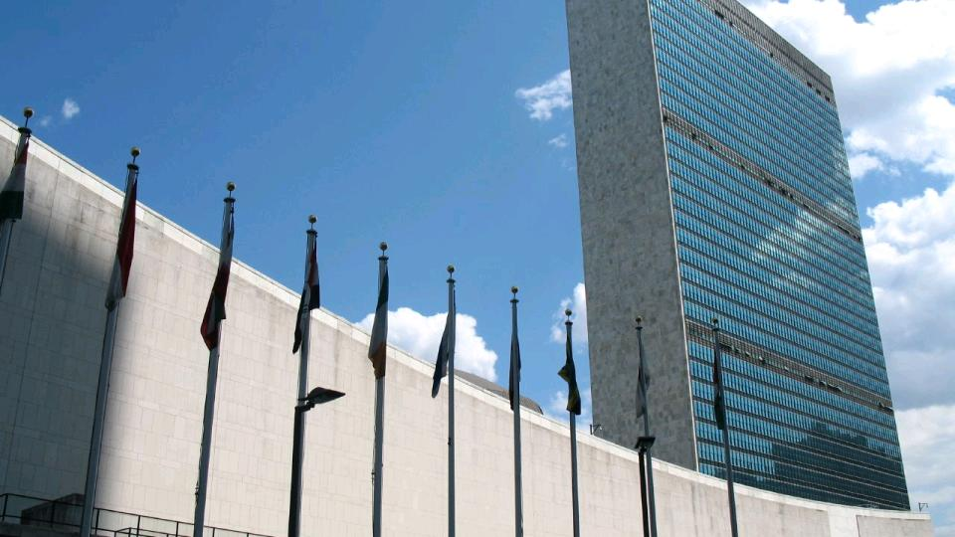
Water Security
and
National security
cc: m g a - https://www.flickr.com/photos/17365853@N00

Slide 12

Water security is a huge challenge that we can only achieve if we are able to visualize new ways of managing water.
cc: Mike Scheid - https://unsplash.com/@mscheid?utm_source=haikudeck&utm_medium=referral&utm_campaign=api-credit

Slide 13

Thank you!
Roberto Olivares
Director General, ANEAS
Sept/2018
cc: warein.holgado - https://www.flickr.com/photos/84129012@N00

