Slide 1


SUSTAINABLE WATER SECURITY
UNESCO CHAIR
at FLORIDA INTERNATIONAL UNIVERSITY

Slide 2

APPROACH TO INTERNATIONAL RESEARCH AND EDUCATION
Fostering a Multi-cultural Environment to Graduate Global Citizens
International Career Development Internship
Alternative Breaks
Hosting foreign Scholars
Short-term Programs
Exchange Programs
Offering Study Abroad Programs
Attracting Foreign Students
Attracting and Retaining Internationally Experienced Faculty and Staff
p.3

Slide 3

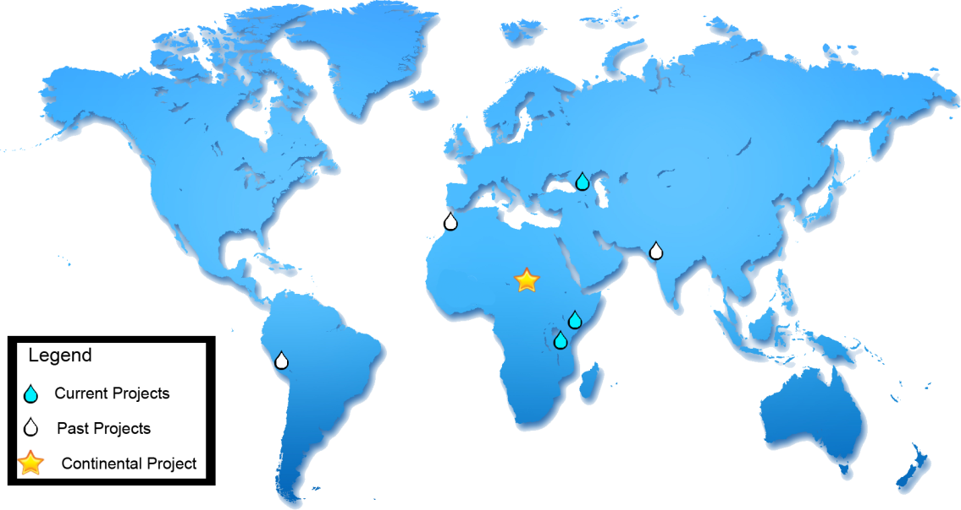

USAID -GLOWS projects geographical distribution: Peru, Ecuador, Morocco, Tanzania, Kenya, Georgia, Ghana, Niger, India, Burkina Faso, Mexico, Honduras, Haiti, and Rwanda .
.
p.5

Slide 4
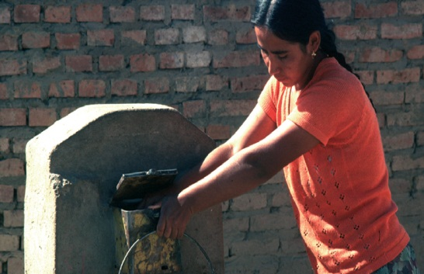
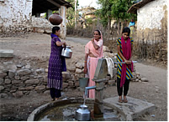
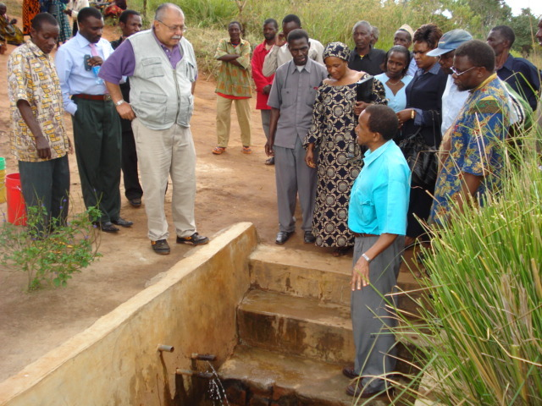
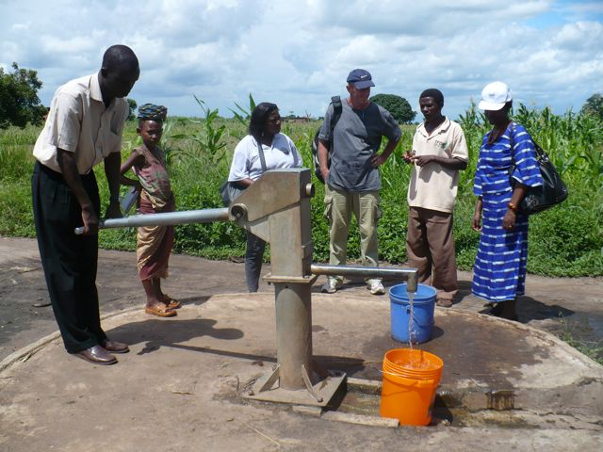
Applying Integrated Water Resources Management (IWRM) is critical for the successful implementation and long term benefits of interventions in development water program of various nature
Water Security is substantial to
IWRM
p.9

Slide 5
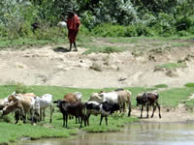
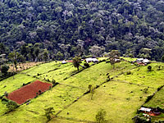
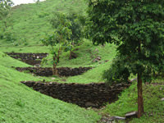
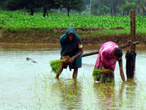
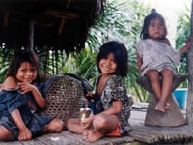
Water: a vital resource
Water Security: a key challenge for the 21st century
p.7

Slide 6
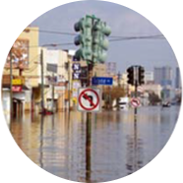
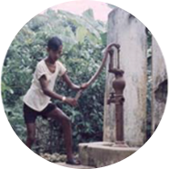
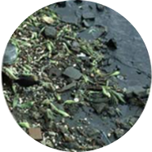
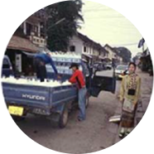


IHP-VIII 2014-2021
Axis 1
Mobilizing International cooperation to Improve knowledge and innovation to address water security challenges
Water Related Disasters and Hydrological Changes
Education, Key to Water Security
Groundwater in a Changing Environment
Addressing Water Scarcity and Quality
Water and Human Settlements of the Future
EcohydrologyEngineering Harmony for a Sustainable World
Axis 3
Developing institutional and human capacities for water security and sustainability
Water Security, Addressing Local, Regional and Global Challenges
Axis 2
Strengthening the Science-Policy interface to reach water security at local, national, regional, and global levels
p.8

Slide 7
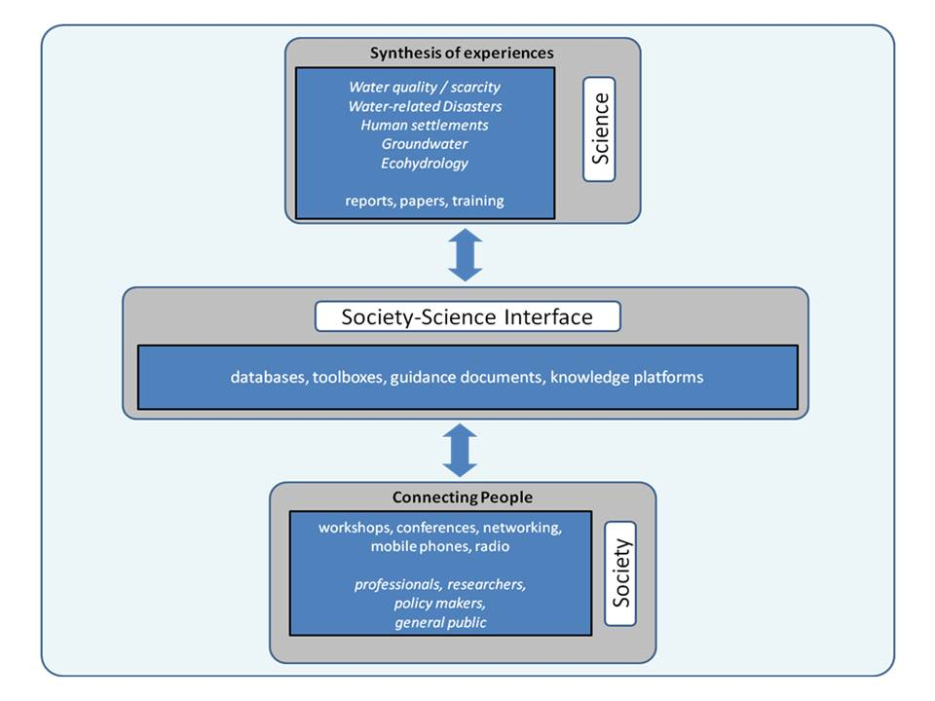
Putting science into action
p.12

Slide 8
SDG
Goal 6:
Insure availability and sustainable management
The UNESCO Chair on
Water Security Sustainability
p.11

Slide 9
FOCUS
advance the knowledge needed to address complex water security issues, both locally and globally,
promote interdisciplinary research, education, capacity building and public engagement,
link academics, students, researchers and water professionals with local, regional, and international programs and stakeholders to foster water sustainability.

Slide 10

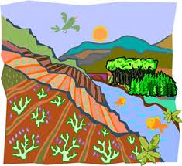

Development objective
–The long term development objective of the UNESCO Chair “Sustainable Water Security” is to contribute to the overall sustainable development goals by supporting ensure equitable availability and sustainable management of water.
1

Slide 11

Specific objectives
To coordinate and contribute to research, science and technology development, innovation and policies related to Sustainable Water Security.
To promote and foster national and international scientific cooperation and integrated scientific approaches to effectively manage and conserve water resources.
To build human and institutional capacity at all levels to support sustainable water security.
To advocate for, strengthen, and participate in global partnerships to bridge the science-policy interface.
p.14

Slide 12


FIU-UNESCO Sustainable Water Security Chair Structure
ADVISORY BOARD
FIU Members
External Members
UNESCO Representative
FIU-UNESCO
CHAIR HOLDER
Dr. Maria Donoso
THEME
COORDINATION COMMITTEE
Education & Capacity Building
Policy
Water Quality
Cybersecurity
Water Balance & Modeling
Sustainable Communities
Gender & Culture
Energy Nexus

Slide 13
Advisory Board
FIU Members of the Advisory Board
Todd Crowl - Director InWE
Brian Fonseca - Director Gordon Institute
Ines Triay- Director ARC
Frank Mora - Director LAC Center
External Members of the Advisory Board
Patricia Aquing (St. Lucia) – Executive Director, Caribbean Water and Wastewater Association
Max Campos (Costa Rica), invited – Chief Section Integrated Water Resources Management, Organization of American States
Fabio Castelli (Italy) – Dean, School of Engineering, University of Florence
Pilar Cornejo (Ecuador) – Dean FIMCBOR, Escuela Politecnica del Litoral
Roberto Olivares (Mexico) – Director General, Association of Water Utility Enterprises (ANEAS) Association of Water Utilities Enterprises
Andras Szollozi-Nagy (Hungary) – Chair, Water Future
William Cunningham (USA) – Director of the Earth System Processes Division, USGS
UNESCO Representative to the Advisory Board
Miguel Doria – UNESCO Regional Hydrologist for Latin American and the Caribbean.

Slide 14
Theme Coordination Committee
Thematic Area | FIU Theme Coordinator | External Theme Coordinator
Education an Capacity Building | Dr. Rita Teutonico, (Associate Dean, CASE) | Dr. Evens Emmanuel, Vice Rector for Research, University of Quisqueya, (Haiti), invited.
Policy | Dr. Shlomi Dinar, (Associate Professor SIPA) | Mr. Victor Pochat – Member of the Academy of Environment Sciences Argentina)
Water Quality | Dr, Henry Briceno (InWE-CASE) | Dr. Rafael Val Segura, Instituto de Tecnologia del Agua and UNESCO Chair on Water Culture (Mexico)
Cybersecurity | TBD (invited, GIPP and ARC) | TBD (invited, OAS)
Water Balance and Modelling | Dr. Reinaldo Garcia (InWE-CASE) - | Dr. Alfonso Gutierrez, U. Queretaro – LAC Regional Coordinator of the International Flood Initiative (Mexico)
Sustainable Communities | Dr. Shahin Vassigh (Associate Dean CARTA) | Dr. Fernando Nardi, U. Perugia – Professor and UNESCO Co-Chair on Water and Culture (Italy)
Gender and Culture | Dr. Jennifer Veilleux (SIPA – InWE) | TBD
Energy Nexus | Dr. Leo Lagos (Associate Director ARC) | TBD

Slide 15
Outreach of the FIU-UNESCO Chair
FIU-UNESCO
CHAIR

Slide 16

WHAT HAVE WE DONE? ( March to Dec. 2017)
Coordinated and edited an Aqua-LAC Special Number on Haiti
Established a MoU FIU-Univ. Perugia, based on UNESCO Chairs cooperation
In collaboration with a private foundation supported the Bi-annual Meeting of IHP-LAC
Presentation of the Chair in Dom. Rep, Bahamas, Mexico, Haiti, Itally, Private Sector France
Contribute to the WWF8 report for SA

Slide 17
WHAT HAVE WE DONE? ( January to August, 2018)
Established a MoU FIU-Pontificia Univ. Catolica Madre y Maestra
Co-authored the WWF8 report for SA
Presentation of the Chair in Brasilia, Panama, Paris, Washington
Facilitated negotiations and liaised with the Italian counterparts to establish dual Ph.D. Program FIU-Univ. Florence, FIU UNESCO Chair
WATER SECURITY CONFERENCE

Slide 18
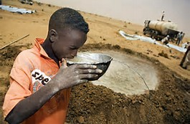
WHAT HAVE WE PLANNED for 2018
Contribute to a Special Publication on the 50 years of IHP in the Americas
Develop a capacity building action on hydrologic modeling in Haiti
Support and facilitate the establishments of MoUs with Universities in Ecuador (ESPOL), Mexico (IMTA and UNAM), India, other.
Presentation of the Chair in at least 5 countries
Support the establishment of a GRAPHIC site in Belize.

Slide 19
WHAT HAVE WE PLANNED for 2018
Participate in WWF 9 process and activities with UNESCO and others.
Contribute to an ongoing NSF-funded program Mex-Cuba-USA on coastal communities.
Support the application of the IWRM-SIT (USAID supported its development) in Dom Rep
In collaboration with LACC, carryout presentation(s) on water security to the Hispanic community in S. Florida.
Contribute to the UNESCO global water quality net.

Slide 20
WHAT HAVE WE PLANNED for 2018
In collaboration with OAS, the J. Gordon Institute ANEAS and ARC, further expand activiteis on cyber security for water security.
Under the Chair’s Policy Theme Coordination, support and strengthen the global water security forum, in collaboration with SIPA
Support the application of the IWRM-SIT (USAID supported its development) in Dom Rep.
Support the organization of the UNESCO Global Conference of Water Security.

Slide 21

FIU is glad to be part of the UNESCO
Water Family

Slide 22
Maria C. Donoso - FIU
Thank you !

