Slide 1

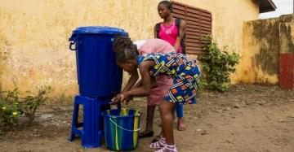
Keynote Presentation: UNESCO International Hydrological Programme
Strategy on Water Security
2018 Water and Environment Security Conference
Florida International University
Giuseppe Arduino
Division of Water Sciences,
UNESCO International Hydrological Programme
Paris, France

Slide 2


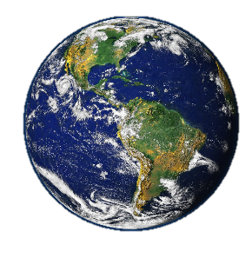
Water Security ?
Water Security is defined as:
The capacity of a population to safeguard access to adequate quantities of water of acceptable quality for sustaining human and ecosystem health on a watershed basis, and to ensure efficient protection of life and poverty against water related hazards, floods, landslides, land subsidence, and droughts. (IHP 8th Phase Strategy)

Slide 3
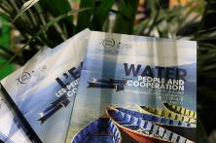
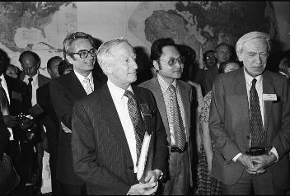
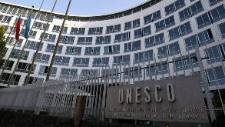

What Is Unesco IHP ?
The International Hydrological Programme (IHP) is UNESCO’s intergovernmental scientific cooperation program on water
It was created in 1975, becoming the first and only intergovernmental freshwater initiative institutionalized in the UN system

Slide 4
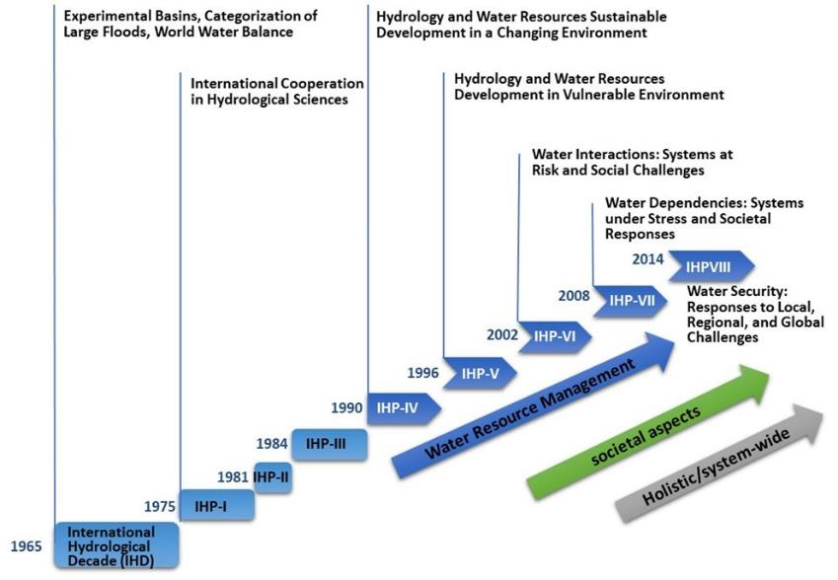
The evolution of IHP
From experimental models to societal needs

Slide 5

IHP’s Eighth phase 2014-2021
Existing regional Institutions
Institutional capacity
Human resources capacity
Mobilize International Cooperation
Improve Knowledge and Innovation
Strengthen the Science-Policy Interface
And reach WATER SECURITY at all levels
Strong Political will
Science based decisions
Data Information
Scientific research
Funding mechanisms
Third-party involvement
Water cooperation

Slide 6
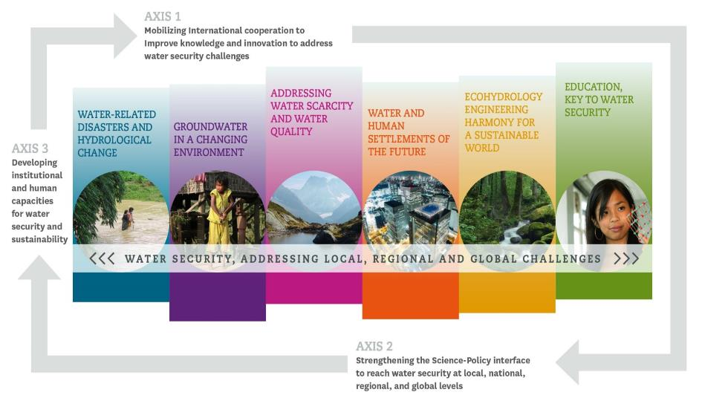
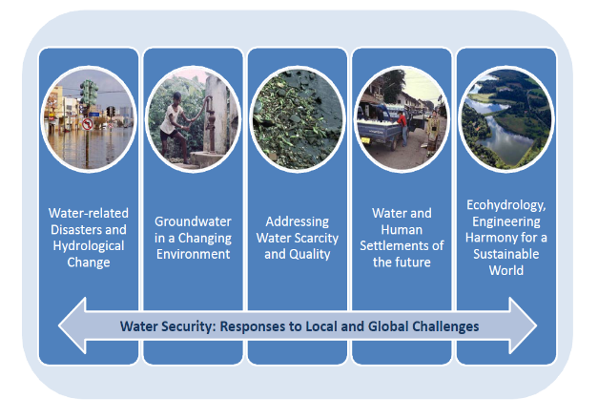
IHP’s Eighth phase 2014-2021
3 Axes
Axis 3: Enhancing policy advice to reach water security at local, national, regional and global levels.
6 Themes

Slide 7


IHP’s Governance
As the only Intergovernmental Programme of the UN system devoted to water research, water resources management, education and capacity building, IHP is governed by:
The IHP Intergovernmental Council
As per its Statutes and Rules of Procedure, the IHP Intergovernmental Council is composed of 36 UNESCO Member States elected for four years by the General Conference of UNESCO at its ordinary sessions. Each of UNESCO’s six electoral regions (North America and Western Europe; Eastern Europe; Latin America and the Caribbean; Asia and the Pacific; Africa, and Arab States) elects Member States for membership in the Council to ensure equitable geographical distribution and appropriate rotation. The Council ensure planning, definition of priorities, and supervision of the execution of IHP.
The IHP Bureau
It is composed of six members elected by the Council for two years representing the six electoral regions of UNESCO. The IHP Bureau fixes the dates of the Council sessions, prepares them, supervises the implementation of its resolutions, and reports to the Council.
Notes:
The UNESCO Water Family counts 36 Category 2 Centres on Water and 42 Water Chairs

Slide 8

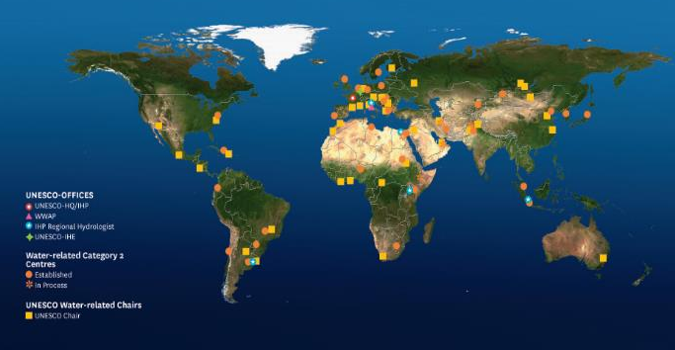

The UNESCO Water Family, is IHP and…
56 Chairs
37 Centres
In 70 countries
Notes:
The UNESCO Water Family counts 36 Category 2 Centres on Water and 42 Water Chairs

Slide 9

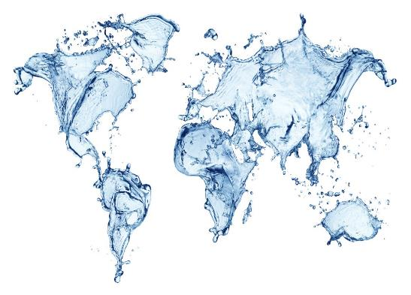
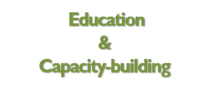



The UNESCO WATER FAMILY
promotes international scientific cooperation
in WATER RESEARCH
Notes:
The Division of Water Sciences of UNESCO, of which IHP is part, also manages the coordination of the UNESCO Water Family which works as a single entity comprising 169 IHP National Committees in Member States, the World Water Assessment Programme (WWAP), and 37 other water centres under the auspices of UNESCO, and 54 water chairs This, in sum, represents more than 2000 experts and decision-makers in different water related fields, located all over the world and able to work in many of the commonly used languages.
These include;
UNESCO-IHE Institute for Water Education, located in Delft, The Netherlands, is formally part of UNESCO since 2003. UNESCO-IHE is the largest postgraduate water education facility in the world.
The World Water Assessment Programme (WWAP), located in Perugia, Italy, is a flagship programme of UN-Water, which brings together 30 UN agencies.

Slide 10
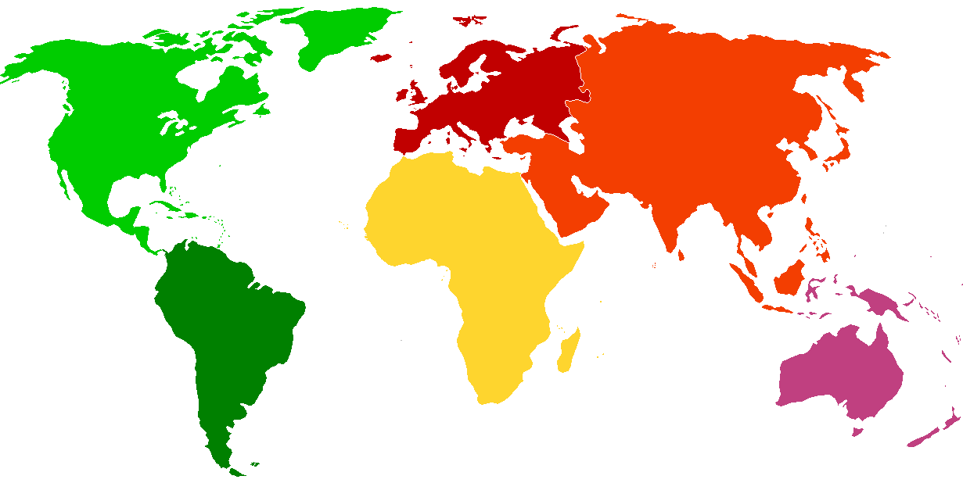

















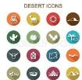






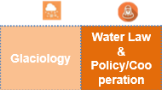







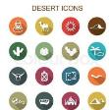






37 Centres
IHP Theme 1
IHP Theme 2
IHP Theme 3
IHP Theme 4
IHP Theme 5
IHP Theme 6

Slide 11







































56 Chairs
Water related disasters | Ground water | Water scarcity Quality | Water & Human Settlements | Eco-hydrology | Water education | Water and Gender | Water and Culture
Notes:
1. Water-related Disasters and Hydrological Changes
UNESCO Chair in Hydrological Change and Water Resources Management (Germany)
UNESCO Chair on Integrated River Research and Management (Austria)
UNESCO Chair on the prevention and sustainable management of geo-hydrological hazards (Italy)
2. Groundwater in a Changing Environment
UNESCO Chair in Geohydrology (South Africa)
UNESCO Chair in Sustainable Groundwater Management (Japan)
UNESCO Chair in Global Environmental Changes (Montreal)
3. Addressing Water Scarcity and Quality
UNESCO Chair in Water Resources (Sudan)
UNESCO-EOLSS Chair in Wadi Hydrology (Jordan)
UNESCO Chair on Water in Desert and Arid Zones (Lybia)
UNESCO Chair in Water Resources (Russian Federation)
UNESCO Chair in applied membrane sciences for environment (France)
UNESCO Chair on Water Resources Sustainability, Guatemala
UNESCO Chair in Sustainable Water Services (Finland)
UNESCO Chair on Water Reuse at the University of Tehran (Iran)
4. Water and Human Settlements of the Future
UNESCO Chair in Water and Environment Management for Sustainable Cities (Iran)
UNESCO Chair on Water Access and Sustainability (USA)
5. Ecohydrology, Engineering Harmony for a Sustainable World
UNESCO interdisciplinary Chair in Sustainable Water Resources Management (Morocco)
UNESCO Chair in Water ManagementCentral African Republic
UNESCO Chair on Water Resources Management and Ecohydrology (Russian Federation)
UNESCO Chair in Hydroinformatics for Ecohydrology China
UNESCO Chair in Water for Ecologically Sustainable Development (Serbia)
UNESCO Chair on Knowledge Systems for Integrated Water Resources Management (Pakistan)
UNESCO Chair on the Theory and Technology of Environmental Safety in Water Resources Control (Russian Federation
UNESCO Chair in Hydropolitics (Switzerland)
UNESCO Chair in Ecohydrology Water for Ecosystems and Societies (Portugal)
UNESCO Chair in Water Resources, Planning and Environmental Engineering (Ethiopia)
6. Water Education, Key to Water Security
UNESCO Chair/International Network of Water-Environment Centres for the Balkans on ‘Sustainable Management on Water and Conflict Resolution( Greece)
UNESCO Chair in Water in the Knowledge Society (Mexico)
UNESCO Chair in Water Economics and Transboundary Water Governance (Australia)
UNESCO Chair in Water and Education for Sustainable Development (Argentina)
7. Water and Gender
UNESCO Chair on Water, Women and Development (Brazil)
UNESCO Chair in Water, Women and Decision-making, (Côte d'Ivoire)
UNESCO Chair Water, Women and Decision-making, (Morocco)
UNESCO Chair in Women, Science and Reasoned Water Management in West Africa (Togo)
UNESCO Chair on Water, Women and Governance Dominican Republic
8. Water and Culture
UNESCO Chair on Water Resources Management and Culture Italy
UNESCO Chair on Environmental History: Water and Indigenous Peoples (USA)
UNESCO Chair on Water and Culture (Uruguay)

Slide 12

Water-related Disasters and Hydrological Change
Theme 1

Slide 13

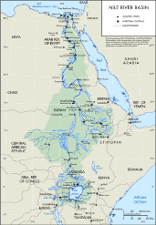
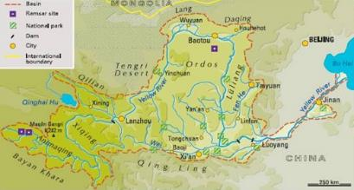
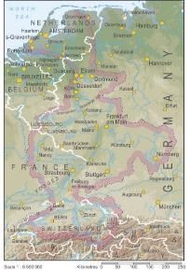
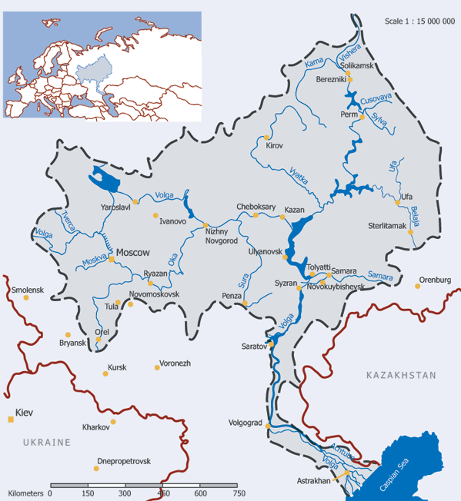
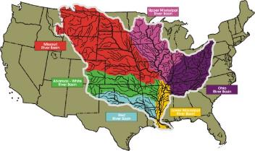
Benefiting from global and local earth observation systems
ISI - Sediment Issues & Sediment Management: Large River Basins Case Studies
The Yellow River Basin
The Nile River Basin
The Rhine River Basin
IHP THEME 1
The Mississippi River Basin
The Volga River Basin

Slide 14
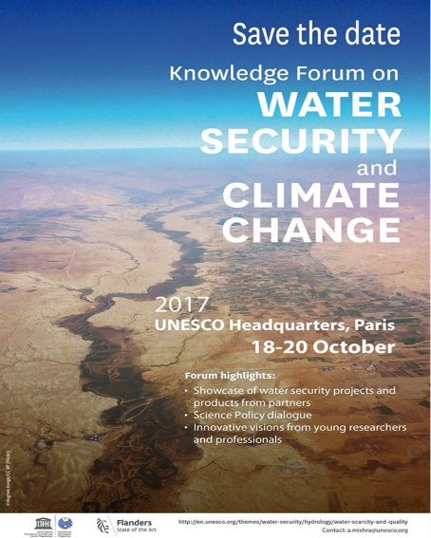
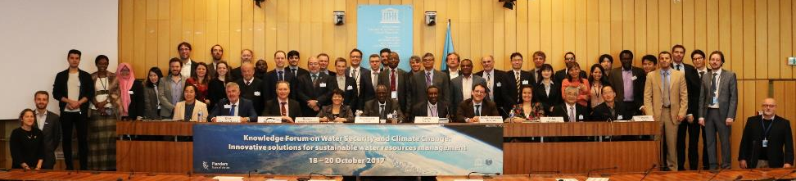
Improving the scientific basis for hydrology and water sciences for preparation and response to extreme hydrological events
Knowledge Forum:
Water Security and Climate Change,
October 2017,
Paris, France
124 participants
of more than 25 countries
(15% women)
IHP THEME 1

Slide 15
Improving the scientific basis for hydrology and water sciences for preparation and response to extreme hydrological events
IHP THEME 1

Slide 16
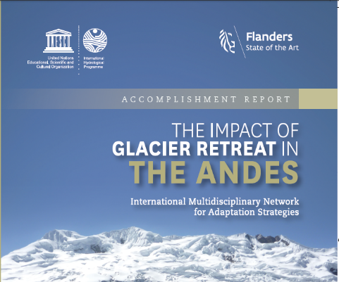
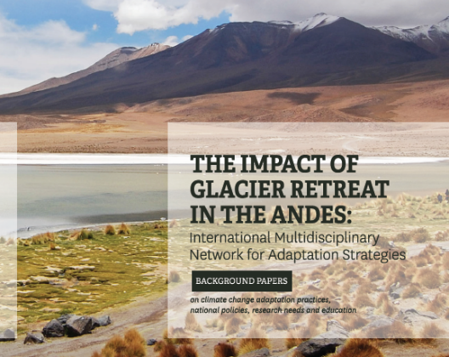
The Impact of Glacier Retreat in the Andes
Improving the scientific basis for hydrology and water sciences for preparation and response to extreme hydrological events
Synthesis meeting of Glacier Retreat in the Andes project
August 2017,
Mendoza, Argentina
IHP THEME 1
40 participants
of 14 countries
(15% women)

Slide 17
Groundwater in a changing Environment
Theme 2

Slide 18

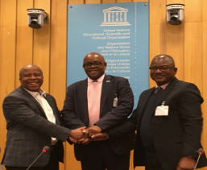
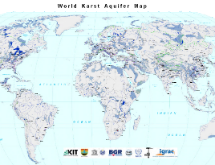
Theme 2 - Groundwater in a changing environment
Establishment of the first example of a Multi-country Cooperation Mechanism Southern Africa region, hosted by a River Basin Commission –ORASECOM (Botswana, Namibia, South Africa) Official agreement in September 2017. Stampriet Transboundary Aquifer System.
Map of the Karst Aquifers of the World
Monitoring SDG6 target 5 Indicator 6.5.2 on transboundary water.
Coordination with Member States to prepare a new set of projects to be financed by GEF and World Bank in different regions of the world: Northern Africa, Estearn and South Eastern Europe, Sahel region, Africa, East and South Mediterranean region.

Slide 19
Addressing Water Scarcity and Quality
Theme 3

Slide 20

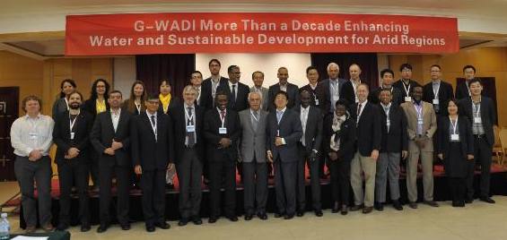
Improving governance, planning, management, allocation, and efficient use of water resources
International Conference on G-WADI
October 2016,
Beijing, China
36 participants
(18% women)
IHP THEME 3

Slide 21
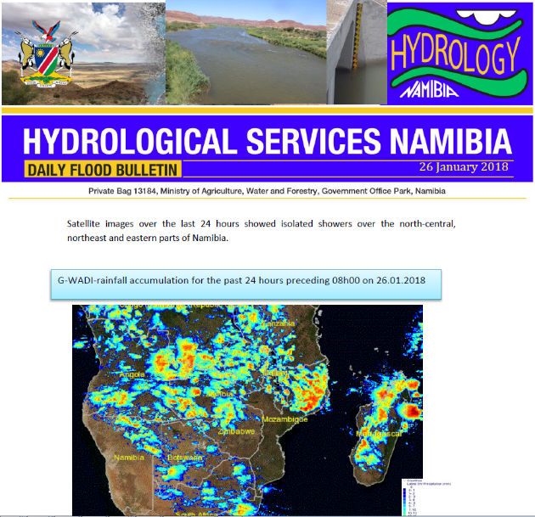
Dealing with present water scarcity and developing foresight to prevent undesirable trends
G-WADI Geoserver application in Namibia - Science communication
IHP THEME 3

Slide 22
Promoting tools for stakeholders involvement and awareness and conflict resolution
AGRHYMET Regional Center, June 2017, Niamey, Niger
40 participants
from 15 countries
(15% women)
IHP THEME 3

Slide 23

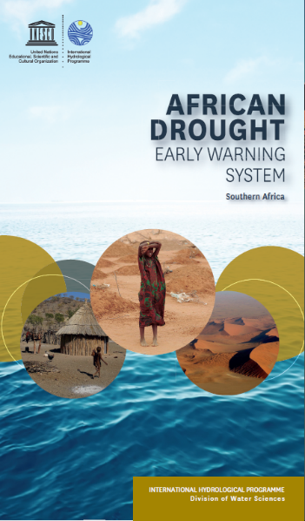
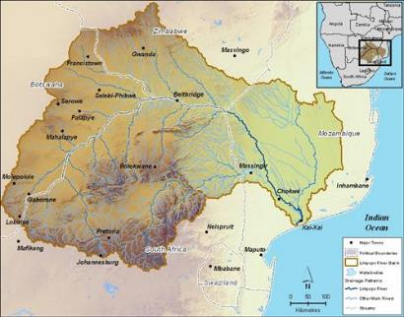
African Drought Early Warning System Expansion to Southern Africa – Review of SADC drought mitigation plans
Training on the African Early Warning System
November 2016,
Harare, Zimbabwe
35 participants
(23% women)
12 countries (Angola, Botswana, Democratic Republic of Congo, Lesotho, Malawi, Mauritius, Namibia, South Africa, Swaziland, United Republic of Tanzania, Zambia, Zimbabwe)
IHP THEME 3

Slide 24


UNESCO-IHP International Initiative on Water Quality (IIWQ)
IHP-VIII Theme 3 - Activities on water quality
IHP THEME 3

Slide 25

UNESCO Extrabudgetary Project: Emerging Pollutants
Strengthening knowledge generation, scientific research and policy
(2015-2017)
Promoting
scientific exchange and collaboration
(2015-2018)
Capacity building
and
awareness raising
(2016-2018)
Component 2
Scientific meetings and workshops
Component 3
Regional training workshops
Case-study series
Technical and policy guidelines
Network of experts and institutions
Raising awareness materials
Component 1
IHP THEME 3
http://en.unesco.org/waterquality-IIWQ
http://en.unesco.org/emergingpollutants

Slide 26
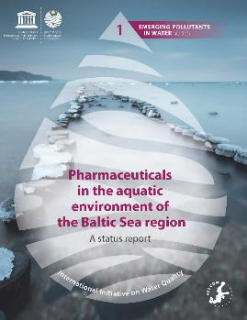
UNESCO Extrabudgetary Project
Emerging Pollutants in Water
16 IIWQ Technical and Policy Case Studies on Emerging Pollutants
  3 global, 3 regional, 10 nationals—covering 20 countries in all regions
Launch of new UNESCO Emerging Pollutants in Water Series
IHP THEME 3

Slide 27
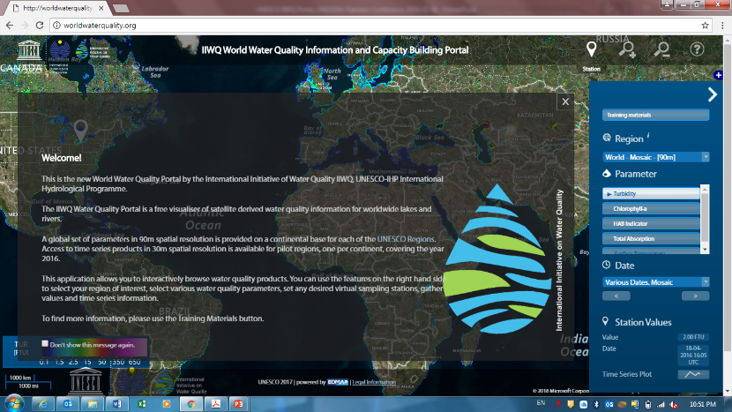
UNESCO-IHP IIWQ
World Water Quality Portal
An innovative tool to monitor water quality, using Earth Observation (satellite data), to support the SDG 6 implementation and monitoring at the global and national levels
IHP THEME 3
www.worldwaterquality.org

Slide 28
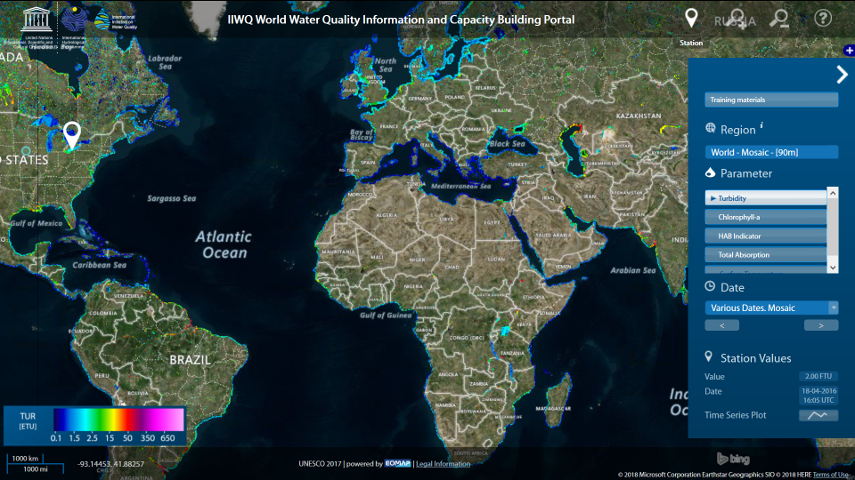
UNESCO-IHP IIWQ
World Water Quality Portal
Water quality parameters
Turbidity (sedimentation)
Chlorophyll-a
HAB indicator
Total absorption
Surface temperature
IHP THEME 3
www.worldwaterquality.org

Slide 29
Water and human settlements of the future
Theme 4

Slide 30



Retrospective
          Knowledge exchange and raising awareness sessions of UNESCO’s work on Urban Water management, covering events such as the World Water Forum, HABITAT III, COP22 and 23, and all International Weeks, benefiting more than 1000 people, in at least 60 countries, 25% of which female.
          Furthermore, 74 people were trained, 28% of which women
IHP THEME 4
Knowledge Transfer
Human Resources

Slide 31

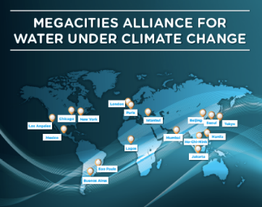

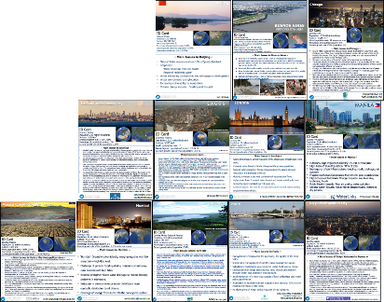
IHP THEME 4
Notes:
Megacities Alliance for Water under Climate Change was launched in Paris during COP21 on December the 2nd at COP 21 by UNESCO during Resilience Day
At Water, Megacities and Global Change International Conference organised by ARCEAU IdF and UNESCO.
The Alliance gave birth to a publication on Water, Megacities and Global Change that discusses the challenges Megacities face in managing their water resources, especially under the climate change challenges and the solutions they have arrived at to cope with them.

Slide 32
Ecohydrology, engineering harmony for a sustainable world
Theme 5

Slide 33

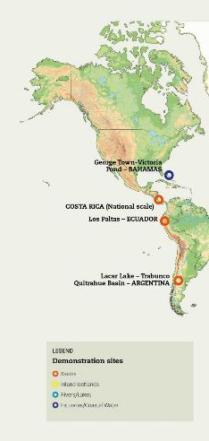
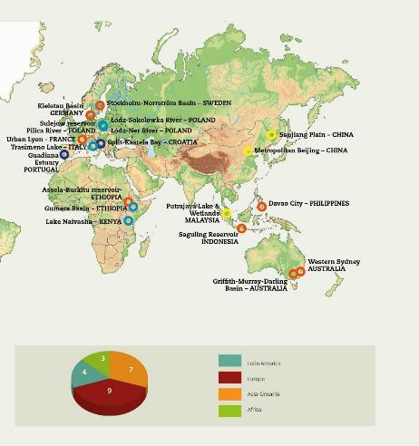
Theme 5: Ecohydrology
8 out of the 23 Sites are established and currently operated by 4 Water Centres & 2 Water Chairs
They integrate the concept of “enhanced ecosystem potential” with EH strategies closely related with water to improve IWRM on specific areas.
3 new sites were added to the Ecohydrology Demonstration Sites Network:
Saguling in Indonesia
Los Paltas in Ecuador (located in Bosque de Paz trounsboundary biosphere reserve Ecuador/Peru)
Lyon in France (in the peripheral urban area)
UNESCO IHP Ecohydrology operates through 23 demonstration sites in 18 Countries
IHP THEME 5

Slide 34
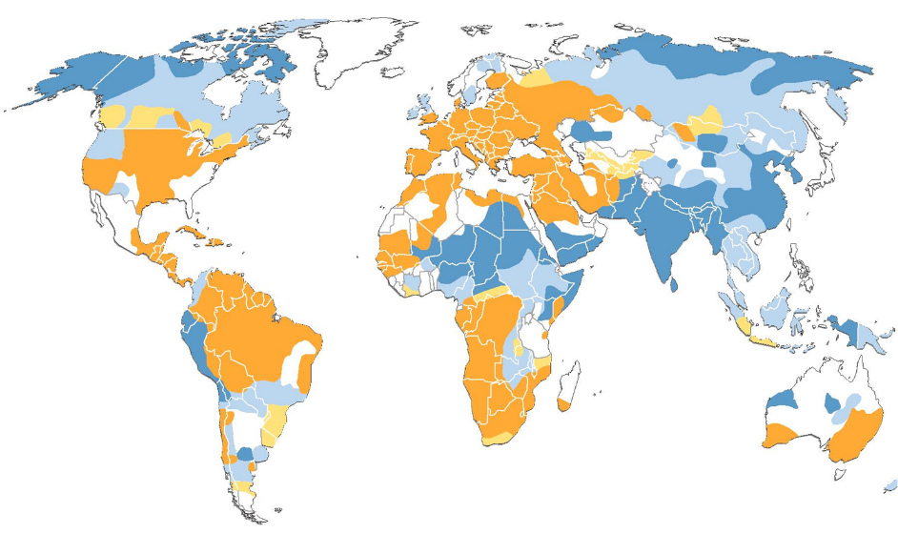
Theme 5: Unesco’s Ecohydrology “family”
SCIENTIFIC ADVISORY COMMITTEE
MEMBERS - IHP COORDINATION
IHE
2
ERCE
1 – RESEARCH
2 – EDUCATION, CAPACITY BUILDING
3 – OUTREACH AND DISSEMINATION
2
ICCE
1,2,3
ASPAC
2
2
1,2,3
CENTRES:
ICCE - International Centre For Coastal Ecohydrology, Portugal
ERCE - European Reginal Centre For Ecohydrology, Poland
ARCE – African Regional Centre For Ecohydrology, Ethiopia
APCE – Asia-pacific For Ecohydrology, Indonesia
CIH – International Centre On Hydroinformatics, Brazil
CHAIRS:
Ecohydrology And Hydroinformatics – Capital Normal Univ. Beijing
Ecohydrology – Ihe, Delft
Ecohydrology: Water For Ecosystems And Societies, Univ Algarve,
Faro, Portugal
FOCAL POINTS FOR ECOHYDROLOGY
LAC – Latin America And Caribbean
ARCE
LAC
APCE
L. Chicharo, 2016
G. Arduino, 2018

Slide 35
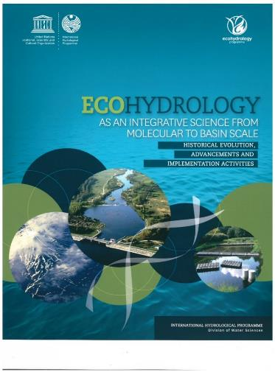



Theme 5 Results - 2016-2017
2nd African International Symposium “Ecohydrology for Water, Biodiversity, Ecosystem Services and Resilience for Africa”,
Addis Ababa, Ethiopia, November 2016
2 SAC Meetings
3 International Conferences/Symposia
10 TCs/WSs
3 Side Events / Sessions
International Conference on Ecohydrology for Security of Aquatic Ecosystems and Societies, Campos de Goytacazes, Brazil, March 2017
IHP THEME 5
International Symposium on Ecohydrology for the Circular Economy and Nature Based Solutions, Lodz, Poland, September 2017
IHP-VIII
Session on “Ecohydrology for sustainability and water security in Africa”, 6th Edition of the Africa Water Week, Tanzania, May-June 2016
IHP-VII
IHP-VI
IHP-V
Total for 2016-2017= 1119 Participants
including 425 Women (38%)
694 Men
IHP-IV
Historical Evolution, advancements and implementation activities. 500 hard copies distributed from Sep. 2015 to Oct. 2017

Slide 36
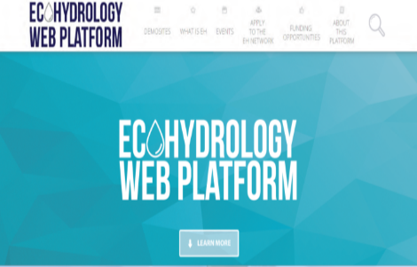
Theme 5: Ecohydrology Demonstration sites
ECOHYDROLOGY DEMONSTRATION SITES
Region | Site | Country | Downloads Count
Latin America & Caribbean | CATACOCHA-PALTAS | Ecuador | 169
 | VICTORIA POND WETLAND | Bahamas | 246
 | SAN MARTÍN DE LOS ANDES - NEUQUÉN | Argentina | 259
 | RANA-ICE STUDY | Costa Rica | 270
Africa | NAIVASHA BASIN | Kenya | 372
 | ASELLA CITY | Ethiopia | 283
 | RIBB WATERSHED & LAKE TANA SHORE |  | 760
Asia-Pacific | PUTRAJAYA LAKE AND WETLAND | Malaysia | 293
 | DAVAO CITY | Philippines | 321
 | SAGULING RESERVOIR | Indonesia | 144
 | METROPOLITAN BEIJING | China | 237
 | SANJIANG PLAIN |  | 321
 | MURRAY-DARLING BASIN | Australia | 275
 | WESTERN SYDNEY |  | 308
Europe | TRASIMENO LAKE | Italy | 247
 | CONSTRUCTED POROUS RIFFLE | France | 26
 | KAŠTELA BAY | Croatia | 286
 | GUADIANA ESTUARY | Portugal | 266
 | NORRSTRÖM DRAINAGE BASIN | Sweden | 309
 | KIELSTAU CATCHMENT | Germany | 459
 | NER RIVER | Poland | 266
 | SOKOLOWKA RIVER |  | 440
 | PILICA RIVER CATCHMENT |  | 268
 | August 2018 | TOTAL | 6,825
Ecohydrology Web Platform
Operational since 2016
ecohydrology-ihp.org
IHP THEME 5

Slide 37
Water Education – Key for Water Security
Theme 6

Slide 38

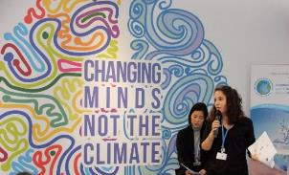
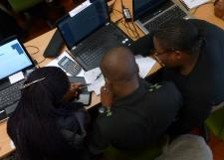
Theme 6: Water Education : Key for Water Security
    Focal area 6.1 – Enhancing tertiary water education and professional capabilities and 6.2 – Addressing vocational education and training of water technicians
    Focal area 6.3 – Water education for children and youth
        - Survey on water supply and sanitation in schools
        Survey on Youth Employment and Unemployment in the Water Sector
        - “Water Education Training for Teachers” in the Arab Region
    Focal area 6.4 – Promoting awareness of water issues through informal water education
    -Workshop for journalist educators on climate change and water management
    Focal area 6.5 – Education for transboundary water cooperation and governance
        -Activities related to education for transboundary water cooperation and governance are undertaken in the framework of different IHP Themes
IHP THEME 6
DEVELOPMENT OF A NEW INDICATOR ON WATER EDUCATION
The 23rd Session of the IHP Council adopted in June 2018 Resolution XXIII-9:“IHP support to Member States towards the proposal for a new sustainable development goal indicator 6.a.2 on Water Education”.
Requested IHP to start developing a methodology, in cooperation with OECD, WHO, and UNEP, for an effective indicator on water education, within IHP-VIII Theme 6 “Water Education, Key for Water Security”, in coordination with the UNESCO Water Family

Slide 39





IHP Theme 6: Water Education : Continuous Youth Engagement
Youth are more than just beneficiaries of UNESCO-IHP’s work, they are essential actors in finding solutions to Water Security . IHP’s youth engagement approach can strengthen youth involvement in the water sector by:
IHP THEME 6
Giving youth the platform to advocate for their local and global water priorities
Involving youth leaders as knowledge holders and innovators in global water governance and policy processes and forums
Providing IHP’s technical expertise for local and global youth-led initiatives when needed
Supporting youth-led activities that facilitates cooperation between youth networks globally and regionally to address water security
Notes:
Some examples include;
1. Supported the organization and participation of youth in the youth forum of the World Water Forum 2018 and World Water Forum.
2. Organized a side event on, ‘The role of Youth in Bridging Water and Climate Change during the United Nations Climate Change Conference’ (2017) .
3. Supported youth advocacy for water issues in global events such as UNLEASH - A Global Innovation Lab for the Sustainable Development (2017) and “Youth and their Social Impact” – Seventh International Forum of NGOs in official partnership with UNESCO 2017.

Slide 40
UNESCO’s water related chairs
UNESCO’s water related chairs are a part of the UNESCO Water Family and contribute to IHP-VIII through research, training and community outreach which also contribute to achieving or monitoring the 2030 Agenda for Sustainable Development.
Supporting development of institutional and human capacities
Producing and improving knowledge and using innovation to address water challenges
Strengthening
science-policy interface
Water security at the local, regional and global levels

Slide 41
The role of UNESCO Chairs
The UNITWIN/UNESCO Chairs Programme was launched in 1992.
UNESCO Water-related Chairs:
Act as "think tanks" and "bridge builders" between academia, civil society, and government
promote international inter-university cooperation and networking between higher education institutions to enhance institutional and human capacities
facilitate the production and exchange of knowledge
encourage training and research as well as exchange of academics in the field of water resource management
create poles of excellence and innovation at the regional or sub-regional level

Slide 42
Strategic alignment required
All Water Related Chairs are required to Align their activities with:
a priority area and contribute to implementing the UNESCO approved Programme and Budget and Medium-Term Strategy (C/4 & C/5)
UNESCO-International Hydrological Program (IHP) VIII strategy
The 2030 Agenda for Sustainable Development

Slide 43
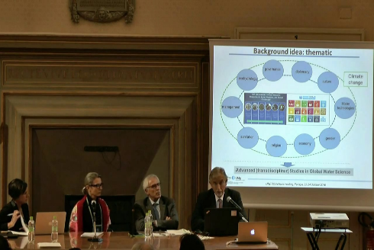
Some recent activities of the Chairs’ network
1st UNESCO Water Chair Meeting,
(Perugia, Italy October 2016)
Objectives
Identify contribution of the Chairs to the UN 2030 Agenda for Sustainable Development (SDGs)
Improve the contribution of Chairs to
IHP-VIII phase (2014-2021)
Increase the cooperation between
Chairs
Main Outcomes
The Perugia action plan
Web platform for Water-related Chairs

Slide 44
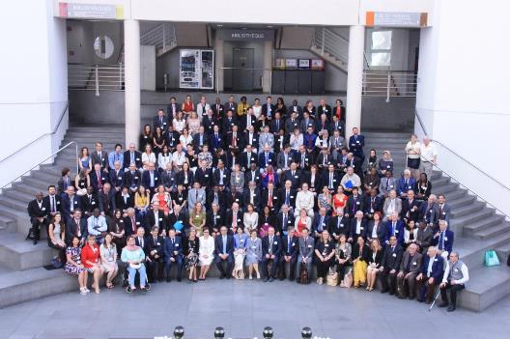
Some recent activities of the Chairs’ network
First Conference UNESCO Science Sector CHAIRS
(Geneva, Switzerland, July 2017)
Objectives
Engage chairs to reflect on how to best
contribute to the SDGs
Facilitate cooperation between Chairs
Main Outcomes
Geneva Milestone
Brown Bag Lunch meeting of
Water-related Chairs

Slide 45
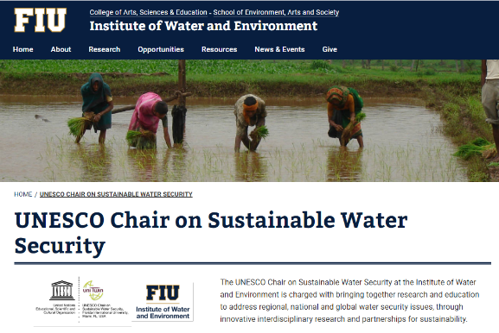
Welcoming a New Water Chair
The UNESCO Water Family is happy to welcome the
UNESCO Chair on Sustainable Water Security, at the Institute of Water and Environment, Florida International University !

Slide 46
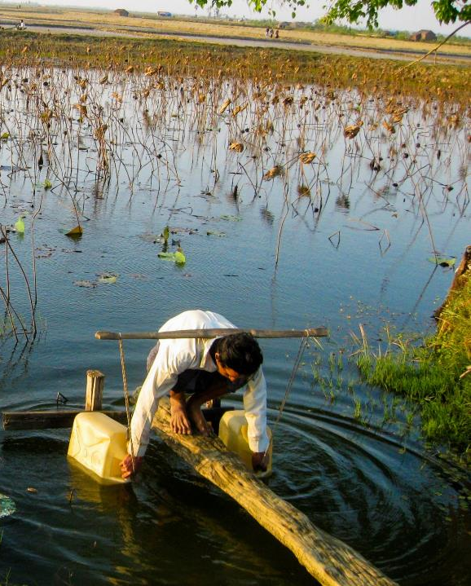

Thank you for your attention
Division of Water Sciences,
International Hydrological Programme
UNESCO-IHP
http://en.unesco.org/themes/water-security/hydrology
ecohydrology-ihp.org

