Slide 1
Water security during crisis situations or extreme natural events
M.Pilar Cornejo R. de Grunauer
Pacific International Center for Disaster Risk Reduction Director
Marine Sciences Dean
ESPOL
pcornejo@espol.edu.ec
September, 2018

Slide 2
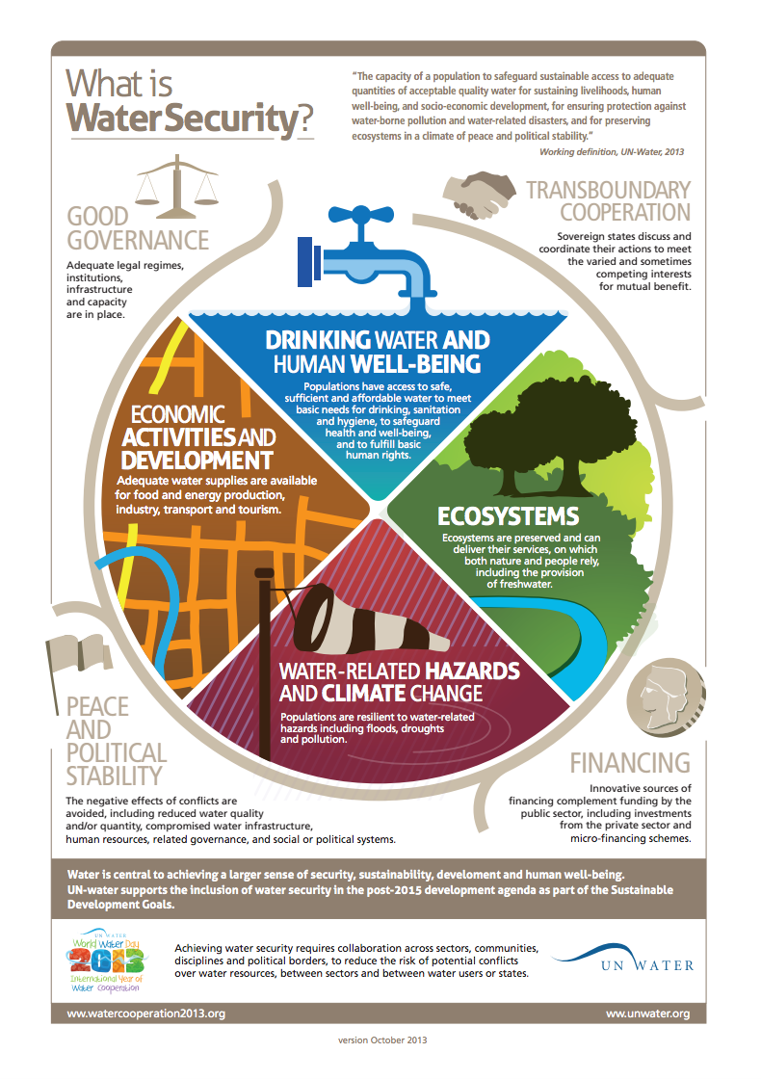
WS – extreme events
According to UNESCO, Water Security is the capacity of a population to safeguard sustainable access to adequate quantities of of acceptable quality water for sustaining livelihoods, human well-being, and socio-economic development, for ensuring protection against water-borne pollution and water-related disasters, and for preserving ecosystems in a climate of peace and political stability.
WATER-RELATED HAZARDS AND CLIMATE CHANGE
Populations are resilience to water-related hazards including floods, droughts and pollution

Slide 3
WS – extreme events

Slide 4
WS – extreme events
Risk = Hazard x Exposure x Vulnerability
What are the hazards? How much is everybody exposed? How vulnerable is the community?
Is the community capable of recovery?
How do we build up resilience?
Vulnerability
Hazard
Risk
Exposure

Slide 5
WS – extreme events
What are the steps for an adequate disaster risk reduction?
  Prevention
  Preparation of the Response
  Preparation for the Recovery
  Building up resilience

Slide 6
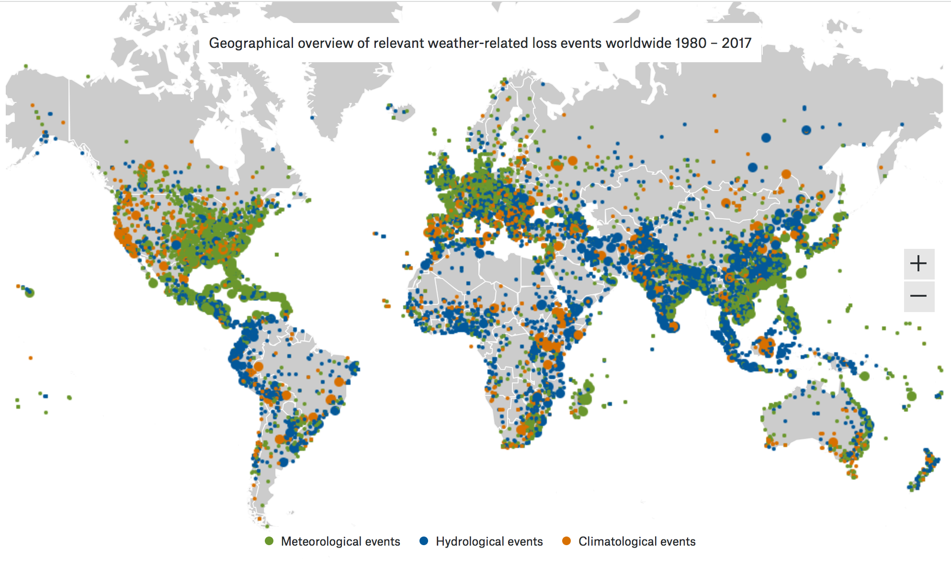
WS – extreme events
SOURCE: https://natcatservice.munichre.com/

Slide 7
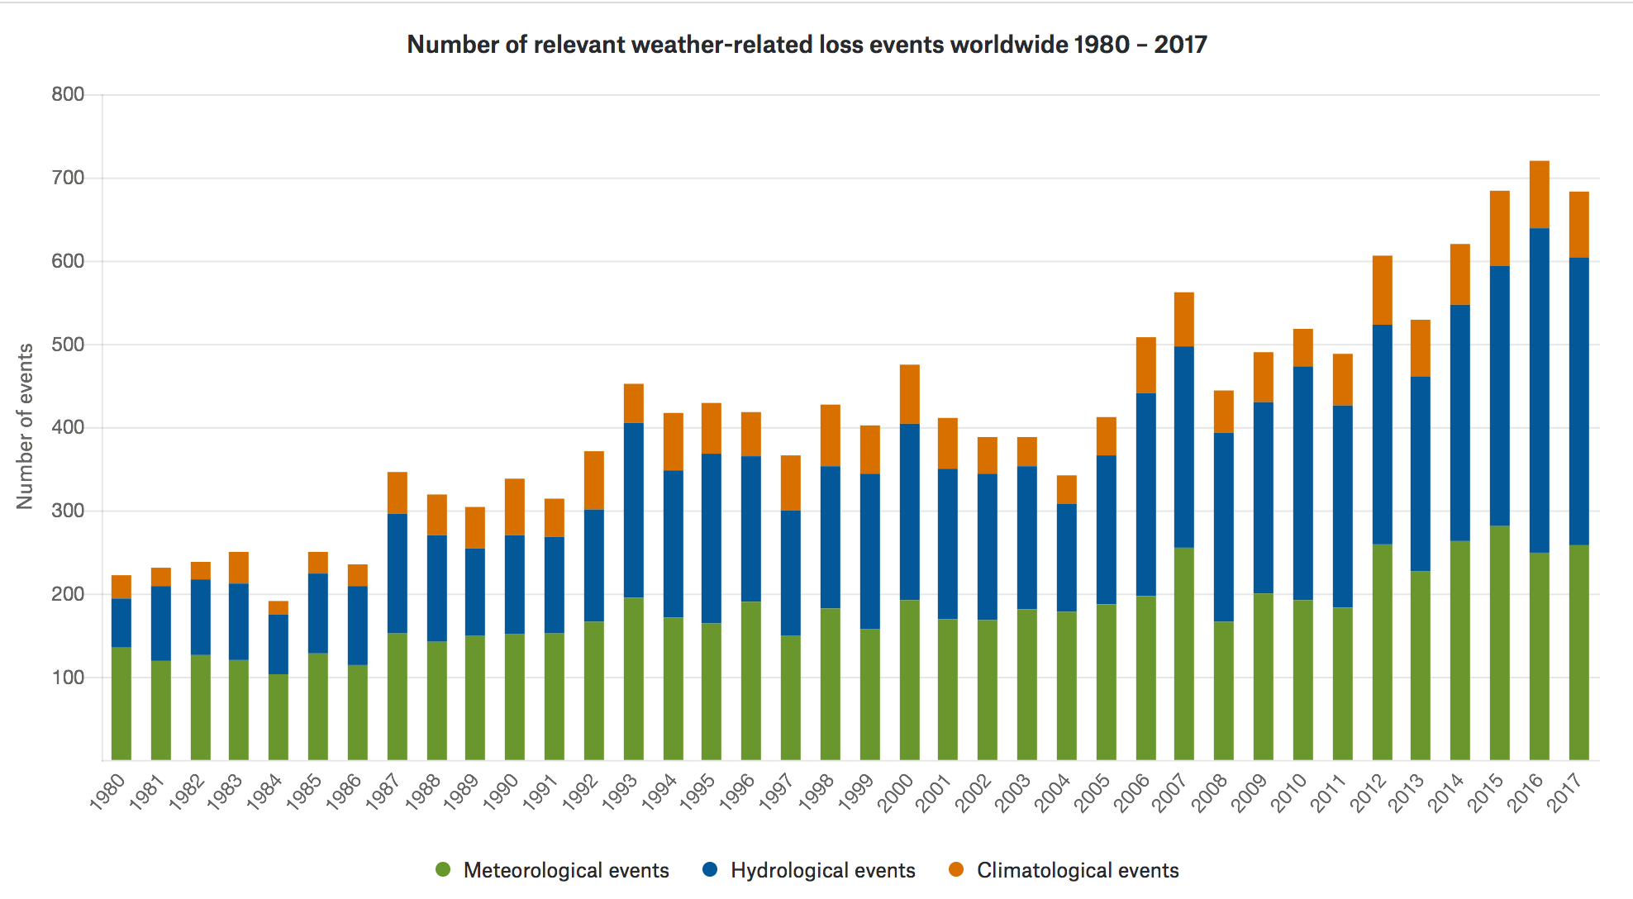
WS – extreme events
SOURCE: https://natcatservice.munichre.com/

Slide 8
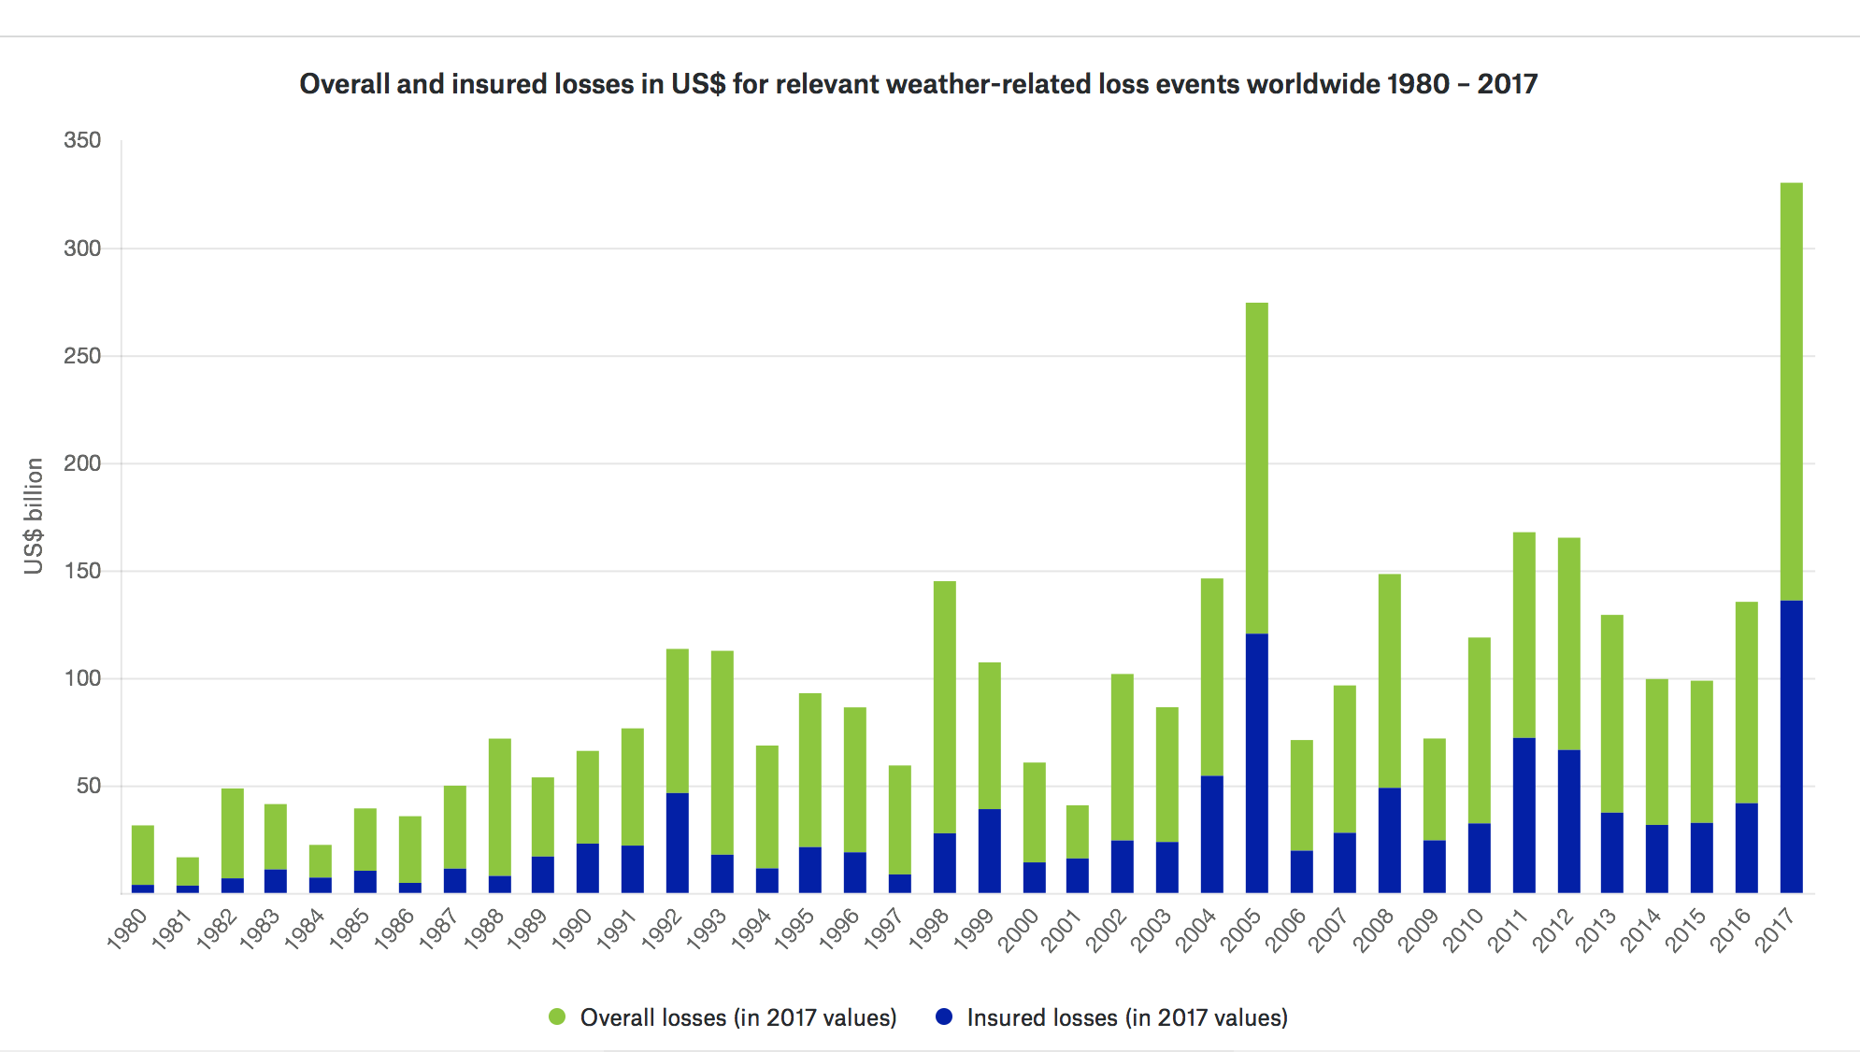
WS – extreme events
SOURCE: https://natcatservice.munichre.com/

Slide 9
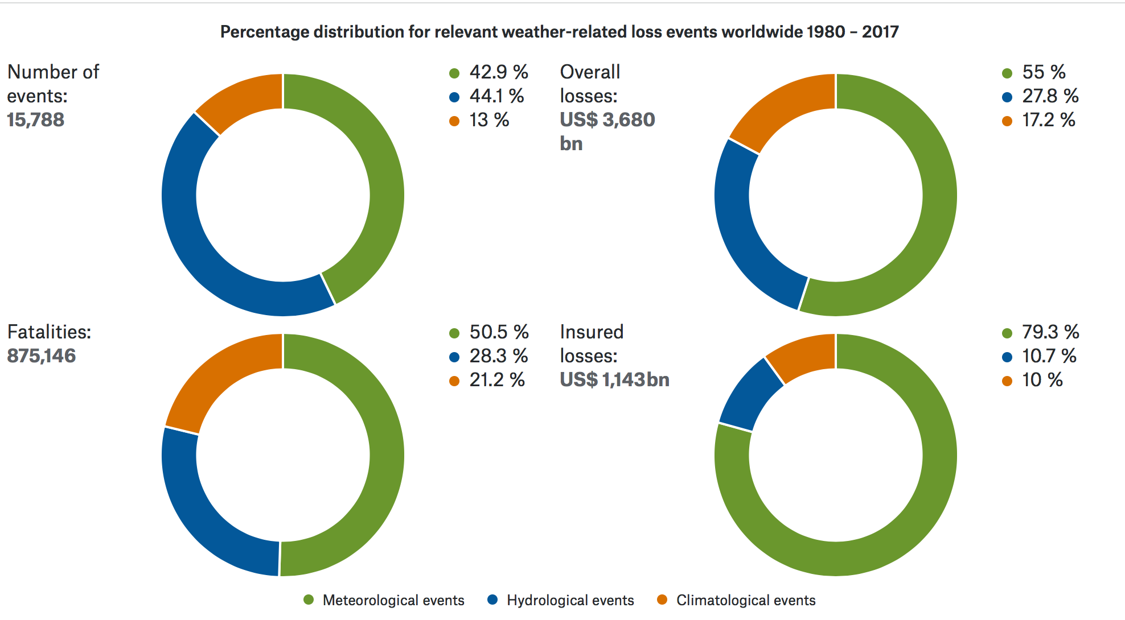
WS – extreme events
SOURCE: https://natcatservice.munichre.com/

Slide 10
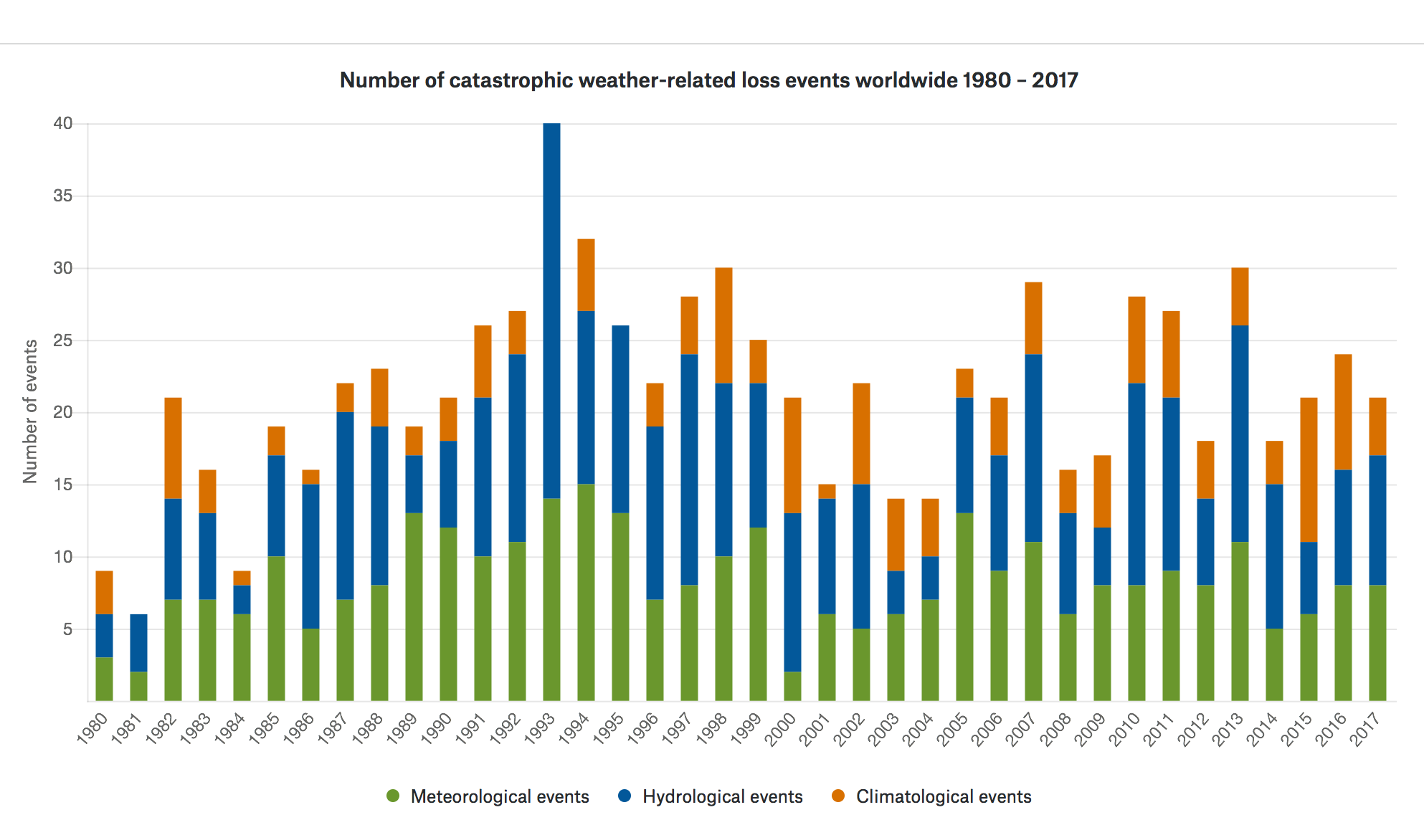
WS – extreme events
SOURCE: https://natcatservice.munichre.com/

Slide 11
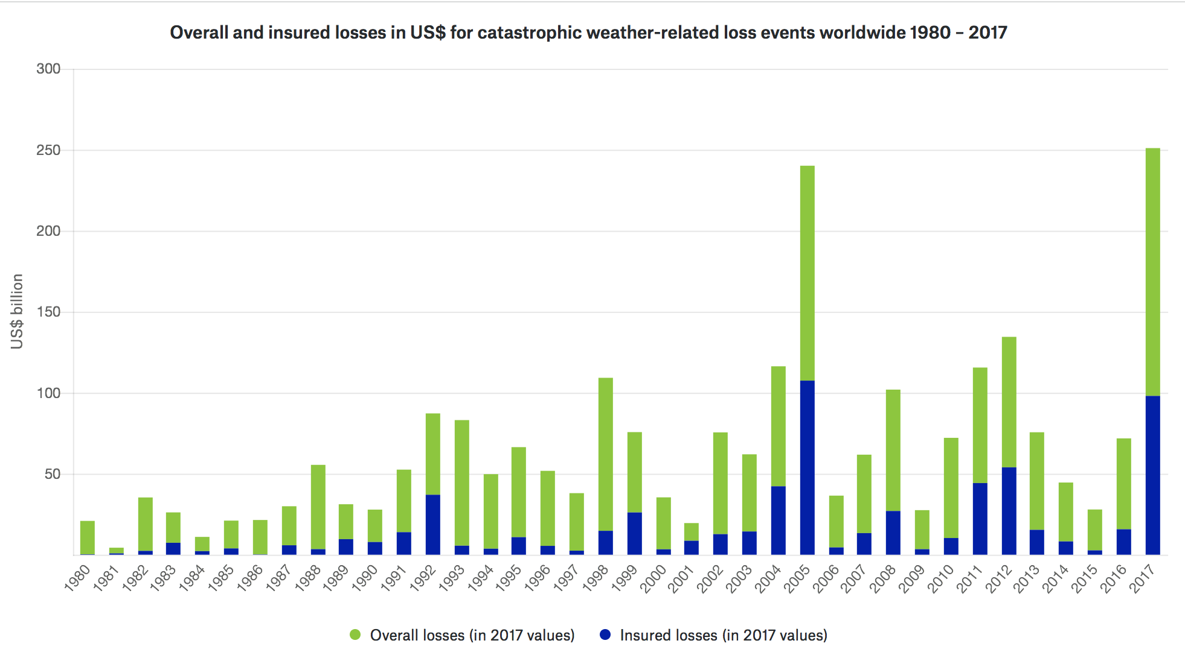
WS – extreme events
SOURCE: https://natcatservice.munichre.com/

Slide 12
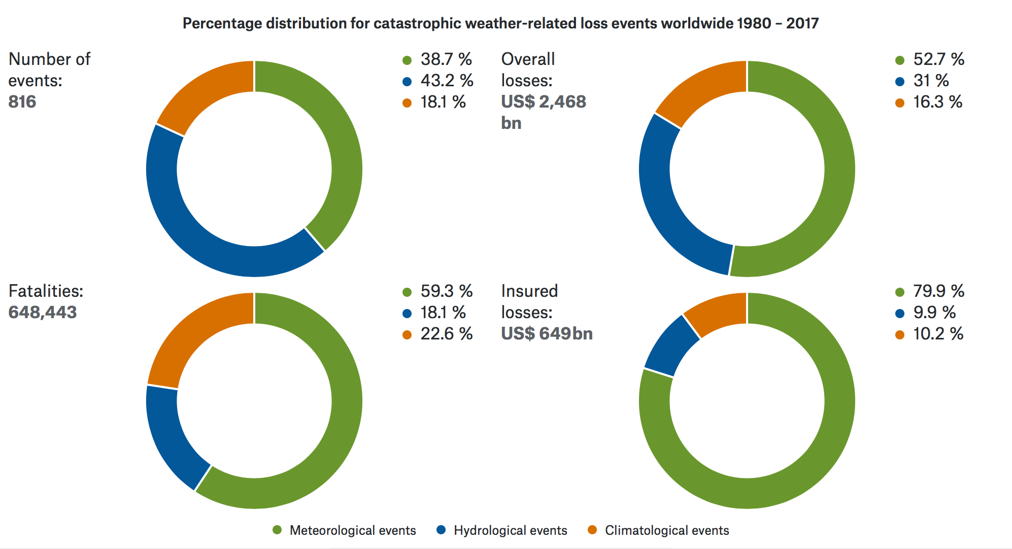
WS – extreme events
SOURCE: https://natcatservice.munichre.com/

Slide 13
WS – extreme events
What are the steps for an adequate disaster risk reduction?
  Prevention
  Preparation of the Response
  Preparation for the Recovery
  Building up resilience

Slide 14
WS – extreme events
Early Warning Systems
hazards monitoring
communication
response
generation of knowledge
Notes:
SE PUEDEN ESTABLECER SI SE CONOCE LA AMENAZA Y CUALES SON LOS UMBRALES DE PELIGRO
REQUIERE MONITOREO CONSTANTE DE LAS AMENAZAS QUE ALIMENTE AL SISTEMA
REQUIERE QUE LA CIUDADANIA CONOZCA EL SIGNIFICADO DE LAS ALERTAS
REQUIERE UN MEDIO EFECTIVO PARA COMUNICAR LA ALERTA
DEBE ESTAR CONECTADO A SISTEMAS DE RESPUESTA FRENTE A LOS POTENCIALES IMPACTOS QUE TENGA UNA AMENAZA QUE SE HAYA CONVERTIDO EN UN EVENTO ADVERSO
ALERTA TEMPRANA: PROVISION DE INFORMACION OPORTUNA Y EFICAZ A TRAVES DE INSTITUCIONES IDENTIFICADAS QUE PERMITEN A INDIVIDUOS EXPUESTOS A UNA AMENAZA , LA TOMA DE DECISIONES PARA EVITAR O REDUCIR SU RIESGO Y SU PREPARACION PARA UNA RESPUESTA EFECTIVA
SISTEMA: CONJUN TO DE COSAS QUE RELACIONADAS ENTRE SI ORDENADAMENTE CONTRIBUYEN A DETERMINADO OBJETO

Slide 15
WS – extreme events
Are weather and climate forecast available? are they reliable? Should we use forecast by analogy?

Slide 16
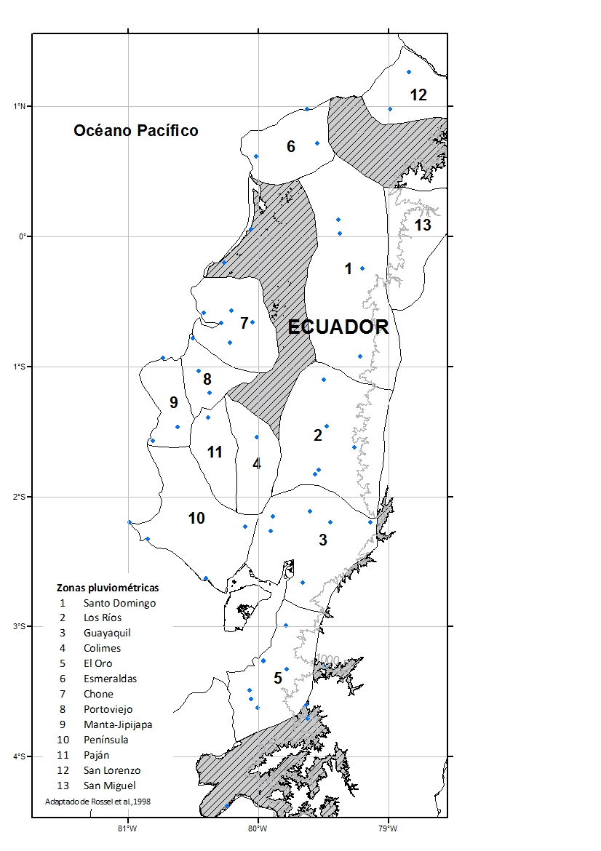
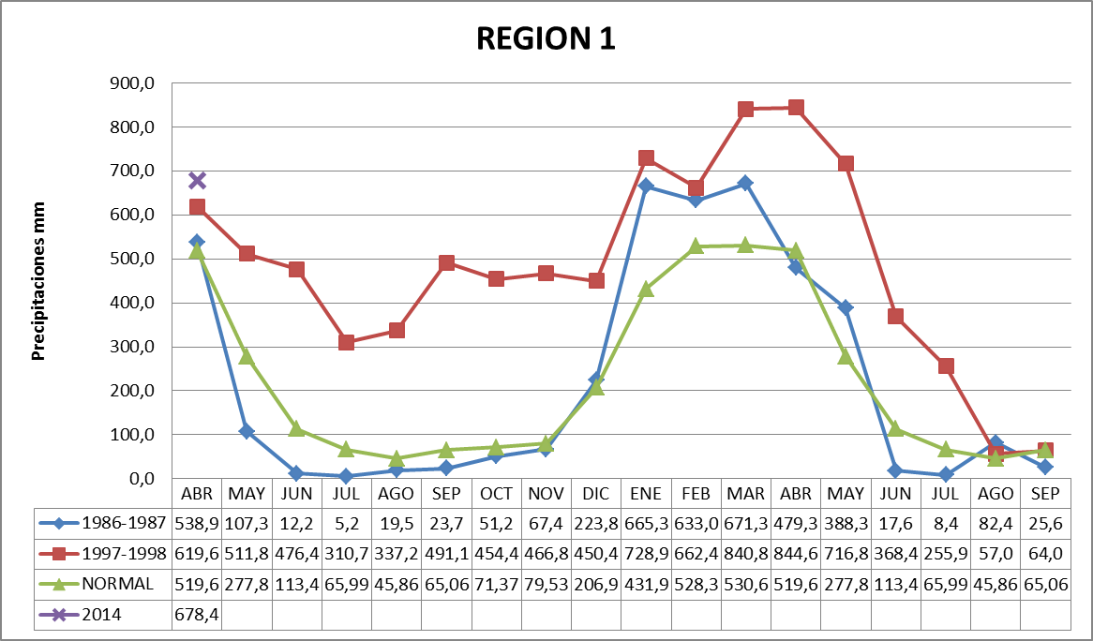
WS – extreme events
Are weather and climate forecast available? are they reliable? Should we use forecast by analogy?

Slide 17
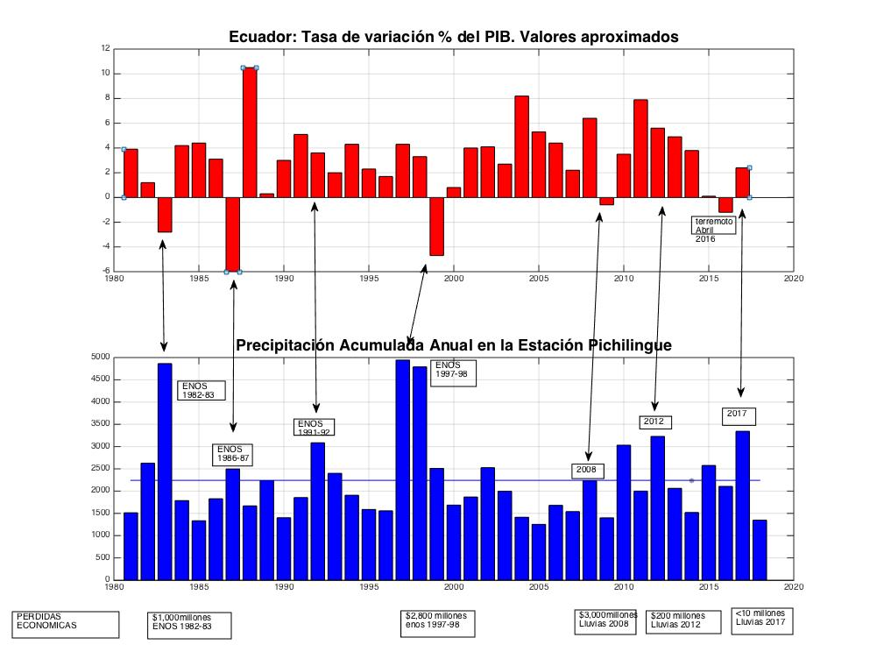
WS – extreme events

Slide 18
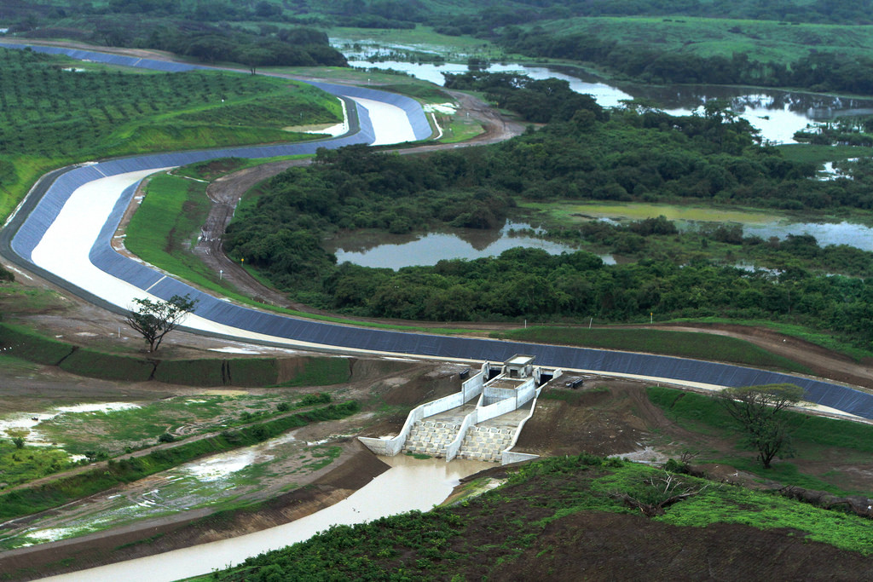
WS – extreme events
What kind of structural and non-structural solutions could we work out for water security?

Slide 19
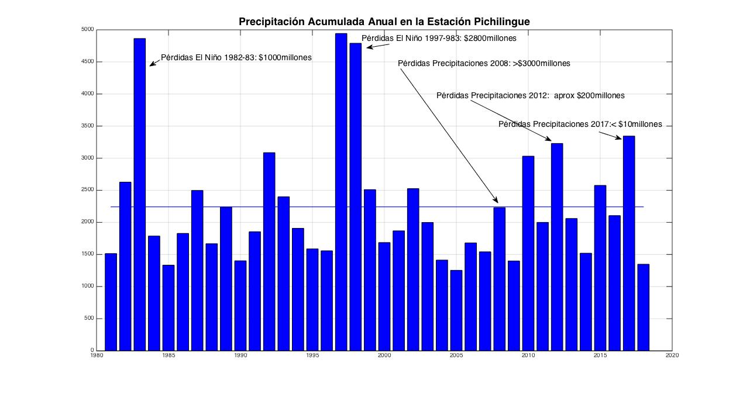
WS – extreme events

Slide 20
WS – extreme events
CONCLUSIONS
Extreme events, their impacts and losses are not decreasing
We need to improve knowledge about hazards, monitoring density (space and time) but we most use the available information and a make it usable
If forecast are not available, or there is large uncertainty we could use other tools
Preparing for response is a most! We could allocate secure water or facilities prior to an extreme event
For achieving water security we need a combination of structural and non-structural measures
Culture is part of the socio-ecosystem; solutions may not be universal in its applications, but can be adapted to different environments

Slide 21
WS – extreme events
SDG 6 Clean Water and Sanitation facts
Floods and other water-related disasters account for 70 per cent of all deaths related to natural disasters
Water scarcity affects more than 40 per cent of the global population and is projected to rise. Over 1.7 billion people are currently living in river basins where water use exceeds recharge.
More than 80 per cent of wastewater resulting from human activities is discharged into rivers or sea without any pollution removal
Approximately 70 per cent of all water abstracted from rivers, lakes and aquifers is used for irrigation.
SDG 6, goals
By 2030, substantially increase water-use efficiency across all sectors and ensure sustainable withdrawals and supply of freshwater to address water scarcity and substantially reduce the number of people suffering from water scarcity

Slide 22
WS – extreme events
SDG 13 Climate Action goals
Strengthen resilience and adaptive capacity to climate-related hazards and natural disasters in all countries
Integrate climate change measures into national policies, strategies and planning
Promote mechanisms for raising capacity for effective climate change-related planning and management in least developed countries and small island developing States, including focusing on women, youth and local and marginalized communities

Slide 23
The Seven Global Targets of the Sendai Framework of Action
Substantially reduce global disaster mortality by 2030, aiming to lower average per 100,000 global mortality rate in the decade 2020-2030 compared to the period 2005-2015.
Substantially reduce the number of affected people globally by 2030, aiming to lower average global figure per 100,000 in the decade 2020 -2030 compared to the period 2005-2015.
Reduce direct disaster economic loss in relation to global gross domestic product (GDP) by 2030.
Substantially reduce disaster damage to critical infrastructure and disruption of basic services, among them health and educational facilities, including through developing their resilience by 2030.
Substantially increase the number of countries with national and local disaster risk reduction strategies by 2020.
Substantially enhance international cooperation to developing countries through adequate and sustainable support to complement their national actions for implementation of this Framework by 2030.
Substantially increase the availability of and access to multi-hazard early warning systems and disaster risk information and assessments to the people by 2030.

Slide 24
WS – extreme events
What we need? Where do we go?
Resilience
Constant capacity building
Risk transfer
To look at the problem from a trans-disciplinary view.

Slide 25
WS – extreme events
Thank you
pcornejo@espol.edu.ec

