Slide 1
2018 Water and Environment Security Conference
Nile River Basin
Marius Claassen

Slide 2
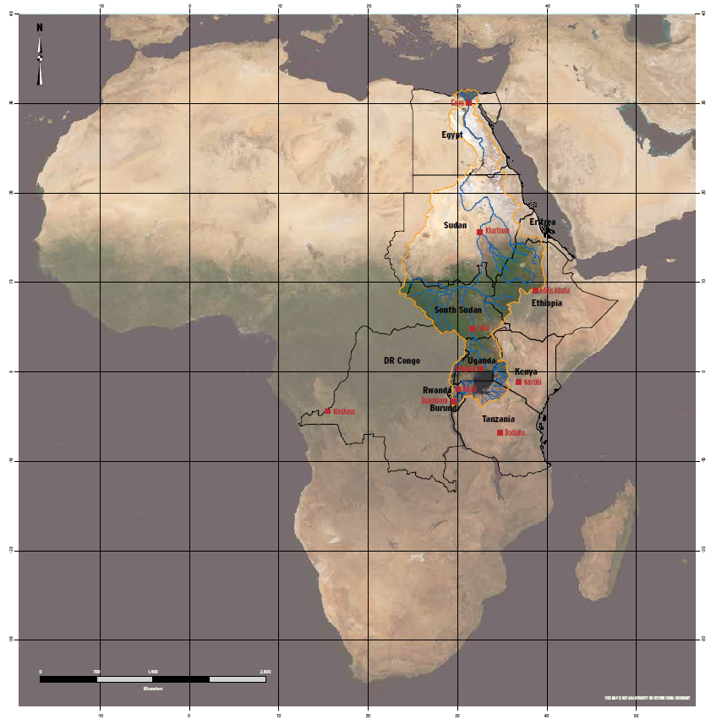
Where?
NBI, 2016
Notes:
NBI, 2016, Nile Basin Resources Atlas.

Slide 3
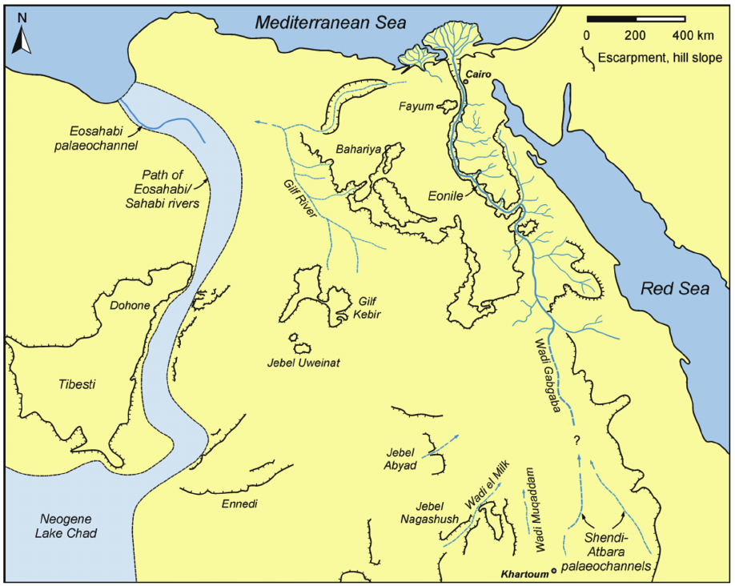
When?
Bussert et al., 2018
20 Ma – 3 Ma
Notes:
Robert Bussert, Ali A.M. Eisawi, Basher Hamed, Ibrahim A.A. Babikir,
Neogene palaeochannel deposits in Sudan – Remnants of a trans-Saharan river system?,
Journal of African Earth Sciences,
Volume 141,
2018

Slide 4
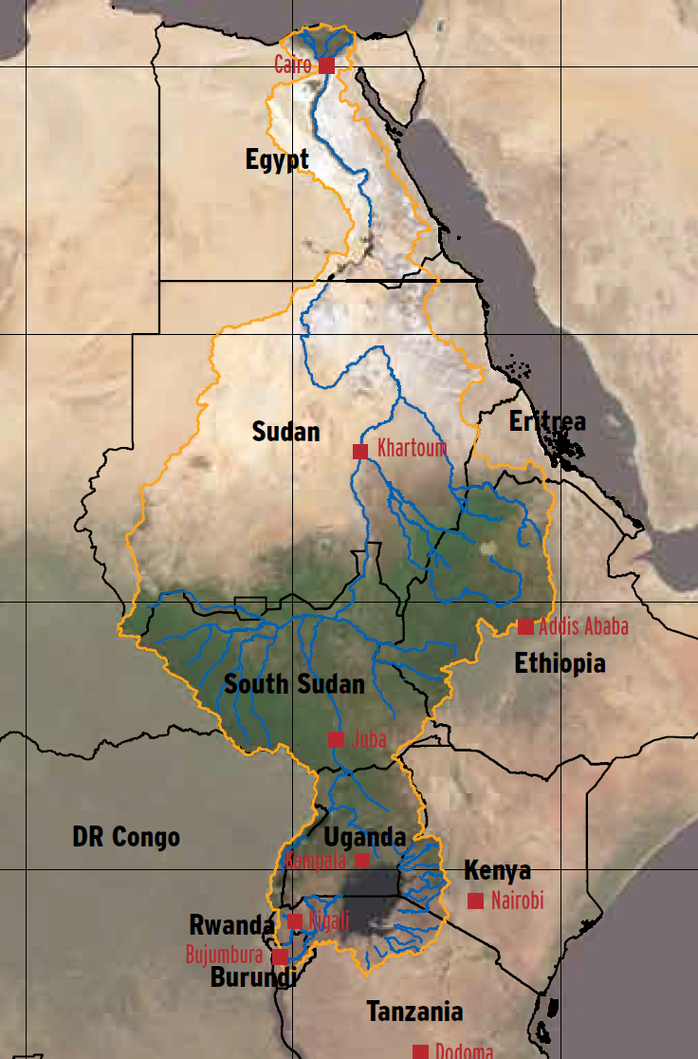
When?
Bussert et al., 2018; NBI, 2016
20 Ma – 3 Ma
2018

Slide 5
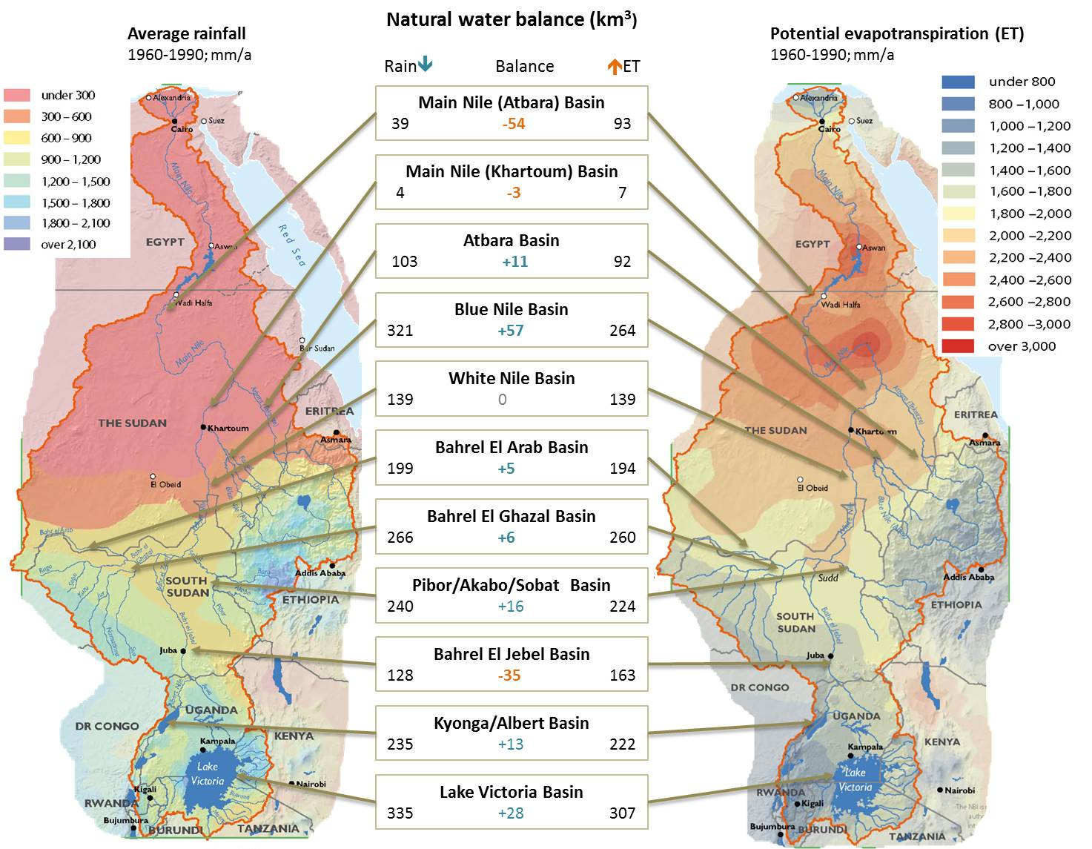
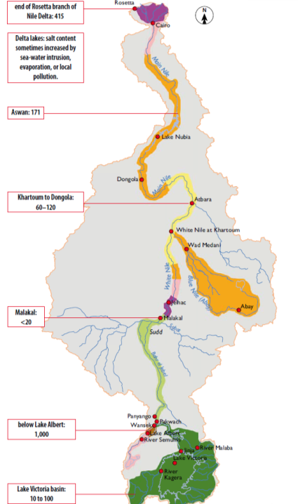
What?
Claassen, 2016
415
Salinity (mg/l)
171
60-120
<20
1000
10-100

Slide 6
Who?
NBI, 2016
Notes:
NBI, 2016, Nile Basin Resources Atlas.

Slide 7
Independence
CIA, 2018
Egypt 1953
(from Britain)
Eritrea
(from Ethiopia)
1993
Sudan 1956
(from Egypt & Britain)
Ethiopia
(Aksumite Kingdom)
100BC
South Sudan 2011
(from Sudan)
Kenya
(from Britain)
1963
DR Congo 1960
(from Belgium)
1961/3
Tanzania
(from Britain)
Uganda 1962
(from Britain)
Burundi
(from Belgium)
1962
Rwanda 1962
(from Belgium)
Notes:
https://www.cia.gov/library/publications/the-world-factbook/

Slide 8
Life Expectancy
UNDP, 2018
Egypt 71.7
Eritrea
65.5
Sudan 64.7
Ethiopia
65.9
South Sudan 57.3
Kenya
67.3
DR Congo 60.0
Tanzania
66.3
Uganda 60.2
Burundi
57.9
Rwanda 67.5
(USA: 79.5)
Notes:
http://hdr.undp.org/en/content/human-development-index-hdi

Slide 9
Mean Years of Schooling
UNDP, 2018
Egypt 7.2
Eritrea
4.0
Sudan 3.7
Ethiopia
2.7
South Sudan 4.8
Kenya
6.5
DR Congo 6.8
Tanzania
5.8
Uganda 6.1
Burundi
3.0
Rwanda 4.1
(USA: 13.4)
Notes:
http://hdr.undp.org/en/content/human-development-index-hdi

Slide 10
GNI per Capita (USD)
UNDP, 2018
Egypt 10 355
Eritrea
1 750
Sudan 4 119
Ethiopia
1 719
South Sudan 963
Kenya
2 961
DR Congo 796
Tanzania
2 655
Uganda 1 658
Burundi
702
Rwanda 1 811
(USA: 54 941)
Notes:
http://hdr.undp.org/en/content/human-development-index-hdi

Slide 11
Historical Perspective
OSU , 2018
The 1929 Agreement: Signed between Egypt and Great Britain (representing Uganda, Kenya, Tanganyika (Tanzania) and Sudan, gave Egypt the right to veto projects higher up the Nile that would affect its water share.
The 1959 Agreement: Signed by Egypt and Sudan, supplementing the previous agreement, gave Egypt the right to 55.5 billion cubic meters of Nile water a year and Sudan 18.5 billion cubic meters per year (out of a total of 84 billion), but ignored the rights to water of the remaining eight Nile countries.
Notes:
https://transboundarywaters.science.oregonstate.edu/content/international-freshwater-treaties-database

Slide 12
Historical Perspective
NBI, 2018
Cooperative Framework Agreement: Negotiate from 1997 to facilitate the more equitable allocation of the water from the Nile. In 2010, seven countries agreed to open the CFA for signature, but Egypt and Sudan then rejected it.
Nyerere Doctrine: The East African States’ doctrine, reformulated by Julius Nyerere, advocates that sovereign countries should not by bound by colonial agreements.
Notes:
http://www.nilebasin.org/index.php/nbi/cooperative-framework-agreement

Slide 13

Nile Basin Initiative
It is built around a
shared belief that countries can achieve better outcomes for all the people of the Nile Basin through cooperation rather than competition
A regional partnership for promoting growth and addressing the critical challenges faced by the Nile Basin

Slide 14
1997
Nile Basin Initiative
Nile-COM (Council of Ministers) request financial support from World Bank and other development partners
1999
Nile Basin Initiative (NBI) established
Nile Equatorial Lakes Subsidiary Action Program (NELSAP) established.
2002
1998
Eastern Nile Technical Regional Office (ENTRO) established.
First meeting of the Nile-TAC (Technical Advisory Committee)
2005
2001
The first set of cooperative investment projects start up in the Nile equatorial lakes region
Development partners pledge $140M
2004
NBI starts to implement projects, starting with Shared Visions Program
2008-2009
Institutional Strengthening Project
2007-2008
2011-2012
The first investment projects start up in the eastern Nile region
South Sudan joins the NBI
2012
2018
NBI data & information tools and guidelines approved
More than 30 investment projects worth more than USD 6 billion
2014
Eleven investment projects under implementation by countries, 19 more in preparation

Slide 15
Approach
Claassen & Nortje, 2014
Context
e.g. Politics, Policy, Management, Economics, Beliefs and values, Biophysical system
State, causality and change
Basin condition
Basin services
Human well-being
Options and trade-offs towards development outcomes
(To increase well-being, ensure efficient use of services, maintain integrity)

Slide 16
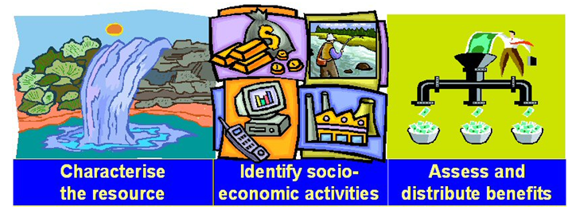
Benefit Sharing
Claassen, 2016
“Cooperation between countries can unlock more value from the basin than would be available if countries didn’t cooperate”
Benefit Sharing is thus: “Cooperation between states to increase the benefits in a transboundary basin and to fairly distribute the benefits in support of local, national and regional development objectives”

Slide 17
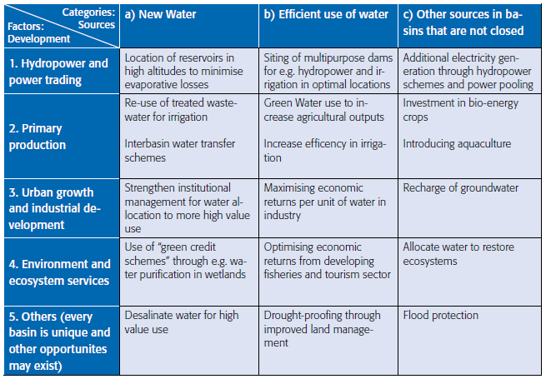
Benefit Sharing: “TWO” analysis
What do we have?
What can we do with it?

Slide 18
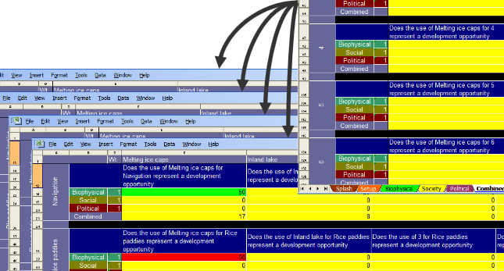
Benefit Sharing: “TWO” analysis

Slide 19
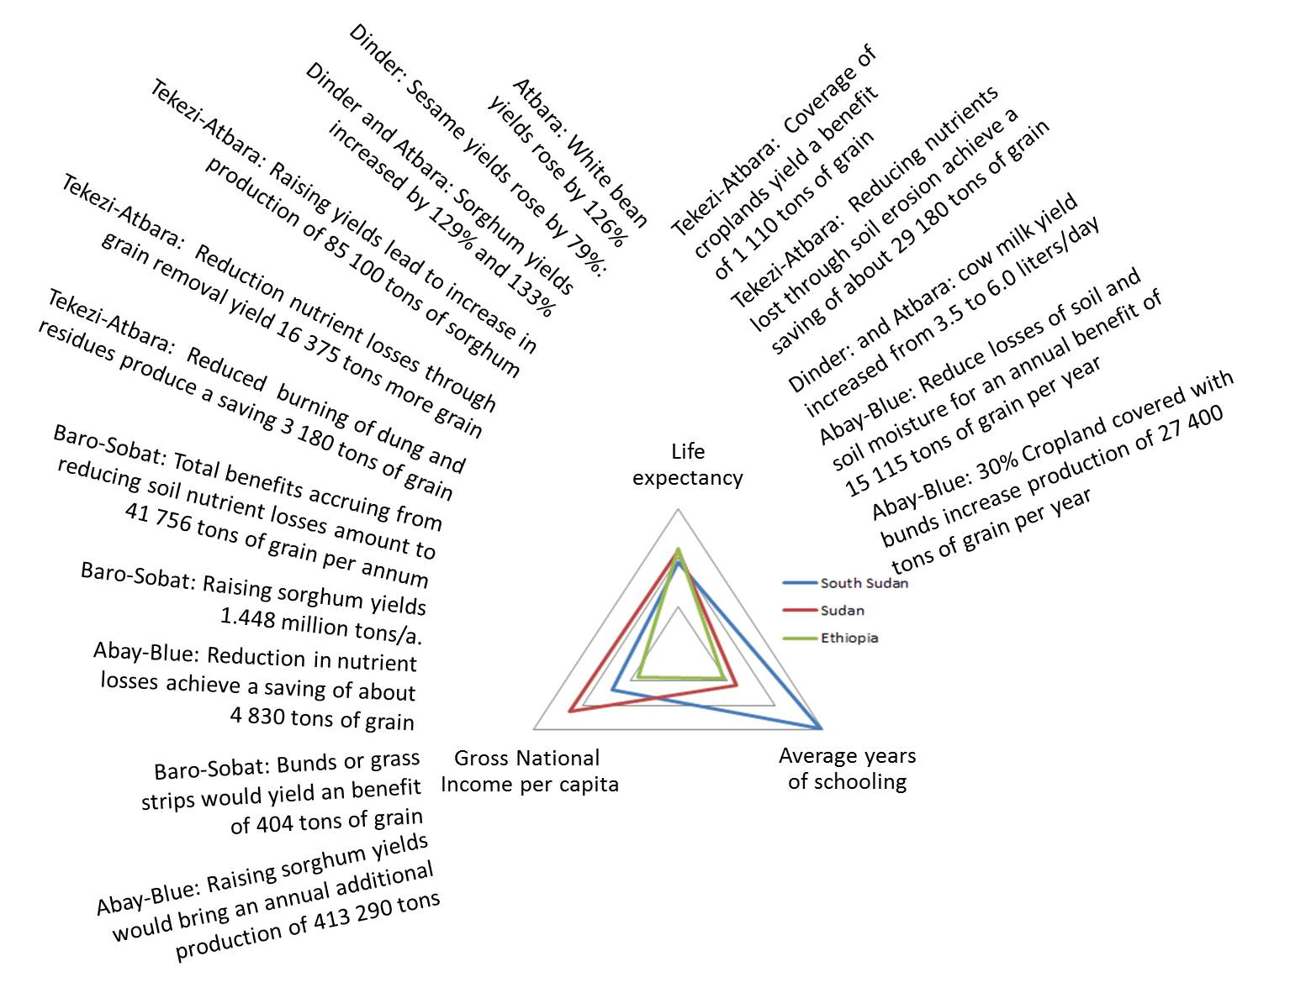
Benefit Sharing: Watershed Management
Claassen, 2016

Slide 20
Benefit Sharing: Hydropower Generation
The hydropower potential in the Nile Basin is 26 191 MW, with 20% currently installed

Slide 21
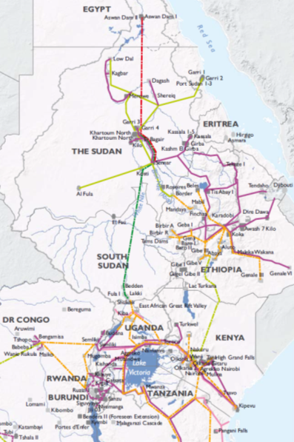
Benefit Sharing: Interconnections
Regional interconnections and markets can increase stability in the electricity system and reduce the need for system reserves
An increase in power quality (reliability) in the region can increase GDP by US$ 21 billion per annum (2%)
A 5% reduction in reserves will translate in an annual saving of US$180 million

Slide 22
Benefit Sharing: Power Interconnections
Claassen, 2016
Increase in GDP (million USD) due to increased reliability of electricity supply

Slide 23
Benefit Sharing: Hydropower
Claassen, 2016
Annual benefit in GDP (millions US$) based on 12% growth in electricity production.

Slide 24
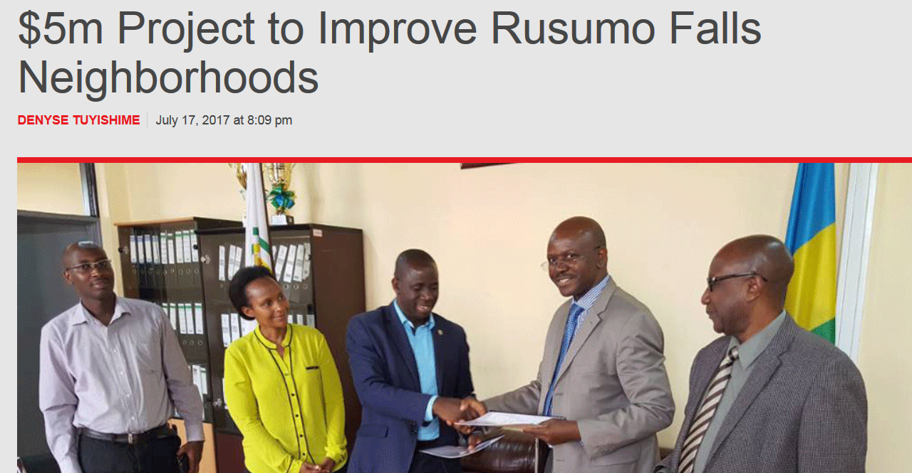
Costs of Non-Cooperation
Claassen, 2016
The lost electricity due to a 12 month delay in the implementation can be worth
US$ 430 million for Murchison Falls and US$ 35 million for Rusumo Falls
If hydropower projects in the Nile Equatorial Lakes region were delayed by 12 months due to objections or funding constraints due to unilateral action, the value of lost electricity would be US$ 2.9 billion

Slide 25
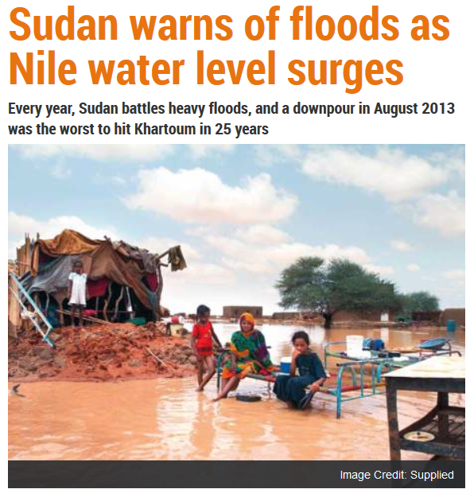
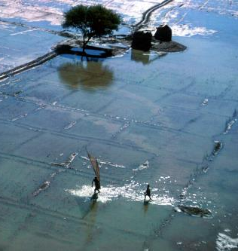
Risks
Claassen, 2016
“The average annual damage due to floods is estimated at
US$ 25.8 million in Sudan and US$ 5.5 million in Ethiopia”

Slide 26
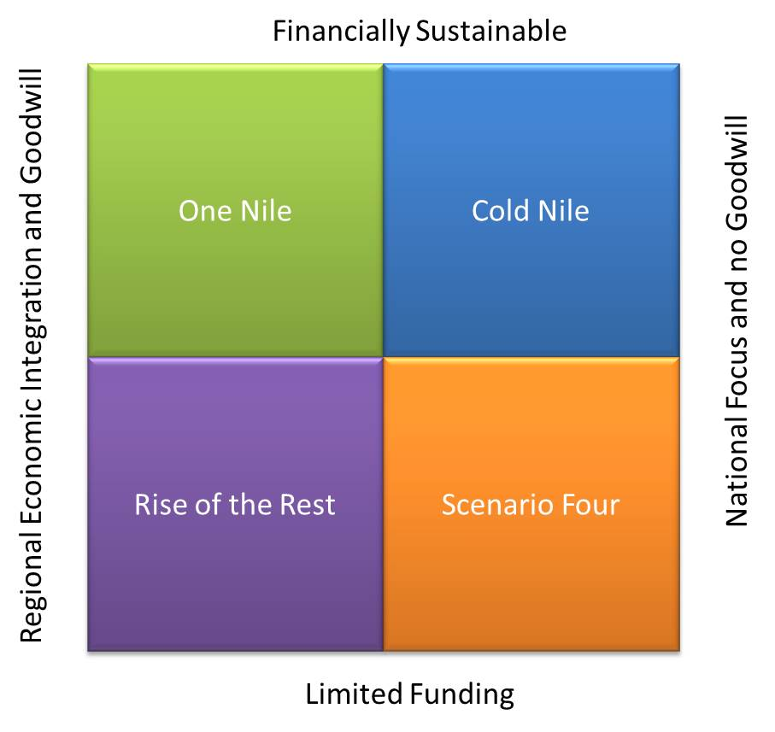
Scenarios

Slide 27
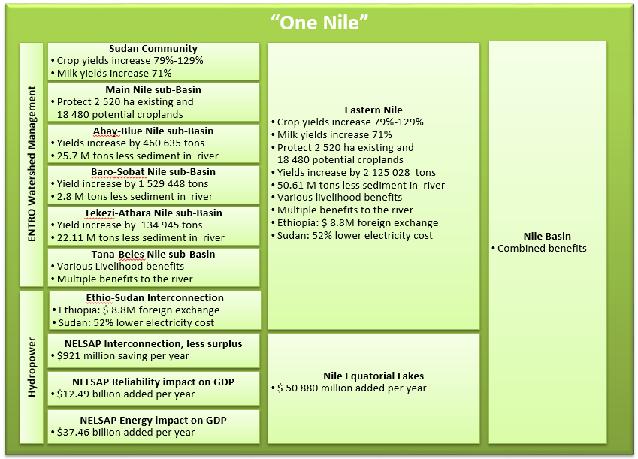
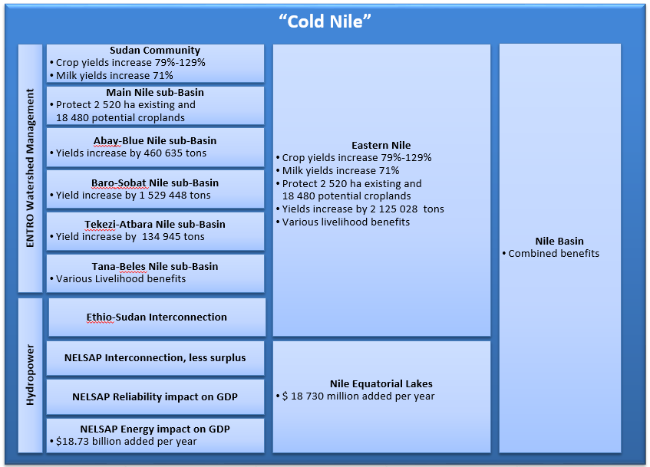
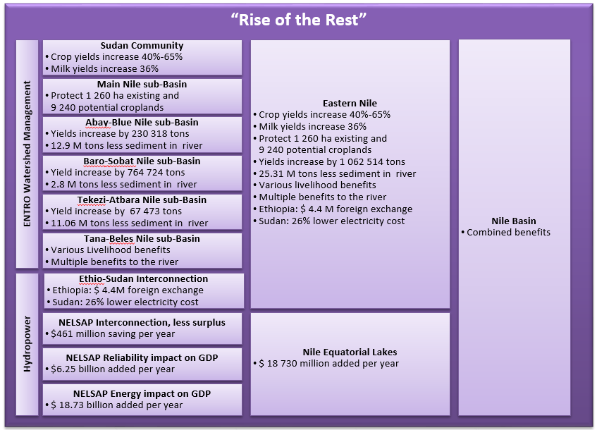
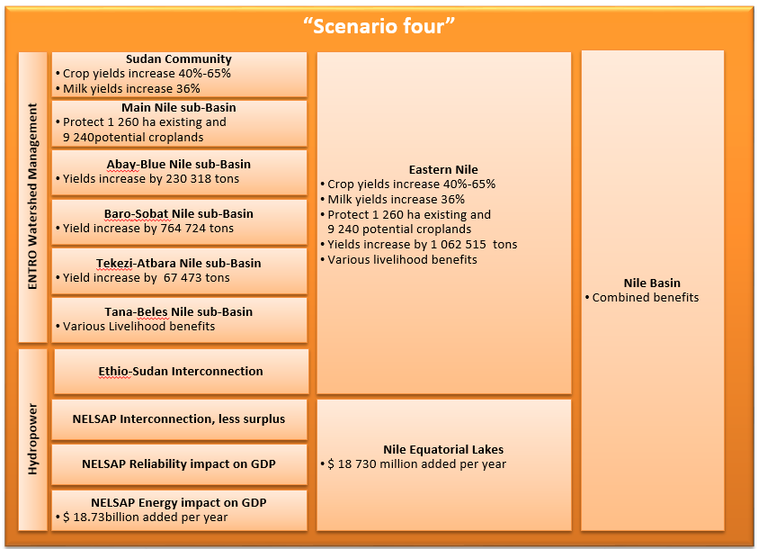

Slide 28
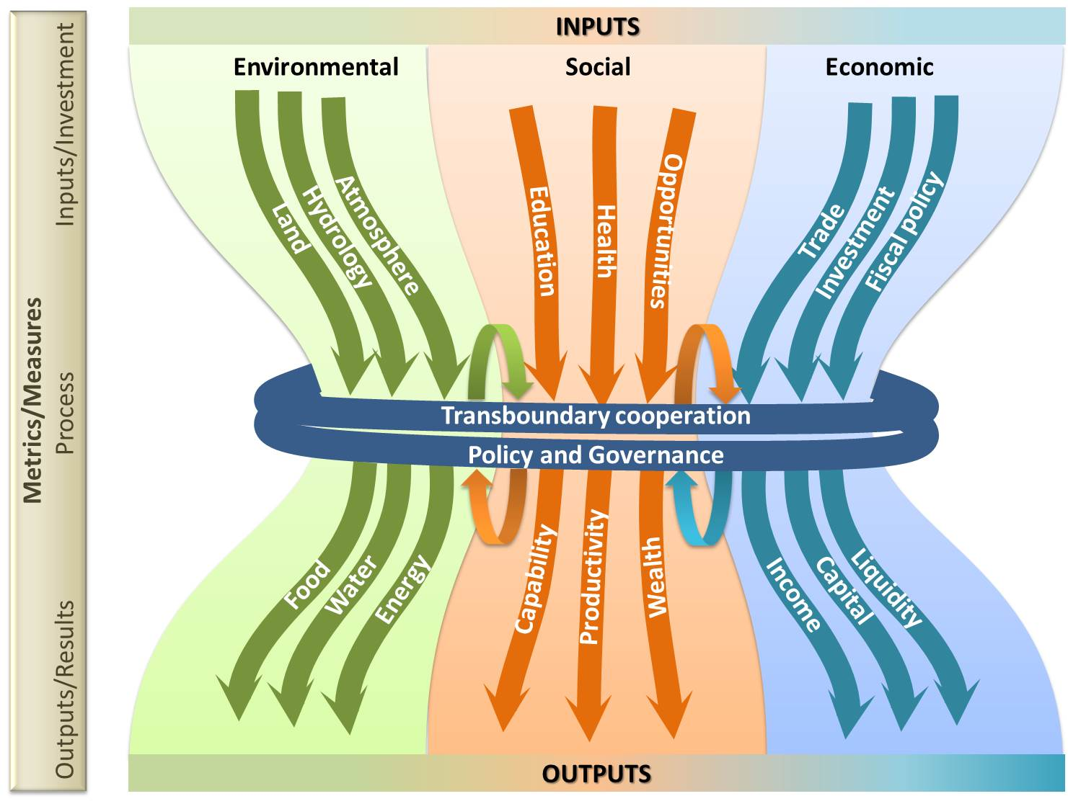
Framework for assessing benefits

Slide 29
Way Forward
1
It is important to consider the spatial and temporal scales of the analysis and in particular the linkages between scales.
2
It is not necessary to have complete knowledge to make good decisions, but information that could pose a risk to good decisions and effective implementation should be populated.
3
A clear articulation of the preferred development opportunities is needed to create a common platform for decision-making. Development opportunities should then be actively promoted.
4
The benefits of transboundary cooperation are vested in the cumulative regional synergies and opportunities. Integration between sectors will yield significantly bigger results than each on their own.

Slide 30
Thank you

