Slide 1
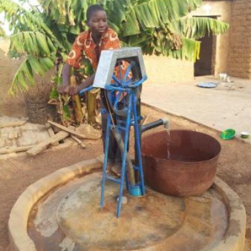
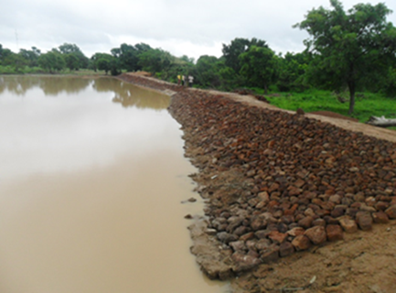
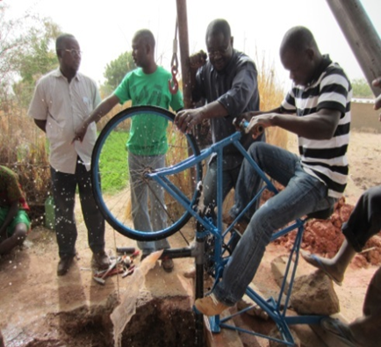
WEST AFRICA WATER CHALLENGES
Dr. Lakhdar Boukerrou
Research Associate Professor, Earth and Environment, FIU
Co-Director, International Program, Institute for Water and the Environment, FIU
Affiliate Faculty, African and African Diaspora Studies
Miami, Florida
September 17 – 18, 2018
Water and Environment Security Conference
Miami, Florida

Slide 2
Africa is the world´s second-driest continent after Australia.
About 66% of Africa is arid or semi-arid and more than 300 of the 800 million people in sub-Saharan Africa live in a water-scarce environment – meaning that they have less than 1,000 m3 per capita per year.
115 people in Africa die every hour from diseases linked to poor sanitation, poor hygiene and contaminated water.
35% of Water and Sanitation aid commitment on MDG goes to Africa with Sub-Saharan having 27% of the financial allocation.
In Africa, especially sub-Saharan Africa, more than a quarter of the population spends more than half an hour per round trip to collect water.
Africa’s rising population is driving demand for water and accelerating the degradation of water resources. By mid-2011, Africa’s population (excluding the northern-most states) was around 838 million and its average natural rate of increase was 2.6% per year, compared to the world average of 1.2%. By one estimate its population will grow to 1,2 billion by 2025 and to over 2 billion by 2050.
The urban slum population in sub-Saharan African countries is expected to double to 400 million by 2020.
                Source UN.ORG

Slide 3
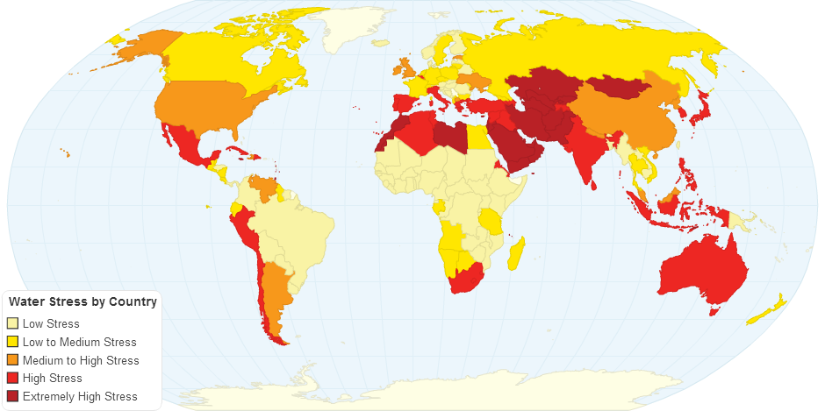
Water Stress by Country, ChartsBin.com <http://chartsbin.com/view/30647>.

Slide 4
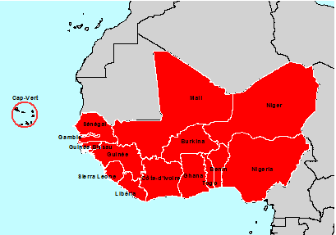
WEST AFRICAN COUNTRIES
15 countries
Area = 6 millions km2
Population (2014) = 347,7 millions
Population (2025) over 450 millions

Slide 5
TYPES OF COUNTRIES IN WEST AFRICA
Regional synthesis on water resources situation in West Africa, 2007

Slide 6
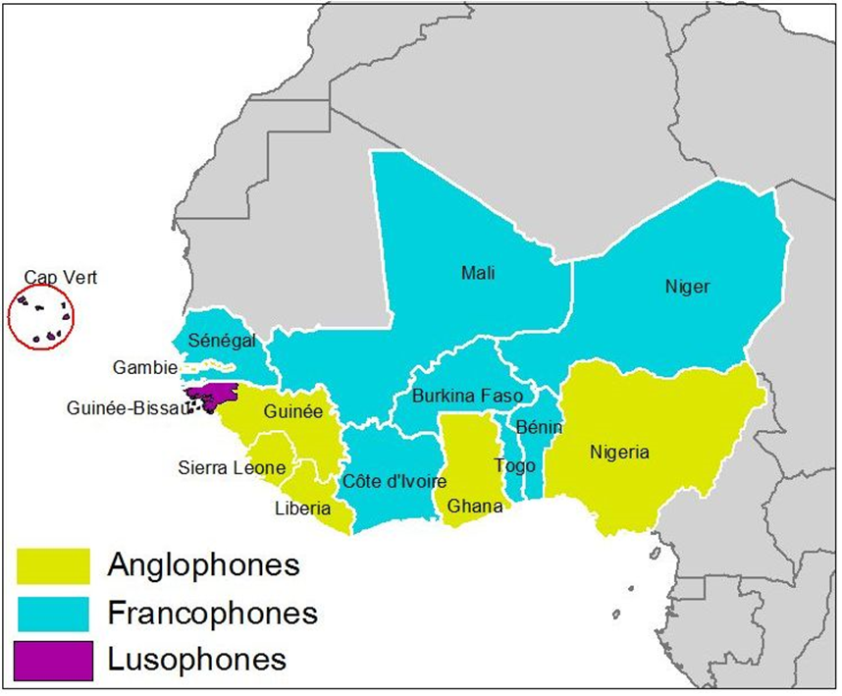
CLASSIFICATION BY OFFICIAL LANGUAGES IN WEST AFRICA
Different official languages are practiced by the West African countries

Slide 7
SURFACE AND GROUND WATER RESOURCES IN WEST AFRICA

Slide 8
WATER RESOURCES AVAILABILITY IN WEST AFRICA

Slide 9
WATER DEPENDENCY IN WEST AFRICA
The dependency factor represents the percentage of renewable water resources produced outside the country boundary

Slide 10
PROGRESS ON ACCESS TO DRINKING WATER IN WEST AFRICA URBAN AND RURAL AREAS

Slide 11
POPULATION WITH NO ACCESS TO DRINKING WATER IN WEST AFRICA
As of December 2015

Slide 12
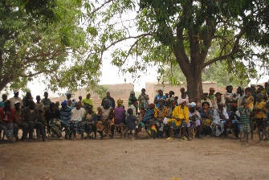
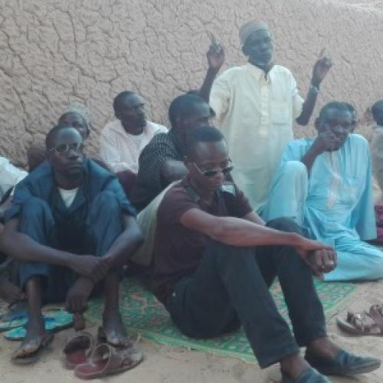
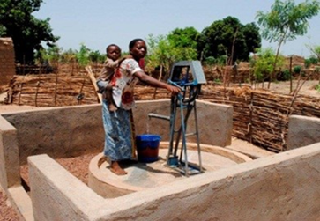
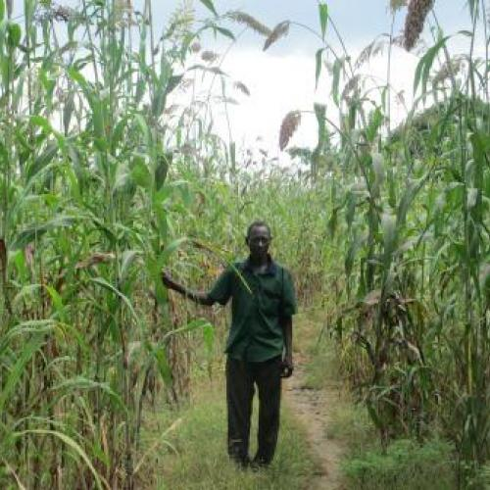
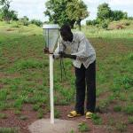
LINK BETWEEN THE THEMATIC AREAS
CONTEXT AND JUSTIFICATIONS
WATER SANITATION AND HYGIENE
FOOD SECURITY
INTEGRATION OF CAPACITY BUILDING, KNOWLEDGE MANAGEMENT AND INFORMATION SHARING
GENDER MAINSTREAMING
CLIMATE CHANGE
Increased income leads to better health, better education, better livelihood

Slide 13
PROGRAM IMPLEMENTATION CONTEXT
ALONE WE CAN GO FAST
Scale: Local, National, Regional
CULTURAL SOCIAL-ECONOMIC
INTEGRATION
ACTIVITIES, PARTNERS
Actors: NGO, Academic, Public, Private,
WORK PLAN M&E PLAN
TOGETHER WE CAN GO FAR
ENSURE SUSTAINABILITY
« We are not staying forever but we want our actions to last a lifetime »

Slide 14
INTEGRATED WASH COMMUNITY APPROACH
Behavior change and communication - Capacity building – Knowledge management – Information sharing - Gender mainstreaming – Governance – Partnership development
Promote latrine construction
Open defecation free communities
Promote personal hygiene
Hand washing in schools and homes
BETTER LIVELIHOOD
Low Cost Technologies – Point of Use Treatment
Multiple Use Services

Slide 15
ASSISTANCE OBJECTIVE
Strengthen resilience and sustainable access to water supply, sanitation and hygiene for better livelihoods
IR A.
Increased community access to potable water and improved sanitation
IR B.
Improved sustainability of WASH services
IR C.
Increased income generation and food security outcomes of WASH investments
IR D.
Strengthened national and regional enabling environment for integrated WASH
Sub-IR A.1
Improved access to and quality of sustainable water supply services for domestic and productive purposes
Sub-IR B.1
Adoption of replicable and sustainable WASH management approaches
Sub-IR C.1
Adoption of complementary agricultural technologies and practices in WASH programs
Sub IR D.1
Strengthened national and regional organizations in integrated WASH advocacy
Sub IR D.2
Increased regional integrated WASH knowledge management and networking
Sub IR B.2
Strengthened national and local policies and governance for WASH service delivery and management
Sub-IR A.2
Improved access to and use of sustainable sanitation services
Sub-IR C.2
Increased local and national capacity to adapt to water-related climate change
Sub IR D.3
Enhanced gender mainstreaming in integrated WASH programs
Sub-IR A.3
Increased adoption of key hygiene behaviors
Sub-IR B.3
Increased access to sustainable financing for WASH services
Sub IR C.3
Increased availability of climate relevant information
Sub IR D.4
Expanded private sector engagement in integrated WASH programs
Notes:
Revoir les traits en haut

Slide 16
GEOGRAPHICAL FRAMEWORK
Knowledge management and information sharing
Regional network development (academic, etc.)
PoU cross-learning and implementation
Network development (journalist network, parliamentarians, etc.)
WASH governance and monitoring of infrastructure
Water resources management approach
Water quality strategy and assessment
Integration of government strategy into program
Academic institution program building
CAPACITY BUILDING
WASH Integrated community approach
Community leadership and engagement
Infrastructure investment and monitoring (latrines, low cost technologies, farming practices, etc.)
Climate change adaptation and climate smart ag.
We cannot prevent droughts and floods but we can prevent famine through our resilience work and the sustainability of our activities

Slide 17
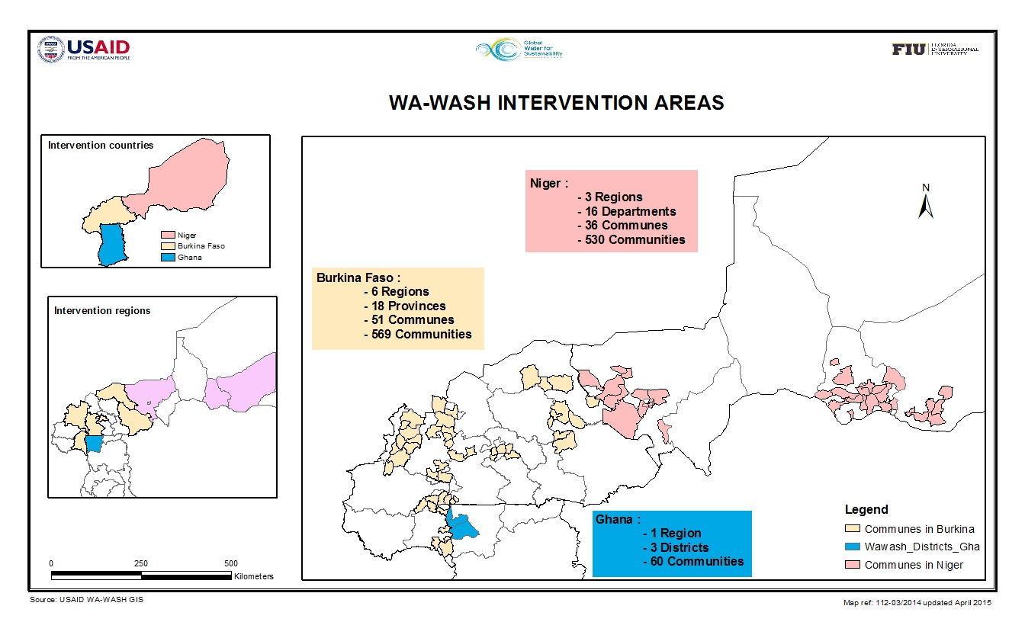
Intervention COUNTRIES

Slide 18
ACHIEVEMENTS FOR WATER
Achievements | Burkina | Ghana | Niger
Number of people with access to drinking water | 42,954 | 10,367 | 12,370
Aquatab shops | 1,261 | - | 576
Aquatab tablets sold | 3,293,400 | 1,200,000 | 5,091,000
Quantity of water treated | 65,868,000 liters | 24,000,000 liters | 101,820,000 liters
Sand dams constructed | 4 | - | -
Rain harvesting tanks constructed | 18 | - | -
Family water points | 197 | 9 | 2
Community water points | - | 18 | 43
Standpipes | 40 | 18 | 50
Length of pipes installed | 64.5 km | - | -
As of December 31, 2015

Slide 19
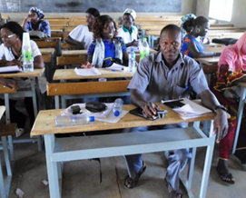
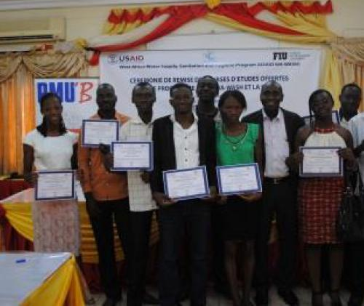
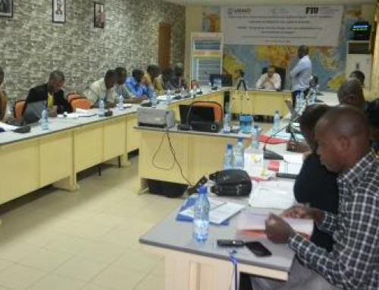
ACHIEVEMENTS FOR CAPACITY BUILDING
Achievements | Burkina | Ghana | Niger
Number of water management agencies trained on water resource management | 12 | 10 | -
Number of decision makers trained on WASH governance | 115 | 131 | -
Number of people who received training on adult teaching | 68 | 67 | -
Number of scholarships awarded | 44 | 17 | 11
Number of interns | 139 | 14 | -
Number of people trained on WASH | 2,506 | 1,578 | 369
Number of participants in the WASH professional development forum | 200 | 91 | -
As of December 31, 2015

Slide 20
WATER SUPPLY SUSTAINBILITY SCORE – BURKINA FASO

Slide 21
WATER SUPPLY SUSTAINBILITY SCORE – GHANA

Slide 22
WATER SUPPLY SUSTAINBILITY SCORE – NIGER

Slide 23
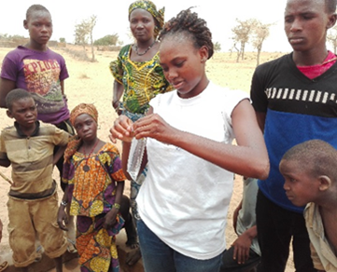
WATER QUALITY MONITORING
Water samples were collected and analyzed by the M&E team per target country to check on bacteriological contamination
Between July and November 2016

Slide 24
REMEDIAL MEASURES
The Program developed an action plan to treat drinking water and ensure good quality in a sustainable manner. The action plan includes:
Focus group with municipal authorities to get their involvement
Training of water point repairers in chlorination
Promotion of Aquatabs at the PoU
Well treatment using chlorine

Slide 25
REMEDIAL MEASURES IMPACTS
The approach adopted by the Program paid off. Between February and April 2017, the monitoring activities showed that:

Slide 26
WATER TREATMENT SUSTAINABILITY SCORE
BURKINA fASO – Ghana - niger
The sustainability score of water treatment has improved over time
Burkina Faso Ghana Niger

Slide 27
WATER TREATMENT SUSTAINABILITY Factors - BURKINA

Slide 28
Interpretation of sustainability factors graph-BURKINA
Financial sustainability [+]: Water treatment products are affordable and accessible to households.
Institutional sustainability [+]: Existence of trained community moblizers/animators.
Social sustainability[-]: Household members do not frequently use water treatment products

Slide 29
WATER TREATMENT SUSTAINABILITY Factors - Ghana

Slide 30
Interpretation of sustainability factors graph-GHANA
Financial sustainability [+]: Water treatment products are affordable and accessible to households.
Institutional sustainability [+]: Existence of community support to the promotion of water treatment products.
Social sustainability[+]: Household members frequently use water treatment products and households understand the benefits of water treatment products.

Slide 31
WATER TREATMENT SUSTAINABILITY Factors - NIGER

Slide 32
Interpretation of sustainability factors graph-Niger
Financial sustainability [+]: Water treatment products are affordable and accessible to households.
Institutional sustainability [+]: Existence of community support to the promotion of water treatment products.
Social sustainability[-]: Not all the people in the household drink the treated water.

Slide 33

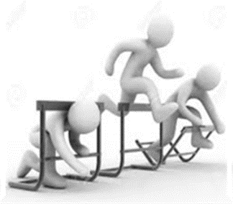
CHALLENGES TO WATER RESOURCES MANAGEMENT
High evaporation
Unsteady flow velocity of the streams
Sedimentation of surface water resources
Lack of water facilities and qualified engineers
Low level of water mobilization
Invasion of surface water resources by plants
Poor management of existing water facilities
Lack of financial means
High cost of water facilities and equipment

Slide 34
POTENTIAL SOLUTIONS
Promote an integrated water resources management
Encourage PPP to facilitate investments
Strengthen the capacity of water stakeholders
Reinforce communication for behavior change
Monitor the quality of raw water
Protect surface water resources from pollution
Improve knowledge on water resources
Prevent sedimentation
Reduce land degradation

Slide 35
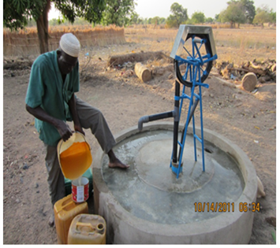
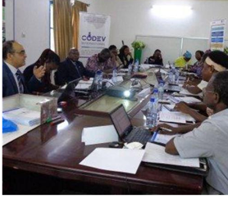
THANK you
Dr. Lakhdar Boukerrou
Co-Director, International Program, InWE
Research Associate Professor, FIU
Affiliate Faculty, African and African Diaspora Studies
Websites: http://wawash.fiu.edu
www.inwe.fiu.edu

