Slide 1

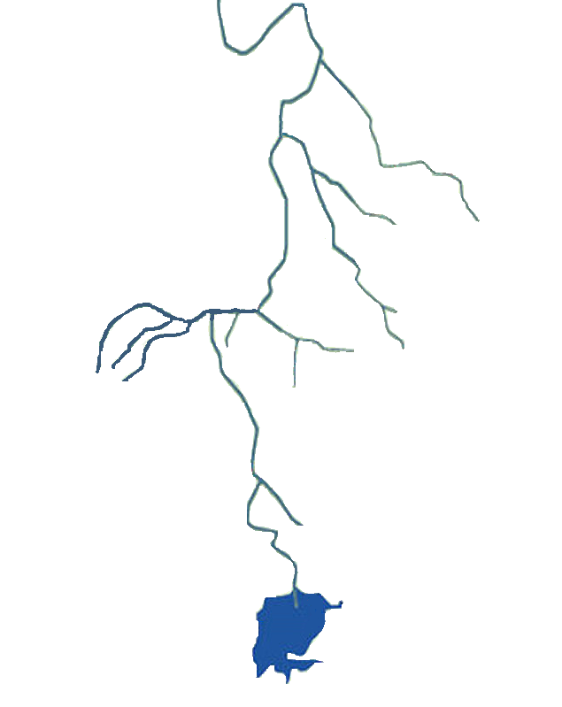
what to learn from histor
A look into the historical depths of the Nile waters:
History is, according to Pieter Geyl’s, “an argument without end” (Schölch 1976, 773), unlike the water.
In the face of increasing water scarcity and a change in the status quo, scholars have warned for decades about the risk of conflict in the Nile Basin, in the absence of an inclusive agreement among the eleven countries.
The aim of this presentation is to explain what status quo is, the historical water governance of the Nile with attention to the relationships of power that have determined the management of its resources.

Slide 2

Structural unbalanced condition of basins
The Egypt’s position as “a gift of the Nile” and Ethiopia as “tower of Africa”, but also “great unknown”, is common in the dynamics between upstream and downstream riparian countries where the hydrologically weaker state is the stronger state (Wouters 1992).
The recent Amharic songs on Nile convey that Ethiopians did not benefit from the Nile as well as they should (B.E. Getahun 2014):
The unbeaten chapter is conquered, the
hidden is uncovered. […]
We transformed regret into a vision.

Slide 3

Hydro-Politics background
For a long time, all countries had as main concern the control of Nile’s floods.
Khedive Mohammed Ali, ruler of Egypt 1811-1849, conquested Sudan and western frontiers of Ethiopia, a steppingstone to secure control over the Nile system, necessary for the cultivation and production of cotton.
With a view to profiting from the ‘Cotton Famine’, Khedive Sa'id (1854-1863), turned Egypt into a major producer of cotton.
Khedive Ismail (1863-1879) was defeated by Emperor Johannes IV of Ethiopia in the Battle of Gundet (1875) and Gura (1876).
1882 Great Britain invaded Egypt.
The Great Britain assured itself militarily and diplomatically the control of the entire basin (after Fashoda Incident, 1898). They created a pattern of water utilization which favored a single state (Egypt) at the expense of the interests of the whole basin.

Slide 4
Nile Treaties and Agreements
Protocol between the UK and Italy
Agreement between the UK and Ethiopia
Treaty between the UK and Congo
Agreement between the UK, France and Italy
15 April 1891
15 May 1902
9 May 1906
13 December 1906
Exchange of Notes between Italy and the UK
Exchange of Notes between Egypt and UK
14-20 December 1925
Agreement between Belgium and the UK
Supplementary Agreement between the UK and Egypt
Exchange of Notes between the UK and Egypt
31 May 1949, 5 Dec 1949
Jan-Mar 1950,
July 1952 - Jan 1953
22 November 1934
1932
7 May 1929
Agreement between Republic of the Sudan and U.A.R.
Jonglei Canal Project Agreement
Ethio-Sudanese Agreement
Ethio-Egyptian Framework Agreement
Lake Victoria
Agreement
30 June 1994
5 August 1994
8 November 1959
1974
23 December 1991
1 July 1993

Slide 5
Building asymmetric control of Nile System
Protocol between the UK and Italy – Rome, 15 April 1891
art.3: The Italian Government engages to no construct on the Atbara, in view of irrigation, any works which might sensibly modify its flow into the Nile.
Agreement between the UK and Ethiopia – Addis Ababa, 15 May 1902 (English version)
art.3: His Majesty the Emperor Menelik II, King of Kings of Ethiopia, engages himself towards the Government of His Britannic Majesty not to construct or allow to be constructed any work across the Blue Nile, Lake Tana, or the Sobat, which would arrest the flow of their waters in to the Nile except in agreement with His Britannic Majesty's Government and the Government of Sudan.
Treaty between the UK and Congo – London, 9 May 1906
art. 3: The Government of the Independent State of the Congo undertake not to construct, or allow to be constructed, any work on or near the Semliki or Isango River, which would diminish the volume of water entering Lake Albert, except in agreement with the Soudanese Government.
Agreement between the UK, France and Italy – London, 13 December 1906
art.4: […] France, Great Britain, and Italy shall make every effort to preserve the integrity of Ethiopia. In any case, they shall concert together, […] in order to safeguard: a. The interests of Great Britain and Egypt in the Nile Basin, more especially as regards the regulation of the waters of that river and its tributaries (due consideration being paid to local interests), without prejudice to Italian interests […].
Exchange of Notes between Italy and the UK - Rome, 14 - 20 December 1925
The Italian Government, recognizing the prior hydraulic rights of Egypt and the Sudan engage not to construct on the head waters of the Blue Nile and the White Nile and their tributaries and effluents any work which might sensibly modify their flow into the main river.

Slide 6
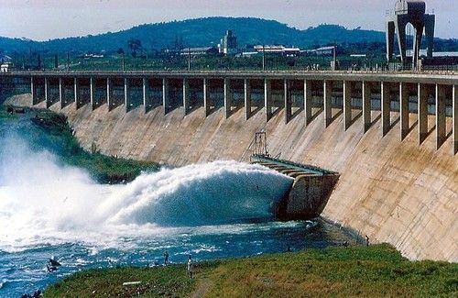
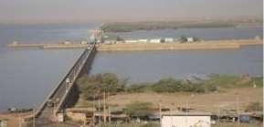
Great Britain awards Egypt as owner of the Nile
Exchange of Notes between Her Majesty's Government in the United Kingdom and the Egyptian Government on the Use of Waters of the Nile for Irrigation. Cairo, 7 May 1929.
The imbalanced agreement recognises Egypt’ s right to monitor upstream flows; to undertake projects without the consent of upstream states, and to veto any construction projects that would affect its interests adversely. The essence is the safeguarding of what is described as the “Egypt’s natural and historical rights in the waters of the Nile and its requirements of agricultural extension”, a net gain for Egypt (Crabités 1929,146).
The 1932 Anglo-Egyptian Agreement for the Construction of the Jebel Awliya Dams in Sudan
The Agreements and the Exchanges of Notes 1949-1953 about Owen Falls in Uganda
Agreement between the Republic of the Sudan and the United Arab Republic for the full utilization of the Nile waters.
Cairo, 8 November 1959.
The agreement provided a fairer division of water resource and its full, ironically, utilization from the two now independent countries, which continued to exclude others riparian Nile. This cooperative framework decided to build the AHD and Jonglei Canal, provided a level of year to year security for the availability of water. Because of this agreement the Khashm el Girba Dam and the Roseires Dam were built in Sudan.

Slide 7
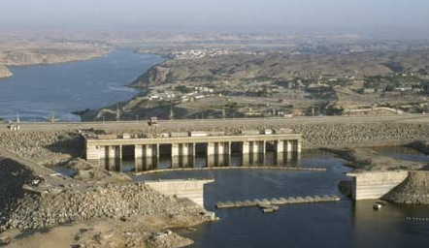
Post-colonial system of power
The other riparian countries denied the validity of colonial Nile agreements and treaties, but no new one was produced.
Even in the absence of agreements covering all the countries, dams have been built for decades with country-driven projects, a distinguishing factor of the Nile Basin (Salman 2016).
The dams’ construction fits into the hydro-mission of Cold War period. The story of the AHD financing, in the end by the USSR, is its symbol. The project for a large Ethiopian dam began in the 1960s, under the aegis of the USA, in this climate of conflict.
President Nasser of Egypt (1956-1970) had dreams of building the unity of the Nile Valley. Sadat (1970-1981) had equally ambitious projects, such as carry water across the Suez Canal to the Sinai desert for irrigation and, if it was possible, to Israel (1975). This created strong instability, especially with Ethiopia, that in turn intended to proceed with the construction of a dam on Lake Tana.
The Aswan High Dam, Aswān, Egypt.

Slide 8

Signs of change
In the 1980s there were events that led to a change in the status quo (Nicol et al. 2011, 319), built unilaterally and only recently, starting from the colonial period:
famine of 1984/5 in Ethiopia;
low flows of the Nile caused concern in Egypt;
weakening of Mengistu’s dictatorship, until its fall in 1991;
the rise of Islamism in the region (for Egypt, the Muslim Brotherhood, and for both, state change in Sudan towards a more Islamist orientation and state disintegration in Somalia).
Since the 1990s WB, UNDP and other international donors, have begun to lay the foundations for formal setting for cooperation among Nile Basin riparian countries, in order to legitimate their financing in cases of transboundary water:
Ethio-Sudanese Agreement regarding the Nile (1991);
Ethio-Egyptian Framework Agreement (1993);
The Nile 2002 Conference was inaugurated in Swan in 1993 and repeated every year for a decade;
Lake Victoria Agreement (1994).

Slide 9
New cards, old game
Behind Nile cooperation, national logics and interests continued to prevail over a regional vision, aimed at maximizing hydropower and reducing water losses in the river and basin:
there have been projects financed by bilateral agreements or domestic resources;
the case of the Toshka project in Egypt;
the event of 2011;
about GERD, “the escalation of political rhetoric […] casts shadow on the progress of dialogue and negotiations while creating grounds for potential conflict (Abtew at al. 2019, 142)”.
What to learn from History
“In the past Ethiopian politicians presented the GERD as an African project, benefiting the entire region. Nowadays the nationalistic pride trumps all alternative narratives, as exemplified by the hashtag #ItsMyDam that went viral on social media […]” (Fantini 2019).
Upper-riparian states must not give in to the temptation of payback and “resort to a version of the ancient Harmon Doctrine” (Okidi 2014,178).
“The truth though must be told forcefully, that it is time for Egyptians to let go of the wrong belief ‘that their country will have the right forever, ad vitam aeternam, to all of the water carried by the Nile, as at the time of the Pharaohs’” (Mekonnen 2010,440).
“Nothing is sadder than seeing history repeat itself” (Todorov 1992, 298).

Slide 10
References
Abdalla, I. H. 1971. «The 1959 Nile Waters Agreement in Sudanese-Egyptian Relations». Middle Eastern Studies 7 (3): 329–41.
Abtew, Wossenu, and Dessu, Shimelis Behailu. 2019a. «Dialogue and Diplomacy Through the Construction of the Grand Ethiopian Renaissance Dam». In The Grand Ethiopian Renaissance Dam on the Blue Nile, 131–46. Springer Geography.
Abtew, Wossenu, and Dessu, Shimelis Behailu. 2019b. «Financing the Grand Ethiopian Renaissance Dam». In The Grand Ethiopian Renaissance Dam on the Blue Nile, 161–69.
Alan, Nicol, and Cascão, Ana Elisa. 2011. «Against the flow – new power dynamics and upstream mobilisation in the Nile Basin». Review of African Political Economy 38 (128): 317–325.
Allan, J. Anthony. 1999. «The Nile Basin: evolving approaches to Nile waters management». SOAS Water Issues Group Occasional Paper 20, June.
Calchi Novati, Giampaolo, and Pierluigi Valsecchi. 2012. Africa: la storia ritrovata. Dalle prime forme politiche alle indipendenze nazionali. Seventh Edition. Roma: Carocci Editore.
Chen, Huiyi, and Swain, Ashok. 2014a. «The Grand Ethiopian Renaissance Dam: Evaluating Its Sustainability Standard and Geopolitical Significance». Energy Development Frontier 3 (1): 11–19.
Collins, Robert, and Herzog, Richard. 1961. «Early British Administration in the Southern Sudan». The Journal of African History 2 (1): 119–35.
Crabitès, Pierre. 1929. «The Nile Waters Agreement». Foreign Affairs 8 (1): 145–49.
«Dams and development: A new framework for decision-making. Overview of the report by the World Commission on Dams». 2001. World Commission on Dams, December.
Dellapenna, Joseph W. 1996. «Rivers as Legal Structures: The Examples of the Jordan and the Nile». Natural Resources Program 32 (2).
Dellapenna, Joseph W. 2001. «The Nile as a Legal and Political Structure». Conflict and Cooperation related to International Water Resources: Historical Perspectives.
Dorsey, and Whitney. 2006. «The Nile Waters Agreement: imposition and impacts of a transboundary legal system». Columbia Journal of Transnational Law 44: 622–48.
Ferede, Wuhibegezer, and Sheferawu Abebe. 2014. «The Efficacy of Water Treaties in the Eastern Nile Basin». Africa Spectrum 1: 55–67.
Garretson, Albert H. 1960. «The Nile River System». Proceedings of the American Society of International Law at Its Annual Meeting (1921-1969), 54 (April): 136–44.
Getahun, Berhanu Engidaw. 2014. «A Content Analysis of Amharic Songs on Nile River». Journal of Arts and Humanities (JAH) 3 (7): 92–104.
Hammond, Michael. 2013. «The Grand Ethiopian Renaissance Dam and the Blue Nile: Implications for transboundary water governance». Global Water Forum, February 2013.
Hayne, Kingsley E., and Dale Whittington. 1981. «International Management of the Nile. Stage Three? » Geographical Review 71 (1): 17–32.
Hess, Steve, and Aidoo Richard. 2016. «The Political Staleness of China–Ethiopia Relations». In Charting the Roots of Anti-Chinese Populism in Africa., 79–108. Springer.
Kasimbazi, Emmanuel B. 2010. «The impact of colonial agreements on the regulation of the waters of the River Nile». Water International 35 (6): 718–732.
Keefer, Edward C. 1981. «Great Britain, France, and the Ethiopian Tripartite Treaty of 1906». A Quarterly Journal Concerned with British Studies 13 (4): 364–80.
Kendie, Daniel. 1999. «Egypt and the Hydro-Politics of the Blue Nile River». Northeast African Studies 6 (1/2): 141–69.
Kersting, Erasmus, and Kilby Christopher. 2018. «Do domestic politics shape U.S. influence in the World Bank? » The Review of International Organizations Published online in August.
McKenzie, Scott O. 2012. «Egypt’s Choice: From the Nile Basin Treaty to the Cooperative Framework Agreement, an International Legal Analysis». Transnational Law &Contemporary Problems 21: 571–99.
Mekonnen, Dereje Zeleke. 2010. «The Nile Basin Cooperative Framework Agreement Negotiations and the Adoption of a ‘Water Security’ Paradigm: Flight into Obscurity or a Logical Cul-de-sac?» The European Journal of International Law 21 (2): 421–440.
Obengo, Joel Okundi. 2016. «Hydropolitics of the Nile: The case of Ethiopia and Egypt». African Security Review 25 (1): 95–103.
Okidi, Charles Odidi. 2014. «Nile Waters: the threat of war is not justifiable in modern times». Environmental Policy and Law 44 (1/2): 176–80.
Salman M. A., Salman. 2007. «The United Nations Watercourses Convention Ten Years Later: Why Has its Entry into Force Proven Difficult?» Water International 32 (1): 1–15.
Salman M. A., Salman. 2009. Facing the challenge on International Water ways. The World Bank Policy for projects on International waterways. An historical and legal analysis. Washington, DC: World Bank.
Salman M. A., Salman. 2010. «Downstream riparians can also harm upstream riparians: the concept of foreclosure of future uses». Water International 35 (4): 350–364.
Salman M. A., Salman. 2011. «The Baardhere Dam and Water Infrastructure Project in Somalia—Ethiopia’s objection and the World Bank response». Hydrological Sciences Journal 56 (4): 630–40.
Salman M. A., Salman. 2013. «The Nile Basin Cooperative Framework Agreement: a peacefully unfolding African spring?» Water International 38 (1): 17–29.
Salman M. A., Salman. 2016. «The Grand Ethiopian Renaissance Dam: the road to the declaration of principles and the Khartoum document». Water International 41 (4): 512–27.
Schölch, Alexander. 1976. «The “Men on the Spot” and the English Occupation of Egypt in 1882». The Historical Journal 19 (3): 773–85.
Smith, Laurence C.. «Rivers of Power: How a Natural Force Raised Kingdoms, Destroyed». Hachette Book Group, New York, 2020
Swain, Ashok. 1997. «Ethiopia, the Sudan, and Egypt: The Nile River Dispute». The Journal of Modern African Studies 35 (4): 675–94.
Todorov, Tzvetan. 1992. La conquista dell’America. Il problema dell’<<altro>>. Second Edition. Torino: Einaudi.
Ullendorff, Edward. 1967. «The Anglo-Ethiopian Treaty of 1902». Bulletin of the School of Oriental and African Studies, University of London 30 (3): 641–54.
Verhoeven, Harry. s.d. «Bis is beautiful: Megadams, African water security, and China’s role in the new global economy». Global Water Forum.
Warburg, Gabriel R. 2007. «The search for the sources of the White Nile and Egyptian–Sudanese relations». Middle Eastern Studies 43 (3): 475–86.
Waterbury, John. s.d. «Legal and institutional arrangements for managing water resources in the Nile Basin. » International Journal of Water Resources Development 3 (2): 1987.
Wiebe, Kristin. 2001. «The Nile River: Potential for Conflict and Cooperation in the Face of Water Degradation». Natural Resources Journal 41 (3): 731–54.
Wondimneh, Tilahun. 1979. Egypt’s Imperial Aspirations over Lake Tana and the Blue Nile. United Printers Ltd. Addis Ababa.
World Commission on Dams. 2001. «Dams and development: A new framework for decision-making. Overview of the report by the World Commission on Dams», December.
Wouters, Patricia K. 1992. «Allocation of the Non-Navigational Uses of International Watercourses: Efforts at Codification and the Experience of Canada and the United States», 43–88.
Yihdego, Zeray, Alistair Rieu-Clarke, and Ana Elisa Cascão. 2016. «How has the Grand Ethiopian Renaissance Dam changed the legal, political, economic and scientific dynamics in the Nile Basin? » Water International 41 (4): 503–511.
Zwarteveen, Margaret, e et al. 2017. «Engaging with the politics of water governance». WIREs Water 4 December.
Official Documents
The Anglo-Italian Protocol was signed in an attempt by Italy and Great Britain in the attempt of legitimizing their capture of parts of East Africa.
A Treaty Between Ethiopia and Great Britain on the Delimitation of the Frontier between Ethiopia and Sudan.
Agreement between Great Britain and the Independent State of the Congo, modifying the Agreement signed at Brussels, May 12,1894, relating to the Spheres of Influence of Great Britain and the Independent Sate of the Congo in East and Central Africa.- Signed at London, May 9,1906.
Agreement between the United Kingdom, France, and Italy, Respecting Abyssinia, signed at London, December 13, 1906.
Exchange of Notes between Great Britain and Italy.
Exchange of Notes between Her Majesty's Government in the United Kingdom and the Egyptian Government on the Use of Waters of the Nile for Irrigation.
Exchange of Notes constituting an agreement between the Government of the United Kingdom of Great Britain and Northern Ireland (on behalf of Uganda) and the Government of Egypt regarding cooperation in meteorological, and Hydrological surveys in certain areas of the Nile Basin Parties: Egypt, Great Britain (Uganda).
Agreement between the Republic of the Sudan and the United Arab Republic for the full utilization of the Nile waters signed at Cairo, 8 November 1959.
Emanuele Fantini, The Grand Ethiopian Renaissance Dam: From Diplomatic Deadlock to Nationalistic Lockdown, 22 May 2020.
Thanks for the attention

