Slide 1

Water Resources account of Egypt vs Ethiopia's Nile Sub-Basins: The Utility of the Water Budget Model
By
Tekleab S. Gala
Associate Prof. Geomatics
Chicago State University
2020 International Conference on the Nile and Grand Ethiopian Renaissance Dam: Science, Conflict Resolution and Cooperation

Slide 2
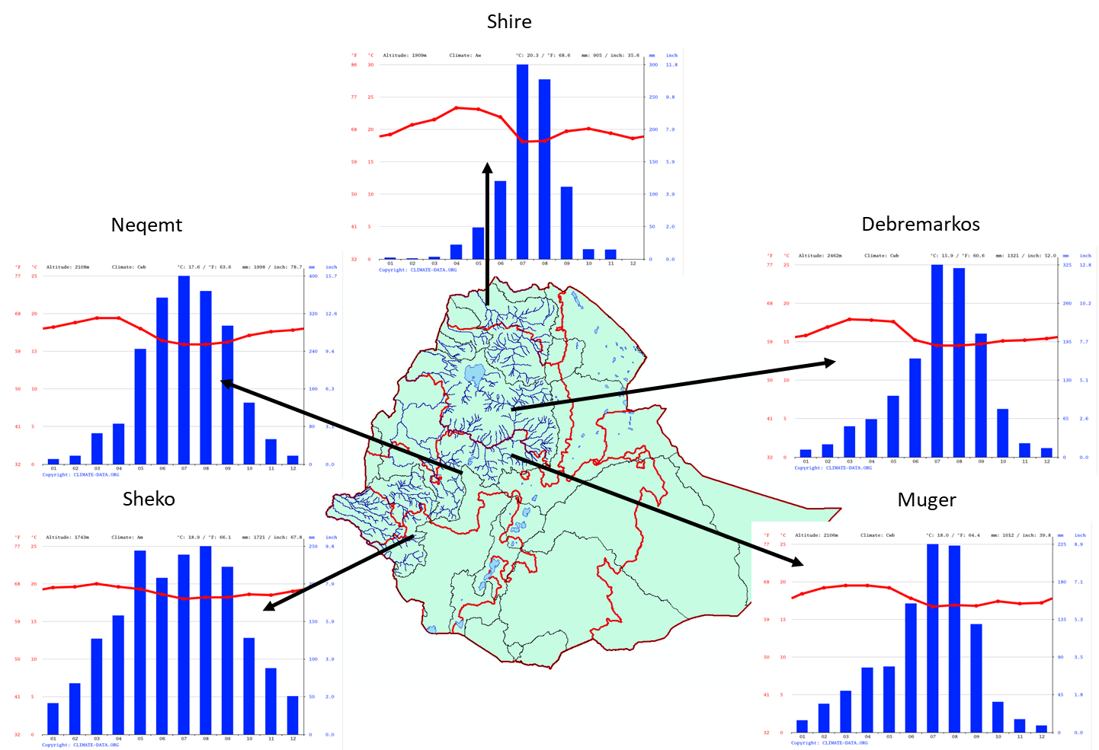
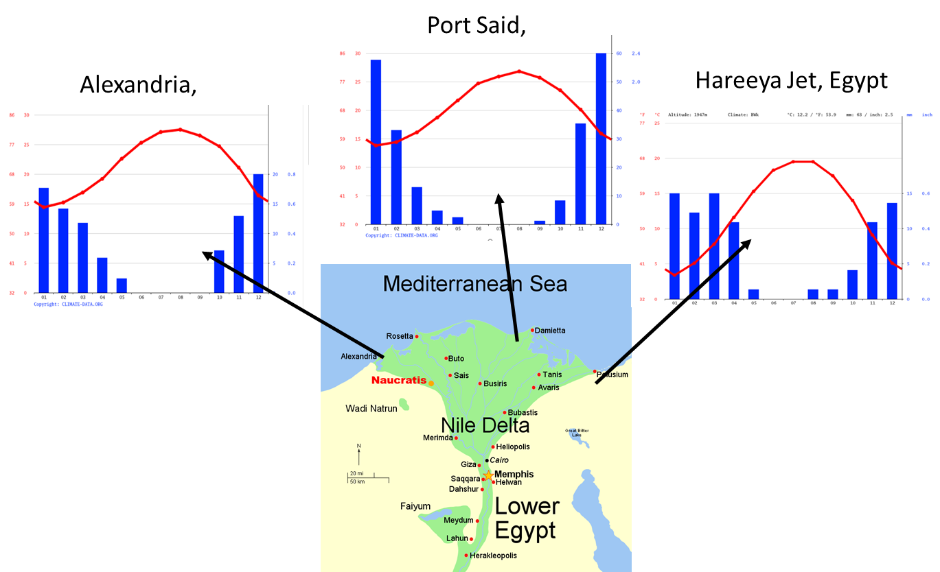
Ethiopia: Water Tower of Africa
There is an overwhelming perception of Ethiopia’s plentiful water resources.
Ethiopian highlands obtain rainfall as high as 2000 mm per annum, in comparison to Egypt annual average rainfall, which in the order 200mm.
an average RF on the delta is 100 –200 mm.

Slide 3
Rainfall is not the only sources
Several hydrologic inputs are available for a watershed or country to gain water resource. These are:
          Surface water Inflow
          Extraction of Groundwater
          Applied water reuse
          Return (recycled) water flow
          Imported water
          Subsurface water inflow and
          Desalinization
The fates of inputs can be run-off, evaporation, and infiltration into soils

Slide 4
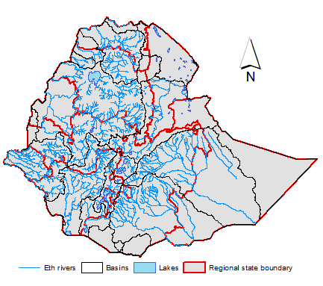
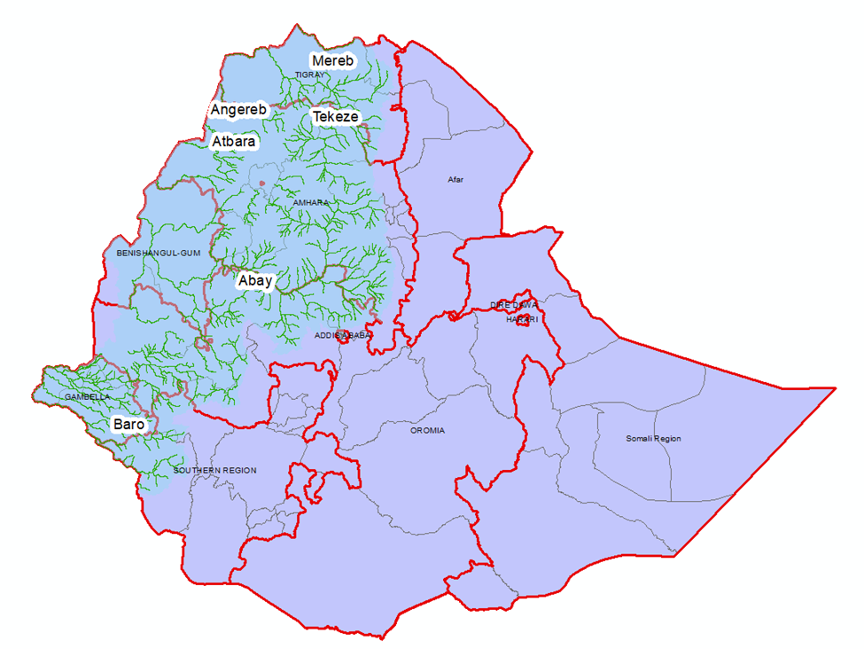
Stream outflows
97% of these streams/rivers are transboundary, and only 3% remains within the country
The western Ethiopian highlands, source of Nile river accounts for 70% of the overall stream water resources of the country.

Slide 5
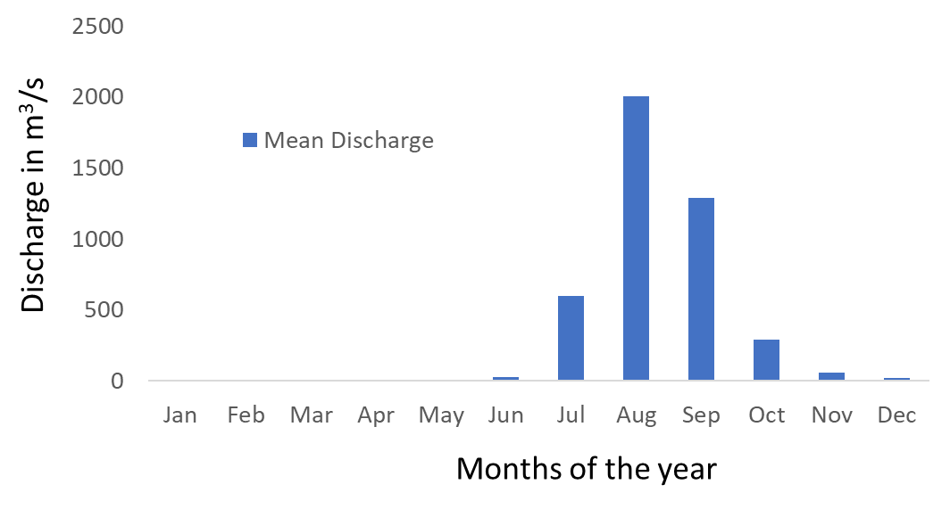
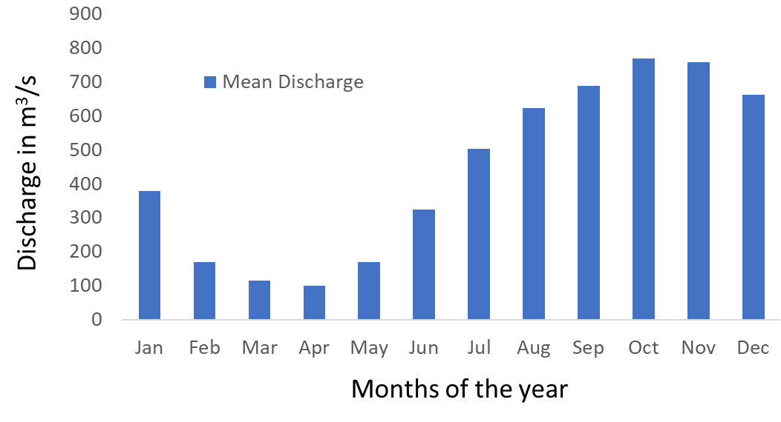
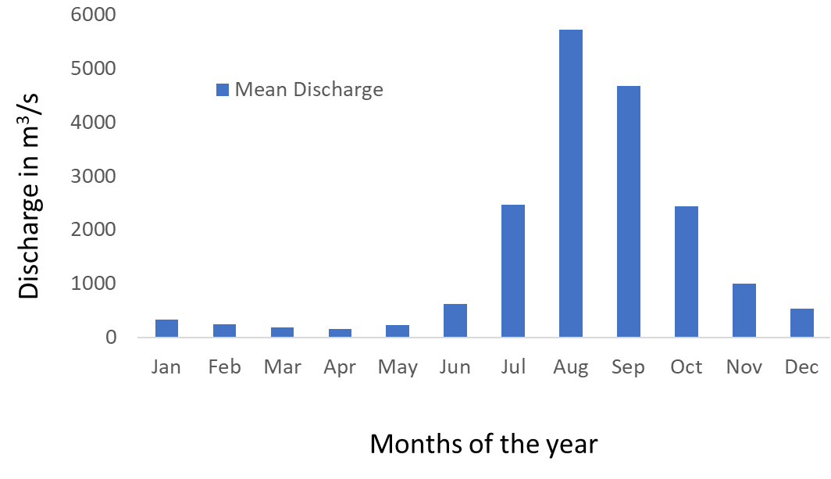
Hydrographs Showing Stream Discharge
Tekeze-Atbara
Baro-Akobo-Sobat
Sub-basins’ calculation | Mean Discharge (m³/s)
Atbara | 437.6
Blue Nile | 1548.4
Sobat | 358.7
Blue Nile
(Source: University of New Hampshire - Global Runoff Data Centre)

Slide 6
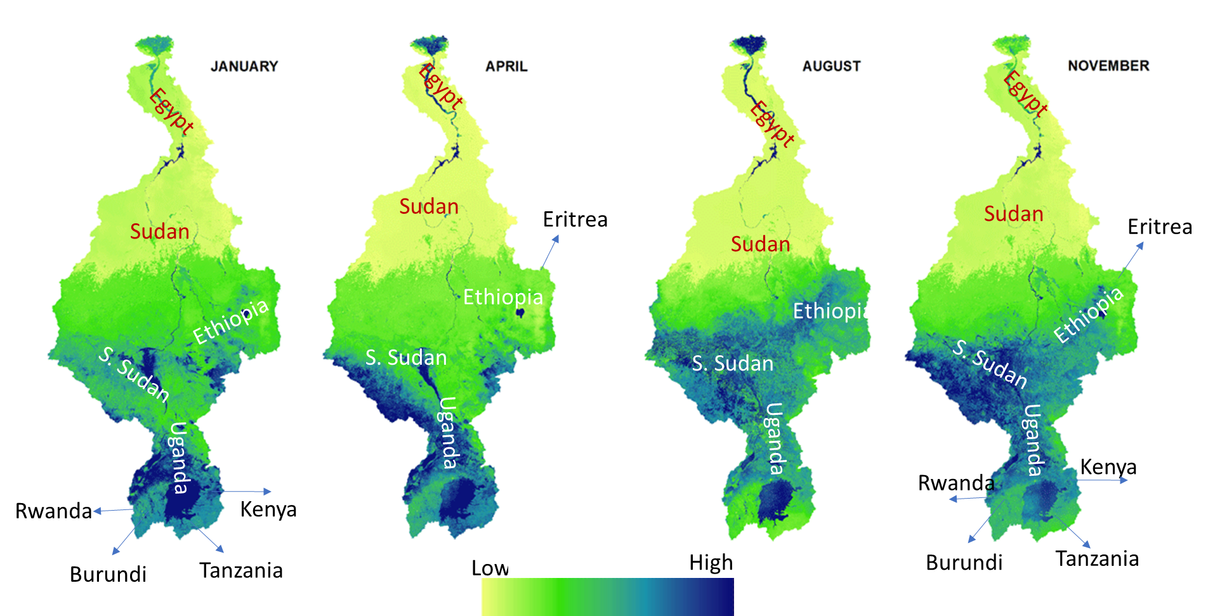
Evapotranspiration
Direct evaporation and evapotranspiration (ET) of January, April, August, and November from the Nile river basin (Source; Nile basin water resource Atlas).

Slide 7
Objectives
Therefore, given these prevailing hydrologic processes, there is a need:
  to conduct detailed and dynamic water resources inventories in the Nile basin in these two countries.
  to verify if indeed Ethiopia has plentiful alternative freshwater resources, and Nile water is the Egypt's sole freshwater source and the dam is an existential threat.

Slide 8
Water Budget Concept
This study uses the concept of water budget, a hydrologic tool used for measuring water movement in between hydrologic regimes (atmosphere, surface and the subsurface).
It also involves measurement of the quantities of water storages in each component, particularly, the surface and subsurface.
Watershed managers use this tool for evaluating sustainable qualities and quantities of water supplies; watershed best practices, and watershed planning and management thereof.

Slide 9
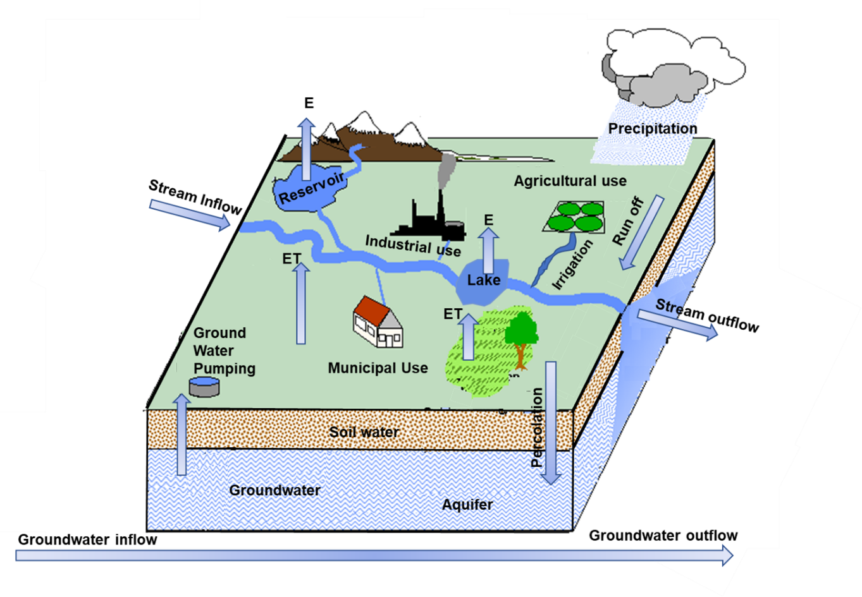
Water Budget Concept
The water budget concept applies the law of conservation of mass/matter.
The law states that matter or mass can’t be created or destroyed but can change from one form to another,
such that the total mass of the matter on the reactant is equal to the total mass of the matter on the product side.
Notes:
The law states that matter or mass can’t be created or destroyed but can change from one form to another, such that the total mass of the matter on the reactant is equal to the total mass of the matter on the product side.

Slide 10
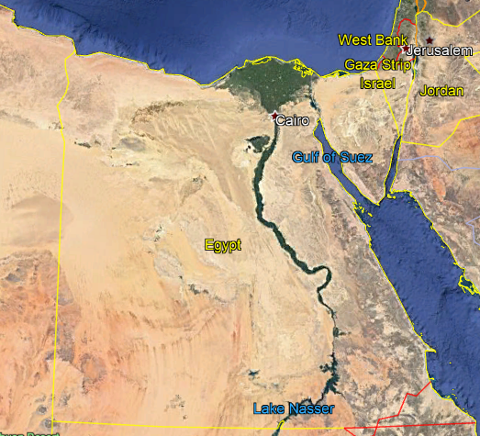
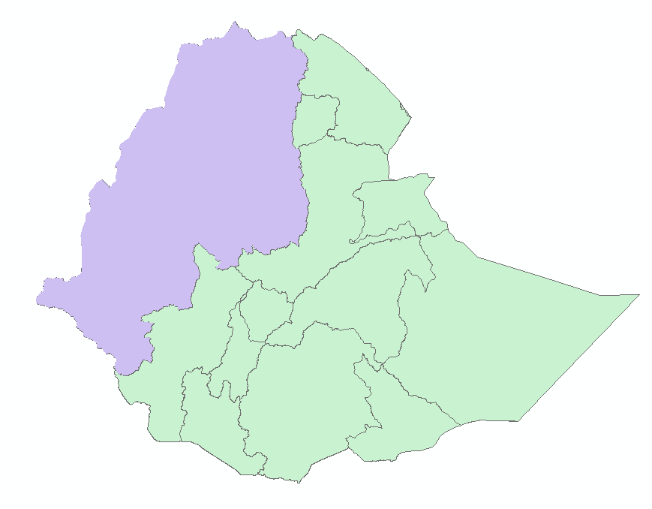
Sub-basins
405110 km²
According to FAO report 1997, out of the total inhabited area of 77,041 km²; cultivated area is 46200 km².

Slide 11
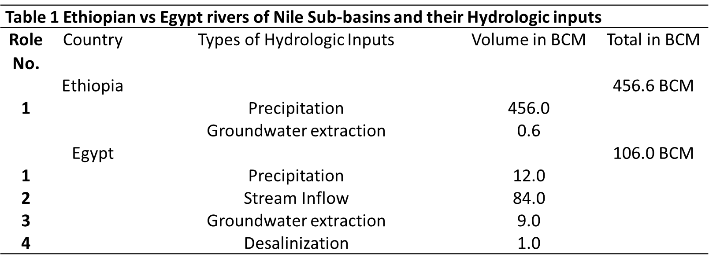
Result: Sources of Water Resources
Notes:
The hydrologic input of Ethiopia’s Nile river sub-basin is 330% higher than the amount Egypt’s receives.

Slide 12
Result: Stream outflow
Table 2 Ethiopian vs Egypt rivers of Nile Sub-basins and their outflows
Role No. | Country | River system | Major tributaries | Average Surface Water loss | Total
 | Ethiopia |  |  |  | 81.0 BCM
1 |  | Atbara | Tekeze, Angereb, Ataba and Mereb | 12.0 BCM
2 |  | Blue Nile | Abbay, Jamma, Muger, Guder, Didessa, Beles, and Dabus | 54.4 BCM
3 |  | Sobat river | Boro, Bako and Akobo | 13.6 BCM
 | Egypt |  |  |  | 13 BCM
1 |  | Nile river | Nile River | 13 BCM

Slide 13
Result: Evapotranspiration
Table 3 Ethiopian vs Egypt Nile Sub-basins and their total ET loses
Role No. |  | Surface | Mechanism of loses | Amount of ET losses | Total Loss
Ethiopia |  |  |  |  | 362.3 BCM
1 |  | Crops/Vegetation | ET loses | 357 BCM
2 |  | Lake Tana | Evaporation | 5.3 BCM
Egypt |  |  |  |  | 51 BCM
1 |  | Irrigated agriculture | ET loses | 39 BCM
2 |  | Lake Nassir | Evaporation | 12 BCM

Slide 14
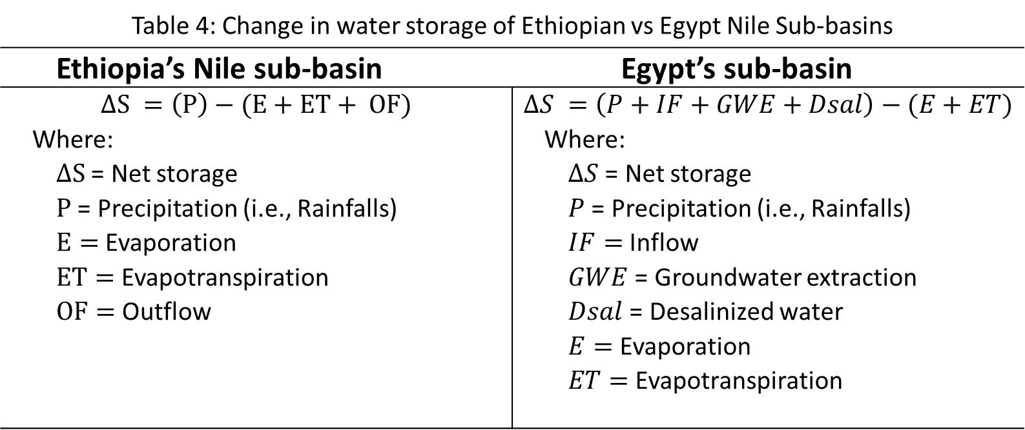
Result: Net Change in storage
Table 4: Change in water storage of Ethiopian vs Egypt Nile Sub-basins
Ethiopia’s Nile sub-basin | Egypt’s sub-basin
$$∆S =\left(P\right)−(E+ET+ OF)$$ Where: $∆S$ = Net storage $P$ = Precipitation (i.e., Rainfalls) $E=$Evaporation $ET=$Evapotranspiration $OF=$ Outflow | $$∆S =\left(P+IF+GWE+Dsal\right)−(E+ET)$$ Where: $∆S$ = Net storage $P$ = Precipitation (i.e., Rainfalls) $IF=$Inflow $GWE$ = Groundwater extraction $Dsal$ = Desalinized water $E=$Evaporation $ET=$Evapotranspiration

Slide 15
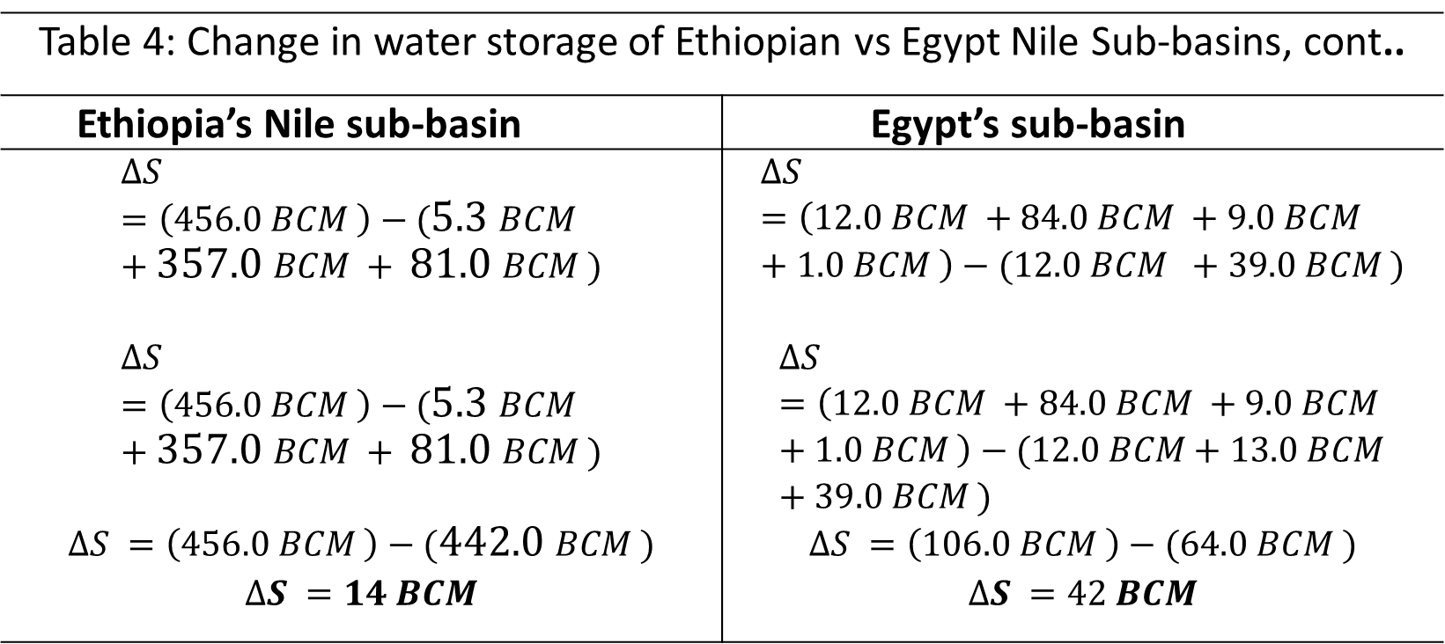
Result: Net Change in storage
Table 4: Change in water storage of Ethiopian vs Egypt Nile Sub-basins, cont..
Ethiopia’s Nile sub-basin | Egypt’s sub-basin
$$∆S =\left(456.0 BCM \right)−(5.3 BCM +357.0 BCM + 81.0 BCM )$$ | $$∆S =\left(12.0 BCM +84.0 BCM +9.0 BCM +1.0 BCM \right)−(12.0 BCM +39.0 BCM )$$
$$∆S =\left(456.0 BCM \right)−(5.3 BCM +357.0 BCM + 81.0 BCM )$$ | $$∆S =\left(12.0 BCM +84.0 BCM +9.0 BCM +1.0 BCM \right)−(12.0 BCM+13.0 BCM+39.0 BCM )$$
$$∆S =\left(456.0 BCM \right)−(442.0 BCM )$$ | $$∆S =\left(106.0 BCM \right)−(64.0 BCM )$$
$$∆S =14 BCM$$ | $$∆S =42 BCM$$

Slide 16
Result: Surface Water
Table 5: Water stored on the surfaces of Egypt’s and Ethiopia’s Nile river basin
 | Lakes | Elevation | Surface area (km²) | Average depth (m) | Volume of water (BCM) | Total (BCM)
Egypt |  |  |  |  |  | ~138
 | Lake Nassir | 183 | 5370 | 25 | 132
 | Lake Idku | 5 | 63 | 79 | 5.5
Ethiopia |  |  |  |  |  | ~30
 | Lake Tana | 1788 | 3047 | 9 | 28.2
 | Lake Fincha | 2,302 | 239 | 2 | 0.7

Slide 17
Groundwater Reserve
Egypt is among the African countries’ that has a huge groundwater reserve. It ranks 4th among the African countries; only Libya, Algeria, and Sudan have more groundwater reserve than Egypt.
There are three major aquifers for storing the groundwater in Egypt, namely: the Nubians sandstone aquifer, the Moghara aquifer, and the Nile aquifer storing an estimated total groundwater storage of 63,200 BCM.
On contrary Ethiopia ranking 14th, among the African countries, 9 ranks below Egypt and has an estimated groundwater reserve is in the order of 12,700 BCM of water.

Slide 18
Coastline water
A direct interface between Egypt’s Nile sub-basin and Mediterranean coastal water is about 300km.
This is a gateway for access to coastal water reserve, from which infinite freshwater can be harvested, through desalinization

Slide 19
Conclusion
The water budget concept has assessed a comprehensive analysis and assessment water resources and water movements in the Nile river sub-basins of two countries.
The net annual water storage for Egypt is, therefore, 42 BCM, indicating a clear water resource advantage over Ethiopia’s 14 BCM.
Secondly, there is 108 BCM more surface water reserve in Egypt’s sub-basin compared to Ethiopia.
Thirdly, Egypt’s groundwater reserve is approximately, 400% higher than Ethiopia’s.
Lastly, Egypt has an infinite access to coastal water, which up on desalination can provide unlimited domestic water supply, compared to landlocked Ethiopia
Therefore, it is verified that Egypt has an overwhelming water resource advantage, and that Nile water is not the only freshwater source, and so the dam is not remotely Egypt’s existential threat.
The perception pushed by Egypt that Ethiopia has a plentiful water to share Nile and/or Egypt would cease to exist with Ethiopia’s dam, is mendacious.

