Slide 1


Impact of Climate Change on the Ecohydrology of the Nile River Basin
Shimelis G Setegn, Ph.D.
Senior Scientist, SFWMD
Assistant Professor, FIU

Slide 2
Presentation Outline
Introduction
Upstream Catchment degradation
Climate Change in the Nile
Modeling tools
Impact of climate change
Adaptation strategies

Slide 3
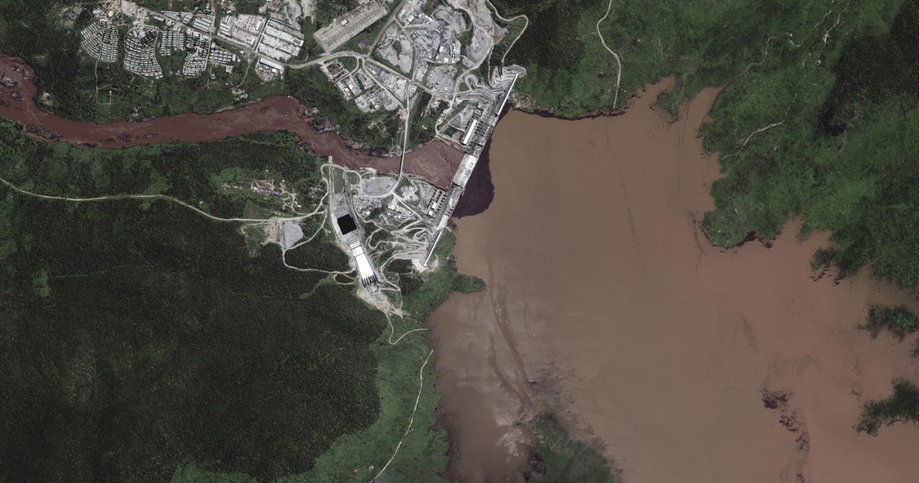
Major threats in the Nile Basin
Deforestation, Soil erosion - land degradation
Climate Change

Slide 4
Impact of soil erosion
Land and water degradation are the major issues in the Upper Nile due to deforestation and soil erosion.
Poor land use practices and improper management systems have played a significant role in causing high soil erosion rates, sediment transport and loss of agricultural nutrients.
Studies indicated that Ethiopia loses about 1.3 billion metric tons of fertile soil every year and the degradation of land through soil erosion is increasing at a high rate, Hurni (1989)

Slide 5
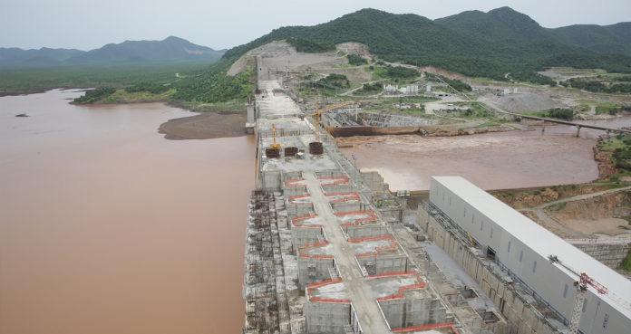
River flow with high sediment concentration

Slide 6
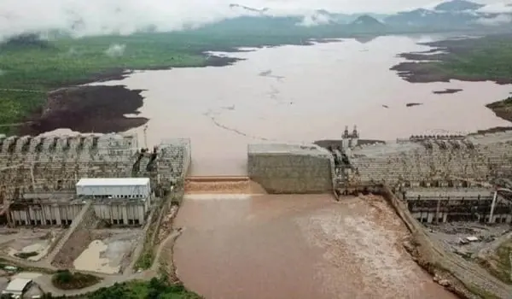

Slide 7
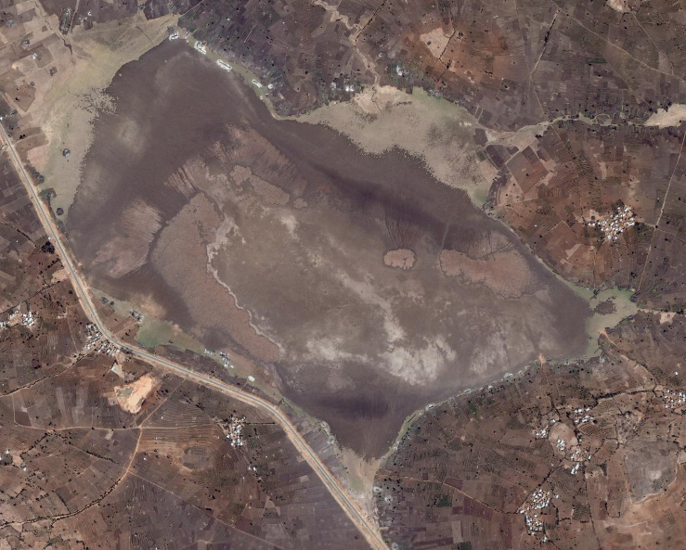
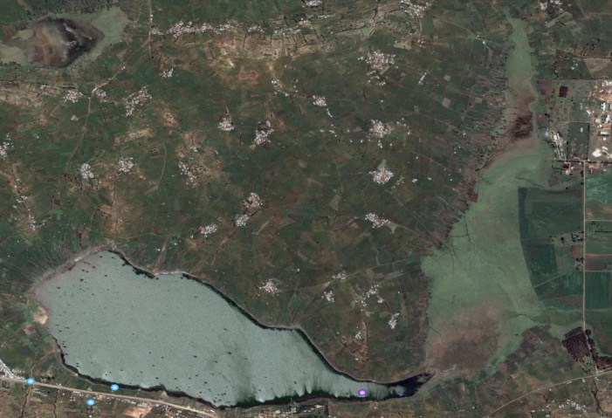
Lake Adele
Lake Alemaya
Degradation in water bodies due to hydrological and environmental changes

Slide 8
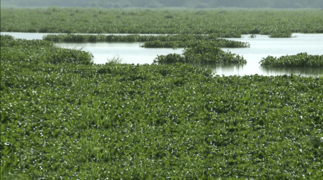
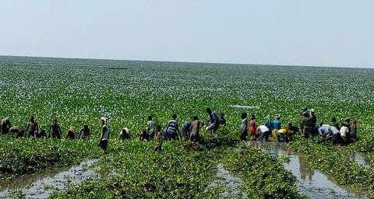
Emboch
the top 250 lake regions of Global Importance for Biodiversity
the aquatic biodiversity at extreme risk due to invasion of Emboch – Aquatic weed (water hyacinth)

Slide 9
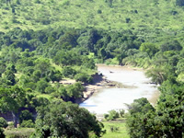
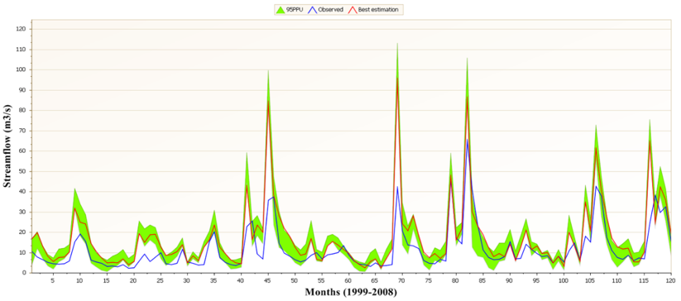
Modeling Tools
Soil water Assessment Tool – SWAT
Generalized Environmental Modeling System for Surface waters (GEMSS)
GIS based - Multi criteria Evaluation

Slide 10
SWAT (Soil water Assessment Tool)
SWAT is a river basin scale developed to predict the impact of land management practices on water, sediment and agricultural chemical yields
The SWAT system (ArcSWAT), embedded within geographic information system (GIS),
  can integrate various spatial environmental data

Slide 11
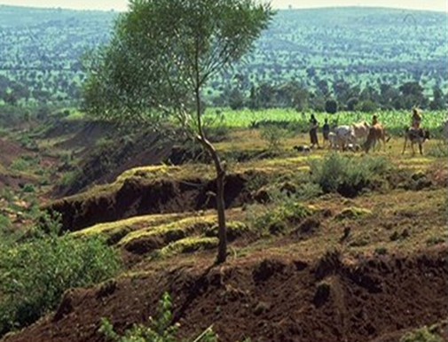
GEMSS - Generalized Environmental Modeling System for Surface waters
GEMSS is an integrated system of 3-D hydrodynamic and transport modules embedded in GIS
The hydrodynamic and transport relationships used in GEMSS are developed from
  the horizontal momentum balance,
  continuity,
  constituent transport and
  the equation of state.

Slide 12
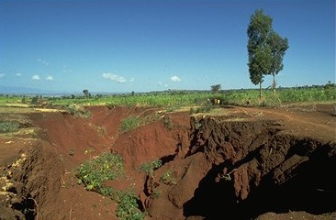
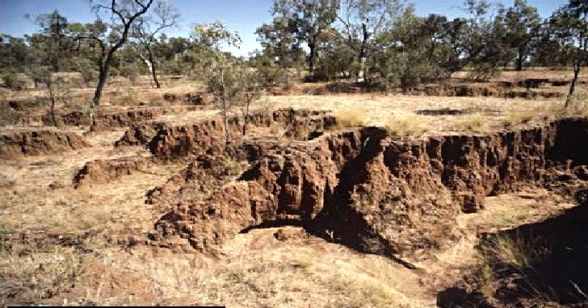
MCE-GIS tool for Decision support system
Multi-Criteria Evaluation (MCE) is a method for decision support
  number of different criteria are combined to meet one or several objectives.
The decision was made after combination of four criteria (factor maps): Slope, Landcover, Soil types and River

Slide 13
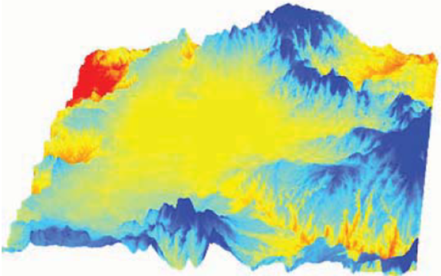
Model Input Data
GIS input files needed:
    the digital elevation model (DEM),
    land cover,
    soil layers
DEM
    delineate boundaries,
    stream network
    calculate average slopes
Land use, Soil and Slope layers
    to create and define Hydrological Response Units (HRU’s).

Slide 14
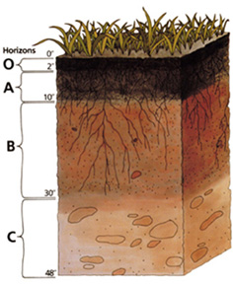
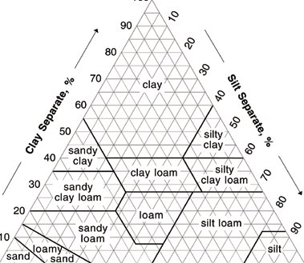
Model Input cont.
Soil physical properties
  Number of layers in the soil
  Soil hydrologic group (A, B, C, D)
  Maximum rooting depth of soil profile
  Texture of soil layer
  Depth from soil surface to bottom of layer
  Moist bulk density
  Available water capacity of the soil layer
  Saturated hydraulic conductivity
  Organic carbon content
  Clay content, Silt content,
  Sand content

Slide 15

Model Input cont.
Meteorological Data
  precipitation
  air temperature
  solar radiation
  wind speed and
  relative humidity

Slide 16
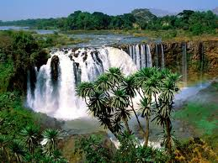
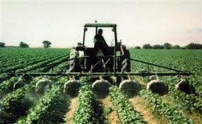
Model Input Data
Hydrological Data
  River Discharge and
  Suspended sediment load
Land Management
data for management practices such as planting, harvest, tillage operations, and pesticide and fertilizer application.

Slide 17
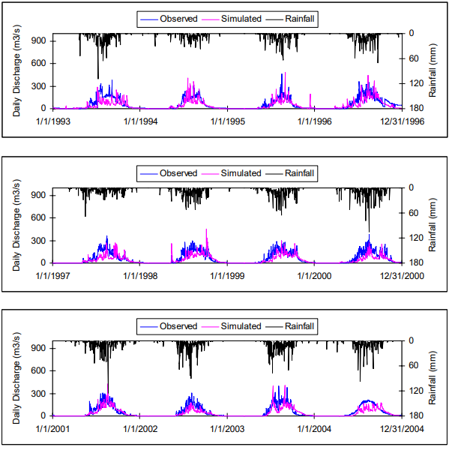
Time series of measured and simulated flow, Gilgel Abay

Slide 18
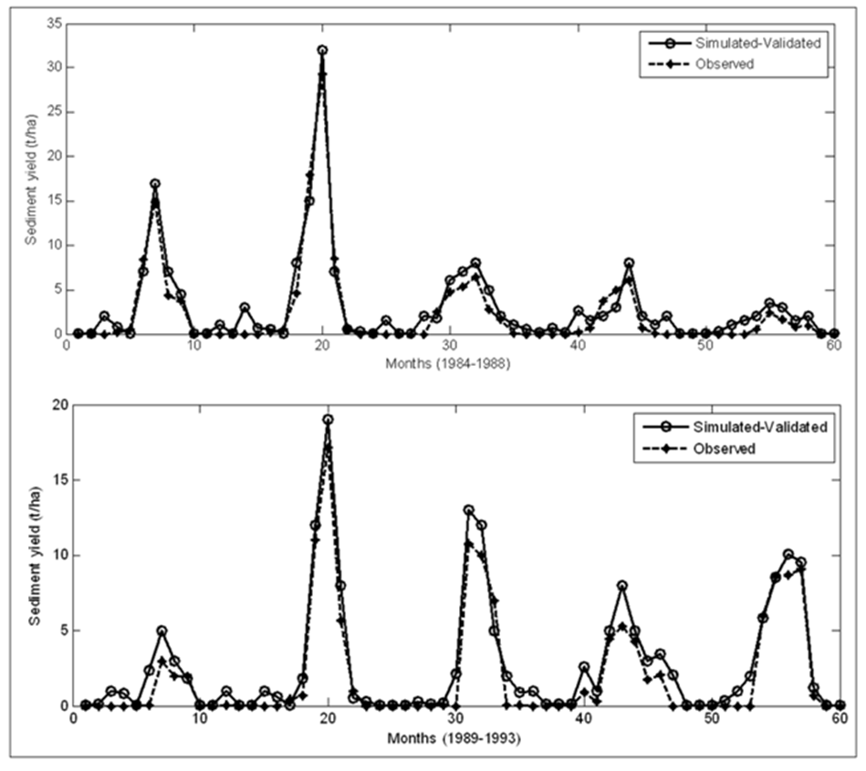
Sediment Yield Modeling
The annual average simulated sediment yield was 28.7
Calibration period: NSE=0.81, PBIAS=28 %, RSR=0.23 & R²=0.85
Validation period: NSE=0.79, PBIAS=30 %, RSR=0.29 & R²=0.80
Comparison between measured and simulated monthly sediment yield

Slide 19
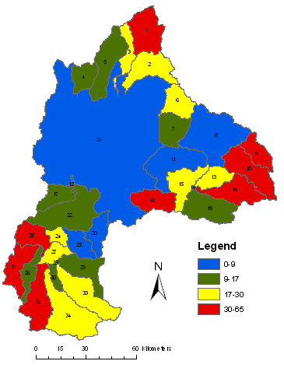
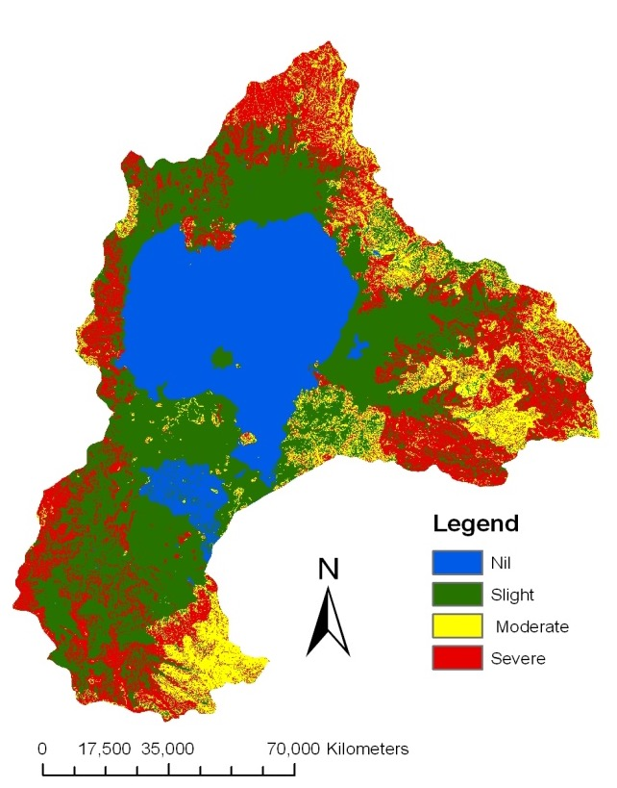
Erosion vulnerable areas in Lake Tana Basin, Ethiopia
SWAT=18.4 %
MCE=25%

Slide 20
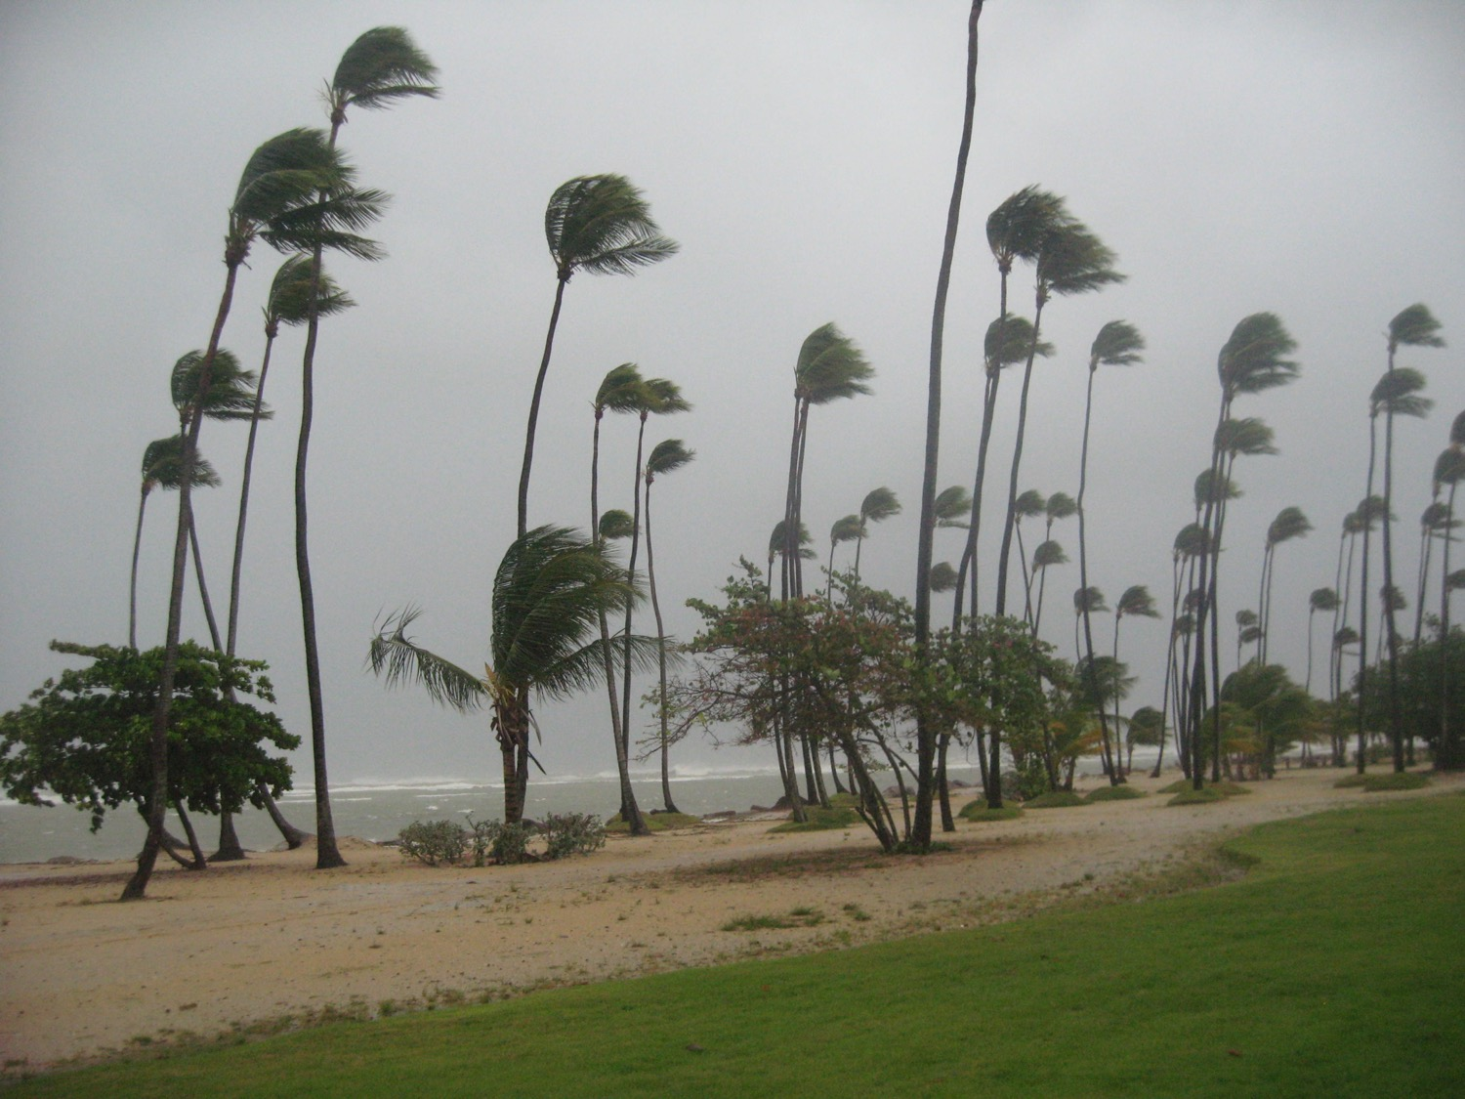
Climate Change
30 August 2010, Gran Melia, Puerto Rico, photo by Shimelis S

Slide 21

Climate Change
Climate change is a significant change in the statistical distribution of weather patterns over periods. eg. weather conditions or the distribution of extreme events.

Slide 22
Climate Change
By 2040 the share of people in the Nile region facing water scarcity could reach 35%. That’s more than 80 million people, Coffel and Mankin 2020
250 million people rely on the Nile for water that may not exist by 2080, Zoë Schlanger 2019

Slide 23

Effect of climate change
A major effect of climate change is alterations in hydrologic cycles and changes in water availability.
Increased evaporation & changes in rainfall, has the potential to affect runoff, floods and droughts

Slide 24
Assessment of impact of climate change
Assessing the impact of climate change involves
  Projections of climatic variables (e.g. precipitation, temperature) at a global scale.
  Downscaling of global-scale climatic variables to local-scale hydrologic variables

Slide 25




Projected changes

Slide 26
Projected seasonal changes in rainfall
B1 A1B A2
Decreasing rainfall trend

Slide 27
Projected seasonal changes temperature
B1 A1B A2
Increasing Temperature (0.6 – 2.8 C)

Slide 28
Variation among
GCM outputs for different SRES - Precipitation/
Rainfall

Slide 29
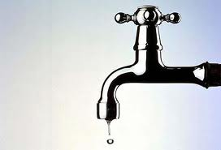
Impact of Climate Change on Water Resources

Slide 30
Water Resources and Climate Change Blue Nile – Lake Tana
ETHIOPIA - Lake Tana Basin
Lake Tana basin comprises an area of 15096 km²
The lake is a natural type
  Average area = 3300 km²
  Maximum depth = 14 m.
  Inflow Rivers are GilgelAbay, Ribb, Gumera, Megech

Slide 31
Impact of Climate Change on Surface and Ground Water 2046-2065

Slide 32
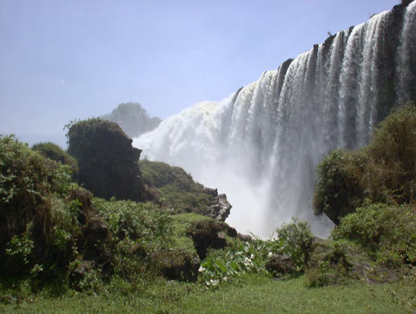
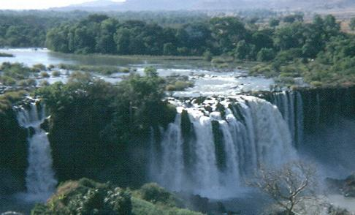
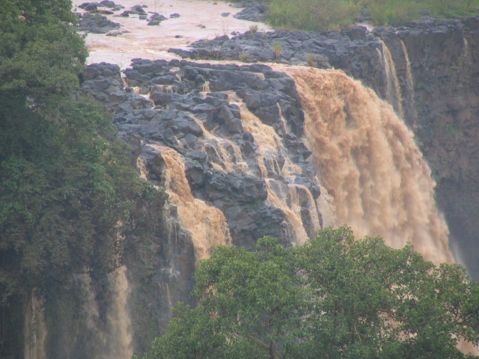
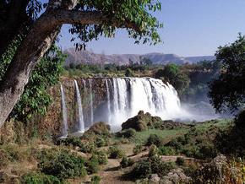

Slide 33
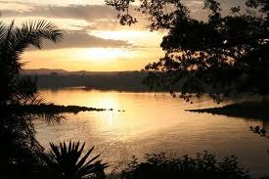
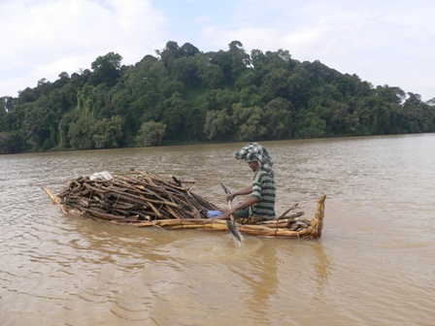
Hydrodynamics of Lake Tana - using Combined SWAT and GEMSS model

Slide 34
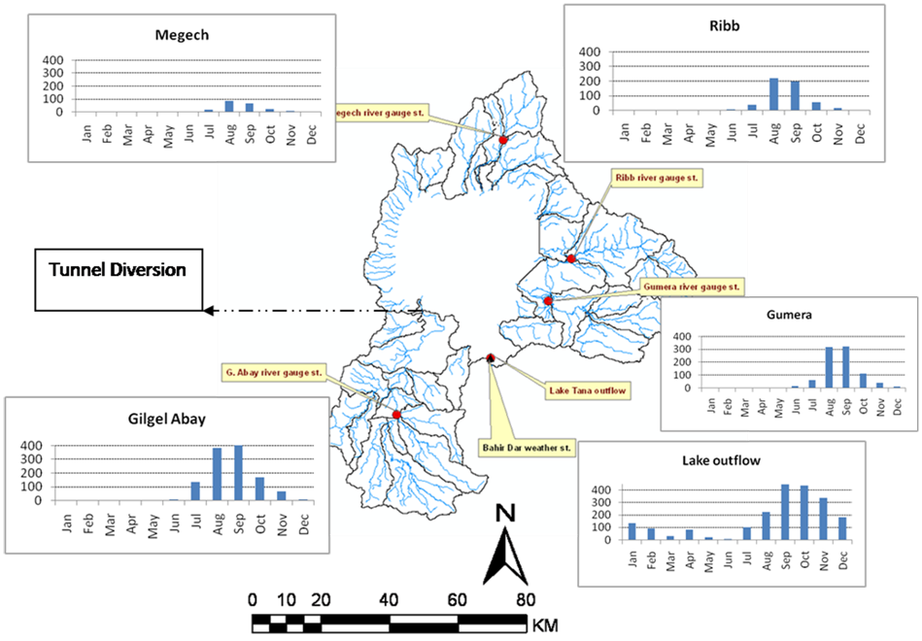
Lake Tana: flow discharge hydrographs of the inflow rivers and the lake outlet for year 2006, the positions of meteorological station and the water withdrawal tunnel (under construction).

Slide 35
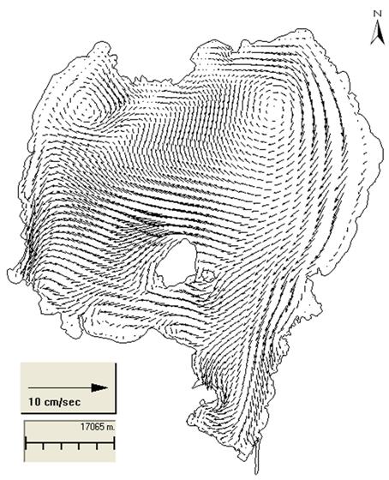
Flow Structures
The velocity vectors in cm/s at the water surface, Feb. 10, 2006.

Slide 36
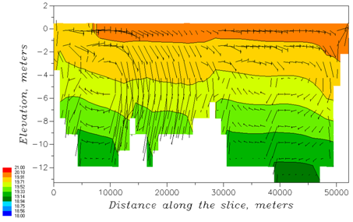
Temperature contours and the velocity vectors, section S5, January 2, 2006), legend color in °C.

Slide 37
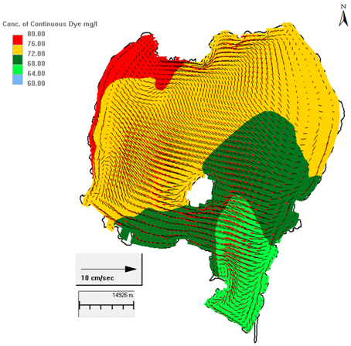
Flushing Time
Contours of dye concentration (mg/l) at the water surface December 31, 2006.

Slide 38
Adaptation strategies - Measures
Appropriate catchment treatment strategies should be implemented
  Watershed management methods like afforestation and water conservation are recommended to reduce the impact on the Blue Nile basin.
create an equitable water allocation scheme upstream and downstream countries.
  “historical rights” –Egypt’s long-held claims need to be revised so that the needs of upstream countries like South Sudan and Ethiopia, which require water to build their economies, should be highly considered
  Water may be often pointed to as a source of conflict, but it can also be a means to cooperation, getting nations to the negotiating table.
  Any intervention and planning strategies should highly consider the short and long-term climate variability and change

Slide 39
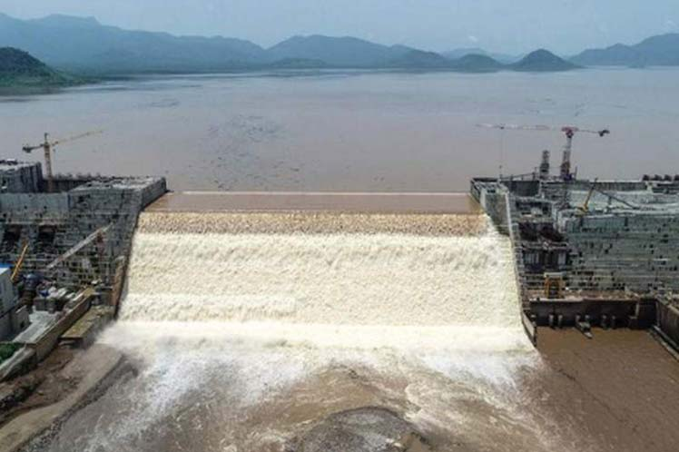
Thank You!

