Slide 1
GERD and Aswan High Dam: Technical, Socio-Economic and Geo-Political Parallels between the Two Mega-dams on the Nile River
Shimelis Dessu
West Palm Beach, Florida, USA
Email sbehailu@gmail.com

Slide 2


Why the “Parallels” are important?
The mainstream discourse about GERD lacked the benefit of comparative assessment with the Aswan High Dam (AHD) of Egypt, the largest dam on the Nile River.
Looking back in the history of AHD from inception to operation can provide invaluable lessons and insight into the challenges and opportunities of GERD.
These parallels can also provide perspectives and common ground for understanding and establish trust.

Slide 3
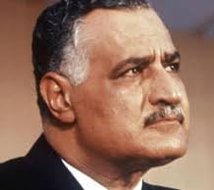

What the leaders might have seen:
Motivations to construct these dams at any cost:
  Monuments of national pride
  center of political mobilization for their leaders.
  envisioned to boost economic growth
  improve livelihood of their citizens.
Over the last half century, AHD saved Egypt from catastrophic droughts while scores of Ethiopians were dying of food shortages.
National
Security
President Gamal Abdel Nassar
(Egypt)
Prime Minister Meles Zenawi (Ethiopia)

Slide 4
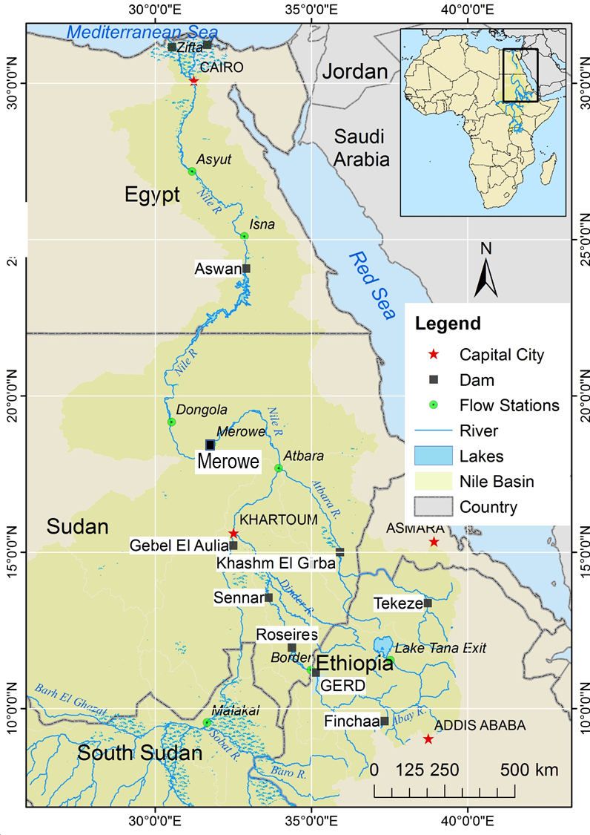
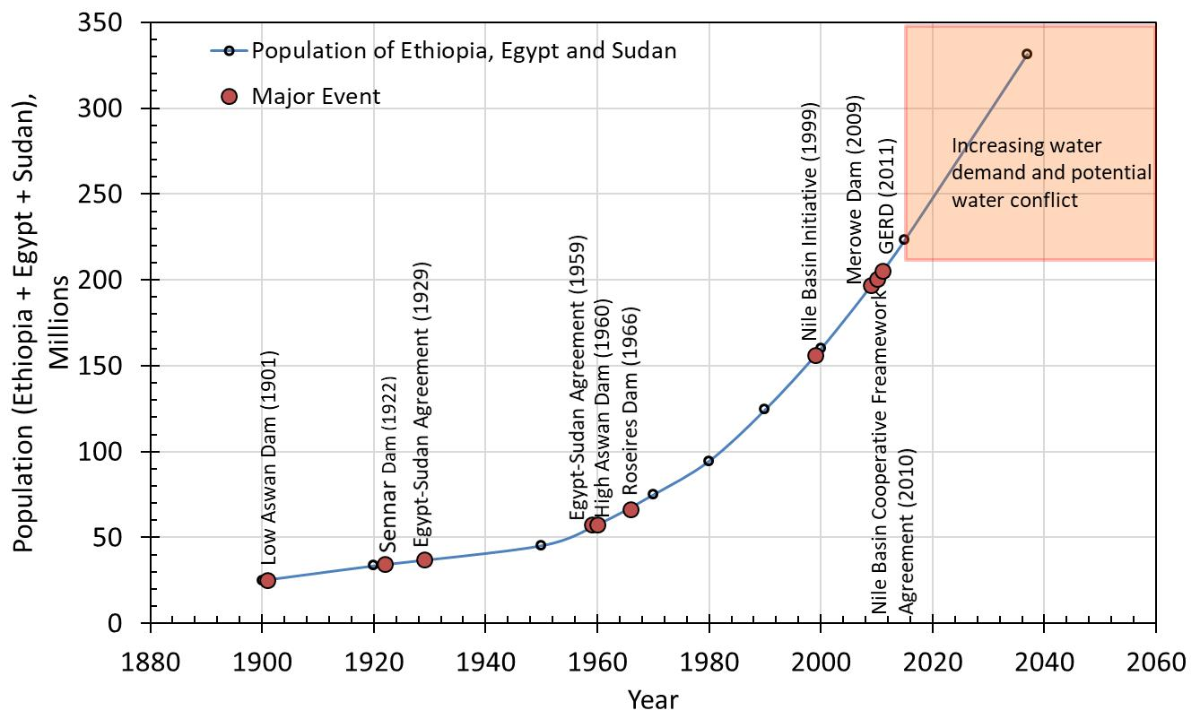
Milestones in Eastern Nile Leading to GERD

Slide 5
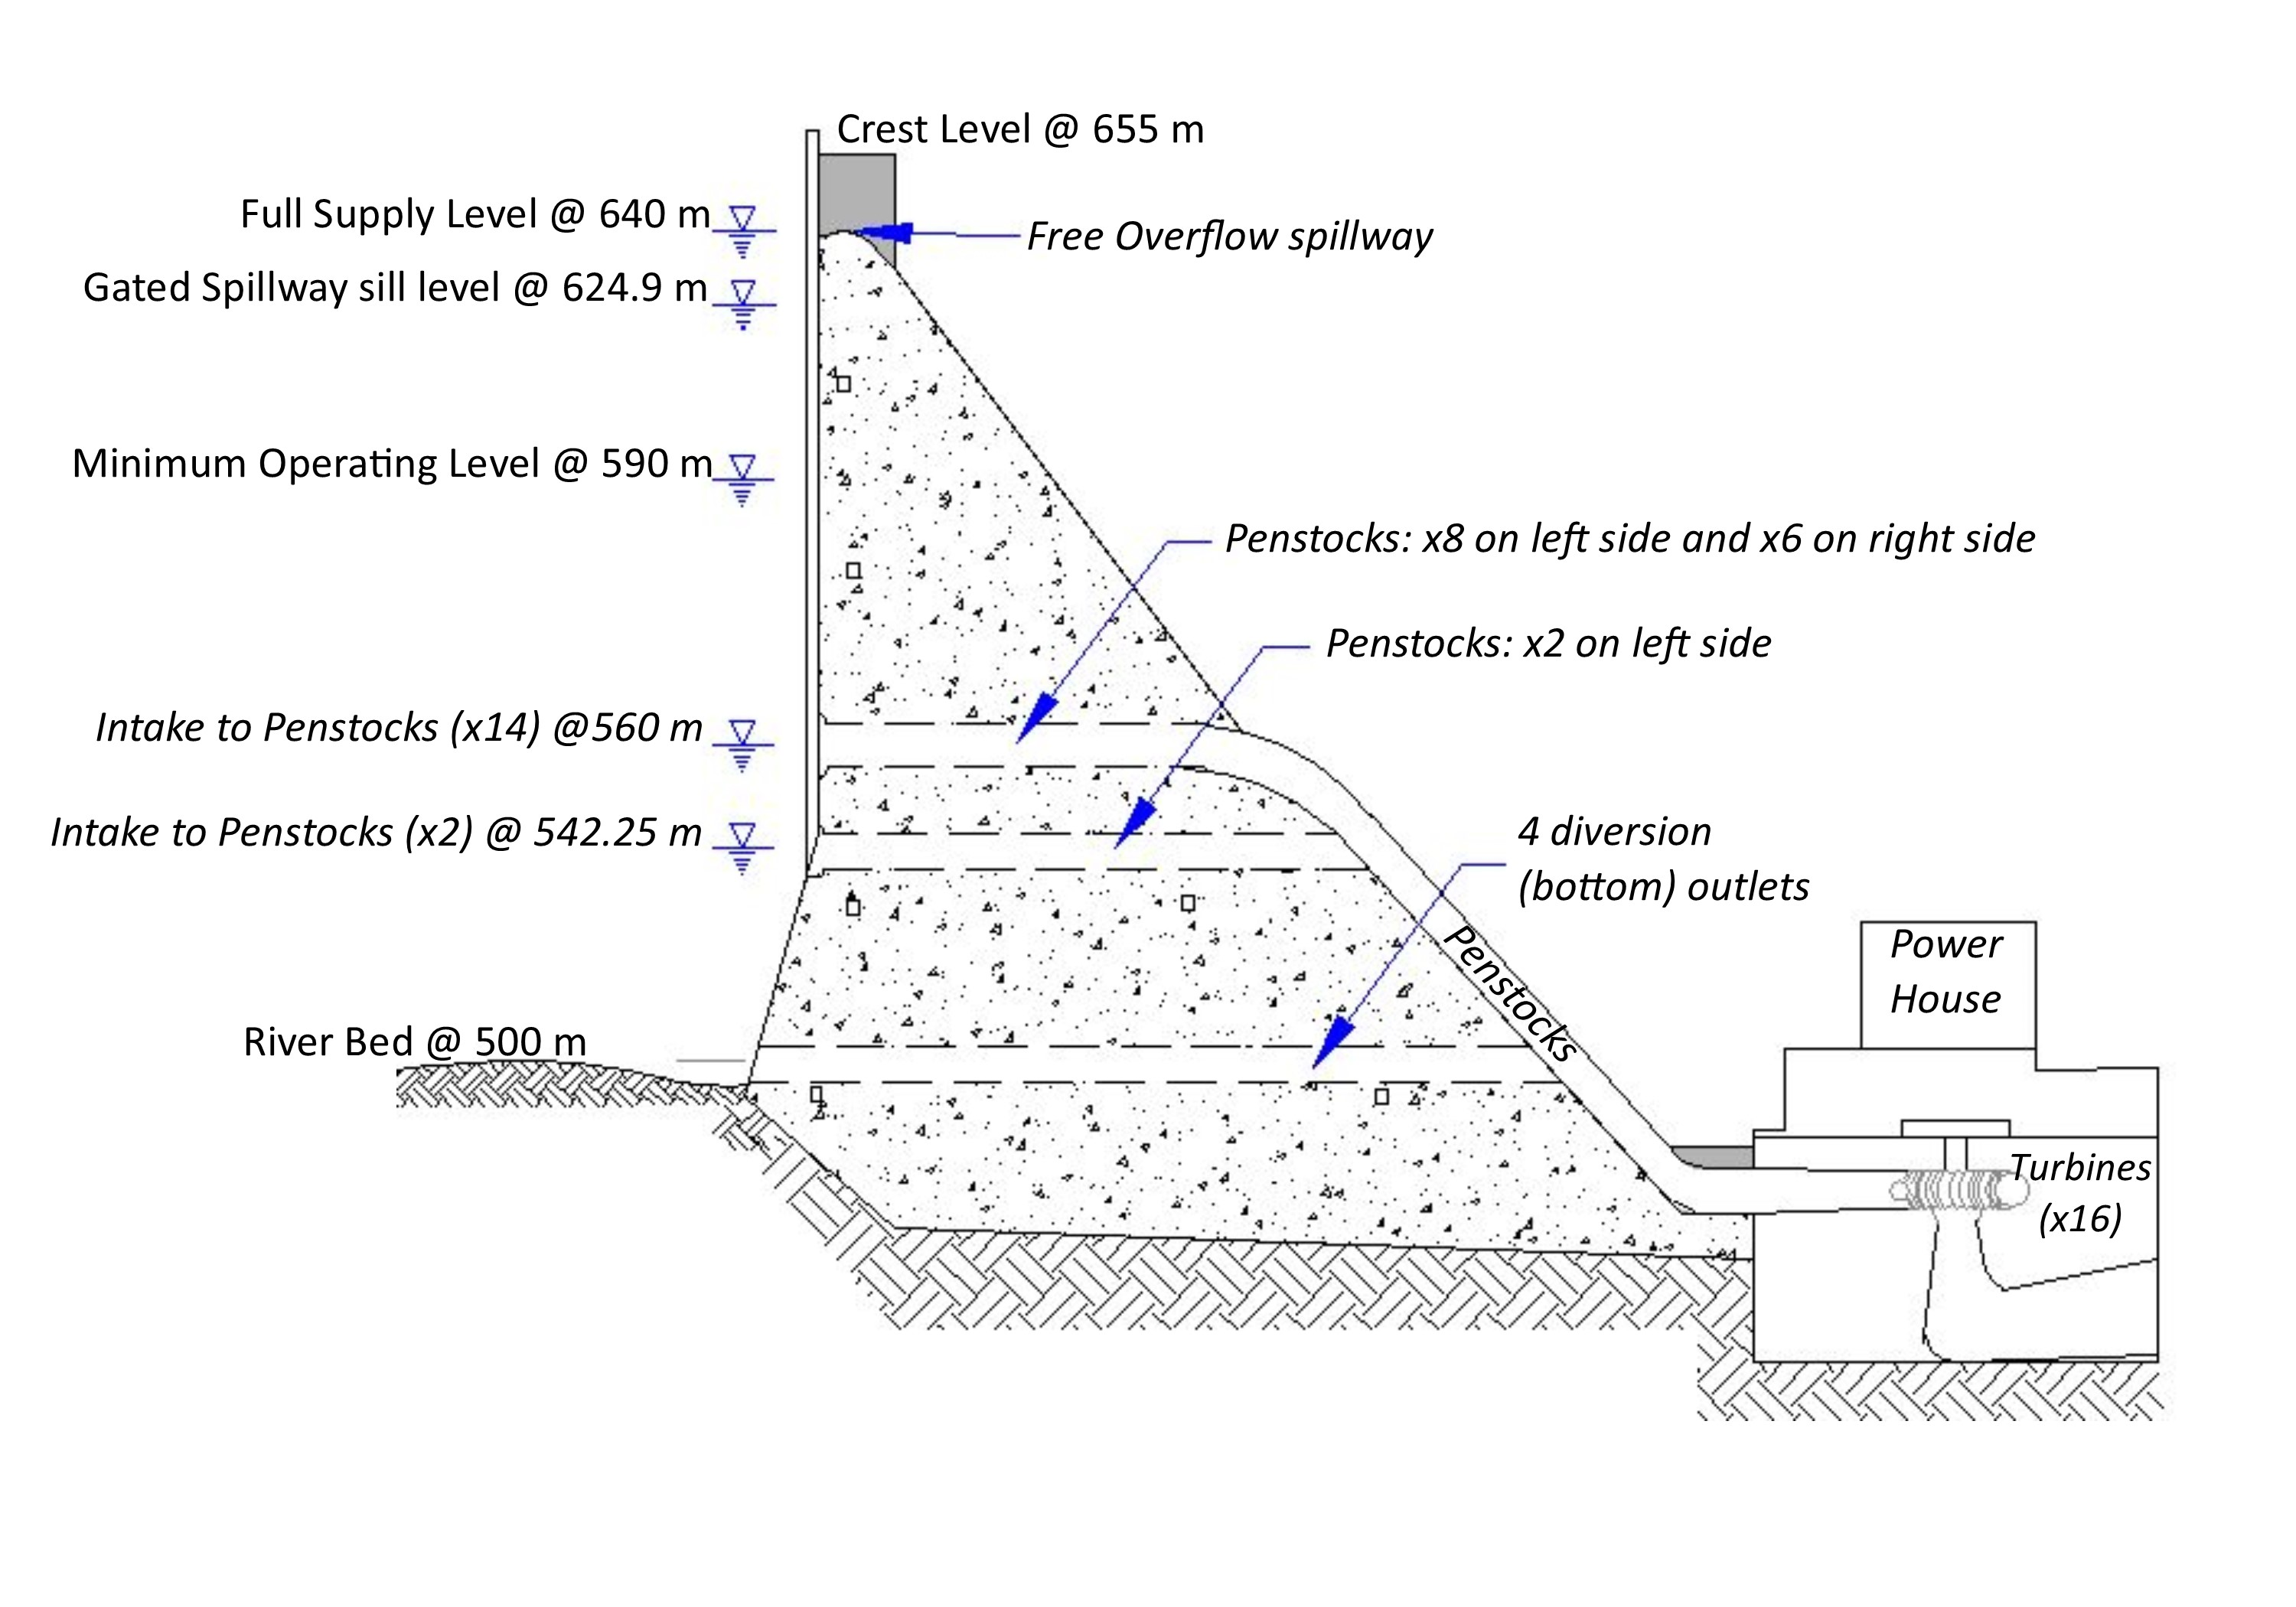
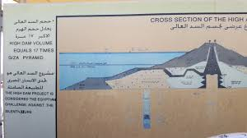
Purpose of AHD & GERD:
AHD and GERD: pivotal to planned industrialization.
AHD (1960’s): to better control flooding, provide increased water storage for irrigation and generate hydroelectricity.
GERD (2011): to generate hydroelectricity.

Slide 6
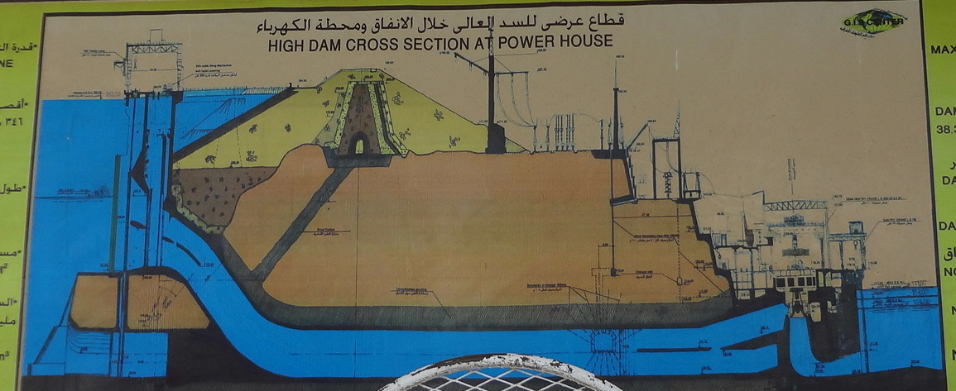
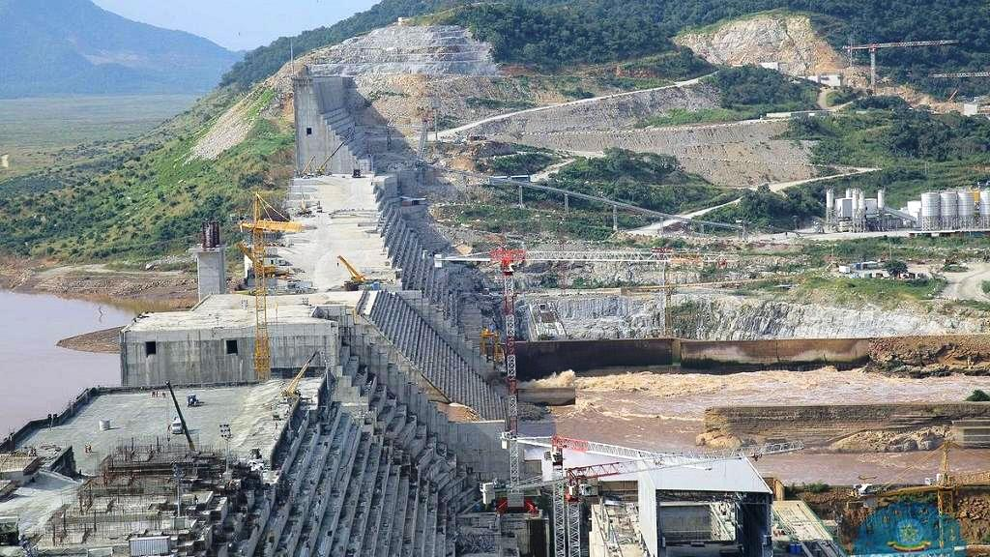
Technical Parallels:
Attribute | Unit | AHD | GERD
Purpose |  | Multi | HP
Construction started |  | 1960 | 2011
Filling Period | years | 12 | 8(?)
Reservoir volume | BCM | 132 | 65
Length | km | 4 | 6.8
Hight | m | 111 | 155
Fetch Length | km | 550 | 250
Reservoir Surface Area | sq km | 5,250 | 1,740
Installed HP capacity | MW | 2,100 | 6,000
Annual HP Generation | GWH | 10,000 | 16,000

Slide 7
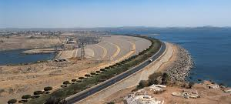
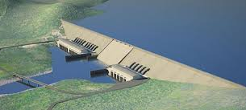
Planning & Design
AHD:
  President Nassir moved the construction of large dam from downstream to Egypt
  Sudan was not independent at the time of planning
  Perhaps a full control over the dam and a potential to unite Sudan and Egypt
GERD:
  USBR studied the Blue Nile Basin and recommended cascading dams in 1964
  Cooperative multi-purpose dams were studied under ENTRO

Slide 8
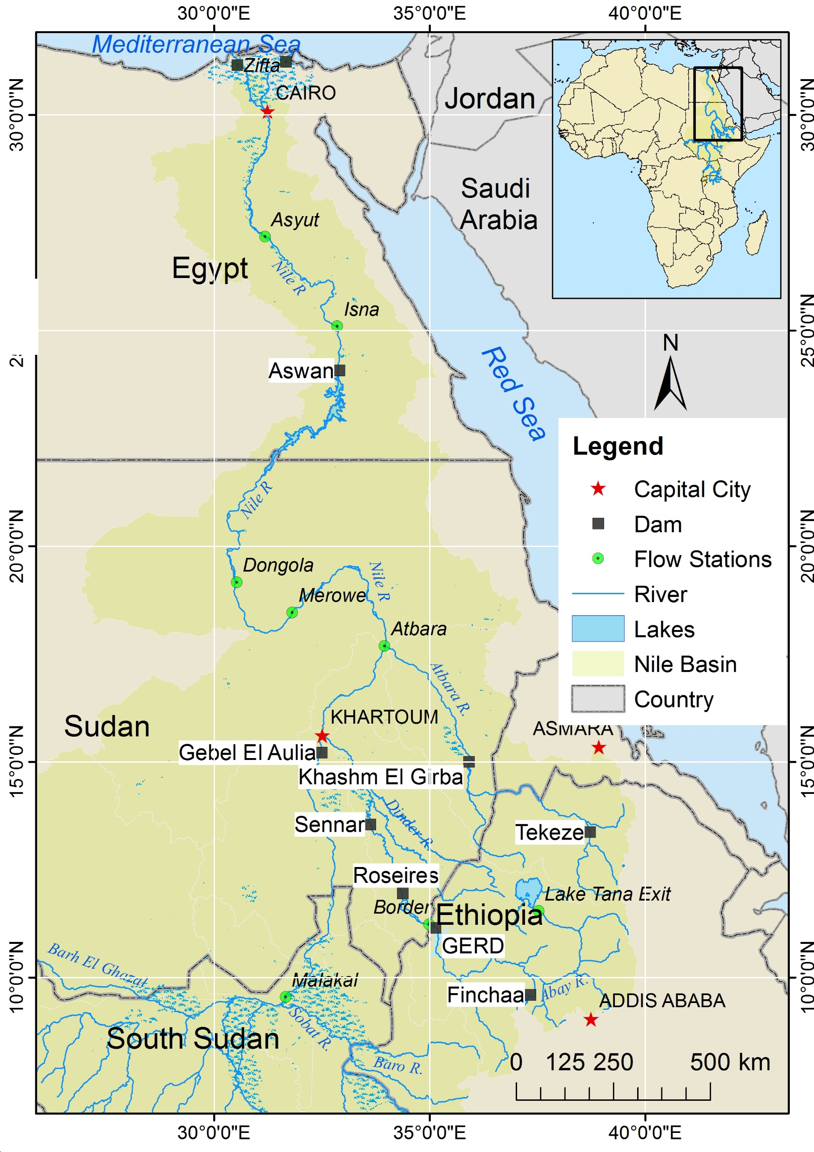
Planning & Construction
The planning and construction of GERD shares a stark similarity with AHD
Planning of both dams involved downstream alternatives
Like the early construction periods of AHD, critics of GERD has evolved from
  the technical feasibility,
  structural safety,
  economic feasibility
  initial filling strategy.
Similarities will likely continue to manifest more parallel attributes during operation.
Merowe

Slide 9
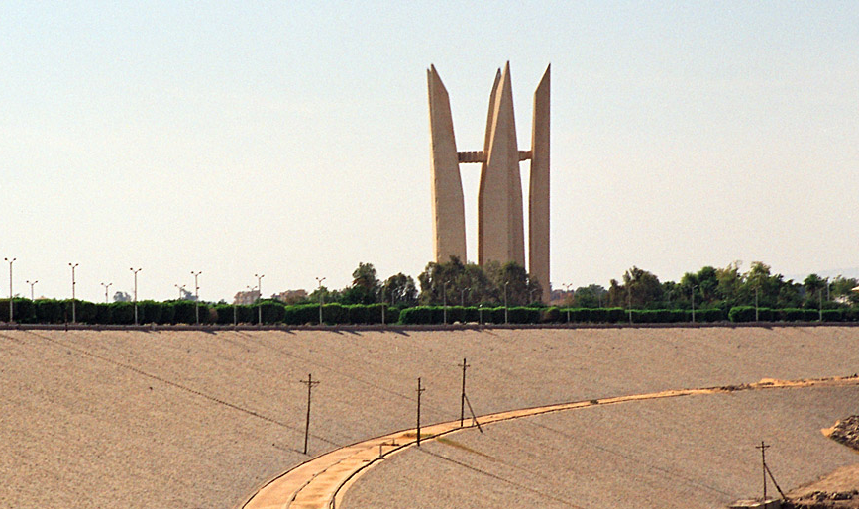
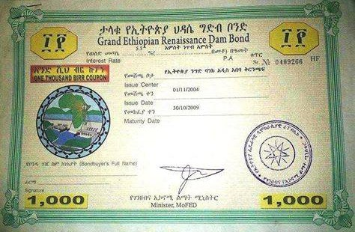
Finance
AHD:
  International funding: 270M promised by USA and Britain but withdrawn (strings attached)
  Nationalized the Swiss canal
  USSR provided 1.2B loan to be paid by cotton and grain
GERD:
  International funding not explicitly reported
  Crowd funding through bond offering

Slide 10
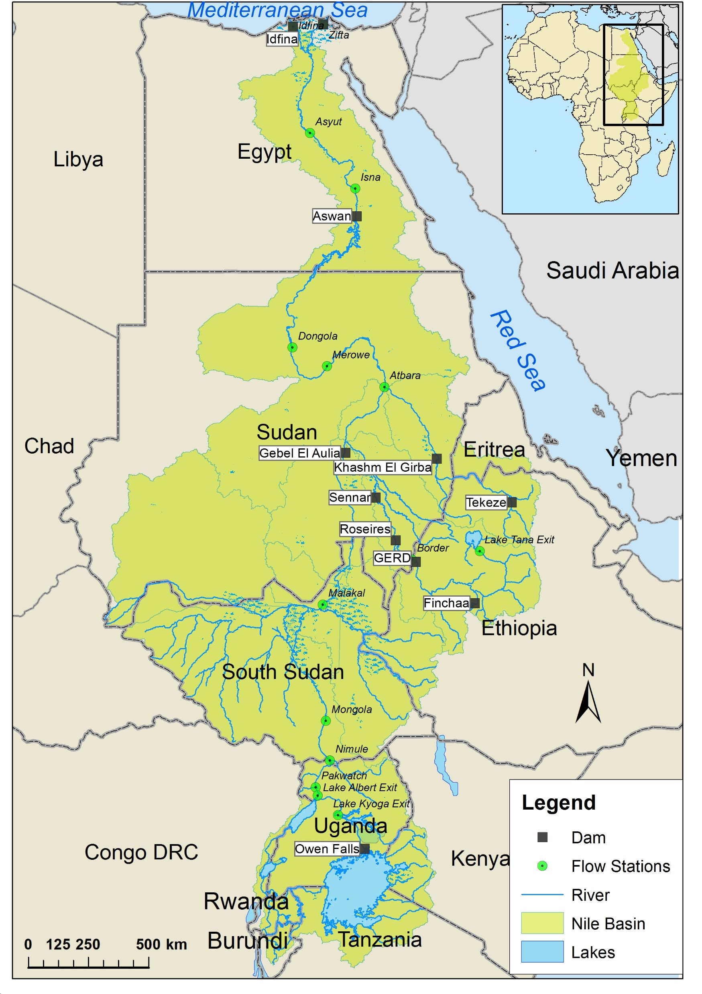
Who is the “Gift of the Nile”
Burundi,
Rwanda,
Tanzania,
Congo DRC,
Uganda,
Kenya,
South Sudan
Ethiopia,
Eritrea,
Sudan, and
Egypt.
Merowe
Notes:
Contrary to the narrow ancient Herodian attribute, the eleven Nile riparian Nations are ‘Gifts of the Nile’.

Slide 11
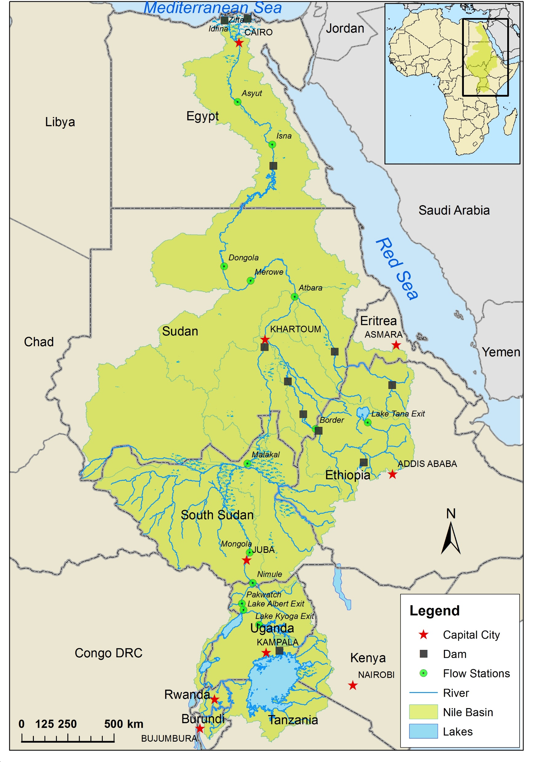
The Nile River Basin
The cultural, socio-economic and political history of residents living in the Nile watershed has always been intertwined with the River.
  Most recent Initiative (Nile Basin Initiative): One River, One People, One Vision ‘To achieve sustainable socio-economic development through the equitable utilization of, and benefit from, the common Nile Basin water resources’ (https://nilebasin.org/)

Slide 12
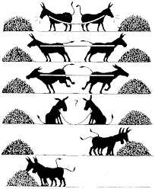
Going Forward
Media → public perception → political influence
The dialogue and negotiations initiated with GERD may help to move away from ownership towards building shared vision and trust for equitable development and utilization of the Nile water resources among all riparian nations.

