Slide 1
Beyond GERD: Hydropolitical, Hydrological, Technological and Investment (HHTI) Imperatives for Sustainable Economic Cooperation in the Nile Basin
Semu Moges (Ph.D. P.E.)
Consultant and University of Connecticut
2020 International conference on Nile and GERD, Florida International University, USA, August 20-21, 2020

Slide 2
Contents
Background
Water Scarcity drivers
Available renewable water resources
Imperatives for sustainable development
The way forward: Cooperative Agreement, Institutions and Investment

Slide 3
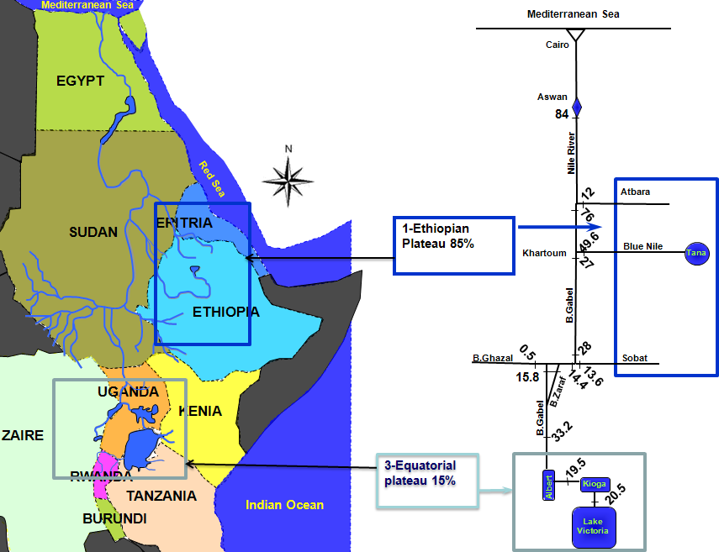
1. Background: The Nile River Basin:

Slide 4
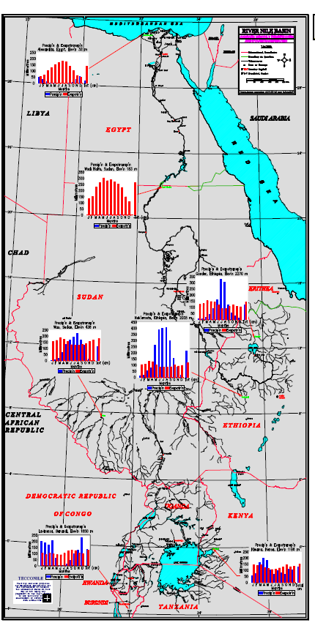

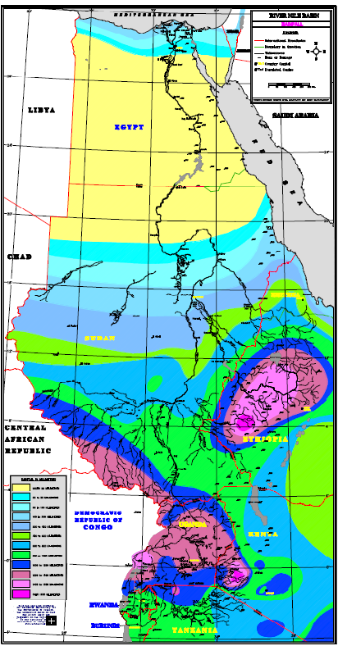
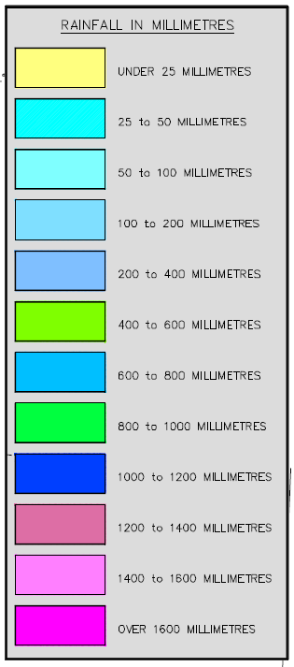
Hyd &
Climate
Teconile (1998)

Slide 5
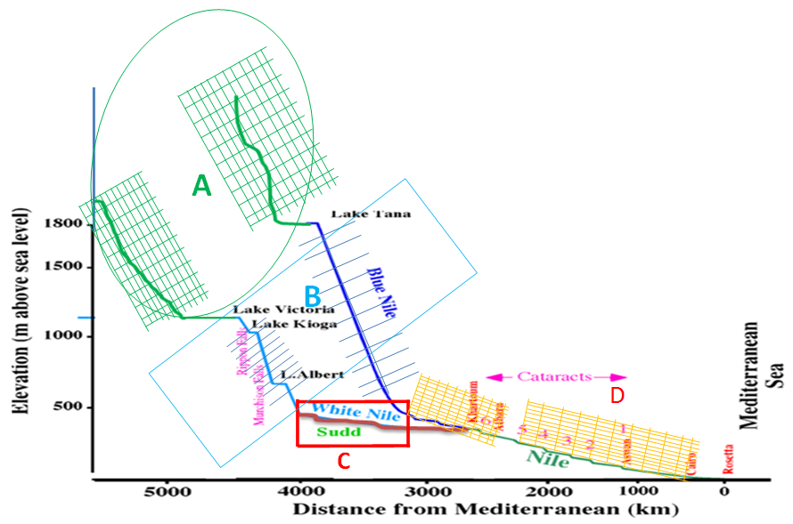
1. Background: The Nile River Basin:
A- Water Source Area
B – Energy Sources Area
C – Water losing and Large Ecosystem area
D. Large Abstraction Area

Slide 6
2. Water Scarcity Drivers: Population and Economic growth
Pop. In 2020
> 550 million
Population based Water Scarcity Index – a tip of the iceberg
Superimposing emerging Economic and other water needs and climate change – huge change in water scarcity index
Water Scarcity is a real Issue to be tackled – Undermines
Future Water Security of the Basin Countries

Slide 7
2. Water Scarcity Drivers: Climate Change and Uncertainties
- Most predictions is that increased tendency of precipitation with increased variability (Flood and drought).
- Uncertainty of the prediction is an issue for planning
Di Baldassarre et al, 2011

Slide 8
3. Available Renewable Water
Nile River Flow
  Historical Mean Nile Flow – (1901 - 1959)
  Historical Mean Nile Flow – (1913 - 1976)
  Historical Mean Nile Flow – (1871-1999)
Rainfall and Green Water
  Overall 2000 BCB Rainfall
  51% Sudan (both Sudans)
  23 % Ethiopia
  13% Uganda
84.0 BCB
88.4 BCB
91.8 BCM
- Other supplementary water sources are also discussed later
- Water in old aquifer systems and desalinization

Slide 9
4. Imperative for Sustainable Nile Development: Hydro-Political Cooperation
Early conclusion of basin wide agreement is essential
Delayed Cooperative Agreement will become less relevant to riparian countries and aggravates water scarcity in the basin
Building Integrated Framework can achieve future water security and Human Development in the Nile basin – Integrating Hydrosolidarity principles, Strict Cooperative Agreements, Institutional Mechanisms and IWRM Principles
  This leads Regional Infrastructure Development and Economic integration – Leading to Human Security in the basin
Pop. In 1959
98 million
Pop. In 2020
554 million
Pop. In 2050
> 1.0 Billion

Slide 10
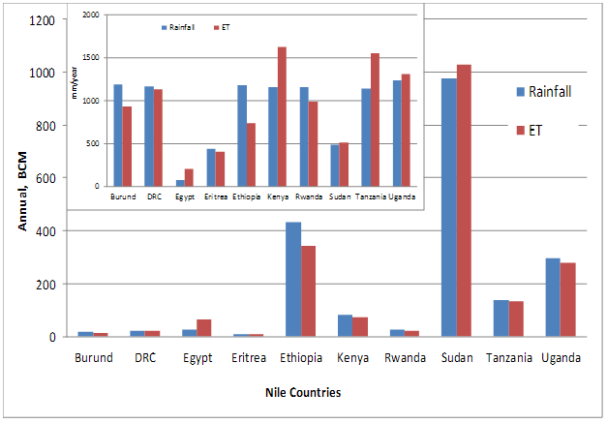
4. Imperative for Sustainable Nile Development: Hydrology a) Rainfall productivity Enhancement
The total rainfall in the basin exceeds 2000 BCM,
The Sudan including South Sudan (51%), Ethiopia (23%) and Uganda (13%) generate over 87% of the total volume of rainfall (FAO, 2011)
Productive use rainfall – Soil moisture infiltration enhancement, supplementary irrigation and Watershed management
Wide Area Productive Rainfed Agriculture Development
Improving crop productivity, Rainfed Technology, Resilience and Farmers Capacity, Organic, Market Linkage and Branding

Slide 11
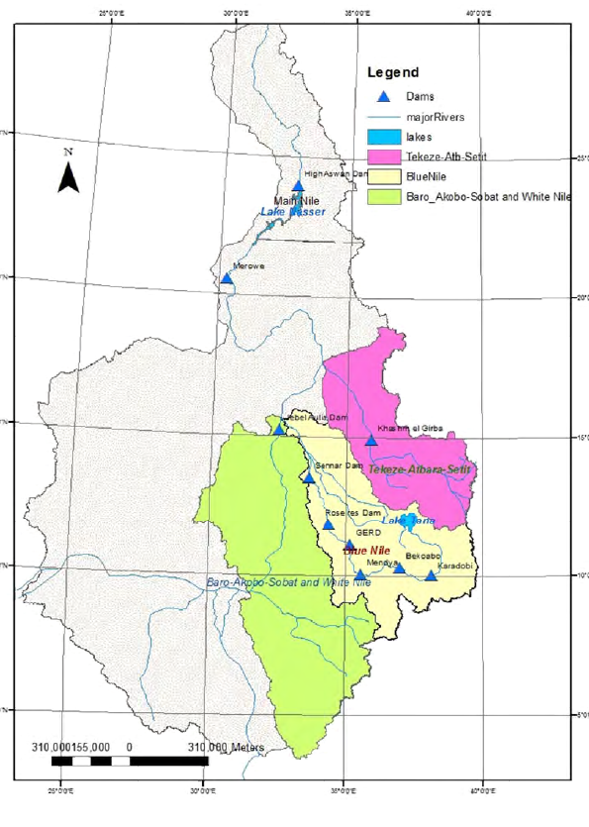
4. Imperative for Sustainable Nile Development: Hydrology b) Water gain through 21st Century Storage Schemes
  Energy and Ecosystem service storage dams – regulated for energy, fishery and high return floods, ecosystem release
  Energy and Flood storage dams – regulated for large scale energy and flood protection, regulated downstream release
  Studies indicate more than 20 BCM water can be added to the system plus benefits from fish farming and Energy
Main Nile Dongolla
84.4
Atbara
11
Loss after border
-3.5
Blue Nile
Khartoum46
Blue Nile
Border
49.5
Loss -11.3
Sobat outflow
13.5
Bahr El-Ghazal
Baro
Loss
-4.0
Baro-Border 9.2
0.6
11.9
Baro-Gambella 13.2
Sudd Loss -19.9
Sudd inflow 37.1
The symbols may be one or cascaded dams
L. Victoria 30.3

Slide 12
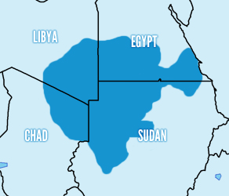
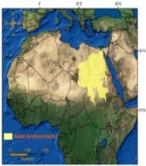
4. Imperative for Sustainable Nile Development: Hydrology c) Non-Renewable -Aquifer Water Utilization
No. | Stored GW (Km3) | Author | Remark
1. | 15,000 | Ambroggi (1966)
2. | 135,000 | Gossel et al (2004)
3. | 457,550 | CEDARE (2002)
4 | 373,000 | -do- | NSA (41.5%- Egypt, 36.6%-Libya; 9%-Sudan & 12.8%-Chad
5 | 84,600 | -do- | PNA (46%-Egypt; 54% - Libya
6 | 14,818 | Abu Zeid, 2003 | Recoverable
7 | 543,500 | -do- | Storage volume
8 | 60,000 | Fatima (1999)
9 | 372,950 | Bakhbakhi (2011) | Total fresh GW
10 | 14,459 | Bakhbakhi (2011) | Total recoverable fresh GW
Even though the recoverable volume is uncertain, the potential as abatement for increase population is huge,
A study on the 100 thick aquifer in Egypt indicates a water yield in the order of 5000 Km3 (Bakhbakhi, 2006)

Slide 13
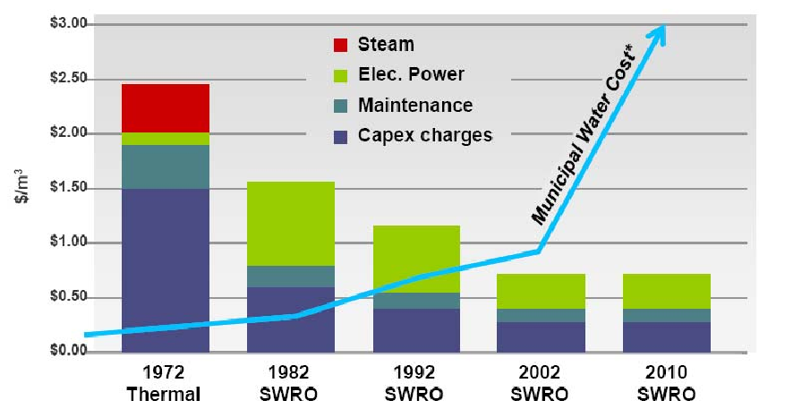
4. Imperative for Sustainable Nile Development: Hydrology d) Desalinization
The total cost of desalinization has reduced to 0.6$/m3 and adding 70% for distribution, the total cost is around 1.02$/m3
Current municipal water supply cost reached 3.1$/m3
Experience exists : in 2008 about 3.1 Billion m3/yr in the Arabian Gulf and 800 Million m3/yr in the Mediterranean region (Waterline Report Series No. 9, 2008
- Collective Regional Initiative such as Linking with Nile Basin Vision and funds and Technology can be acquired for large scale desalinization in coast line countries

Slide 14
4.Imperative for Sustainable Nile Development: New Technologies and Large scale water use Management
Many studies indicate water loss in Egypt and Sudan is Significant
  more than 85% of the large irrigation schemes are gravity system
By 2017, about 40% of the agricultural withdrawal in Egypt is being lost in Egypt
  evaporation and seepage losses from canals and fallow lands, (31,000 km of irrigation canals,
  infiltration losses from lands, or consumption losses of aquatic weeds in water streams
  About 15% of deep groundwater withdrawal is being lost either (Omar and Moussa, 2016
Agricultural water saving strategies that outlines modernizing the old irrigation system in Egypt indicted as much as 40 BCM water can be saved from water losses (El-Nashar and Elyamany , 2018)
There is similar trend of water lose in Sudan - large scale performance indicators in the Gezira - irrigation efficiency varies between 19% and 36%, while for the whole Gezira scheme irrigation efficiency stands at 22% (Mohammed et al, 2011)

Slide 15
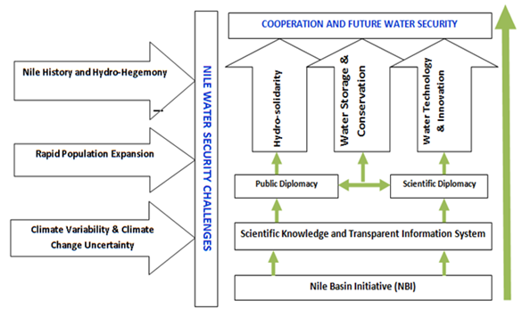
The way forward: Cooperative Agreement, Institutions and Investment
Improved Water Security and sustainable development
Agreement and Investment

Slide 16
Thanks you

