Slide 1
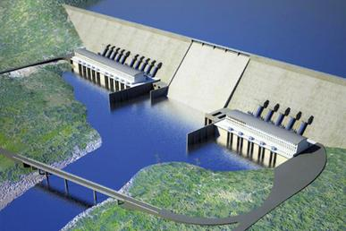
Analaysis of the impact of Land use change and climate change on the Blue Nile River using SWAT
Sead Ahmed Swalih
Istanbul Technical University
August 2020

Slide 2
Introduction
Problem statement and objectives
Materials and methods
Results and discussion
Conclusion and recommendations
1
2
3
4
5

Slide 3
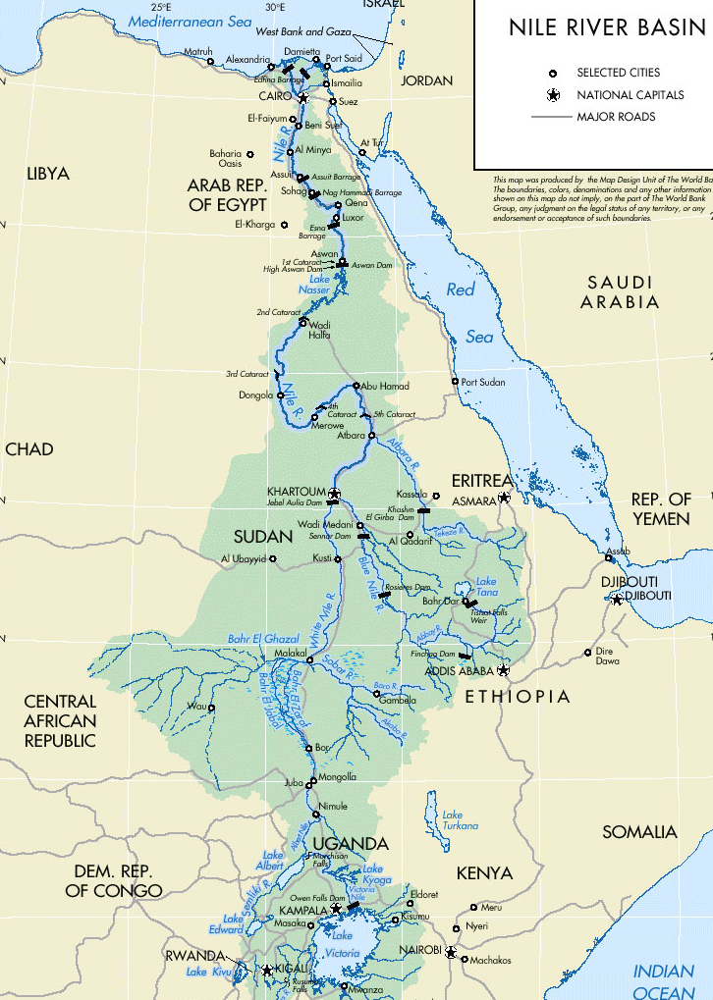
Introduction
World’s climate - changing & expected to continue in the coming century
Africa - most vulnerable to climate change and variability
The Nile basin, the largest basin in Africa – high topographic and climatic variability
  Increase vulnerability
NILE
BLUE NILE
WHITE NILE
Analysis of the impact of land use change and climate change on Blue Nile river using SWAT

Slide 4
Introduction
Problem statement and objectives
Materials and methods
Results and discussion
Conclusion and recommendations
1
2
3
4
5

Slide 5
Problem statement
high development on the Nile, i.e. construction of the Aswan Dam, Sennar, and Rosieres reservoirs for irrigation and hydropower generation
increased demand for irrigation and hydropower Ethiopia - GERD
high vegetation degradation in Ethiopia, i.e. deforestation, results in land use change
  ecosystem degradation due to massive utilization of river waters in Sudan and Egypt, eg. loss of biodiversity
increasing water demand upstream + climate change and land use change
Notes:
Health issues are also important
their impact on water resource sustanabily downstream need to be assessed

Slide 6
Objectives
Assessing the dynamics of climate in the Basin
Projecting basin hydrology using climate change and land use change scenarios to assess their impacts

Slide 7
Introduction
Problem statement and objectives
Materials and methods
Results and discussion
Conclusion and recommendations
1
2
3
4
5

Slide 8
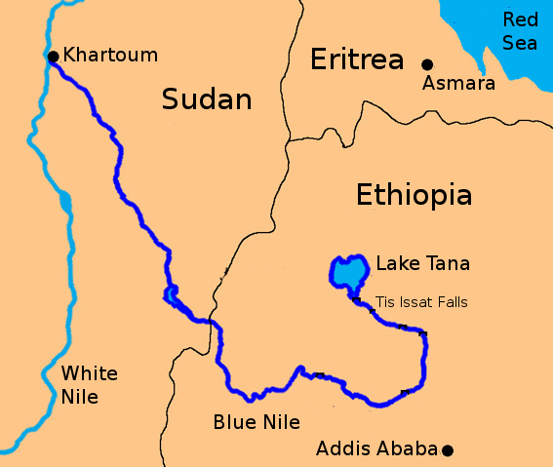
Study area
  Blue Nile (in Amharic Abbay/in Arabic the Al Bahr al-Azraq)
    1529 km long (longest in the world)
    elevation of the basin varies from 4000m (little Abbay) to 700m at foot of the plateau
    contribute for 60 % flow of Nile
    crucial for thesurvival of downstream countries
The Blue Nile River

Slide 9
Study area cont’d
SAVA – Savanah forest
CRDY – Crop land/Dry land
WATB – Water body
CRWO – Crop land/Wood land
GRASS – Grassland
BSVG – Bush land vegetation

Slide 10
Study area cont’d
Climate varies from humid to semiarid
  Kiremt …(Jun-Sept)
  Bega ……(Oct-Jan)
  Belg …….(Feb-May)
For the year 1961-1990,
  Annual preciptation was 1200mm to1600mm
  Annual temprature-was 18.3°C (2°C seasonal variation)

Slide 11
Materials
Climate change scenario data
  Source: IPCC data distribution centre
  SRES-AR4 scenario runs of six AOGCMs were chosen
    BCM2_BCCR … abbreviated as BCM2 (Norway)
    CSIRO_MK3 ……. “ “ CSMK3 (Australia)
    INMCM3 ………… “ “ INCM3 (Russia)
    GISAOM …………. “ “ GIAOM (USA)
    MIROC3_2HI ….. “ “ MIHR (Japan)
    MIROC3_2MED.. “ “ MIMR (Japan)
    Preciptation and Temprature projections for 2020, 2055 and 2090 were analysed for storylines A1B and B1
Notes:
A1- A future world of very rapid economic growth, low population growth, rapid introduction of technologies with convergence among regions and increased cultural interactions.
A1B- A future world of very rapid economic growth, low population growth and rapid introduction of new and more efficient technology.

Slide 12
Materials cont’d
Preciptation change
Temprature change

Slide 13
Materials cont’d
Preciptation change
Temprature change

Slide 14
Materials cont’d
Preciptation change
Temprature change

Slide 15
Materials cont’d
Land use and cover (LUC) change scenario data
  Two hypothetical LUC scenarios for 2080 assuming + 10% change on savana forest
  It has also been assumed that change in SAVA (savana) cover will be compensated by CRDY (crop land/ dry land)
    LUS-1……. Land use scenario 1 - 10% increase in SAVA
    LUS-2 …… « « « 2 - 10% decrease «

Slide 16
Materials cont’d
Change in land use percentage

Slide 17
Methods
Observed Flow
Observed Baseline Precip.
Bias Assessment for GCM uncertainty
Baseline Flow
Model bias Correction
IPCC AR4 Baseline Precip.
SWAT Model
Corrected flow (1961-90)
IPCC AR4 Scenario Precip.
Analysis & comparison
Observed Baseline Temp.
SWAT Model
Corrected flow (2011-99)
Bias Assessment for GCM uncertainty
IPCC AR4 Baseline Temp
)
Scenario Flow
Model bias Correction
IPCC AR4 Scenario Temp.
Input Data
Processes
Output Data

Slide 18
Approaches
Model evaluation
Climate change anaysis
Land use and cover (LUC) change analysis
Land use change analysis coupled with climate change

Slide 19
Introduction
Problem statement and objectives
Materials and methods
Results and discussion
Conclusion and recommendations
1
2
3
4
5

Slide 20
Results
Model evaluation
Climate change anaysis
Land use and cover (LUC) change analysis
Land use change analysis coupled with climate change

Slide 21
Results cont’d
Global water balance
  Preciptation……………………1026.1mm
    Surface runoff……………………208.6mm
    Lateral discharge……………….7.6mm
    Shallow aquifer recharge….120.1mm
    Deep « « ……………46.0mm (5%)
    Total aquifer recharge……….300.3mm
    Totla water yield……………….273.4mm
    ET……………………………………..509.3mm
    PET……………………………………2185.4mm
    Transmission loss………………7.0mm
The water balance closes with about 7% error

Slide 22
Results cont’d
Annual yield

Slide 23
Results cont’d
Annual yield

Slide 24
Results cont’d
Annual yield

Slide 25
Results cont’d
Annual yield

Slide 26
Results cont’d
Seasonal flow
Notes:
Peak flows have been underestimated

Slide 27
Results cont’d
Seasonal flow

Slide 28
Results cont’d
Statisticla indices

Slide 29
Results cont’d
Statistical indices

Slide 30
Results cont’d
Statistical indices

Slide 31
Results cont’d
Statistical indices

Slide 32
Results cont’d
Model predictive range

Slide 33
Results cont’d
Residual analysis

Slide 34
Results cont’d
Residual analysis

Slide 35
Results cont’d
Residual analysis

Slide 36
Results cont’d
Model evaluation
Climate change anaysis
Land use and cover (LUC) change analysis
Land use change analysis coupled with climate change

Slide 37
Results cont’d
Preciptation

Slide 38
Results cont’d
Temprature

Slide 39
Results cont’d
GCM uncertainty
Bias
Water yield

Slide 40
Results cont’d
Base period

Slide 41
Results cont’d
Base period

Slide 42
Results cont’d
Base period

Slide 43
Results cont’d
Average flow change

Slide 44
Results cont’d
Average flow change

Slide 45
Results cont’d
Average flow change

Slide 46
Results cont’d
Seasonal flow change

Slide 47
Results cont’d
Seasonal flow change

Slide 48
Results cont’d
Seasonal flow change

Slide 49
Results cont’d
Model evaluation
Climate change anaysis
Land use and cover (LUC) change analysis
Land use change analysis coupled with climate change

Slide 50
Results cont’d
Annual yield change
Land-use Scenario | Annual WYLD (mm) | Change in Savana forest % | ∆WYLD %
Baseline (1961-90) | 223.4 | 0 | 0
LUS-1 (2080) | 189.6 | 10 | -15
LUS-2 (2080) | 249.9 | -8 | 12

Slide 51
Results cont’d
Seasonal flow change

Slide 52
Results cont’d
Model evaluation
Climate change anaysis
Land use and cover (LUC) change analysis
Land use change analysis coupled with climate change

Slide 53
Results cont’d
Annual yield change
GCMs | LUS | Climate Change |  | Land use Change | Annual WYLD (mm) | ∆WYLD%
 |  | ∆P% | ∆T% | ∆SAVA%
BCM2 | 1 | 0.1 | 1.7 | 10 | 158.9 | -37.0
 | 2 | 0.1 | 1.7 | -8 | 216.5 | -14.2
MIMR | 1 | 3.2 | 1.2 | 10 | 276.7 | 9.7
 | 2 | 3.2 | 1.2 | -8 | 337.1 | 33.6
MIHR | 1 | 10.5 | 2.5 | 10 | 207.8 | -17.6
 | 2 | 10.5 | 2.5 | -8 | 274.2 | 8.7

Slide 54
Results cont’d
Seasonal flow change

Slide 55
Introduction
Problem statement and objectives
Materials and methods
Results and discussion
Conclusion and recommendations
1
2
3
4
5

Slide 56
Conclusion
  The SWAT model has been successfully evaluated
    Satisfactory performance - minimum NSE=0.7
    But high flow predictions were not as good as low flow predictions
Land use and climate change scenarios - helped to better understand the impact of climate change and land use change on Blue Nile river
It has been proven that land use and cover (LUC) changes as well as climate change has resulted in significant changes (either by increasing or decreasing) in the hydrology of the basin

Slide 57
Recommendations
use of long time series and good quality data in the hydrologic models
investigate the reasons of underestimation of peak flows for Blue Nile
It will be of great importance to incorporate other factors in the assessment like, sediment transport and water quality analysis.
Incorporating the newly constructed dam by Ethiopia (GERD) in the already built hydrologic model and analyzing the impact (on development)

Slide 58
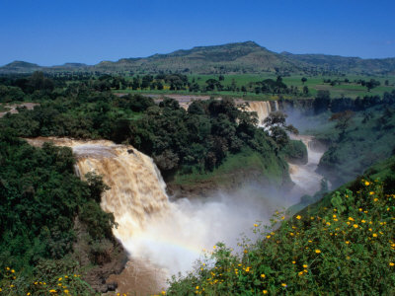
Thanks for listening!

