Slide 1


International Conference on the Nile and Grand Ethiopian Renaissance Dam
August 2020
The Operation of the Grand Ethiopian Renaissance Dam under Future Climate Scenarios
Rehenuma Lazin, Xinyi Shen, Semu Moges, and Emmanouil Anagnostou
University of Connecticut, Civil and Environmental Engineering, Storrs, CT, United States

Slide 2
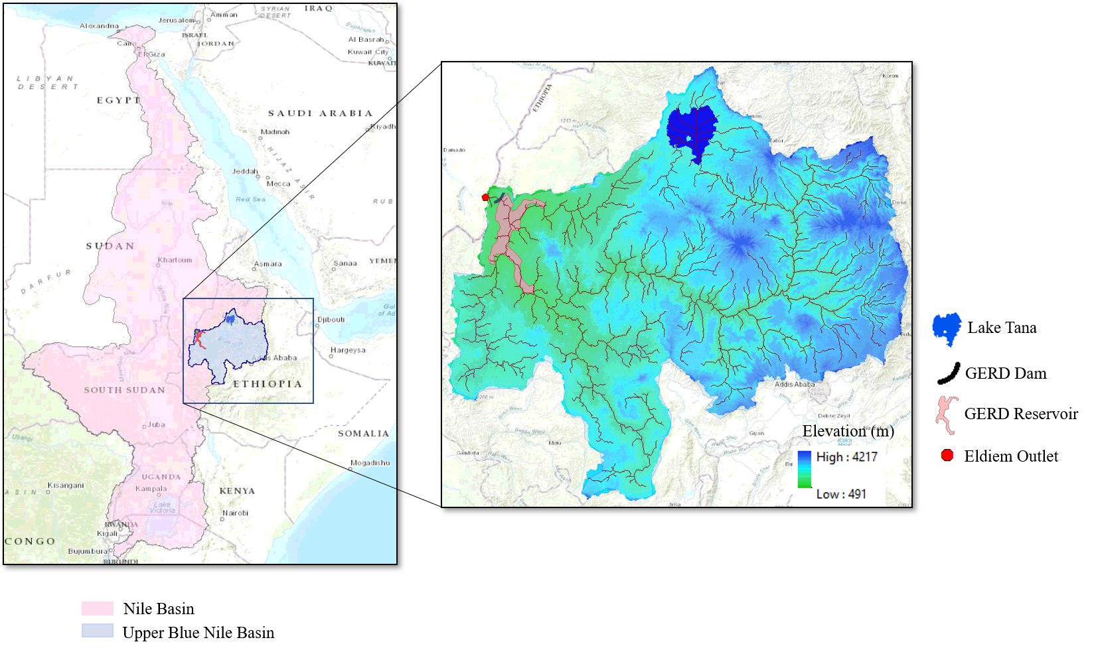
Objectives
Simulate hydrological parameters for the reservoir management in the Upper Blue Nile (UBN) basin for future climate projections using CREST-SVAS.
Predict the inflow at Eldiem outlet close to the dam, Grand Ethiopian Renaissance Dam (GERD).
  GERD Configuration:
- Volume :74 Billion Cubic Meter (BCM)
- Area: 1760 km²
Analyze effect of climate change on the streamflow at Eldiem.
Analyze hydropower generation and dam operation for future climate projection.
Fig 1: Study Area, Upper Blue Nile Basin

Slide 3
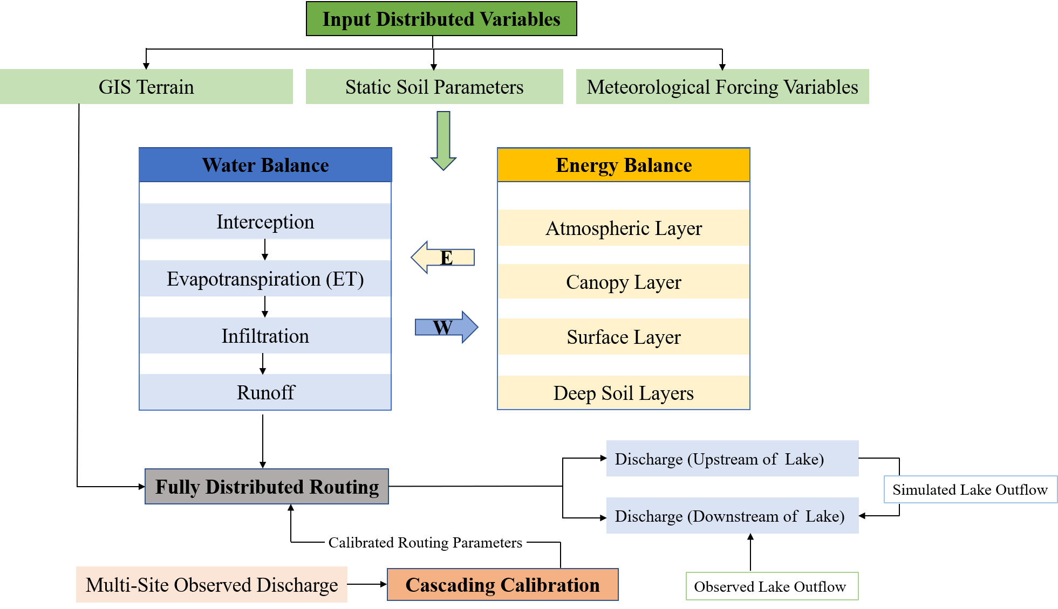
CREST-SVAS Hydrological Model
Coupled Routing and Excess Storage (CREST), Soil-Vegetation-Atmosphere-Snow (SVAS) is a fully distributed hydrological model that strictly couples energy and water balances and imposes closed energy balance.
It can simulate for small to large watersheds (a few 100 km² to 176,000 km²⁾ at a fine spatiotemporal resolution (500 m and 3-hourly).
Meteorological variables that are required to force the model include precipitation, air temperature, shortwave solar radiation, longwave solar radiation, wind speed, humidity, and air pressure.
Fig 2: CREST Framework (Shen and Anagnostou, 2017)

Slide 4
Meteorological Forcing Data Source
Climate Projection Data
Baseline Data
  We consider 1981-2010 as baseline period and compared the climate data for three time windows, 2011-2040, 2041-2070, and 2071-2100.
Reference Flow for the Recent Years
  For recent years (2001-2019), we used ERA Land and MSWEP forced flow as reference
Regional Climate Model (RCM) | Global Circulation Model (GCM) | Representative Concentration Pathway (RCP) | Temporal Extent | Spatial Resolution | Temporal Resolution
Rossby Centre regional Atmospheric model (RCA4) | Model for Interdisciplinary Research On Climate (MIROC5) | 4.5 | 2006 - 2100 | 50 km | 3-Hourly
 |  | 8.5
Variables | Data Source
Precipitation | MSWEP
Temperature | ECMWF
Flow | Observed

Slide 5
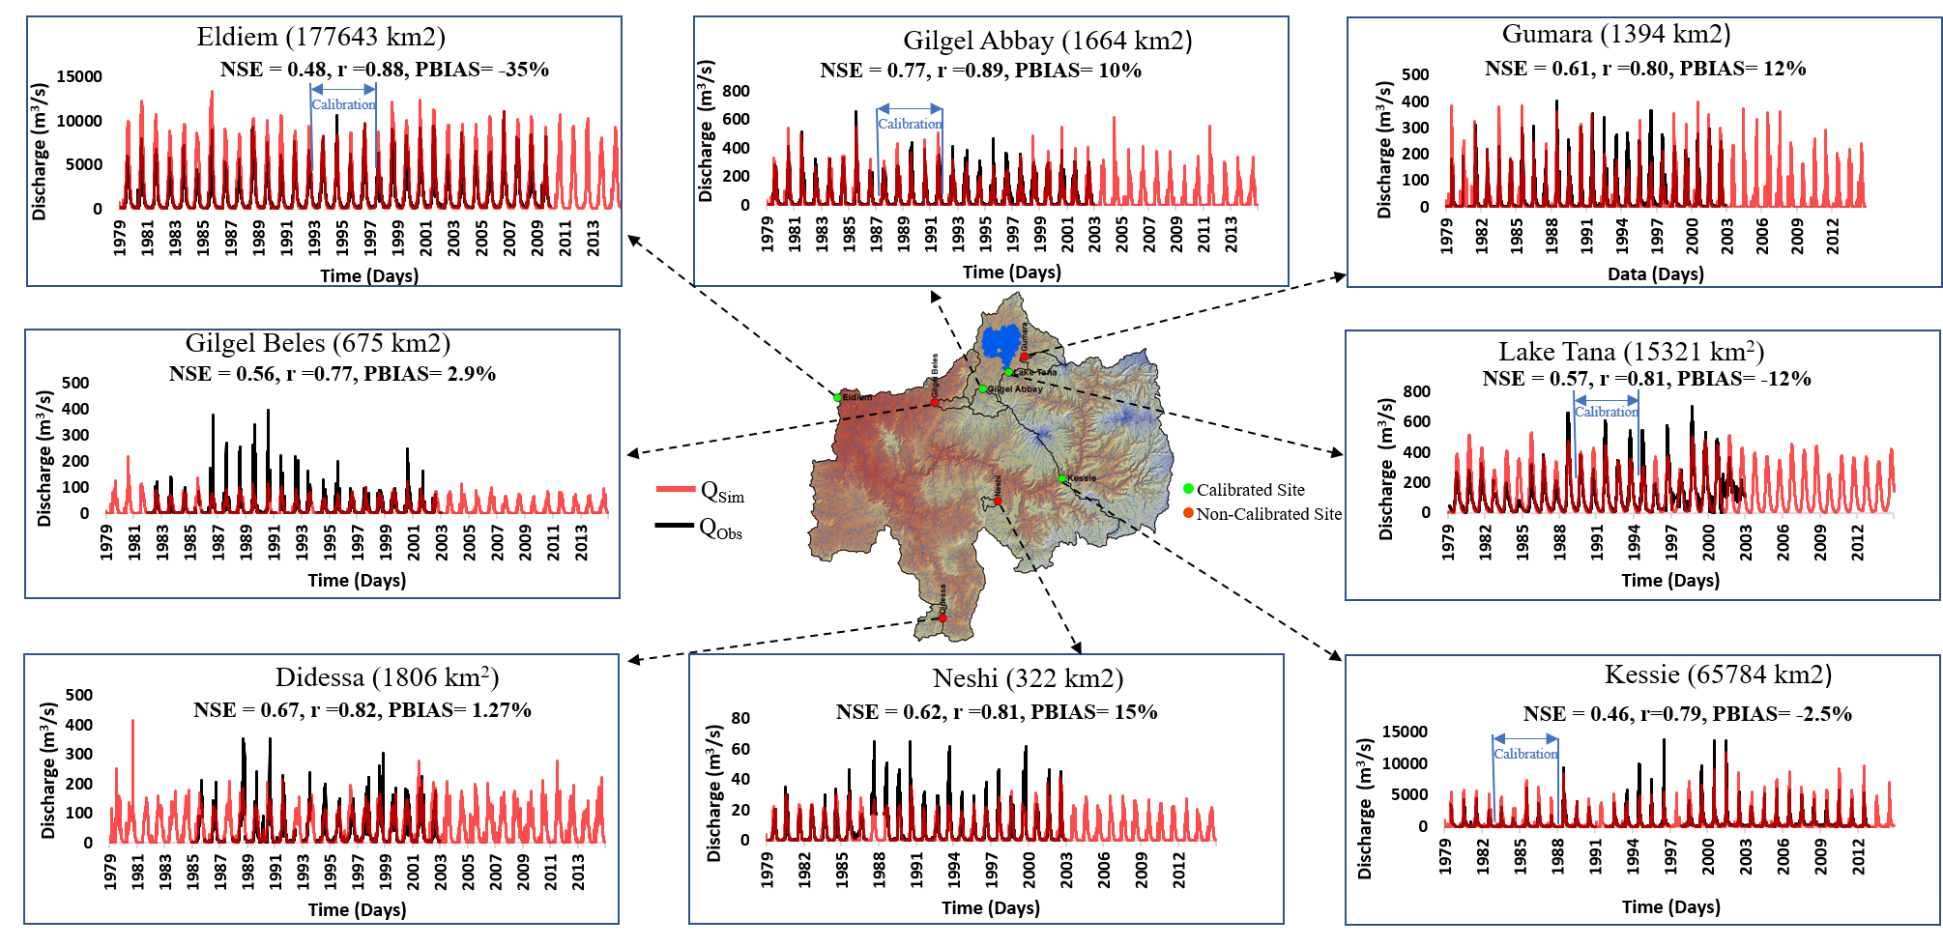
Model Calibration
Fig 3: Multi Site Cascade Calibration of Daily Streamflow (Lazin et al., 2020)

Slide 6
Validation of Discharge From Reference and Climate Projection Simulation
Discharge at Eldiem
Fig 4: (Left) Validation the ERA Land and MSWEP forced discharge with respect to the observed discharge which is later used as reference discharge to evaluate Climate Projection simulations of RCP 4.5 (middle) and RCP 8.5 (right) for the recent years.

Slide 7






Climate Projection Analysis
Precipitation
Temperature
Flow at Eldiem
+4$.1 ℃$
+63.7. %
+3$.4 ℃$
+41.2 %
+9.1 %
+9.2 %
+9.9 %
Baseline
(Observed)
+24.7 %
RCP 4.5
Baseline
(MSWEP)
+1.8 $℃$
Baseline
(ECMWF)
+23.2 %
+4$.8 ℃$
+91.2 %
+90.1 %
+18.1 %
+3$.2 ℃$
+81.2. %
+14.1 %
RCP 8.5
Baseline
(MSWEP)
+1.9 $℃$
Baseline
(Observed)
Baseline
(ECMWF)
Fig 5: Climate Projections for Temperature, Precipitation and Flow for RCP 4.5 and RCP 8.5

Slide 8
GERD Proposed Annual Filling Volume
Number of Years | Retained Amount in the Dam (BCM)
1 | 4.9
2 | 13.5
3 | 10.4
4 | 10.5
5 | 10
In 5 years the dam will be filled up to 49.3 BCM at the end of the dry season. The dam is intended to be filled up to the capacity of 74 BCM for higher performance of power generation.

Slide 9
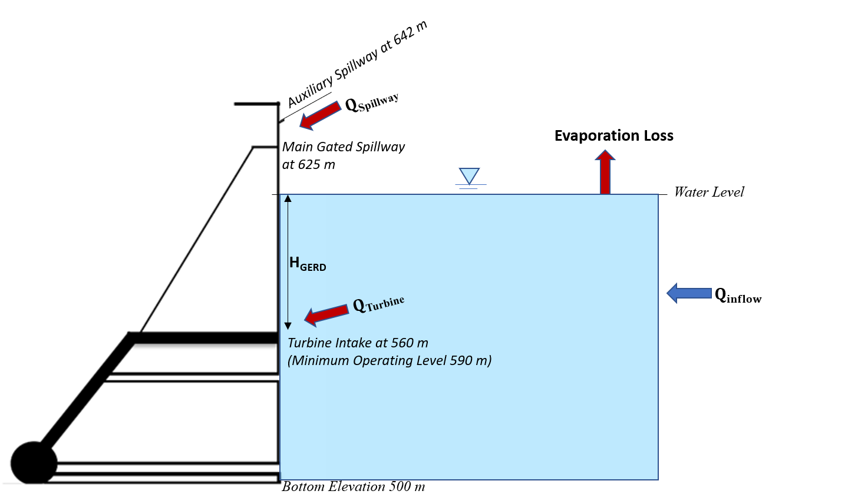


Reservoir Mass Balance and Hydropower Generation
The mass balance equation for GERD can be represented as,
  $S_{GERD_{i}}={S_{GERD_{i−1 }}+ Q}_{in}−Evaporation loss_{GERD} −Q_{out}$……(1)
  $Q_{out}={Q_{spillway}+ Q}_{Turbines}$
  $Evaporation lo{ss}_{GERD}=Prec_{GERD} −0.8×ET_{pot_{GERD}}$(Kevin et al. 2007)
  $Q_{Turbines}≤0.373$ $(km^{3}/day)$ [When Elevation > 590]
  $Q_{Spillway}≤1.573 (km^{3}/day)$ [When Elevation > 640]
$Reservoir water level_{i}$ is determined from Elevation-Storage Curve (Fig 7)
Hydropower production is formulated as,
  $HP=$ $γ×η×Q_{Turbines}×H_{GERD}$…………………………………(2)
  $γ$ = Specific Weight of Water (98 07 N/m³)
  $H_{GERD}$ = $Reservoir water level_{i} – Turbine level (560 m)$
  $η$= Efficiency of the turbine
Fig 6: Mass Balance in the GERD Reservoir
$$E=−0.0268 × S^{2} + 3.4039×S + 530.0079$$
Fig 7: Elevation Storage Curve

Slide 10
GERD Storage and Annual Flow Volume (RCP 4.5)
Fig 8: Annual Flow in the Reservoir. The flow through the Turbine and Spillway represent the Total Outflow
Fig 9: Daily Storage in the GERD Reservoir

Slide 11
GERD Storage and Annual Flow Volume (RCP 8.5)
Fig 10: Annual Flow in the Reservoir. The flow through the Turbine and Spillway represent the Total Outflow
Fig 11: Daily Storage in the GERD Reservoir

Slide 12
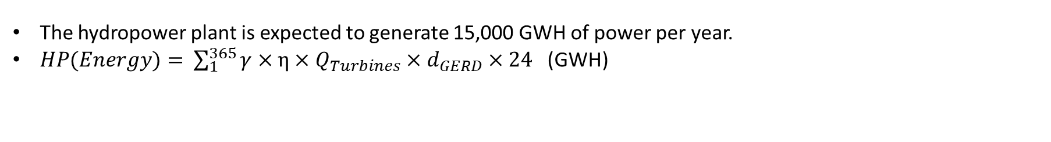
Hydropower Generation
The hydropower plant is expected to generate 15,000 GWH of power per year.
$HP(Energy)=$ $\sum_{1}^{365}{γ×η×Q_{Turbines}×d_{GERD}×24 }$(GWH)
RCP 4.5
RCP 8.5
Fig 12: Hydropower Generation Under Future Climate Projections

Slide 13
Conclusions
Climate Projections from RCA MIROC 5 model (RCP 4.5 and RCP 8.5) indicate an increasing trend in terms of precipitation and temperature that results in a similar increasing trend of streamflow.
From RCP 4.5 projections, since during the 2050 s the flow is high, the dam will frequently reach to its capacity and spillway need to be activated whereas for the later part of the century, the spillway is rarely activated. For RCP 8.5 projections the flow is so high for some years that the storage exceeds the dam capacity of 74 BCM even after activating the spillway at 640 m
The mass balance and hydropower production framework represents that the dam can produce the expected energy (15000 GWH). For high inflow (RCM 8.5 and during 2050 s of RCP 4.5) the hydropower generation can be higher. However, during the dry years it can drop below 10,000-12,000 GWH.

Slide 14
Limitations and Future Work
The projections of the climate model can be uncertain which might cause the inconsistent future hydrological performance.
Evaluation of the impact of climate change on the Evapotranspiration and Soil Moisture and the consideration of irrigation release from the GERD can be analyzed in future studies.

Slide 15
Thank You!

