Slide 1

Implication of GERD to Sudan and Prospects of Long-Term Resolution for Conflicts Around the Eastern Nile
Yosif A. Ibrahim (Ph.D., P.E,)
August 21, 2020
2020 International Conference on the Nile and GERD : Science Conflict Resolution and Cooperation

Slide 2
Content
Context: Exploring Ethiopia Irrigation and Hydropower Development Plans
Options for Accommodating Ethiopia Future Water Needs and the path forward for Sharing the Nile Water
GERD Positive and Negative Impacts to Sudan
Key Issues that needs immediate attention

Slide 3
Blue Nile: Ethiopia Irrigation Potential

Slide 4
Blue Nile: Ethiopia Power Potential

Slide 5
Atbara: Ethiopia Irrigation Potential

Slide 6
BAS: Ethiopia Irrigation Potential

Slide 7
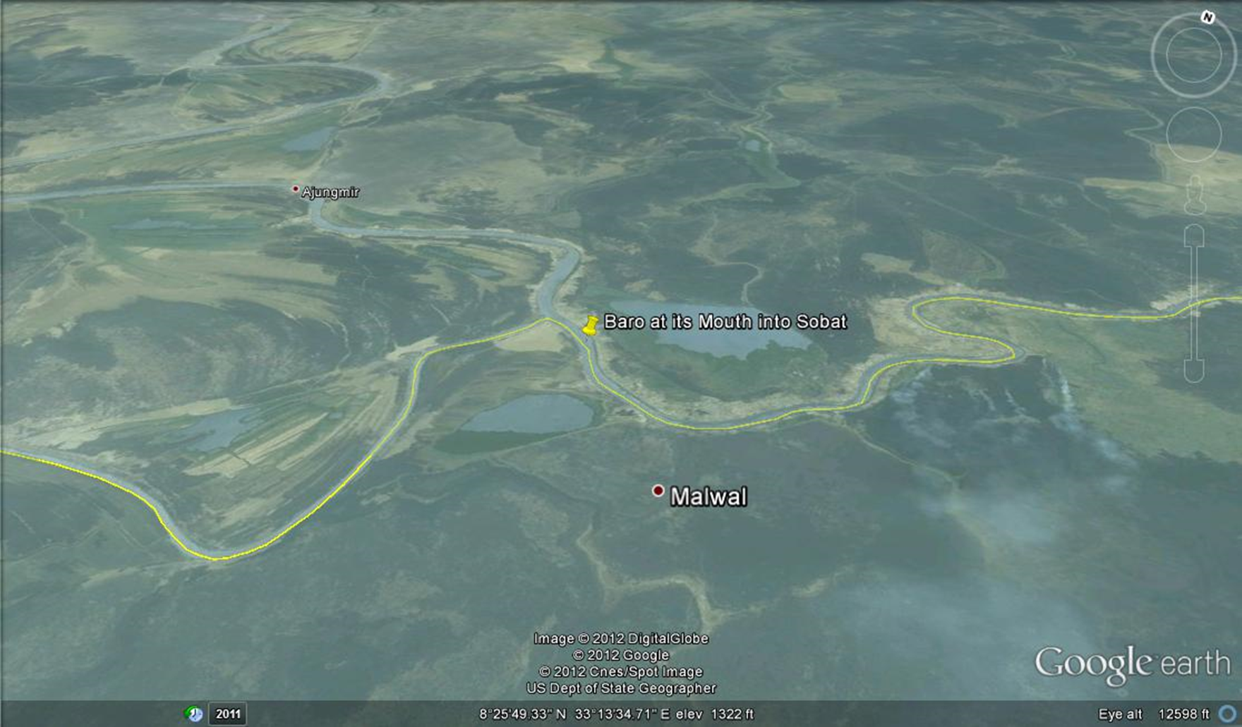
BAS: Ethiopia Irrigation Potential Continue

Slide 8
Summary of Ethiopia Demand
Total Investment Portfolio= 22.183 Billion US$
Total Irrigation Potential =1.4 Million Ha
Total Water Requirements = 8.7 BCM (Excluding Evaporation Losses)
Anticipated Net Revenue Generated = 249 (Irr.)+3865 (Hydro)=4.11 Billion/Yr
Water Value for Hydro= 1.33 US$
Water Value for Irrigation=2.86 Cents
Total Employment Generated Irrigation=14.9 Billion

Slide 9
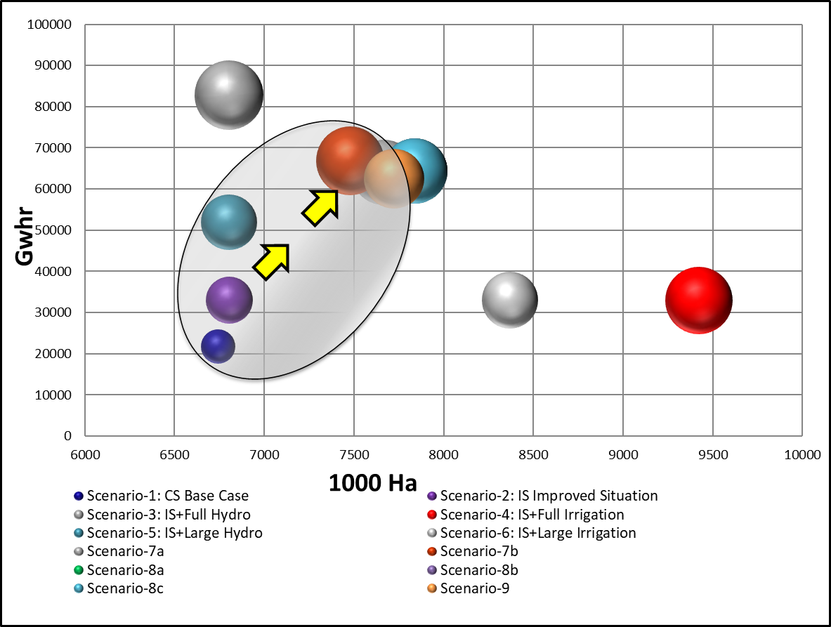
Eastern Nile Multi-Sector Opportunity Analysis

Slide 10
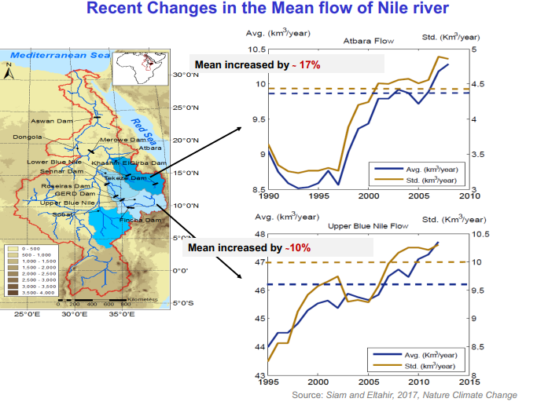

Slide 11
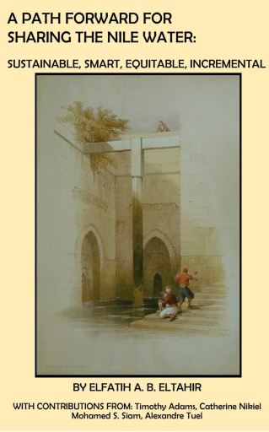
Prospect for Long-Term Solution (Prof. Eltahir)
Increase in Yield ➔ 5 BCM (Blue Nile) + 2 BCM (Atbara)
Allow Ethiopia to Fully Exploit Hydro-BN
Allow Ethiopia to Fully Exploit Irrigation
Incremental Basin Approach
Start with Agreement Around BN + Atabara
Negotiation Around BAS Shall Involve South Sudan
Terms of Agreement Shall be based on Decadal Yield because of Large Interannual variability; i.e.
  Egypt Measured at H.A.D=555 BCM/10-Yrs
  Sudan Measured at H.A.D=185 BCM/10Yrs-
  Ethiopia Measured at H.A.D= 70 BCM/10Yrs

Slide 12
Potential Benefits of GERD?
Regulation By Default Help in:
  Addressing flood impact
  Avail water for irrigation year around ➔ Irrigation intensification (Facilitate Irrigation of .5 Million Ha)
  Reduce Sedimentation ➔ Reduction in Sediment load by 85% and cost of dredging by USD 50 million/year
  Improve performance of existing hydropower plants ➔ increase in hydropower generation will account for 2,000 GWh/Year, amount to about 23 million USD annually (Mordos et al., 2018)
  Access to clean and cheap source of energy (Thermal is no longer an option )
  Navigation

Slide 13
GERD Concerns….
Coordinated operation of the GERD to maximize benefit and minimize negative impacts ➔
Impact of GERD during filling
Reduction in soil fertility;
Impact to Recession Agriculture
Risk of dam failure
Revisiting Power Trade Agreement as Part of GERD Negotiation

Slide 14
Environmental and Socio-Economic Impacts
  Recession Agriculture (Social) : The Regulation of the Blue Nile will reduce the recession agri. Irrigated land by about 50%
  Brick making activities (Social)
  Sediment Reduction ➔ Lost in soil fertility (Fertilizers)
  Loss in hydropower generation capabilities during filling
  Morphological changes (Env.)
  Changes in river water quality
  Fisheries

Slide 15
Key Issues Short Term….
  Coordinated and Joint operation of GERD during both Filling and long-term operation
  Dam Safety: Reduce Risk of Failure and Demand transparency from Ethiopia to release all Reports that Pertain to Dam Safety
  Environmental Impact Study that address recession agriculture, loss in fertile land and other losses in ecosystem benefits and socio-economic benefits with options for mitigations and compensation
  Power Trade Agreement to be part of GERD Negotiations
  Have a legally binding agreement and institute some sort of mechanism for operationalization

Slide 16
Key Issues: Middle to Long Term
  Sudan should have a plan to fully utilize its share of 18.5 BCM ➔ Upgrade conveyance system for irrigation; irrigation modernization for existing schemes etc.
  Improve agriculture productivity and water use efficiency (Adoption of Technology and best practices e.g. improved use of fertilizers, advanced irrigation system)
  Work with the Egypt and Ethiopia to have long-term water sharing and Benefit sharing agreement that could potentially acknowledge legal water rights per 1959 and at the same time accommodate the development plans for Ethiopia
  Augment hydro-generation through enhancing operation of existing scheme and runoff-river hydro plants
  Horizontal expansion in irrigated agriculture

Slide 17
Thank You
Questions

