Slide 1
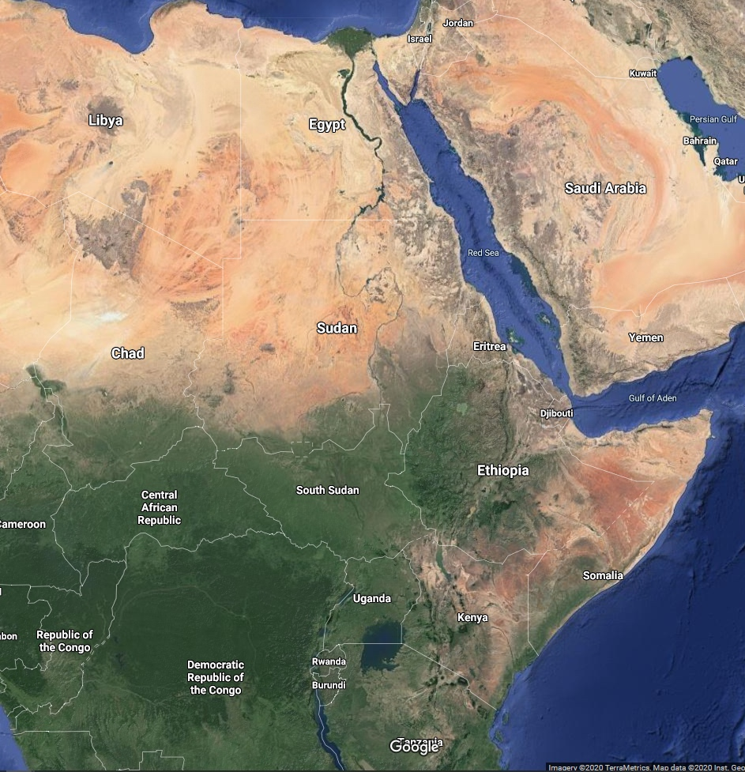
Lessons Learned, Lessons Shared
Global Perspectives from Treaties on Transboundary Waters
2020 International Conference on the Nile and Grand Ethiopian Renaissance Dam: Science, Conflict Resolution and Cooperation
Florida International University
Nebiyu Daniel Tiruneh, Ph.D.
Nebiyu Daniel Tiruneh: 2020 International Conference on the Nile and Grand Ethiopian Renaissance Dam: Science, Conflict Resolution and Cooperation

Slide 2
DISCLAIMER
This presentation was prepared by Nebiyu Daniel Tiruneh in his personal capacity. The opinions expressed in this article are the author's own and do not reflect the view of the agency the author works for or that of the United States government.
Nebiyu Daniel Tiruneh: 2020 International Conference on the Nile and Grand Ethiopian Renaissance Dam: Science, Conflict Resolution and Cooperation

Slide 3
OUTLINE
Transboundary water resources
The emergence of regulatory framework
Transboundary water treaties
The global experience of transboundary water resources management
Lessons learned
Nebiyu Daniel Tiruneh: 2020 International Conference on the Nile and Grand Ethiopian Renaissance Dam: Science, Conflict Resolution and Cooperation

Slide 4
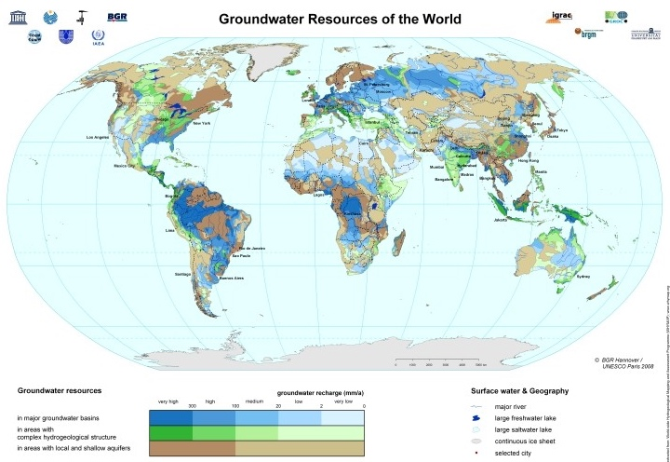
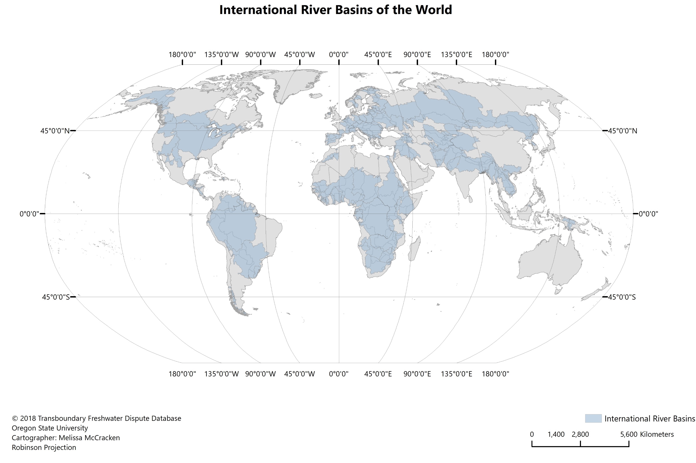
Transboundary Water Resources
270 transboundary river basins.
200 transboundary aquifers.
39 countries have more than 90% of their territory within one or more transboundary river basins.
21 countries lie entirely within one or more of these watersheds.
40% of the world population lives in them.
UNEP GEF International Waters: https://www.grida.no/publications/230
https://www.whymap.org/whymap/EN/Home/gw_world_g.html
https://transboundarywaters.science.oregonstate.edu/database-and-research/galleries/global-map-gallery
Nebiyu Daniel Tiruneh: 2020 International Conference on the Nile and Grand Ethiopian Renaissance Dam: Science, Conflict Resolution and Cooperation
Notes:
When we examine our shared human history, we are reminded that water resources helped stimulate socio-economic development, determined the geopolitical and strategic standing of countries. We also learn that ancient civilizations flourished along water courses and wars were fought over the control of water resources. As our knowledge base grew, we have come to realize the nexus between food, energy, and water. But most importantly we are beginning to realize that water resources are indeed finite and precious resources.
According to data from the United Nations’ Environment program Global Environment Facility, globally there are over 270 transboundary river basins and 200 transboundary aquifers, while 39 countries have more than 90% of their territory within one or more transboundary river basins and 21 lie entirely within one or more of these watersheds
These watersheds cover about one-half of the Earth’s land surface and are home to about 40% of the world’s population
These river basins cover more than 45% of the earth’s surface, and about 145 states share international river basins. Of the 145 states within the international river basins, about two-thirds (92) have at least half of their national territory within an international basin, while more than one-third (50) have at least 80 percent or more of their national territory within an international basin.

Slide 5
Global Figures on Transboundary Waters
148 countries : Territory within one or more transboundary river basins
39 countries : More than 90% of their territory within one or more transboundary river basins
21 countries : Within one or more of these watersheds
Almost 450 agreements
On international waters signed between 1820 and 2007
Nebiyu Daniel Tiruneh: 2020 International Conference on the Nile and Grand Ethiopian Renaissance Dam: Science, Conflict Resolution and Cooperation

Slide 6
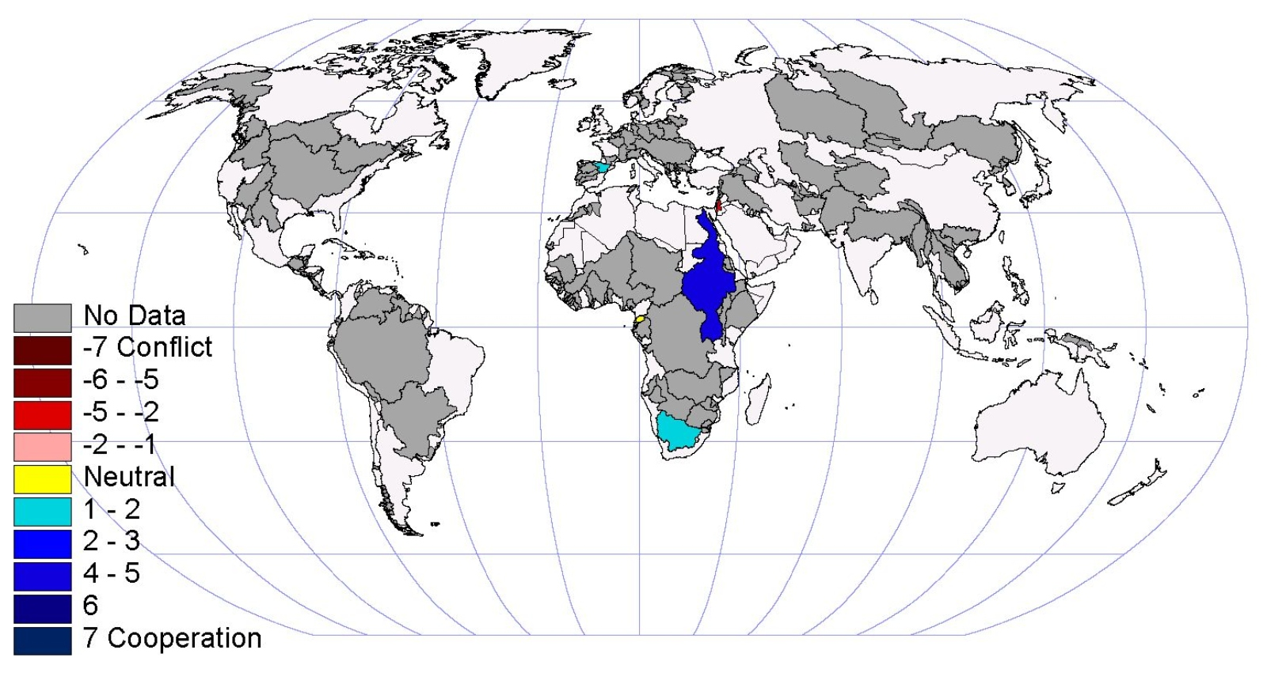
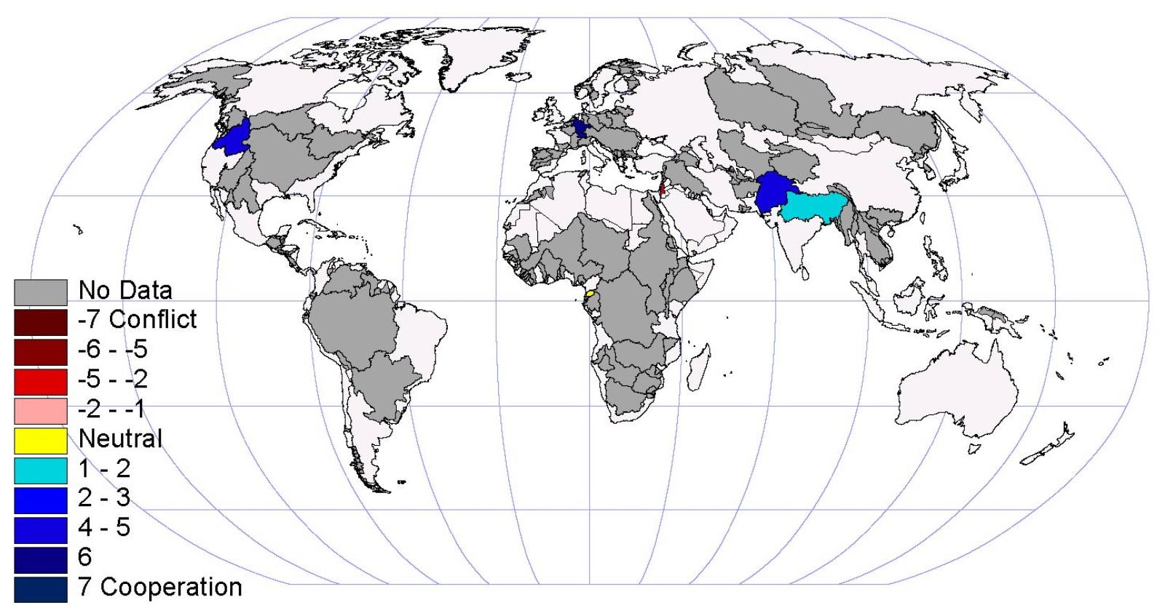
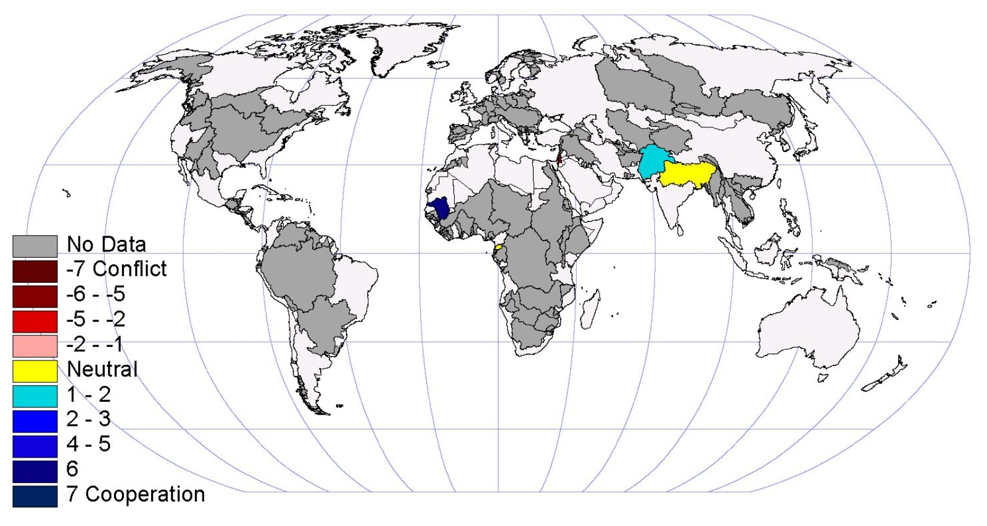
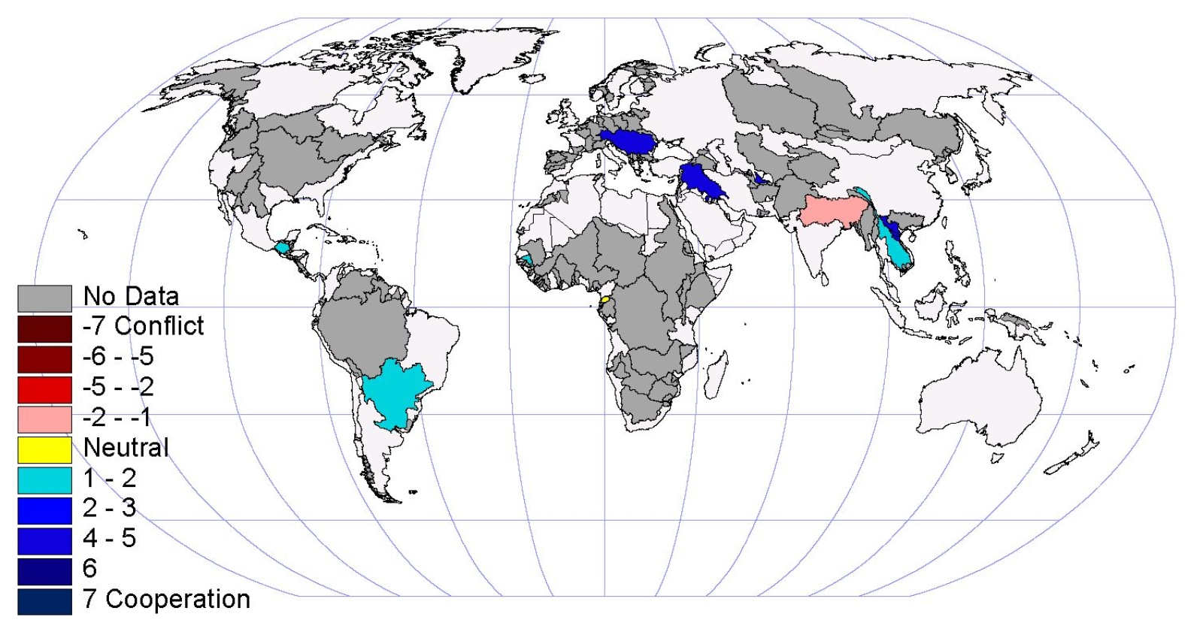
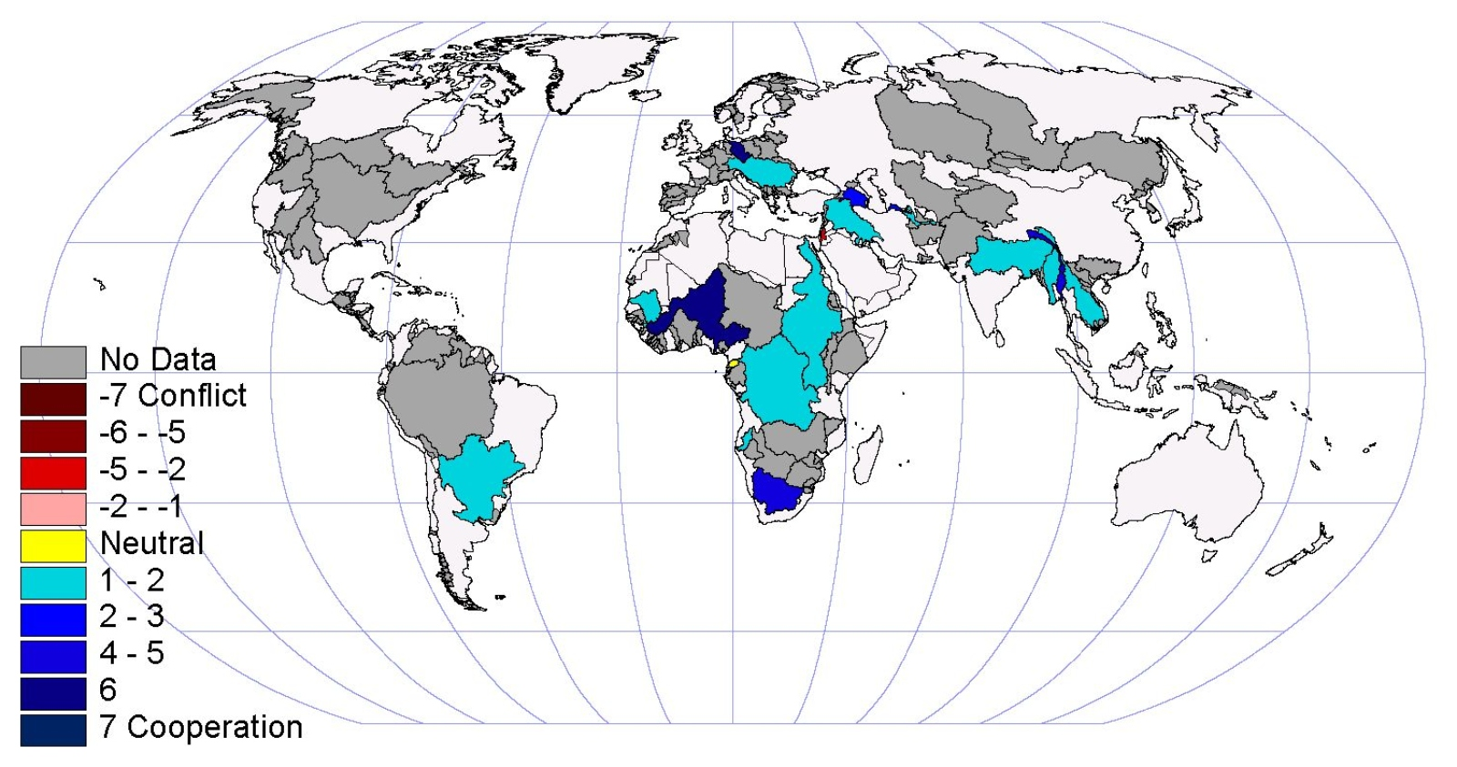
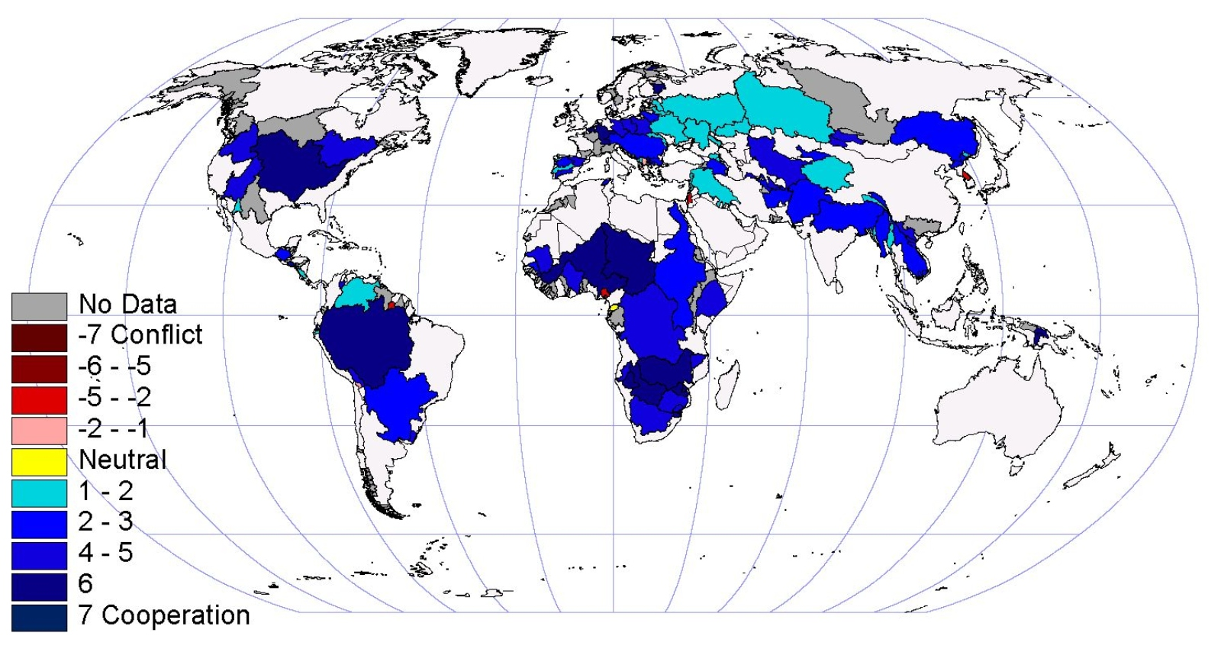
Historic conflict and cooperative events
1950
1960
1970
1980
1990
Average
Nebiyu Daniel Tiruneh: 2020 International Conference on the Nile and Grand Ethiopian Renaissance Dam: Science, Conflict Resolution and Cooperation
https://transboundarywaters.science.oregonstate.edu/database-and-research/galleries/historic-basins-at-risk
Notes:
The animation is based on information from Oregon State University’s Program in Water Conflict Management and Transformation. The animation shows Average conflictive or cooperative events occurring in international transboundary river basins. The conflict to cooperation scale is the Basins at Risk Scale. The time period is for records beginning in 1950 through 1999 and the final is the average of almost 60 years. The data shows there is a considerable activity in the realm of cooperation albeit within the early stages of cooperation owing to protracted negotiations, emerging issues, and the failure to build mutual trust.

Slide 7
The Emergence of Regulatory Framework to Manage Transboundary Waters
More than 300 bilateral and multilateral agreements since 1814.
About 37 incidents of acute conflict over water since 1948.
    The Indus, The Jordan, The Columbia
Approximately 295 international water agreements were negotiated and signed in the same period.
The International Law Association (ILA) in 1954 embarked on an ambitious plan to study the legal aspects of the use of the waters of international drainage basins
    The Indus
    The Jordan
    The Nile
Nebiyu Daniel Tiruneh: 2020 International Conference on the Nile and Grand Ethiopian Renaissance Dam: Science, Conflict Resolution and Cooperation
Notes:
Since 1814, more than 300 bilateral and multilateral agreements on the cooperative use and development of transboundary water have been concluded (Gerlack, 2007).
A recent study by the University of Arizona indicates that cooperative institutional arrangements on water exist in about 41% of all transboundary river basins in the world (ibid).
This in turn means that about 158 of the world’s transboundary river basins, plus transboundary aquifer systems, lack any type of cooperative management framework’ (UN-Water, 2008, p. 6).

Slide 8
Treaties and Agreements
Treaties and Other International Agreements
  Major Global and Regional Agreements
    Convention and Statute on the Regime of Navigable Waterways of International Concern Barcelona, April 20, 1921)
    Convention on Wetlands of International Importance especially as Waterfowl Habitat (Ramsar, February 2, 1971)
    Convention on the Protection and Use of Transboundary Watercourses and International Lakes (Helsinki 1992)
    Protocol on Water and Health to the 1992 Convention on the Protection and Use of Transboundary Watercourses and International Lakes
  United Nations Convention on the Law of the Non-Navigational Uses of International Watercourses – Sources of Regional, Multilateral and Bilateral Agreements
  Non-Treaty Instruments: The Helsinki Rules, The Berlin Rules, The Seoul Rules,…
Nebiyu Daniel Tiruneh: 2020 International Conference on the Nile and Grand Ethiopian Renaissance Dam: Science, Conflict Resolution and Cooperation
Notes:
A close examination of the regulatory environment pertaining to transboundary water resources reveals that there are three major approaches

Slide 9
Timeline of Water Rules by ILA
Non-Treaty Instruments
1954-1966
The first committee
The 1966 Helsinki Rules.
1966-1986
The second committee
Drafting of articles amplifying aspects of the Helsinki Rules
1990
The third committee, continues this work of amplification
1997
Convention on the Law of the Non-navigational Uses of International Watercourses.
2004
The Berlin Rules (2004)
The Seoul Rules, approved by the International Law Association in 1986 as a supplement to the Helsinki Rules to address groundwater (ILA 1986),
International Law Association
Nebiyu Daniel Tiruneh: 2020 International Conference on the Nile and Grand Ethiopian Renaissance Dam: Science, Conflict Resolution and Cooperation
Notes:
Over the past six decades the subsequent committees of the International Law Association (ILA) have enabled formulation of rules through international rulemaking efforts.
The first committee drafted The Helsinki Rules,
The second committee formulated a number of articles amplifying particular aspects of the Helsinki Rules
In 1986 The Seoul Rules resulted in a supplement of the Helsinki Rules
The third committee established in 1990 continued work of amplification
In 1997 the Convention on the Law of the Non-navigational Uses of International Watercourses was held. It was modeled after the Helsinki Rules of 1966.
The Berlin Rules was adopted in 2004 and it presented a new paradigm that focuses on ecological integrity, sustainability, public participation, and minimization of environmental harm principles

Slide 10
International Rules and Conventions
The Helsinki Rules
Requires the reasonable and equitable sharing of the benefits of the waters of an international drainage basin,
is seen as the one best suited for achieving the rational management of these waters.
  international drainage basins as indivisible hydrologic units
  includes all tributaries (including tributary groundwater) within the concept of “drainage basin”
  first formulated the phrase “equitable utilization
The Berlin Rules
  Participatory water management
  Conjunctive management
  Integrated management
  Sustainability
  Minimization of environmental harm
Three rules relating to water in a strictly international or transboundary context:
  Cooperation
  Equitable utilization and
  Avoidance of transboundary harm
Nebiyu Daniel Tiruneh: 2020 International Conference on the Nile and Grand Ethiopian Renaissance Dam: Science, Conflict Resolution and Cooperation
Notes:
The Helsinki Rule treats international drainage basins (watersheds extending over two or more States) as indivisible hydrologic units to be managed as a single unit to assure the “maximum utilization and development of any portion of its waters” (ILA 1966, art. II).
The Helsinki Rule explicitly includes all tributaries (including tributary groundwater) within the concept of “drainage basin” and thus extends the reach of the rules beyond the primary international watercourse itself.
The Helsinki Rules first formulated the phrase “equitable utilization” to express the rule of restricted sovereignty as applied to fresh waters: “Each basin State is entitled, within its territory, to a reasonable and equitable share in the beneficial uses of the waters of an international drainage basin” (ILA 1966, art. IV).
The Helsinki Rules also had chapters on pollution, navigation, timber floating, and procedures for preventing and settling disputes.
The Berlin Rules introduced novel concepts related to
Participatory water management (arts. 4, 17-21, 30, 69-71);
Conjunctive management (arts. 5, 37);
Integrated management (arts. 6, 22-24, 37-41);
Sustainability (arts. 7, 10(1), 12(2), 13(2)(h), 22, 23(1), 29, 35(2)(c), 38, 40, 54(1), 58(3), 62, 64(1)); and
Minimization of environmental harm (arts. 8, 13(2)(i), 22-35, 38-41).
Additionally, the Berlin Rules posit three further rules relating to water in a strictly international or transboundary context:
Cooperation (arts. 9(2), 10, 11, 32-35, 42, 56-67);
Equitable utilization (arts. 12-15, 42); and
Avoidance of transboundary harm (arts. 16, 42).

Slide 11
The global experience of transboundary water resources management
Nebiyu Daniel Tiruneh: 2020 International Conference on the Nile and Grand Ethiopian Renaissance Dam: Science, Conflict Resolution and Cooperation

Slide 12
From Database of treaties
ECOLEX The gateway to environmental law
Type of Treaties | Number of Treaties (Search Results)
River | 172
Lake | 68
Sea | 655
Ocean | 193
Nile River | 5
Amazon River | 1
Colorado River | 21
TOTAL 1115 as of June 2020
ECOLEX The gateway to environmental law
Nebiyu Daniel Tiruneh: 2020 International Conference on the Nile and Grand Ethiopian Renaissance Dam: Science, Conflict Resolution and Cooperation

Slide 13
From Database of treaties
FAO Legal Office WATER TREATIES
Geographical Area | Number of Treaties
Africa | 103
AFRICA FAO | 69
Alps | 53
Amazonia | 32
Americas | 85
Aral Sea | 22
Arctic | 62
Asia | 181
ASIA AND THE PACIFIC | 69
Atlantic Ocean Islands | 3
Benelux | 13
Black Sea | 60
Caribbean | 73
Caspian Sea | 46
Central Africa | 21
Central America | 29
Central Asia | 151
CIS (Commonwealth of Independent States) | 64
East Asian Seas | 19
East Pacific | 52
TOTAL 1207 as of June 2020
(FAO Legal Office WATER TREATIES Database
Nebiyu Daniel Tiruneh: 2020 International Conference on the Nile and Grand Ethiopian Renaissance Dam: Science, Conflict Resolution and Cooperation

Slide 14
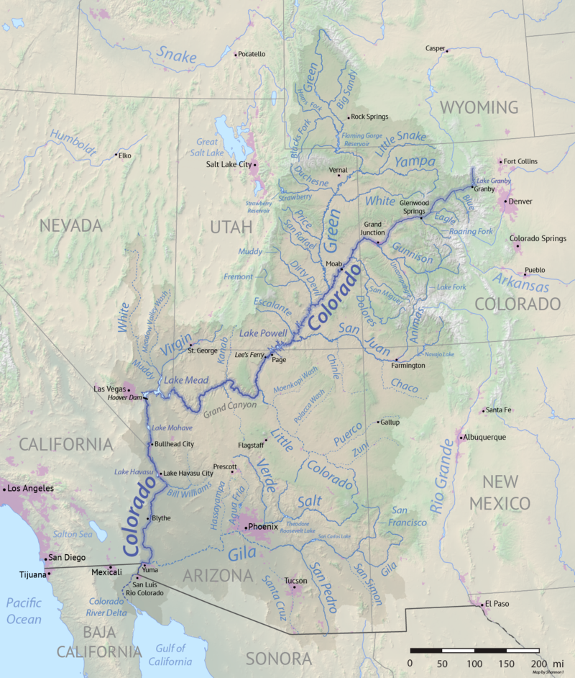
Colorado River Basin
Rivers Colorado, Rio Grande, Tijuana, Yaqui are rivers shared by Mexico and the United States of America.
The International Boundary and Water Commission (IBWC) - Comisión Internacional de Límites y Aguas entre México y Estados Unidos (CILA) govern all these rivers shared by the two countries.
Interstate Compact signed in 1922
Upper Basin States, 7.5 x10⁶ ac-ft/year Total
Lower Basin States, 7.5 x10⁶ ac-ft/year Total
State | Allocation (%) | Allocation x10⁶ ac-ft
Colorado | 51.8 | 3.86
Utah | 23.0 | 1.71
Wyoming | 14.9 | 1.04
New Mexico | 11.3 | 0.84
Arizona | 0.5 | 0.05
State | Allocation (%) | Allocation x10⁶ ac-ft
California | 58.7 | 4.4
Arizona | 37.3 | 2.8
Nevada | 4.0 | 0.3
Treaty signed in 1944
Mexico 1.5x10⁶ ac-ft/year
https://en.wikipedia.org/wiki/Colorado_River_Compact
https://en.wikipedia.org/wiki/Colorado_River_Compact#/media/File:Colorado_River_basin_map.png
Nebiyu Daniel Tiruneh: 2020 International Conference on the Nile and Grand Ethiopian Renaissance Dam: Science, Conflict Resolution and Cooperation
Notes:
https://wrrc.arizona.edu/publications/arroyo-newsletter/sharing-colorado-river-water-history-public-policy-and-colorado-river
By the early 1920s, the Colorado Basin states were anxious about their share of the Colorado River. Then, as now, California's growth was viewed with concern.
The compact between states was signed on November 24, 1922. Wyoming, Colorado, Utah, New Mexico, California, Arizona, Nevada
Concern turned to alarm when the U.S. Supreme Court ruled in June 1922 that the law of prior appropriation applied regardless of state lines. A fast-growing state, i.e. California, could then establish priority use of Colorado River water to the extreme disadvantage of slower growing states in the upper basin.
Recognizing the likelihood of a Colorado River treaty with Mexico the compact designated that water for that country would come from unallocated "surpluses" then thought to be available. Upper and Lower Basin states would equally make up any resulting "deficiency." A 1944 U.S-Mexico treaty allocated 1.5 maf of Colorado River water to Mexico. In the absence of surpluses, it would seem that the Upper and Lower Basin states, according to the compact, must each provide 750,000 af for Mexican use. Some say this would be a priority even during severe, sustained drought.
The compact directs the Upper Basin states to deliver 75 maf in any ten-year period to the Lower Basin states. To help the Upper Basin states make good this obligation, the Colorado River Storage Project Act of 1956 authorized four projects. In the event of a severe drought, the Upper Basin states might need to curtail water use to fulfill their delivery obligation.
Mexico gets 1.5 MAF per year pursuant to the treaty relating to the use of waters of the Colorado and Tijuana rivers and of the Rio Grande, signed February 3, 1944, and its supplementary protocol signed November 14,

Slide 15
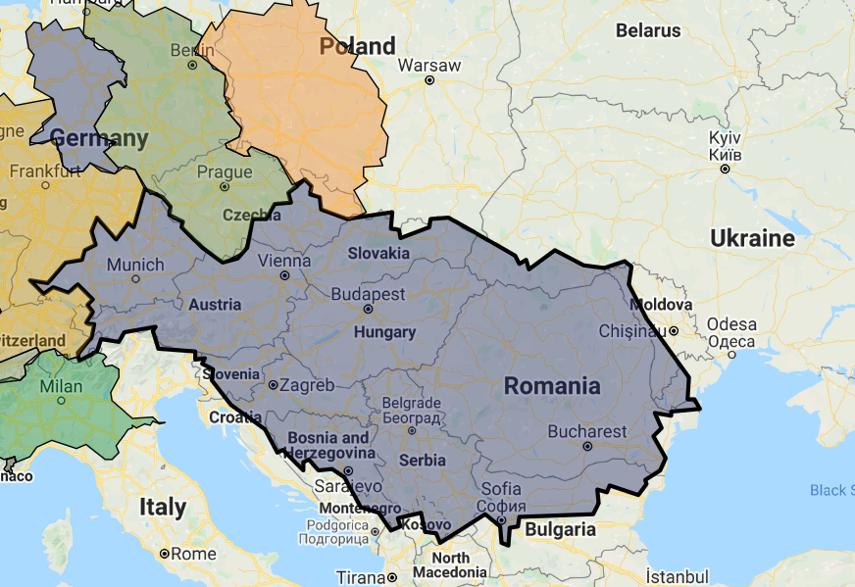
Danube River Basin
Governed by multilateral agreements since 1856
Non-navigational use governed by the Convention on Cooperation for the Protection and Sustainable Use of the Danube (the “Convention” or “DRPC”), signed on 29 June 1994 and entered into force in October 1998.
DRPC established the International Commission for the Protection of the Danube River (“ICPDR” or “Commission”).
The DRPC and ICPDR Contracting Parties are Austria, Bosnia-Herzegovina, Bulgaria, Croatia, the Czech Republic, Germany, Hungary, Moldova, Montenegro, Romania, Serbia, the Slovak Republic, Slovenia, and Ukraine.
Provides mechanisms for:
Dispute Resolution,
Data Information Sharing, Exchange, and Harmonization
Funding and Financing
Benefit Sharing
Compliance and Monitoring
DANUBE
Area: 797,335 km²
Countries
Ukraine; Romania; Albania; Italy; Czech Republic; Kosovo; Poland; Montenegro; Macedonia; Moldova; Slovenia; Austria; Croatia; Bosnia and Herzegovina; Hungary; Switzerland; Germany; Republic of Serbia; Slovakia; Bulgaria
http://www.internationalwatersgovernance.com/danube-river-basin.html
http://www.icpdr.org/.
Nebiyu Daniel Tiruneh: 2020 International Conference on the Nile and Grand Ethiopian Renaissance Dam: Science, Conflict Resolution and Cooperation
Notes:
Governed by multilateral agreements and various forms of international administration almost continuously since 1856
Currently, the non-navigational use of waterways in the Danube River Basin is governed by the Convention on Cooperation for the Protection and Sustainable Use of the Danube (the “Convention” or “DRPC”), signed on 29 June 1994 in Sofia, Bulgaria. Entered into force in October 1998.
DRPC established the International Commission for the Protection of the Danube River (“ICPDR” or “Commission”).
The DRPC and ICPDR Contracting Parties are Austria, Bosnia-Herzegovina, Bulgaria, Croatia, the Czech Republic, Germany, Hungary, Moldova, Montenegro, Romania, Serbia, the Slovak Republic, Slovenia, and Ukraine.

Slide 16
Jordan River Basin
Diverse ecosystem, extreme seasonal and annual variability of river flow (ex- 40% of annual flow in February, but 3-4% in summer and autumn when needed most.
Surface water 35%, groundwater 56% of the water resources of the basin.
Several dams on the river (IR, HY, WS, FP, RE, NAV)
Water quality an issue (esp. Lake Tiberias)
The 1994 peace agreement between Jordan and Israel has provisions for the alleviation of water shortages ➔ created a Joint Water Committee (JWC).
The treaty specifies allocations of the Yarmouk River and groundwater abstraction.
includes other alternative and innovative ways of sharing resources.
Upper Tributaries
Hasbani: Emerging in Lebanon, flowing mostly in Lebanon.
Banyas: Emerging and flowing in Syria.
Dan: Emerging and flowing inside Israel.
The three tributaries meet at a location inside Israel and form the beginning of the Jordan River
Lower Tributaries
Yarmouk: Four tributaries in Syria, one in Jordan, flowing in a gorge where the common borders are located. Downstream it forms the borders between Jordan and Israel.
Area = 18,500 km²
40% - Jordan
37% - Israel
10% - Syria
9% - West Bank
4% - Lebanon
http://www.fao.org/nr/Water/aquastat/basins/jordan/jordan-CP_eng.pdf
Nebiyu Daniel Tiruneh: 2020 International Conference on the Nile and Grand Ethiopian Renaissance Dam: Science, Conflict Resolution and Cooperation
Notes:
In the Jordan River Basin, the relationship between Israel and Jordan dominates the hydro-regime.
The 1994 peace agreement between Jordan and Israel introduced provisions for the alleviation of water shortages.
The agreement:
allocates fixed volumes of water, as opposed to a more flexible strategy,
includes other alternative and innovative ways of sharing resources such as
clauses indicating strategic cooperation over desalination and wastewater reclamation;
exchange of diversions to Jordan from Lake Kineret in the north of Israel for the same amount of groundwater pumped by Israel in the Arava Valley;
joint projects to find new water sources during drought years; and permanent supplies to meet the needs of both sides during dry periods.

Slide 17
Indus River Basin
Diverse ecosystem that extends from the Himalayas to the dry alluvial plains of Sindh province in Pakistan.
Climate varies –subtropical to semi-arid.
Surface water: glacier melt, snowmelt, rainfall and runoff.
Extensive aquifer (16.2 million ha.)
Irrigation boundaries resulted in Indo-Pakistan water dispute (1948) [India unilaterally cut off supply to Pakistan canals].
Indus Water Treaty (1960).
Indus Basin Project (1960-1971): 8 canals, 6 barrages, 3 dams, 4 remodeling of existing works.
Extensive developments resulted in Pakistan owning the world’s largest contiguous irrigation system.
Two main tributaries
Kabul (on the right bank)
Panjnad (on the left bank)
Area = 1.12 million km²
47% - Pakistan
39% - India
8% - China
6% - Afghanistan
The Sutlej Valley Project (1933) [4 barrages, 2 canals]
Kotri, Taunsa and Guddu barrages (1958) [controlled irrigation]
The Indus Basin Project (1960-1971) two major storage reservoirs Jhelum (Mangla0 and Indus (Tarbela)
http://www.fao.org/nr/water/aquastat/basins/indus/indus-CP_eng.pdf
Nebiyu Daniel Tiruneh: 2020 International Conference on the Nile and Grand Ethiopian Renaissance Dam: Science, Conflict Resolution and Cooperation

Slide 18
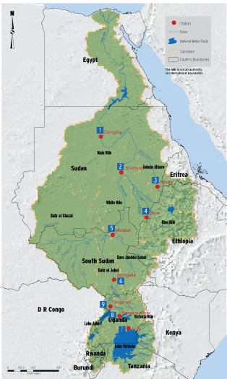
Nile River Basin
River Length: 6,695 km
Area of the Nile Basin: 3,176,541 km²
Population: 257 million
Country Estimated Total Area Area in the Nile Basin
(of total basin Area) (of total country area)
(km²) (km²) (%) (%)
Eleven countries share the river: Burundi, the Democratic Republic of the Congo, Egypt, Eritrea, Ethiopia, Kenya, Rwanda, the Sudan, South Sudan, the United Republic of Tanzania and Uganda.
Burundi 27,834 13,860 0.44 49.39
DR Congo 2,345,410 21,796 0.69 0.91
Egypt 996,960 302,452 9.52 30.34
Eritrea 121,722 25,697 0.81 21.11
Ethiopia 1,144,035 365,318 11.50 31.93
Kenya 593,116 51,363 1.62 8.66
Rwanda 26,338 20,625 0.65 84.01
South Sudan 644,329 620,626 19.54 97.71
Sudan 1,864,049 1,396,230 43.95 74.90
Tanzania 945,000 118,507 3.73 12.69
Uganda 241,248 240,067 7.56 99.51
Total 3,176,541
The Nile Basin Initiative (NBI) is an inter-governmental partnership of 10 Nile Basin countries namely; Burundi, DRCongo, Egypt, Ethiopia, Kenya, Rwanda, South Sudan, The Sudan, Tanzania and Uganda, established on 22nd February,1999. Eritrea participates as an observer.
https://atlas.nilebasin.org/start/
Nebiyu Daniel Tiruneh: 2020 International Conference on the Nile and Grand Ethiopian Renaissance Dam: Science, Conflict Resolution and Cooperation
https://nilebasin.org/atlas/wp-content/uploads/2017/03/Political-Map-vivek-747x1024.jpg

Slide 19
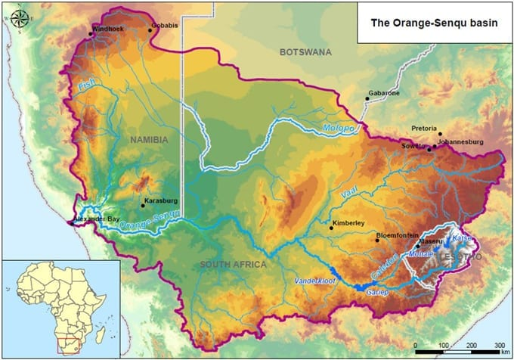
Orange-Senqu River Basin
The total Orange-Senqu River basin extends over four countries, Botswana, Lesotho, Namibia, and South Africa
Total Area = 1,000,000 km²
South Africa: 64.2% Namibia: 24.5%
Botswana: 7.9% Lesotho: 3.4%
‘Agreement for the Establishment of the Orange-Senqu Commission’ (November 3, 2000)
The Orange-Senqu River Commission (ORASECOM) promotes the equitable and sustainable development of the resources of the Orange-Senqu River.
ORASECOM agreement refers to, and recognizes the following agreements:
Helsinki Rules (1966)
UN Convention on Non-Navigational Uses of International Watercourses (1997)
The SADC Revised Protocol on Shared Watercourse Systems (2000)
http://orasecom.org/
https://infrastructurenews.co.za/wp-content/uploads/sites/4/2016/12/Orange-Senqu-River-Basin.jpg
Nebiyu Daniel Tiruneh: 2020 International Conference on the Nile and Grand Ethiopian Renaissance Dam: Science, Conflict Resolution and Cooperation

Slide 20
QUANTIFYING COOPERATION
Supporting Mechanism to Establish A Decision Support Tool
Nebiyu Daniel Tiruneh: 2020 International Conference on the Nile and Grand Ethiopian Renaissance Dam: Science, Conflict Resolution and Cooperation
Notes:
The Water Cooperation Quotient developed by the Strategic Foresight Group is one approach.
WCQ distinguishes between basic and active water cooperation, between technical and political dynamics and between routine and effective actions
WCQ is indicative of the fact that countries engaged in active, dynamic, politically driven water cooperation are not likely to engage in conflicts that are based on shared water resources.

Slide 21
Water Cooperation Quotient
Agreement
Communication mechanism
Technical projects
Exchange of data
Alternative dispute resolution
Floods, droughts and ecosystem protection
Water infrastructure
Inclusion
Political commitment
Institutional functioning
The WCQ distinguishes between:
basic and active water cooperation
technical and political dynamics and
routine and effective actions
WCQ of a riparian nation is computed using ten parameters. These parameters are indicative of water cooperation in the technical and the political realm.
Riparian countries with
WCQ < 23.33 are likely to face the risk of war.
WCQ ≥ 50 likely to enjoy a relatively peaceful and stable relationship and zero risk of war.
https://www.strategicforesight.com/publication_pdf/Water%20Cooperation%20Quotient%202017.pdf
Nebiyu Daniel Tiruneh: 2020 International Conference on the Nile and Grand Ethiopian Renaissance Dam: Science, Conflict Resolution and Cooperation
Notes:
Agreement: The riparian countries have a legally binding agreement acknowledging the water relationship between them. The agreement may provide for allocation of water resources or for cooperation with or without any reference to allocation
Communication mechanism: There is a mechanism for regular and formal communication between riparian countries in various forms, including meetings of officials of water ministries. The mechanism may include meetings of Water Ministers, but not other ministers such as Foreign Ministers and Finance Ministers and certainly not Heads of Government. The mechanism may be in the form of committees within respective water ministries.
Technical Projects: The riparian countries engage in collaborative scientific and technical projects in relation to their shared watercourse such as small demonstration projects relating to navigation, irrigation, electricity or livelihood creating activities. It is to be noted that these projects are not those that are carried out by individual countries domestically but are those that are either basin wide or international in nature and are often implemented by or through River Basin Organisation or River Basin Commission (RBO/RBCs) or jointly by the riparian countries. It is to be further noted that these projects are different from large infrastructure projects.
Exchange of data: The riparian countries agree to exchange data on quantity and quality of shared water resources where the data is collected nationally, but exchanged on a regular basis through an agreed channel or it is collected and shared through a basin organization.
Alternative Dispute Resolution: The riparian countries have a well-defined mechanism for resolving disputes, which could be either through a River Basin Organisation, to which they belong, or through reference to a specific third party. If the countries approach the International Court of Justice (ICJ) to complain against other riparian countries, it is not to be taken into account in this context.
Floods, Droughts and Ecosystem Protection: The riparian countries agree on long term coordination and cooperation mechanisms to manage floods, drought and ecosystem in a collaborative way, including early warning, rapid response, pollution control, coordination on deforestation, coordination on farming patterns and agricultural trade, and explicit long term coordination mechanism for emergency response.
Water Infrastructure: Riparian countries agree that all infrastructure related to transboundary water resources such as dams, reservoirs, irrigation networks, navigation are built with active collaboration and transparency in a way that takes into account the interest of all relevant riparian countries and not merely the host country of the concerned project. They could have any one of the following: a. Infrastructure in any country built only with prior approval and consent of other riparian countries. b. Infrastructure built through joint or coordinated planning; joint investment. c. Infrastructure that have joint ownership. It is essential however, that the countries have no other projects that do not have prior approval and have been built over the objections of any of the other riparians.
Inclusion: All countries in the basin, without exception, are members of the regional or basin wide arrangement.
Political Commitment: The riparian countries commit to cooperate at the highest political level with either one or both of the following components: 1. Regular engagement at a level higher than Water Ministers, such as: a) Foreign Ministers b) Heads of Governments And/Or 2. Co-ordination and harmonization of national laws/policies to satisfy common standards.
Institutional Functioning: The riparian countries have (a) A permanent, independent and joint organisation for transboundary water cooperation such as a River Basin Organisation with an independent secretariat or (b) Permanent, though separate entities located in the respective riparian countries, acting as a joint mechanism for water governance, and having regular formal communication in the form of meetings and approval authority for projects in any of the countries In addition and essentially, The riparian countries make joint strategic plans and implement them ensuring that the projects are executed within an agreed time frame and are not reduced to mere statements of intention.

Slide 22
Scoring and WCQ
Agreement
Communication mechanism
Technical projects
Exchange of data
Alternative dispute resolution
Floods, droughts and ecosystem protection
Water infrastructure
Inclusion
Political commitment
Institutional functioning
Nebiyu Daniel Tiruneh: 2020 International Conference on the Nile and Grand Ethiopian Renaissance Dam: Science, Conflict Resolution and Cooperation

Slide 23
WCQ Comparison: Colorado River Basin
Colorado, Rio Grande, Tijuana, Yaqui.
Countries: Mexico-United States of America (USA)
Authority: International Boundary and Water Commission (IBWC) - Comisión Internacional de Límites y Aguas entre México y Estados Unidos (CILA)
Nebiyu Daniel Tiruneh: 2020 International Conference on the Nile and Grand Ethiopian Renaissance Dam: Science, Conflict Resolution and Cooperation

Slide 24
WCQ Comparison: Danube River Basin
Danube
Countries: Austria, Bosnia and Herzegovina, Bulgaria, Croatia, Czech Republic, Germany, Hungary,
Moldova, Montenegro, Romania, Serbia, Slovakia, Slovenia, Ukraine
Authority: International Commission for the Protection of the Danube River (ICPDR)
Nebiyu Daniel Tiruneh: 2020 International Conference on the Nile and Grand Ethiopian Renaissance Dam: Science, Conflict Resolution and Cooperation

Slide 25
WCQ Comparison: Jordan River Basin
Jordan River*
Countries: Israel, Jordan, Lebanon, Syria**
Authority:
Israel-Jordan: Israeli-Jordanian Joint Water Committee
Israel-Lebanon: No cooperation
Nebiyu Daniel Tiruneh: 2020 International Conference on the Nile and Grand Ethiopian Renaissance Dam: Science, Conflict Resolution and Cooperation

Slide 26
WCQ Comparison: Indus River Basin
Indus
Countries: Afghanistan, China, India, Pakistan
Authority:
India-Pakistan: Permanent Indus Commission between India and Pakistan
Afghanistan-Pakistan: No cooperation
China-India: No authority
Nebiyu Daniel Tiruneh: 2020 International Conference on the Nile and Grand Ethiopian Renaissance Dam: Science, Conflict Resolution and Cooperation

Slide 27
WCQ Comparison: Nile River Basin
Nile
Countries: Burundi, Democratic Republic of the Congo (DRC), Egypt*, Eritrea**, Ethiopia, Kenya, Rwanda, South Sudan, Sudan, Tanzania, Uganda
Authority: Nile Basin Initiative (NBI)
Egypt-Sudan: Permanent Joint Technical Commission for the Nile Waters (PJTC)
Nebiyu Daniel Tiruneh: 2020 International Conference on the Nile and Grand Ethiopian Renaissance Dam: Science, Conflict Resolution and Cooperation

Slide 28
WCQ Comparison: Okavango and Orange
WCQ 50
Orange
Countries: Botswana, Lesotho, Namibia, South Africa
Authority: Orange-Senqu River Commission (ORASECOM)
Okavango
Countries: Angola, Botswana, Namibia, Zimbabwe*
Authority: Permanent Okavango River Basin Water Commission (OKACOM)
WCQ 73.33
Nebiyu Daniel Tiruneh: 2020 International Conference on the Nile and Grand Ethiopian Renaissance Dam: Science, Conflict Resolution and Cooperation

Slide 29
Lessons learned
  Water resources have been bones of contention as well as entry points of overall cooperation.
  Equitable and reasonable sharing is a core principle that needs to be an integral component of agreements.
  Agreements are absolutely necessary and delays are the forebearers of wasted opportunities in terms of cooperative economic development.
  It is important to have a regional sustainable view of water resources development.
  International cooperation and treaty mechanisms provide a good starting point for regional cooperation agreements
  Treaties need to have clearly defined arbitration rules and remedial measures
  Sharing both costs and benefits enhances cooperation.
  Climate change and ecosystem considerations need to be addressed in regional agreements
  It is important to contextualize water use on the basis of appropriate technology and resource development.
Nebiyu Daniel Tiruneh: 2020 International Conference on the Nile and Grand Ethiopian Renaissance Dam: Science, Conflict Resolution and Cooperation

Slide 30
Points to ponder
Transboundary lake and river basins account for an estimated 60 per cent of global freshwater flow and is home to 40 per cent of the world’s population. (UN-Water: Transboundary Waters: Sharing Benefits, Sharing Responsibilities, 2008)
An estimated 148 states have international basins within their territory, and 21 countries lie entirely within them. (4th UN World Water Development Report, 2012)
Around 60 per cent of the world’s international river basins lack any type of cooperative management framework. (4th UN World Water Development Report, 2012)
In the 20th century, only seven minor skirmishes took place between nations over shared water resources, while over 300 treaties were signed during the same period of time. (UN-Water: Transboundary Waters: Sharing Benefits, Sharing Responsibilities, 2008)
There are numerous examples where transboundary waters have proved to be a source of cooperation rather than conflict. (4th UN World Water Development Report, 2012). However, failure to engage the basin hegemon constructively will hamper effective cooperation on transboundary waters. (SIWI: Addressing Power Asymmetry: How Transboundary Water Management May Serve to Reduce Poverty, 2011)
There are several ways that improved transboundary water management arrangements may bring about benefits for poor people living within shared basins. More equitable and efficient water sharing amongst farmers across borders, for example, can lead to more sustainable water use and more secure yields. (SIWI: Addressing Power Asymmetry: How Transboundary Water Management May Serve to Reduce Poverty, 2011
https://www.siwi.org/facts-and-statistics/5-transboundary-waters/
Nebiyu Daniel Tiruneh: 2020 International Conference on the Nile and Grand Ethiopian Renaissance Dam: Science, Conflict Resolution and Cooperation

Slide 31
Thank You
Nebiyu Daniel Tiruneh: 2020 International Conference on the Nile and Grand Ethiopian Renaissance Dam: Science, Conflict Resolution and Cooperation

