Slide 1
Water Management Priorities for Sustainable Socio-Economic Development
Muluneh Imiru
South Florida Water Management District

Slide 2
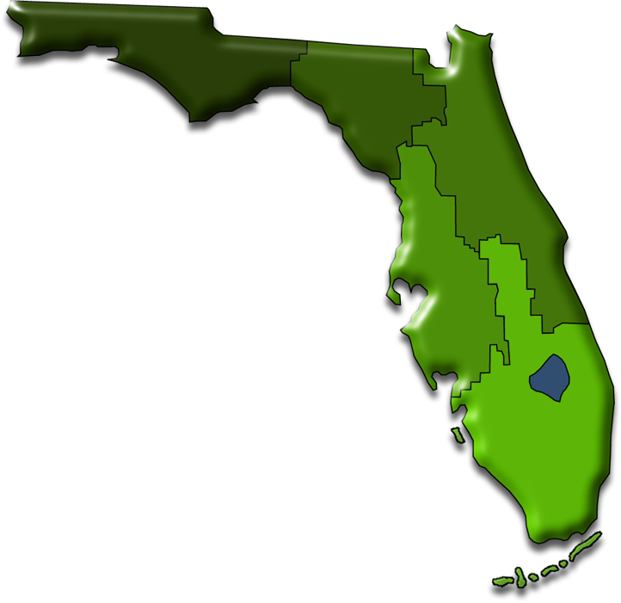
The South Florida
Water Management District:
Oversees water resources in the southern half of the state
Oldest and largest of Florida’s five water management districts
Established by the legislature
Notes:
The South Florida Water Management District is a regional, governmental agency that oversees the water resources in the southern half of the state. It is the oldest and largest of Florida's five water management districts. We are established by the legislature and recognized in the constitution.
Each district oversees water and land-related resources for:
Water quality
Flood protection
Natural systems
Water supply
Headquartered in West Palm Beach, the South Florida Water Management District covers 18,000 square miles. That's larger than Connecticut, Delaware and Maryland combined. And with a population of more than 7 million people, the 16-county region could be the nation's 14th largest state.

Slide 3
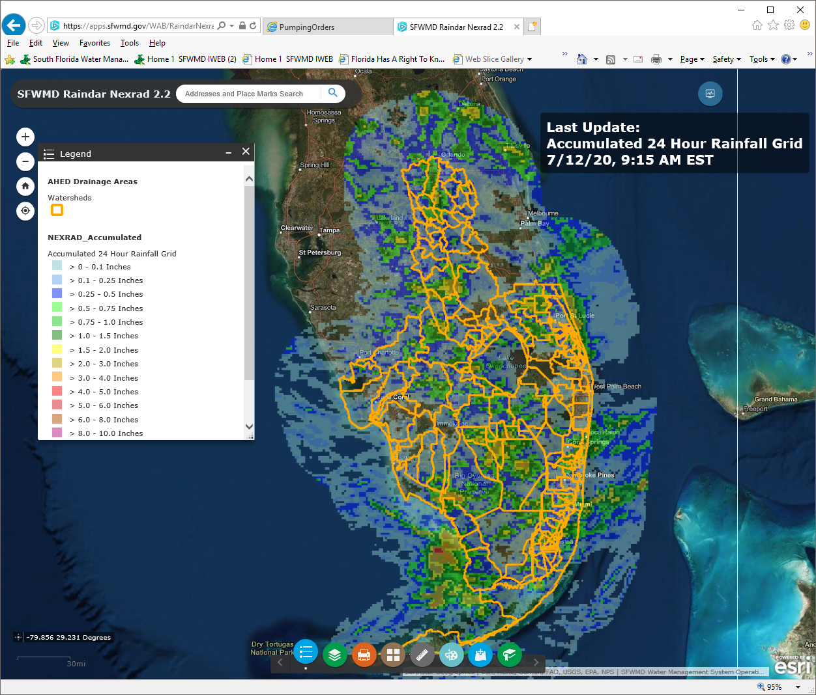

Slide 4

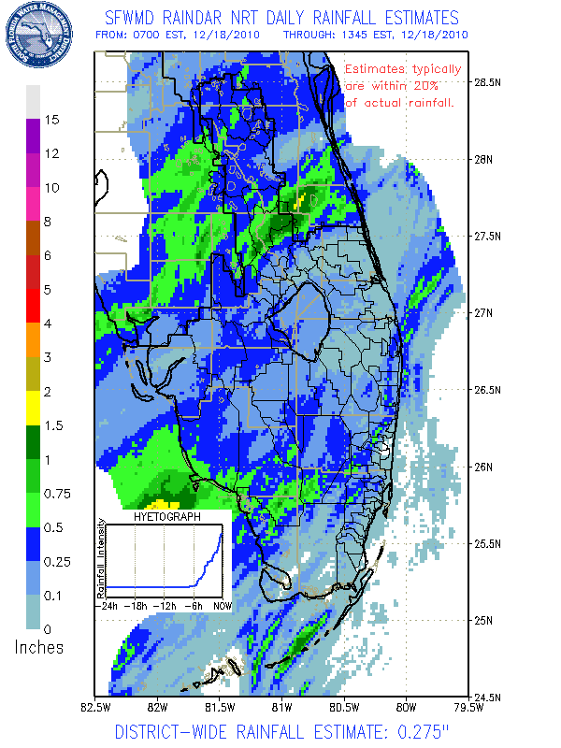
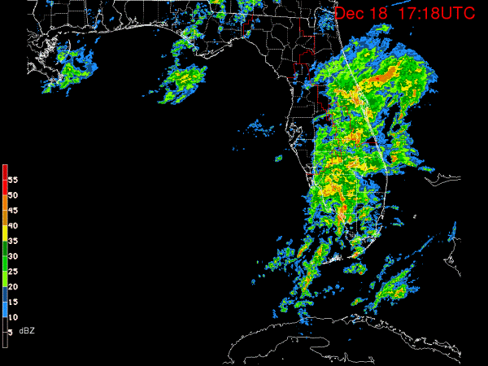
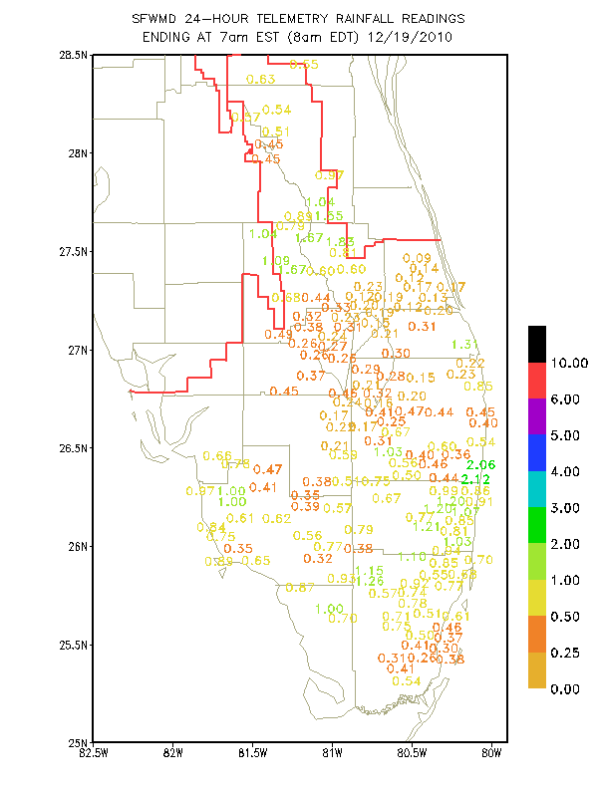
Analyze Previous Rainfall:
Radar, Raingages, Raindar

Slide 5
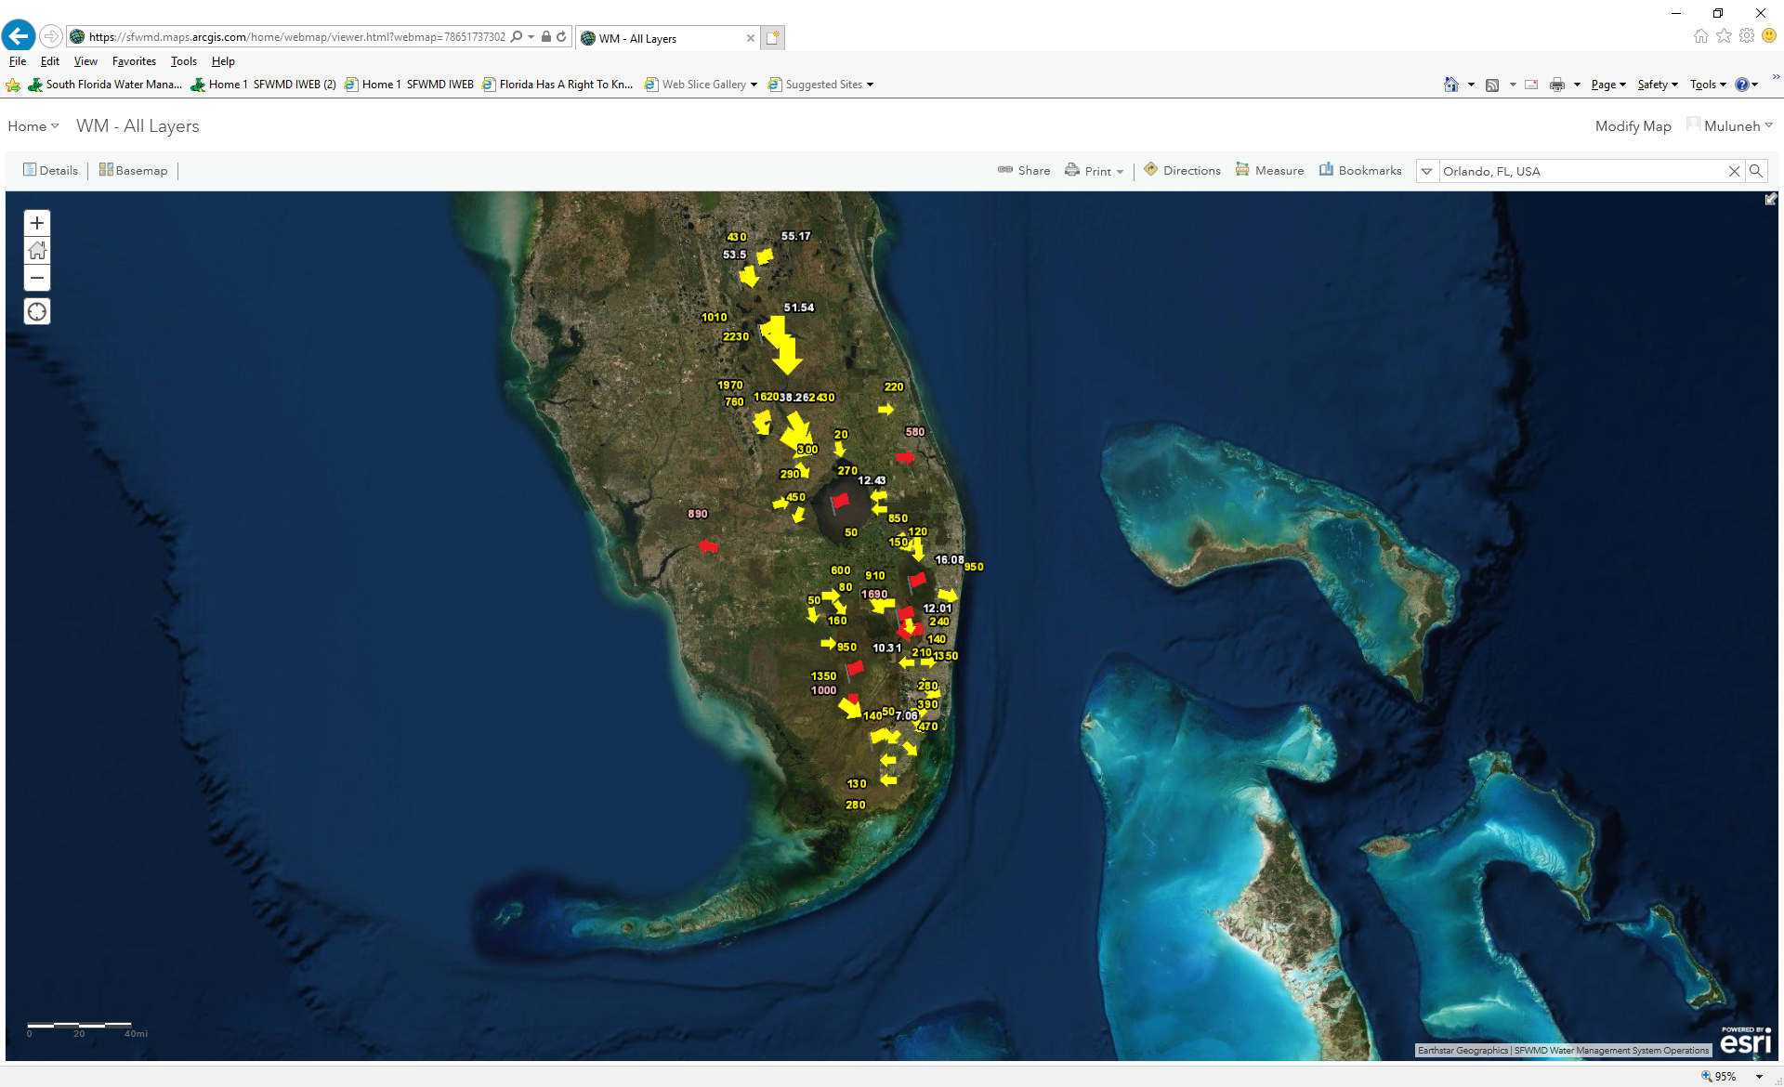
SFWM SYSTEM

Slide 6
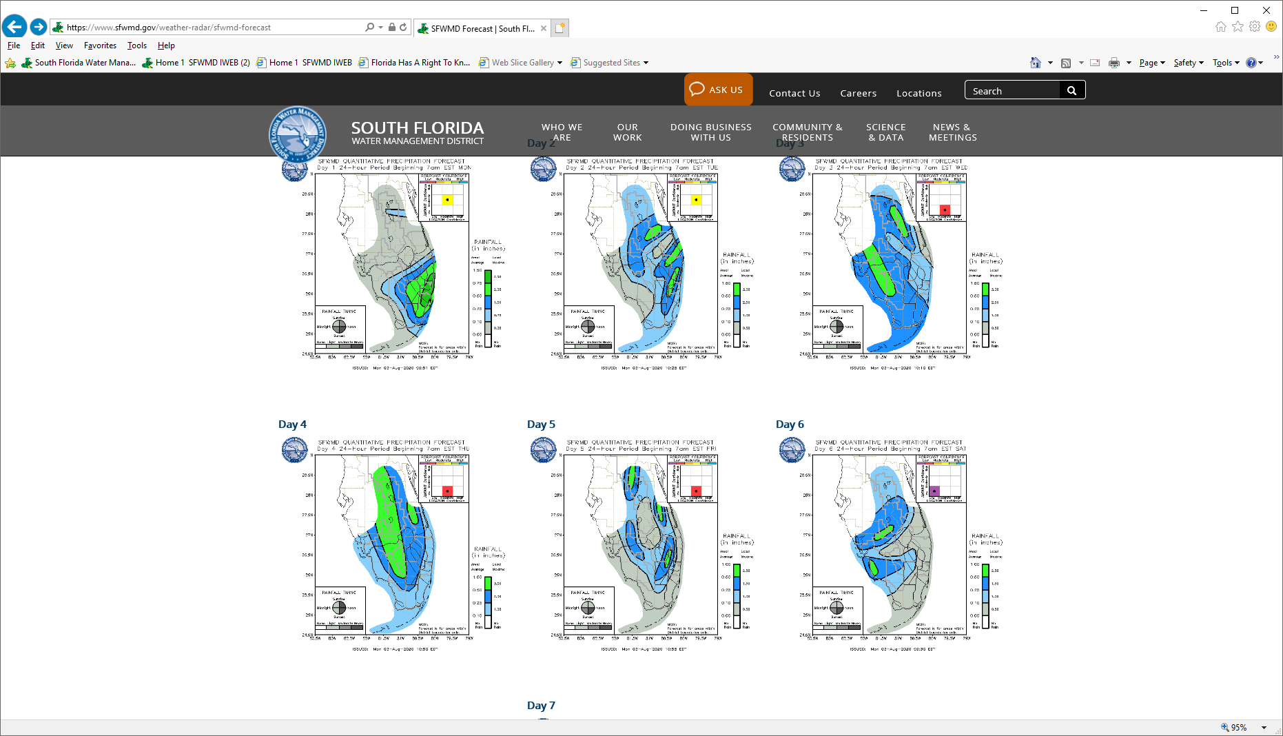
Weather forecast

Slide 7
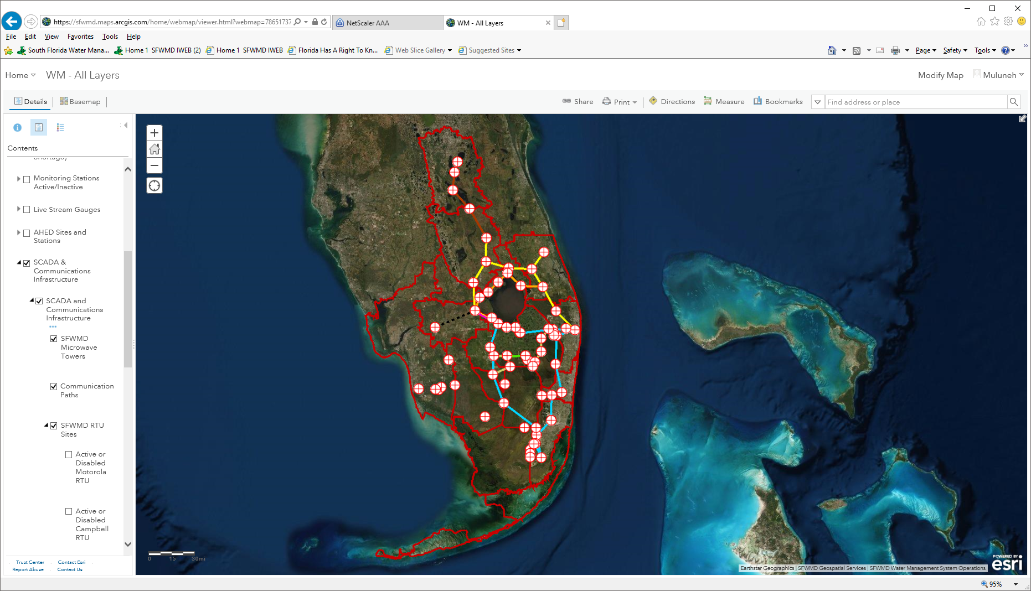
DATA ACQUISITION & TRANSMISSION

Slide 9
Review External Information & Criteria

Slide 10
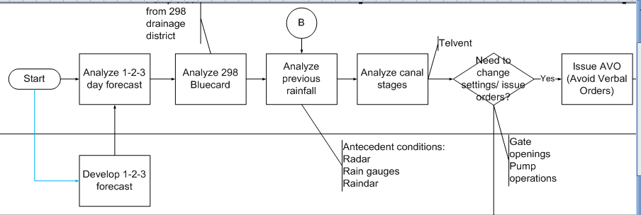
Brief on process from Start to Finish
- Major Inputs to Process
ROLE: Water Managers

Slide 11
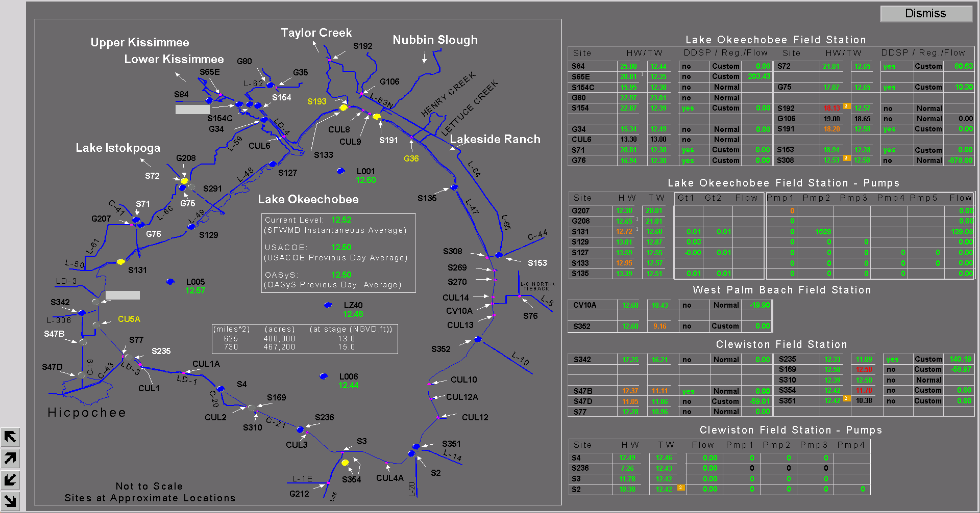
REAL-TIME DATA AND OPERATION

Slide 12
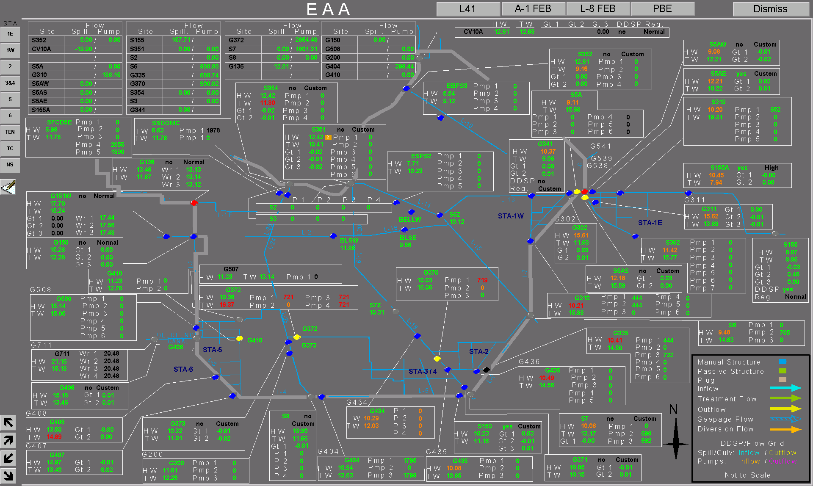

Slide 13
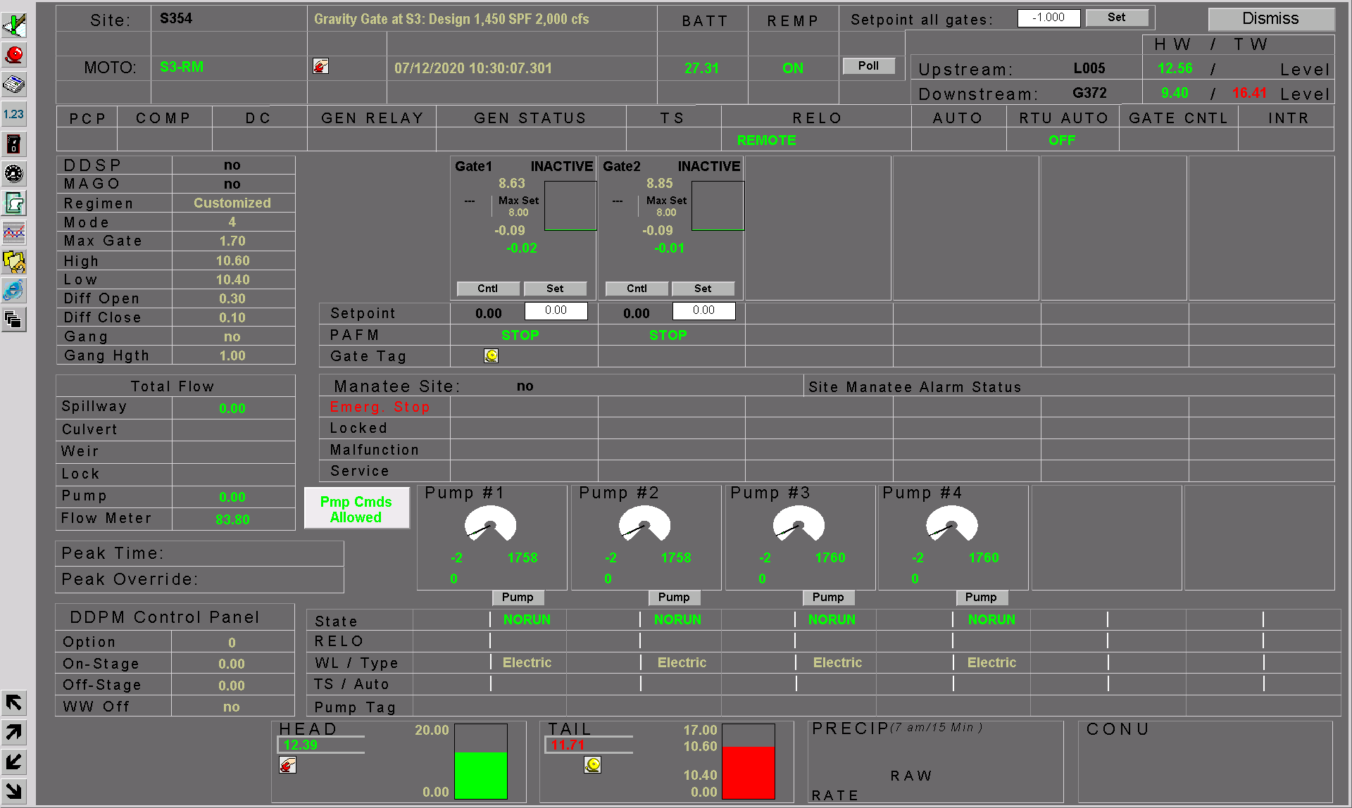

Slide 14


Slide 15
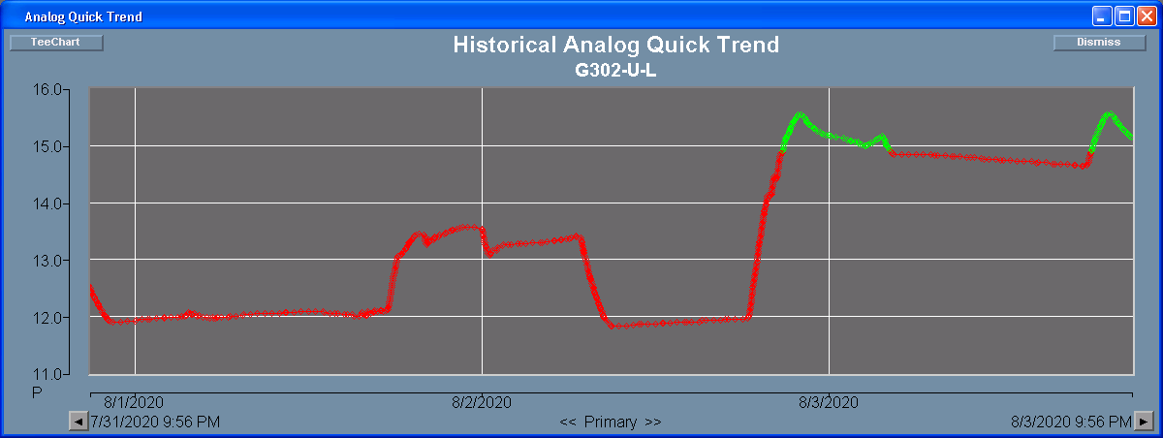

Slide 16
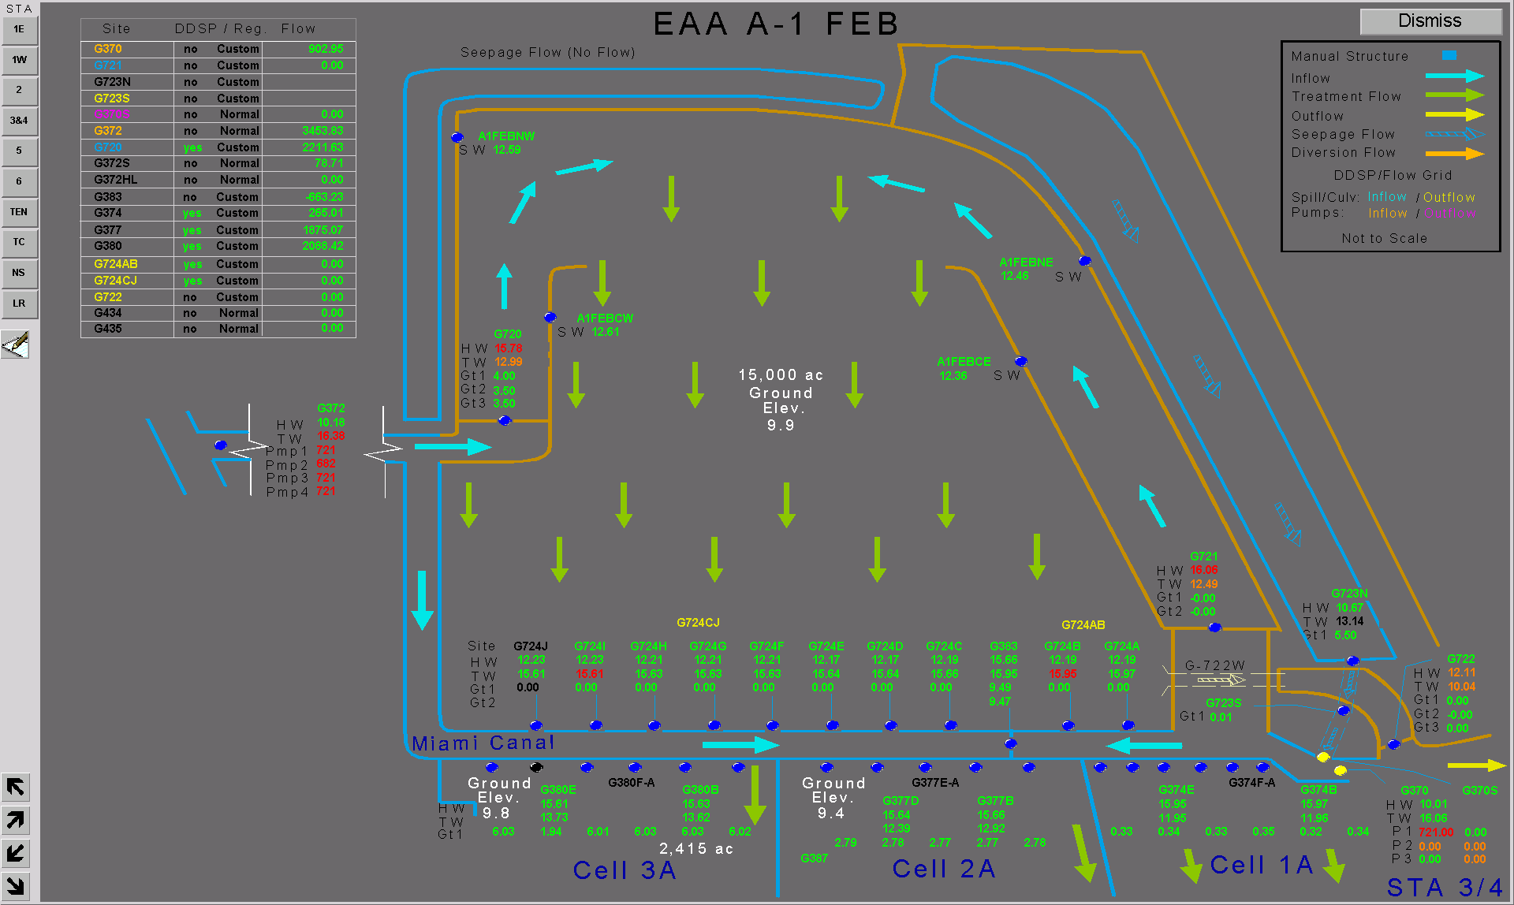

Slide 17
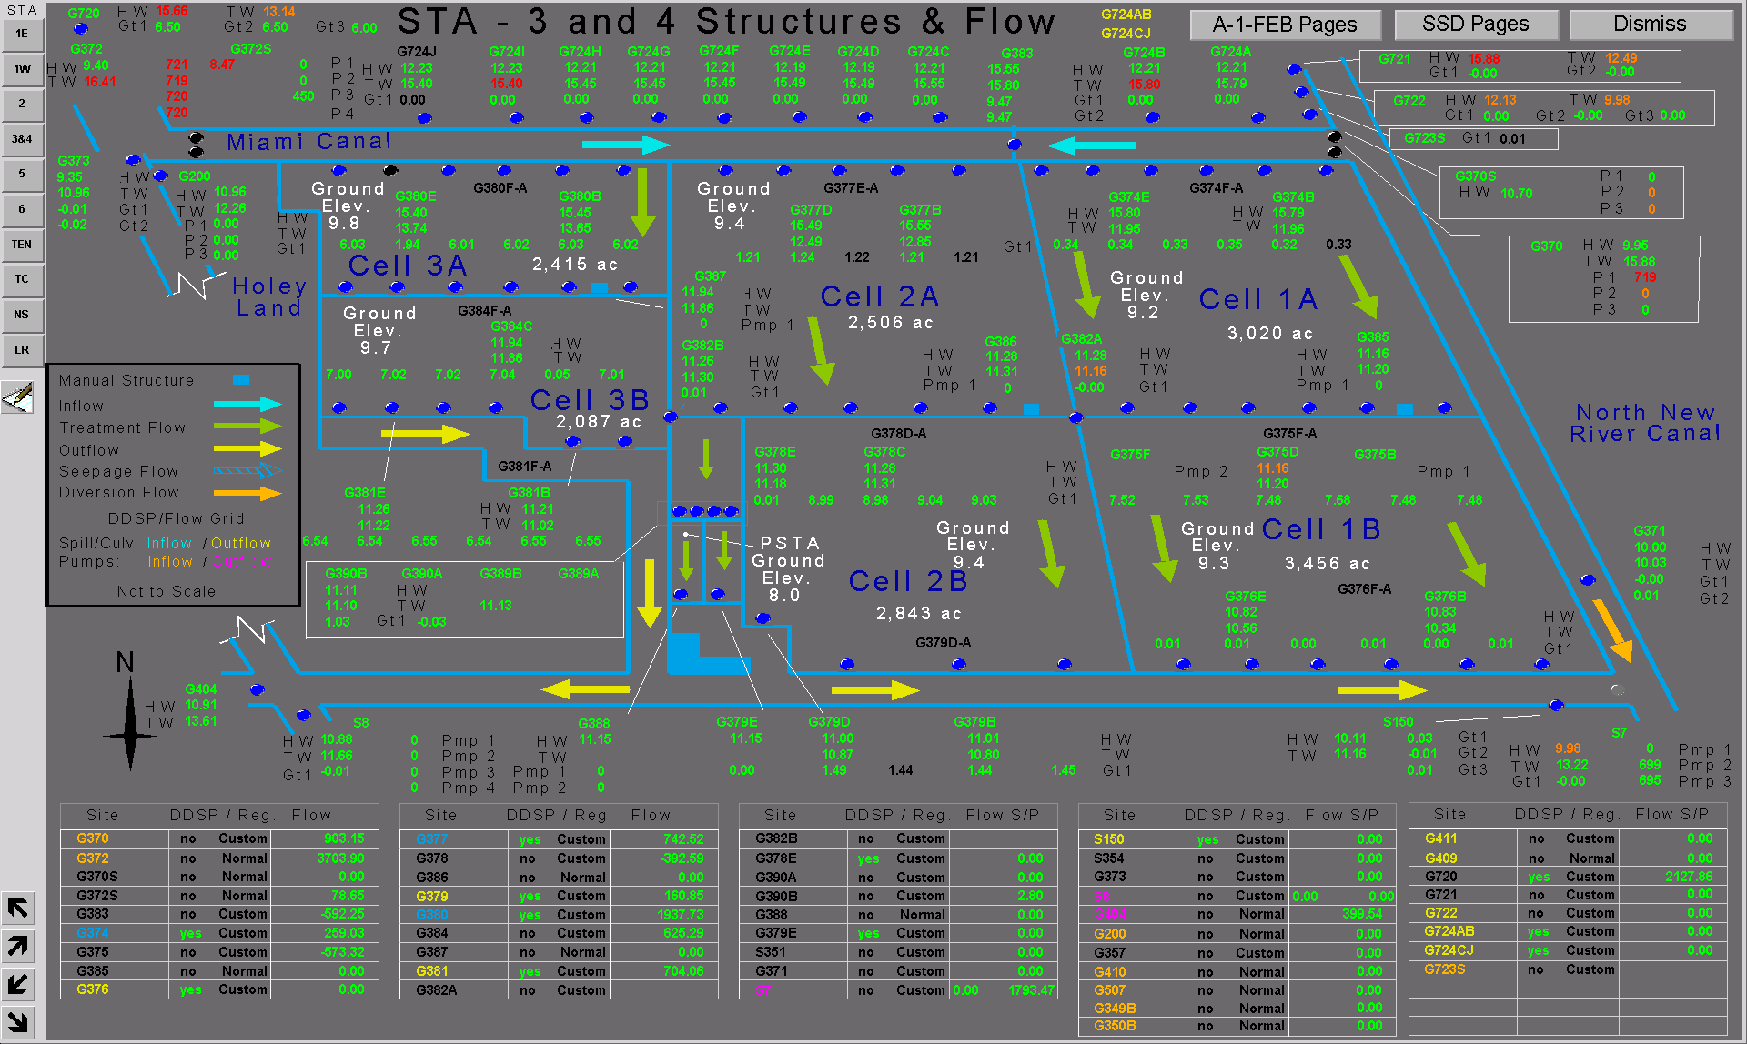

Slide 18

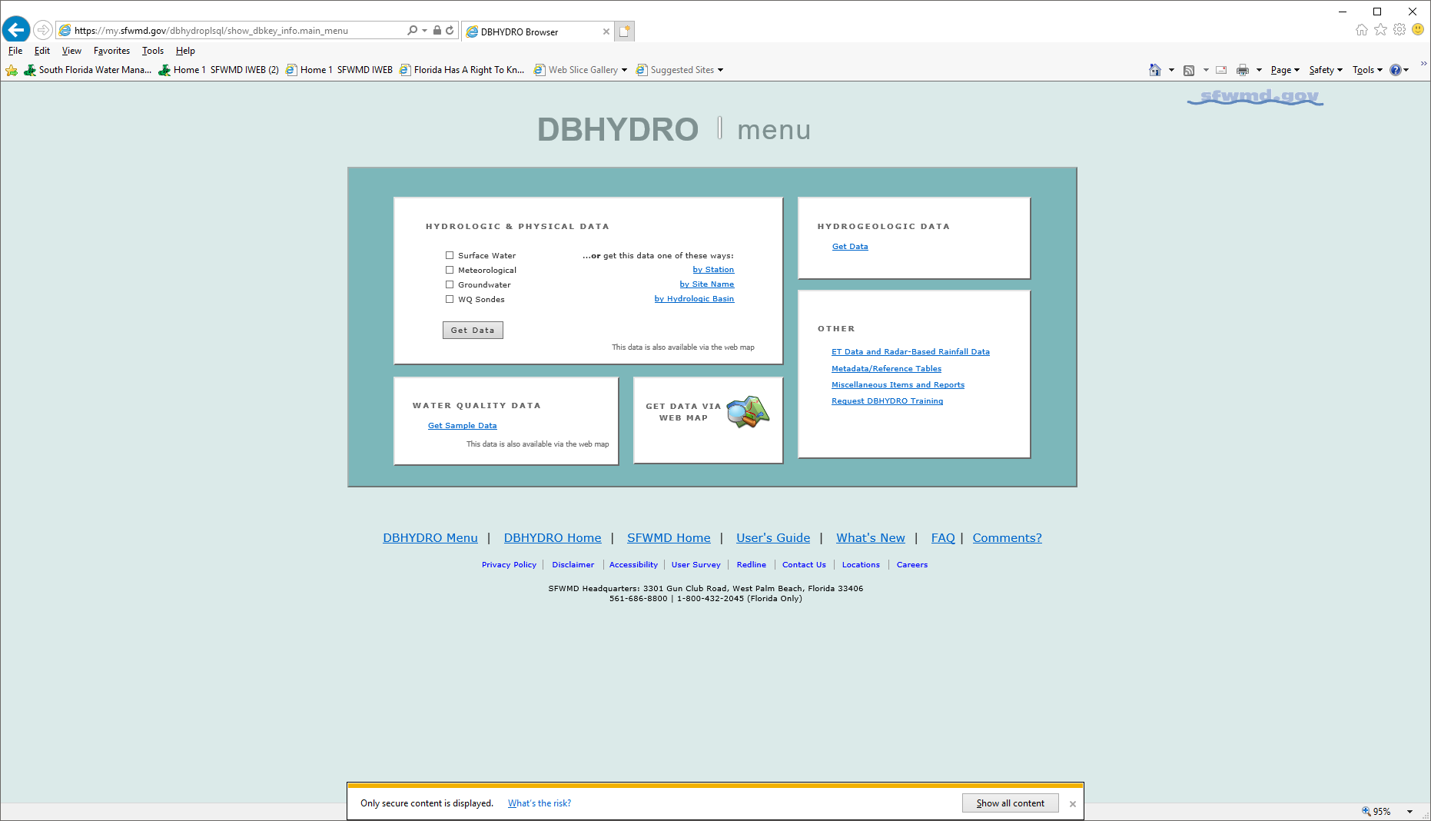
Database
DATA ARCHIVAL AND USE

Slide 19
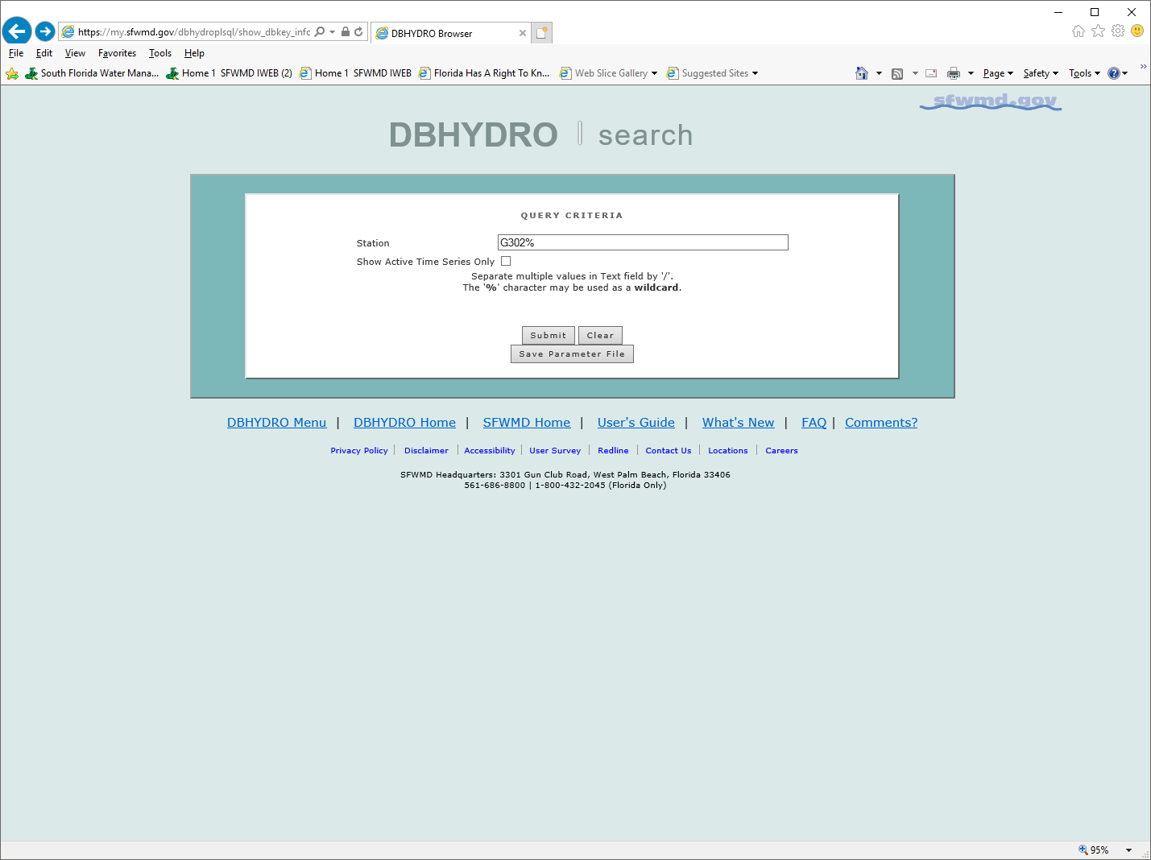

Slide 20
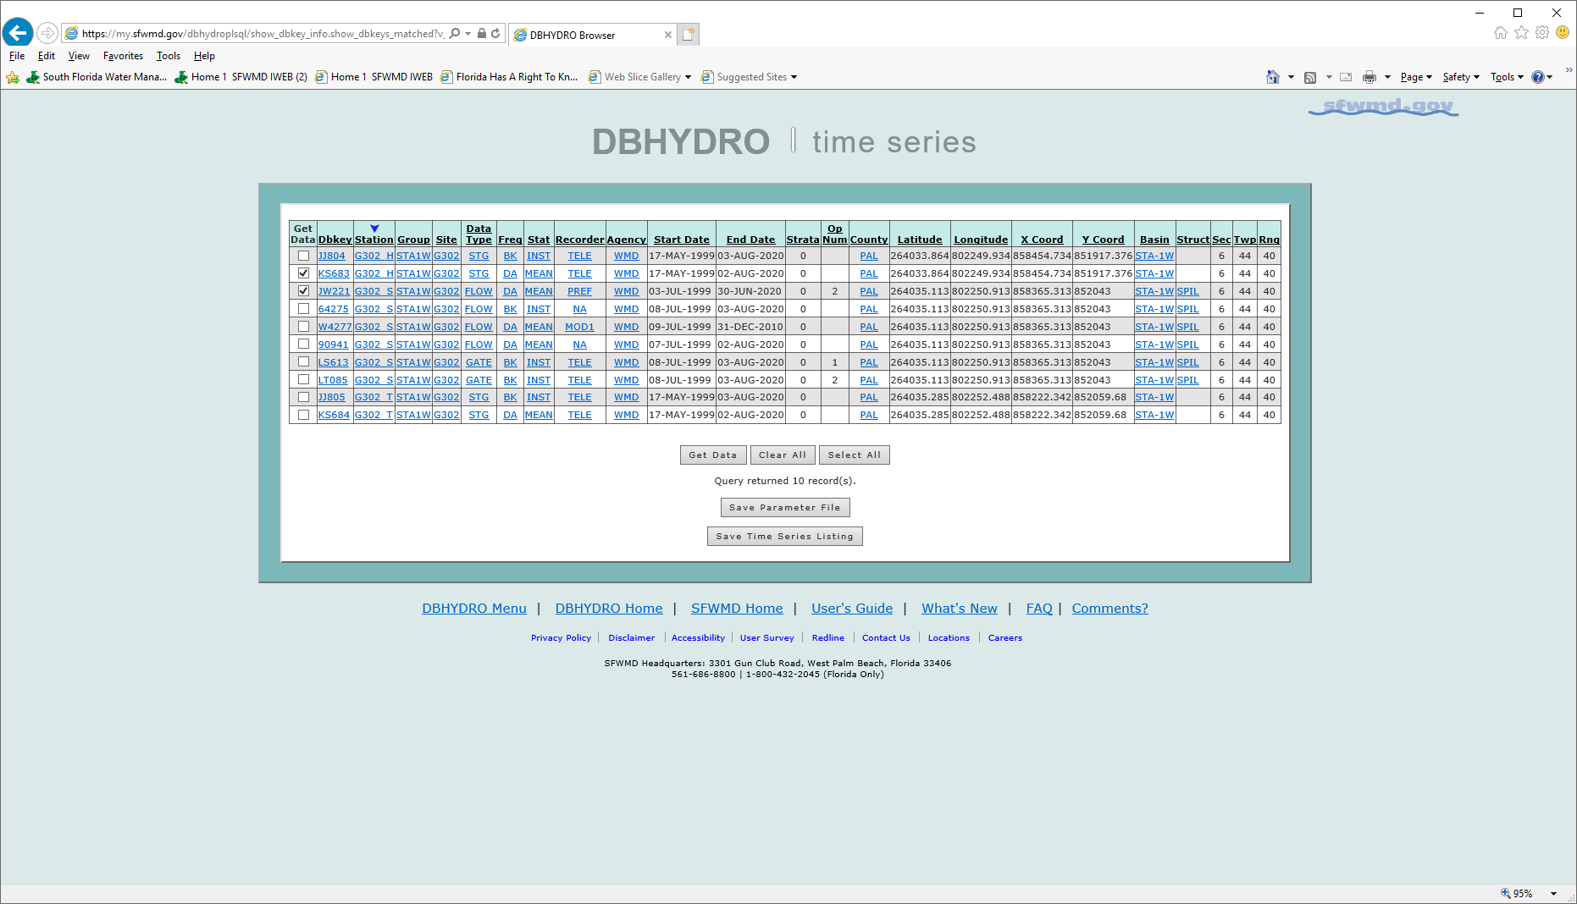

Slide 21
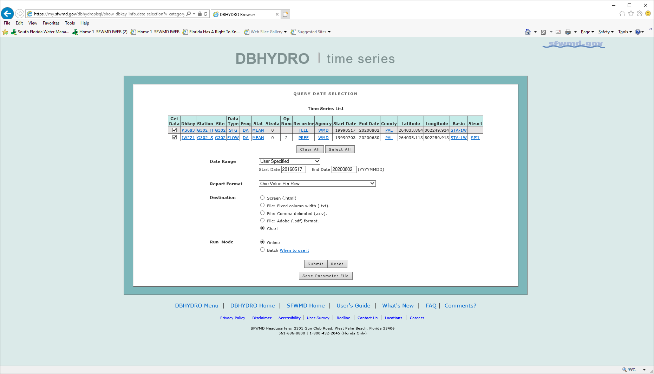

Slide 22
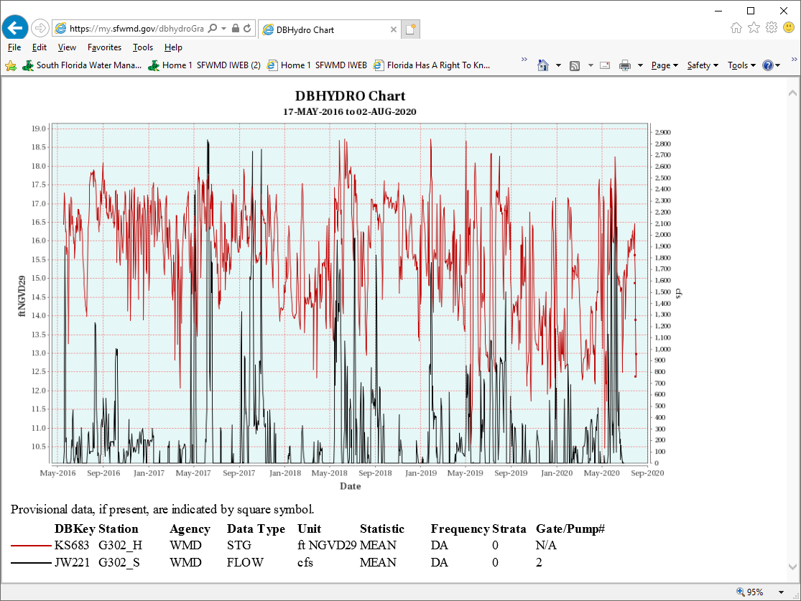

Slide 23
Water Management for competing objectives
Food production (irrigation)
Afforestation (ecology)
Soil conservation (ecology)
Domestic/industrial water supply (rural, urban)
Hydropower

Slide 24
Hydropower can be done in concert with
Food production (irrigation)
Afforestation (ecology)
Soil conservation (ecology)
Domestic/industrial water supply (rural, urban)
Condition: hydropower upstream of other areas
of endeavor listed above; consider alternative sources.
Reservoirs for IWM
IWM → Temporal priorities → Food->Eco->Energy Dev
Spatial priorities →Eco-> Energy->Food

Slide 25
Ethiopia’s Potential
Irrigation 7.5 million ha
Hydropower 45000 MW
Solar Power 5.5 kwh/m2/day
(2 GWH/ha/year)
Geothermal 10000 MW
Wind (7 m/s, 50 m alt.) 1000 GW

Slide 26
Caution
Ethiopia can severely limit its right to use Blue Nile for food production and ecological objectives if:
any agreement it signs directly or indirectly stipulates that projects upstream of GERD need prior consent of riparian countries (Egypt and Sudan)
Commits to deliver 1500 MW of electricity for domestic consumption and/or for sale to foreign countries from GERD only.
To resolve competition for water: Food vs Energy
Look into alternatives
Wind, solar, geothermal, gas for energy production
Hydropower u/s of irrigation, afforestation endeavors

