Slide 1

Impacts of SWCPs on sediment trapping, landscape disconnectivity & sustainable reservoir use, NW Ethiopia
Mulatie Mekonnen

Slide 2
Introduction
The northwest highlands of Ethiopia are the major water sources of Abay River/GERD
More than 80% of the water is from these highlands

Slide 3
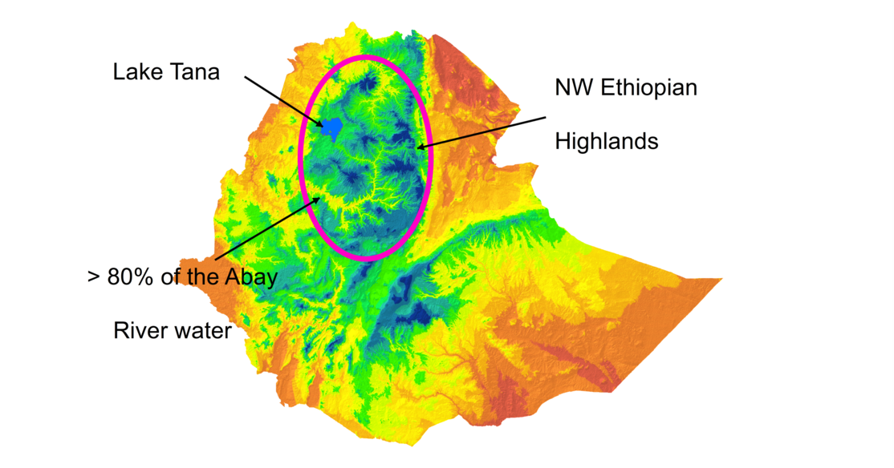

Slide 4
Besides the highlands are
Suitable for human settlement (>60% popn)
Origins of many crop & tree species
Most suitable for agriculture, agriculture
widely practiced, etc.

Slide 5
However;
Land degradation in the form of soil erosion, soil fertility depletion, water resources reduction, forest deterioration, etc.
is a prime problem in the highlands

Slide 6
Consequently:
Reservoirs/lakes sedimentation
Reduced agricultural productivity
Infrastructures damage, etc.
are common problems

Slide 7
To halt such nature devastating problems:
SWCPs both physical, biological & bio-physical have been practiced for half of a generation age
4 - 5 decades

Slide 8
However,
The natural resource conservation & management works aren’t sustainable,
Farmers’ are destructing the constructed SWCPs claiming lack of benefits,
Like:

Slide 9
Landscape dis-connectivity/
Slope gradient reduction,
Soil loss reduction
Soil fertility improvements
Crop productivity increment, etc.

Slide 10
Hence,
The objectives of this investigation in the
Koga catchment representing the northwest highlands of Ethiopia is,

Slide 11
To investigate the impact of SWCPs on sediment trapping, slope gradient reduction & Maize grain yield improvement

Slide 12

Methodology
Field experiment
Field measurement
Field observation
Statistical analysis
GIS software
SPSS

Slide 13
Results
SWCPs are trapping a dry sediment of:
26 - 44 kg m⁻¹ yr⁻¹
~55 kg m⁻¹ yr⁻¹ ( Mekonnen et al. 2016)
~ 25 kg m⁻¹ yr⁻¹ (Mekonnen & Getahun, 2020)
STE ~54%

Slide 14
< 5 yrs old SWCPs
SB with retention basin trapped more sediment than FJ ridge
Reason, availability of the retention basin with enough space to trap sediment,

Slide 15
> 10 yrs old SWCPs
FJ ridges trapped more sediment than SB
Reason, retention basin was filled by sediment & STE of SB reduced
No maintenance
But STE of FJ increased

Slide 16
SWCPs are reduced slope gradient by:
1.2 % (below 5 yrs)
2.2% (5 - 10 yrs)
3.2% (10 - 20 yrs)
2-3 % in 20 yrs (Mekonnen et al. 2016)

Slide 17
SWCPs are improving crop yield by:
~ 920 kg ha⁻¹ yr⁻¹ Maize
~700 kg ha⁻¹ Barley (Mulat et al. 2020)
10 -15% (Teshome et al. 2013)
ETC.

Slide 18
On the contrary,
No significant soil loss reduction
Water reservoirs sedimentation is high
Farmers are using the same rate of fertilizer as before

Slide 19
Nutrient load to water reservoirs is high & causing weed emergency
like water hyacinth
In general land degradation is still a prime problem

Slide 20
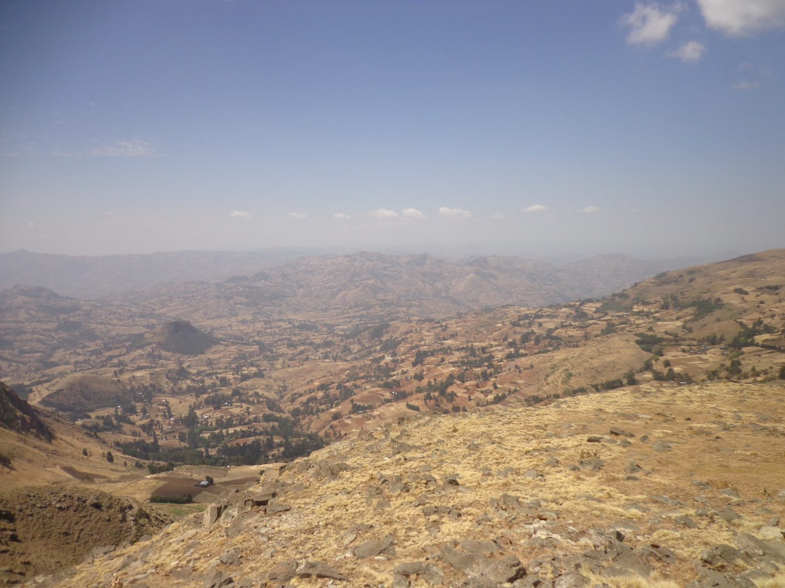
Highlands degradation

Slide 21
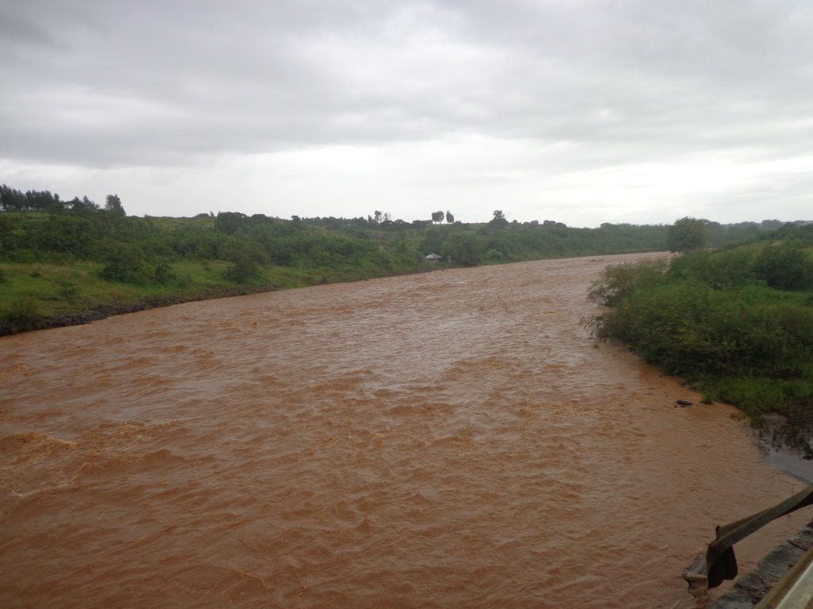

Rivers carrying sediment to water reservoirs NW highlands of Ethiopia

Slide 22
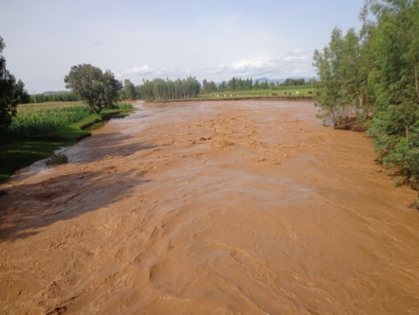
Rivers carrying sediment to water reservoirs NW highlands of Ethiopia

Slide 23
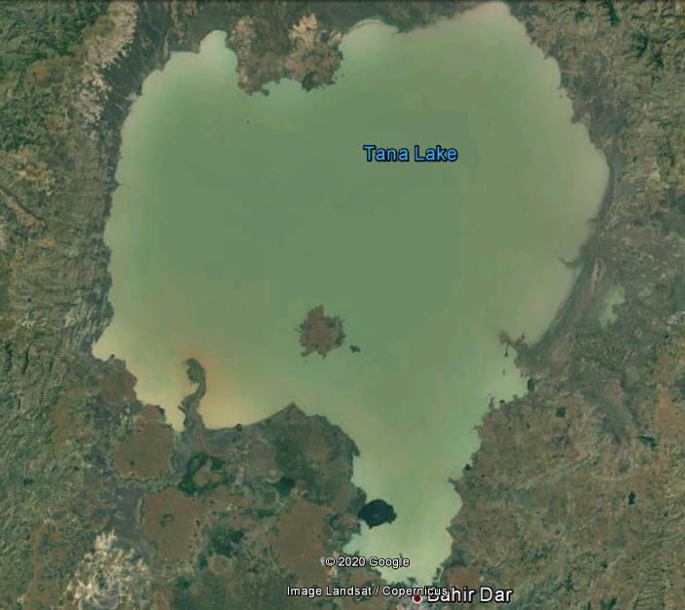

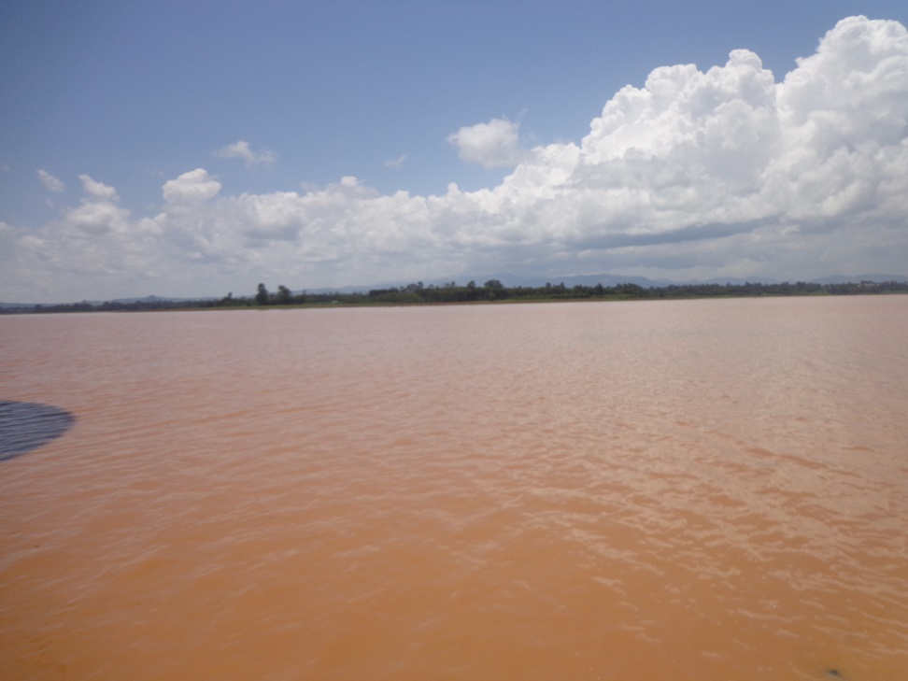
Impact of sedimentation on water reservoirs
Koga man-made reservoir

Slide 24
Conclusion
Although the existing SWCPs are
Trapping large amount of sediment,
Reducing slope gradient/landscape
connectivity,
Increasing crop yield,
etc.

Slide 25
Soil erosion not significantly reduced
Sedimentation is critical,
Slope gradient is not minimized,
Land degradation is the main problem
After half of a generation age

Slide 26
So What ???

Slide 27
Therefore,
Researchers & experts, are expected to develop alternative approaches or modify the existing practices, after half of a generation age experience.

Slide 28
Thank you

