Slide 1
Conflict Resolution and Cooperation
over Blue Nile Water Resources
Projects
Mohammed Mustafa ABBAS (PhD, CE)
Sudan

Slide 2
Presentation outline`
Item 1
Introduction
Item 2
Research objective
Item 3
Study area
Item 4
Methodology
Item 5
Cooperation bet. SD and ET
Item 6
Analysis
Item 7
Conclusion
Item 8
Recommendations

Slide 3
Water is increasingly becoming a source of conflict not only in the Nile region but also in many other parts of the world. Water conflicts are found in many different settings: Locally, some pastoralists and farmers compete over scarce drinking water and water for their livestock. The residents in dam construction sites sometimes clash with the government when they are not adequately compensated or appropriate relocation plans are not made or implemented. Conflicts between and among countries, rich and poor people, pastoralists, nomads and farmers and non-farmers over water resources is a phenomenon in many part of the world.
Introduction

Slide 4
Conflicts between and among the upper (e.g. Ethiopia) and lower (e.g. Sudan) Nile countries are old. The lack of a basin-wide agreement on water development projects poses a problem for both upstream countries (concern of their development being hindered) and downstream countries (concern of water security). Under pressure from rising demand, water resources will become increasingly exploited due to population growth, agriculture expansion, and the ever-rising expectations for improved standard of living worldwide. This encourages us to enhance and to move to joint projects or multipurpose projects between the two countries.
Cont.

Slide 5
The objectives of the study are to:
- Draw the attention of stakeholders of the Blue Nile Basin countries to the necessity of joint projects for sustainable utilization and cooperation over shared water resources.
- See the comparative advantages, challenges and risks and potentials, of the future joint integrated water resources projects.
Research Objective

Slide 6
Study Area
Blue Nile River Basin

Slide 7
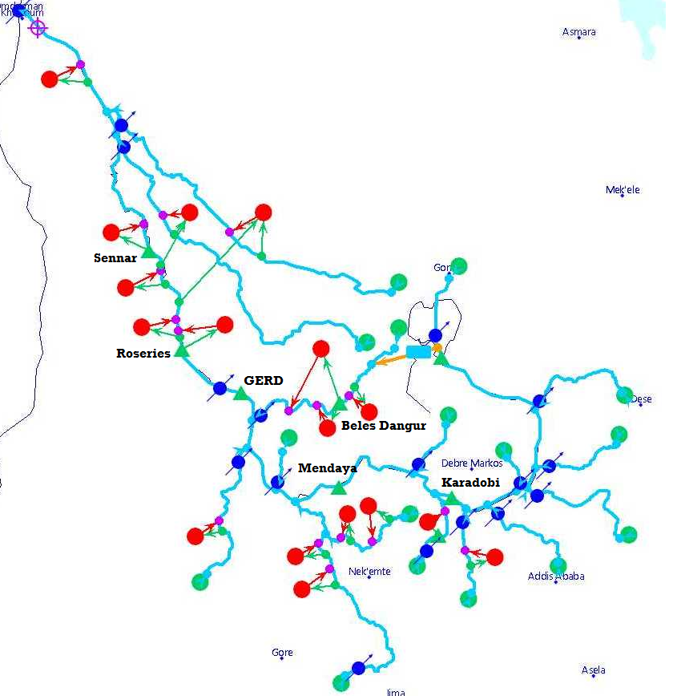
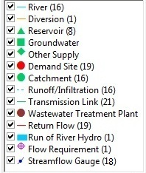
Schematic Diagram for BNRB

Slide 8
The study used an expert-interview methodology, 30 people were interviewed, 50 from Sudan, 50 from Ethiopia, including academics, consultant s, experts working for their governments on water issues, and coordinators for the Eastern Nile Technical Regional Office (ENTRO). Furthermore, background analysis of the available documents from workshops, Nile 2002 conference series, and other conferences and workshops were used. The researcher does not present a governmental position in his research. The research approach (Figure 1) consisted of independently assessing the upstream (Ethiopia) and downstream (Sudan) views, and then comparing them in this report.
Methodology

Slide 9
The study takes a conflict prevention and/or resolution transformation approach. There are four types of conflict management types, except for overt actions (such as use of military means), which are:
- Prevention.
- Avoidance.
- Settlement.
- Resolution.
Cont.

Slide 10
Joint win-win projects are ones that can enhance the cooperation between the two countries. Some suggested areas for joint projects are small and large dams and irrigation systems on a village or household level along the various Lake Tana and Blue Nile tributaries. Small-scale hydro-electric power stations can also be built in most of the tributaries on community and village levels.
Joint Projects between SD and ET

Slide 11
Some areas located around Lake Tana have been suggested as a natural storage, suitable for the regulators of large volumes of water. One of the numerous advantages of the construction of the Blue Nile reservoirs in Ethiopia can be the saving of a huge amount of waters that presently evaporates (through evaporation and evapotranspiration) from the downstream countries (e.g. Sudan). These reservoirs could provide over-year storage. They could also control the unexpected floods that also affect the Sudan, and they could help to reduce the large sediment loads. Through the construction of water reservoirs, in the BN main stem and its tributaries, can be irrigated and could be cultivated 2-3 times a year, which could help the Blue Nile river basin to be self-sufficient in food.
Cont.

Slide 12
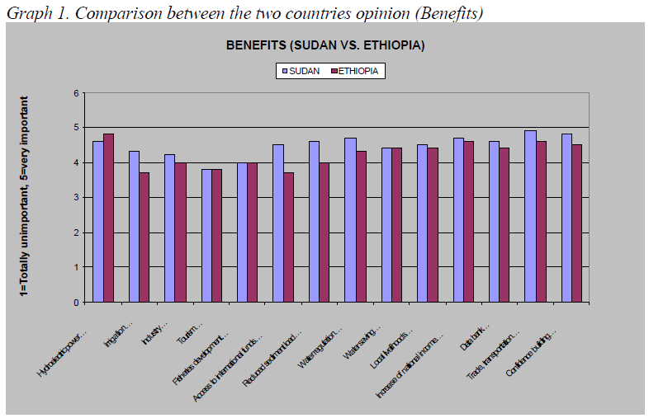
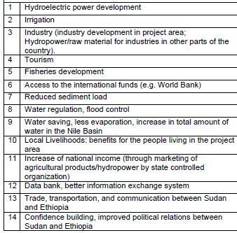
Analysis

Slide 13
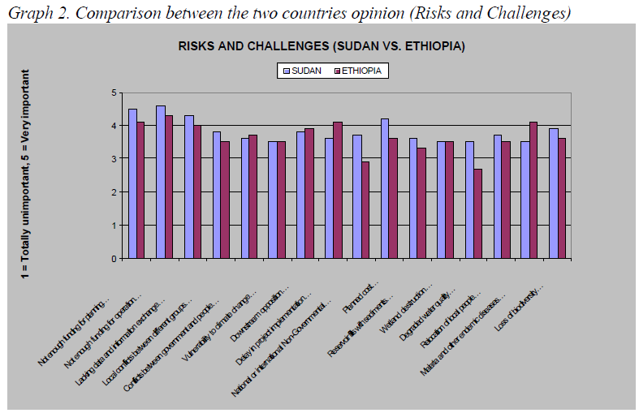
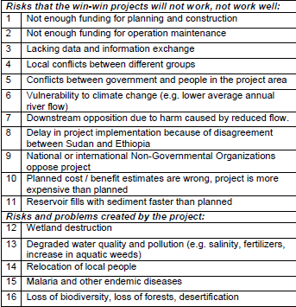
Cont.

Slide 14
By enhancing joint projects between Ethiopia and Sudan to build dams and construct irrigation projects, the Nile countries can enhance peace and stability in the region. Without this principle it is not possible to satisfy human needs for the present and coming generations.
Conclusion and Recommendations

Slide 15
If the upper and lower Nile riparian countries continue arguing on legal issues over the so called ‘national and regional rights’ to water, planning uncertainty is greater and more environmental deterioration is imminent. It is therefore advisable to follow a basin approach and use water on a sustainable basis, because nature has its own laws and limitations to serve its users. Joint management implies agreement on a set of principles or structures on the collective use of common water resources of the two countries. The Integrated Water Resources Management approach will only work if practitioners and policy-makers recognize and accept that sustainability is as much about the social and economic as about water and the environment.
Cont.

Slide 16
Impacts of hydropower projects on the Blue Nile could be mitigated by proper planning, consultation and proper operating schedules agreed upon by the two countries. Some of our interviewers (Ethiopian) said that hydropower projects have no affect for downstream countries, where the dam operation is carried out well, keeping the water and releasing it when needed is a potential benefits for the downstream country. In Sudan, where the river flows on the flat surface area, many people have to be displaced when building a dam, in Ethiopia the river flows in gorges, so there are not, or much less, displacement of people.
Cont.

Slide 17
The benefits of joint projects can be summarized in:
· Maximizing water resources,
· Linking the issue of water to other resources,
· Establishing a supra-national organization,
· Better use of technology,
· Basin-wide conservation,
· Positive spill- over for political relations,
· Environmental protection, and
· Combating drought.
Cont.

Slide 18
Recommendations
Ethiopia and Sudan need more water for their future projects. If Ethiopia and Sudan take water unilaterally, then tension will rise which may lead to conflict between the two countries (as well as with Egypt, the most downstream country). To avoid this tension three ways forward can be identified:
1. A “hard” comprehensive legal and institutional framework.
2. A “soft” institutional framework, clarifying the framework in very general terms, but leaving the present open issues for later clarification (15%).
3. A “very soft” institutional framework (e.g. such as the NBI at the moment), only clarifying how decisions are made on a project-by-project basis.

Slide 19
Future Prospective
The future vision for Sudan and Ethiopia (eg. 2025) could be designed to avoid the disastrous consequences of the threats that face the region and lead to a future where the full potential in the Blue Nile River water resources can be readily unleashed to stimulate and sustain growth in the region’s economic development and social well-being. This follows the shared vision agreed by the Nile Basin Initiative (see quote above). Within this agreed overall vision between the two countries, the Blue Nile river may serve as a key catalyst, with its yield increased and utilized in a rational, fair, efficient and environmentally sustainable manner, with effective flood and drought management, watershed management, reversed desertification, and pollution control.

Slide 20
Thank you!

