Slide 1
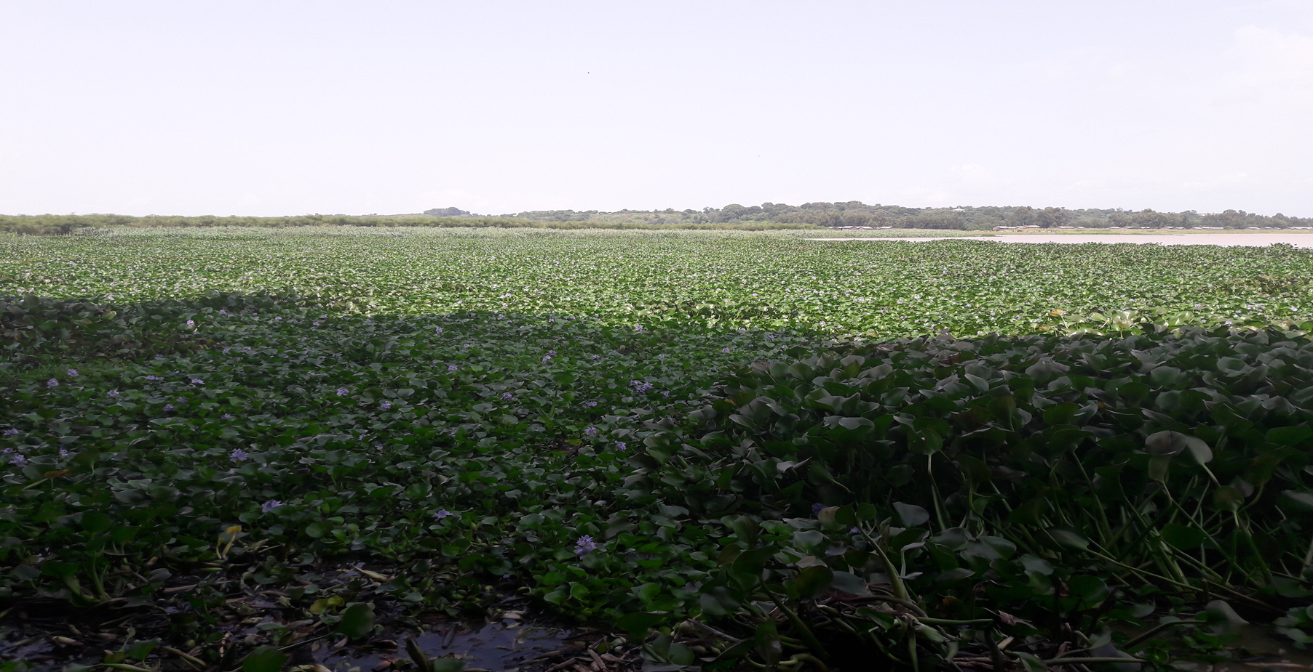
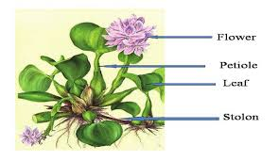

Water quality deterioration and its linkage with water hyacinth expansion in Lake Tana, Ethiopia
    By Minychl G. Dersseh
    Authors:
    Minychl G. Dersseh (PhD student) – Bahir Dar University, Ethiopia
    Assefa M. Melesse (Dr., Prof) - Florida International University, USA
    Seifu A.Tilahun (PhD) - Bahir Dar University, Ethiopia
    Abeyou W.Worqlul (PhD) - Texas A&M AgriLife Research, USA
    Mamaru A. Moges (PhD) - Bahir Dar University, Ethiopia
2020 International Conference on Nile and GERD
August 20-21, 20202

Slide 2
Lake Tana and its Sub Basin
Created in ca 5 million years ago (quaternary period) (Vijverberg et al., 2009)
Source of the Blue Nile
Average and maximum depth of 9.7m and 14.8m respectively (Kebedew et al. 2020)
Around 44 monasteries , a place of beauty and one of tourist destination places
Registered by UNESCO in 2015 as a natural biosphere reserve heritage
Surrounded by degraded catchments and intensive agricultural fields (15000 km2)

Slide 3
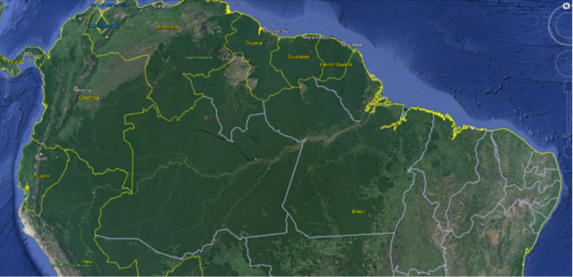

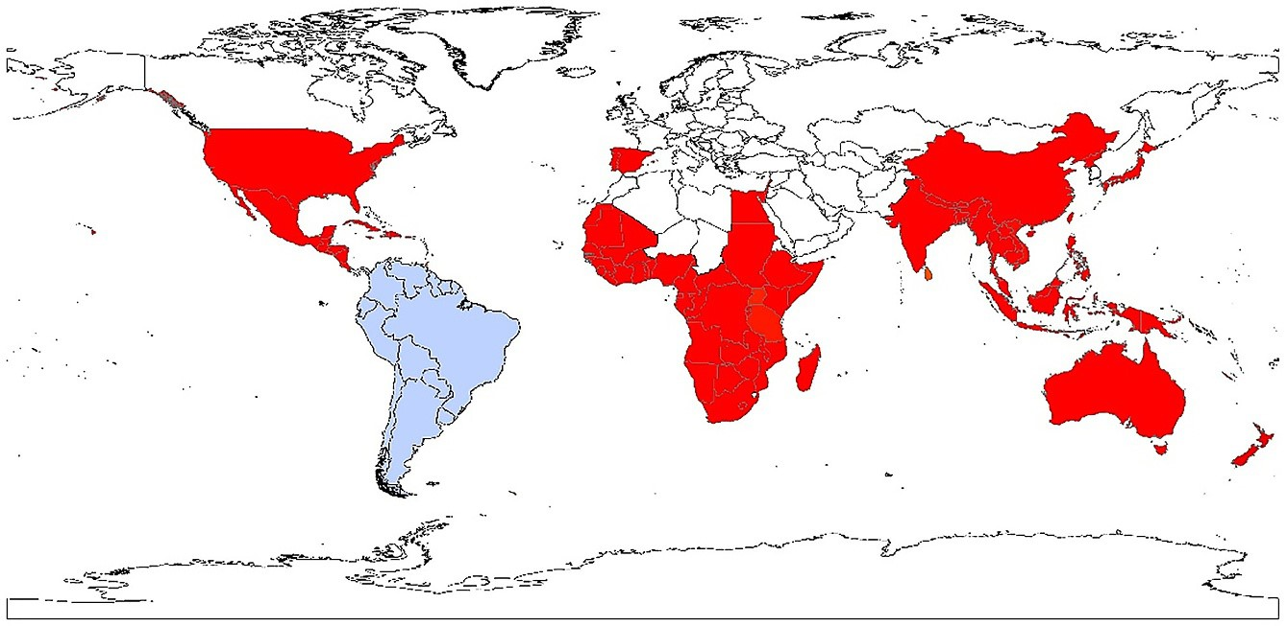
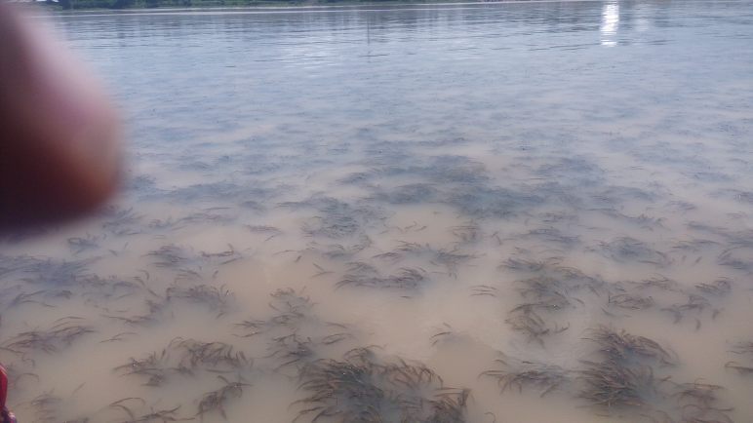
Water Hyacinth
Originating in the Amazon Basin, Latin America (Hill & Coetzee, 2008).
Since the late 1800s, the weed has spread in large areas of the World by man, legs of birds, common watersheds and sharing rivers (Driesche et al., 2002).
In Ethiopia, first introduced around Aba-Samuel dam in 1965 then spread to rift valley lakes
In Lake Tana, officially recognized in 2011
The lake is shifting from Oligo-meso to Meso-eutrophic

Slide 4
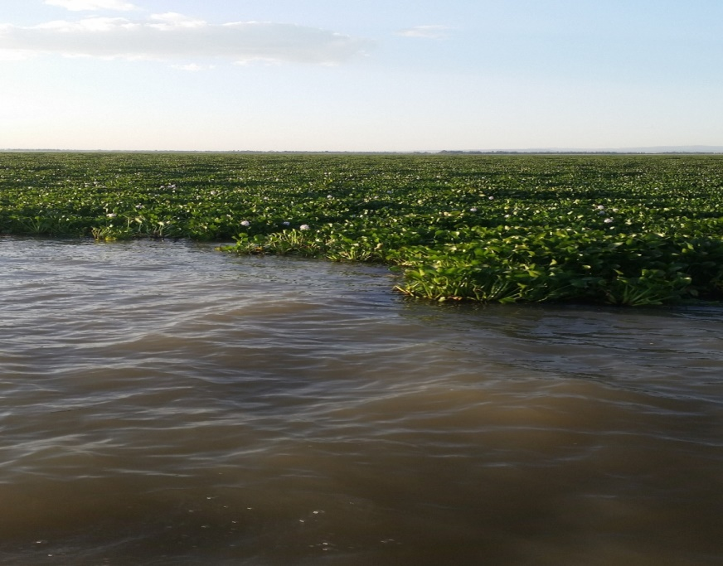
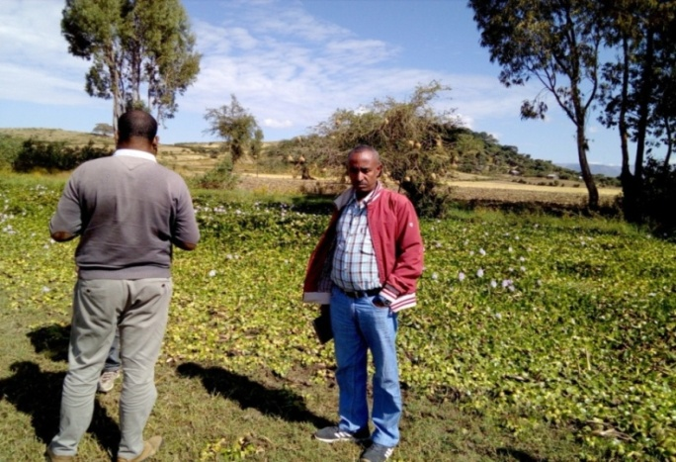
Objectives
General objective:
To evaluate the water quality and lake level fluctuation, and their linkage with water hyacinth on Lake Tana
Specific objectives:
Evaluate the dynamic nature of major water quality parameters on the shores of the lake and their linkage with water hyacinth expansion
Predict the potential areas of the water hyacinth using GIS-based multi-criteria evaluation (MCE) technique.
Determine the spatiotemporal distribution of water hyacinth and its relation with lake-level fluctuation

Slide 5
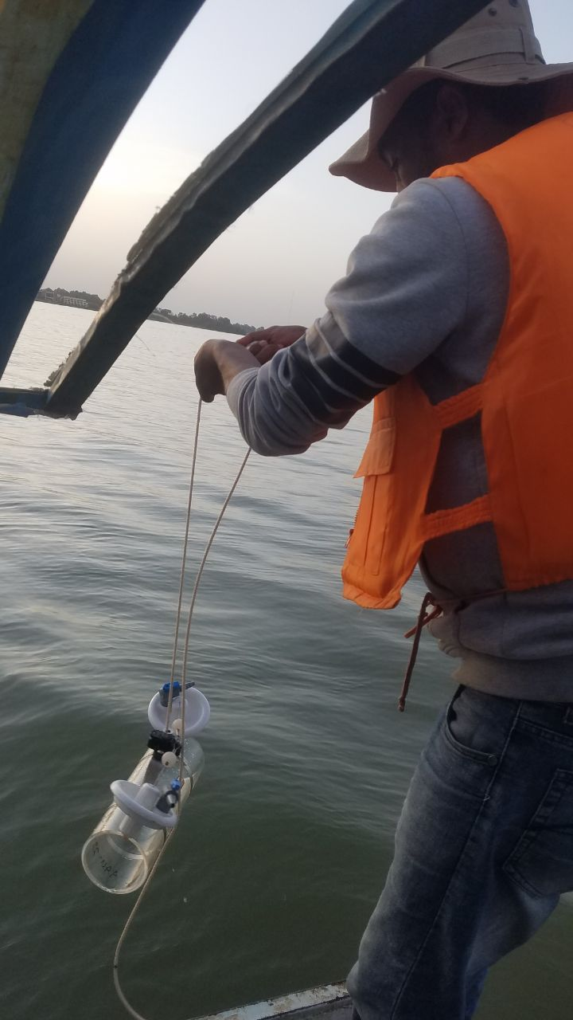

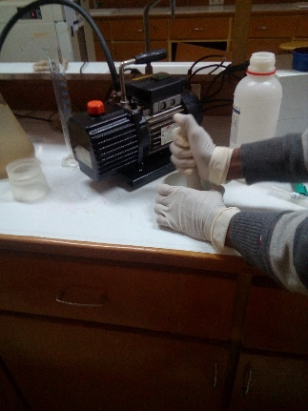
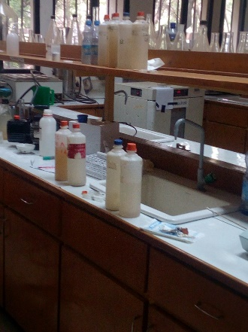
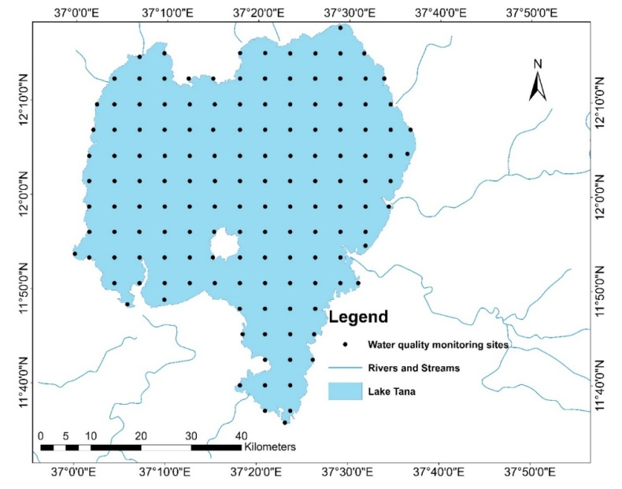
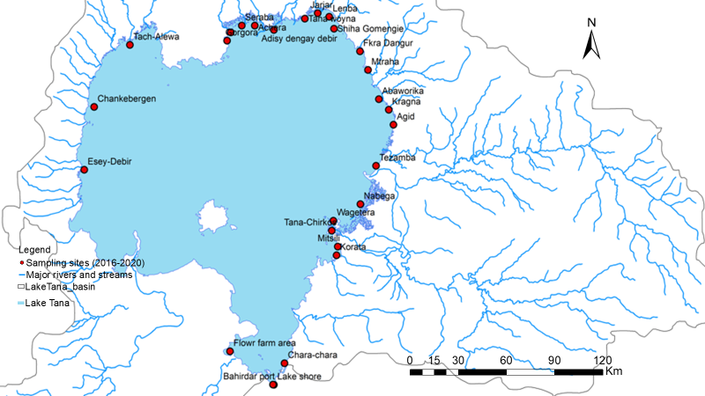
Methods
      27 sampling sites for water quality analysis
      143 sampling sites for suitability analysis
      Lake level data
      Satellite data (Sentinel-2)
      sample and data collection
      laboratory work
      ArcGIS and remote sensing
      Google earth engine platform
      GPS tracking for validation
      Descriptive statistics

Slide 6
Water quality and Water hyacinth
2.05mg/l TP, 1.8mg/l TN, 4.59µg/l Chl-a, 0.23m SDD
1.08mg/l TP, 1.8mg/l TN, 6.34 µg/l Chl-a, 0.28m SDD
2.07mg/l TP, 2.7mg/l TN, 5.25µg/l Chl-a, 0.28m SDD
High nutrient concentration
  ~ severe water hyacinth infestation
Low Chl-a and SDD
  ~ Severe water hyacinth infestation
1.94mgl TP, 1.8mg/l TN, 0.2µg/l Chl-a, 0.28m SDD

Slide 7
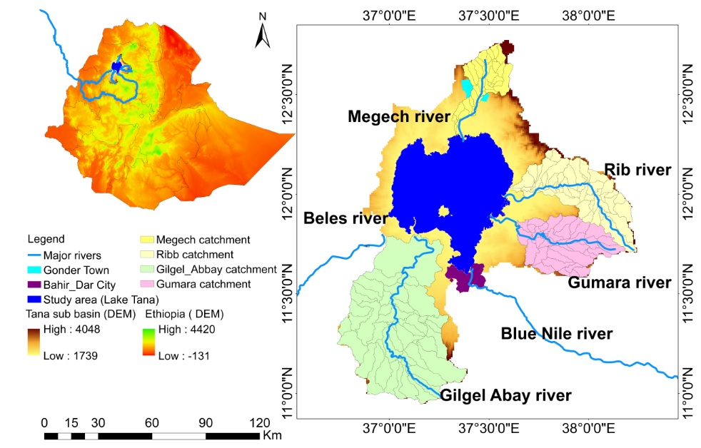
Major sources of pollutants
The catchment
Application of fertilizer, herbicides and pesticides and transported by
  The four major rivers and streams
Annual total nutrient load of the four major rivers:
  TP: 12,529 t/yr.
  TN: 22,671,t/yr.
  Cities
Bahir Dar and Gonder cities

Slide 8
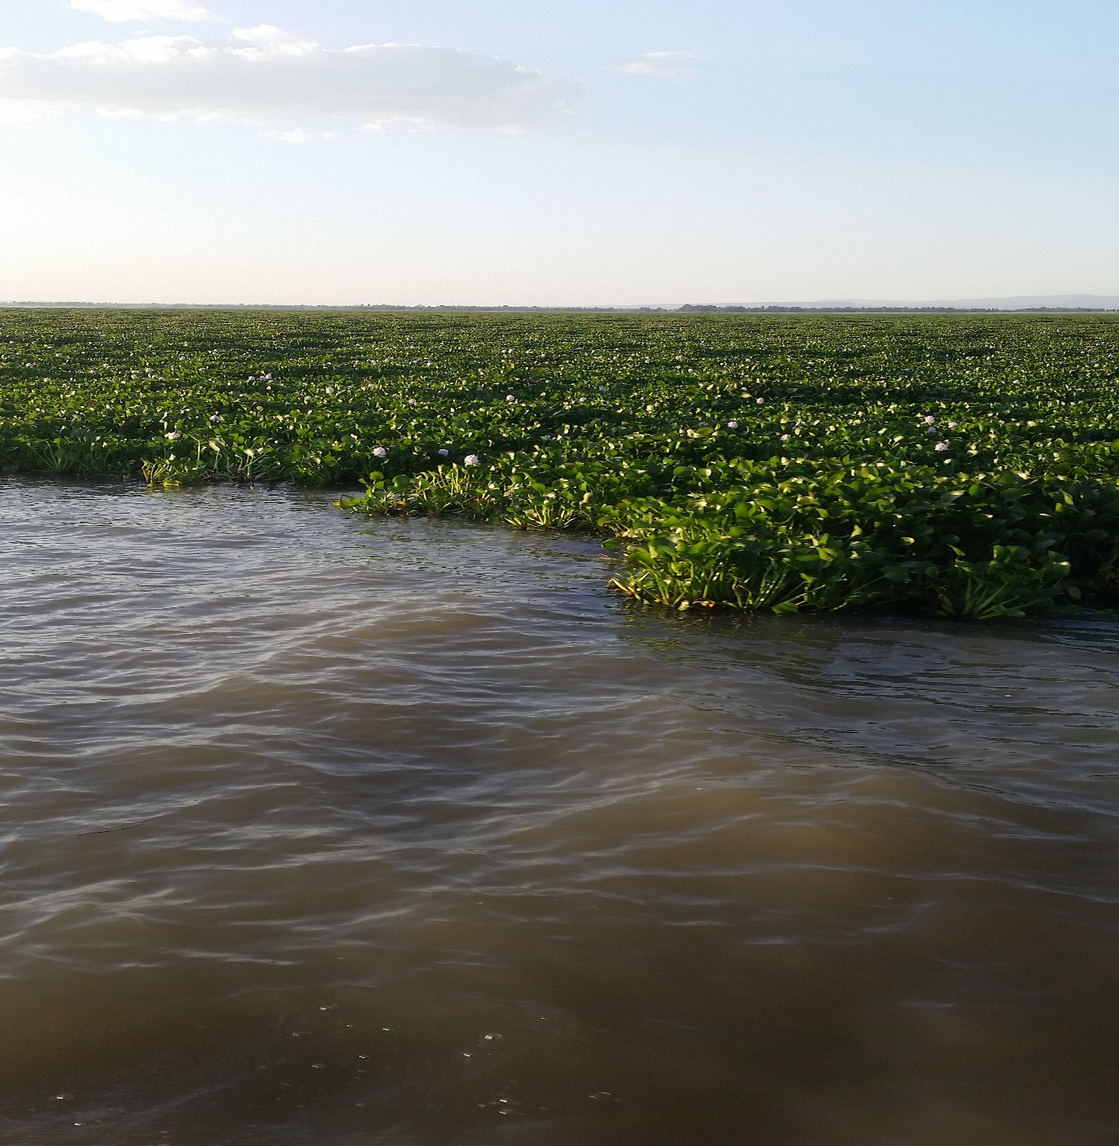
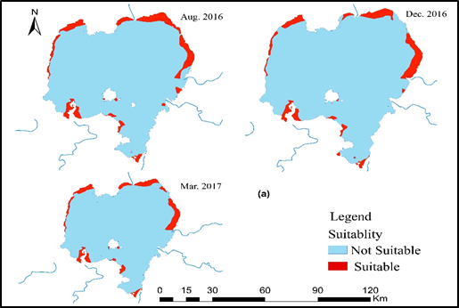
Potential areas for water hyacinth growth
In terms of TP, TN, pH, Temp, Salinity and depth
In terms of TP, TN, PH, Temp and Salinity, the lake is suitable for water hyacinth growth
24000-30000ha

Slide 9
Spatiotemporal distribution of water hyacinth and its relation with lake level fluctuation
278.3 – 2504.5 ha
Significant increasing rate
Decreasing in the north and increasing in the eastern shore
Severe in the post-rainy season (Sept-Dec)
if not managed properly, there is a possibility to increase to its potential areas covering 10% of the lake

Slide 10
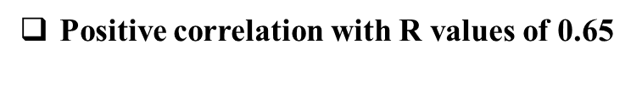
Relation of water hyacinth to lake-level fluctuation
Chara-Chara
Minimum operating level is 1783.35 m amsl
Maximum weir OL (1786.35 m amsl)
Historical flood level (1788.2 m amsl)
Mean monthly lake-level ( 1.5 to 3.98 m)
0,85 m above max operating level
  Low flushing rate, high resident time and high TP coefficient of retention

Slide 11
Conclusion
The lake water quality is decreasing
  Phosphorus is increasing
  Nitrogen is decreasing
  Chlorophyll-II is decreasing
  SDD is increasing
The trend of water hyacinth was increasing significantly
Lake level fluctuation has positive correlation with water hyacinth expansion on Lake Tana
The peak season for water hyacinth expansion on Lake Tana is from September to December.
Northeast shore of the lake is critically invaded by the weed
Average values

Slide 12
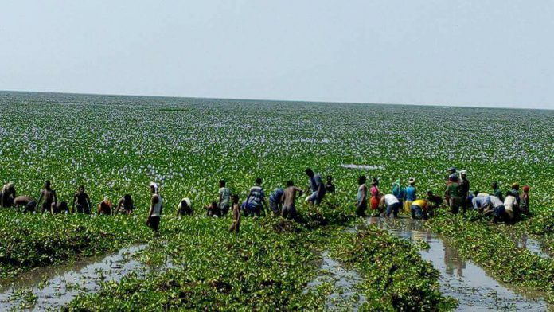
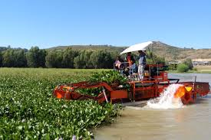
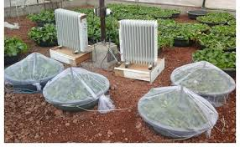
Possible recommendations
Removing the invasive weed
Influents from the surrounding cities must not be discharging to the lake or to the rivers which drain to the lake
Management of fertilizer and chemicals application must have policy framework
Buffer zone delineation
Appropriate land management practices
The agriculture practice needs a special attention in the sub basin
Chara-Chara weir operation needs special attention from water quality point of view

Slide 13
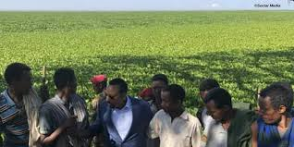
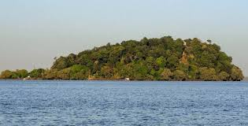
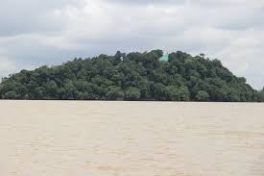
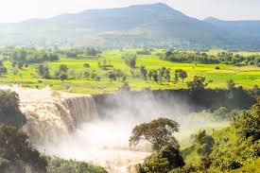
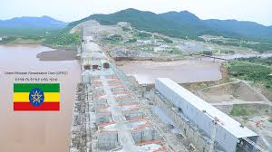
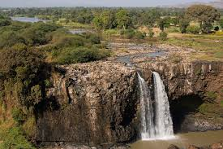
Former Lake Tana
Existing Lake Tana
Former Blue Nile fall
Current Blue Nile fall
        Without Lake Tana, the GERD is ???
        Sudanese and Egyptian water demand???
        So, all actors of the Blue Nile have to save Lake Tana!!!

Slide 14


Thank you
Stay safe!!

