Slide 1

Water Conservation through Decentralized Rain Water Harvesting under climate uncertainty
Mengistu Addis
PhD Candidate in Hydraulic Engineering
Addis Ababa Science and Technology University, College of Architecture and Civil Engineering, Ethiopia
July 2020

Slide 2
Out Lines
Introduction
Climate Change and Uncertainty
Water Supply and Demand
Water Conservation
Rain Water Harvesting
Objective
Methods and Analysis
Results
Conclusion and Recommendation

Slide 3
1. Introduction
1.1 General
Adequate water supply is basic demand for all human being, basis for development
Improved water supply and sanitation is global agenda
More than 31% of world population have no access to safe water supply where as in Ethiopia more than 62% of total population (i.e above 62 million people) have no access for safe drinking water and for other domestic demands.
Even though plenty of resources, Ethiopia has found itself in an extreme water crisis situation, brought on mainly by severe drought and lack of water management and sanitation resources.
Climate change, increase in population and demand with rapid urbanisation (development?)

Slide 4
1.2. Climate Change
What is Climate?
Is the weather in some location/place averaged over some long period of time (Long term average of weather condition)
Climate Change?
The change that occurs over a longer period of time typically over decades and centuries and may not return to it former state unless significant measures are taken place.
Climate Variability?
The change that occurs within smaller or shorter time frame such as a month, a season or a year and may return to its former state.
There is global argument on Climate Variability and Climate Change
Climate Uncertainty = Climate Change + Climate Variability

Slide 5
1.2. Climate Change …
Observed Climate Changes and Causes
According to IPCC AR-5
Significant and clear human influence on the climate system and recent anthropogenic emissions of greenhouse gases are the highest in history.
Widespread impacts on human and natural systems
Increased surface temperature
Increased GHG concentration on the atmosphere
Un expected hazards such as drought, flooding, global warming, rise of ocean and lake levels

Slide 6
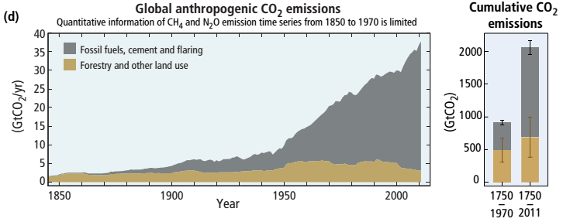
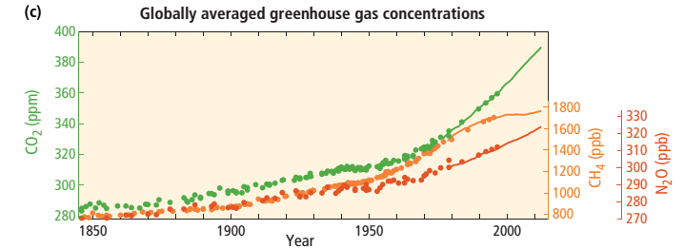

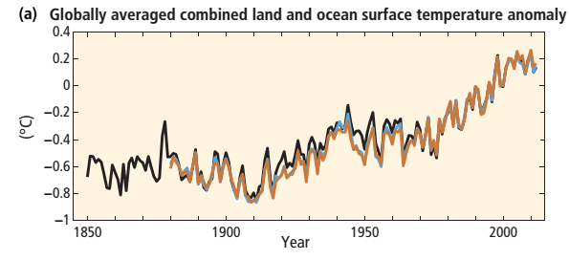
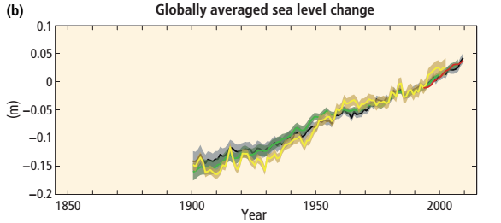
1.2. Climate Change Cont. …
Observed Climate Changes and Causes

Slide 7
1.2. Climate Change Cont. …
Climate Change Scenarios?
Are alternative approaches to forecast/project future climate change using previous baseline and historical trends.
1. SRES (Special Reports on Emission Scenarios) are B1, A1, B2, F1
Climate Projection used from 2000 to 2009 till RCP
Depends on possible emissions of alternatives
2. RCP (Representative Concentration Pathways)
Based on radiative positive forcing from greenhouse gases and negative forcing from aerosols which are unbalanced.
RCP 2.6 (Optimistic) – RCP 8.5 (Pessimistic … A1F1 of SRES)
Includes approaches that combine reductions in emissions and adaptation to reduce climate change damages.

Slide 8
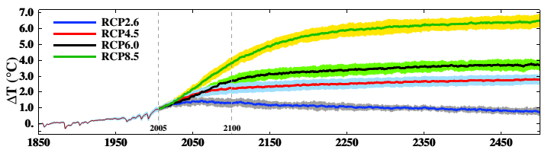
1.2. Climate Change Cont. …
It is very likely that heat waves will occur more often and last longer, and that extreme precipitation events will become more intense and frequent in many regions (IPCC, 2014).

Slide 9
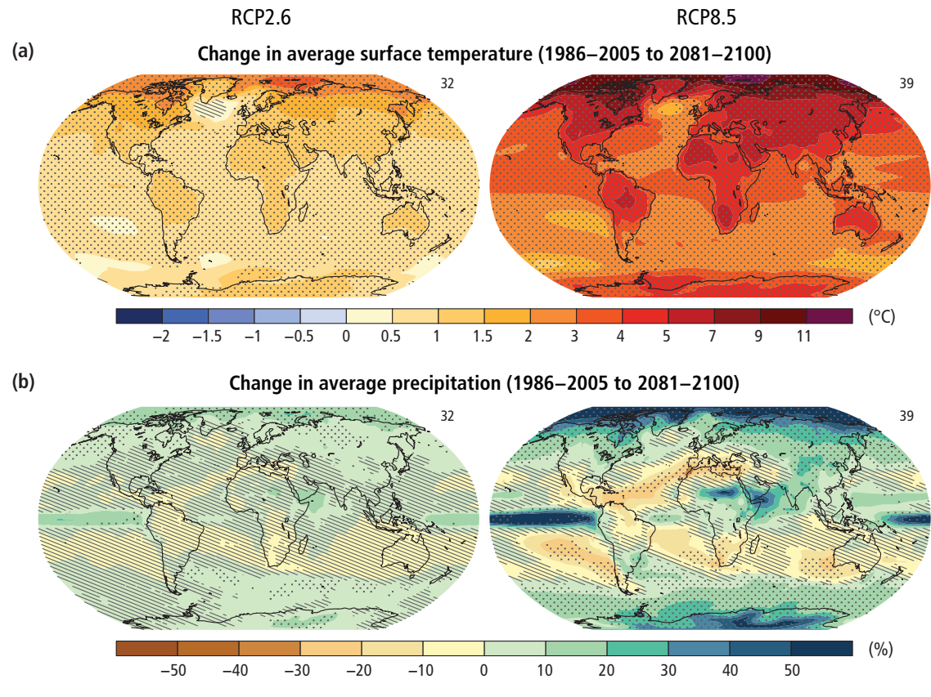
1.2. Climate Change Cont. …

Slide 10
1.2. Climate Change Cont. …
Ethiopia
High potential of extreme events (flood and drought), wet seasons may be more wetter and warm seasons may also be warmer, (NAPA,2007).
For the IPCC mid range (A1B) emission scenario, the mean annual temperature will increase in the range of 0.9 - 1.1 ° C by 2030, in the range of 1.7 - 2.1 ° C by 2050 and in the range of 2.7-3.4 ° C by 2080 over Ethiopia compared to the 1961-1990 normal.
Climate change lead to water demand increase and supply decrease which needs strategic concern

Slide 11
1.3. Water Stress and Scarcity
Water Stress: is less access of water supply to fulfill domestic demand
Water Scarcity: is measure of poverty and is the lack of secure access to safe and affordable water to consistently satisfy domestic need
Globally About 1.2 billion people live in areas of physical water scarcity and up to 33% face water stress.
In 2025, about 1.8 billion people will live in regions with absolute water scarcity and about 67% of the world’s population in areas of water stress

Slide 12
1.3. Water Supply and Demand …
Most cities in Africa are provided with at least 100 lpcd with a 3.5% population growth rate
most of Ethiopian cities are getting average of 20 lpcd with average annual population growth above 4% (Ndaruzaniye, 2011)
About 12% of households in Addis Ababa have flush toilets discharging to sewers or septic tanks, 63% use individual or shared pit latrines, and 25% do not have access to sanitation facilities.
Risk of diseases in densely populated areas where water supply, sanitation, and nutrition are inadequate

Slide 13
1.4. Decentralized Rain Water Harvesting
Water conservation keeping, preserving and restoring of available Water sources
Most modern technologies for obtaining drinking water (exploitation of surface water from rivers, streams and lakes, and groundwater) account only 40% of total precipitation
Rain Water Harvesting is Collection of water directly from rain falling on impervious surfaces (roof tops or paved ground)
Decentralized – collection at house hold level
Why RWH is needed? Due to short rainy season with high volume of RF and extended dry season.

Slide 14
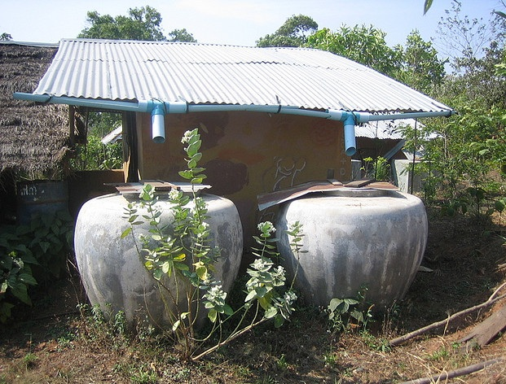
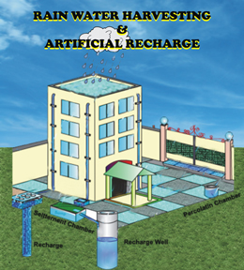
1.4. Objective
To assess water supply potential from rain water harvesting through roof tops for rural and urban domestic water demand
Indicating decentralized water management strategies
Roof Tops
Rain Collection Barrels

Slide 15
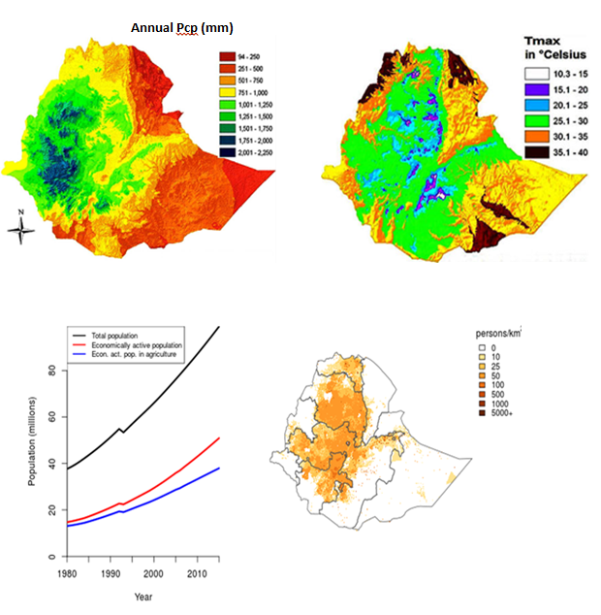
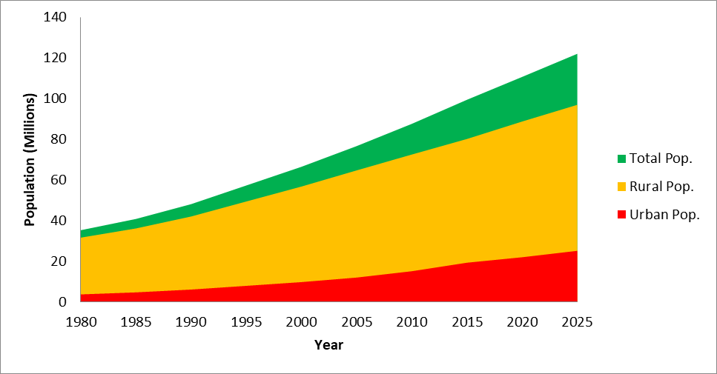
2. Description of Study Area
Population trends up to 2025

Slide 16
2. Description of Study Area (Blue Nile Basin)
The basin accounts about 23% of country’s land area and is the habitat of 37.6% of the total population.
Densely populated compared to other parts of the country.
Gets higher amount of annual precipitation ranging from 800 to 2220mm with an average amount of 1535mm
Densely populated gets higher precipitation

Slide 17
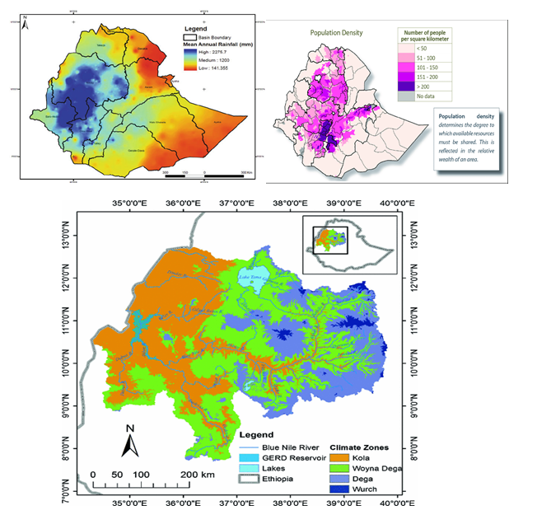
2. Description of Study Area (Blue Nile Basin)
Mean Annual ppt
Population Density
Climate Zones

Slide 18
3. Methodology and Analysis
Population data – from Ethiopian census
Precipitation – from Ethiopian Meteorological agency
Water demand – from WHO and Ethiopian Ministry of WIE standards
Average no of individuals per house hold is 5.6 and 7 for rural areas and 6 for urban areas are taken
Ratio of households to housing units in rural areas is 1.05 where as in urban areas is 1.1 and % of current urban population is about 19.8%.
In Rural areas the average area for housing is 40m² and for those urban areas is 36 m².
Mean annual rainfall of 850mm is taken for nation wide analysis even though more than 60% of the population lives in areas getting rainfall exceeding 1200mm, 1300mm is used for Blue Nile basin,
According to WHO standard, minimum daily domestic percapita water demand for developing countries is 20 l/day in which only 10-15% is for drinking purpose

Slide 19
3. Methodology and Analysis …
Year | Total Pop. | Urban Pop. | Rural Pop. | UAGR (%) | RAGR (%)
1980 | 35,239,974.00 | 3,668,755.00 | 31,571,219.00 | 5.46 | 2.87
1985 | 40,775,997.00 | 4,670,398.00 | 36,105,599.00 | 5.97 | 3.26
1990 | 48,057,094.00 | 6,063,524.00 | 41,993,570.00 | 6.01 | 3.50
1995 | 57,237,226.00 | 7,884,886.00 | 49,352,340.00 | 4.68 | 2.98
2000 | 66,443,603.00 | 9,731,656.00 | 56,711,947.00 | 4.58 | 2.80
2005 | 76,608,431.00 | 11,958,476.00 | 64,649,955.00 | 5.23 | 2.42
2010 | 87,561,814.00 | 15,083,947.00 | 72,477,867.00 | 5.54 | 2.11
2015 | 99,390,750.00 | 19,265,898.00 | 80,124,852.00 | 5.35 | 2.85
2020 | 110,635,984.00 | 22,743,529.00 | 87,892,455.00 | 3.21 | 1.76
2025 | 122,027,143.50 | 26,397,240.00 | 95,629,903.50 | 4.94 | 2.63

Slide 20
3. Methodology and Analysis …
Mean Annual Population Growth Rates (%)

Slide 21
3. Methodology and Analysis …
Amount of Harvested Rain Water (RWH) is calculated using rational formula:
Q = R*P*A
Where, Q = Mean Annual harvested rainwater volume (m³)
R = Runoff coefficient (dimensionless)
P = Mean Annual Precipitation (m)
A = Surface Area of Roof Tops (m²)
Run-off coefficient (R) is considered to account potential losses due to splashing, evaporation, leakage and overflow of roof tops and minimum value is taken as 0.8 (20% loss)
NB: Only residential roof tops are considered

Slide 22
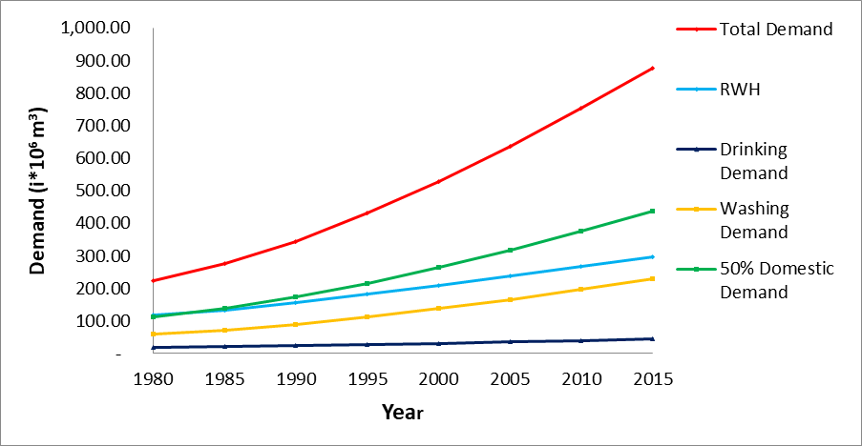
4. Results and Discussion
4.1 Country Level
If appropriately managed and awareness is created, there is a potential to store about half billion m³ water annually from residential roof tops only
Figure 4.1: Available RWH for Rural Water Use compared to total water demand

Slide 23
4. Results and Discussion …
Figure 4.2: Figure 4.2: Available RWH for Urban Water Use compared to total water demand
40% of total domestic water demand in rural areas and 25% for urban community can be satisfied with HRW
In urban areas, harvested rain water can satisfy the toilet water demand and water demands used for gardening and cleaning purposes which accounts above 35% of total water demand.

Slide 24
4. Results and Discussion …
4.1 Blue Nile Basin
more than 50% of total water demand can be fulfilled through rain water harvesting in rural areas where as above 40% of urban domestic demand can be met through decentralized rain water harvesting only
Figure 4.3: Potential RWH for Rural Water Use compared to total water demand

Slide 25
4. Results and Discussion …
Harvested water can be used for toilets, cleaning and washing and for gardening purposes which consumes above 50% of total domestic water demand.
Urban runoff problems due to increased impervious areas in which more than 30% roof tops will be significantly reduced through rain water collection
Figure 4.4: Potential RWH for Urban Water Use compared to total water demand

Slide 26
5. Conclusions and Recommendations
Conclusion
High potential of domestic water supply source from roof tops
Significant direct runoff reduction at urban areas due to rainwater harvesting
Recommendation
Adopt decentralized water management techniques from roof tops and paved areas
Detail study and investigation on water demand variation and rain water harvesting other than residential areas

Slide 27

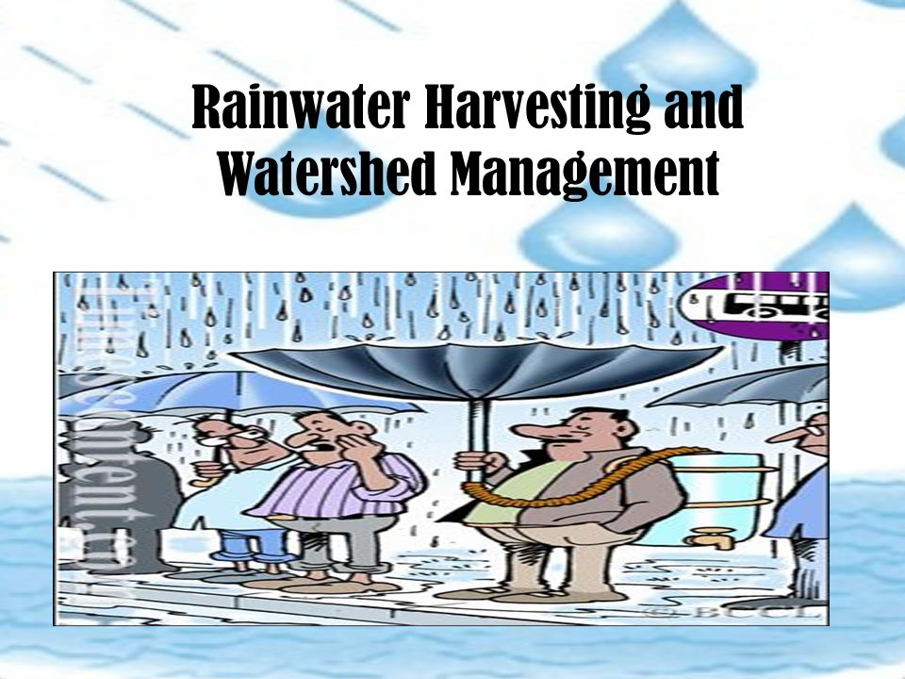
Thank You
???

