Slide 1
Evaluation of Transboundary Water Sharing Rules and Principles: The Case of The Nile River Basin
Mekdelawit Messay Deribe
Addis Ababa Institute of Technology
PhD Candidate at FIU

Slide 2
Background
Water scarcity
Population growth
Climate change
Transboundary waters: 80% of world’s fresh water
2/3 of transboundary river basins do not have a cooperative framework,
Notes:
Readily available fresh water less than 1%
1/5 physical water scarcity
1/5 economic water scarcity
Demand for water growing at twice the rate of population growth last century

Slide 3
Rationale/ Problem Statement
Transboundary water management difficult because:
  Countries’ needs asymmetric
  Claims more than endowments
Different interpretation of water sharing principles
Very general legal principles, Need for contextualization and quantification

Slide 4
Research Objective
Contextualize and quantitively evaluate widely used transboundary water sharing principles on the Nile basin to come up with the basis for a reasonable and equitable water allocation framework

Slide 5

Evolution of Transboundary water sharing Principles
Meslilim Treaty
Navigational rules
Absolute territorial sovereignty/ Harmon Doctrine
Absolute territorial integrity
Prior appropriation
Limited territorial sovereignty
Community of interest
Notes:
Mesilim treaty: 2550 BC, Lagesh and Umma, land tenancy and crop sharing
Navigational rules: until the industrial revolution
20th century navigation decline
WWII rise of non navigational uses
Harmon : 1895
Community of interest: basin as a whole, bestows significant rights over the river to a collective body

Slide 6
Factors for Equitable utilization
Factors | Helsinkin 1966 | UN 1997 | CFA
F1 | Geography | Physical factors | Physical factors
F2 | Hydrology | Socio economic needs | Socio economic needs
F3 | Climate | Dependent Population | Dependent Population
F4 | Past utilization | Effect of use on others | Effect of use on others
F5 | Economic and social needs | Existing and potential use | Existing and potential use
F6 | Dependent Population | cost of Conservation | cost of Conservation
F7 | cost of Alternative means | Alternative resources | Alternative resources
F8 | Availability of other resources |  | Contribution to water
F9 | Avoidance of waste |  | Extent of drainage area
F10 | Compensation
F11 | Degree of not causing harm

Slide 7
International water sharing factors
F1: Geography of the basin
F2: Hydrology of the basin
F3: Climate affecting the basin
F 4: Population dependent on the basin
F5: Existing use
F6: Economic and social needs
F7: Alternative resources
F8: Effect of use on other basin states
F9: Avoidance of unnecessary waste
Notes:
F1: Geography
F2: Hydrology
F3: Climate: ET and RF
F4: Population: Direct and indirect
F5: Existing use
F6: Socio economic needs: future demand
F7: Alternative resources: Ground water and desalination
F8: Effect of use on others: Irrigation potential
F9: avoidance of unnecessary waste: potential irrigation savings

Slide 8
Quantification summary
Country | F1 | F2 | F | F | F | F | F5 | F6 | F | F 7.2 | F8 | F9
 | (%) | (%) | 3.1 | 3.2 | 4.1 | 4.2 | (%) |  | 7.1 | (%) | (%) | (%)
 |  |  | (%) | (%) | (%) | (%) |  | (%) | (%)
Burundi | 0.44 | 4.06 | 13.36 | 6.87 | 2.30 | 2.60 | 0.05 | 0.05 | 0.03 | 0 | 0.02 | 0.1
DRC | 0.69 | 4.33 | 13.01 | 7.1 | 1.17 | 32.07 | 0.01 | 0.02 | 20.79 | 0.49 | 0 | -
Egypt | 9.52 | 0 | 0.45 | 12.42 | 34.55 | 2.69 | 79.07 | 57.9 | 29.96 | 32.52 | 58.47 | 11.95
Eritrea | 0.81 | - | 3.41 | 11.09 | 0.89 | 1.42 | - | - | 6.89 | 0 | 0 | -
Ethiopia | 11.5 | 83.3 | 11.49 | 8.65 | 15.14 | 29.21 | 1.83 | 15.57 | 0.18 | 29.65 | 16.93 | 31.32
Kenya | 1.62 | 7.06 | 8.1 | 9.98 | 6.93 | 12.19 | 1.67 | 3.35 | 4.8 | 7.11 | 1.15 | 1.37
Rwanda | 0.65 | 4.98 | 11.32 | 5.99 | 3.50 | 0.85 | 0.28 | 0.41 | 0.03 | 0 | 0.07 | 0.14
South Sudan | 19.54 | 8.86 | 11.21 | 9.09 | 4.79 | 0.05 | 0.11 | 3.27 | 17.15 | 0 | 3.38 | 18.5
Sudan | 43.95 | 5.88 | 3.01 | 12.64 | 12.65 | 2.22 | 16.35 | 17.92 | 17.15 | 11.32 | 18.96 | 35.25
Tanzania | 3.73 | 4.7 | 10.82 | 7.76 | 4.55 | 15.88 | 0.09 | 0.75 | 2.85 | 18.9 | 0.79 | 1.05
Uganda | 7.56 | 4.6 | 13.84 | 8.43 | 13.53 | 0.19 | 0.54 | 0.75 | 0.18 | 0 | 0.24 | 0.33
Notes:
F1: Geography
F2: Hydrology
F3: Climate: ET and RF
F4: Population: Direct and indirect
F5: Existing use
F6: Socio economic needs: future demand
F7: Alternative resources: Ground water and desalination
F8: Effect of use on others: Irrigation potential
F9: avoidance of unnecessary waste: potential irrigation savings

Slide 9
Scenarios
  Scenario 1: Equal weights
  Scenario 2: Restricted Country Optimization
  Scenario 3: Basin sum maximization

Slide 10
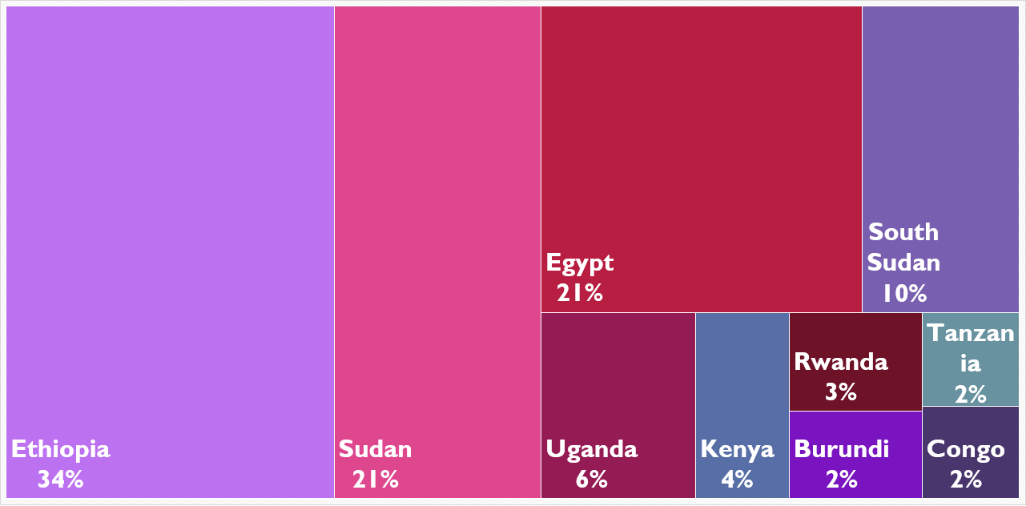
Scenario 1: Equal weights for all factors

Slide 11
Scenario 2: Restricted Optimization

Slide 12
Scenario 3: Basin Sum Optimization
Notes:
Maximize sum of shares
Maximizing individual shares
Weights above 100
All positive factors 100% and all negative factors 0.

Slide 13
Scenario Envelope

Slide 14
Conclusion
Existing water allocation has no basis under modern water sharing laws
Current dominant water users will get lower shares under equitable allocations
Need to go beyond water allocation to accommodate water demands of all countries
Notes:
This study:
Indicative study
A start, Basic, lots of limitations and assumptions
No precedent , no methodology
base for future study
To tap into the current need In the system,

Slide 15
Recommendation
Physical water trade
Virtual water trade
Increased Efficiency
Water Smart Investments
Regional integration for synchronized planning and operation
Benefit sharing and co-owned projects
Exploring alternative water resources
Environmental Conservation and creating water conscious

