Slide 1
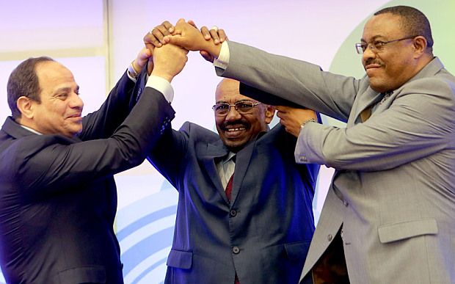
DISTRIBUTIONAL CONFLICT OVER BLUE NILE RIVER BASIN AND ITS IMPLICATION FOR INSTITUTIONAL CHANGE
BY
MEBRATU ALEMU (PhD)
2020 International conference on: Nile and GERD, (Virtual)
20-21 August, 2020
Florida International University, USA

Slide 2
CONTENTS OF PRESENTATION
INTRODUCTION
OJECTIVES OF THE STUDY
THEROTHICAL AND CONCEPTUAL FRAMEWORK
RESULTS AND DISCUSSION
CONCLUSION AND RECOMMENDATIONS

Slide 3
INTRODUCTION
The Nile is one of the world’s longest rivers, passing through 6,695 km.
The drainage Basin of the Nile covers about 3.2 million square kms spread.
The basin area is about 1/10 of the land area of Africa & is shared by 11 countries.

Slide 4
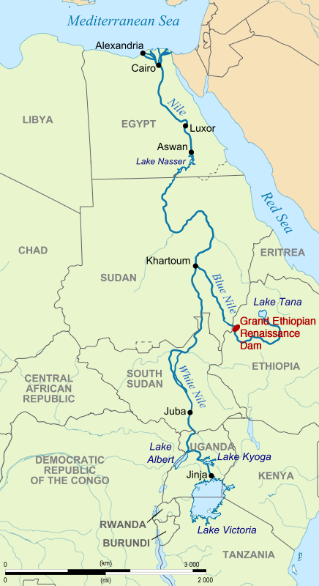
INTRODN..CONTD…

Slide 5
INTROD..CONTD..
The Basin has significant potential for:
  Clean energy (hydropower) dev’t & power trade;
  Irrigated & rain-fed agri. prodn;
  Preservation & use for eco-tourism
  Drinking water, fisheries prodn, navigation, recreation & ecosystem maintenance..

Slide 6
INTROD..CONTD
In spite of all the importance of the Blue Nile Basin(BNB), the scientific understanding of the Nile has been limited due to:
Insufficient basin-wide hydrologic, meteorological, climatic, socio-economic, ecosystem related data & info, & institutional capabilities.
Asymmetry among the riparian countries in terms of water infrastructure dev’t, institutional & technical capacity.
These challenges & threats are by their very nature trans-boundary & the impact that the river has had on the international politics of the region is evident.

Slide 7
Objective of the study
The General Objective
Is to examine the distributional conflict & its implication for institutional change among the 3 riparian countries over Blue Nile River.
The Specific Objectives
To analyze the property rights change about the utilization of Blue Nile River Basin over time.
To investigate the driving forces behind conflicts & cooperation regarding issues of water distrib. among 3 countries.

Slide 8
1.3. Theoretical and Conceptual Framework
Contemporary theoretical debates on PR change are dominated by 2 competing schools.
Each side identifies d/nt factors as critically responsible for the change of
PR.

Slide 9
THEORY..CONTD..
The economic school
The distributional school
regards potential collective efficiency gains as the key factor pushing for PR change.
view PR evolution as a response to changes of relative prices, via the opening of new markets, popn change, technological innovation.
emphasizing the “demand side” of institutional change (i.e., gains from the change).
stresses distrib. Inequality as the determinant force for the evolution of PR.
Potential improv’t in PR cannot be materialized when distr. inequality is involved.
Distrib. conflicts inherent in any PR arrangement, can block or critically constrain the institutions that can be adopted (Libcap, 1998).
Notes:
PR-Property right

Slide 10
THEORY..CONTD..
Distributional school(contd..)
Some get better off(winners); others worse off(losers) b/c of PR change.
The losers are expected to take measures to block PR change if such measures are not so costly to them as the PR change.
factors such as distrib. inequality on the “supply side” can block PR change.
stresses that distrib. disadva. created by PR change may induce potential losers to take efforts to impede it (Libecap , 1989).
However, it is equally likely
that distrb. advantage may induce winners to take steps to speed up & facilitate the change of PR.
stresses the role of winners: “the main goal of those who develop institutional rules is to gain strategic advantage vis-à-vis other actors (Knight ,1992).
Notes:
Institutions are not created to constrain groups or societies in an effort to avoid sub-optimal outcomes but, rather,
are the by-product of substantive conflicts over the distributions inherent in social outcomes.
The coexistence of these two competing views is actually not surprising. By its
very nature, institutional changes create winners and losers as well.

Slide 11
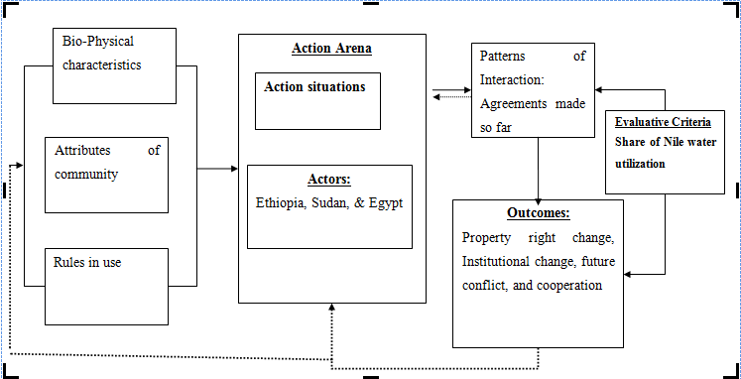
Conceptual Framework.CONTD..

Slide 12
Conceptual..contd..
How social, economic, legal, & political factors exert their influence on the formation of new equilibrium that shed light on the complicated process of restructuring PR over fair utilization of Blue Nile River.
Focus on how economic actors come to grips with their sometimes conflicting & sometimes converging interests in constructing new PR over utilization of the common river.

Slide 13
2. METHODOLOGY OF THE STUDY
2.1. Data sources and Method of Collection
Secondary data sources from d/nt concerned bodies & agencies were gathered.
Published & unpublished documents like statistical figures, news papers, media and reports related to the subject matter from FAO, World Bank, Ministry of water resources were critically reviewed.
2.2. Data Analysis and Presentation
In order to analyze the past and the current institutional interactions of actors (Ethiopia, Egypt and Sudan) about Blue Nile water sharing & see if any PR change exists over utilization of the common river, the Institutional Analysis Development Framework shown before was used.

Slide 14
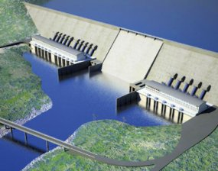
RESULTS AND DISCUSSION

Slide 15
Population and water withdrawal of the 3 countries
Country | Popon. 2015 E (000s) | Water withdrawal in (m^3/year) |  |  | Total H20 withdrawal | Total water withdrawal per capita per year
 |  | Agriculture | Municipality | Industry
Ethiopia Year % age | 99,391 (2015 E) | 5.2 *10^9 (2002 E) 93.63 % | 0.05*10^9 (2005 E) 5.99 % | 0.81*10^9 (2005 E) 0.37 % | 5.558*10^9 (2002 E) | 78.96 m^3/yr
Egypt Year %age | 91,508 (2015 E) | 67*10^9 (2010 E) 86 % | 9*10^9 (2010 E) 11.54 % | 2*10^9 (2000 E) 2.6 % | 78*10^9 (2010 E) | 910.6 m^3/yr
Sudan Year %age | 40,235 (2015 E) | 25.9*10^9 (2011 E) 96.2 % | 0.075*10^9 (2011 E) 3.5 % | 0.995*10^9 (2011 E) 0.28 % | 26.94*10^9 (2011 E) | 714.1 m^3/yr
Source: (FAOSTAT, 2015).

Slide 16
Result..contd
Agreed and conflicting issues over utilization of Nile River(PR change → Institutional change )
  Pre Colonial Agreements
  Colonial Agreements
  Post colonial Agreements
The Blue Nile basin features significant conflict over access and rights to the Nile water resources among the 3 riparian countries(ETHIOPIA, SUDAN & EGYPT)
Most of the existing agreements were reached between the colonial powers, or b/n Egypt & the colonial powers.

Slide 17
Year | Parties | Agreed Issues | Conflicting Issues
1704 | Ethiopia and Egypt |  | King of Ethiopia threatens Egyptian Pasha to cut off the Nile.
1902 | Britain and Ethiopia | Agreement was signed to limit Ethiopian intervention with the Nile waters.
1929 | Britain and (newly Nile independent) Egypt | Nile Water Treaty: Britain provided Egypt with the monopoly over the river, allocating only 4 billion cubic meters to Sudan. | 48 BCM- Egypt 4 BCM-Sudan
1959 | Egypt and Sudan | Nile Water Treaty signed when pro-Egyptian government elected in Sudan. Water Agreement on “the full utilization of the Nile water.” | 55.5 BCM-EGYPT 18.5 BCM-SUDAN 10 BCM-LOST --EVAPORATION
1978 | Egypt and Ethiopia |  | Ethiopia’s proposed construction of dams on the headwaters of the Blue
1979 | Egypt and Ethiopia |  | Anwar Sadat declared: “The only matter that could take Egypt to war again is water”

Slide 18
Year | Parties | Agreed Issues |  | Conflicting Issues
1992 | The Technical Cooperation Committee for the Promotion of the Dev’t & Env’tal Protection of the basin (TECCONILE) was established.
1994 | Egypt & Sudan |  | Egypt planned and then cancelled an air raid on Khartoum, where a dam was being built.
1995 | Egypt & Sudan |  | Increased tensions over the attempted assassination of President Mubarak.
1999 | Water ministers of nine countries established NBI |  | To achieve sustainable socio-economic dev’t through the equitable utilization of, & benefit from, the common NB water resources.
2001 | Egypt, Sudan, & Ethiopia established the Eastern Nile Subsidiary Action Plan (ENSAP), coordinating their efforts to execute joint & independent irrigation, hydroelectric power, & water mgt projects in the basin.
2010 | 6 upstream (NBI) members signed the Cooperative Framework Agreement (CFA), 4 members ratified the Entebbe Agreement:to establish principles, rights and obligations to ensure long-term & sustainable mgmt and dev’t of the shared Nile waters.
2011 | Ethiopia has launched the construction of the Grand Ethiopian Renaissance Dam, GERD. 6,000MW, create a lake with a volume of about 74 billion cubic meters
2015 | Egypt, Ethiopia & Sudan | Signed "Declaration of Principles“ to put an end to a four-year dispute over Nile water sharing arrangements among Nile Basin countries.

Slide 19
Result..contd
The 4th principle of the March 2015 declaration i.e. the Principle of fair and appropriate use”, the 3 countries agreed to use their common water sources in their provinces in a fair & appropriate manner.
The 9th principle of declaration i.e. the “principle of the sovereignty, unity and territorial integrity of the State”
The 3 countries agreed to cooperate on the basis of equal sovereignty, unity & territorial integrity of the state, mutual benefit & good will, in order to better use & protect the River Nile.
This could be considered a big progress for PR change over the use of Blue Nile River.

Slide 20
Two contrasting views
Future cooperation
Future conflict
views water resources as an arena for future cooperation
(Arsano, 2007; Elise Bolding, 1993)
No state boundary, no barbed wire, no wall can stop water flowing along its natural course.
views water resources as an arena for future conflict.
(J. star, 1991; Fakenmark, 1992;
Gelak, 1993; Jorgakos, undated)

Slide 21
Results continued
Verbal conflicts B/n Ethiopia and Egypt
“Egypt is the gift of the Nile.”…Herodutus in 5th Century B.C.E
“Without Nile, there would have been no food, no people, no state, & no monuments”…in Egypt and Sudan
Boutros Boutros-Ghali (1988), the former secretary-general of the UN, has predicted that “the next war in the region will be over water”
BBC(2000) indicated that “In the next 25 years water scarcity will be the main source of conflict”.

Slide 22
Contd…
In 2000, the American congress also indicated water distrib. conflict will be the major factor that would threaten Sub-Saharan African countries especially EGYPT, SUDAN & ETHIOPIA.
Former Egyptian president Morsi warned that “if Egypt’s share of the Nile’s water diminishes by one drop, that ‘blood’ would be the alternative”
Ethiopian PM Meles Zenawi told Algezira: “While Egypt is taking the Nile water to transform the Sahara Desert into something green, we in Ethiopia—who are the source of 86% of that water—are denied the possibility of using it to feed ourselves.”

Slide 23
Contd…
To the contrary, shared waters can better serve as catalyst for cooperation rather than conflict(Arsano, 2007).
Arsano does not see any risk of "water wars" within and b/n states in the Nile Basin.
Yet, the riparian countries still did not established a confidence and trust in one or another way to fully cooperate.

Slide 24
Future Pressures on the Nile’s Water Flow
Human interference in H20 SS
Increased H20 scarcity
Survival resource scarcity
popn growth
Land degradation & loss of biodiversity
Electricity demand
Need for changed water distribution
Interstate tension and conflict over water sharing
Scarce arable land
Land use change
Livelihood insecurity

Slide 25
CONCLUSIONS AND RECOMMENDATION
There is no integrated plan for optimum use & dev’t of the waters of this river, which could benefit the 3 countries.
This study believes that In order to satisfy the future water demands of the economy & the popn growth, utilization of our common resource i.e Blue Nile River will be intensified and hence;
One could expect that future conflicts over water sharing are highly probable.
Moreover, we have to make sure that new rules of PRs over the fair & equitable use of Blue Nile River will serve the interests of those with strong bargaining power.
AS Libecap claimed distributional inequality can impede PR change also sheds light on the role of distrib. inequality in PRs transformation over the fair use of Blue Nile River among the 3 countries.
Notes:
PR-Property Right

Slide 26
Conclu and recomm..contd
Since water crisis in the Blue Nile River Basin is predictable;
Strengthening regional integration & the credible commitment in order to promote mutually beneficial inter-dependencies is very crucial.
This study suggests that Ethiopia should exert maximum effort in convincing countries to ratify the Entebbe Agreement (CFA) b/c any continued delays in negotiations will lead to further degradation of relations between the 3 states.

Slide 27
Thank you

