Slide 1
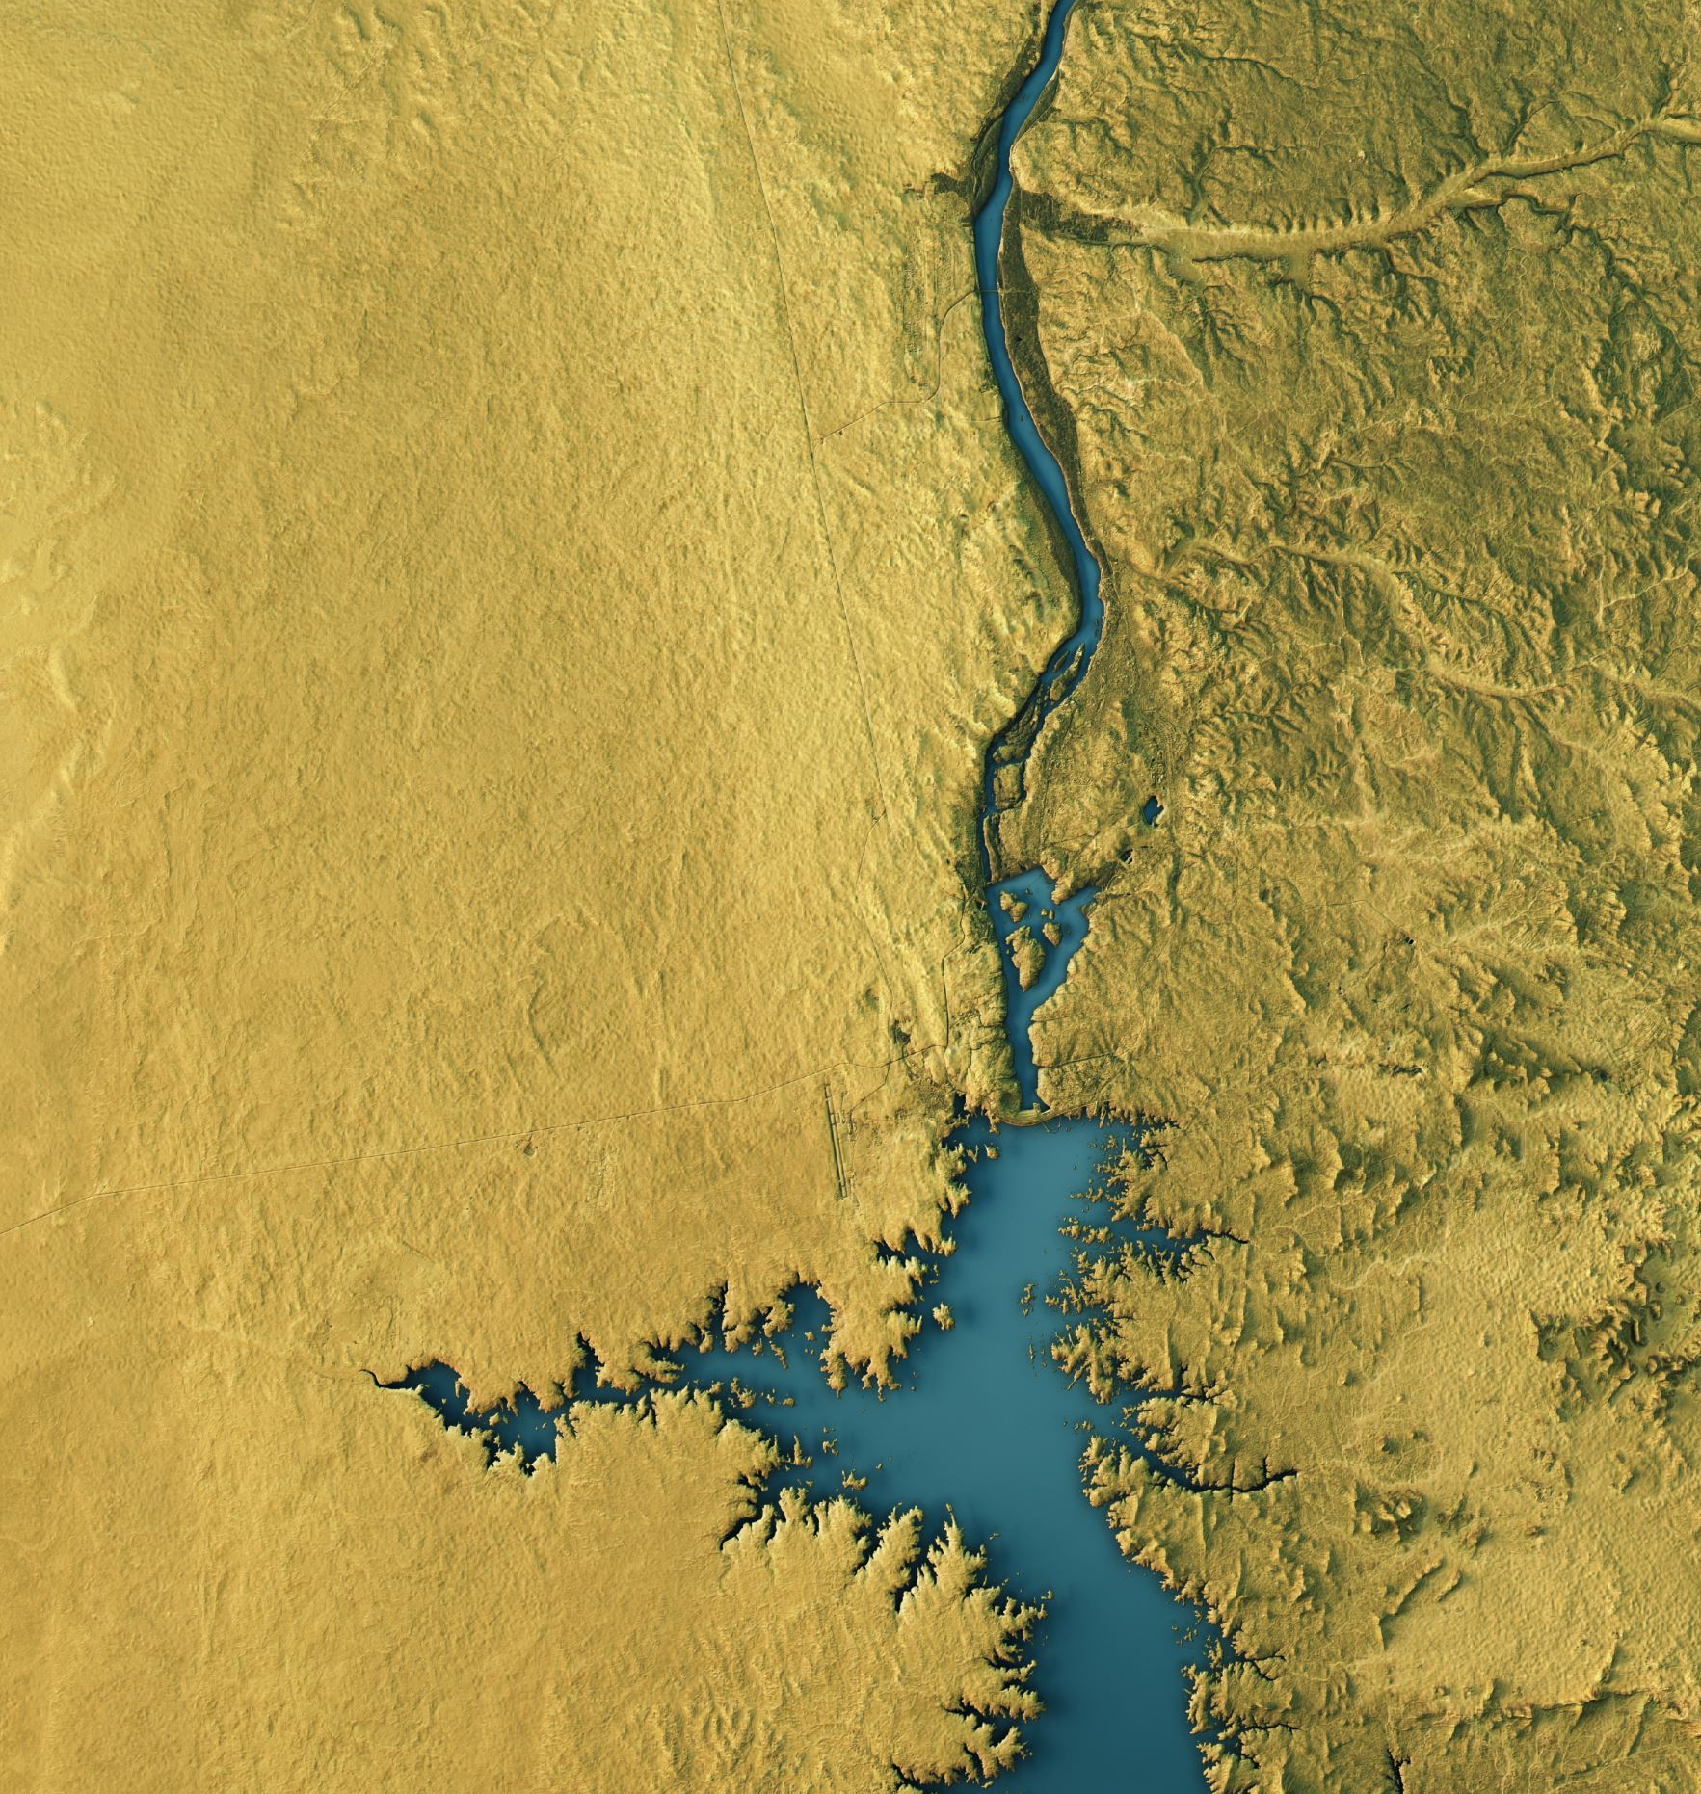
The GERD, and the Revival of the Dispute Over Colonial Nile Waters Treaties
Mahemud E. Tekuya, Ph.D./JSD Candidate at McGeorge School of Law
August 21, 2020

Slide 2
Outline
Introduction
Background: Dispute Over the Nile Colonial Treaties
The Nile Colonial Treaties
Cooperative Framework Agreement: Solidifying the Disputes
The Declaration of Principles: A Symptomatic Treatment?
3. Post DoP negotiations, and the Revival of Dispute Over Colonial Treaties
The Two Studies on the GERD
Egypt’s proposal for the Filling and Operation of the GERD
Washington Process and the Letters to the UNSC
4. Way forward: Towards Taming the Elephant in the Room

Slide 3
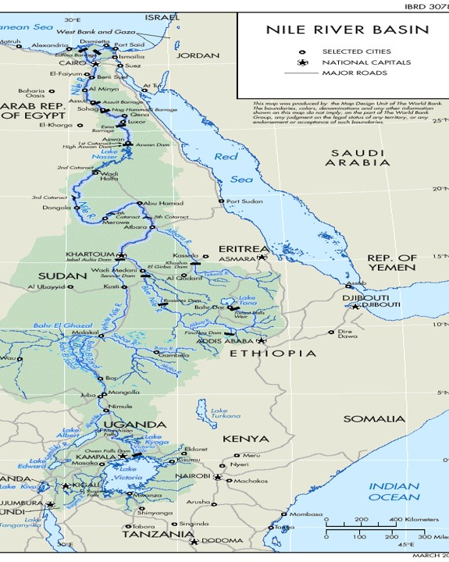
1. Introduction
The Nile is made up of several tributaries.
Three tributaries, the Blue Nile, Sobat (Baro) River and the Atbara (Tekeze and Angereb) River, originate in Ethiopia and contribute 86 % of the Nile waters.
The other main tributary, the White Nile, originates in Lake Victoria and shared among Tanzania, Rwanda, Burundi, Kenya, Uganda, and the Democratic Republic of Congo, contributes the rest of the Nile flow.
Generally, eleven countries share the Nile River

Slide 4
Objectives
General objective
To examine the implications of the Colonial Nile Waters (CNWT) on the GERD negotiations
Specific Objectives
To discuss the dispute over the CNWT
To show how the dispute over the CNWT revived in
the GERD’s impact studies (2) the Washington process and letters to UNSC
To Explore possible alternatives for unlocking the dispute

Slide 5
Methodology
Research paradigm
It is a doctrinal research
Evaluative legal research model is used to scrutinize
- the salient features,
-and ramifications the CNWT and the DoP on the GERD negotiation
Sources of Data: Both primary sources (international agreements, treaties, CIL, and DoPs) and Secondary sources (literatures, journals, books) have been used.
Method of data analysis: A qualitative method of data analysis i.e. the narrative and content analysis of both primary data and secondary sources have been undertaken

Slide 6
2. Background: Dispute over the CNWT
The CNWT
Several bilateral treaties, but the 1902, 1929 and 1959 treaties are the most dispute treaties
1902 Anglo-Ethiopian Treaty
It is a bilateral treaty concluded to determine the boundary between Ethiopia and Sudan
Article III is about the Nile where Ethiopia undertook “not to construct or allow to be constructed any work…that would arrest” the flow of the Nile without prior authorization from UK (Sudan)
Source of dispute between Ethiopia vs Egypt and Sudan
Egypt and Sudan consider themselves as successors of this agreement and so claimed that Ethiopia must get their consents to build any project in the Nile

Slide 7
Con.
Ethiopia rejects this, claiming that the treaty was not ratified and that the meaning of the word “arrest” both in the Amharic and English versions does not preclude Ethiopia from using the waters
2. 1929 Anglo-Egyptian Treaty
Britain, representing Sudan and its East African colonies (Kenya, Uganda, and Tanganyika).
So called “historic” and “natural” rights of Egypt (48 BCM) & Sudan (4 BCM for Sudan) (52 BCM)
Veto power, explicitly granting Egyptian authorities a right to preempt any changes in the status quo

Slide 8
Con.
A source of dispute Egypt vs. Kenya, Uganda, and Tanzania
They invoked the clean State (Nyerere doctrine) doctrine and argued that had no role in conclusion, so should not be bound by it.
Egypt claims it is binding based on ‘territorial’ and ‘boundary” treaties exception.
African states boundaries were determined by colonizers. Like boundaries, this treaty survives the treaty survives decolonization and bound former British East African colonies.
3. 1959 Nile Water Treaty
Allocated the net benefit (32 BCM) generated HAD
Sudan 18 BCM= (14.5 BCM + 4 BCM)
Egypt 55.5 BCM =(7.5 BCM+ 48 BCM)
1O BCM for evaporation

Slide 9
Cont.
But Egypt invokes “established right”, “historical use” or “existing use and right” principles and claims that it is legally entitled to the water share allocated in this agreement.
Upstream States vehemently rejected this claim and called for a basin-wide treaty.
B. Cooperative Framework Agreement: Solidifying the Disputes
Started in the early 1990s and formalized in the adaption of the Nile Basin Cooperative Framework Project (Project D3) in 1995.
All Basin States at the time, except Eritrea, negotiated for about 15 years (13 in NBI, but not correct)
During the negotiations, the fate of the CNWT was subjects of the controversy

Slide 10
Cont.
Upstream States argued that the CFA should replace and supersede over the CNWT
Downstream States insisted that the CFA must explicitly recognize the CNWR so they would bind all Nile Basin States
Non-legal and elusive concept called, water Security, came to reconcile the controversy. But they could not agree on 14 (b)
Upstream countries 14(b) an obligation “not to significantly affect the water security of any other Nile Basin State”
Egypt and Sudan wanted the language to be “not to adversely affect the water security and current uses (60 BCM) and rights (18.5 BCM) of any other Nile Basin State”
Unequivocal recognition of CNWT (Egypt and Sudan walked away)

Slide 11
C. The Declaration of Principles: A Symptomatic Treatment?
In April 2011, after signing the CFA, Ethiopia started constructing the GERD.
Egypt and Sudan opposed the dam alleging that it would violate the CNWT.
Considering the enormous advantages it would get from the dam including, regular flow of water (increase irrigation capacity), flood control, reduction of evaporation, enhancing production of electric and cheaper electricity, Sudan supports the dam in 2012.
Gradually, after painstaking negotiations, Egypt also recognized the importance of the dam and the three States signed an agreement of the DoP on the GERD on March 23, 2015.

Slide 12
Cont.
The DoP is a unique addition in codifying equitable and reasonable utilization, and of the ‘no significant harm’, as the governing rubric of the Nile Basin.
But one of the problems of this document is that a symptomatic treatment and does not resolve the dispute over CNWT.
Salman argues it abrogate the CNWT, but that is not the case.
Tacit abrogation requires two conditions (1) same subject matter and (2) incompatible
It is not a treat, but even if it is, the DoP (framework for GERD) and CNWT (the whole Nile and veto) govern different subject matters.
It is a special one that can go along with the CNWT
So, it does not abrogate the CNWT, and hence does not bring about de-jure change in the status quo.
Rather, it creates the opportunity to maintain the CNWT.

Slide 13
3. Post DoP negotiations, and the Revival of the Dispute Over Colonial Treaties
Two studies recommended by IPoE
Before the adoption of the DoP, the three States established IPoE
The IPoE two studies: a transboundary impact study and a hydrological modeling study.
The studies would be conducted under the supervision of the Tripartite National Committee (TNC), and the TNC hired two French firms.
Egypt says baseline data to determine the impact should be its “current use of the Nile waters” (61 BCM). Tried also to exclude Sudan.
Sudan demanded the 1959 Nile Treaty water allocation serve as the baseline
Ethiopia rejects both, and propose National Independent Scientific Research Group (NISRG) to study scenarios for filling and annual operating the GERD

Slide 14
Cont.
B. Egypt’s proposal
Ethiopia should fill the GERD slowly while releasing 40 BCM of water every year
Egypt should have surplus water in lake Nasser (HAD must be 165 meters above sea level)
Egypt can use the water as it wishes and claim more water from the GERD
GERD non-functional (second reservoir for Egypt)
III. Ethiopia should get approvals from Egypt at various stages of the filling and operation of the dam
CNT and veto to Egypt.
IV. Ethiopia should release the entire flow of the Nile waters after the filling of the GERD
CNT, and will foreclose Ethiopia’s existing and future right to use
V. Egypt should open office in GERD site
Sovereignty and again veto

Slide 15
Cont.
C. Washington Process and the Letters to the UNSC
Disagreed in every legal aspect. But two main sticking points.
Three Drought mitigations (drought 37, Prolonged drought 39 and prolonged dry years 40).
Release the flow…Prohibits Ethiopia from using tributaries and impose the 1959 Treaty on Ethiopia.
Additional water from the GERD
Presupposes that Ethiopia does not have a share from the Nile, Ethiopia is delivering below their share in 1959 Treaty, and so must pay it back.
There is no water sharing arrangement in the Nile case, so inappropriate
2. Compulsory dispute resolution is inappropriate because
DoP requires dispute to be resolved through negotiations, conciliations and mediations
Kills the CFA. If they need binding dispute resolution, they should go to CFA

Slide 16
Cont.
In its letter to UNSC, Egypt dined it is not trying to impose any colonial treaties on Ethiopia.
But, ironically it invoked the 1902 Anglo-Ethiopian Treaty, trying to benefit from its colonial legacy.
It also called upon Ethiopia to respect the “current and existing uses”.
This is worst than imposing the 1959 Treaty because Egypt is currently using 61 BCM, and Sudan can’t use its “share” under the treaty.
Harm to the existing use is allowed under international law.
So, while using its equitable share, Ethiopia can cause significant harm to the current use.
What is prohibited is exceeding from equitable share.

Slide 17
5. The Way forward: Towards Taming the Elephant in the Room
Now they are undertaking the tripartite negotiations through the AU.
For the negotiations to move forward, the implications of the CNWT must be dispensed with.
a. AU should help the three States to create a positive bargaining zone by (1) restricting the scope of the ongoing talks only on the filling and annual operation of the GERD, and (2) encouraging the States resort to the CFA for water allocation, dispute resolution and long-term operation of the GERD.
b. No recognition of CNT, no water allocation, no prohibition of equitable use above GERD, and no association with HAD
c. Equitable filling considering all factors (not potential impact)…4-7 years
d. Amendment, review and revocation clause
Otherwise, ANY GERD Treaty will be a tool for perpetuating of the CNT

Slide 18
Thank You

