Slide 1
Need of Intensified Watershed Management Interventions in the Upper Catchment of GERD
Lakew Desta
Biybone Consultants PLC
Addis Ababa, Ethiopia

Slide 2
Outline of the Presentation
Background
Literature Review on GERD Sedimentation
Literature Review on d/s of GERD Sedimentation
Sediment Valuation
Prevailing Challenges in WM in Ethiopia
Framework Opportunities in Ethiopia for the Pursual of WM
The Way Forward /Recommendations

Slide 3
Background
The upper catchment of the GERD is 172,250 Km², it stretches up to 900km, hosts 31.9 million people (28%), and 39% LS,
Highland, steep slope, canyons, diverse agroecology, farming system, dense and fragmented holding, oxen plowing, free grazing, high rate of erosion – it is as if all the rugged part is given, by nature, to Abbay Basin
Deep and wide gully dissections is a common phenomenon – 10% of the sediment load comes from gullies
What is eroding is fertile top soil which otherwise would have been used for agriculture /cropping
We are losing the soil, seed, applied fertilizer, compost, manure, lime
Although, there is on-going re-greening and slope correction /terracing effort, it is a long way behind

Slide 4
Literature Review on Sedimentation u/s GERD
Nº | Original Figure | Unit | Conversion Unit | Actual Value | Rounded Value
1 | 207 | Million Cubic Meter | 1.0 | 207 | 207
2 | 245 | Million ton | 1.1 | 269.5 | 270
3 | 287 | Million Cubic Meter | 1.0 | 287 | 287
4 | 308.6 | Million ton | 1.1 | 339.46 | 340
5 | 473 | Million ton | 1.1 | 520.3 | 520
 |  |  |  |  | 325 MCM
 |  |  |  | Average

Slide 5
Literature Review on Sedimentation - d/s of GERD
^{[1]} Tekeze dam, also contributes to Nile, is not in the d/s of GERD but it is also a dam with potential sedimentation risk to dams in the d/s - https://www.google.com/search?channel=trow2&client=firefox-b-d&q=tekeze+hydropower+project+pdf.
Nº | Name | Year Commissioned | Purpose | Storage Volume in BCM | Sediment Volume/tone | Source
1 | Sennar | 1925 | Sed. Management, irrigation, hydropower | 1 | 0.71 BCM, in 61 years | Belachew, 2013
2 | Jabal Awlia | 1933 | Hydropower /Fishery | NA | Highly silted
3 | Rosaires | 1966 /1971 | Irrigation /Hydropower | 7.4 | 2.7 BCM in 28 years | Belachew, 2013
4 | Merwoe | 2009 | Hydropower | 12.5 | 84 MCM | ENTRO, 2006
5 | AHD | 1968 | Irrigation/Hydropower | 162 | 136x10⁶ t TSS yr-1 | Shalash, 1982
6 | Tekeze | 2009 | Hydropower | 9 | 30MCM | *
7 | GERD | Upcoming | Hydropower | 74 | 207MCM/yr | Ethiopia
 | *https://www.google.com/search?channel=trow2&client=firefox-b-d&q=tekeze+hydropower+project+pdf

Slide 6
Sediment Valuation
Valuing the annual soil /sediment lost at GERD, in financial terms
Annual sediment volume is converted into hectarage of crop land having an assumed soil depth of 0.5m
The equivalent area that could be cropped, every year, is 64,930ha.
Cost-benefit analysis using the 10 Billion USD estimated cost for watershed management, at the current rate of wheat production of 27Qt ha-¹yr-¹, at 10% discount rate gives a NPV Present Value (NPV), changing to positive returns, at 29th year
Taking the potential wheat yield of 50qt ha-¹yr-¹ the NPV, showing positive returns will be reduced to 15 years
Practicing double cropping using irrigation and /or residual soil moisture the NPV can be under 10 years
Biological SWC can give NPV changing into +ve in the 2nd year of investment
Physical SWC measures give NPV changing into +ve in the 6th year of investment

Slide 7
Prevailing Challenges in WM in Ethiopia
Land degradation
Absence of national land use policy and tenure security
Lack of long-term reliable financing for watershed /land management programs /project
Short life span of land management-based projects /programs
Lack of applying quality SWC measures
Soil erosion is a threat to lime application
Overlying of fertile agricultural lands and infrastructural facilities with less fertile subsoils and debris
Infestation with invasive and exotic plants
Poor or no involvement of the private sector
Lack of adequate community ownership
Limited research
Inefficient documentation, reporting, and M&E system.

Slide 8
Framework opportunities in Ethiopia for the pursual of WM
Presence of diverse landscapes, agroecology, and farming system
Presence of extensive extension on NRM, SWC and WM
The presence of solidly founded past experience to pursue WM
Existence of community mobilized WM initiatives
Presence of strong policy and strategy on WM approaches
Presence of established planning unit at the community level

Slide 9
WM units and hydrological characteristics
Framework opportunities in Ethiopia for the pursual of WM Continued…
Planning unit | Typical area (KM2) | Example | Degree of coupling
Community /Micro-watershed | 5 | Typical watershed adopted by SLMP II (Ethiopia) – Agam | Very strong
Sub Watershed | 20 to 60 | An assemblage of 9 micro-watersheds Gumara | Strong
Major Watershed | 60 to 200 | An assemblage of 3 to 4 Sub watersheds | Moderate
Sub-basin | Up to 15,000 | Lake Tana | Weak
Basin | Up to 172,250 | Abbay Basin | Very weak

Slide 10
The Way Forward /Recommendations
Need of adequate resource mobilization
Formulation and enforcement of national land use policy
Do comprehensive watershed classification and coding
Scaling up of best practices
Establish labor support system
Acquire sufficient planting materials
Strengthen capacity building and knowledge management

Slide 11
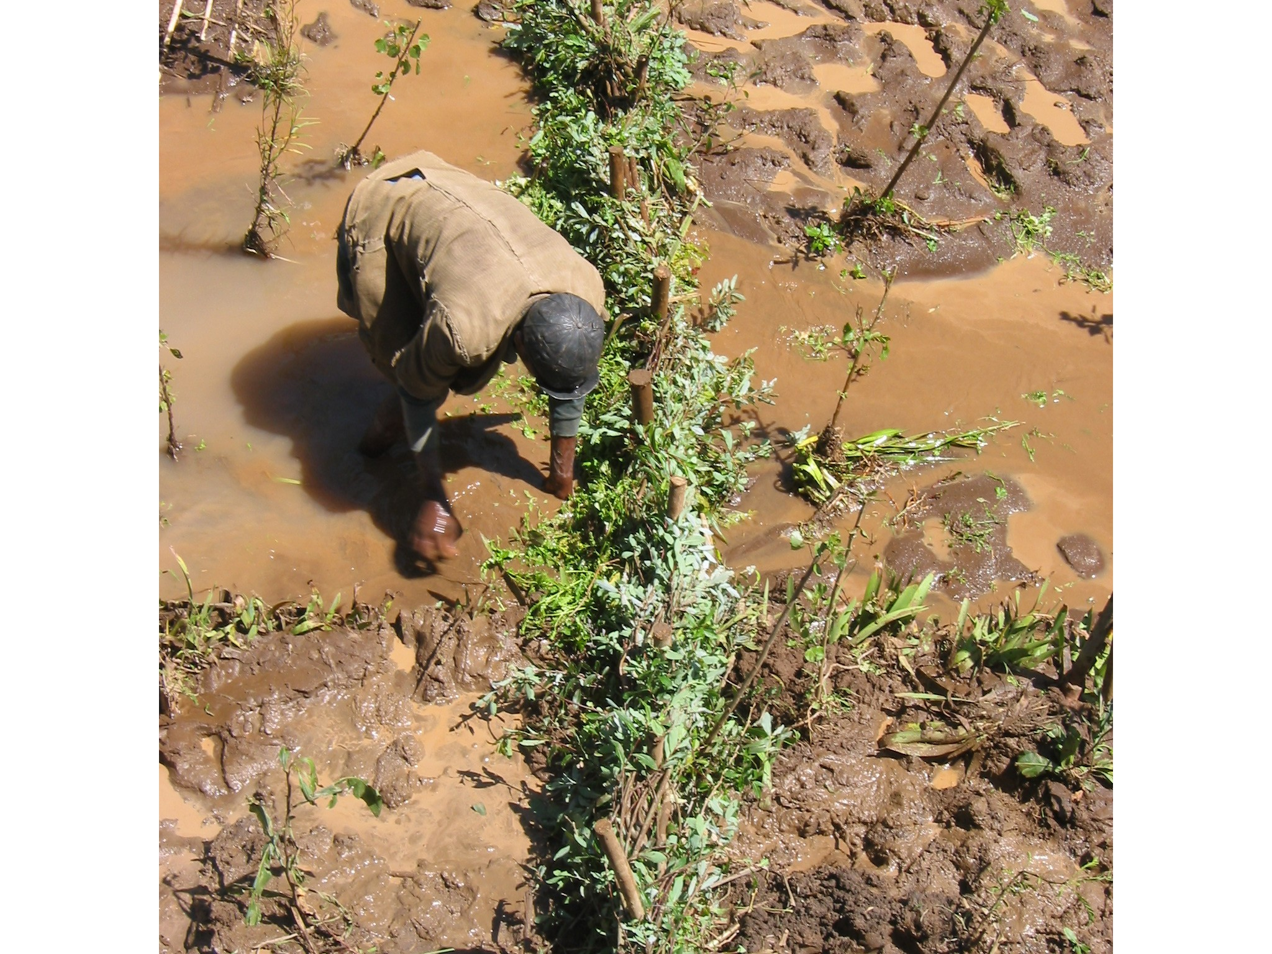
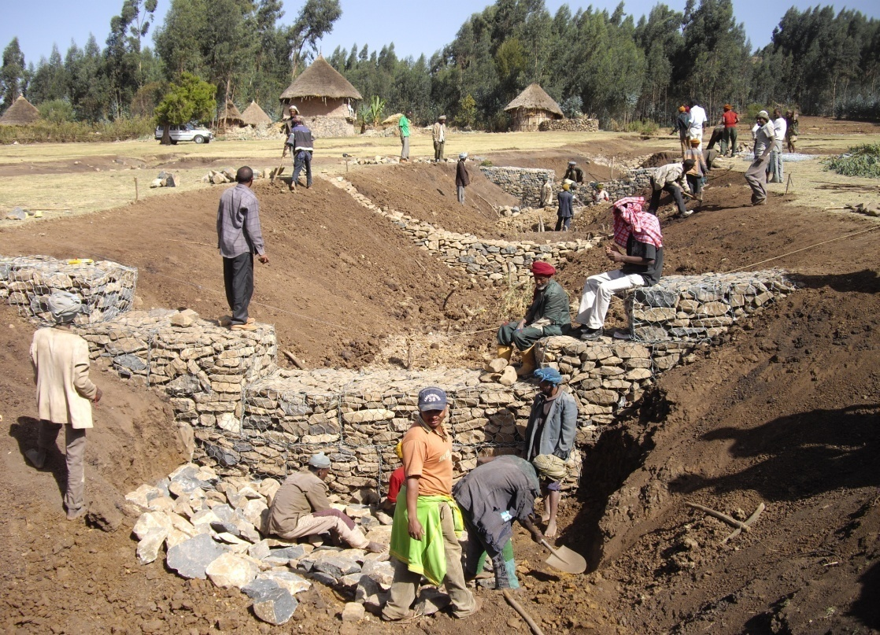
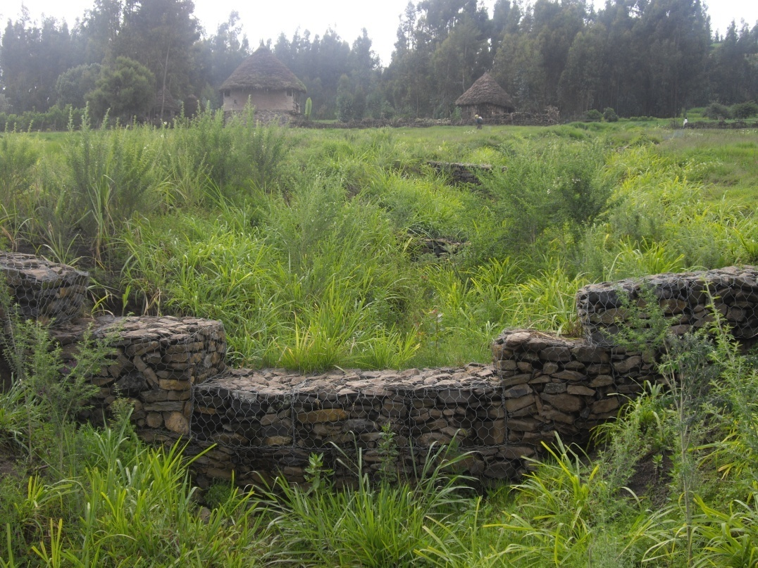
Kes (Mr.) Guadie Assefa, Working on gully plugging in Farta District, Maynet Kebele, Zefie Community Watershed, in the Lake Tana Sub-basin
Watershed Management in the “Before” and “After” – this happened in 1.5 years time – picture is in Farta District, Lake Tana Sub-basin, Maynet, Kebele Administration a proof that WM works, if applied correctly and timely

Slide 12
Thankyou!!!

