Slide 1
Water sharing policies for drought conditions to inform Grand Ethiopian Renaissance Dam operations
Guang Yang, Paul Block
University of Wisconsin-Madison, USA
2020 International Conference on the Nile and Grand Ethiopian Renaissance Dam: Science, Conflict Resolution and Cooperation
August 21, 2020
University of Wisconsin-Madison

Slide 2
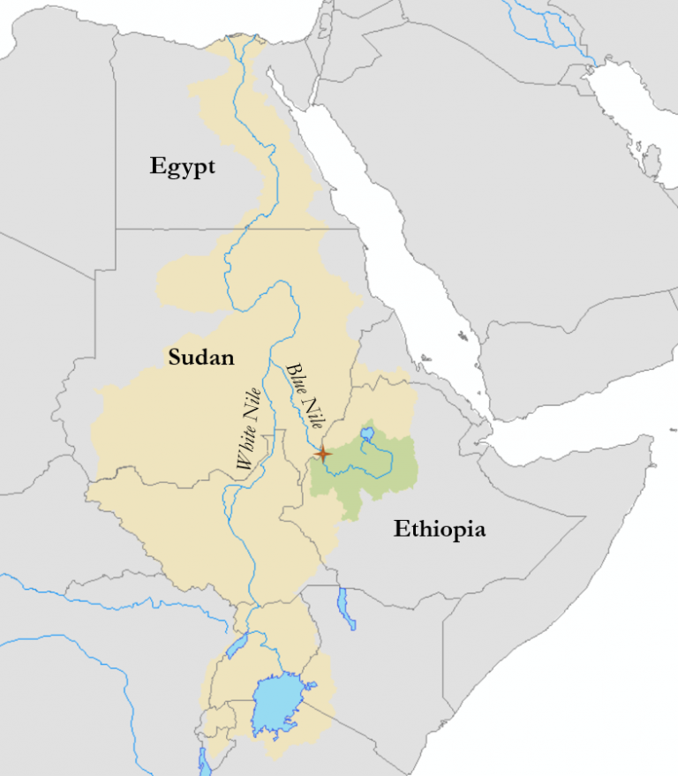
Nile basin and Grand Ethiopian Renaissance Dam (GERD)
The GERD situated on the Blue Nile River in western Ethiopia, will have an installed capacity of over 6,000 megawatts, and create a 74 cubic kilometer reservoir.
After construction, this dam will be the first major infrastructure project in Ethiopia on the main stem of the Blue Nile.
GERD
Notes:
Below is the basic information about Grand Ethiopian Renaissance Dam, we can call it GERD for short.
The GERD is located at Blue Nile basin and will be the greatest dam in Africa.
With its large storage of the reservoir, the GERD will be also installed with the greatest capacity of the power plant in Africa.
With the development of Ethiopia, its electricity demand is forecasted to grow at a rate of approximately 30% per year . Thus the GERD will play an important role in securing electric supply in Ethiopia and other Eastern Africa countries.

Slide 3
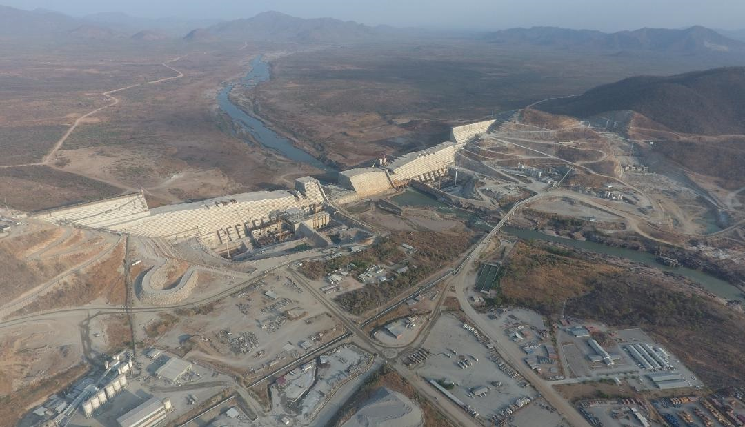
Grand Ethiopian Renaissance Dam (GERD)
74 cubic kilometers
Installed capacity: 6000 MW

Slide 4
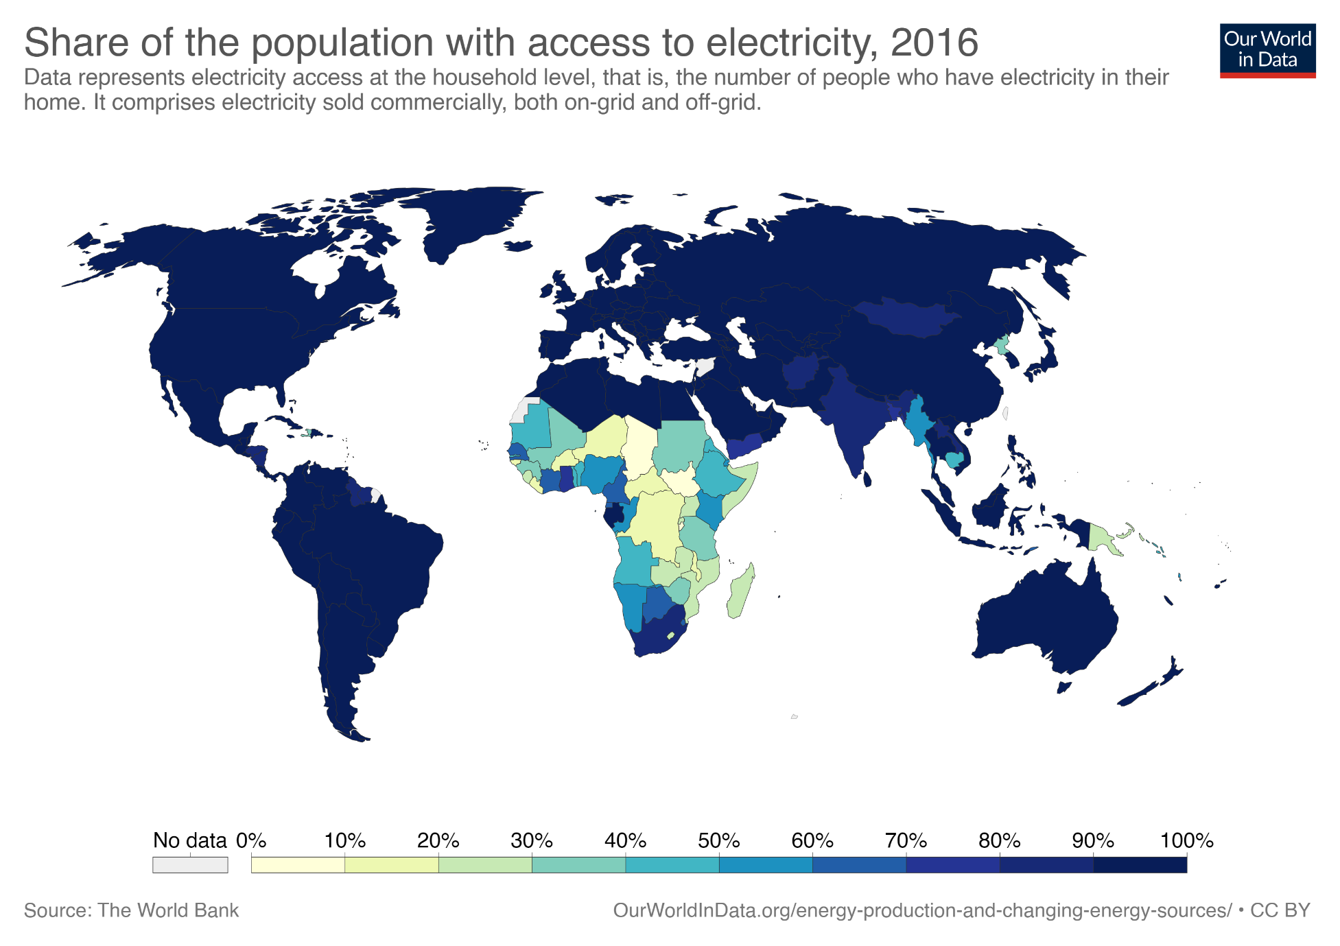
GERD construction and electricity demand in Ethiopia
https://ourworldindata.org/energy-production-and-changing-energy-sources
Notes:
Currently, the share of population with electricity access in Ethiopia is below 30 percent, which shows great potential for future’s increment.

Slide 5
Nile River conflicts and GERD operation
Water conflicts in Nile River Basin
60% of Ethiopian households are not covered by power grid and 40% of connected people suffers from disruptive power cuts.
Impact of GERD operation
Water Sharing for drought conditions
The GERD operation can significantly alter downstream flows, potentially leading to water resources management conflicts and disputes. (e.g., by making other water infrastructures vulnerable to drought or flood )
Most of Egyptians rely on Nile from drinking water to industrial use and irrigation.
There is no legal framework for water allocation agreed by all riparian countries.
Will there be enough water from the GERD reservoir to mitigate drought? (trade-off between power generation and drought mitigation)
How the GERD will be operated, particularly during droughts?
Is it possible to inform the drought mitigation with hydrological forecasts?
Notes:
Currently, the share of population with electricity access in Ethiopia is below 30 percent, which shows great potential for future’s increment.

Slide 6
Water sharing policies for drought conditions
Drought mitigation policy development
Multi-objective optimization
Water release analysis
Drought mitigation policy
Ensure enough water for power generation and drought mitigation simultaneously.
Release enough water from the reservoir to help mitigate drought downstream.
Guide the GERD reservoir operation, especially in drought conditions.

Slide 7
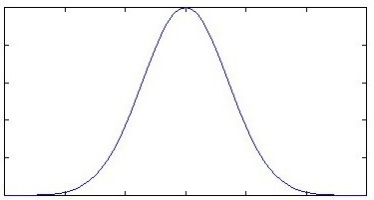
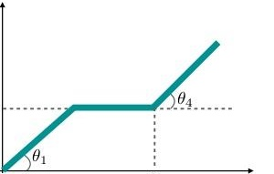
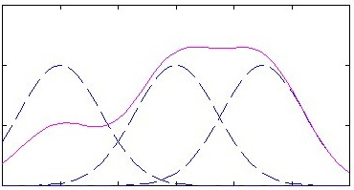





GERD reservoir operating rules
Radial basis functions (RBFs) for reservoir water release
$${\text{Q}}_{\text{t}}^{\text{out}}\text{=}\text{RBFs}\left(Xt\right)$$
X_{t} = $\left({{\text{S}}_{\text{t}}\text{, }\text{Q}}_{\text{t}}^{\text{in}}\text{, }{\text{τ}}_{\text{t}}\right)$
$${{\text{S}}_{\text{t}}\text{, }\text{Q}}_{\text{t}}^{\text{in}}\text{,} \text{and} {\text{τ}}_{\text{t}} \text{are} \text{the} \text{reservoir} \text{storage}\text{, }\text{inflow}\text{, }\text{and} \text{seasonal} \text{information} \text{in} \text{period} \text{t}\text{, }\text{respectively}\text{.}$$
Radial basis function (RBF)
Reservoir storage
Reservoir inflow
Water release
${\text{Q}}_{\text{1}}^{\text{in}}$
${\text{Q}}_{\text{2}}^{\text{in}}$
…
${\text{Q}}_{\text{t}}^{\text{in}}$
Conventional rules
RBFs-based reservoir operating rules
Water release
$$P_{t}=K⋅Q_{t}^{P}⋅H_{t}^{P}$$
Reservoir storage, inflow
Reservoir storage, inflow

Slide 8
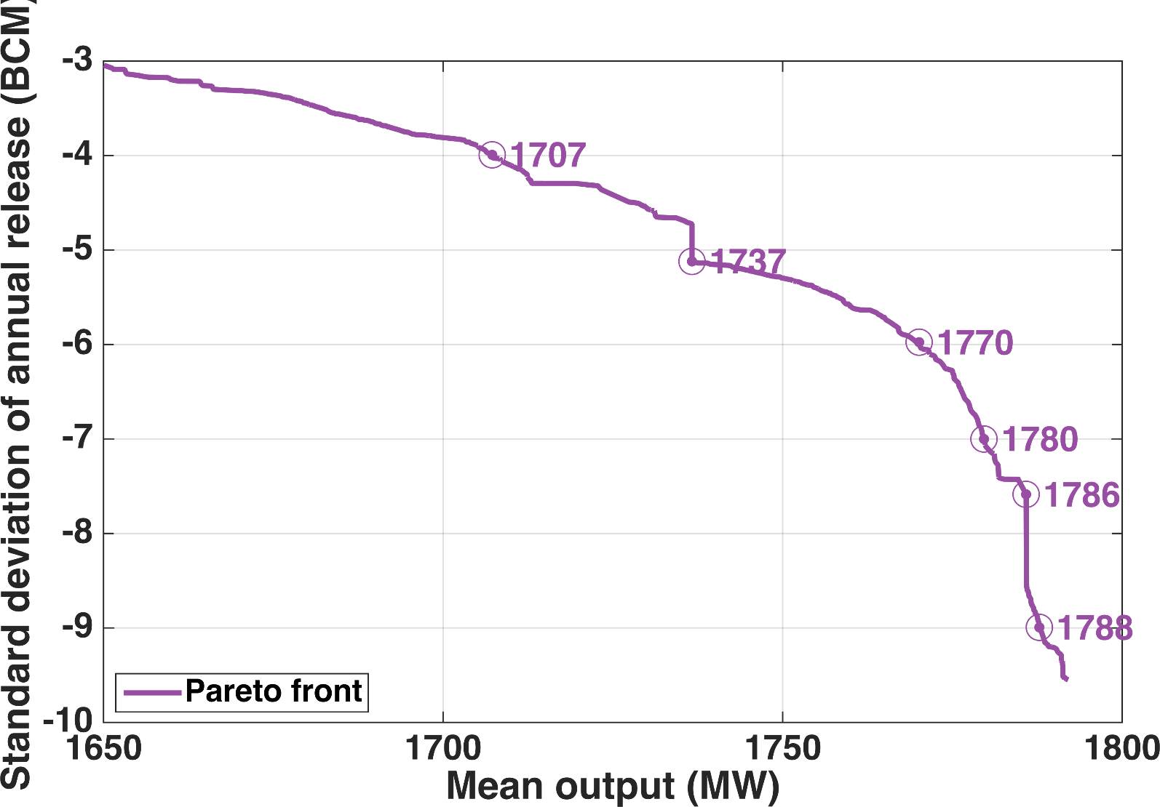
GERD reservoir operating rules optimization
Pareto front of multi-objective optimization (1965-2017)
A slight decrease in power generation can lead to significant decrease in the standard deviation of annual water release

Slide 9
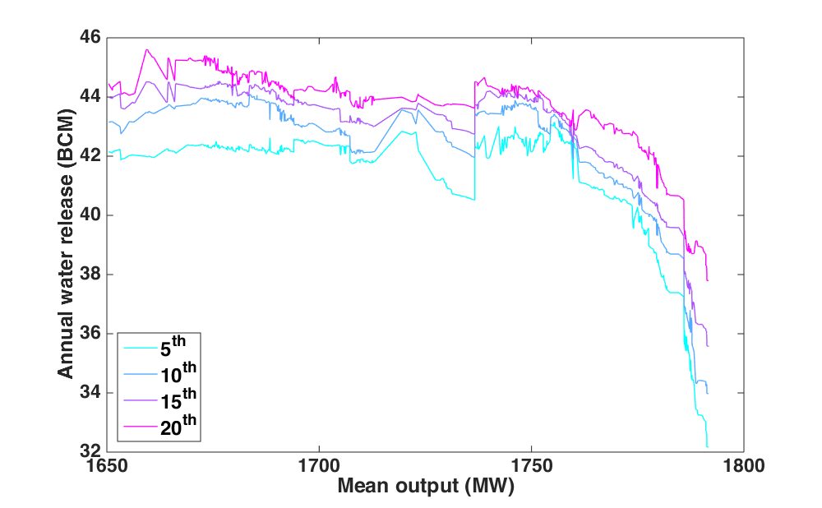
GERD reservoir operating rules optimization
Power generation output and annual water release percentiles (1965-2017)
The Pareto front from multi-objective optimization can represent the trade-off between power generation and downstream water release in drought conditions.

Slide 10
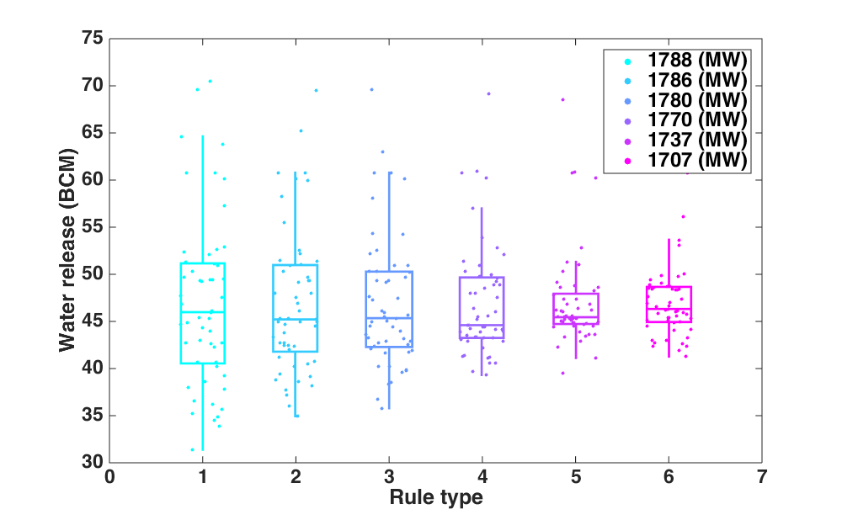
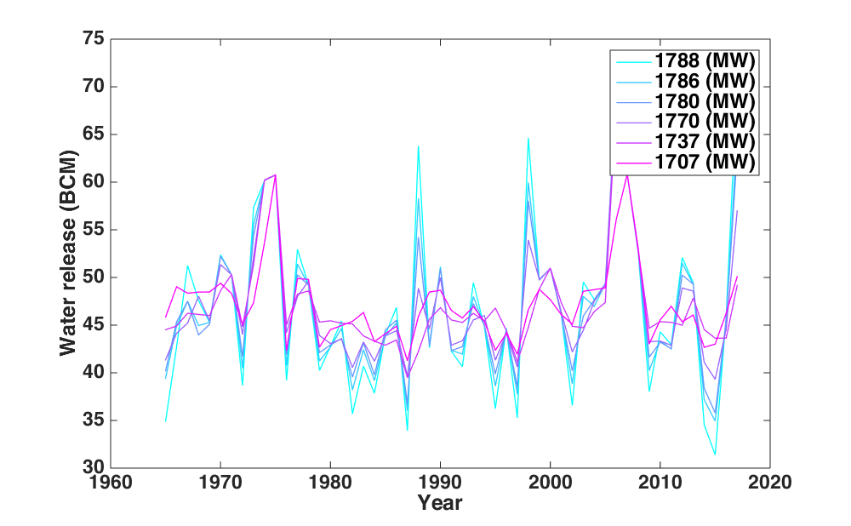
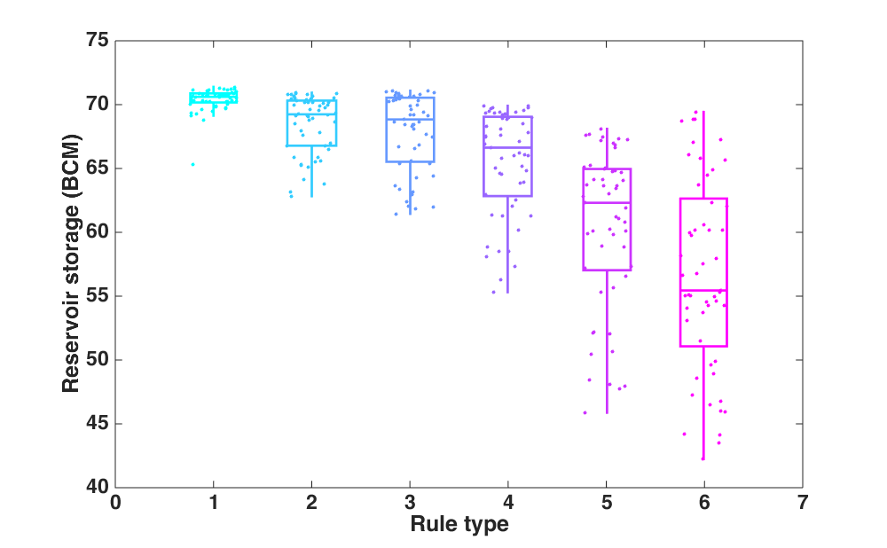
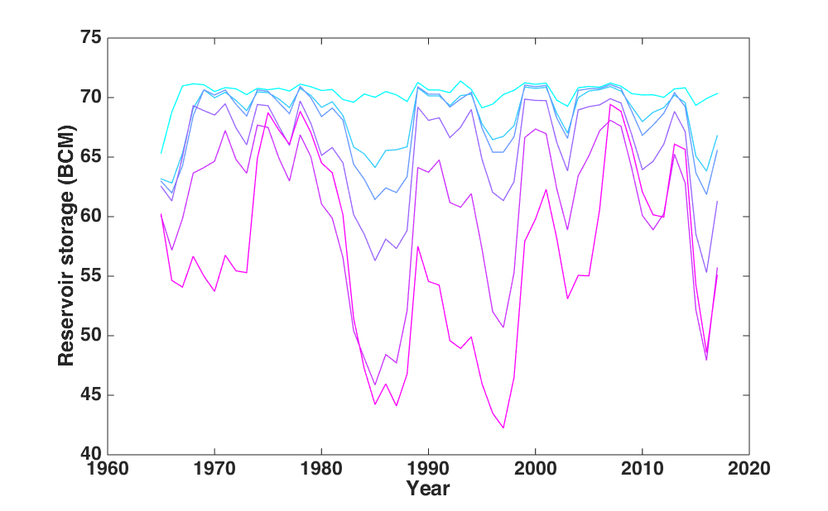
GERD reservoir operating rules optimization
Boxplots and values of annual reservoir water release and storage
Trade-off, risk sharing!

Slide 11
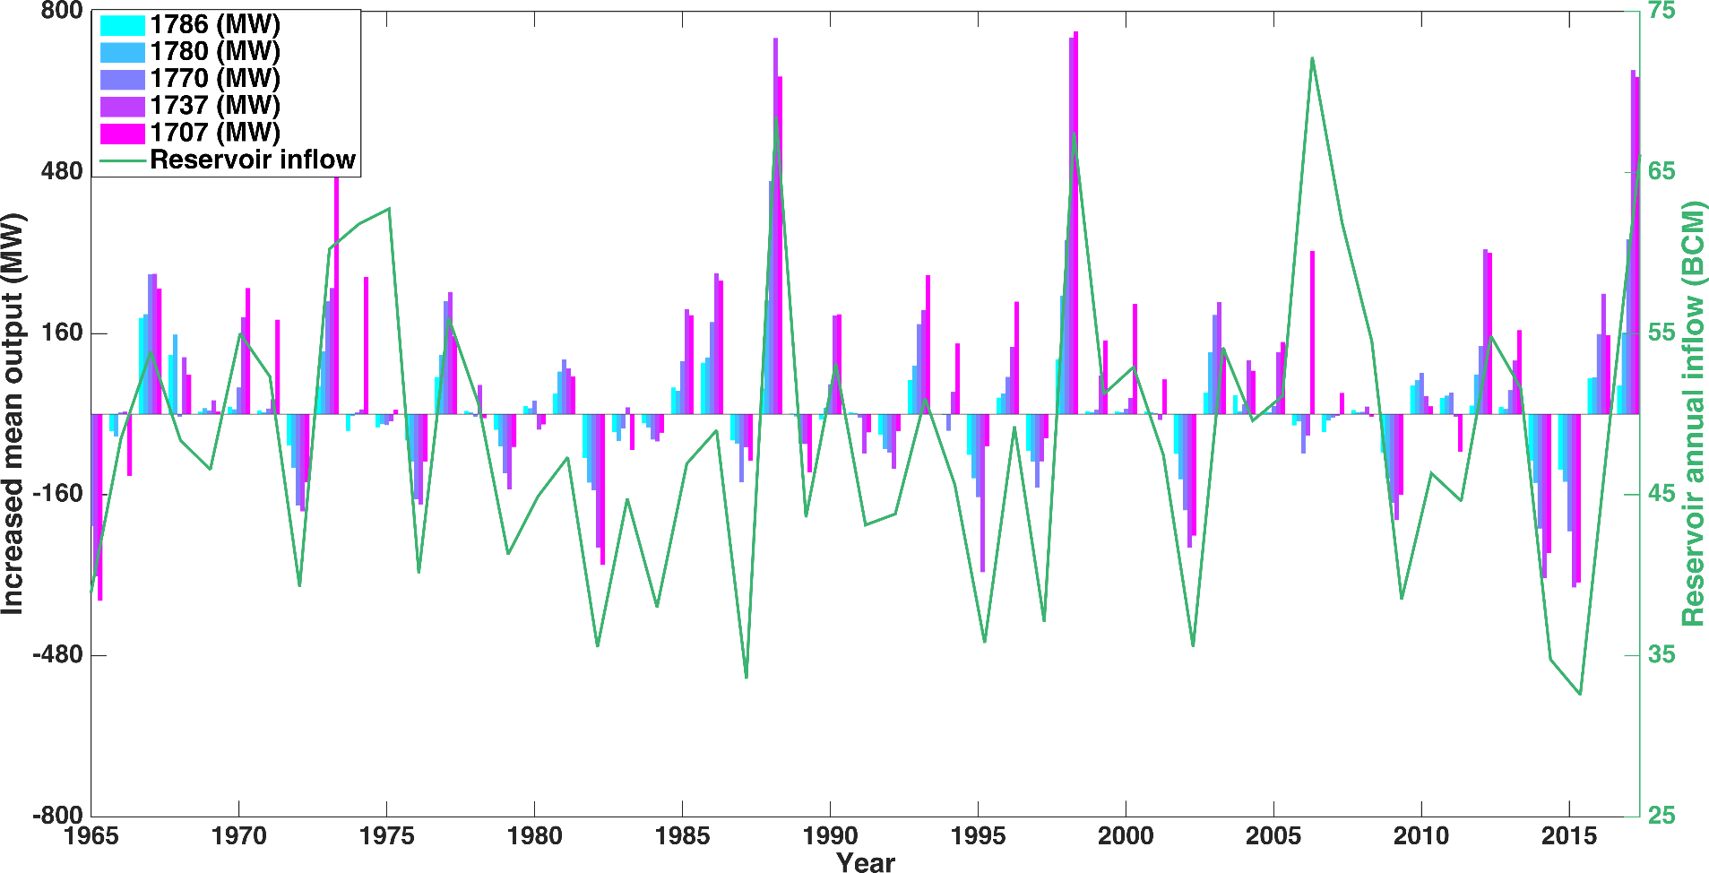
GERD reservoir operating rules optimization
Increased power generation output (maximizing mean output) over other reservoir operating rules
Power-generation-oriented GERD operating rules increase power generation mainly in wet years by decreasing the water release in dry years to ensure high water level.

Slide 12
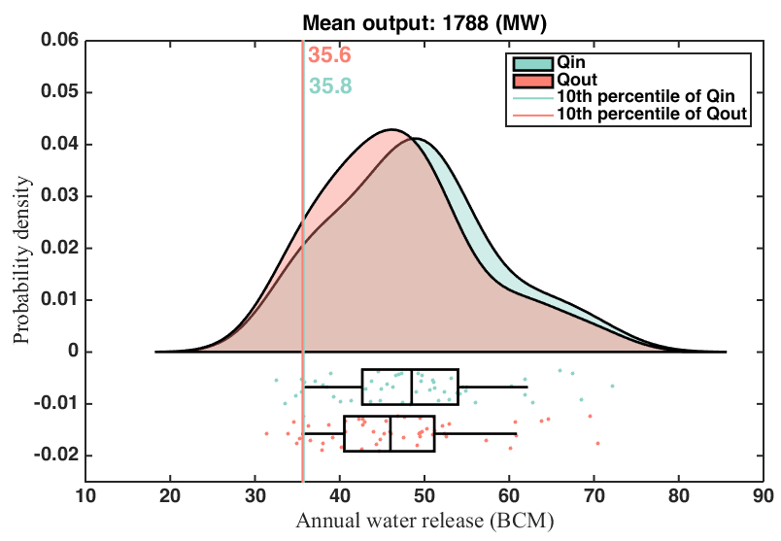
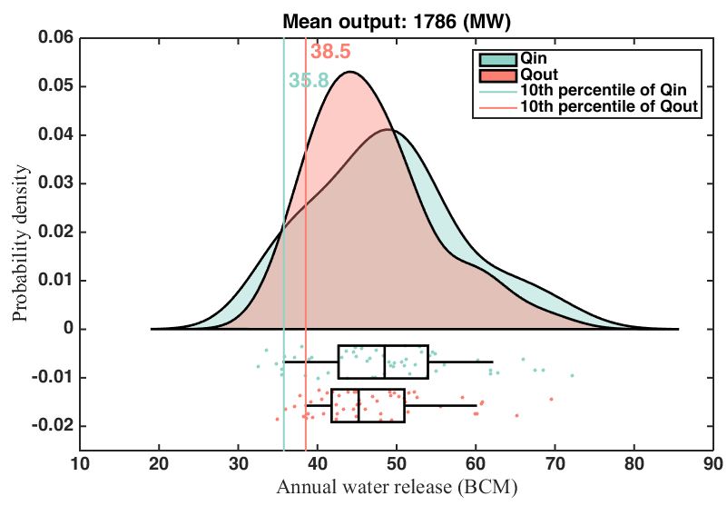
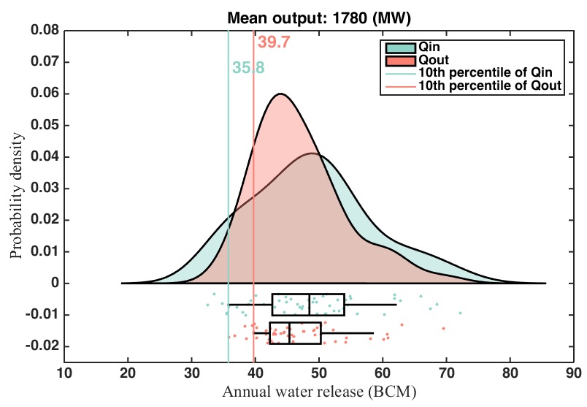
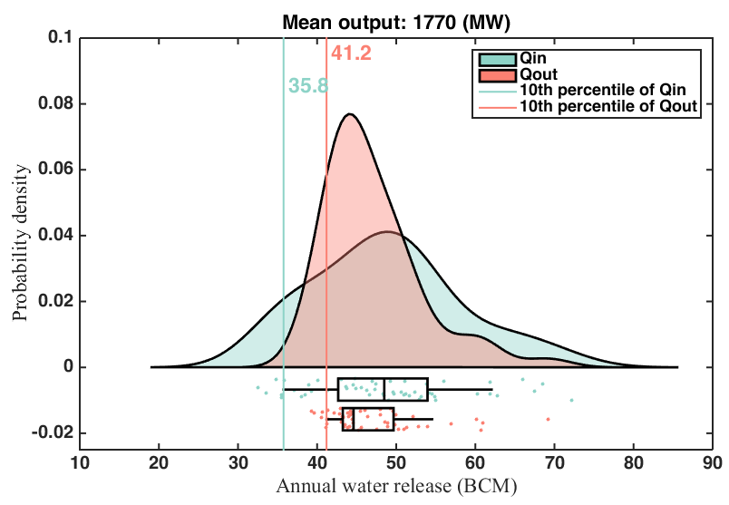
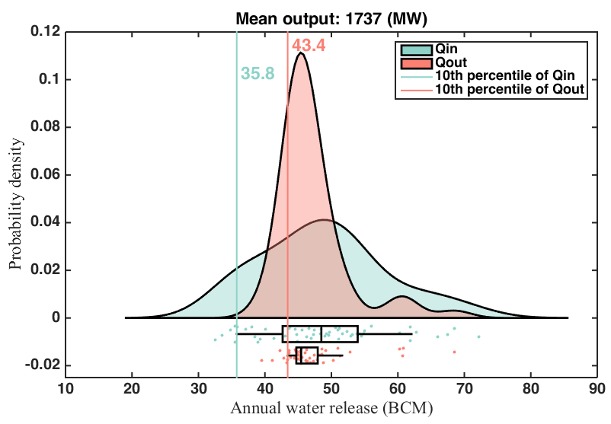

GERD reservoir operating rules optimization
Kernel distribution of annual reservoir inflow (Qin) and water release (Qout)
The relationship between distributions of the GERD annual inflow and water release can be used to balance the GERD power generation and downstream drought mitigation.

Slide 13
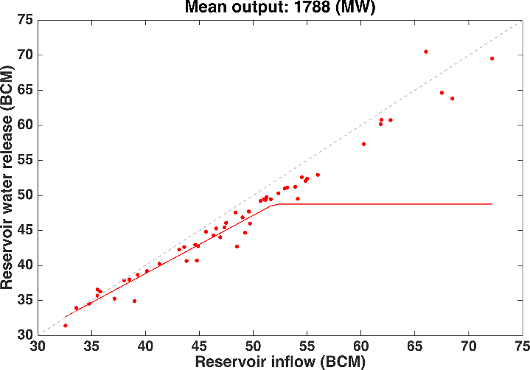
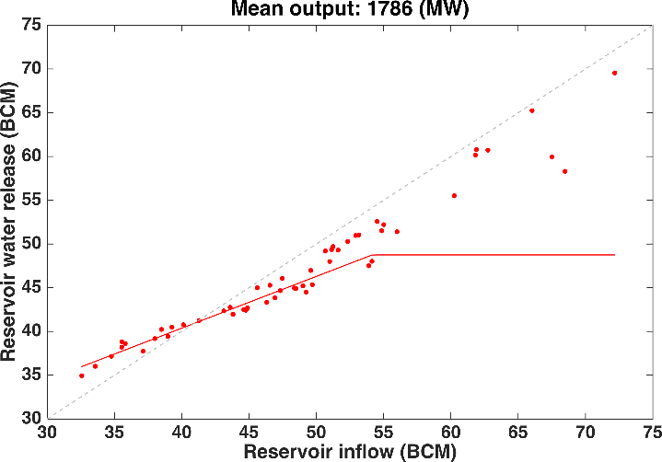
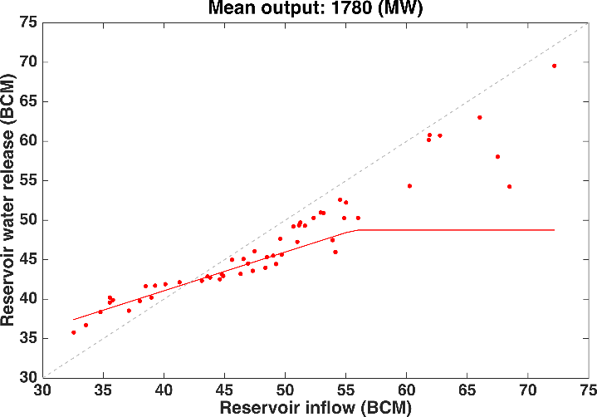
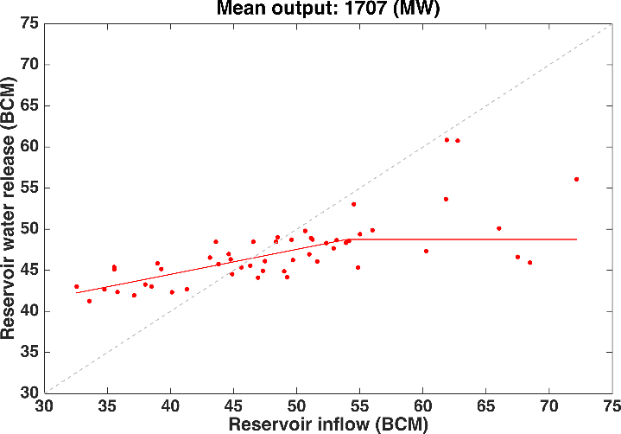
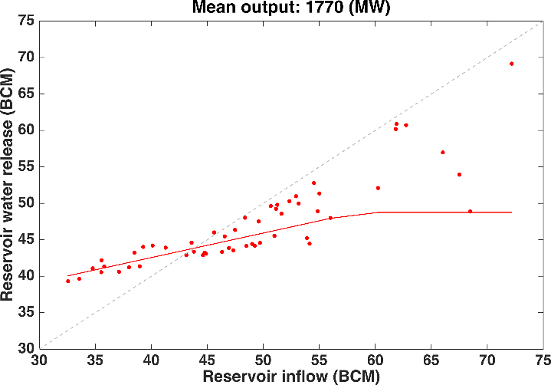
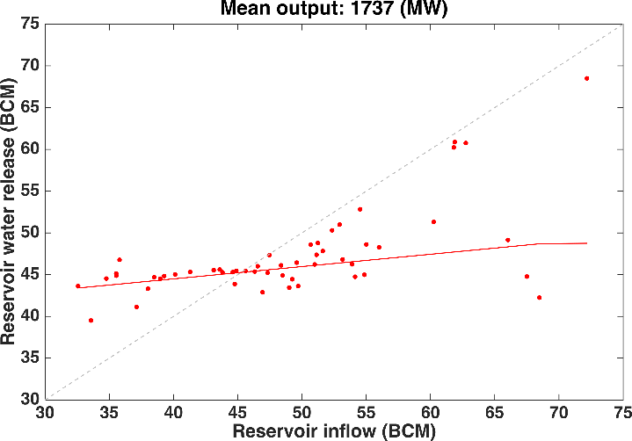
GERD reservoir operating rules optimization
Relationship between annual reservoir inflow (Qin) and water release (Qout)
There is evident relationship between annual reservoir inflow and water release, which can be used to derive water sharing policies.

Slide 14
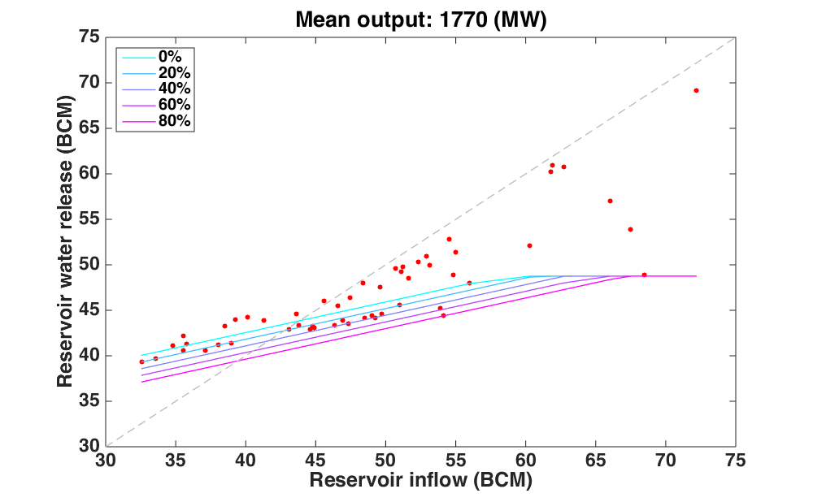
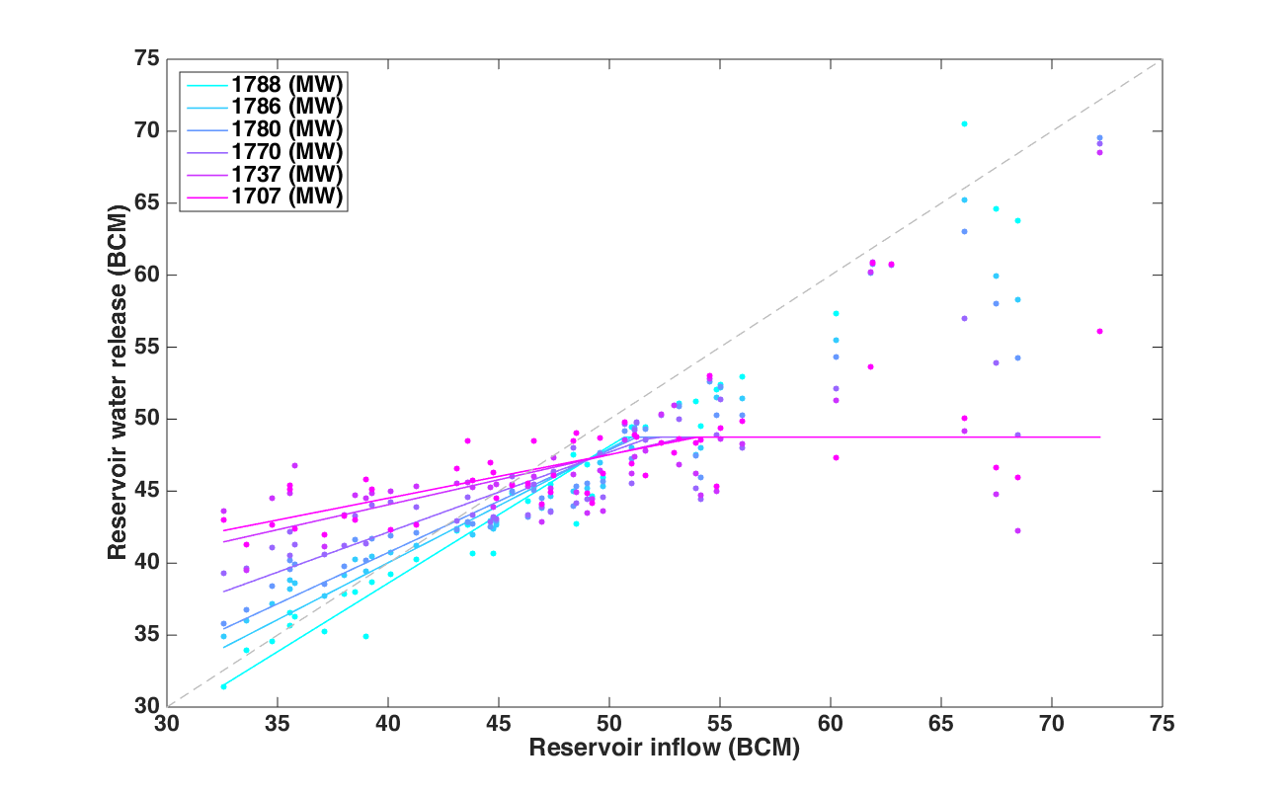
Water sharing policies for drought conditions
Drought mitigation policy
$$R_{y}^{min}=α⋅Q_{y}^{in}+β+z⋅σ_{d}$$
$$z=0$$
Multi-objective optimization
RBFs-based reservoir operating rules
Water release
$$P_{t}=K⋅Q_{t}^{P}⋅H_{t}^{P}$$
Reservoir storage, inflow
Reservoir storage, inflow

Slide 15
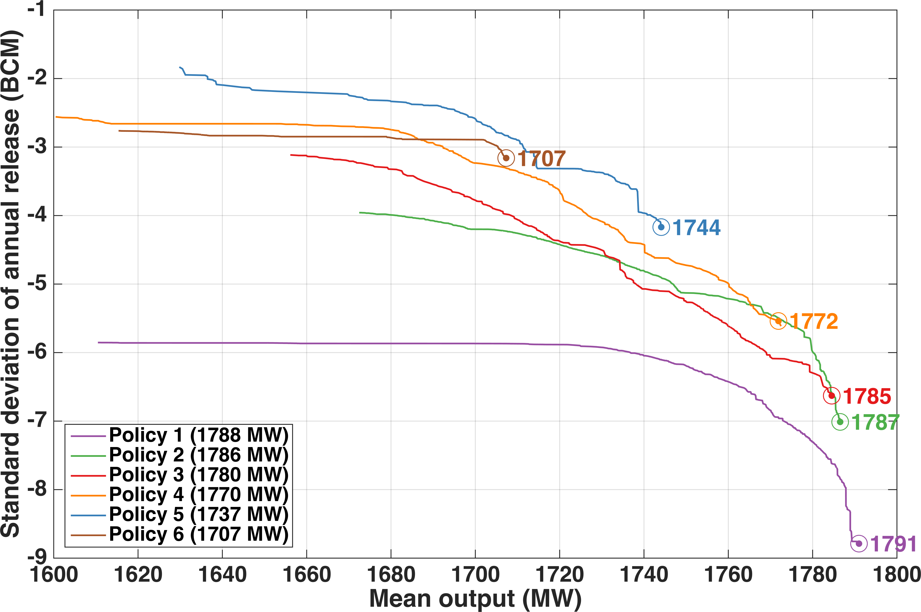
Water sharing policies for drought conditions
Pareto front with drought mitigation policies (1965-2017)
The maximum power generation optimized from the water sharing policy is close to the corresponding power generation.

Slide 16
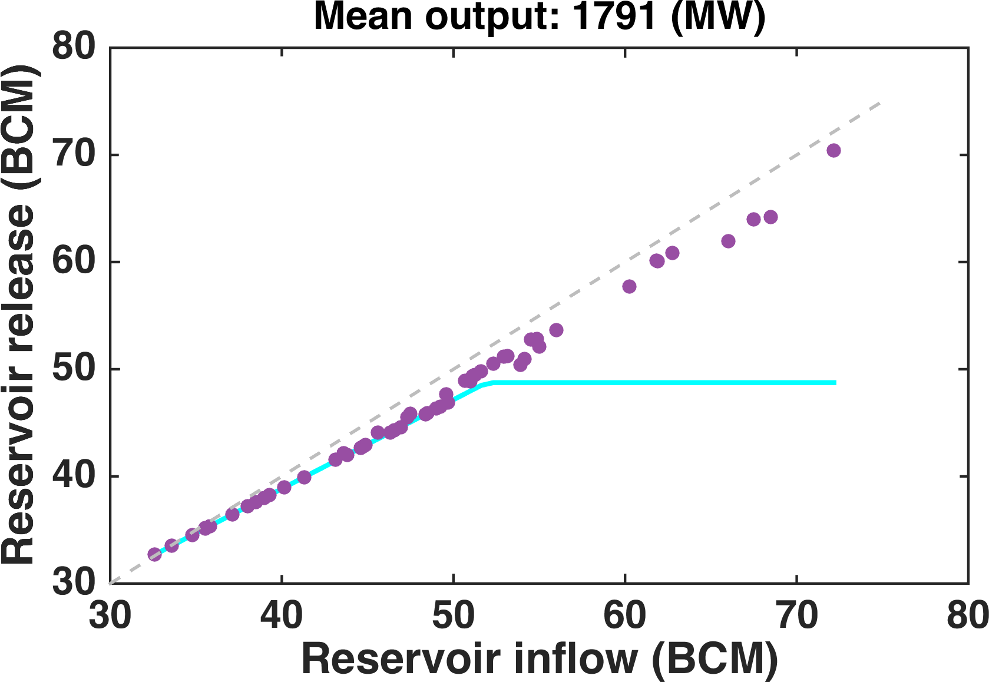
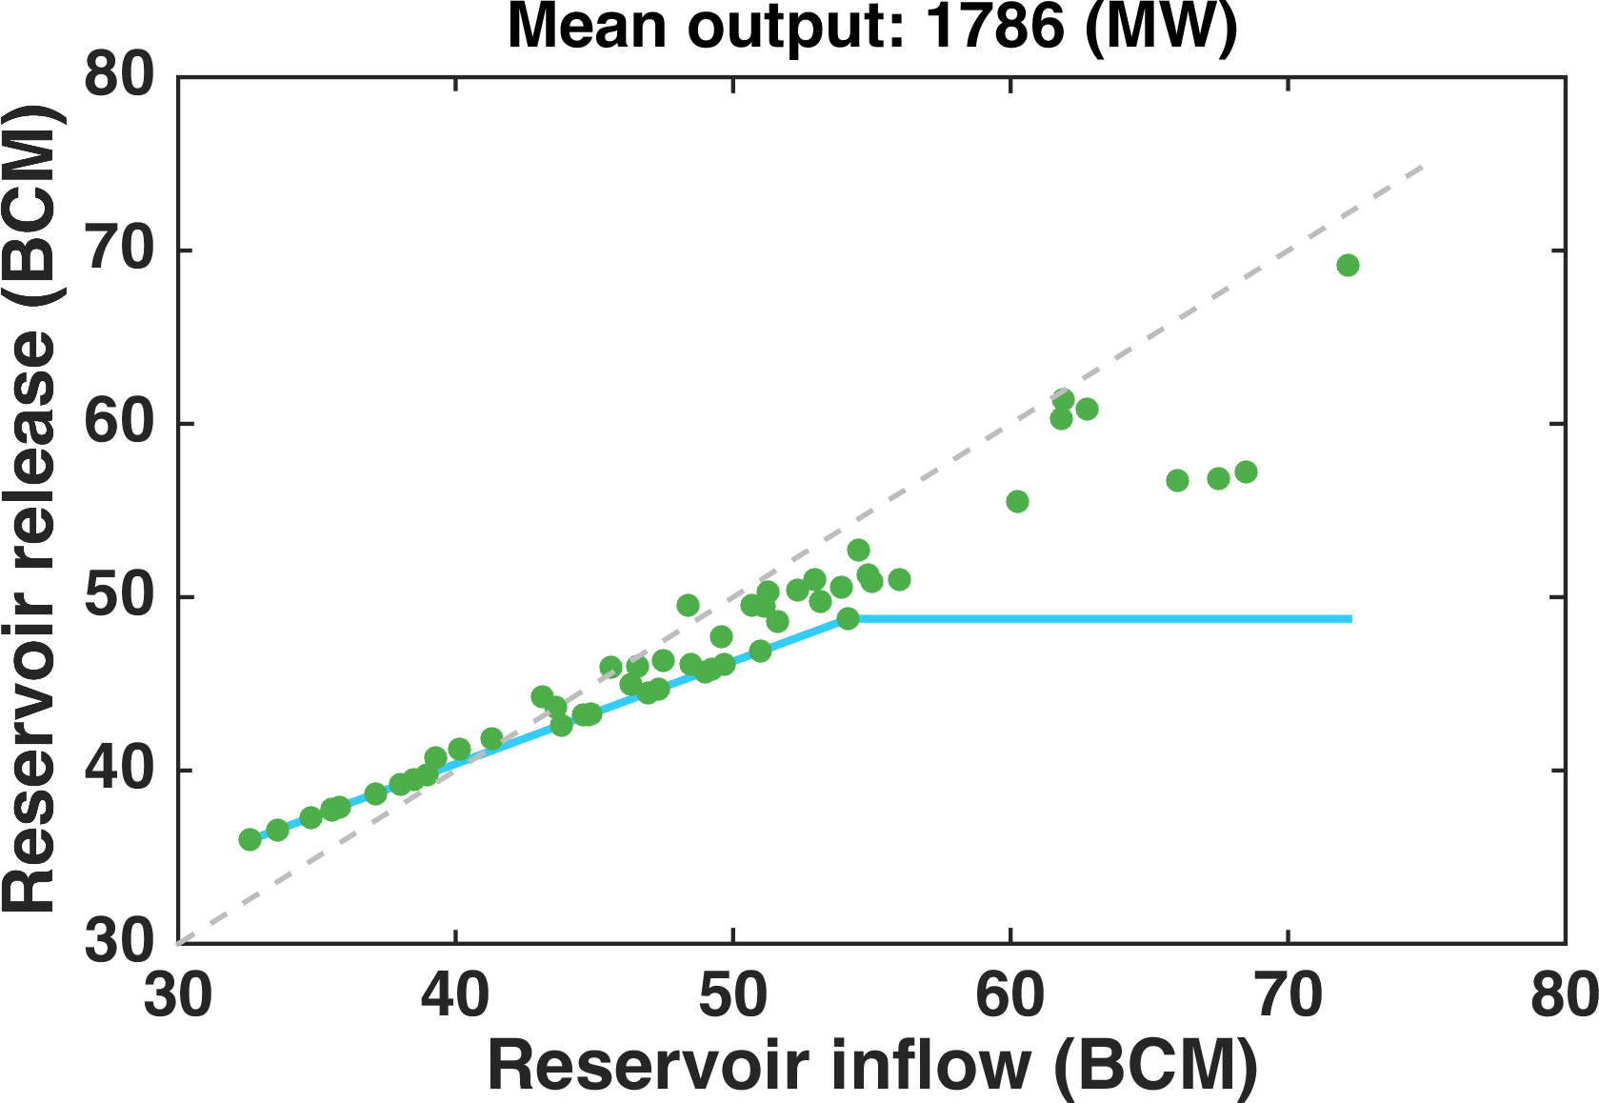
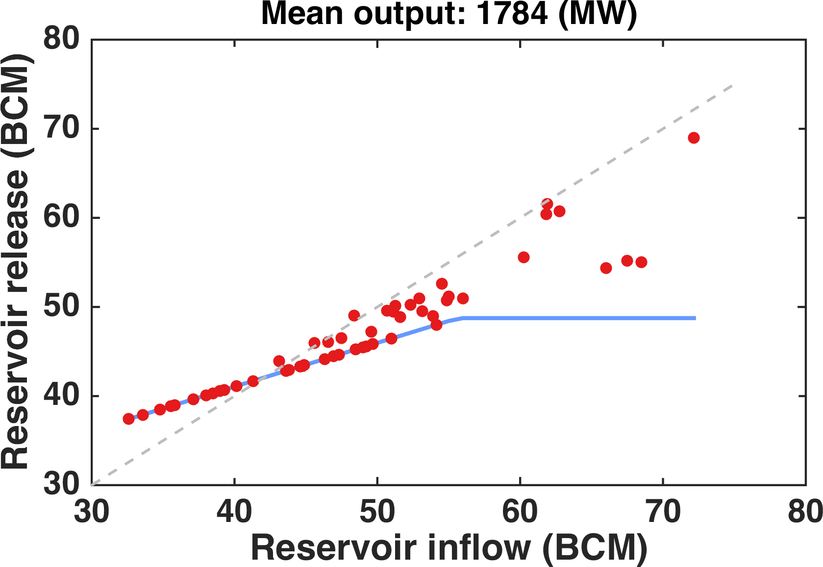
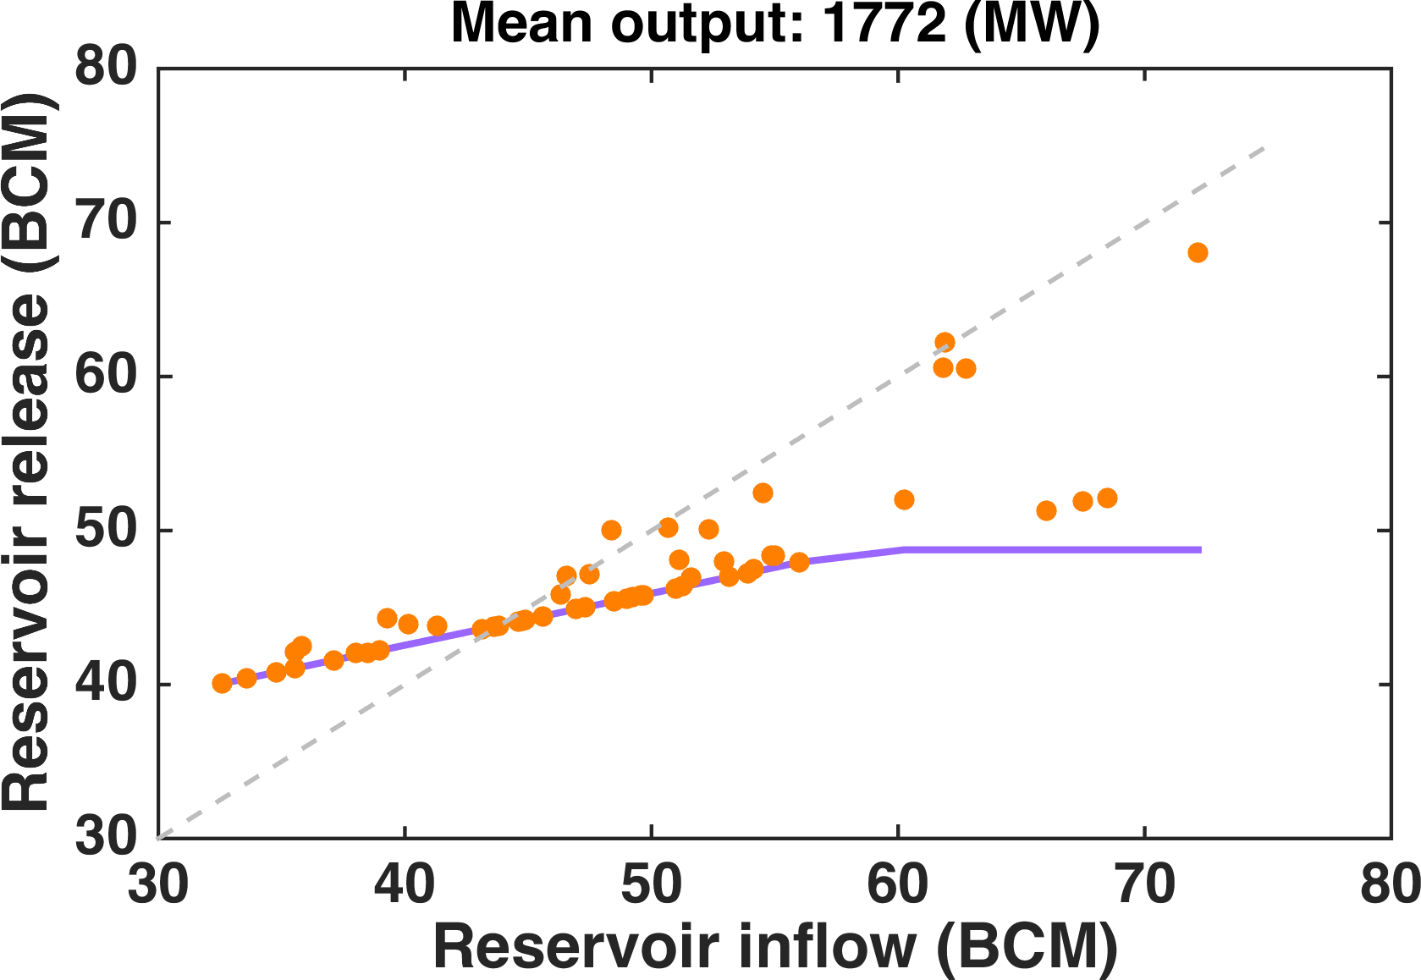
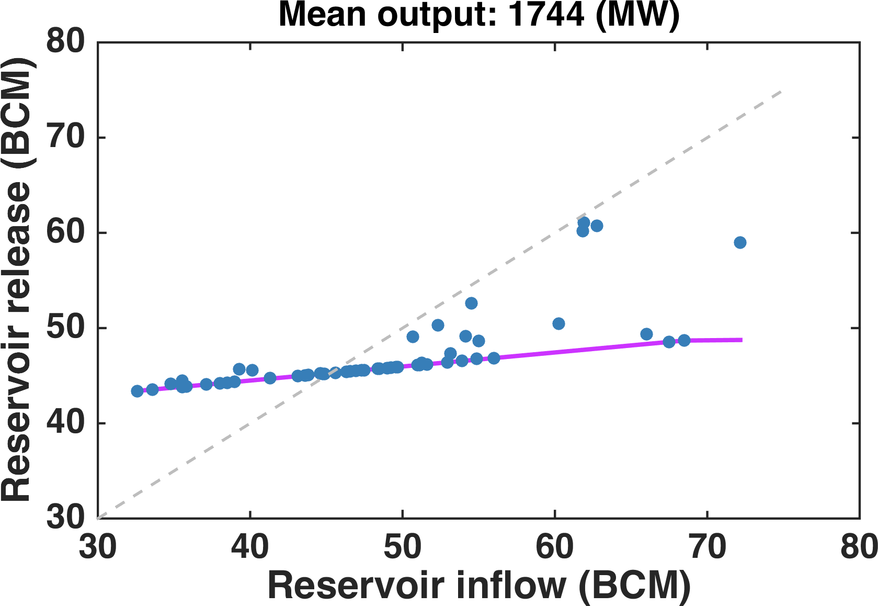
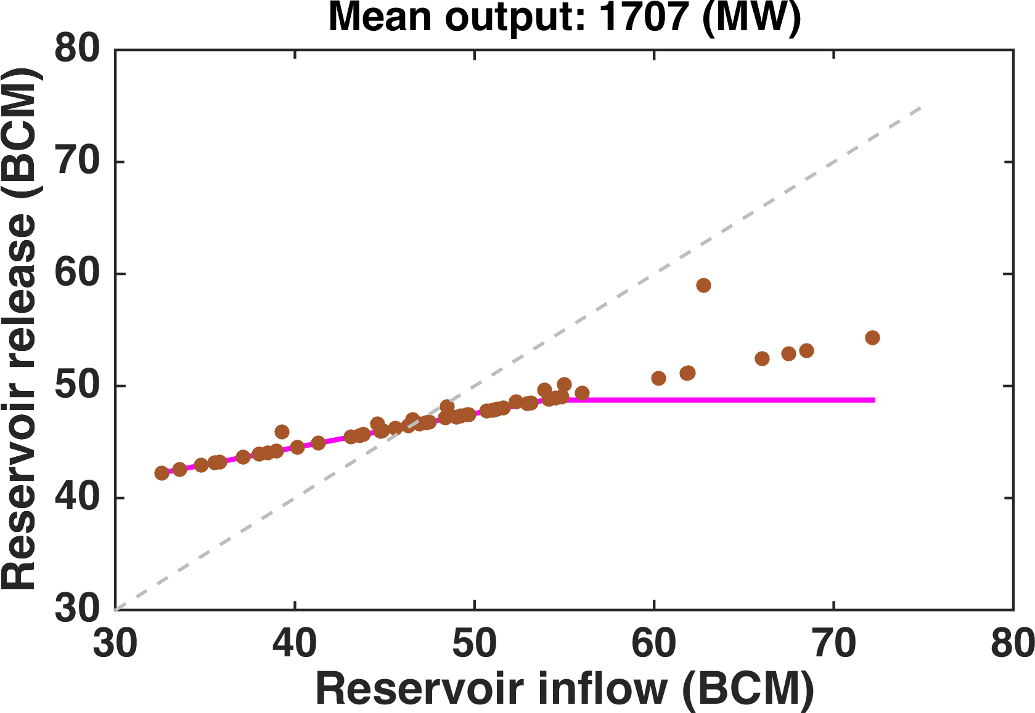
Water sharing policies for drought conditions
Relationship between annual reservoir inflow (Qin) and water release (Qout)
The water sharing policy can effectively mitigate the downstream drought without significantly decreasing power generation.

Slide 17
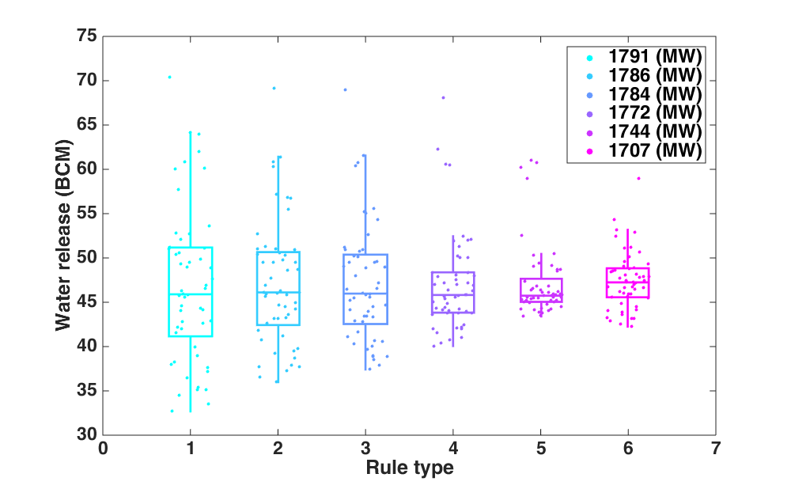
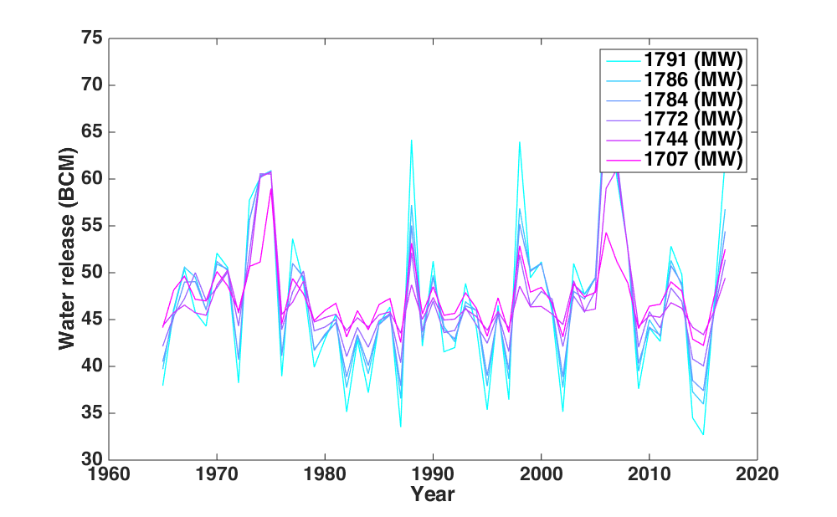
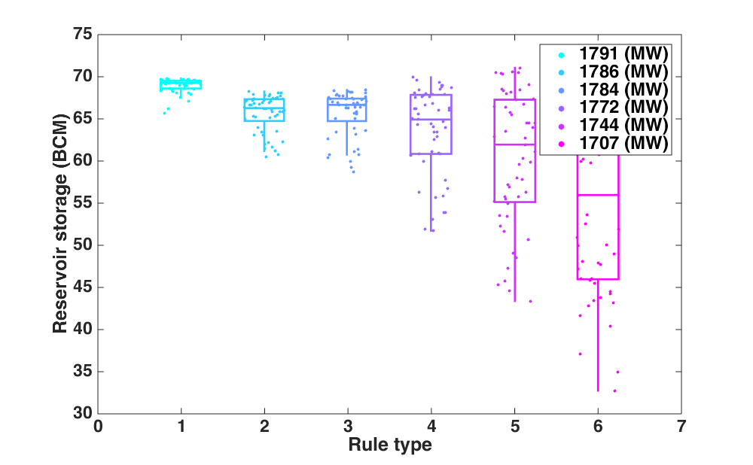
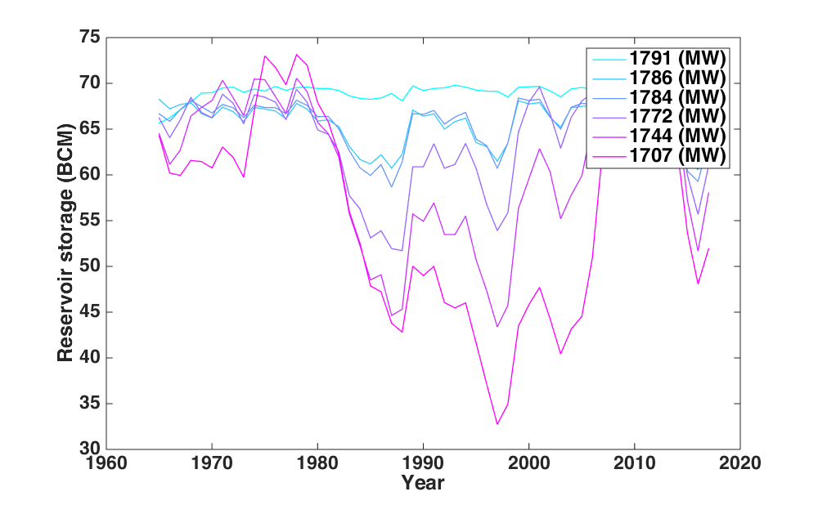
Water sharing policies for drought conditions
Boxplots and values of annual reservoir water release and storage
Storage and release trade-off

Slide 18
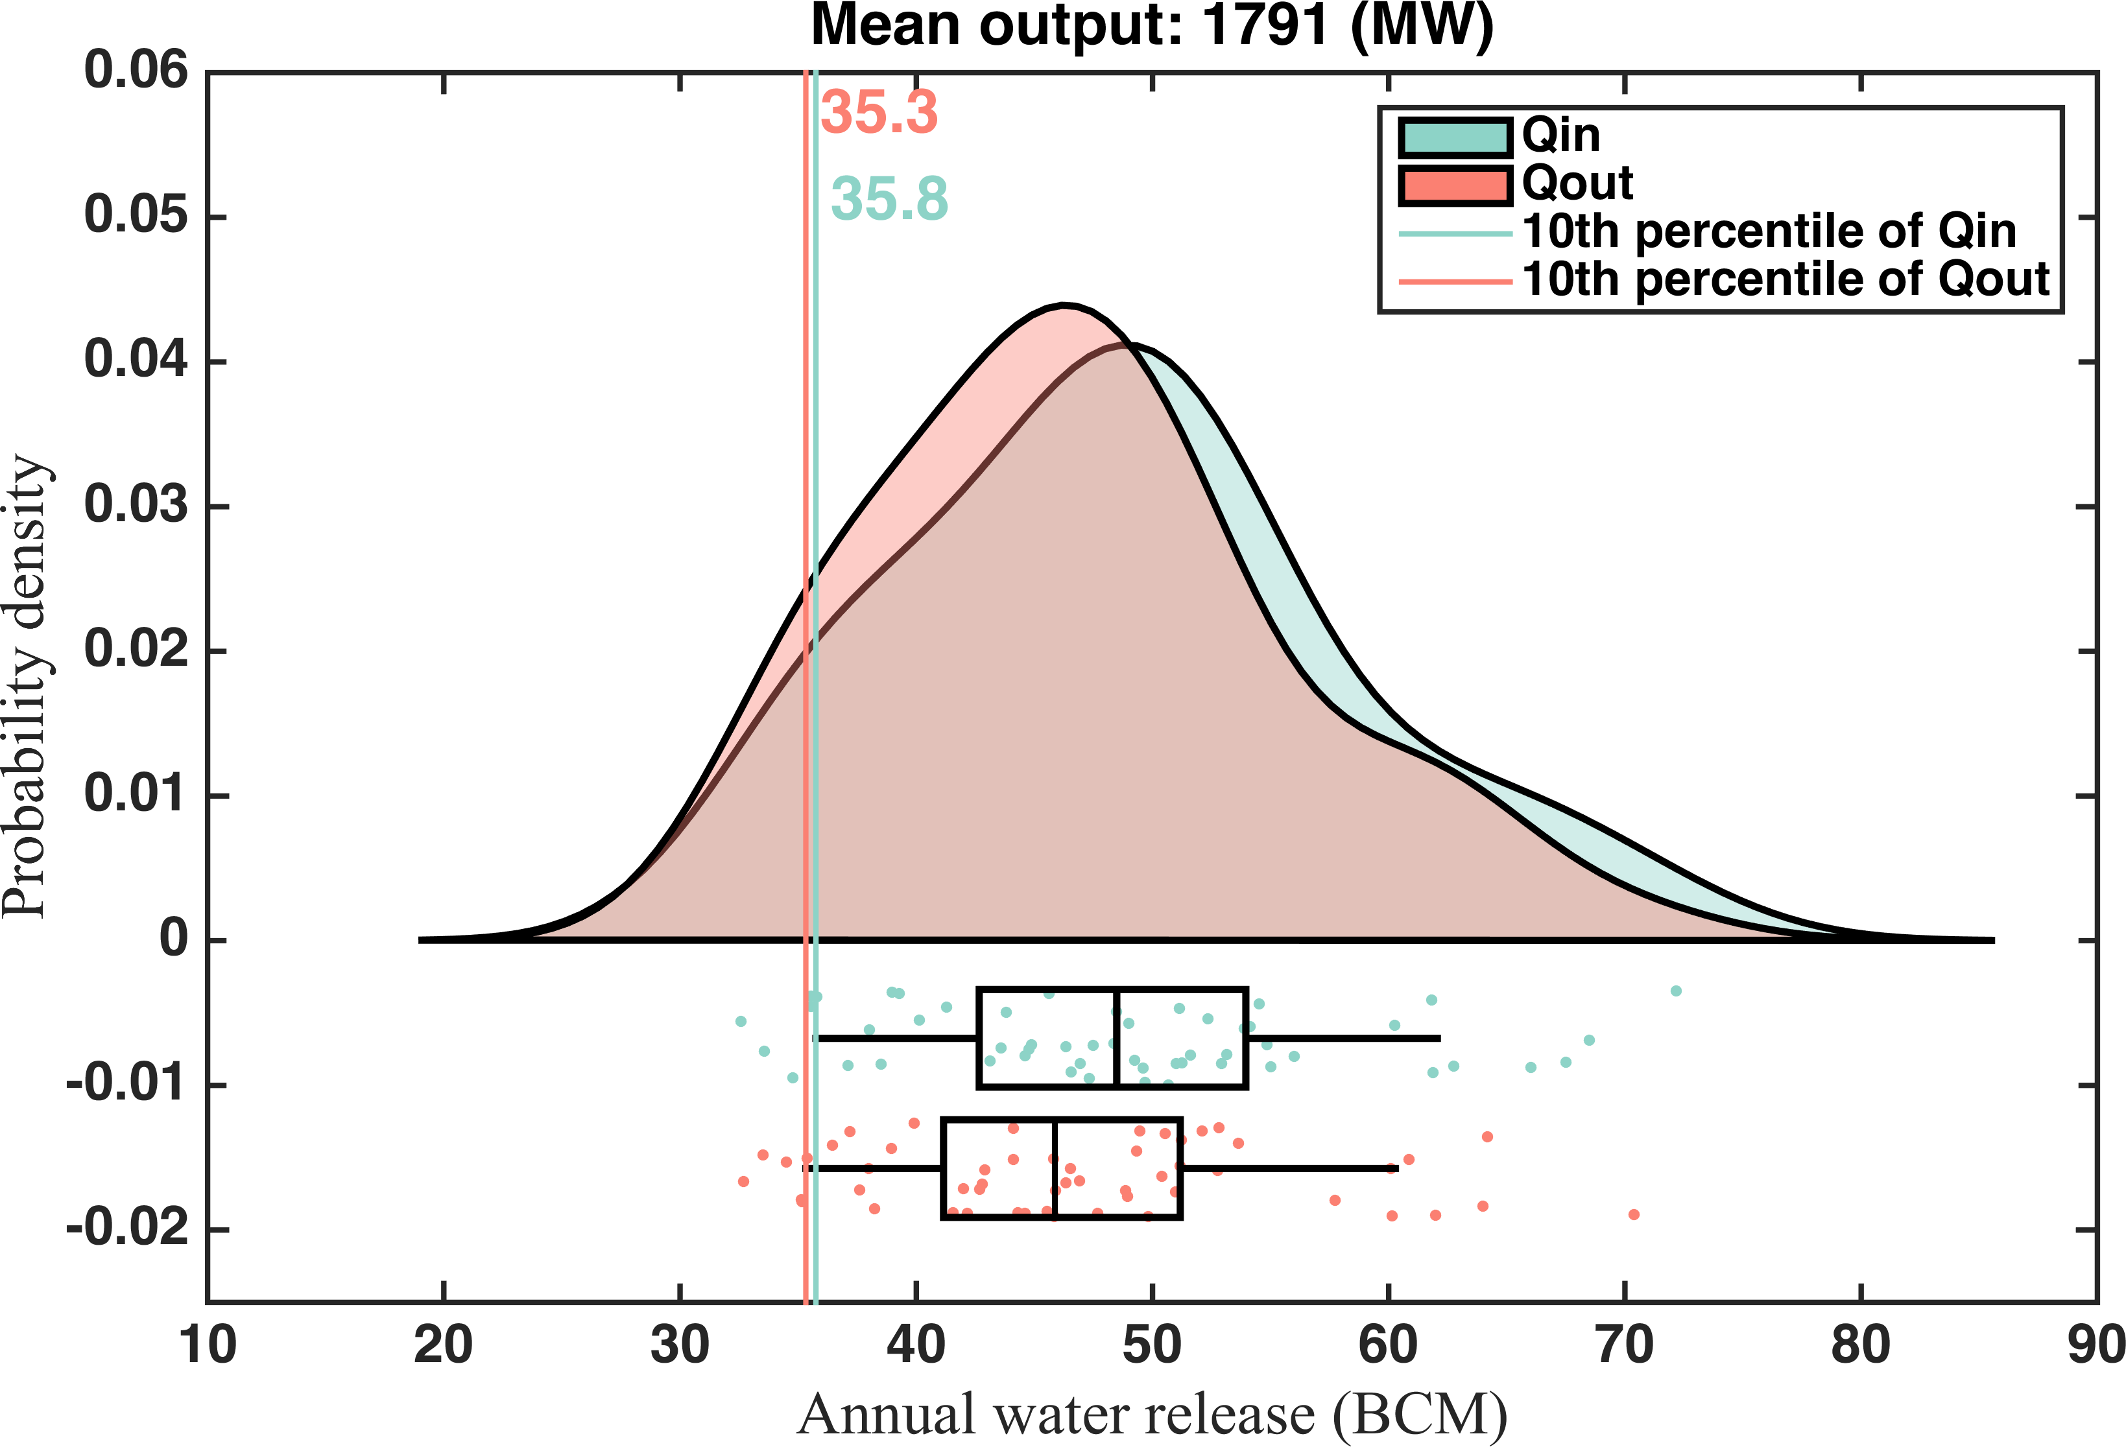
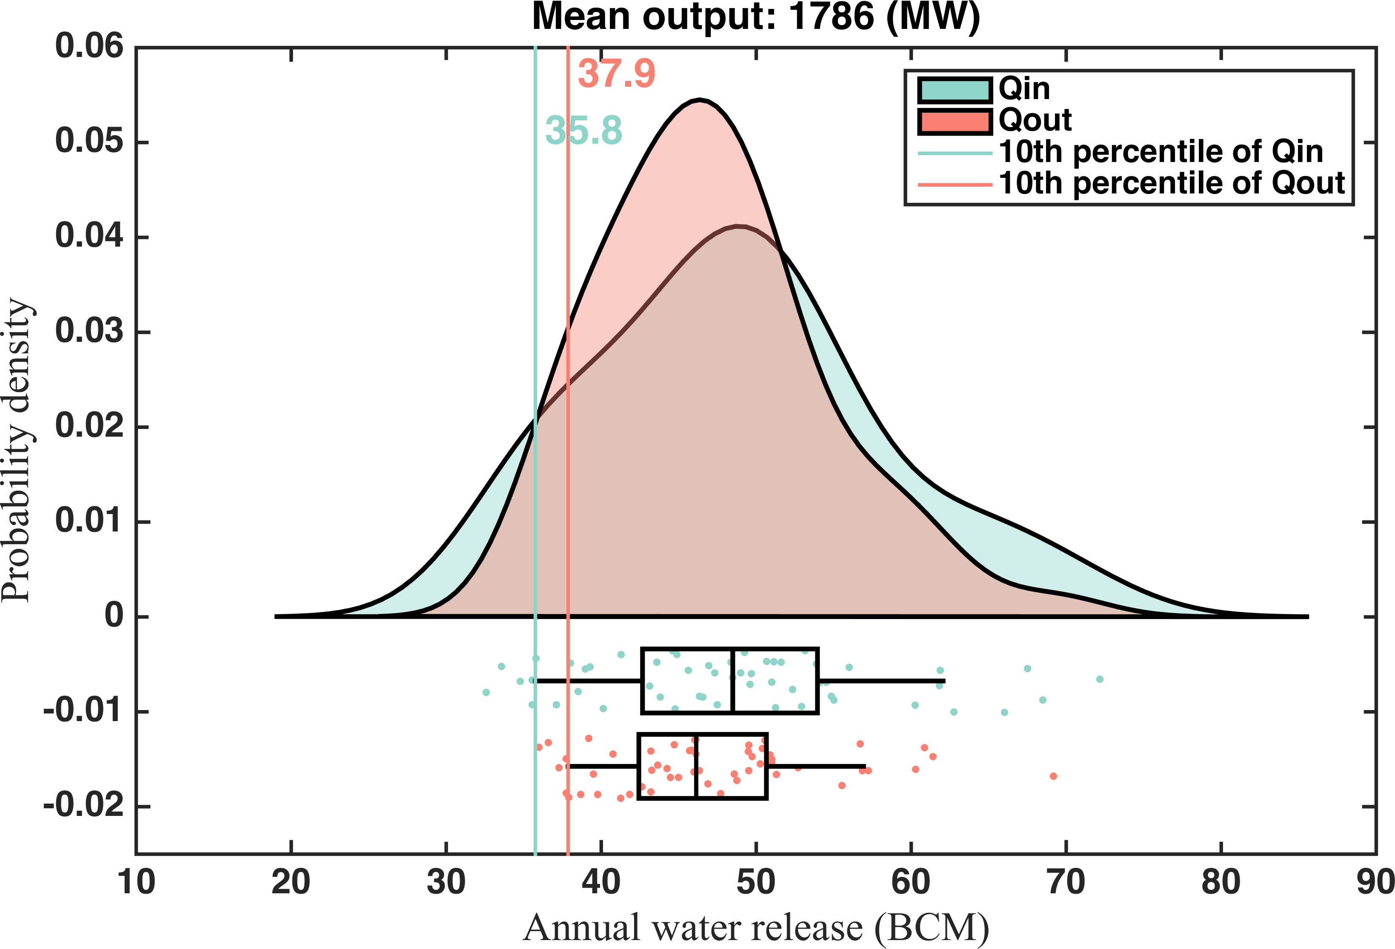
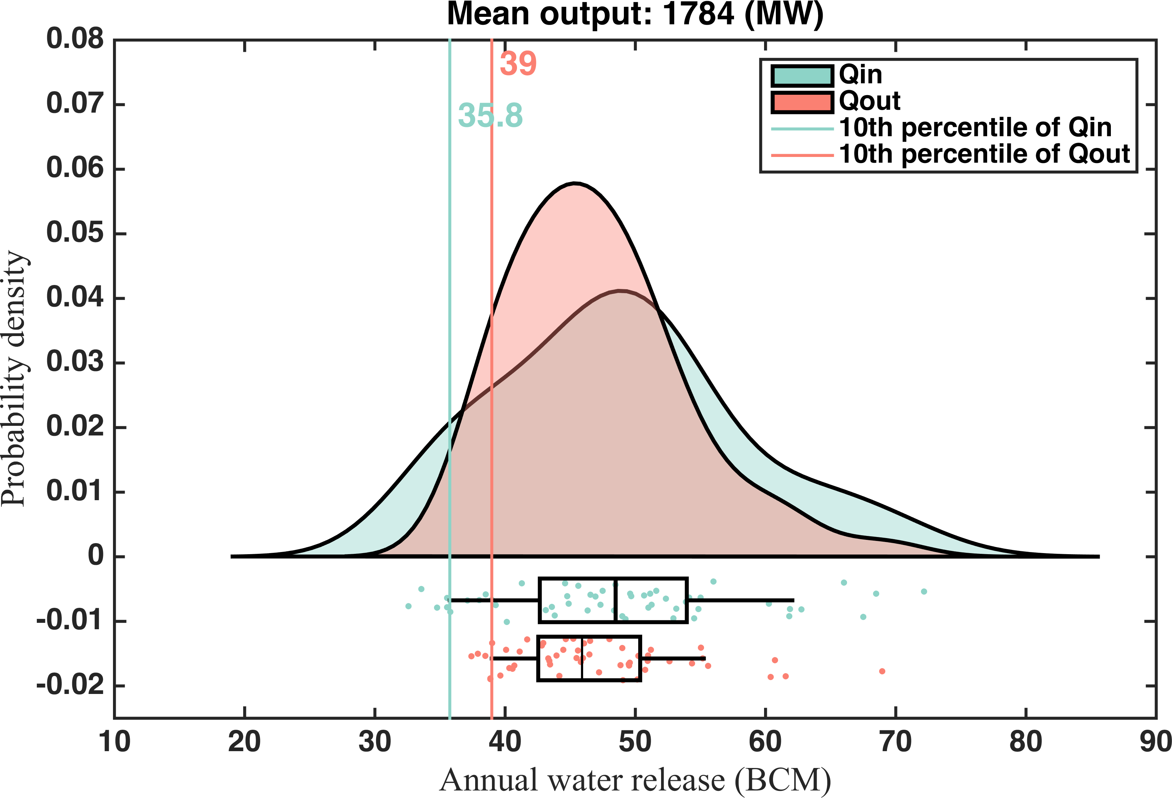
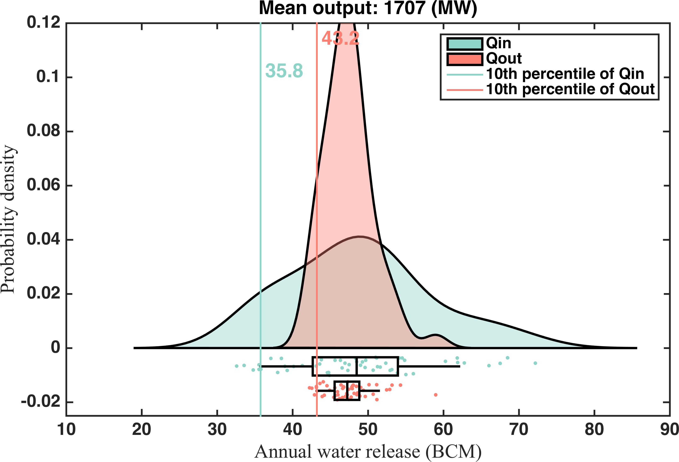
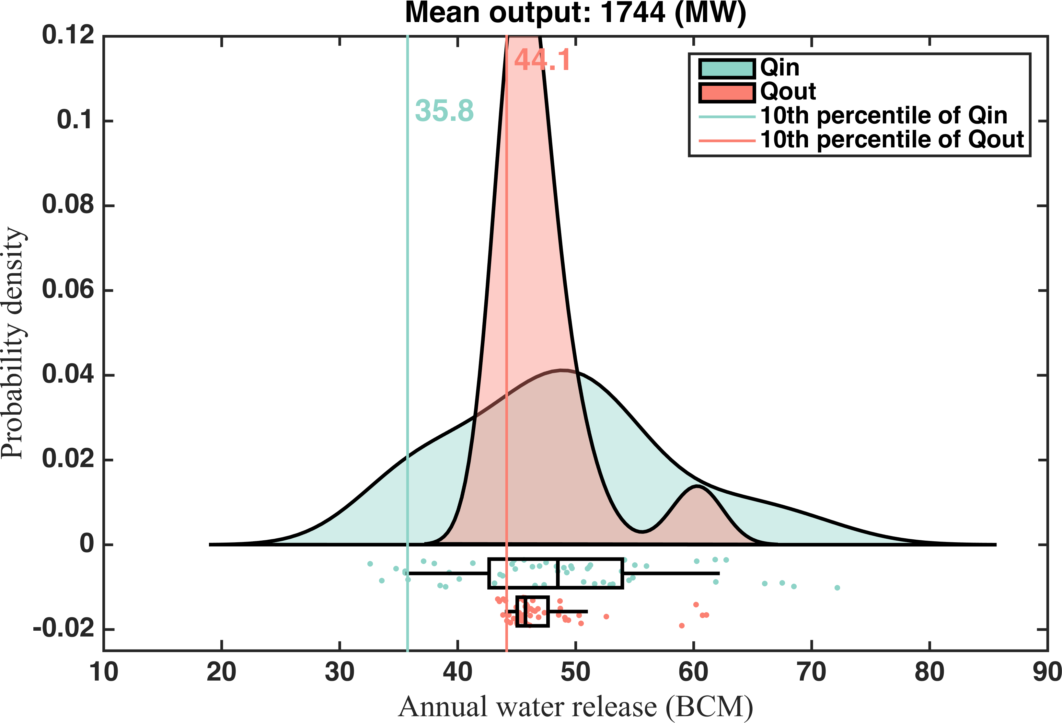
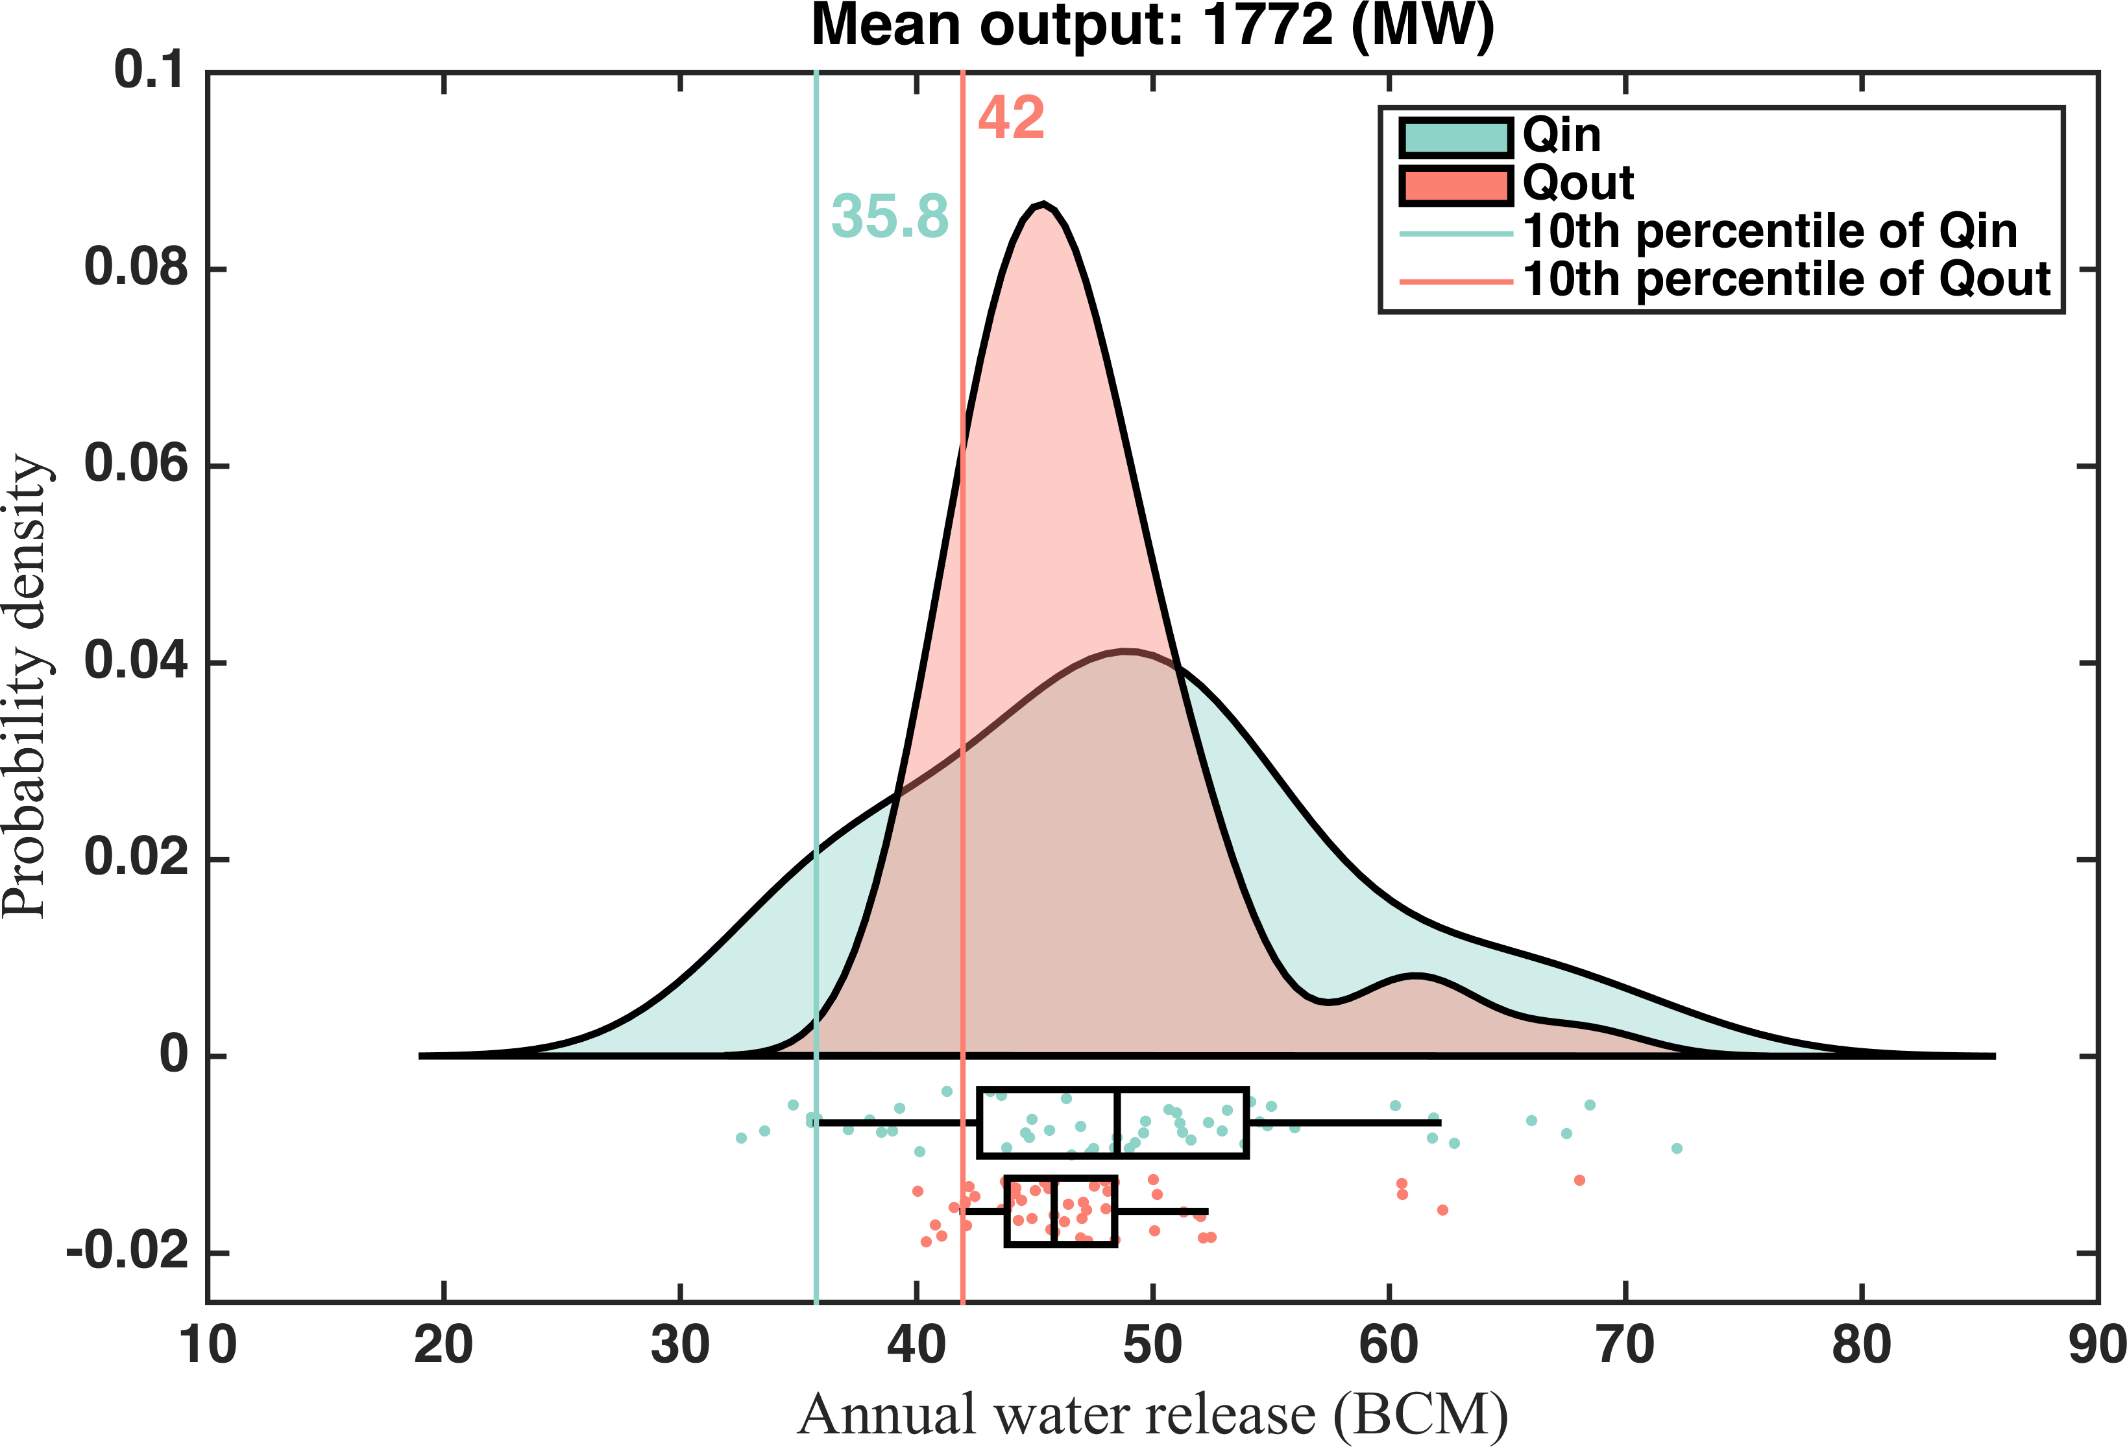
Water sharing policies for drought conditions
Kernel distribution of annual reservoir inflow (Qin) and water release (Qout)
Validation of the water sharing policy

Slide 19
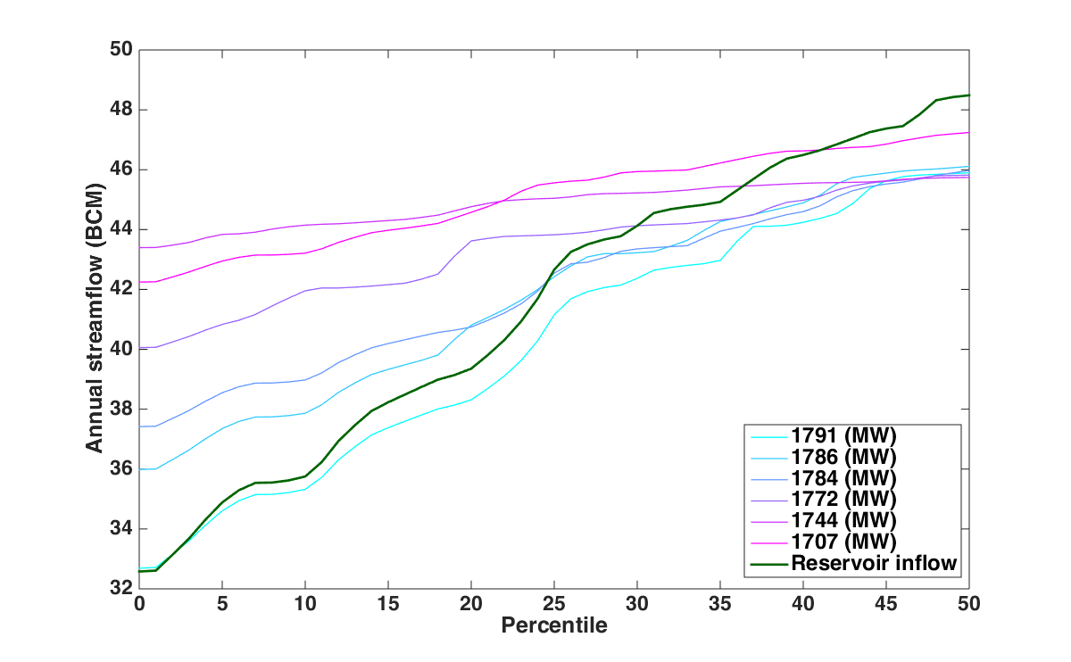
Water sharing policies for drought conditions
Percentiles of annual reservoir inflow and water release under various power generation levels
Water sharing policy validation and selection

Slide 20
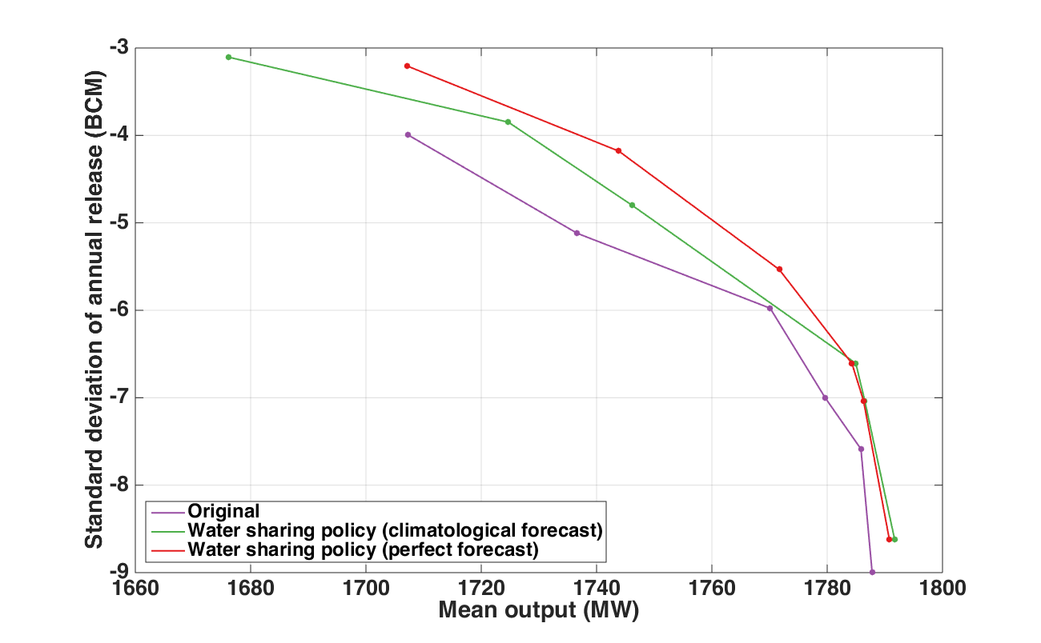
Water sharing policies for drought conditions
Pareto fronts from original and water sharing policy optimization
The performance of water sharing policy is not sensitive to the forecast accuracy.

Slide 21
Summary
There is a trade-off between GERD hydropower generation and dry year water release, a slight decrease in power generation can lead to significant annual water release increase under dry conditions.
The relationship between distributions of the GERD annual inflow and water release can be used to balance the GERD power generation and downstream drought mitigation.
The water sharing policy derived from optimal GERD operating rules can effectively mitigate the downstream drought without significantly decreasing power generation.
Although the implement of water sharing policy relies on annual streamflow forecast, its performance is not sensitive to the forecast accuracy.

Slide 22

Acknowledgements
Paul Block, University of Wisconsin-Madison
Water Systems & Society Research Group
http://wss.cee.wisc.edu
Water Resource Engineering colleagues
Name: Guang Yang
Email: gyang82@wisc.edu
Thank you very much!
Questions?

