Slide 1
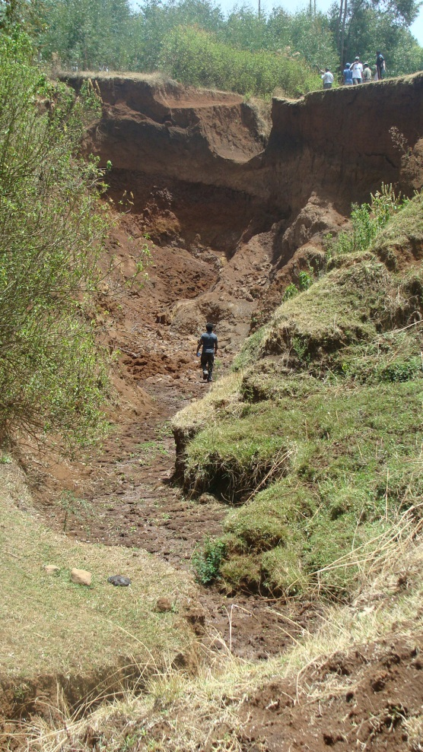

A nine-year study on the benefits and risks of soil and water conservation practices in the humid highlands of Ethiopia: The Debre Mawi watershed.
Demesew A. Mhiret ,Benjamin F. Zaitchik, Seifu A. Tilahun, Tammo S. Steenhuis .
International Conference on the Nile and Grand Ethiopian Renaissance Dam: Science, Conflict Resolution and Cooperation, FIU, USA

Slide 2
Outline
Soil erosion in the Ethiopian highlands
The study area
Experimental findings
Conclusions

Slide 3
Key findings
Catchment runoff and sediment showed decreasing trend
Periodically saturating bottomlands cause gully formation
Gullies are identified as critical sources of catchment soil loss
Upland infiltration furrows filled up with sediment and were ineffective
Eucalyptus trees decrease the direct runoff and thereby the erosion. At the same time they dry out the watershed and springs

Slide 4
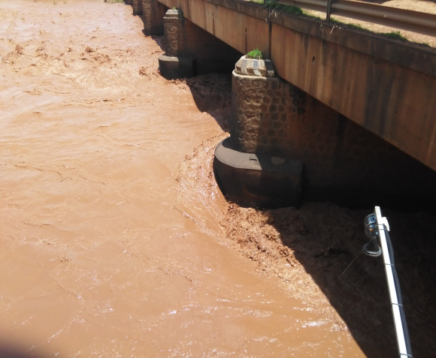
Soil erosion in the Ethiopian highlands
Soil erosion is a devastating problem in the Ethiopian highlands.
Soil degradation-hardpan formation-soil saturation-gully formation.
Soil loss in Ethiopia ranges up to 300 t ha⁻¹ yr⁻¹.

Slide 5
Soil erosion in the humid Ethiopian highlands
Translated to a monetary value of USD 1 - 2 B y⁻¹
1.5 million tons of grain per year
Bottom lands saturate during the rainy season and gullies are formed.
Watersheds with gullies have annual soil loss greater than 20 ton/ha/yr

Slide 6
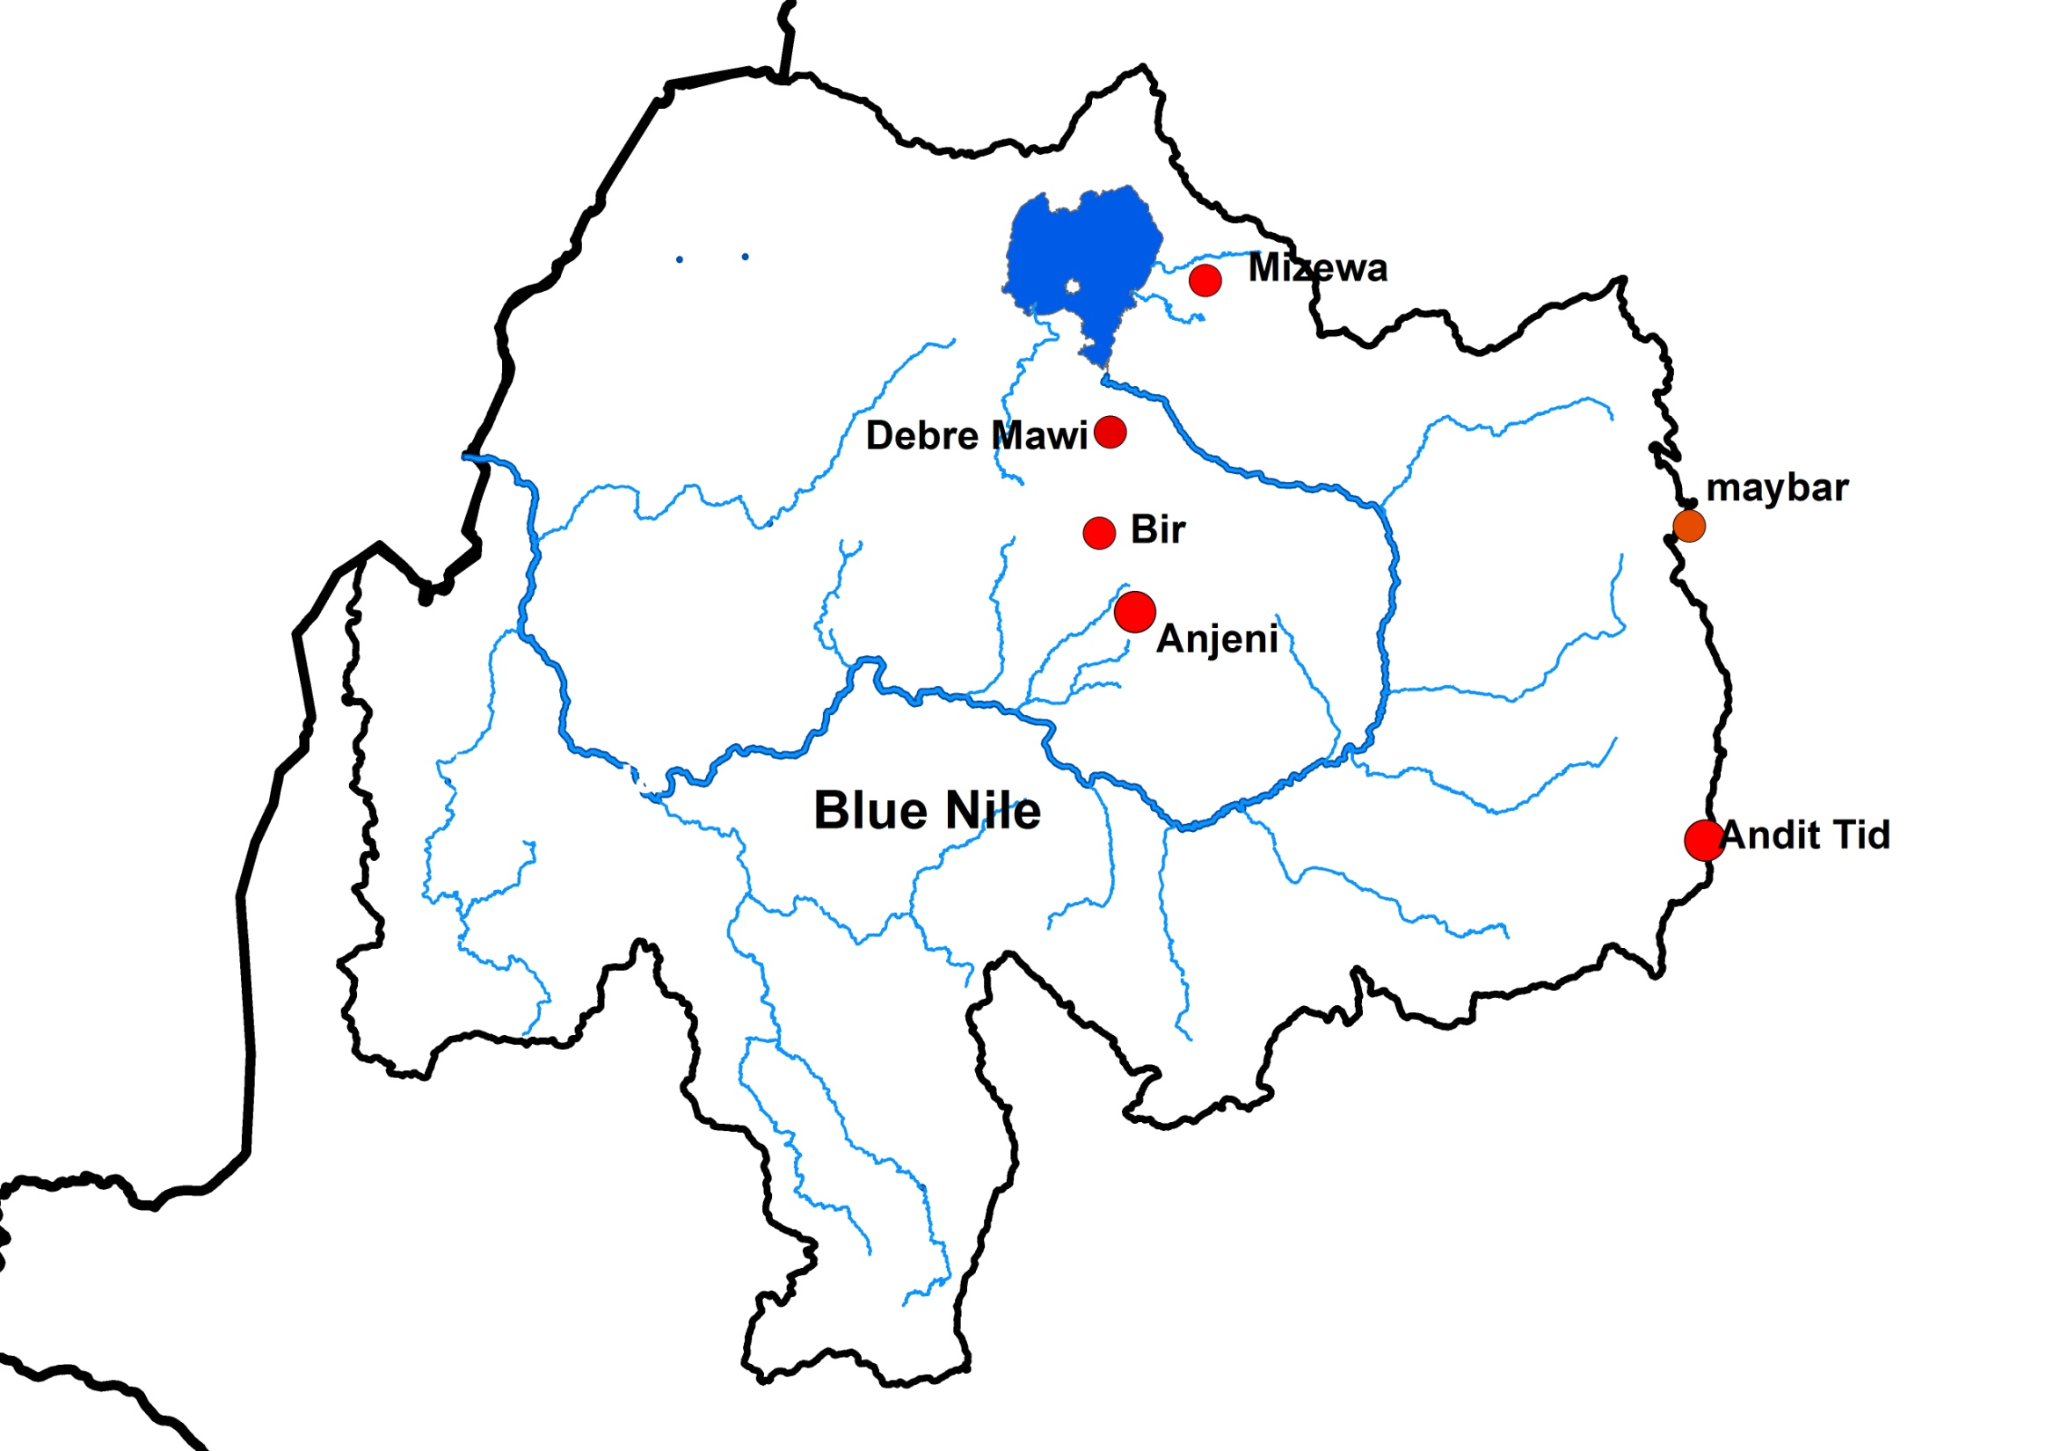
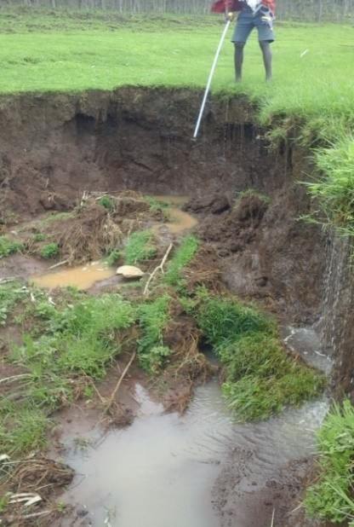
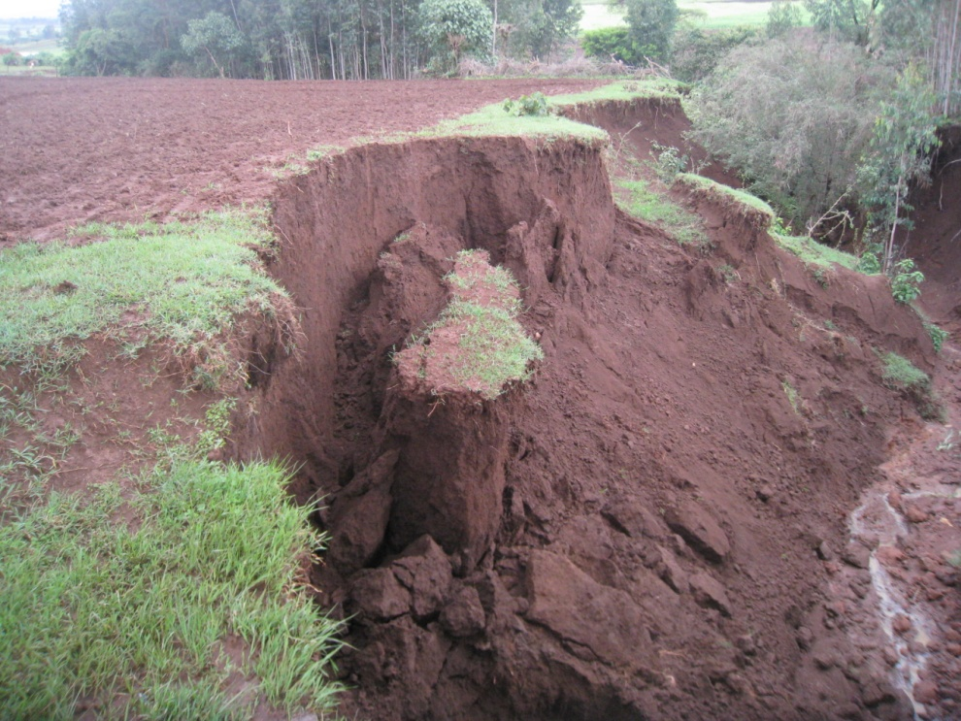
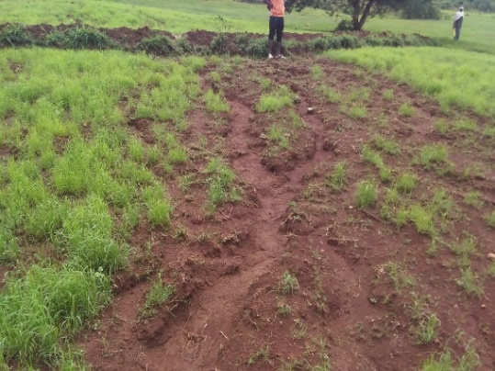
98-18 ton ha⁻¹y⁻¹
Tikur Wuha
10 ton ha⁻¹y⁻¹
65 ton ha⁻¹y⁻¹
7.4 ton ha⁻¹y⁻¹
75 ton ha⁻¹y⁻¹
25 ton ha⁻¹y⁻¹
5.2 ton ha⁻¹y⁻¹
Watersheds with gullies deliver up to 20 times
more sediment than upland erosion
Blue Nile Basin

Slide 7
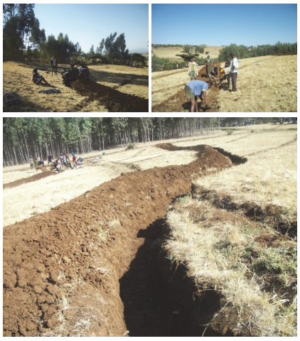
Soil and water conservation practices
Soil erosion should be reduced by effective SWCPs
In response, SWCPs have been implemented widely in Ethiopia.
Few studies were carried out based on the long-term field data, we initiated this study in watersheds of the Upper Blue Nile basin.
Evaluating the long-term performance of SWCPs is vital to increase food self-sufficiency.

Slide 8
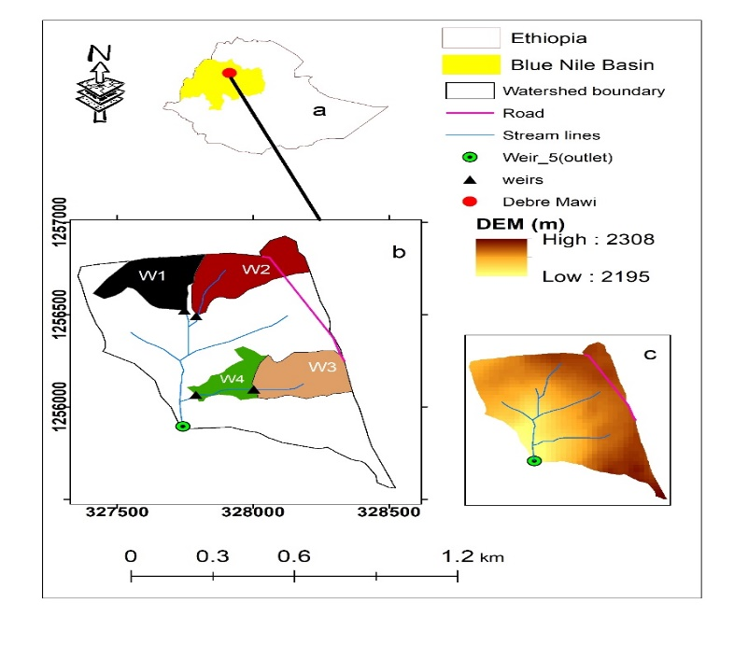
Study area
Debre Mawi watershed
Area: 0.95 km²
Rainfall: 1240 mm
Tepreature :20°

Slide 9
Data
Precipitation
Discharge
Suspended sediment concentration
Perched ground water table uphill and downhill of the infiltration furrows

Slide 10
Experimental findings
Runoff revealed a general decrease but significant only at outlet 2 & 3
Sediment concentration at main outlet was greater than its upland parts, indicating that sediment is picked up in the valley bottom.

Slide 11
Water table depth @ uphill and down hill of the infiltration furrows
In all piezometers water table depth downhill of the infiltration furrows greater than uphill
Only figure b in the midslope highlights an example of the SWCPs functioning as advertised.

Slide 12
Water table depth uphill & downhill of the furrows
However, the water table levels were near the bedrock at upslope (Figure c)
In the bottom lands the infiltration furrows increased the water table instead of decreasing it down stream of the furrows.

Slide 13
Effectiveness of infiltration furrows
Since there is no maintenance, upland infiltration furrows have been fill up with sediment.
Infiltration furrows did not affect the overall hydrology, and therefore were not effective.
Eucalyptus trees decrease the direct runoff and thereby the erosion. At the same time they dry out the watershed and springs

Slide 14
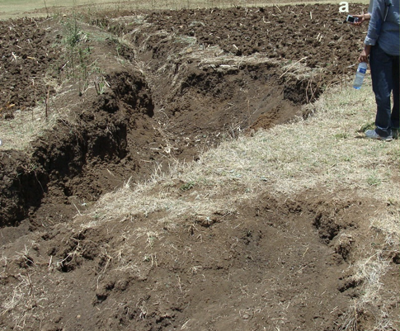
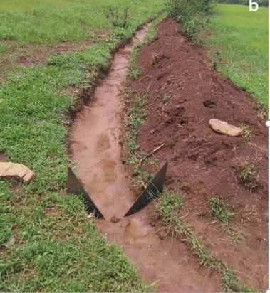
Gully formed b/c of improper positioning of bunds in the saturated valley floors
Infiltration furrows in the downslopes concentrate flow and gully was formed
Bunds in the bottomlands contribute directly to saturation and risk of gully formation

Slide 15
Conclusions
Runoff has been reduced across the watershed
SWCPs led to greater saturation and potential soil weakening in gully-prone toe slopes of the watershed
Downslope SWCPs were ineffective, and potentially problematic
Trends will shift in the future if SWCPs are not maintained and/or if the observed increase in saturation of toe slopes results in a large increase in gully erosion
In humid Ethiopian highlands, due attention has to be given to the safe removal of excess water from the valley bottoms

Slide 16
Thank you

