Slide 1
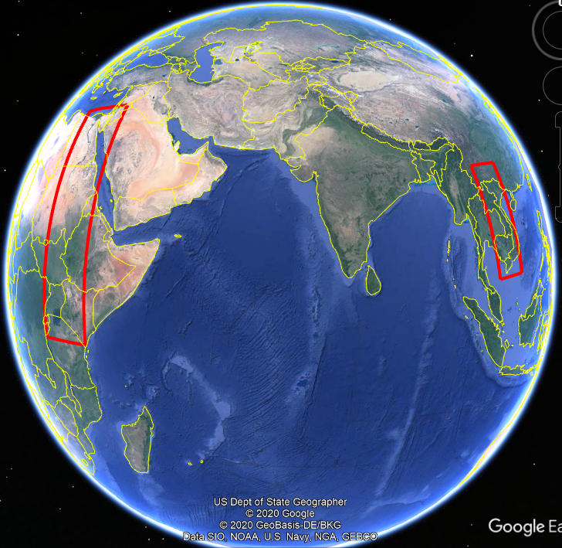
Geographic Aspects of Hydropolitics:
Nile and Mekong Rivers
Daniel Kassahun Waktola, PhD
Austin Community College, TX
2020 International Conference on the Nile and GERD: Science, Conflict Resolution and Cooperation, August 20-21, 2020
Notes:
NOTE: Want a different image on this slide? Select the picture and delete it. Now click the Pictures icon in the placeholder to insert your own image.

Slide 2
Background
Hydropolitics is the systematic study of conflict and cooperation between states over water resources that transcend international borders (Elhance, 1999).
  It is a highly complex, multidimensional, and multidisciplinary subject.
One of the factors complicating hydropolitics is geographic.
Analyzing the “geographic” factor of transboundary rivers could shed light on a better understanding of the complexity of hydropolitics.

Slide 3
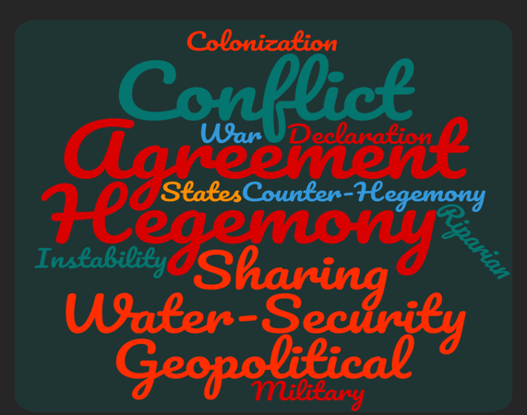
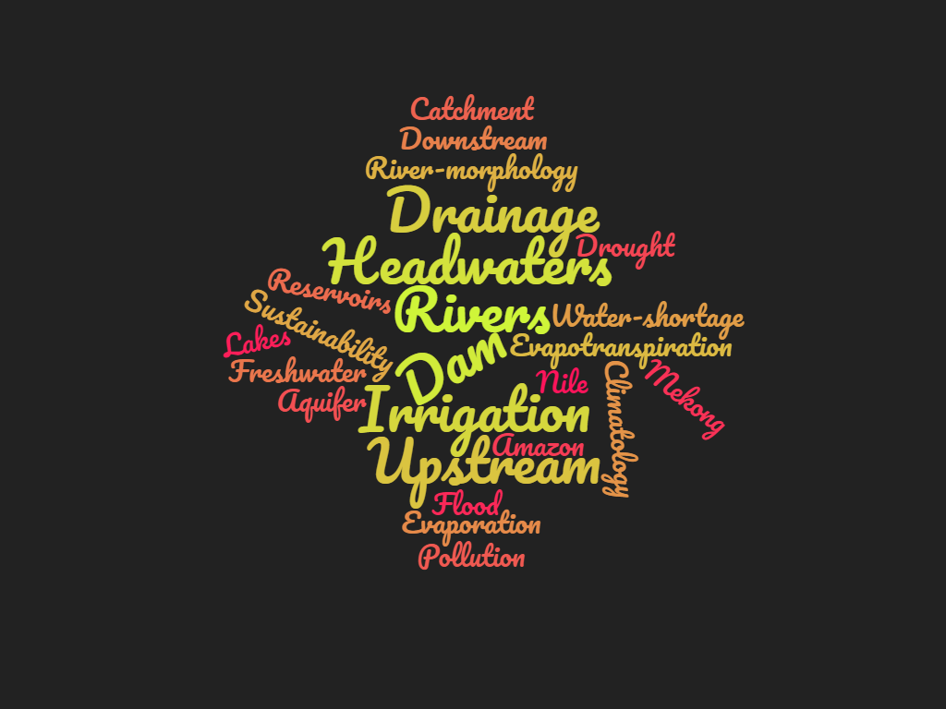
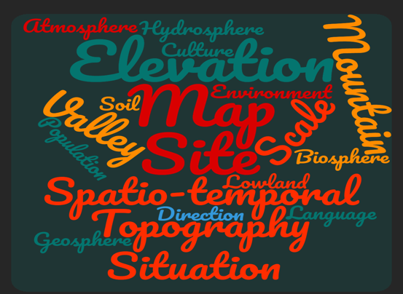
Politics, Hydropolitics & Hydrogeopolitics
Hydropolitics
Politics
Hydrogeopolitics
Hydrosphere
Geography

Slide 4
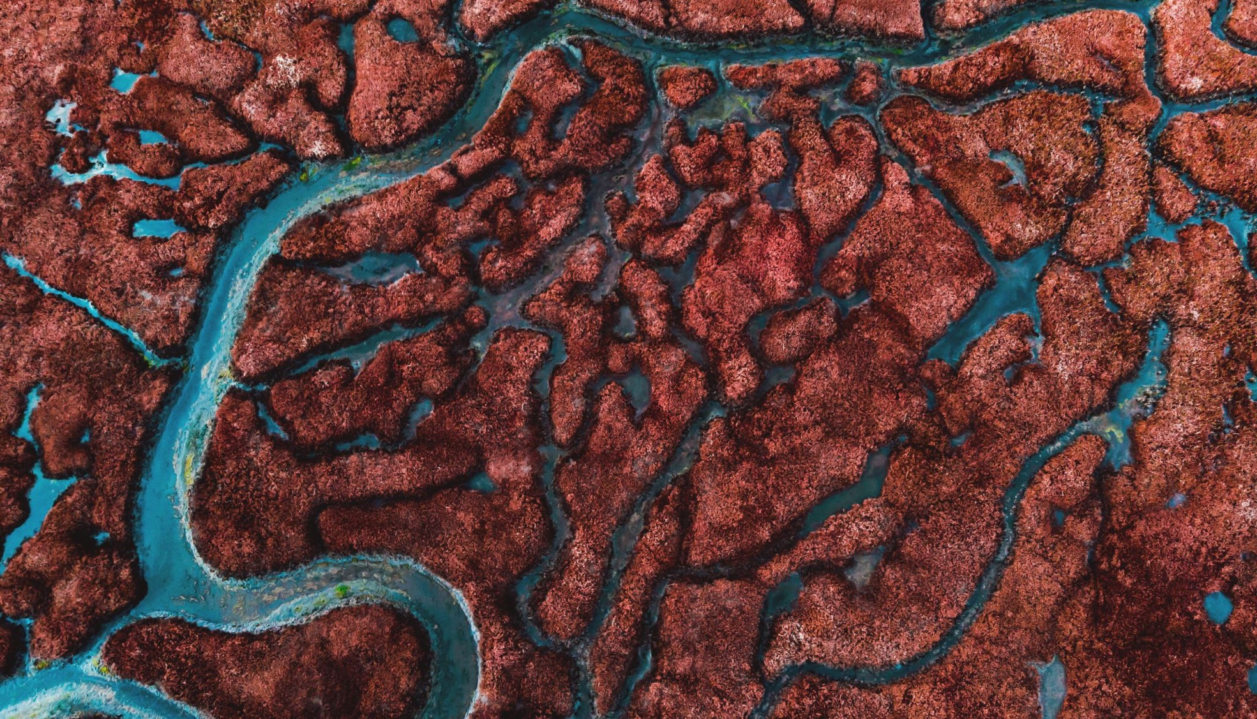

Commonly held narratives
Upstream countries, by virtue of their topographic positions, exert their power over transboundary rivers: polluting, damming, diverting, even blocking water flows.
Ethiopia could rely on its rainfall for food production and economic development (and therefore shouldn't touch Abay/Nile).
Egypt is the gift of the Nile ==> "No Nile" equates to "No Egypt".

Slide 5
Objectives
Assess Ethiopia's biophysical environment in relation to topographic position in the Nile Basin.
Assess the demand and supply of predicted land and water resources in the context of the Nile Basin.
Assess if the argument "No Nile water equates with no Egypt" holds water.

Slide 6
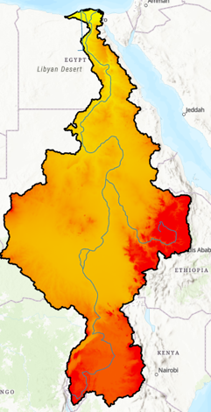
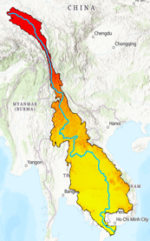

A three-pronged approach
Biophysical Assessment: Topography, climate, land resources
Hydropolitical Argument: In the light of biophysical factors
Mekong River Basin: As a comparative tool

Slide 7
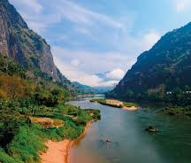
Why Mekong?
While biophysical and hydropolitical landscapes of the two international rivers differs, there are also similarities that could generate important lessons.
The two river basins:
  Became the focus of hydropolitical discourse.
  Harbor 311 million people: 251 million in Nile (20% of Africa) and 60 million in Mekong (3.8% of SE Asia).
  Overwhelmingly shared by poor and rural communities.
  17 countries: Nile (11); Mekong (6)
  The hegemonic actors': China (upstream); Egypt (downstream).

Slide 8


Nile and Mekong: Physical Characteristics
Upstream
Nile River Basin
6,650 km long (the longest in the world).
Basin: 3,400,000 km²
10% of Africa.
Discharge: 2,830 m³/s
Sources: Tana and Victoria Lakes
Mouth: Mediterranean Sea.
Downstream
Mekong River Basin
4,350 km long (12th in the world).
Basin: 795,000 km²
3.8% of SE Asia
Discharge: 16,000 m³/s.
Source: Tibet, China
Mouth: China Sea.
"The rice bowl of Asia"
Downstream
Upstream

Slide 9
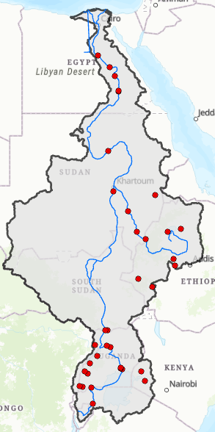
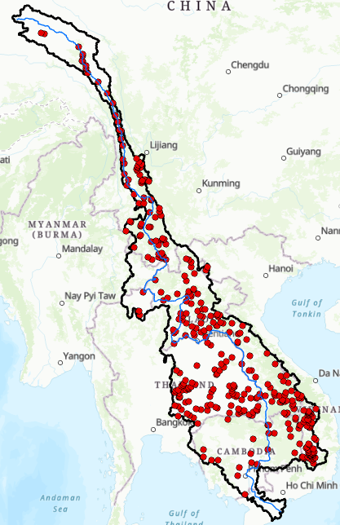
Dams: Nile and Mekong River Basins

Slide 10
Data and Sources
Data | Source | Description
Shapefiles | http://geoportal.icpac.net/documents/478; https://data.opendevelopmentmekong.net/ | Basin and administrative boundaries
DEM | The Shuttle Radar Topography Mission (SRTM) | 30 seconds (elv 30s)
Population | https://www.unocha.org/; https://sedac.ciesin.columbia.edu | Gridded Population of the World, Version 4 (GPWv4) for year 2000, 2005, 2010, 2015 and 2020.
Bioclimatic variables (Historical and Projected) | https://www.worldclim.org/ | Rasterized Global Climate Models (GCMs) data- only MRI-ESM2-0- (2021-2040, 241-2060, 2061-2080, 2081-2100). 0.5-minutes spatial resolution
Soil | ISRC (https://www.isric.org/) | 250 m resolution: soil depth, OM, CEC, pH, ...

Slide 11

Methods of Analysis
  GIS (ArcGIS Pro & QGIS) platform to conduct raster and vector-based analyses (buffer, stream profile, overlay, …)
  Statistical Analysis

Slide 12

Results and Discussion

Slide 13
Result #1: Does topographic position qualify Ethiopia as an upstream hegemonies nation?
Merits of upland position
  For defense.
  Enjoy cooler temperature in the tropical regions (but a disadvantage in the middle and high latitude)
  Less susceptible to tropical diseases (e.g., malaria).
  Exercise the control of transboundary rivers (USA, Turkey, China, Spain, India, ...).
Demerits of upland position: worsening the situations of poorer countries.
  Topographies are rugged
  Susceptible for hazards, e.g. landslide.
  A high rate of soil erosion, leads to shallow soils.
  Little or no potential for mechanized farming (due to steep slope angle).
  Mountain communities increasingly marginalized due to downhill flow of natural assets at unsustainable rates.
  Areas with elevation less than 100m and closer than 100km to the coast housed around one quarter of the global population (Cohen and Small 1998; Small and Nicholls 2003),

Slide 14
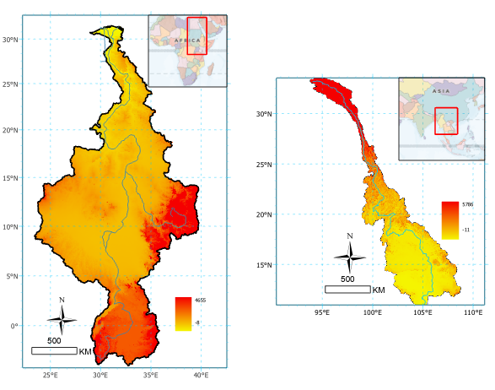
DEM: Nile & Mekong
Upstream terrains are mainly rugged

Slide 15
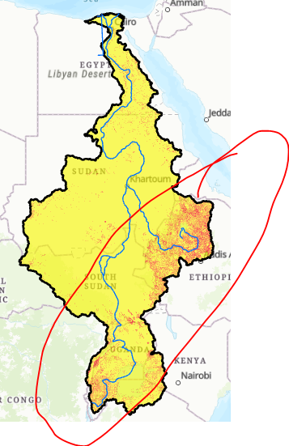
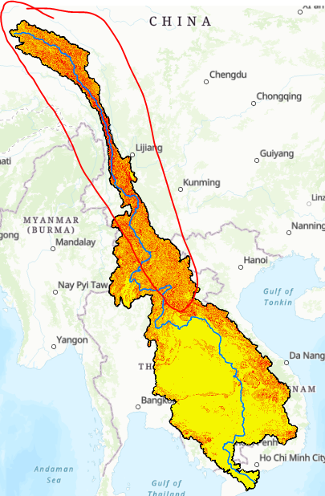
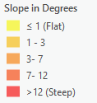
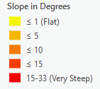
Slope
Both headstreams have a steep gradient terrain.
Mekong is much steeper than Nile
While Egypt occupies the flatter parts of Egypt, China occupies the steeper part.

Slide 16
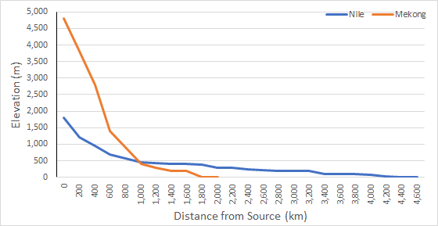
Longitudinal profile of BlueNile/Nile and Mekong
Within Ethiopia, Abay's elevation falls 130 m/100km
Within China, Mekong's elevation falls 444 m/ 100 km
Gohatsion – Dejen Bridge
Reainessance Dam
Khartoum

Slide 17
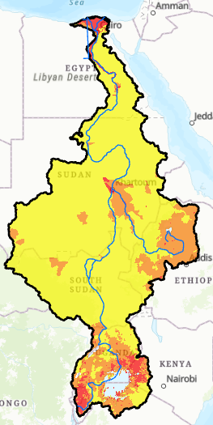
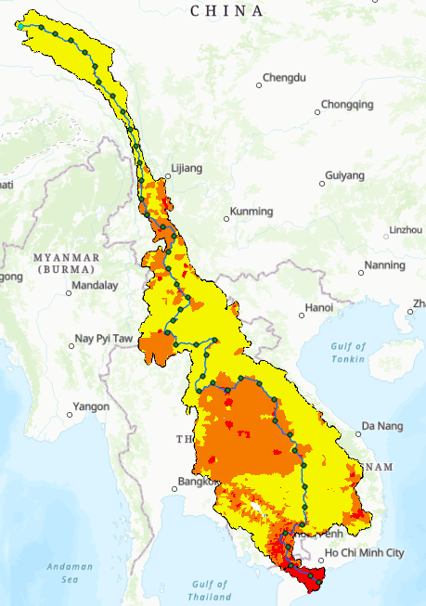


Population Densities: Nile and Mekong Basins
Some Facts
In both basins, downstream areas (especially deltas) are densely populated
While Mekong headwater has sparce population, the upstream areas of the Nile basin have moderate to high population density.

Slide 18
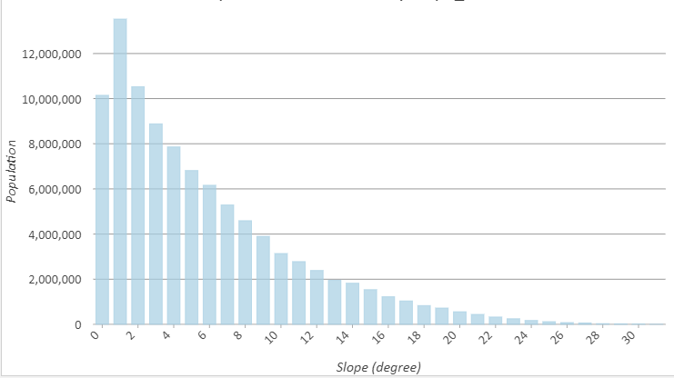
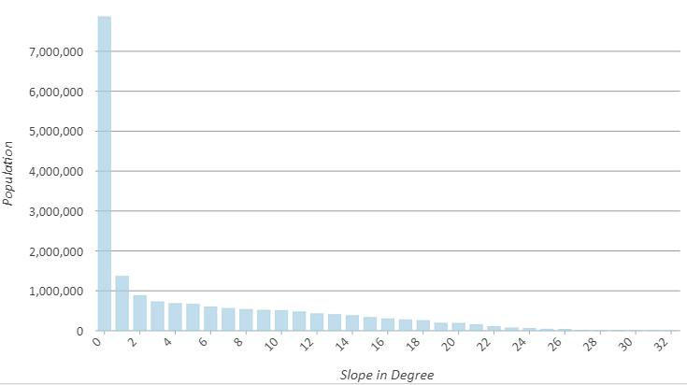
Population and Slope Relationship: Nile and Mekong Basins
Some Facts
In both basins, lowlaying (flat) areas are densely populated.
In the Nile, located in the tropics, population is moderately dense on the moderately steep landscapes.
In Mekong, the upstream is away from the tropics, and area become unberably cold for people to settle densely.

Slide 19
Result #2: Is Future Promissing?
Mounting demographic pressure (i.e, increased demand)
Increased demand for water, food, and energy resources (i.e, increased demand )
Accelerated depletion of land resources and decline of land carrying capacity (i.e., increased supply)
Worsening food insecurity and vulnerability to natural disasters – due to changes in future climate (a complicating factor)

Slide 20

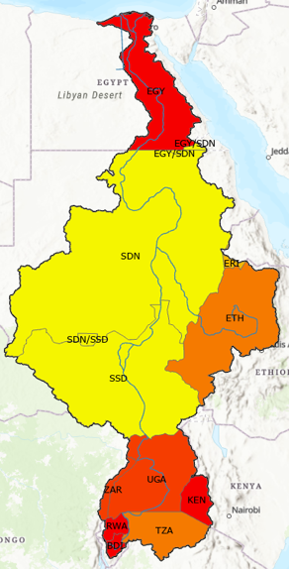


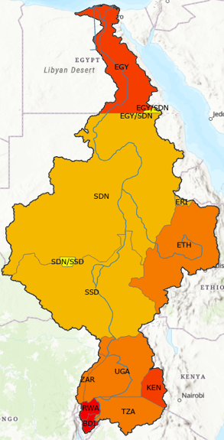
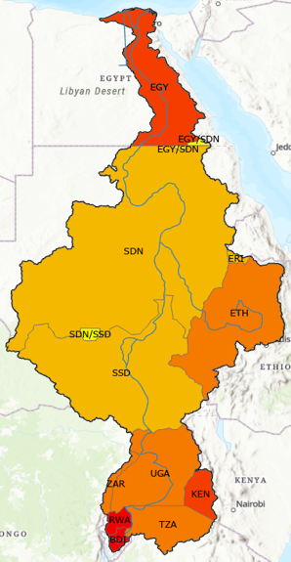

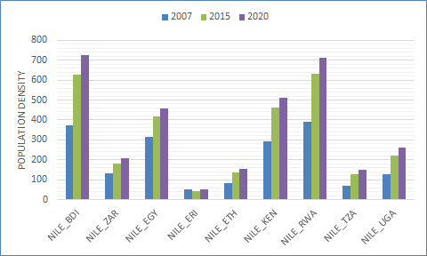

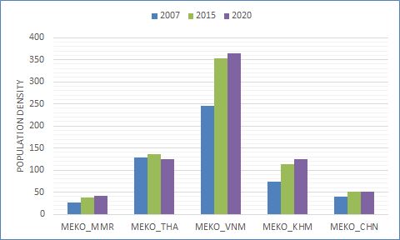
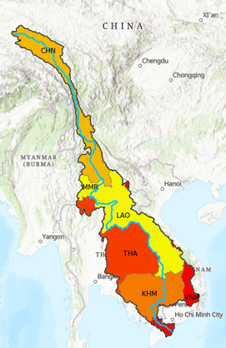
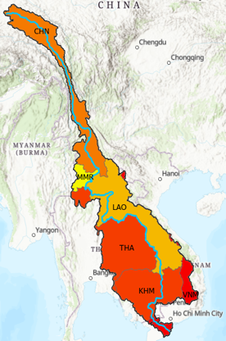



Population Growth: Nile Vs. Mekong
Population in both basins grow fast => leading to increased demand for water & food
Nile Basin
Mekong Basin​

Slide 21
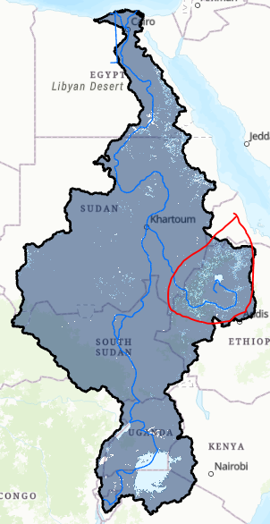
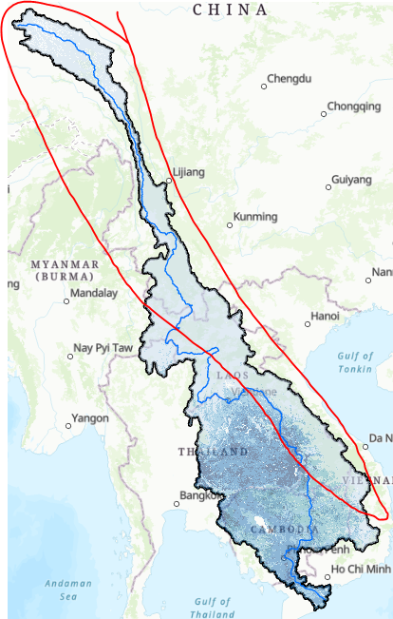

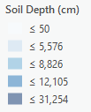
Land resource is debilitating (Soil Depth)
Soil depth in the Ethiopian highlands is already shallow. Every cm lost due to soil erosion, contribute to:
Reduced soil water holding capacity;
Limited buffering capacity for dry spells;
Reduced soil nutrients;
Therefore, reduced land and agricultural productivity

Slide 22
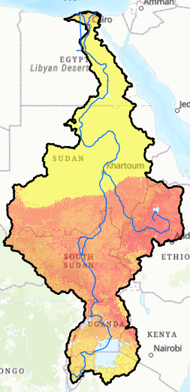
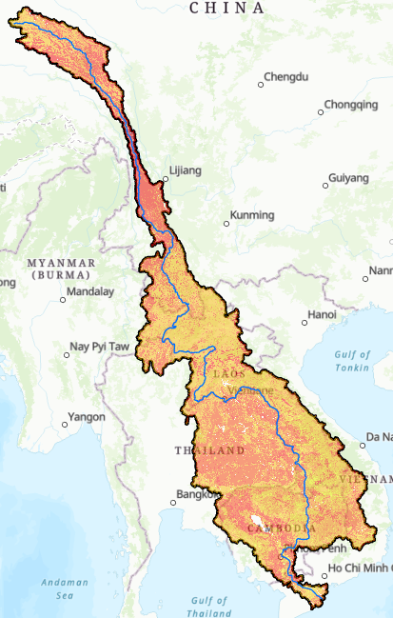


Land resource is debilitating (Soil OM)
SOM increases soil water-holding capacity, nutrients, and ameliorate soil structure
However, Soil OM is declining due to:
  Soil erosion
  Complete removal of crop residue for various purposes
  Use of cow dungs for fuel purposes

Slide 23
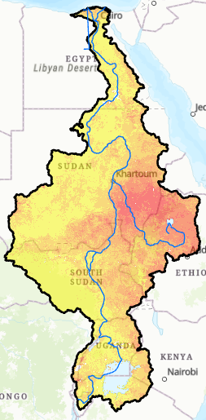
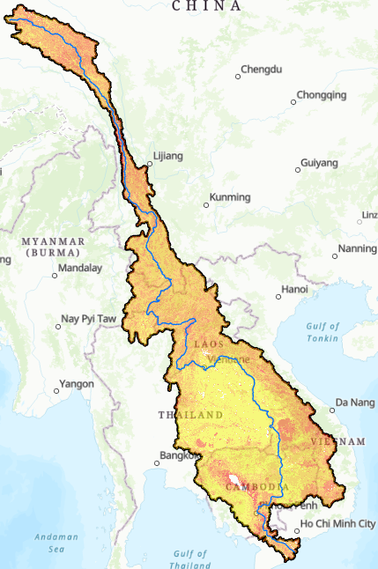

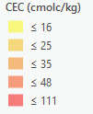
Land resource is debilitating (CEC)
CEC enhances soil aggregation and soil structure
Continuous cultivation of the land results in reduced CEC

Slide 24
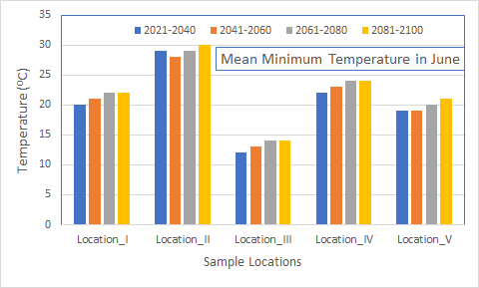
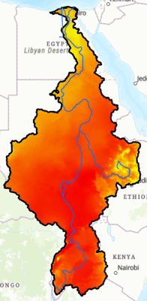
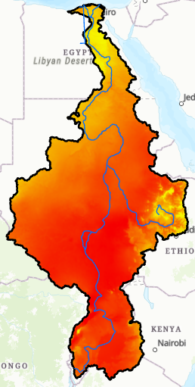
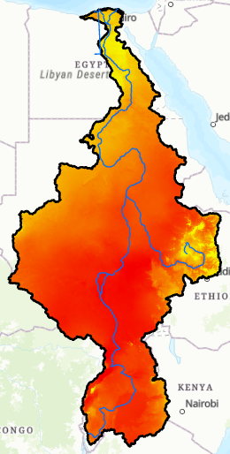
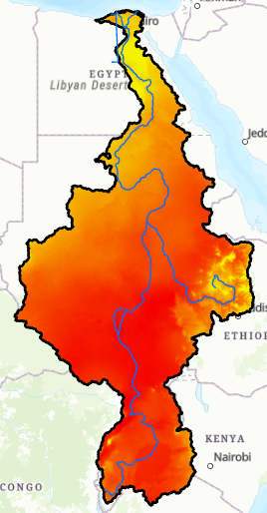
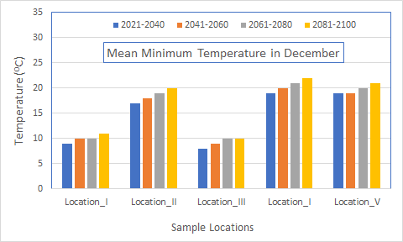
Patterns of Mean Minimum Temperature in Nile Basin(2021 – 2100)
I
II
III
IV
V
2021 - 2040
2041 - 2060
2061 - 2080
2081 - 2100​
Discernible patterns
Increased mean minimum temperature: both in June and December.
Increased mean minimum temperature lead to:
  Water stress,
  Crop stress,
  Reduced land productivities, ...

Slide 25
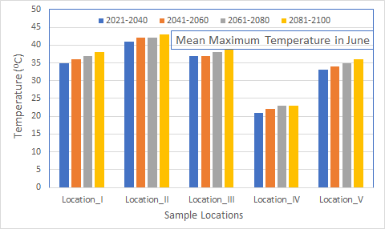
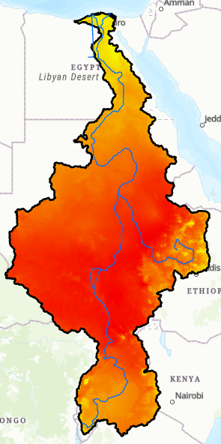
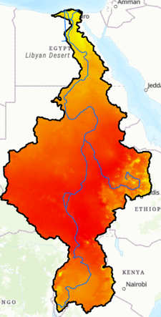
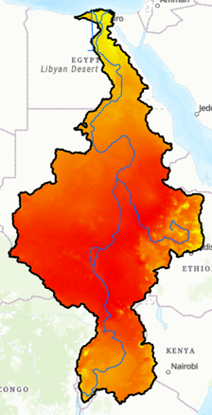
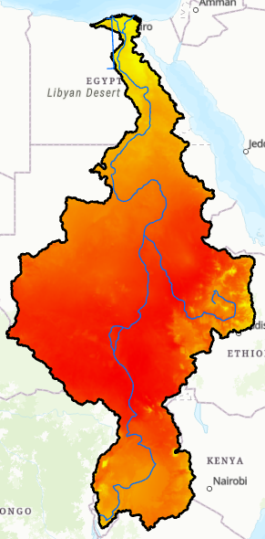
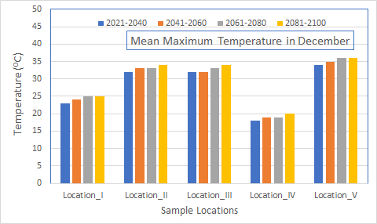
Patterns of Mean Maximum Temperature in Nile Basin (2021 – 2100)
I
II
III
IV
V
2021 - 2040
2041 - 2060
2061 - 2080
2081 - 2100​
Discernible patterns
An increase in mean maximum temperature: June & December.
Leads to increased evaporative demand.
Increased water shortages, crop stresses, reduced land productivities, heat waves,..

Slide 26
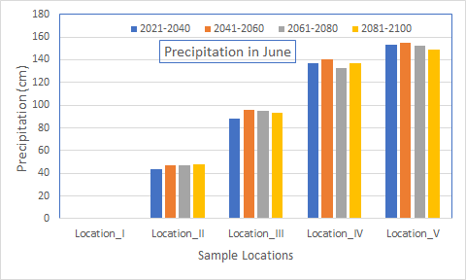
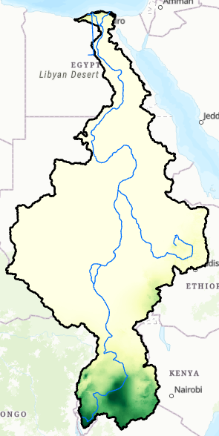
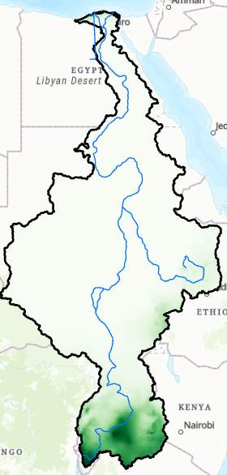



Patterns of Precipitation in Nile Basin (2021 – 2100)
I
2
3
4
5
2021 - 2040
2041 - 2060
2061 - 2080
2081 - 2100​
Discernible patterns
  There is an increase in precipitation, especially in June.
  An increase doesn't mean necessarily good: its terratic: frequent flooding, late start, early cessation, and occurrence of dry spells.
  An increased runoff speeds up soil erosion, filling of dams

Slide 27
Predicted impact of climate change on Mekong
Due to increased demand for electric power and the transition to green energy sources, China is building dams at unprecedented rate.
  Affect 20% of the world’s freshwater fish catch in the Lower Mekong
  Turn off the tap for the countries downstream during drought
  Holding on to that water for leverage
  Unexpected dam release cause rapid rises in river level that have devastated communities
  Affect the river ecosystem
Typhoons and floods would be more intense and frequent
Long coastlines and heavily populated low-lying areas make the region the most vulnerable to weather extremes and rising sea levels.

Slide 28
In general
The combination of demographic pressure, dwindling of land resources, and the predicted climate make the future livelihood much tougher and challenging.
Unfortunately, the focus is amplified on downstream countries. In short, there is a stigma on the upstream countries, which puts Ethiopia at odds with governments, financial institutions, non-state actors, journalists, and activists.

Slide 29
Result # 3:
Do Egypt cease to exist without Nile?
For coastal cities, desalination is a competitive choice. Currently, about 21,000 desalination plants in operation around the globe.
The International Desalination Association claims that 300 million people get water from desalination,
  The biggest ones: United Arab Emirates, Saudi Arabia, Israel.
  Singapore desalinating water for US$0.49 per cubic meter.
  Israeli desalinize water for < US$ 0.40 per cubic meter.
  Perth operating a reverse osmosis seawater desalination plant. The same is true in Sydney.
  A joint venture between Israel and Jordan built a large desalination plant on the Red Sea: piped 100 miles north through Jordan to replenish the Dead Sea.

Slide 30



Egypt's Population Settlement vis-a-vis Red Sea and Mediterranean Sea
Population centers concentrated along Nile River.
95% of the population lives within 20 km of the Nile River and its delta

Slide 31

Desalinization Potentials of Egypt
Alexandria
Cairo
Over 97% of the settlements in Egypt are located within 300-km from Red Sea and Mediterranean Sea.
Against the backdrop of these potentials, Egyptians are upping the ante by capitalizing on the extreme case scenario (playing a victim card):
  "No Nile means, no food, no state, no historical monument, no pyramid. In short, no Egypt"

Slide 32
Conclusion
For a poor country like Ethiopia, damn to be in the upstream and damn to be in the downstream. What matters most is power.
  Paradoxically, Ethiopia is categorized in the upstream nation (becoming a "counter-hegemon"), which is attempting to flex its muscles on downstream countries.
Given the dynamics of demographic and biophysical variables, Ethiopia couldn't satisfy its growing demand with rainfall alone. Using Blue Nile is going to be a necessity for Ethiopians.
Egypt is not going to die due to reduced Nile water flow. To balance the future water deficit, Egypt could effectively harness the Sea waters.
Egypt couldn't continue business as usual, anticipating to enjoy 55.5 million cubic water of water from Nile. To make this happen,
  Ethiopia should not only adopt a hands off Abay, but also divert Shebelle and Awash rivers to feed into the Nile. Or … Ethiopia should slash its current population by 75%.
Whether Ethiopia use the Abay water or not, the Nile discharge would decline in the future.

Slide 33
Recommendations
Ethiopia's hydropolitical argument should go beyond justifying its rights over the Nile water, confined within its territory. It should transcend to alternative water sources in the downstream, too. The potential of dieselization from the two Seas is a good example.
Ethiopia should anchor the Nile issue with the climate change narrative. Highlighting the negative consequences of predicted climate change would gain the support of international pressure groups, non state actors, activists and journalists.

