Slide 1

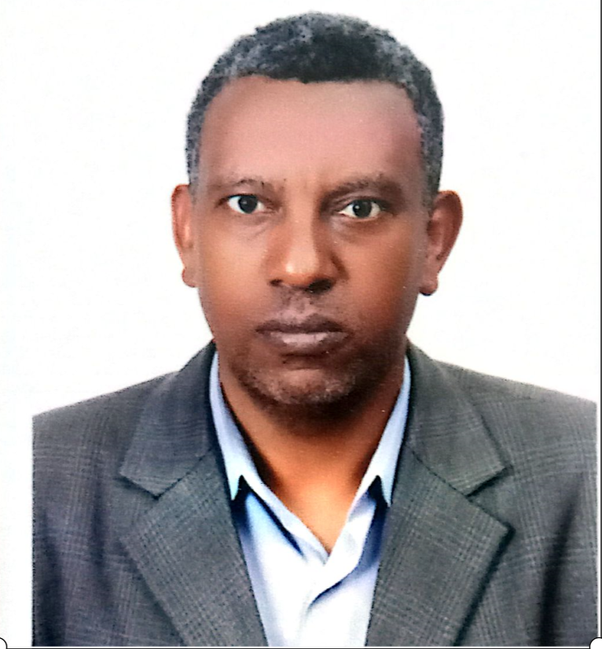


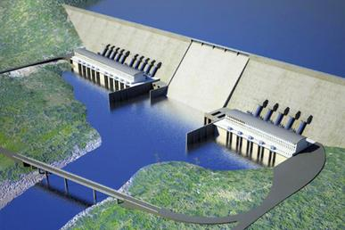

BLUE NILE/ABBAY AND GRAND ETHIOPIAN RENAISSANCE DAM
PRESENTATION 2
2020 International Conference on the Nile and GERD
BELETE BERHANU
Addis Ababa Institute of Technology, Ethiopia
PRESENTATION TITLE:
Stage-based Filling of GERD: An adaptive and Cooperative Approach

Slide 2
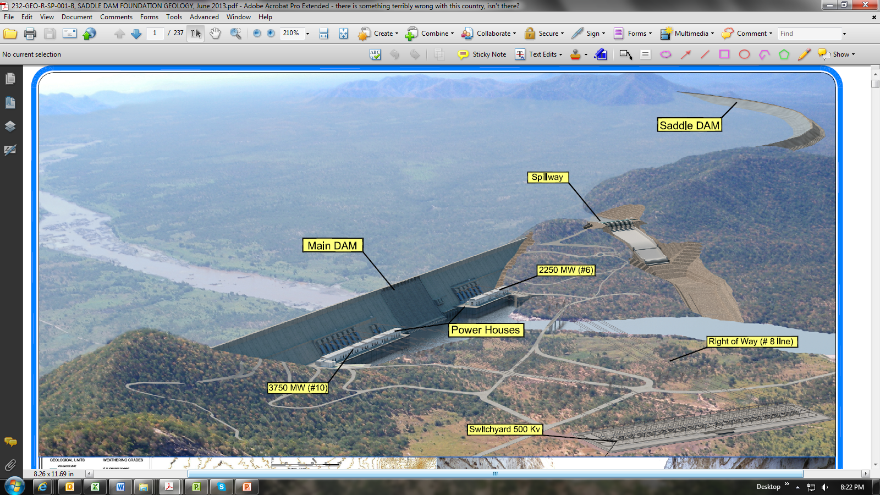
Overview GERD
2020 International Conference on the Nile and GERD
Full Supply Level (FSL): 640 m asl
Minimum optimal operating level 625m asl
Minimum operating level (MOL): 595 m asl
Bottom outlets levels : 560 m asl
Max. Height above foundation : 145 m
Crest elevation: 645 m asl
Crest length 1780 m
Total Storage volume: 74.01 Bm³
Total Installed Capacity: 6000 MW
Annual Average energy generation 15.7TWh/yr

Slide 3
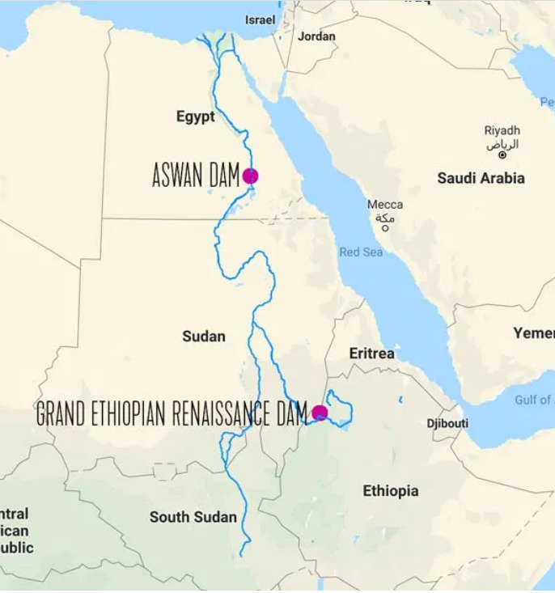
Challenges on the Filling of GERD
2020 International Conference on the Nile and GERD
Existing of two large, over-year storage dams (GERD and AHD) as the ownership of two different countries (Ethiopia and Egypt),
The two dams interconnect each other through other annual reservoirs in the third country, Sudan
There is no agreeable water use arrangement among the countries;
There is no acceptable and reasonable current water uses among the countries
The Blue Nile Hydrology is more variable and unpredictable
Fixed year filling not adaptive and cooperative

Slide 4
Nature of staged based filling
2020 International Conference on the Nile and GERD
Flexible to adopt changes and to cooperate with downstream countries
Not fixed on the filling year and minimum flow release
Filling possible accelerated or decelerated
Stages are not dependent on the flow conditions
It doesn’t refer any water allocation arrangements

Slide 5
Filling Stages of GERD
2020 International Conference on the Nile and GERD
SMART staged based filling schedule of GERD
Water level in GERD, (m ) | Incremental retained water at the end of June, (BCM) | Cumulative retained water at the end of June, (BCM) | Range of possibility of release based on hydrology year, (BCM)
565 | 4.9 | 4.9 | 21 – 69.1
595 | 13.5 | 18.4 | 21 – 60.5
608 | 10.5 | 28.9 | 21 – 63.7
617 | 10.4 | 39.3 | 21 – 63.6
625 | 10.0 | 49.3 | 21 – 64.0
632 | 11.3 | 60.6 | 21 – 62.7
640 | The full supply level of GERD, with 74BCM storage capacity
Construction based stages
Cooperative stages

Slide 6
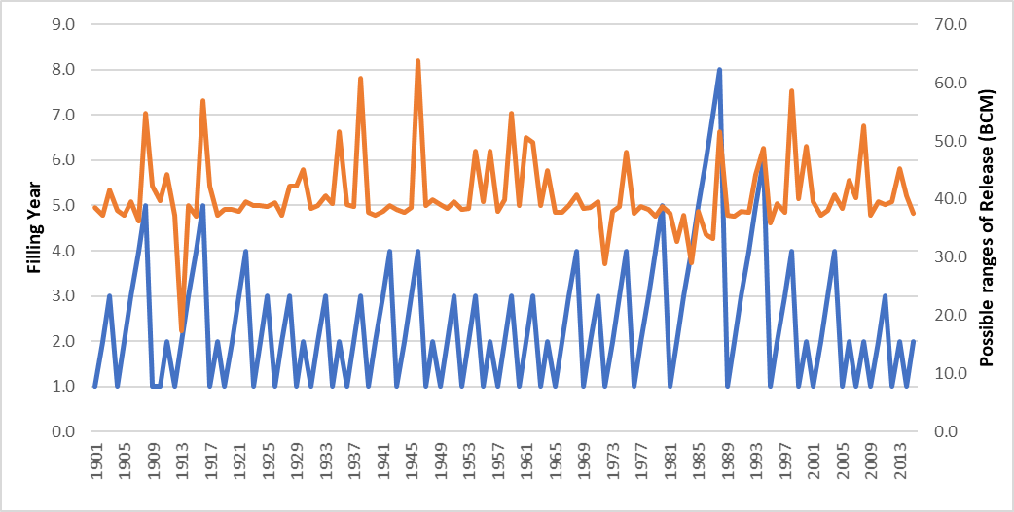
Summary
2020 International Conference on the Nile and GERD
It accepted by the three countries and adopt on all their negotiation text
It gives strong leverages for the progress of the negotiation
It can be evaluated from different perspectives
  With filling year or probability of filling year
  Release water
  Energy generation
  ……

Slide 7
THANK YOU!
We hope you enjoyed the conference.
If you have any follow-up questions/requests, please email: environment@fiu.edu
2020 International Conference on the Nile and GERD

