Slide 1

International Conference on Nile and Grand Ethiopian Renaissance Dam (GERD)
HYDROLOGIC EVALUATION OF HIGH-RESOLUTION SATELLITE PRECIPITATION PRODUCTS: CASE STUDY ON DABUS WATERSHED, UPPER BLUE NILE BASIN, ETHIOPIA
Alemshet Belayneh^{1*}, Adane Abebe²
¹Department of Water resources and Irrigation Engineering, Institute of Technology, Woldia University, P.O.Box 400 Woldia, Ethiopia, E-Mail: alembe29@gmail.com : +251911587987
²Department of Water resources and Irrigation Engineering, Institute of Technology, Arba Minch University, P.O.Box 21, Arba Minch, Ethiopia, E-Mail: adaneabe@gmail.com: +251911544432
August, 2020

Slide 2
 Introduction
Hydrological modeling for runoff simulations requires accurate rainfall data as a model input.
But in many developing countries like Ethiopia, the rainfall observation network is relatively sparse.
Rainfall estimates are mainly derived from two sources:-
    Rain gauge station observations and
    Ground radar measurements

Slide 3
Cont’d
However, recently satellite rainfall products have emerged as an alternative or supplement to conventional rainfall observations for hydrological modeling. Such as,
TRMM and CHIRP
Satellite system that provides rainfall are separated in to GEO and LEO satellites.
Accordingly, this study was intended to evaluate the suitability of TMPA_3B42v7 and CHIRPS_2 satellite rainfall estimates for runoff simulation.

Slide 4
Statement of the Problem
Satellite rainfall estimates have potential use for hydrological modeling.
But model performance depends on;
satellite product type
watershed size and
hydro-climatic region.
However, those studies didn’t cover Dabus watershed and most of the studies were limited to short simulation periods.
Moreover, in Dabus watershed the influences of
water withdrawal
land cover and climate change have not been quantified yet due to scarce rainfall data for rainfall-runoff modeling.

Slide 5
Objectives of the Study
General objectives
To evaluate CHIRPS_2 and TMPA_3B42v7 satellite rainfall products for hydrologic simulation.
Specific objectives
To evaluate the ability of satellite rainfall products to characterize rainfall patterns and capture the magnitude of rainfall.
To assess the skill of satellite rainfall products as an input into a hydrologic model for stream flow simulation.
To evaluate the performance of HEC-HMS model using satellite and ground based rainfall products.

Slide 6
Description of the Study Area
Location
In South-Western Ethiopia Benishangul-Gumuz region, 664 km around the Grand Ethiopian Renaissance Dam (GERD)
9˚0’0’’ - 11˚50’0”N Latitude and
34˚30ʼ0ˮ - 35˚58ʼ40ˮE Longitude
Drainage area of about 21,032 Km².
Out of this 600 to 900 km² area is swamp.

Slide 7
Climate
Rainfall
Characterized with
unimodal rainfall distribution.
About (70-90)% of total rainfall
occurs in rainy summer
(Kiremt) seasons.

Slide 8
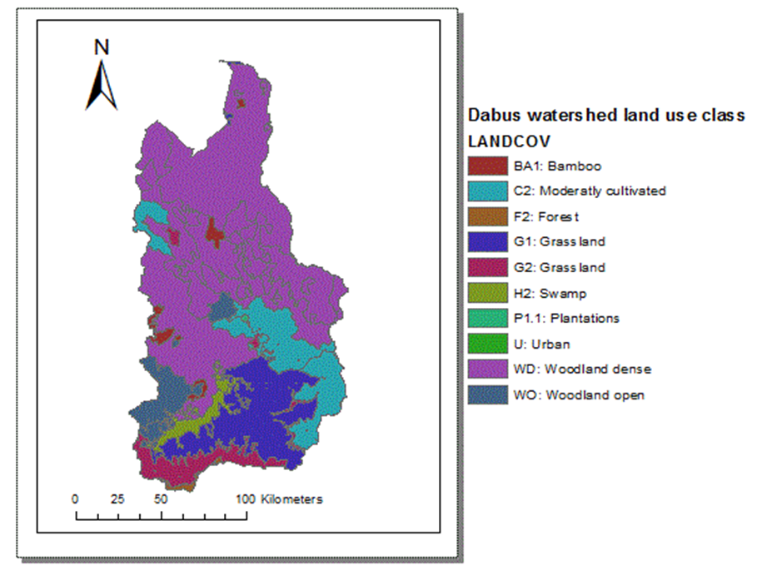
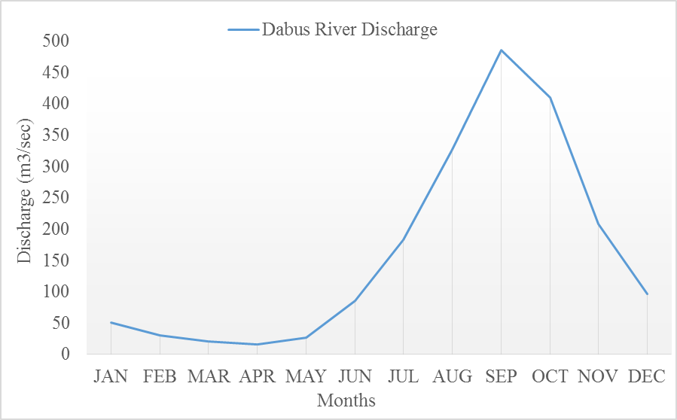
Land Use Land Cover
Wood land
Moderately cultivated
Grass land
Swamp
Gauging station is installed downstream
of the Dabus river.
Has an average annual
daily flow of 161 m³/sec.
Hydrology

Slide 9
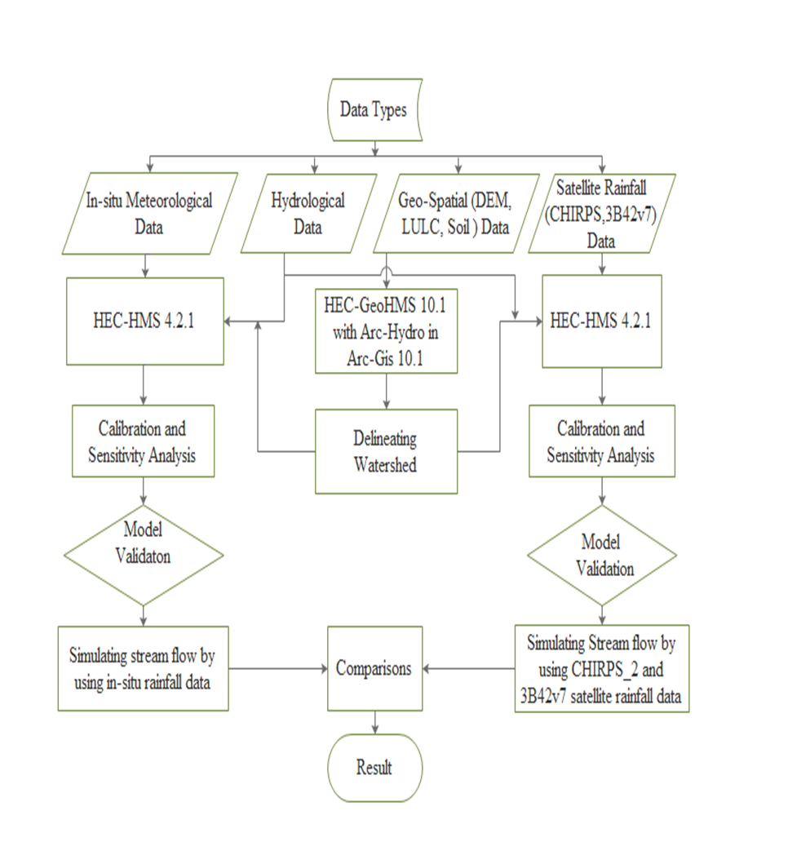
 Materials and Methods
Conceptual frame work of the study area which describes the overall procedure of this thesis work.

Slide 10
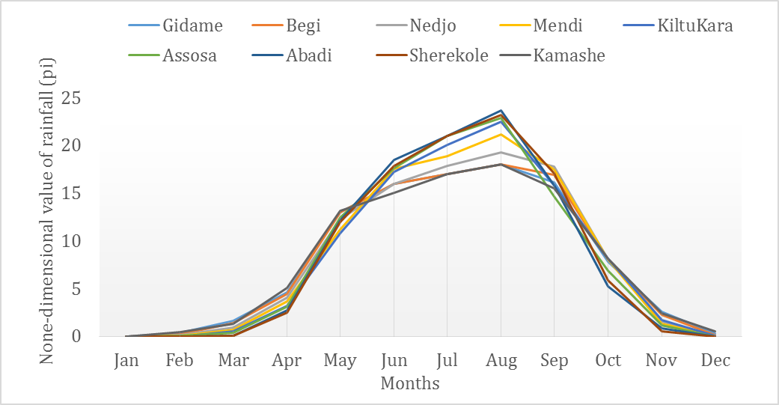
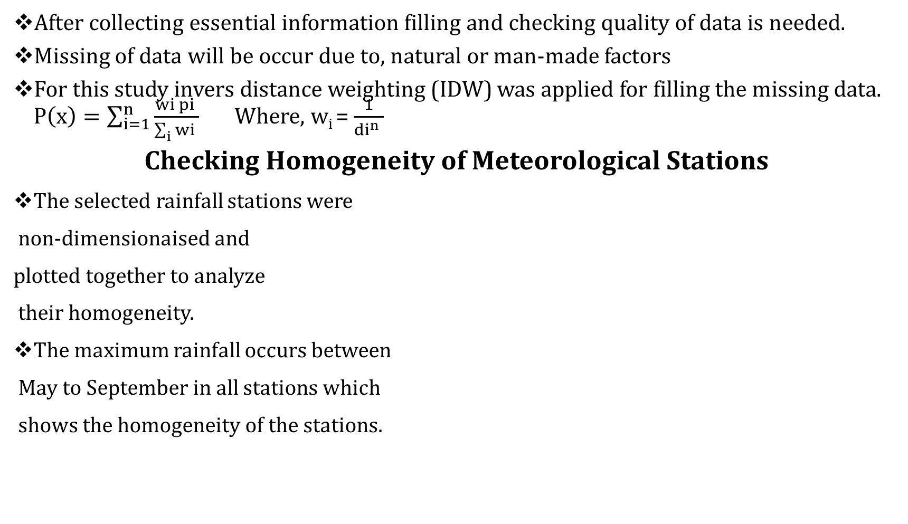
Cont’d
After collecting essential information filling and checking quality of data is needed.
Missing of data will be occur due to, natural or man-made factors
For this study invers distance weighting (IDW) was applied for filling the missing data. $P\left(x\right)=\sum_{i=1}^{n}{\frac{wi pi }{\sum_{i}{wi }}}$ Where, w_{i} =$\frac{1}{{di}^{n} }$
Checking Homogeneity of Meteorological Stations
The selected rainfall stations were
non-dimensionaised and
plotted together to analyze
their homogeneity.
The maximum rainfall occurs between
May to September in all stations which
shows the homogeneity of the stations.

Slide 11
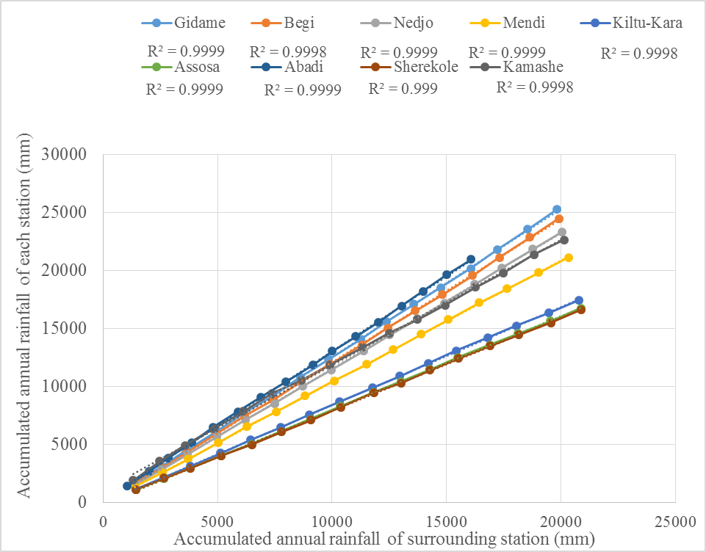
Cont’d
Checking Consistency of Meteorological Stations
Done using double mass curve analysis.
The selected stations were consistent since the graph of the plot forms straight line without break.

Slide 12
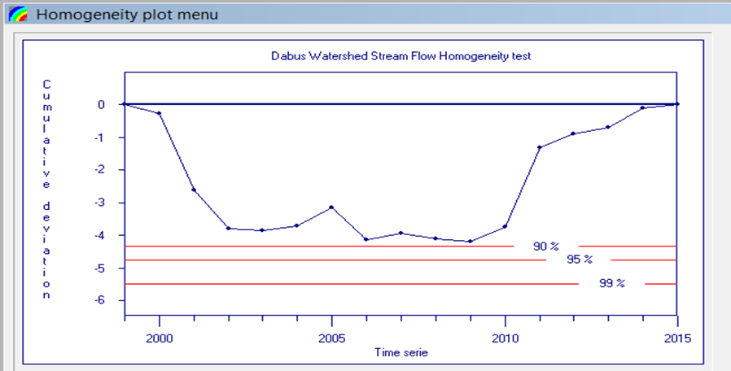
Cont’d
Stream flow Homogeneity Test
Done using Rainbow software.
The rescaled cumulative deviations from the mean would not crossed one of the horizontal 90, 95 and 99% probabilities lines, which shows the homogeneity of the annual data series.
Notes:
$$Sk=\sum_{i=1}^{k}{\left(xi−\overline{x}\right)}$$

Slide 13
Cont’d
Processing of Satellite Rainfall Estimates
5844 files for each of the satellite rainfall estimates were downloaded.
      TMPA_3B42v7
      CHIRPS_2
Those estimates were obtained on a Network Common Data Form (NetCDF) gridded format.
Then, Panoply NetCDF data viewer was used to extract the rainfall data in suitable format for further analysis.
Bias correction of Satellite rainfall products were performed using power transformation methods.
P* = a × P^{b} where, a and b are constants
Notes:
Cv = Std / Avg.
a = Avg_{.Ob} /Avg_{CHIRPS^b}

Slide 14
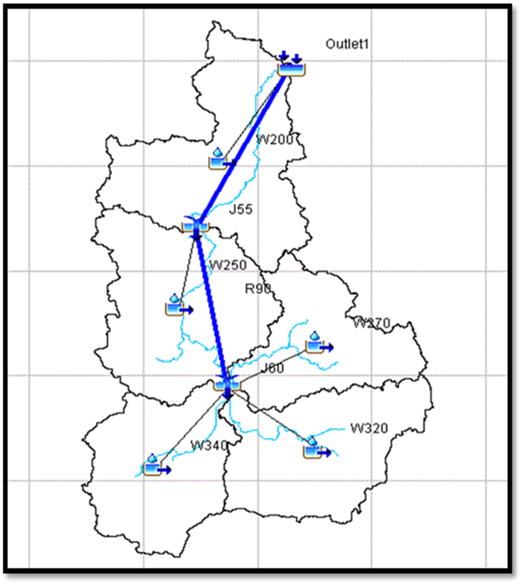
Cont’d
Model Setup
HEC-HMS model contain four components;
basin model
meteorological model
control specification and
input data
HEC-GeoHMS and Arc-Hydro were used to delineate sub-basins and other watershed features from DEM of the study area.
Input data to HEC-HMS were pre-process using HEC-GeoHMS under GIS environment.

Slide 15
Cont’d
Sensitivity Analysis
Sensitivity analysis used to select parameters of the hydrologic model that have highest impact on model result.
sensitivity analysis can be local or global.
HEC-HMS (GUI) model was used to identify the sensitive parameter using local analysis method.
Max –ve or +ve Objective sensitivity function value has high impact on model result.

Slide 16
Cont’d
Model Calibration and Validation
Calibration is a process of changing model parameter values until model results match acceptably the observed data.
Validation is testing model capability to simulate observed data.
A split sample procedure of daily stream flow data were used.
2000 for “warm-up” to mitigate unknown initial conditions.
2001-2010 for calibration and
2011-2015 for validation.
Notes:
Calibration and validation were performed using HEC-HMS GUI MODEL

Slide 17
Cont’d
Model Performance Evaluation
R², describes the proportion of the total variance in the observed data that can be explained by the model.
ENS, indicates the degree of fitness of the observed and simulated hydrographs.
PBIAS, measures the average tendency of the simulated data to be larger or smaller than observed data.
PEPF and RVE
Notes:
RVE = $\frac{\sum_{i=1}^{n}{ \left(Qsim, i − Qobs,i\right) }}{\sum_{i=1 }^{n}{(Qobs,i})}$*100
PBIAS = $\frac{\sum_{i=1 }^{n}{\left(Qo,i − Qs,i\right)}}{\sum_{i=1 }^{n}{(Qo,i})}∗100$
PEPF = 100 * $|\frac{Qobs(peak) – Qsim(peak) }{Qobs(peak) }$|
|

Slide 18
 Results and Discussions
Performance of Satellite Rainfall Estimates
Both of the selected satellite rainfall products were underestimated and overestimated the rainfall.
In-situ and TMPA_3B42v7 satellite rainfall products showed higher difference in Assosa and Kiltukara stations.
In-situ and CHIRPS_2 satellite rainfall products were indicated wider difference in Begie and Abadie stations.
The difference between in-situ and satellite rainfall estimates showed elevation dependent trends.
Notes:
Based on Mean Std, and CV in addition to, NSE, R2, PBIAS, PEPF AND RVE MEAN….. WERE USED TO EVALUATE

Slide 19
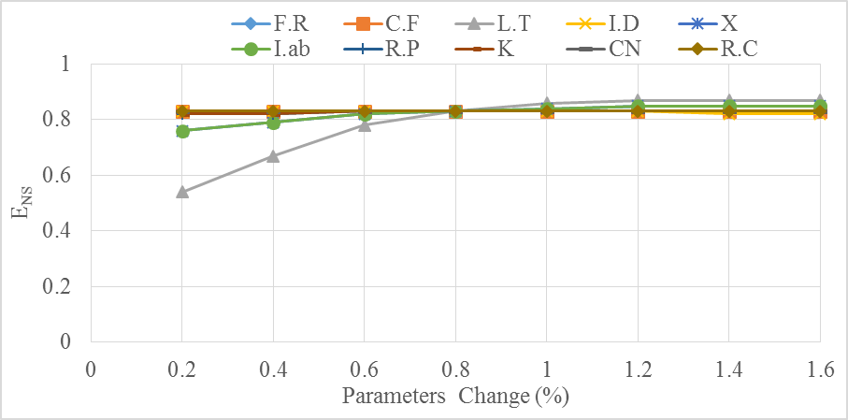
Cont’d
Modeling with in-situ Rainfall Data
Sensitivity Analysis
Lag time (L.T)
Initial abstraction(I.ab)
Initial discharge (I.D)
Based on the value of objective sensitive function L.T was ranked as most sensitive flow parameter.

Slide 20
Cont’d
Calibration and Validation of in-situ rainfall data
Although, Observed and simulated graph matched well overestimation of observed stream flow were occurred.
 | Objective function
Period | E_{NS} | R² | PBIAS (%) | PEPF (%) | RVE
Calibration (2001-2010) | 0.843 | 0.954 | -14.648 | 2.364 | 5.557
Validation (2011-2015) | 0.791 | 0.952 | -19.638 | -6.346 | 6.634

Slide 21
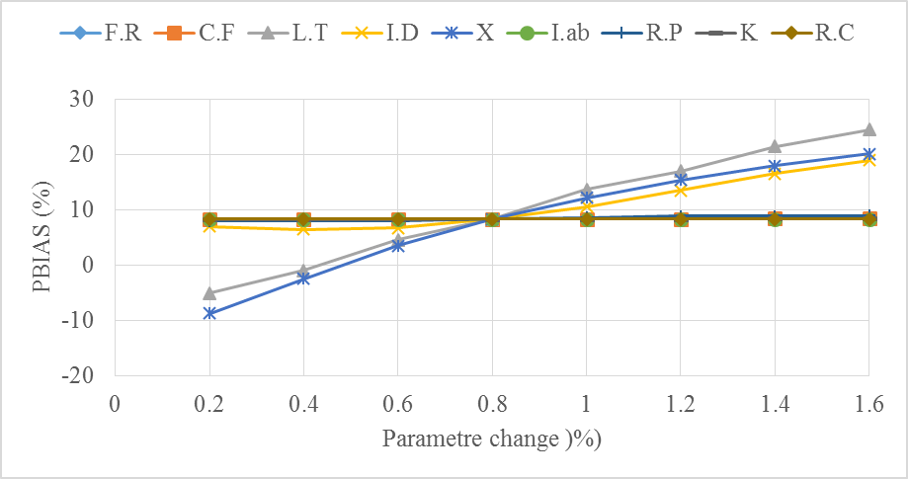
Cont’d
Modelling with CHIRPS_2 Satellite Rainfall Products
Sensitivity Analysis
Muskingum (x)
Lag time (L.T)
Initial discharge(I.D)
Even if, the sensitivity percentage values were slightly different, the above parameters were common for both satellite rainfall estimates.

Slide 22
Cont’d
Calibration and Validation of CHIRPS_2 rainfall products
 | Objective function
Period | E_{NS} | R² | PBIAS (%) | PEPF (%) | RVE
Calibration (2001-2010) | 0.685 | 0.777 | -18.425 | 4.042 | 7.893
Validation (2011-2015) | 0.513 | 0.704 | -21.467 | -6.075 | 8.562

Slide 23
Cont’d
Modelling with TMPA_3B42v7 Satellite Rainfall Products
 | Objective function
Period | E_{NS} | R² | PBIAS (%) | PEPF (%) | RVE %
Calibration (2001-2010) | 0.755 | 0.786 | -11.325% | 7.335 | 9.893
Validation (2011-2015) | 0.714 | 0.705 | -17.357% | -5.075 | 10.00

Slide 24
Cont’d
HEC-HMS Model Performance Comparisons for Satellite Rainfall
HEC-HMS model was showed relatively better performance in stream flow simulation for TMPA_3B42v7 than CHIRPS_2 satellite rainfall estimates.
 | Calibration period (2001-2010) |  |  |  |  | Validation Period (2011-2015)
Rainfall Type | R² | E_{NS} | PBIAS (%) | PEPF (%) | RVE (%) | R² | E_{NS} | PBIAS (%) | PEPF (%) | RVE (%)
CHIRPS_2 | 0.777 | 0.685 | -18.42 | 4.042 | 7.89 | 0.704 | 0.513 | -21.46 | -6.07 | 8.56
TMPA-3B42v7 | 0.786 | 0.755 | -11.32 | 7.335 | 9.89 | 0.705 | 0.714 | -17.35 | -5.07 | 10.0

Slide 25
Cont’d
HEC-HMS Model Performance for in-situ and Satellite Rainfall estimates
HEC-HMS model scored better results for in-situ precipitation products than satellite rainfall estimates.
In-situ rainfall | Objective function
Period | E_{NS} | R² | PBIAS (%) | PEPF (%) | RVE (%)
Calibration (2001-2010) | 0.843 | 0.954 | -14.648 | 2.364 | 5.557
Validation (2011-2015) | 0.791 | 0.952 | -19.638 | -6.346 | 6.634
TMPA_3B42v7 | Objective function
Period | E_{NS} | R² | PBIAS (%) | PEPF (%) | RVE %
Calibration (2001-2010) | 0.755 | 0.786 | 11.325 | 7.335 | 9.893
Validation (2011-2015) | 0.714 | 0.705 | 17.357 | -5.075 | 10.00

Slide 26
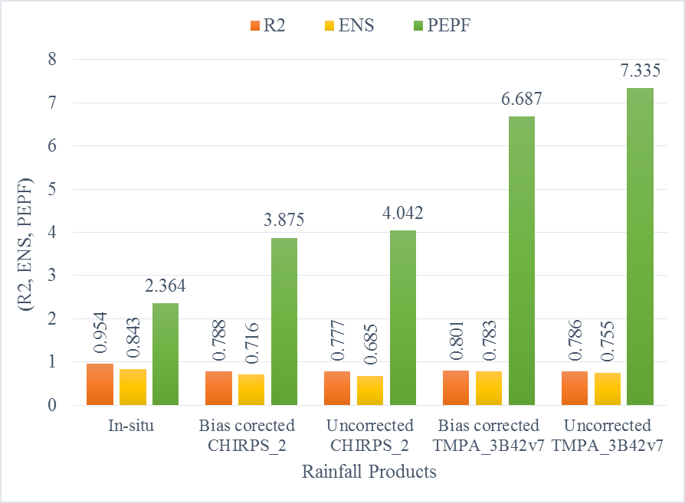
Cont’d
Effects of Bias Correction of Satellite Rainfall Products
The performance of satellite rainfall products increased when bias corrected satellite rainfall estimates used.

Slide 27
 Conclusions
Lag time, Muskingum x, k and initial discharge were the most sensitive.
Calibration and Validation results of HEC-HMS model using in-situ rainfall data's were rated as ‘Good’ for the study area.
Calibration and Validation results of HEC-HMS model using TMPA_3B42v7 and CHIRPS_2 estimates were rated as ‘Satisfactory’.
Low HEC-HMS model performance was reported when CHIRPS_2 satellite rainfall estimates used.
Relatively good performance of HEC-HMS model was resulted while using in-situ rainfall data.
Bias corrected satellite rainfall products were showed slightly better result than uncorrected satellite rainfall estimates.
The performance of bias corrected satellite rainfall estimates still less than performance of in-situ rainfall products.

Slide 28
 Recommendations
Applying physically distributed hydrologic model which incorporate land use land cover changes may lead to get better results.
Applying different type of bias correction techniques including correction for topography may increase the model performance.
Applying studies which includes climate change with land use land cover and sediment inflow to the watershed using satellite rainfall may be important for the safety of Grand Ethiopian Renaissance Dam (GERD).

Slide 29

THANK YOU
FOR YOUR
ATTENTION!!!

