Slide 1
Optimal Power Production of GERD with and without Upstream Irrigation
Abebe Sine Gebregiorgis
and
Semu Ayalew Moges
Texas, USA

Slide 2
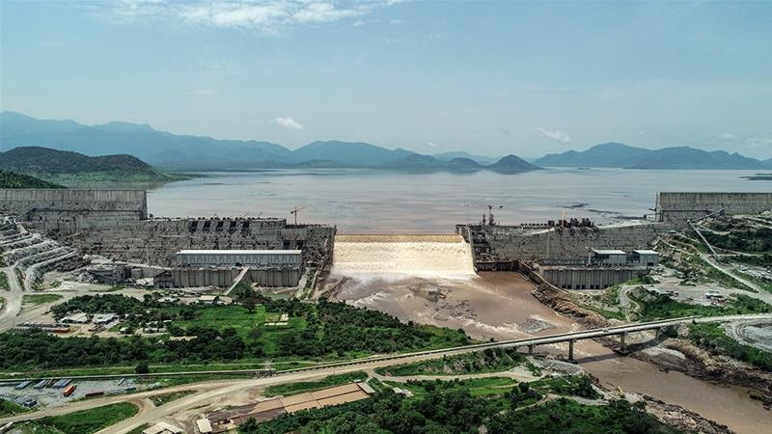
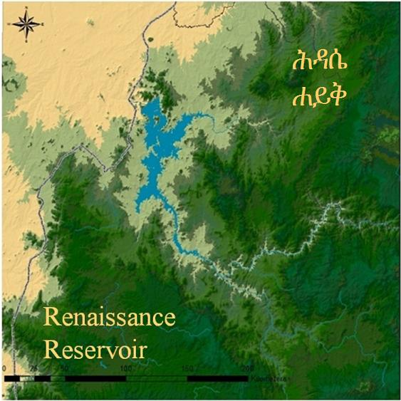
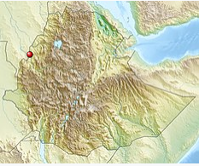
Grand Ethiopian Renaissance Dam (GERD)
Located near Ethio-Sudan boarder
Expected to generate a total annual energy of 15,692 GWh and yield an average annual power of 1791 MW

Slide 3
Driving factors for Irrigation
Agriculture is the backbone of Ethiopia:
  Crucial to economic growth and long-term food security
  Supports 85 percent of the population's livelihoods
  Shares about 40% of the country's gross domestic product
  More than 80 percent of export value
Rainfall in Ethiopia:
  Highly erratic, and extreme spatial and temporal variability
  Most rain falls intensively, often as convective storms, with very high rainfall intensity

Slide 4
Driving factors …
  High population growth (nearly 115 M)
  Soil and land degradation
  Very high risk of annual droughts and intra-seasonal dry spells – rainfed agriculture is insufficient to ensure food security
  Beside hydropower generation, development of modern irrigation schemes is no-choice option for Ethiopia to overcome these challenges
  So it is important to investigate the impact of upstream irrigation on GERD power production

Slide 5
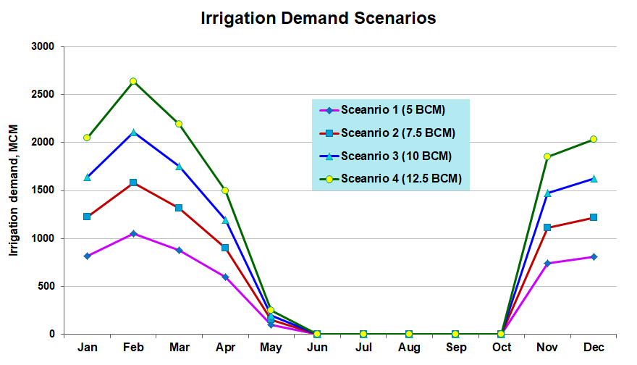
Method
Assume hypothetical annual abstraction of 5 to 12.5 BCM for irrigation upstream of GERD

Slide 6
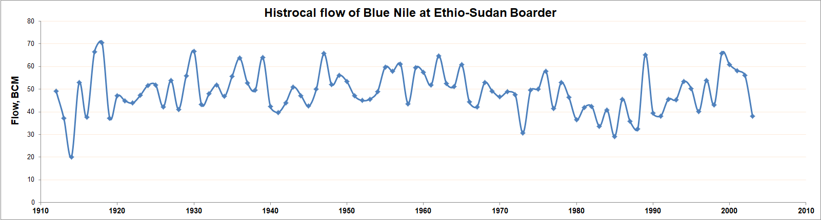
The historical inflow at Ethio-Sudan boarder since 1910 has been used as an input to perform the analysis
Reservoir operation is modeled with and without drought mitigation conditions

Slide 7
Assumption
The existing operation rule in the GERD report has been generated based on optimal average power and annual total energy without upstream irrigation consideration.
This analysis assumed that operation rules remain the same regardless of upstream abstractions

Slide 8
Result
Summary of average power and energy production for different upstream irrigation demands
Scenario | Qin, BCM | Qout, BCM | Power, MW | Energy, GWh
No Irrigation | 48.9 | 47.2 | 1713 | 15030
5 BCM Irrigation demand |  | 42.4 | 1505 | 13199
7.5 BCM Irrigation demand |  | 40.1 | 1374 | 12047
10 BCM Irrigation demand |  | 37.7 | 1251 | 10958
12.5 BCM Irrigation demand |  | 35.2 | 1140 | 9985

Slide 9
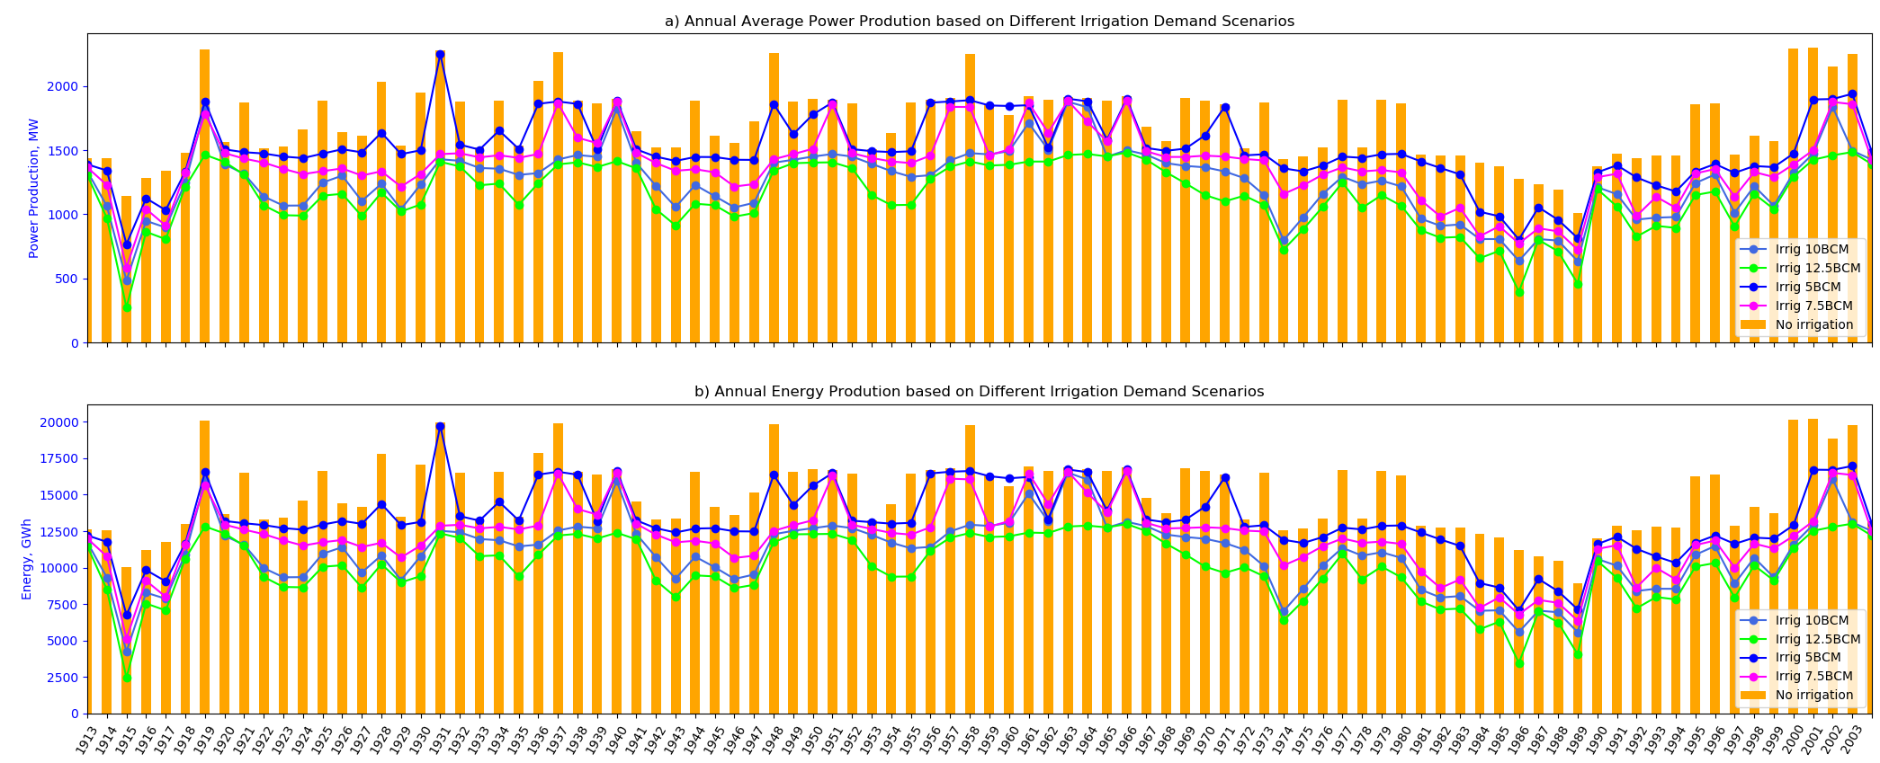
Impact of upstream irrigation on yearly average power and total energy production

Slide 10
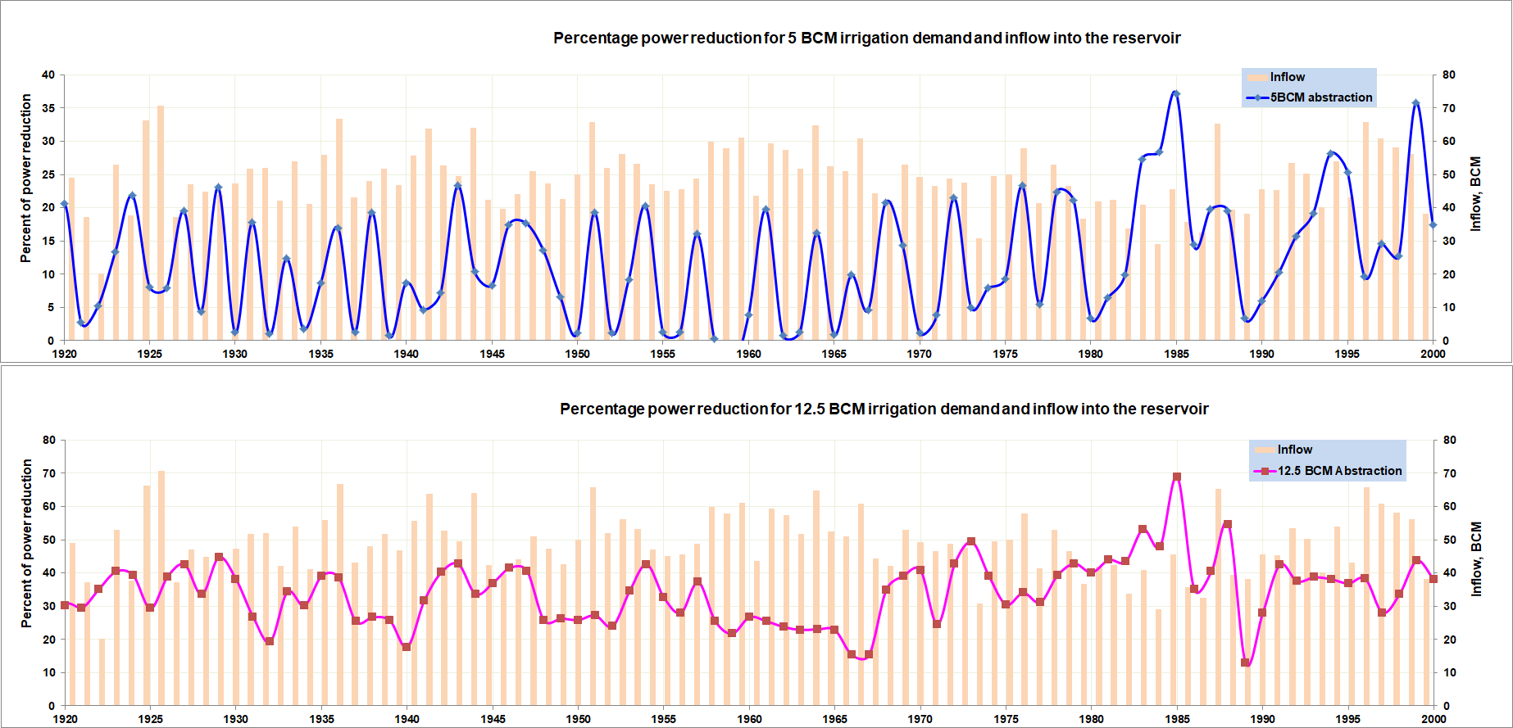
The variation of percent of power reduction is not directly match the variation of inflow. The lag effect is attributed to reservoir operation rules and storage role in power generation

Slide 11
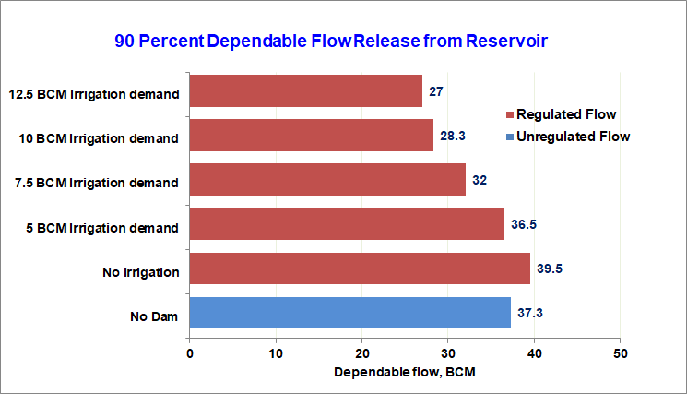
Dependable flow

Slide 12
Summary and recommendation
The study indicates upstream irrigation abstraction between of 5 BCM to 12.5 BCM may reduce average annual power production from 1,713 MW to 1,140 MW and the total annual energy production from 15,030 GWh to 9,985 GWh
Annual power production and total energy generation may reduce within the range of 12% to 33% regardless of the hydrological condition.
This study may help contribute in determination of dependable flow releases and set threshold flows on the ongoing negotiation in the long term operation of the dam

Slide 13
Summary …
Regardless of irrigation demand, the GERD will contribute 6% increase to 90 percent dependable flow as compared to natural flow
With potential upstream irrigation, a new optimized reservoir operation rules should be generated based on a combined irrigation-power production scenario.
Diversifying power sources may compensate the power and energy loses from potential irrigation abstraction upstream of GERD.

Slide 14
Thank you

