Slide 1
EXPLORING THE OPTIONS FOR SUSTAINABLE USE OF THE NILE WATERS
Abdulkarim H Seid (PhD)

Slide 2
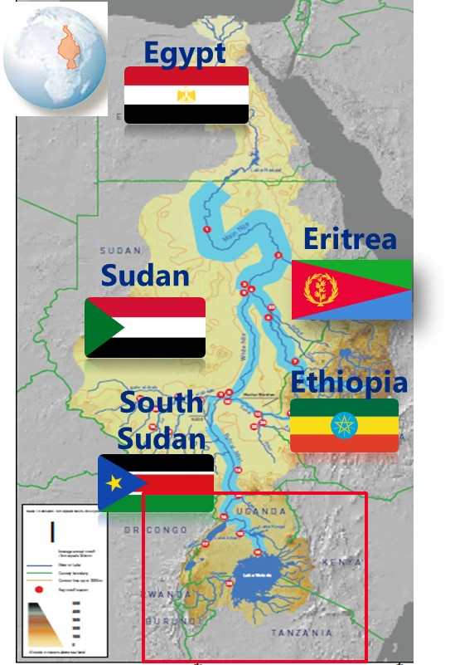
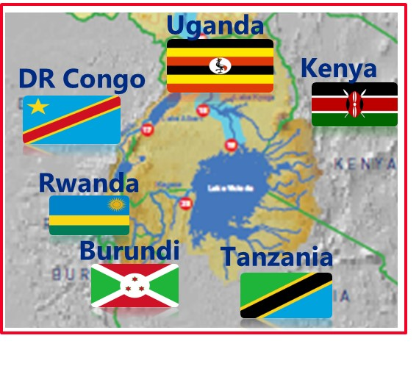
The riparian states
The Nile Delta
The Nile Basin
High Aswan Dam
Main Nile
Tekezze - Atbara
White Nile
Bahr el Gahzal
Blue Nile
Sudd
Baro-Akobo Sobat
Bahr el Jebel
Victoria Nile
L. Victoria

Slide 3
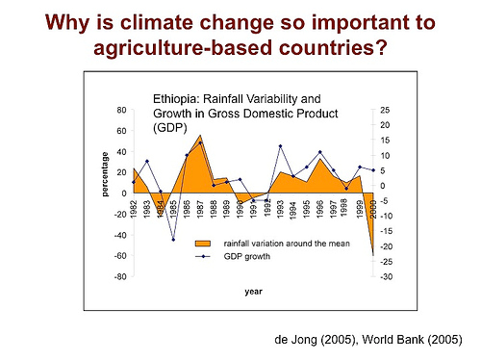
Rainfall distribution
There is substantial variation in rainfall distribution in the basin
Upstream parts of the basin receive annual average rainfall that ranges from 1500 – 2000 mm; in some locations > 2000 mm
Downstream parts of the basin have very little rainfall → negligible internally generated river flow → nearly totally dependent on Nile waters (irrigated agriculture is a must).
Economies of most upstream countries are highly dependent on rainfall (rain-fed agriculture) → frequently exposed to drought and floods

Slide 4
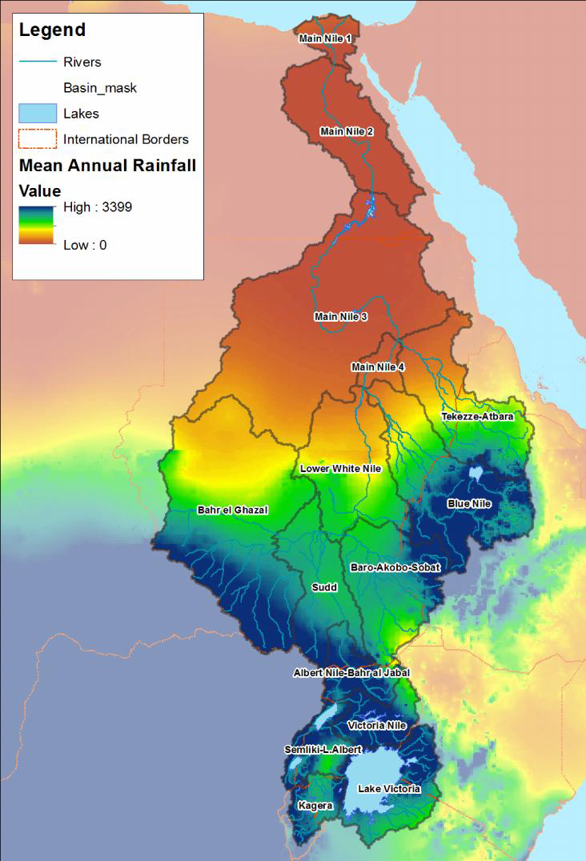
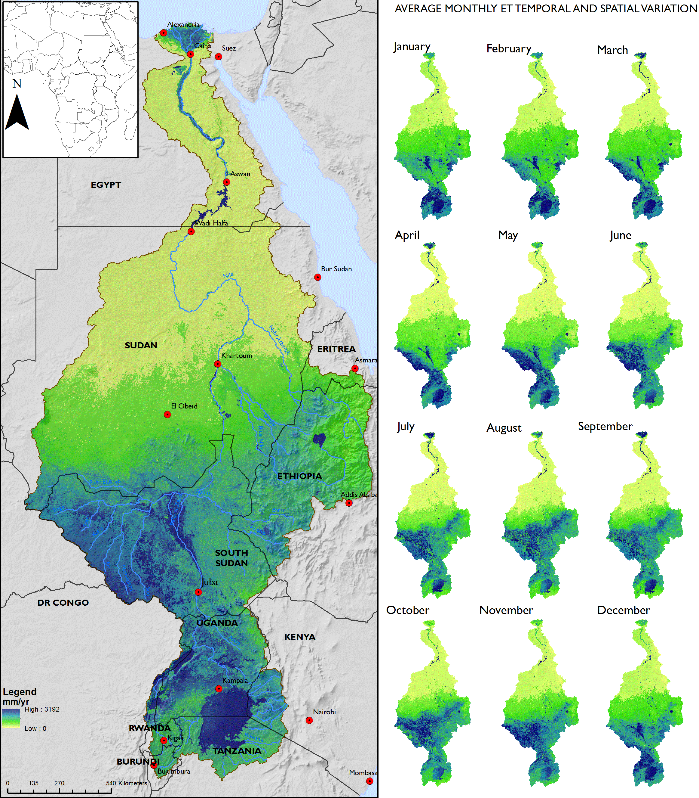
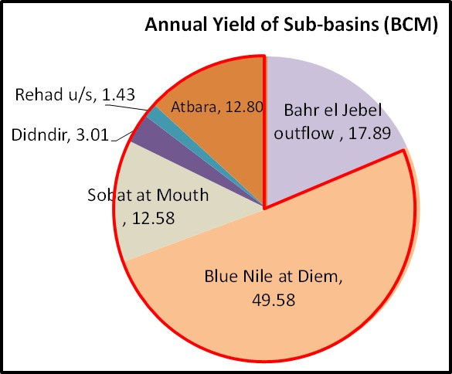
Where the river flow is generated
Where the river flow is used…
Rainfall
EvapoTranspiration

Slide 5
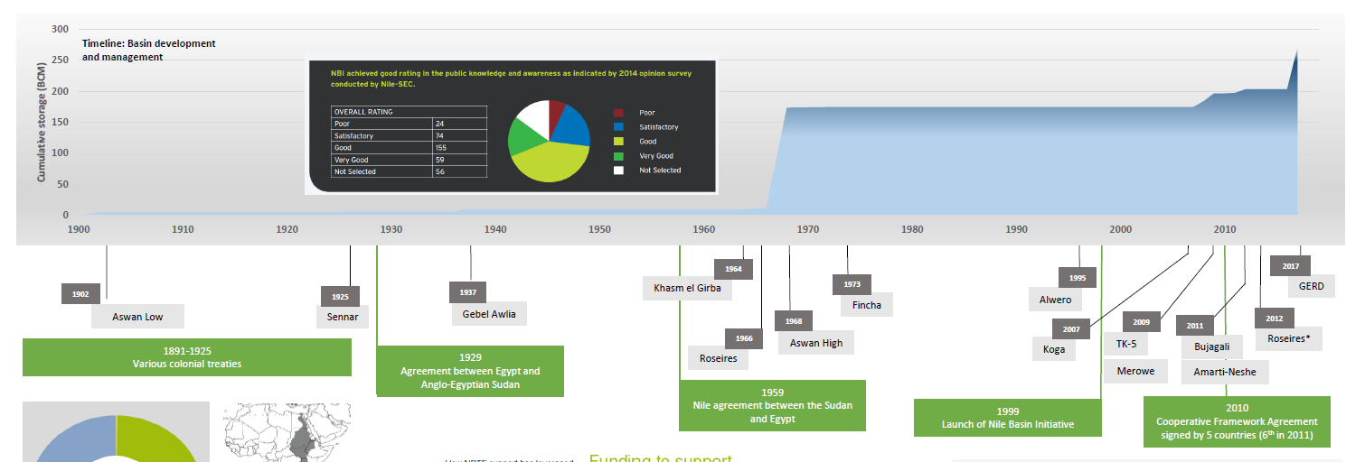
How the Nile Basin evolved: timeline of key water development projects and agreements
Cumulative storage (BCM)
1902
1937
1954
1964
1973
1995
2022 (?)
1925
Khashim
el Girba (SD)
Fincha (Et)
GERD(Et)
Aswan L(Eg)
Sennar (SD)
Gebel Awlia (SD)
Owen Falls (Ug)
Alwero (Et)
1968
2009
2011
2012
1966
Aswan H (Eg)
2007
Bujagali (Ug)
Roseries(SD)
Roseries(SD)
Koga (Et)
TK-5(Et)
Amerti-Neshe (Et)
Merowe(SD)
2015
DoP on GERD-P
1929
Agreement between Egypt and Anglo-Egyptian Sudan
1959
Agreement between Egypt and Sudan
1999
Launch of Nile Basin Initiative
2010
Nile Cooperative Framework Agreement;
1891 – 1925
Various colonial treaties
487
Population in basin countries (Mill)
160
324
84
Notes:
Although the NBI was established in 1999, all water infrastructure projects implemented since then are unilateral projects NBI playing no role;
The 1959 agreement covers the full utilization of the Nile Basin water resources thought it was signed by two countries alone; the HAD enabled Egypt to store more than 2 (?) years of annual nile flows
How did we get where we are: through a system of water infrastructure and agreements;
The signing of the CFA by 6 countries led to freezing of participation by Egypt in NBI;

Slide 6
Future outlook: Water demand in the Nile Basin is rising rapidly
Rapidly increasing water demand for consumption, food and energy production
Decreasing per capita water availability

Slide 7
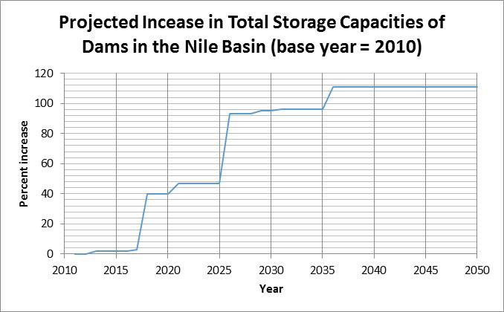
What has the future in store: country plans
Potential for increased
Storage dams capacities
2018 (Total: 6.6 M ha)
2050 (Total: 9.3 M ha)

Slide 8
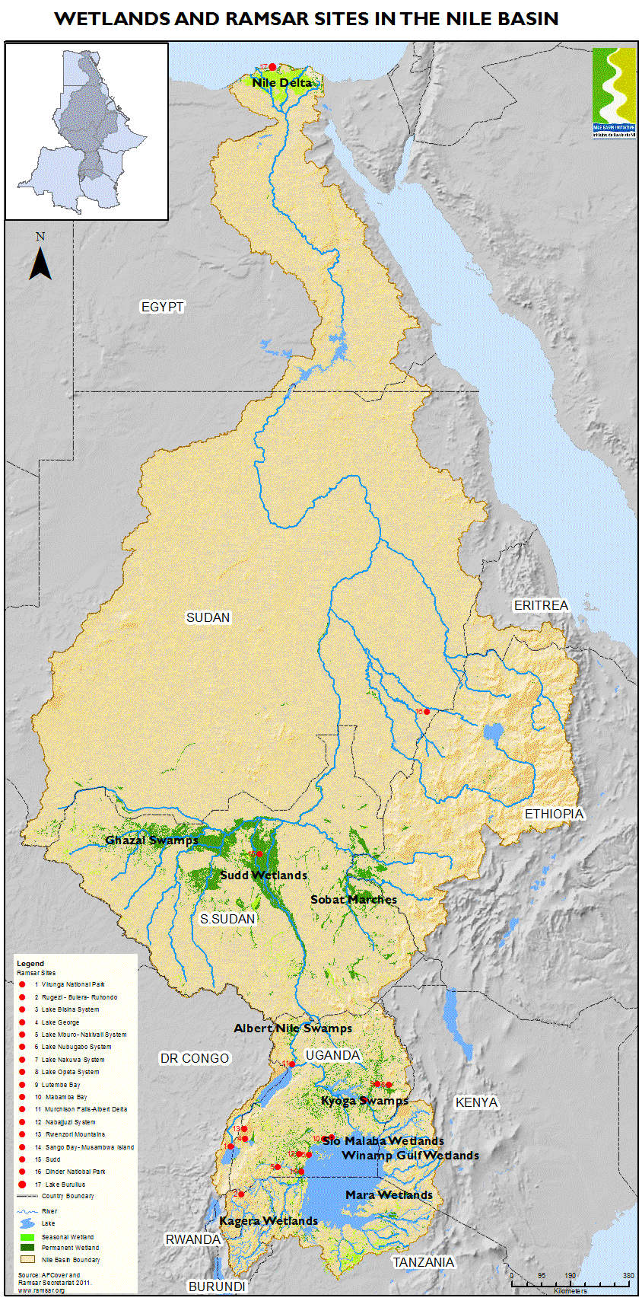
Facing the challenges ….
Rapid population increase
Rapid economic growth
Uncertain climate
Increasing water demand
Nearly totally Nile dependent economy
Favorable colonial and post-colonial treaties
Rapid population increase
Rapid economic growth
Uncertain climate
Increased water demand
Expanding water infrastructure and (consumptive) water uses
A basin at risk!
Lack of basin-wide legal regime

Slide 9
The Search for Common Ground : Reconciling Water Allocation and Sustainability Imperatives : what do we learn from the CFA and GERD process?
CFA process
GERD process
Agreed core principles
Agreed core principles
Equitable and Reasonable Utilization
Obligation not to cause significant harm
Duty to cooperate
Equitable and Reasonable Utilization
Obligation not to cause significant harm
Duty to cooperate
Key differences
Sticking points
Current uses and rights
vs
Water security of riparian states
Guaranteeing minimum flow/natural flow release;
future upstream water resources development

Slide 10
Unresolved Water Allocation vs. Regionally optimized cooperative WR investment: Lessons from [the unrealized] flagship program, the EN Joint Multipurpose Program
EN JMP was an ambitious cooperative WR investment program of Egypt, Ethiopia and Sudan launched in 2006.
Scoping study concluded that the 3 countries could embark on joint multipurpose WR infrastructure development in the Blue Nile/Abbay in Ethiopia and that JMP will confer win-win outcomes to all 3 countries, paving the way for future ….more regionally optimized investments
The JMP was caught up in the disputes over the then parallel CFA Negotiations among 9 MS to establish a new Nile Treaty …. which ended in Sudan and Egypt freezing participation in both NBI … and the JMP
➔ This challenge seems to acquire a recurring nature going forward . . In the search for common ground

Slide 11
The search for common ground : Plausible options scenarios (?)
Scenario 1: DO NOTHING
Scenario 2: NO NILE BASIN WIDE AGREEMENT
The current status continues → no effective measures taken to narrow the differences.
→ Status quo = unilateral development = [from a basin-wide perspective] suboptimal development and utilization of the scarce Nile water resources
Upstream water source countries ratify the CFA and form the Nile River Basin Commission without Egypt and Sudan.
The Basin will be governed by two TB legal regimes concurrently: – the CFA for all (or most) upstream countries and pre-existing (1959) Agreements for Egypt and Sudan.
the core issue of water allocation between the riparian countries will not be resolved. In a way, the impasse will continue.
Scenario 3: PROJECT-by-PROJECT APPROACH
Scenario 4: ALL ON-BOARD: incremental adjustment
Failing to have a basin-wide legal regime, countries, attempt to secure sub-basin or project-based agreements;
Possibly less complicated but without addressing the issue of water allocation, the piecemeal will not address the core issues
More tension, more conflict, impasse will continue
All riparians adopt a commonly agreed upon approach to address the water security concerns of all riparians,
Incremental adjustment the water resources system in downstream countries to reduce vulnerability due to u/s water abstractions
Incremental development upstream → paced development to make increasing reductions in river less ‘painful’ downstream;
➔ Core issues unresolved, but space created for more amicable and trust based lasting solutions

Slide 12
A possible way forward (Scenario 4): Bringing all riparians on board
While studies by NBI show promising technical solutions that can be further studied in detail and implemented to address the core problem of ensuring water security of all countries, they need adjustments from both upstream and downstream sides. The proposed solution has three pillars as described below:
Pillar 1: Incremental Downstream Adjustments ➔ to gradually fine-tune downstream utilization to accommodate upstream (consumptive) water uses and to inclusion of additional water sources
Pillar 2: Incremental Upstream (source countries) Adjustments ➔ to gradually make water resources development adaptive to and in sync with downstream adjustment measures.
Pillar 3: Institutional and financial mechanism to support pillars 1 and 2.

Slide 13
What is needed to make this work
Creating a more conducive political culture for dialogue
Technical solutions for more efficient utilization of available water resources:
Technical
Political
: Increasing water use efficiency and productivity in agriculture; Enhance effective use of rainfall in rain-fed agriculture; bringing more water into the system (desalination, water re-sue)
Finance
Legal/
institutional
Adequate financing mechanism for converting technical solutions into investments on the ground.
Stable institutional and legal setup and mechanism

Slide 14
Conclusion (take away messages)
The Nile Basin is bearing immense pressure
The basin countries have been striving to find a solution that works for all but the attempts haven’t borne fruits
The search for common ground is more pressing today than ever before
Four plausible options/scenarios presented; each having its limitations
As an interim option, Scenario 4 focusing on incremental adjustment is proposed;
Four prerequisites (technical, financial, political, legal/institutional) for scenario 4 to work

Slide 15
Thank you

